Slide 1
Project Activities for MSD
Mayling Wong-Squires
AD Operations Friday 9am Meeting
17 January 2025

Slide 2
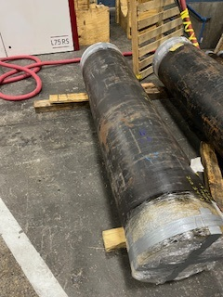
LBNF Primary Window Cartridge & Window Update Chris Ader (Lead Mechanical Engineer), Clark Reid (Design), Greg Bulat (Procurement)
Working on
Completed - FEA of the Beryllium window which added residual stress.
Rotating primary beam window cartridge is being fabricated by Magna in Ohio. Requisition is for under $200K.
Addressing two large pipes that have tolerance and out of roundness issues.
Installation plan of the cartridge assembly.
Coming up
Testing of the rotation of the cartridge would occur at A-Zero with the help of the Beam-lines techs early next year.
Department Resources Needed
Engineering (vacuum window engineering note and installation planning).
Fabrication Procurement (rotating cartridge)
Design (installation and any needed vacuum window modifications).
Pipes Received at Magna for Machining

Slide 3
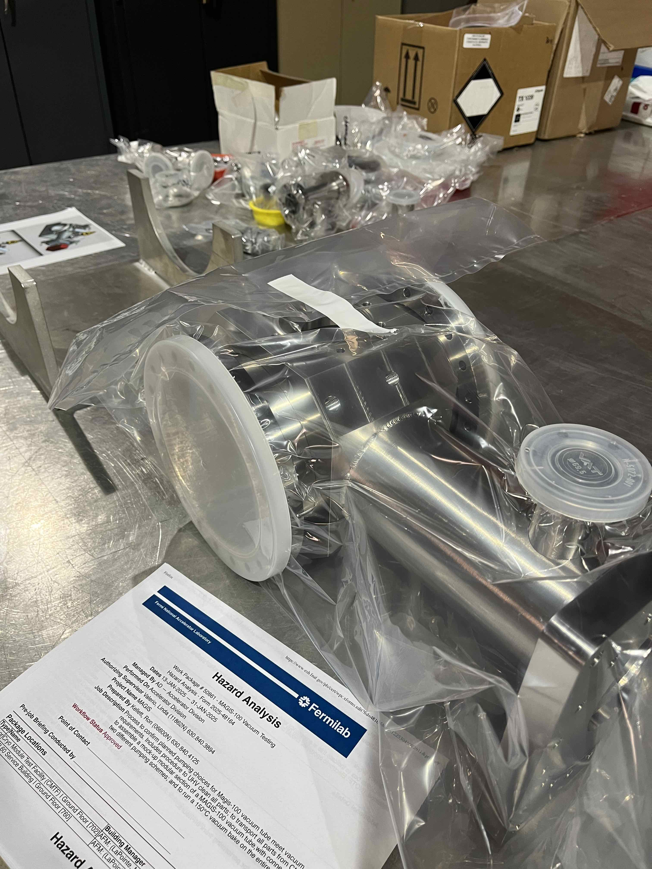
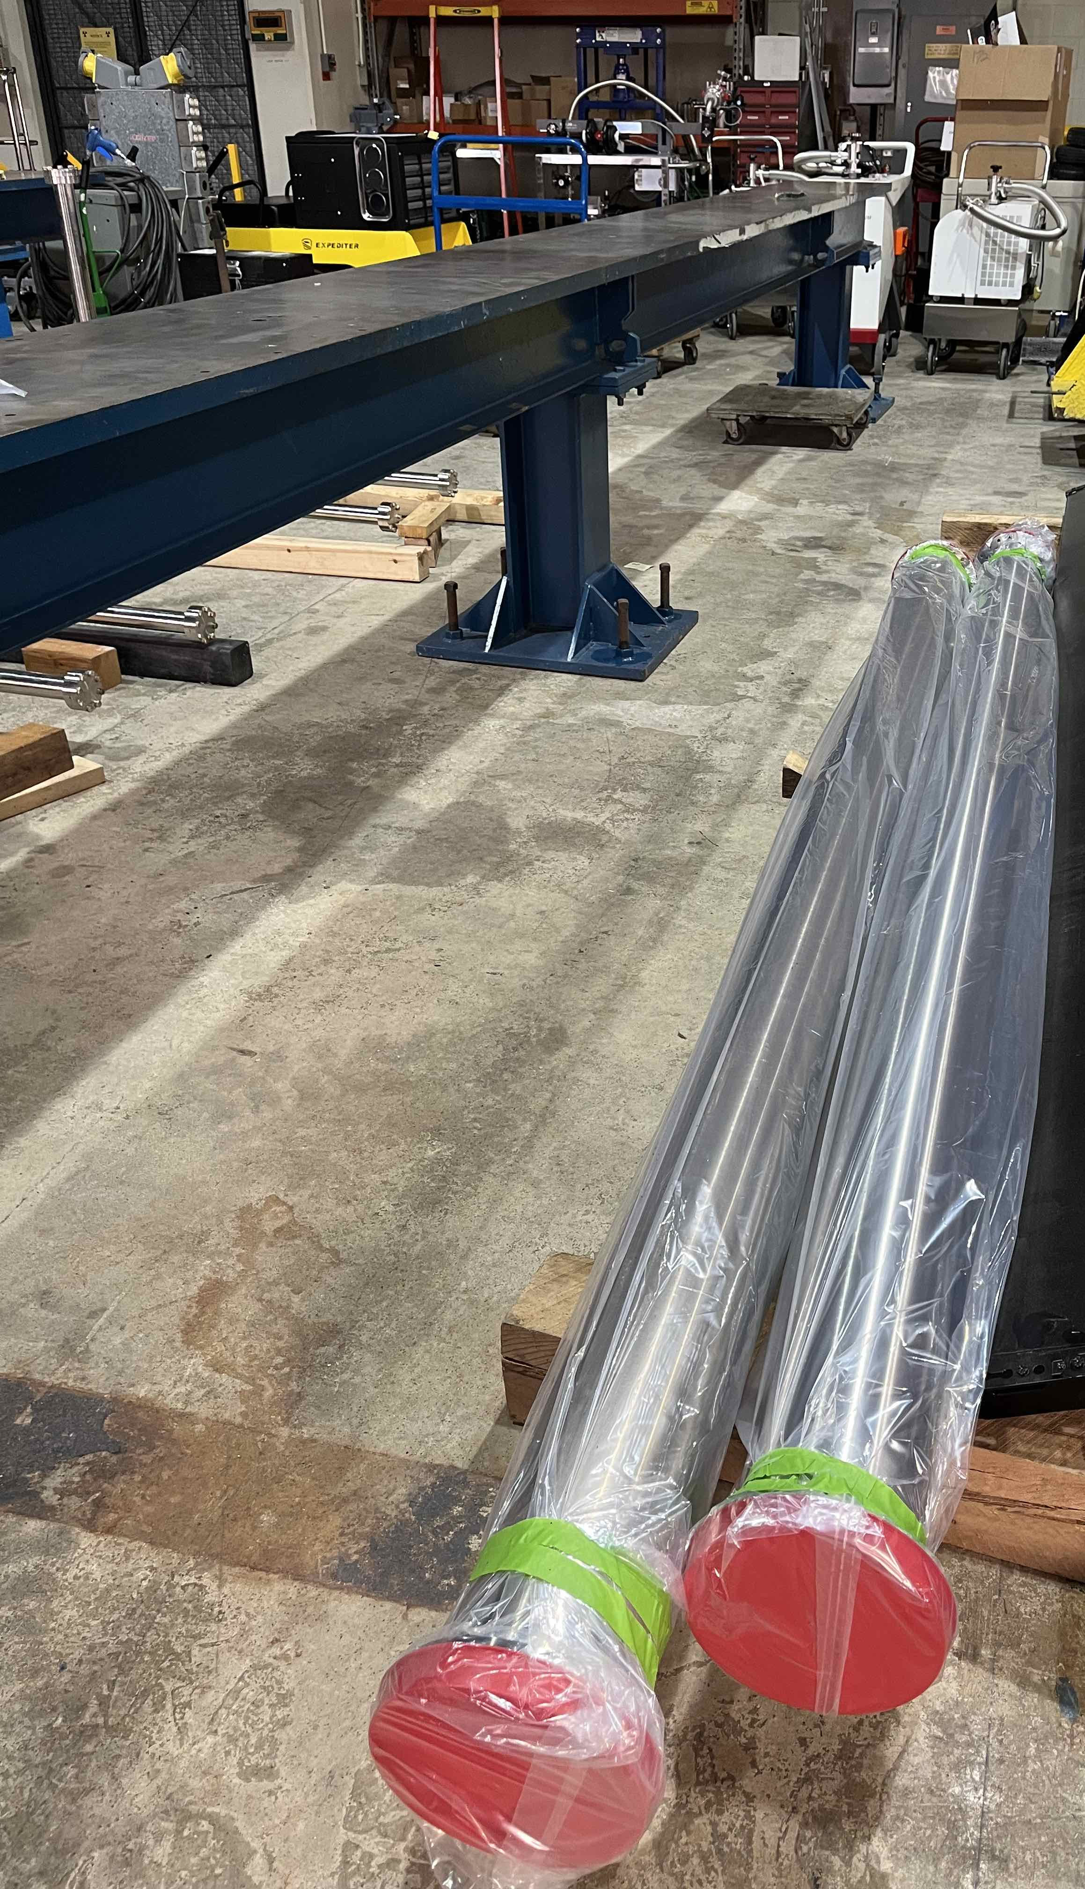
MSD Team: Linda Valerio (Project Engineer), Noah Curfman (Lead Mechanical Engineer), Ty Funk (Lead Vacuum Engineer and Mechanical Engineer), Ron Kellett (Vacuum/Mechanical Design and Technical Support), Dirk Hurd (Designer), Bill Dymond (Assembly Coordinator) Other AD (not from MSD): Jamie Santucci (Lasers), Marty Murphy (Installation Coordinator)
Working on
Completed - Laser tower vacuum and supports technical design review.
Installation and personnel access conceptual development and selection continues.
Vacuum pump test parts are cleaned and ready for assembly. Pump and controller arrived. HA approved. Thanks to MI-60 vacuum technicians for creating space for the test and lending some equipment!
Beam tube magnetometry system prototype is being mechanically tuned, and electronics are nearly ready.
UPS final design review conducted and addressing final comments.
QA testing for custom rod ends as batches arrive.
Laser lab construction expected completion by Feb. Laser pointing stability tests being planned.
Department resources needed
Engineering: Continuous effort from Linda, Noah, Ty. Support engineer(s) anticipated later in FY25.
Technicians: Continuous effort from Ron. Support from Bill and others when requested.
Design/Drafting: Continuous effort from Dirk. Support from others as needed.
Vacuum pump test preparation: space cleared at MI-60 and clean parts ready for assembly.

