Slide 1
RR/MI status
Rob Ainsworth
Ops Meeting
17 January 2025

Slide 2
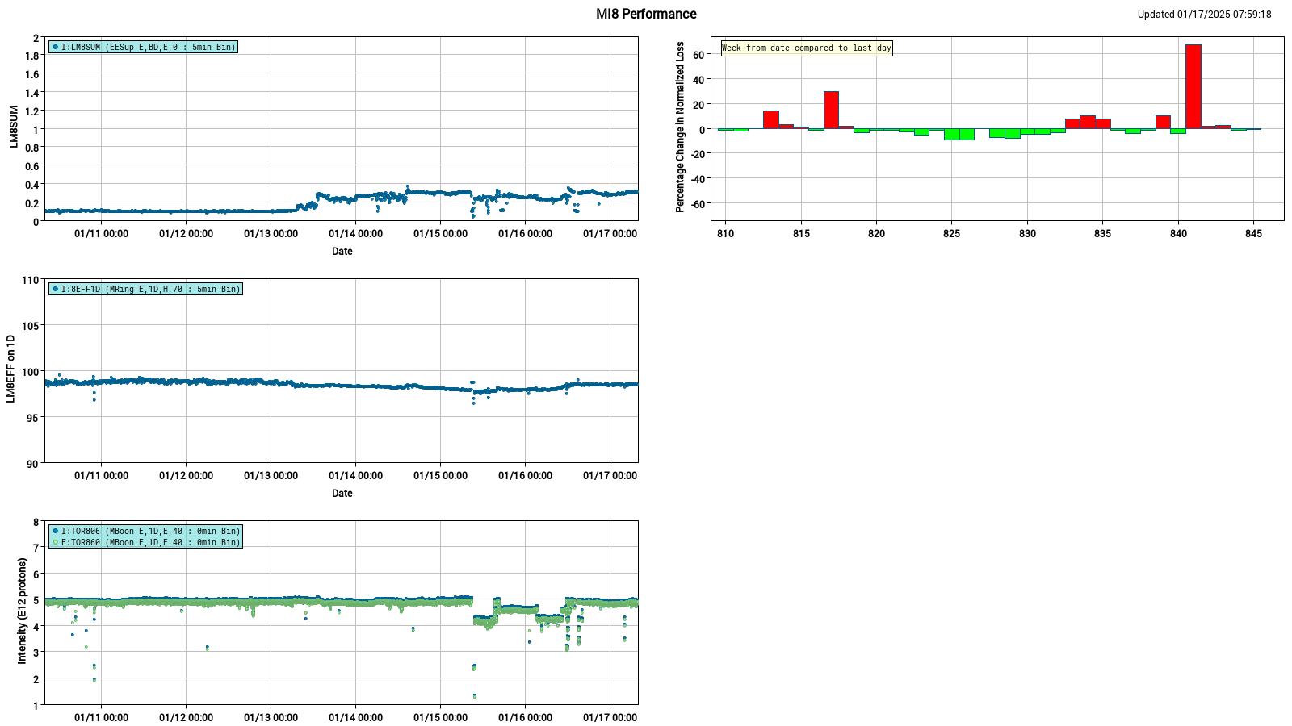
MI8 Performance Summary
Thanks to Kit for validating data and new plots

Slide 3
Summary
MI8 is running well
Downtime
Domestic water leak North of A0
Paused beam, performed USI
Resumed after investigation
Continue to work with PESD and ISD on options for powering RR

