Slide 1
Muon Campus Shutdown Report
Jim Morgan
Friday 09:00 Ops Meeting
January 17, 2025

Slide 2
Muon Campus status
Power supplies were run for several days with a few lingering issues
D:IB bi-modal output, apparent controls or reference issue
D:V907 trips breaker after hours of running
D:QSS apparent bad klixon was found to be shunt trip, need better digital status
Pulsed devices checked out
Pre-Vault and Pre-Target supplies couldn’t be tested with Feeders 94/95 off
Kicker charging supplies for Mu2e require different TLG timing
LCW temperature return temperature appeared high, apparent readback problem
Electrostatic Septa conditioning
Began December 27, nearing completion
Controlled Access period began Wednesday
Thermal scan of magnets
Located and addressed two LCW leaks in Delivery Ring
Safety check of air pressure at Beam Stop locations
Need to address Beam Valve BV510 not showing “open” status this morning
Recovery from short power outage on Thursday morning
Muon Feeder 24 now backfed from Main Injector Feeder 53 via connection at AP-0
Maximum sustained load on Fdr 53 is 6 MW (MI 2.5 MW, Muon 3 MW during ops)
AP-0 A/C work remains paused
Study – M1-M3 Optics
Study – Alternative M5 optics

Slide 3
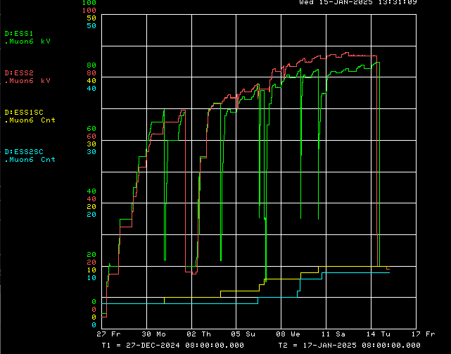
Electrostatic septa conditioning
Operational target voltage
ESS2 Voltage
ESS1 Voltage
Feeder 24 power outage
Delivery Ring access
Delivery Ring access
ESS1 Spark Counter
ESS2 Spark Counter

Slide 4
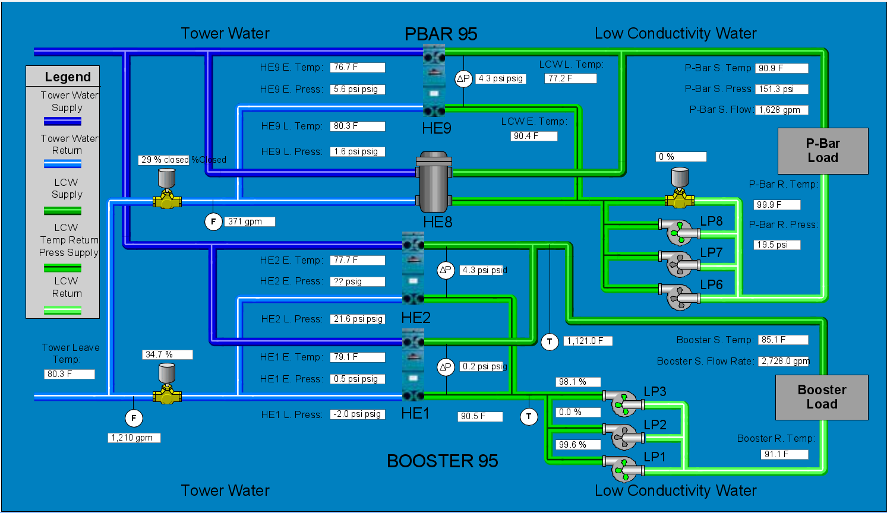
Metasys CUB data from Tuesday afternoon

Slide 5
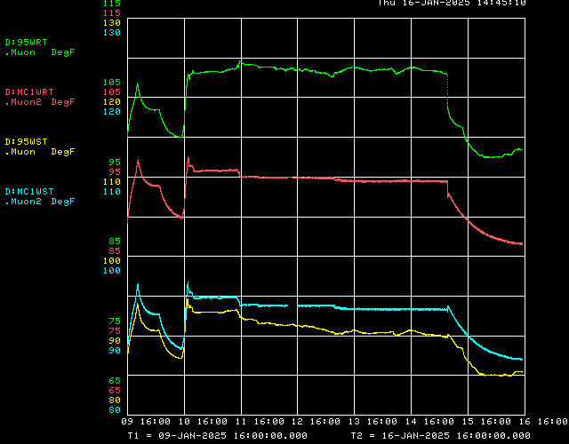
Muon LCW Acnet temperatures
Delivery Ring Access
CUB Return Temperature
Metasys CUB
Return Temperature
MC-1 Return Temperature
Metasys CUB
Return Temperature
MC-1 Supply Temperature
CUB Supply Temperature
Metasys CUB
Supply Temperature
Metasys CUB
Supply Temperature

Slide 6
Upcoming work
Minimal remaining tunnel work
A/C Dipole cable pulls from MC-1 to M4 Enclosure (need Supervised Access on Tue)
Sump monitors for the Mu2e Detector Hall and Pre-Vault Enclosure
Turn power supplies back on after access and fix ones that are problematic
Deciding whether to turn on M4 for weekend, or leave off for cable pulls
Apparent high LCW return temperature appears to be bogus readback
Finish ESS High Voltage Conditioning
ESS2 has reached operational voltage of 85.7 kV, ESS1 is getting close
Finish Critical Device Testing
Need Beamline Feeders 94/95 to be powered
Preparing for beam operation
Work towards resolving remaining power supply problems
Assuming that beam can be delivered from the Recycler
Expect PIP-II BTL construction will prevent Muon Campus beam for 6 weeks
Starting approximately January 29
Hope to address warm power supply circuit breakers during 6-week pause
Replace several circuit breakers identified as running warm (especially V907)
Increase wire size on a few circuits to improve margin

