Slide 1
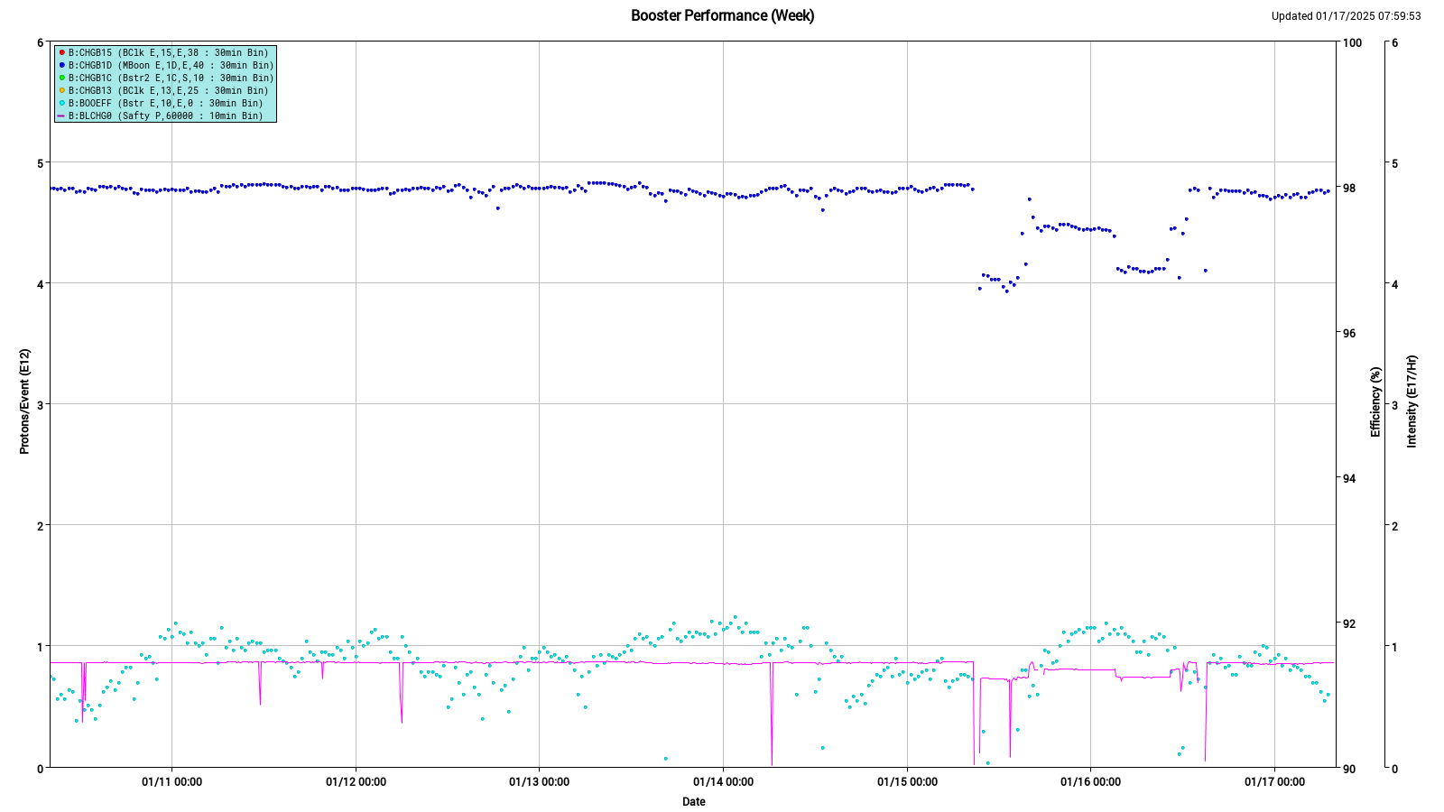
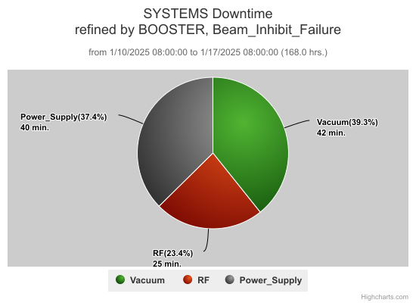
Booster Summary
Running well at 4.7e12 $1D, 91-92% eff
General tuning
Studies
400 MeV beam energy
LLRF phase lock
Python/DPM test
Switched back to old LLRF system for continued development on the new system after a month of successful operation.
DT: 107 min
P14,21,22 RF vac tripsx12
EAPs x 3
BRF22 mod fuse

Slide 2
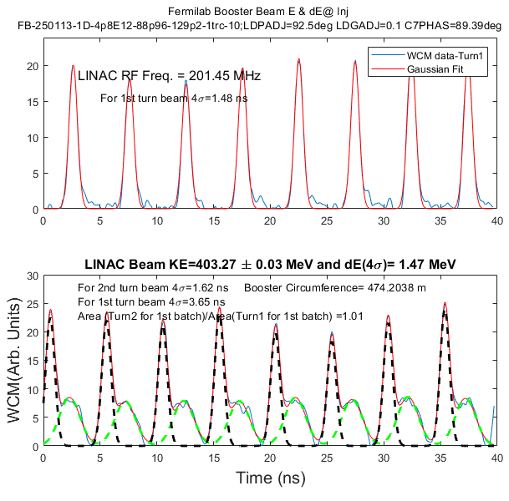
Booster Dedicated/Parasitic Study Report:01/10/2025-01/16/2025
Booster Digital LLRF study (For PIP/PIP-II)
Participants: ECullerton and BSchupbach
Goal:
Generate a fake RR rf signal and try to phase-lock to it and send beam to BNB with phase-lock.← This would help learn phase-lock to RR
Go back to OLD LLRF to work on further developments on DLLRF
Type of Study: Dedicated (~1hr)
What has been done/achieved
Tried to generate a fake RR rf signal and try to phase-lock to it. This was not successful. Needs more work.
Went back to OLD LLRF. Development is going on well.
Highlight: We were running Booster with the new Digital LLRF for the last one months without any problems! ← this is a great success
DPM test
Participants: Jeff Eldred and Nikita Kuklev
Goal: Testing Python DPM to push changes to CAMAC devices without using acsys scaling service.
Type of Study: Parasitic
What has been done:
Tested the Python DPM on a ramp that is not used for operation.
Worked well.
Booster Beam E and dE Measurement at Injection and Cross Calibration (For PIP/PIP2)
Participants: CBhat, RSherankova, Jkuharik, EChen, KTriplett
Goal: Make absolute beam energy measurements at injection by time-of-flight
Using 400 MeV griffin detectors
Using WCM in the Booster
Type of Study: Parasitic (~1.5 hr)
What has been done
Starting from baseline (operational) setting, varied C7 phase (L:L7PADJ), debuncher gradient set point and the debuncher cavity phase set points
Took Scope data by disconnecting Griffin detector cables from velocity monitor.
At the same time took Booster WCM data
Preliminary Analysis
1st turn 1st batch
2nd turn 1st batch
Study results will be posted in the PS Study Sharepoint
https://fermipoint.fnal.gov/org/as/ad/hqsupport/PSStudy/Shared%20Documents/Forms/AllItems.aspx
Notes:
https://fermipoint.fnal.gov/org/as/ad/hqsupport/PSStudy/Shared%20Documents/Forms/AllItems.aspx

