Slide 1


HL-LHC Accelerator Upgrade Project
PMG #67
Giorgio Apollinari/Gianluca Sabbi/Vito Lombardo
Project & Deputy Project Managers
PMG – Jan 21st, 2025

Slide 2

Plans for Today
AUP Status – Apollinari/Sabbi/Lombardo
  Funding
  Progress on Magnets and CryoAssemblies
RFD Crab Cavities Status - Ristori
Next PMG:
  Feb. 18th 2025 (-26 mos from WS early CD-4)

Slide 3

Project Manager Summary Assessment and Funding
AUP is fully funded at the rebaseline TPC level ($266M)
FY24-FY26 are “Carry-forward years”, with FNAL funds supporting activities at BNL and LBNL, if necessary
  No transfer to BNL expected.
  Completed a $2M transfer of funds from FNAL to LBNL in FY24.
  Following the 1TC BCR (all magnets tested vertically at BNL through 1 TC), cost at BNL will increase. Will follow funding at BNL and act accordingly.
 | Funding Received to Date | ACWP+OC to date | Remaining Funds at CD-4 (Based on BAC) | Remaining Funds at CD-4 (Based on EAC)
BNL | 45,541 | 38,982 | 673 | 675
LBNL | 46,634 | 44,539 | -993 | -1,007
Updated Dic 2024

Slide 4
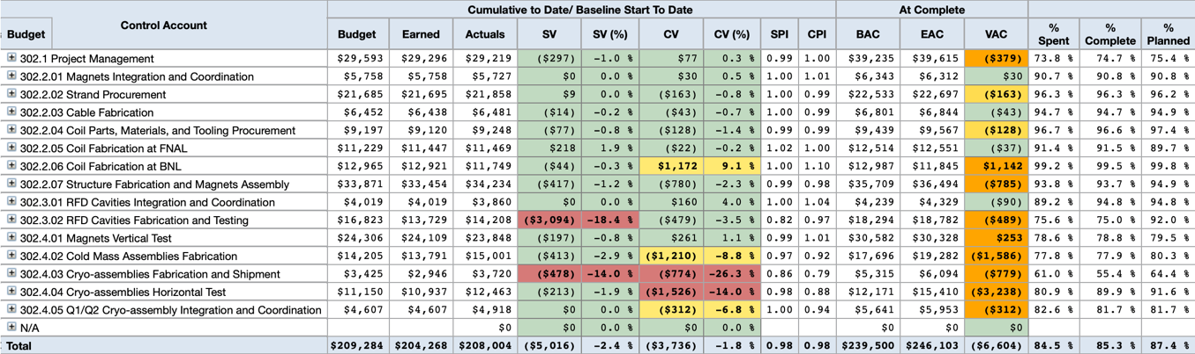
Cost Performance Report (December 2024)
December 2024 Status:
Total Project Cost (TPC): $266.0M
Budget At Completion (BAC): $239.5M
Estimate at Completion (EAC): $246.1M
ETC_{EAC} (EAC-ACWP): $38.1M
Contingency_{EAC} (TPC – EAC): $19.9M
% Spent: 84.5%
Contingency as % work-to-go: 69.6% (on BAC) – up from 68.9%
52.2% (on EAC) – up from 50.7%
Risks and Contingency Analysis: Risks covered at 88% CL
SPI/CPI 0.98/0.98 (stable)

Slide 5
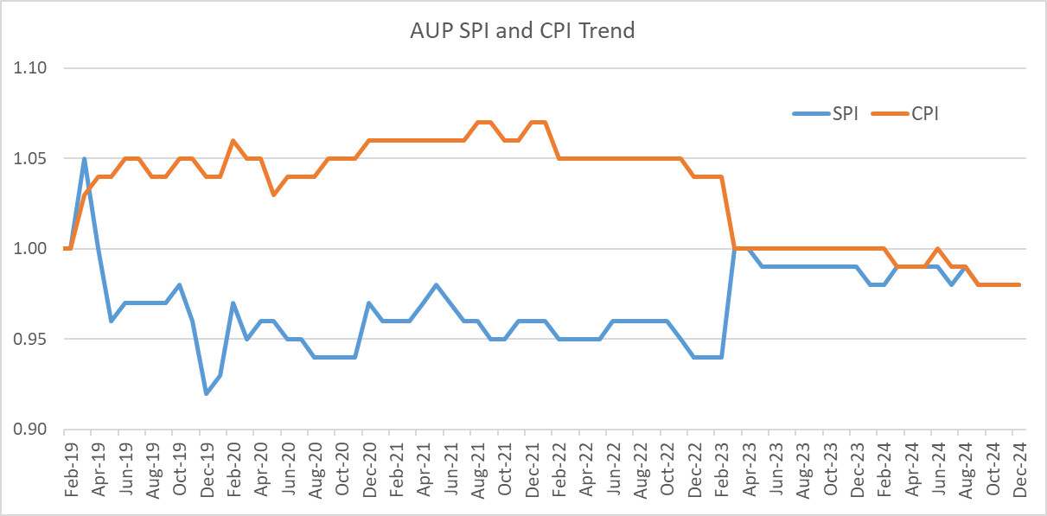
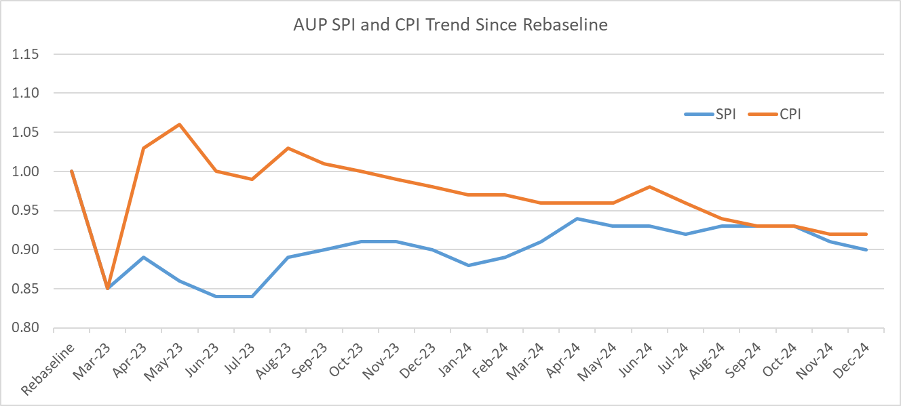
CPI and SPI Historical Performance
For several CAs, SPI and CPI performance can be clouded by large portion of effort completed: CPI/SPI from Rebaseline (Mar. ‘23) is more sensitive to recent trends

Slide 6
AUP Recent Major Decisions/Agreement
Decision: Test all remaining MQXFA Magnets vertically through only TC1 and reduce number of magnetic measurements at BNL (Oct. PMG)
Agreement: Test of 3 Cryomodules at CERN (Dec. PMG).
Agreement: Production at FNAL of 5 additional MQXFA coils (Dec. PMG)
  Coils funded by “debt” in ”AUP-CERN Parts Exchange”.
  Coils not used by AUP will be sent to CERN

Slide 7
Major Recent BCRs
BCR # | Description | Cost Impact | Schedule Impact
BCR0377 | Increase LOE for 302.2.07 (Structure/Magnet Assembly) | 188k$ | -
BCR0376 | Test 3 Cryo-Assemblies at CERN | (730k$) | (21 days)
BCR0375 | Fabrication 5 Additional Spare Coils | 1,310k$ * | -
BCR0374 | FNAL FY25 Rate Update | (1,090k$) | -
BCR0373 | Adjust Strand PO Cost | 215k$ | -
BCR0372 | Purchase 2 Coil Parts | 176k$ | -
BCR0370 | Vertically Test all Magnets | (1,034k$) | (124 days)
* Supported by AUP-CERN Parts Exchange program where AUP had a debt of ~1,200k$ toward CERN. Agreement to send to CERN any unused coil.

Slide 8
Decision on Test of 3 CAs at CERN
Task Force Report
Request from APS-TD Associate Director:
  Is there a way to “retrieve” testing scope back to the US ?
  Are we sure the # of CERN tests is limited to 3 ?
Preliminary Task Force feedback available
  Final touches being applied
  To be shared with APS-TD Management prior to initiation of CA03 test.
    Preliminary messages: usage of IB1 Cryo facilities for cool-down/warm-up to a ~80% fraction of design limits and priority during CA testing

Slide 9
Interactions with ZANON & CERN
ZANON production has been stopped by mid-October after AUP realized Nb-SS brazed flanges were not going to be approved without a C-Scan, which is increasingly difficult to perform as the parts progress in the manufacturing.
Company maintains collaborative spirit but submitted REA (Request for Equitable Adjustment) and a proposal for tri-partite CERN-AUP-ZANON meetings to ensure no surprises - due to lack of approval(s) - lurk in the future.
  REA (under negotiation) added in AUP Risks
Continued pressure to restart production from CERN to accommodate TRIUMF involvement (busy with ARIEL in CY26)
  Trying to get approval of all documents/NCRs to move forward expeditiously
More in Leonardo’s presentation.

Slide 10
302.2 - Strand & Cables
G. Ambrosio
Procuring strands and making cables for 5 additional coils approved by BCR0375 after agreement with CERN
1st cable: completed, insulated and delivered to FNAL
2nd cable: to be fabricated this week
3rd cable: strand to be respooled next week
4th and 5th cables: waiting for strand delivery by BOST
Strand inventory:
  40 km (for 2 cables) to be delivered in Jan 2026
Cable Yield:
  95.6% vs. 90% assumed in Baseline at AUP start

Slide 11
302.2 Coil Fabrication (w/o 5 additional coils)
11
  Three coils on hold accepted for use in MQXFA20 after MQXFA20 Coil Acceptance Review
  Coils on hold: The number of coils on hold expected to be used is the sum of the probabilities of using each coil on hold (0%, 25%, 50%, 75%).
  **Integration and test yield computed after removing Covid impact
Fabrication of 5 additional coils is starting next week

Slide 12
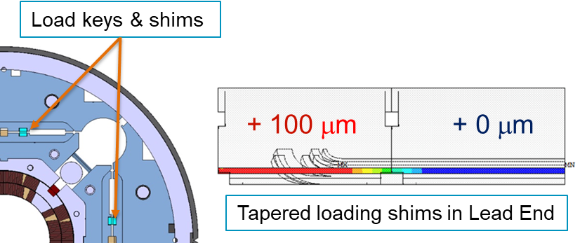
302.2 - MQXFA Structures and Assembly
Magnet assembly is at peak production with two assembly lines fully operational
21 MQXFA magnets have been assembled
  MQXFA03-18,7b,8b,12b,13b,17b
  Revised MQXFA Series Magnet Production Specification (doc-4009) for adding Tapered Load Shims in the lead end
    Lesson learned from analysis of MQXFA13 and MQXFA17
  At LBNL being assembled: MQXFA19 and MQXFA20
  At BNL waiting for test: MQXFA16 and MQXFA17b

Slide 13
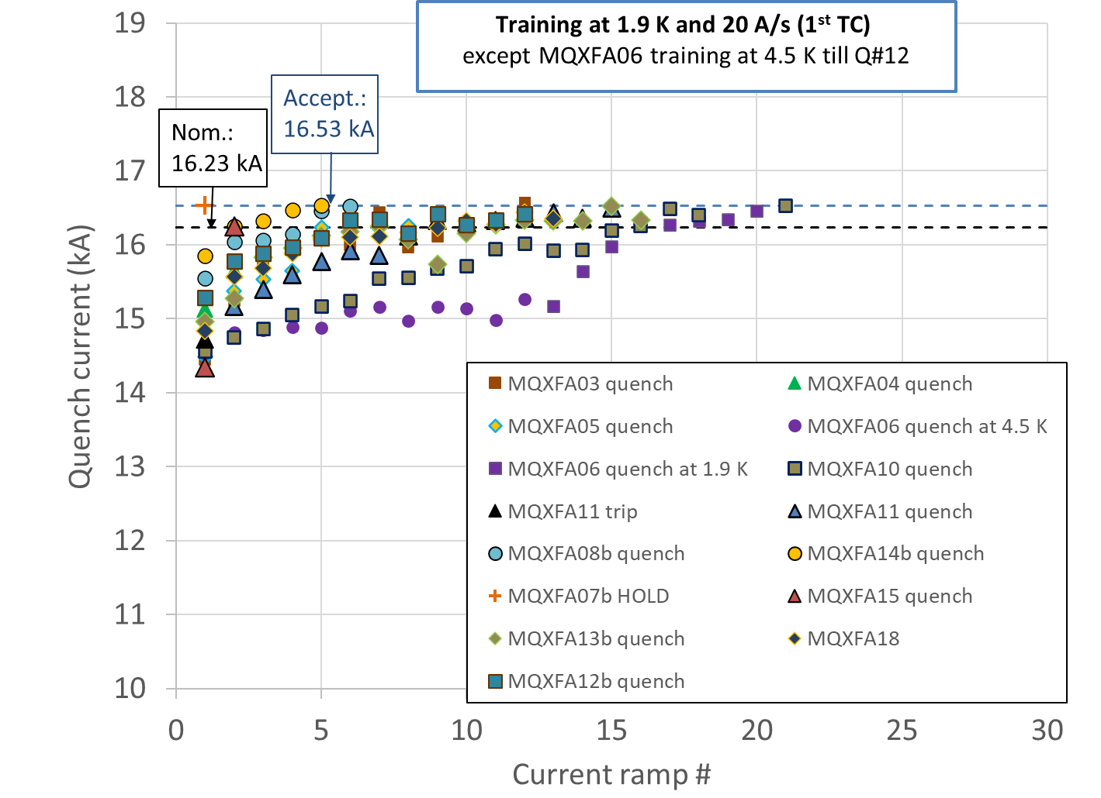
MQXFA Test Analysis
Vertical test is done at BNL by 302.4.01, post-test analysis is done by 302.2.01
13 magnets (MQXFA03/4/5/6/7b/8b/10/11/12b/13b/14/15/18) met requirements during vertical test
  MQXFA05 passed an Endurance Test
  MQXFA11 demonstrated resilience after highway crash
4 magnets (MQXFA07/8/13/17) did not meet requirements:
  67% COVID attribution for MQXFA07/8 issues
  Design changes and specification changes implementing lessons learned
  MQXFA07b, A08b and A13b met requirements after replacing the limiting coil with a new one
Test yield w/o Covid impact: 83.0%
Original yield in Baseline: 83.3%
Yield of future magnets in BL: 88.9%
Notes:
Failure Mode Analysis
Magnet disassembly and reassembly needed to meet the requirements
- Structure Fabrication and Magnet Assembly Threat RT-302-2-07-007 Magnet disassembly and reassembly needed to meet the requirements If after a magnet is assembled, and the magnet does not meet requirements then disassembly and
reassembly are needed, which will increase labor cost and cause delay to the schedule

Slide 14
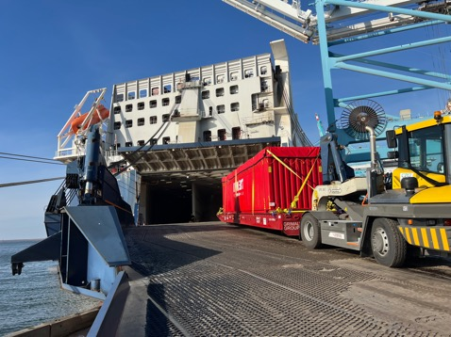
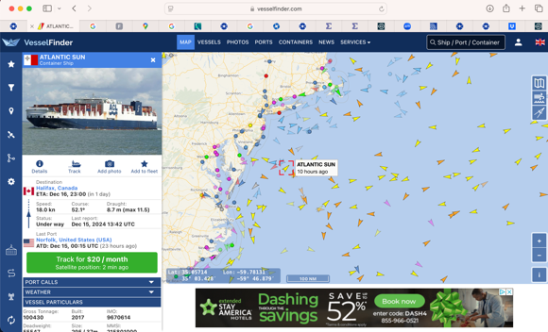
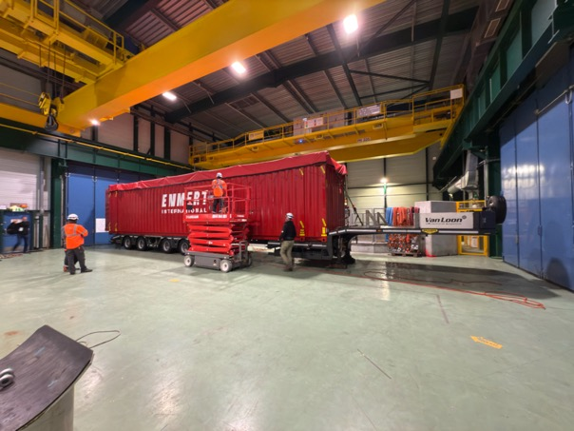
Shipment of LQXFAB-02
LQXFAB-02 arrived at CERN on Jan. 8th 2025
LQXFAB02 at CERN

Slide 15
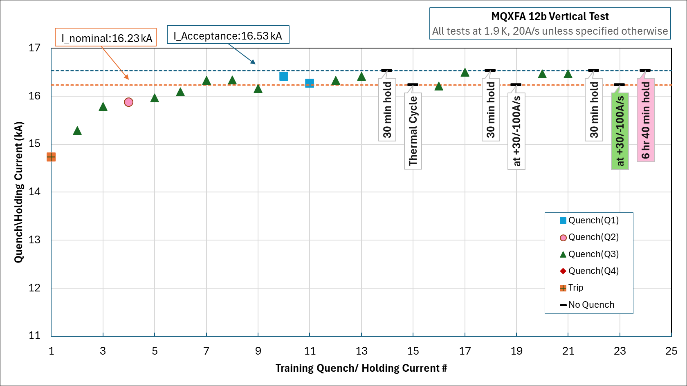
302.04 - Magnets Vertical Test at BNL
S. Feher
MQXFA12b test
  The test facility is functioning well, though there was a power loss event in December inducing an unexpected thermal cycle.
  Second thermal cycle has been successfully completed

Slide 16
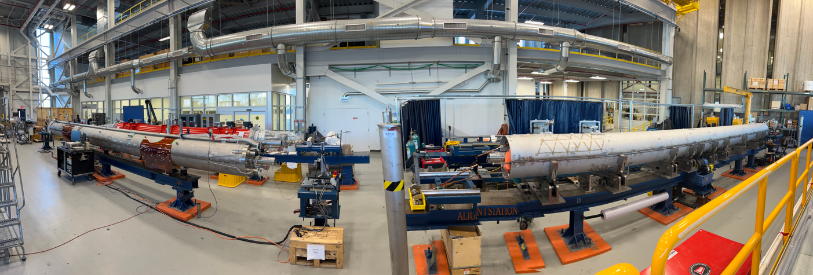
302.04 Cold Mass Assembly Fabrication
CM04 and CM05 fabrication progressing; these magnets will be shipped to CERN without cold testing them at FNAL
CM04 close to completion; preparation for the pressure test is in progress expected to be completed in two weeks
CM05 longitudinal weld has been completed and preparation for the end cover installation has started
CM06 both magnets (MQXFA13b and MQXFA18) have been received form BNL; going through initial inspection
CM04
(MQXFA14b, MQXFA08b)
CM05
(MQXFA15, MQXFA07b)

Slide 17
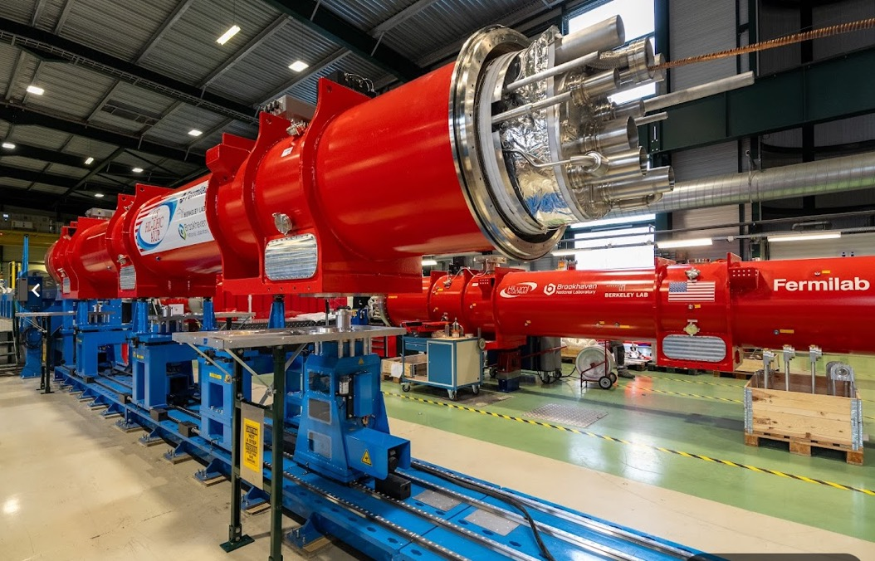
302.4.03 Cryo-Assemblies Fabrication
CA01 is being prepared for the string test; completion in four weeks
CA02 has been shipped to CERN
  Arrived on January 8th
  Already went through the acceptance tests successfully; waiting for the formal approval; Shipping post removal in progress
CA03 preparation for the cold test is close to completion; expected to be shipped to the horizontal test facility next week
CA02
CA01

