Slide 1
FD1/FD2 Installation Engineering Update
Nicholas Joniak
01/21/2025

Slide 2
Engineering Updates
Procurement Status:
  Upcoming:
    No update.
  Existing:
    No update: Lift Table initial delivery still on track for late January/early February.
FD2 TCO:
  Analysis Plans submitted to compliance office for review:
    TCO Hoist Beam.
  Engineering Notes submitted for review:
    TCO Platform.
      2D drawings in progress.
      Installation plan and floor design finalization required.

Slide 3
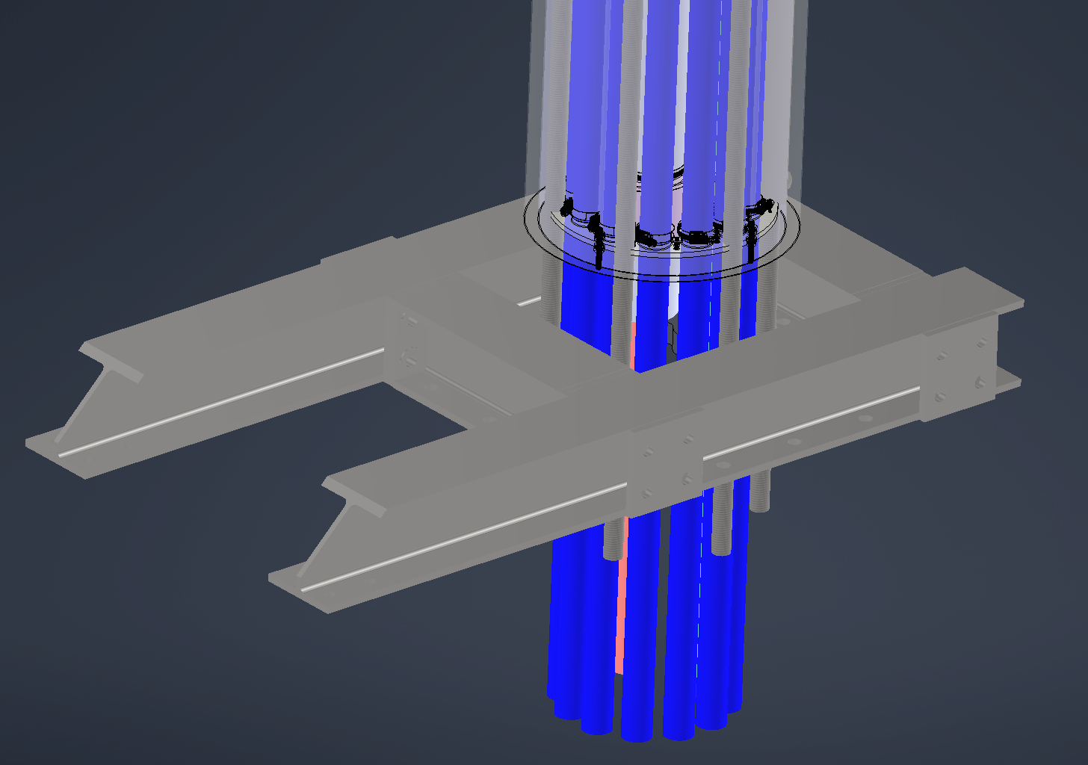
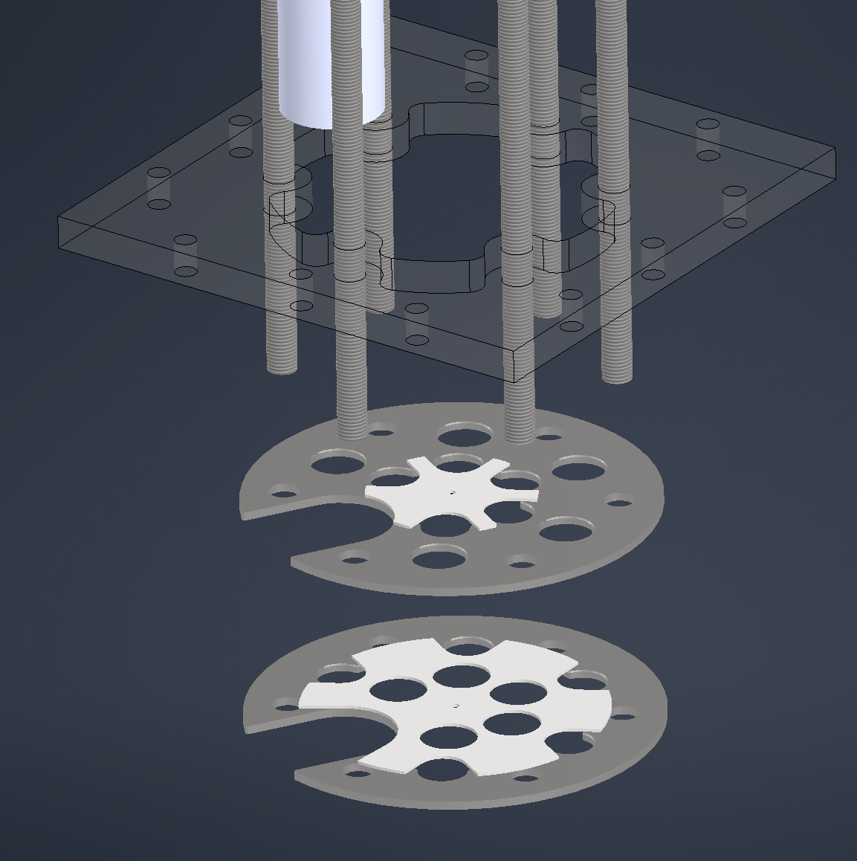
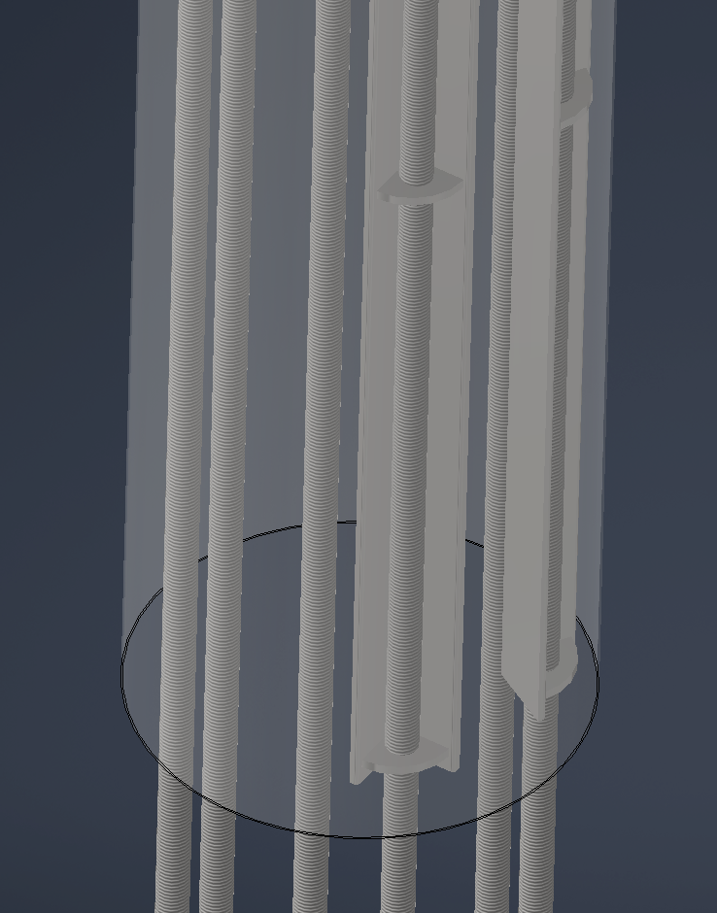
Engineering Updates
Vertical Drift – BDE Cable Tray Support
  BDE went through proposed solution and had concerns about space within the penetration.
    The current strain relief plate design would also not work.
  Proposed solutions to try out later today:
    New dual strain relief plate concept – BDE checking this out.
      Would allow better routing of cables through center of penetration.
      Also binding bundles together above this could reduce overall space usage in penetration.
    Revised rod compression devices.
      Angle braces sharp and could damage cables.
      Tube sleeves might work better but take a little more space.

