Slide 1
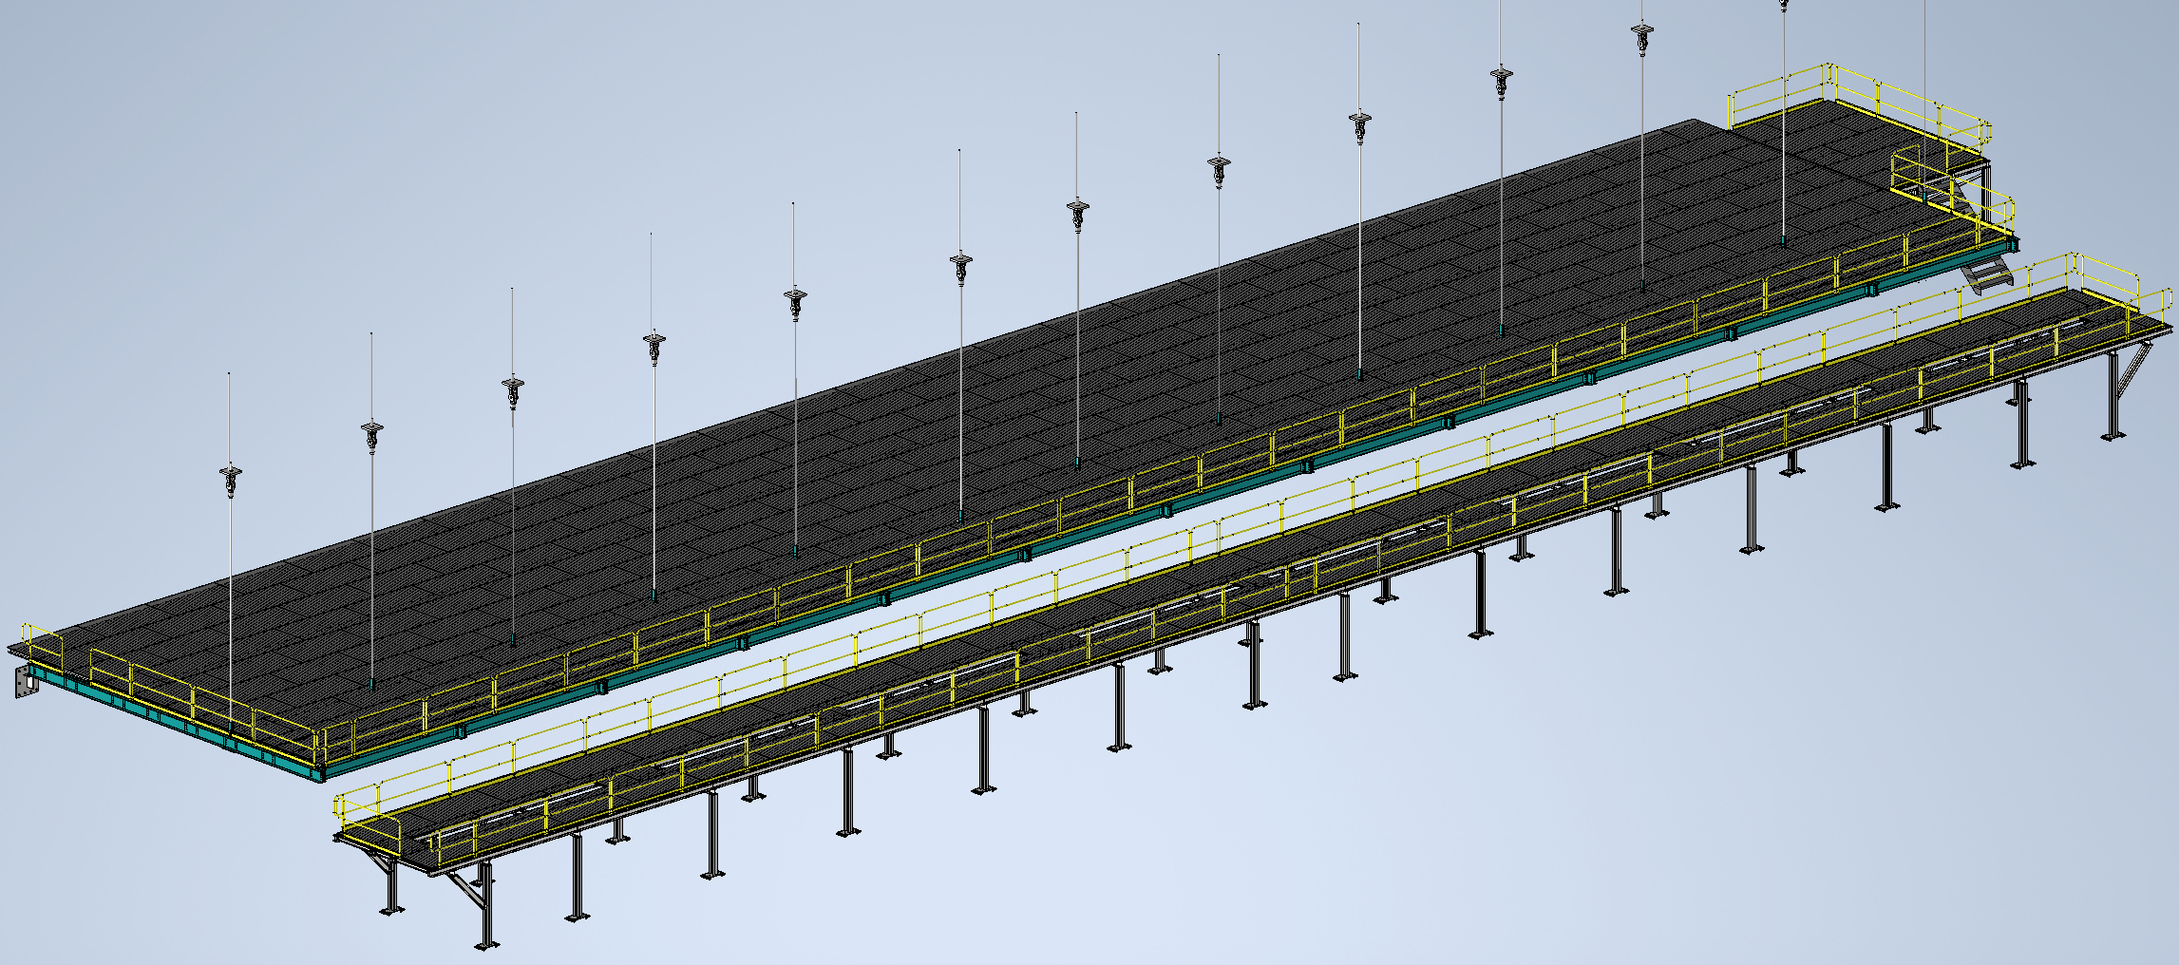
Mezzanine Flooring and Railing
Status
  Design note and calculation note uploaded to edms
    264185
  Working on updates from CO
Walking surface and railings for mezzanines
Install Activity:
Install flooring and railing onto detector, cryo, and ledge mezzanines
16-Sept-26
Tech Spec. | N/A | Empty
3D Model | N/A | Complete | 11/1/24
Design Note | N/A | First Draft Complete | 11/8/24
Eng. Analysis | N/A | First Draft Complete | 12/2/24
CO Report | N/A | Empty
2D Drawings | N/A | Empty
Schedule Contact | N/A | Empty
Install Procedure | N/A | In Process
Store/Move 120d - 4mo
Fabrication
30d – 1mo
Procurement plan
  Decking and railings are COTS
  Two types of custom railing mounts will be required
  Self install
Procurement
90d – 3mo
Latest “Submit to Procurement”
16-Jan-26
Fabrication/delivery
PRR Target: Dec. 2024

Slide 2
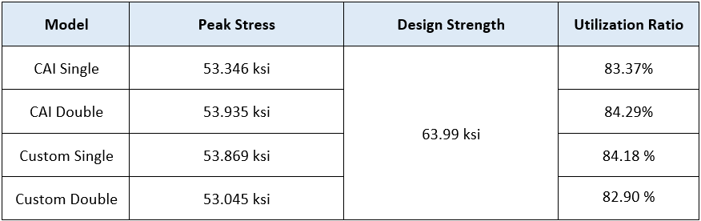
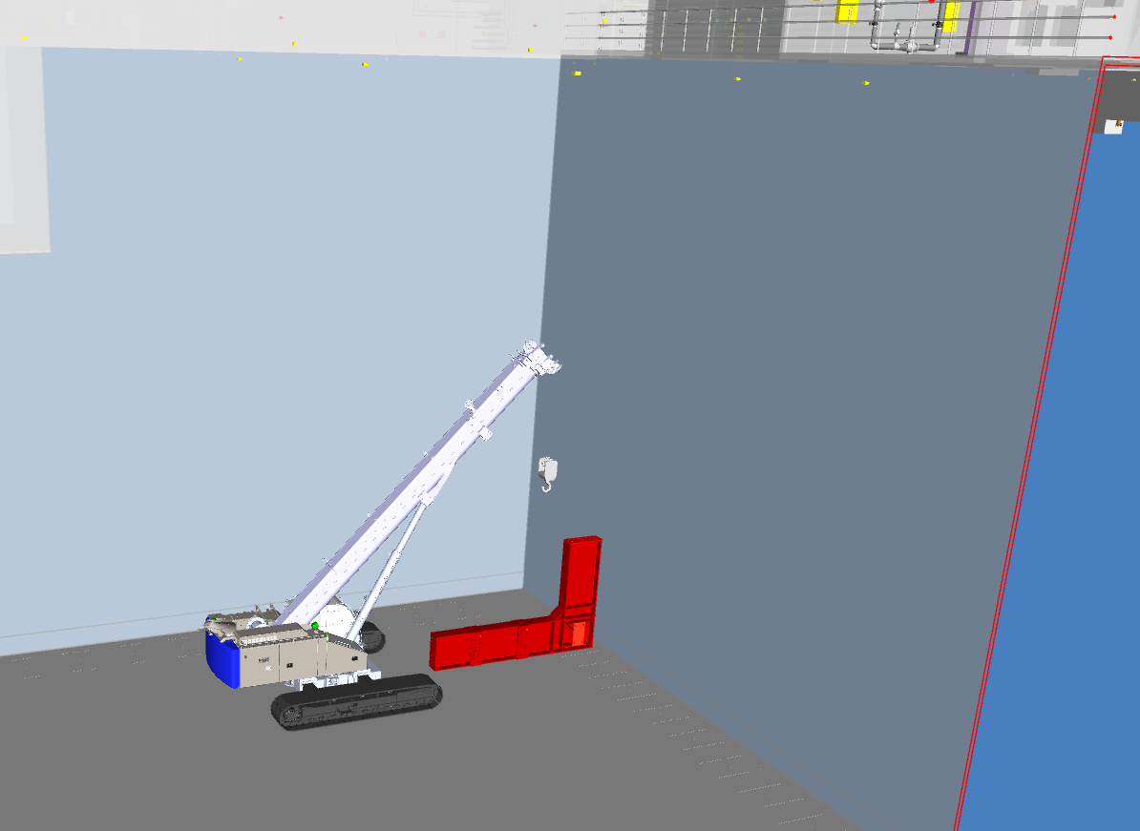
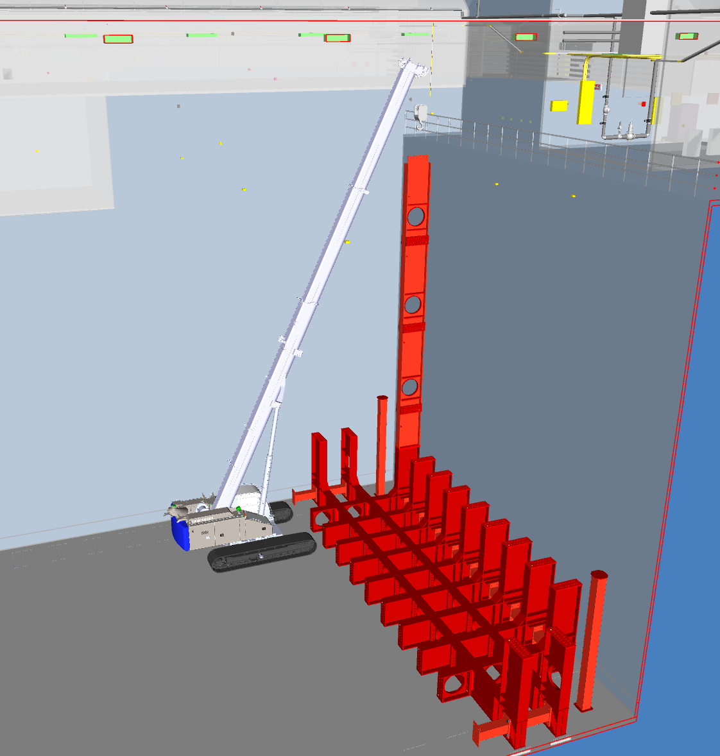
Last Week(s)
Railing Base Analysis
  Updated analysis complete
    Uploading to EDMS after meeting
    Overall stresses and UR looking better and more consistent
    Higher quality mesh across the board
Mobile Crane and Material Handling
  Continued working through difficult beam movements and installations
    Putting together slides going over the overall plan along with highlighting the challenge points
  Began looking into updated plans for mezzanine and flooring installation without bridge cranes

