Slide 1
9 AM Meeting
Sophie Stevens
MCR Crew Chief
Wednesday January 22, 2025

Slide 2
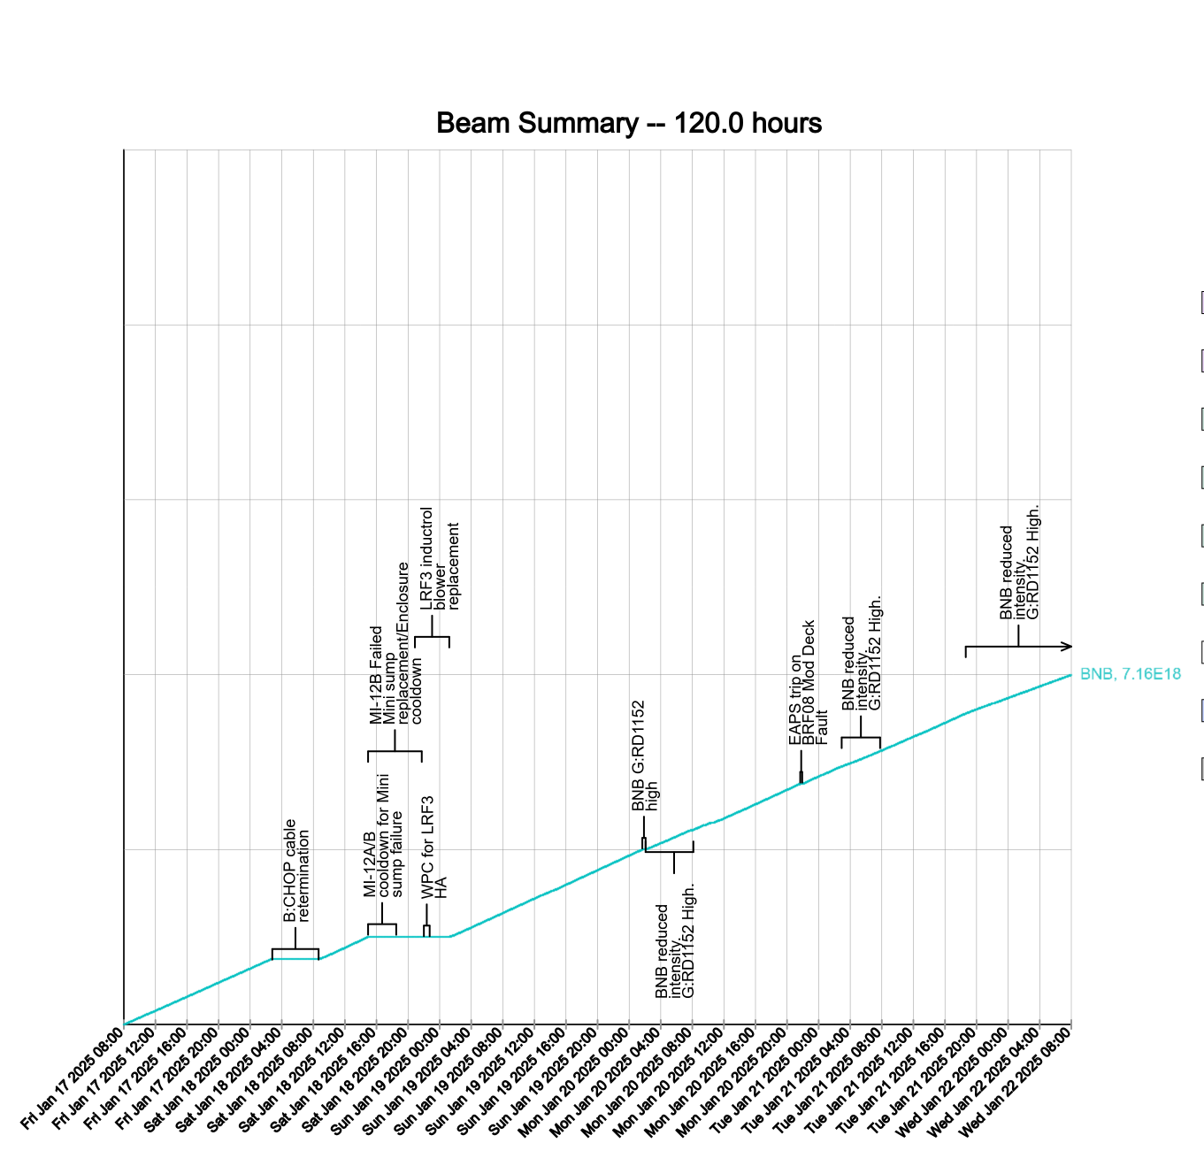
Since Friday…
B:CHOP failed
Required Linac Access
MI-12B Mini-sump pump failed
Required Access to replace
LRF3 Inductrol Blower failed
MI-12 SB Air Monitor at upper limit
Reduced Rep Rate
M4 put into Supervised Access
MI Hipot
Monitored Domestic Water leak by AP0
MOS 87 repair has started
MI and F Sector No Access
Beam to BNB
Reduced Rep Rate due to G:RD1152

