Slide 1
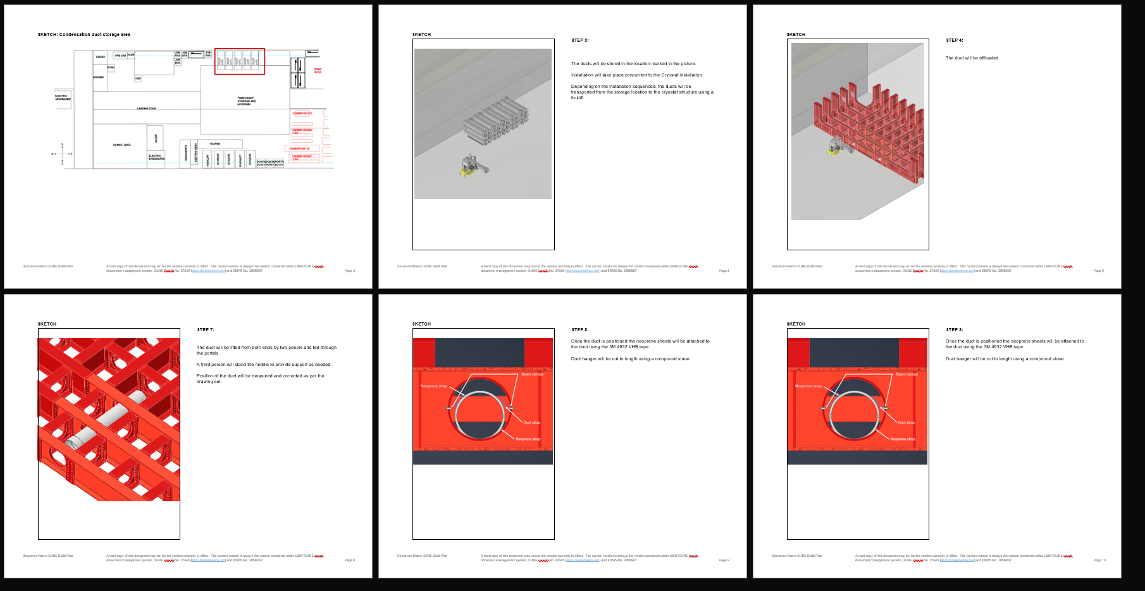
Week of 1/28/2025
Condensation prevention duct.
A draft of bill of planning, (Work activity plan) is ready.
Duct will be pre-cut to length and will also include intake slots. Minor adjustment in length will still be needed during installation. Meeting with ESH to understand fiberglass machining requirements and constraints.
Meeting with Steve to review the web req.
Detector Mezzanine
Working through compliance office comments on the engineering note.

Slide 2
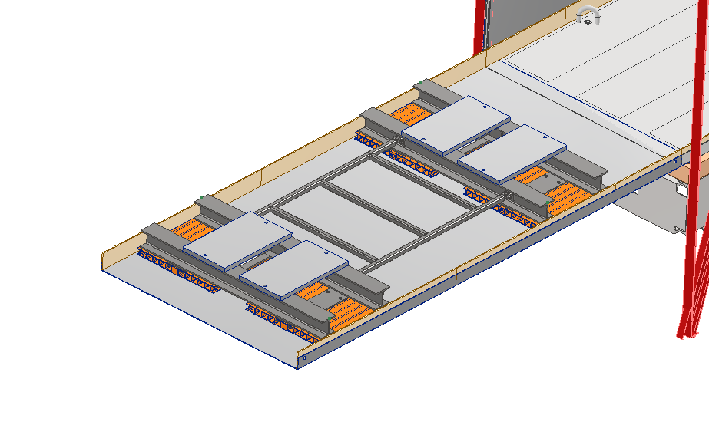
Week of 1/28/2025
L-beam sled
3D models for the sled and floor plates have been updated as per the lessons learned during the test.
Draft for procurement specification for the production sled is ready

Slide 3
HD/VD Detector Mezzanine
Status
Working on engineering analysis and note on updated model
Install Activity:
Installed one portal at a time.
06-June-26
Tech Spec. | 234809
3D Model | 234790 | Submitted
Eng. Analysis | 2822247 | Submitted
CO Report | 252309 | Empty
2D Drawings | 234790 | Empty
Schedule Contact | 252399 | Empty
Install Procedure | 252429 | Empty
Store/Move 120d - 4mo
Fabrication
60d – 3mo
Procurement plan
Railing and flooring off-the-shelf
Stairs off-the-shelf with supports built into mezzanine structure.
Installed by contractor.
Procurement
180d – 6mo
Latest “Submit to Procurement”
06-May-25
PRR Target: December 2024

