Slide 1
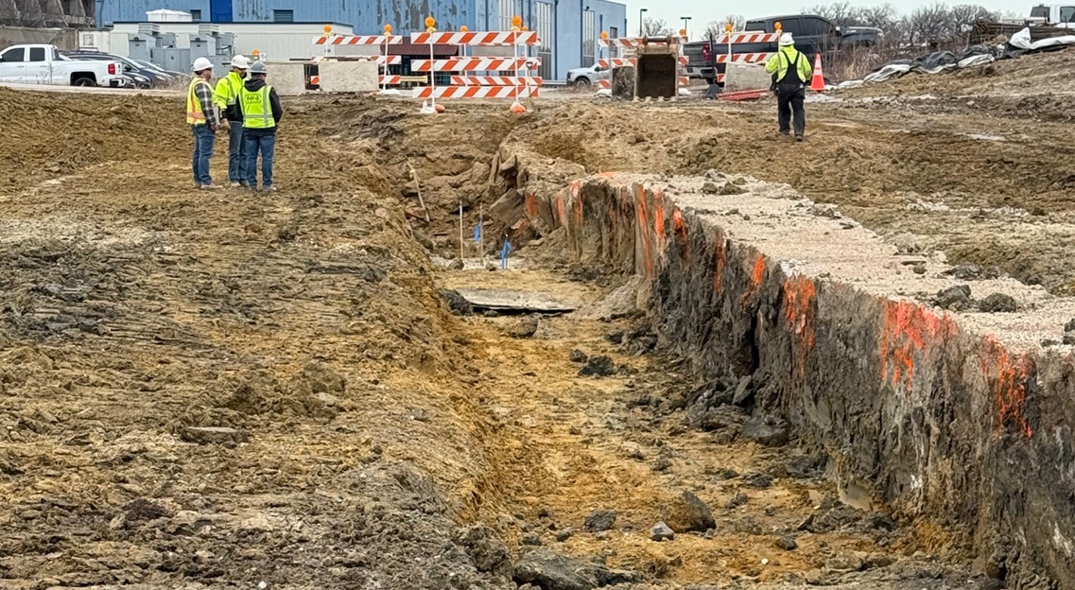
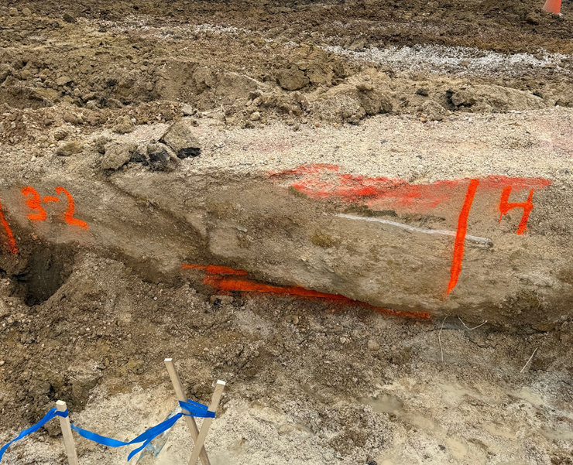
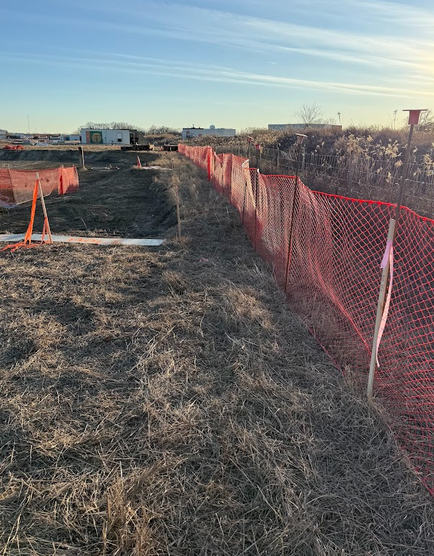
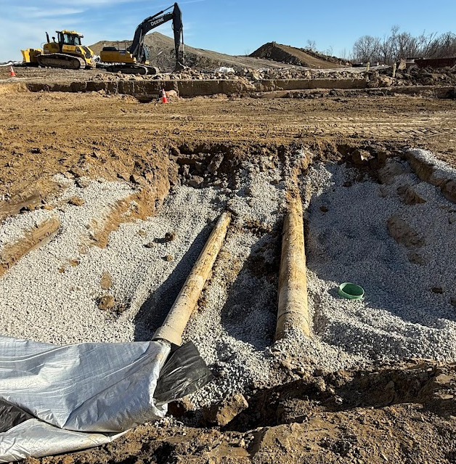
PIP-II Highlights
Last Week
Placed ~600 cubic yards of concrete (~80 trucks)
Started work on main ring ductbank (thanks ISD for support)
Exposed two transite cement pipes
Identified “no dig” zone (thank you Joel, Maddie and Wayne)
Next Week
Concrete pours scheduled for all next week (weather dependent)
Excavation continues
Mobilize for H-Pile installation for duct bank support (to start the week of February 10th
F4
Conduit Cover Issue
Exposed Ductbank
F4
“No Dig” zone marking
Transite pipe
1

