Slide 1
9 O’Clock Meeting
Nathan Ruffatti
MCR Crew Chief
Friday, Jan 31th, 2025

Slide 2
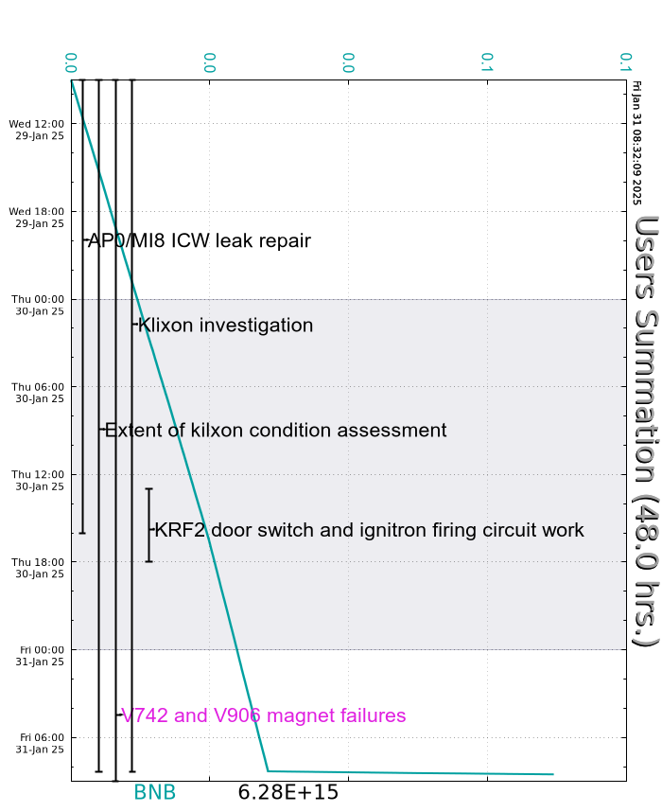
Since Wednesday…
Wednesday:
MI12B access for sump samples
Thursday:
SOLA transformer at bottom of Booster RCC rack failed
USI for AP0/MI8 leak repair completed and approved. MI mode key unlocked
Work and accesses wrapped up, machines powered and in standby waiting for HEP approval
Friday:
Approval received for HEP beam, Beam to BNB!

