Slide 1
Mu2e report – “In the Hall”
Greg Rakness (FNAL)
Friday 9am AD meeting
31-Jan-2025
https://indico.fnal.gov/event/68015/

Slide 2
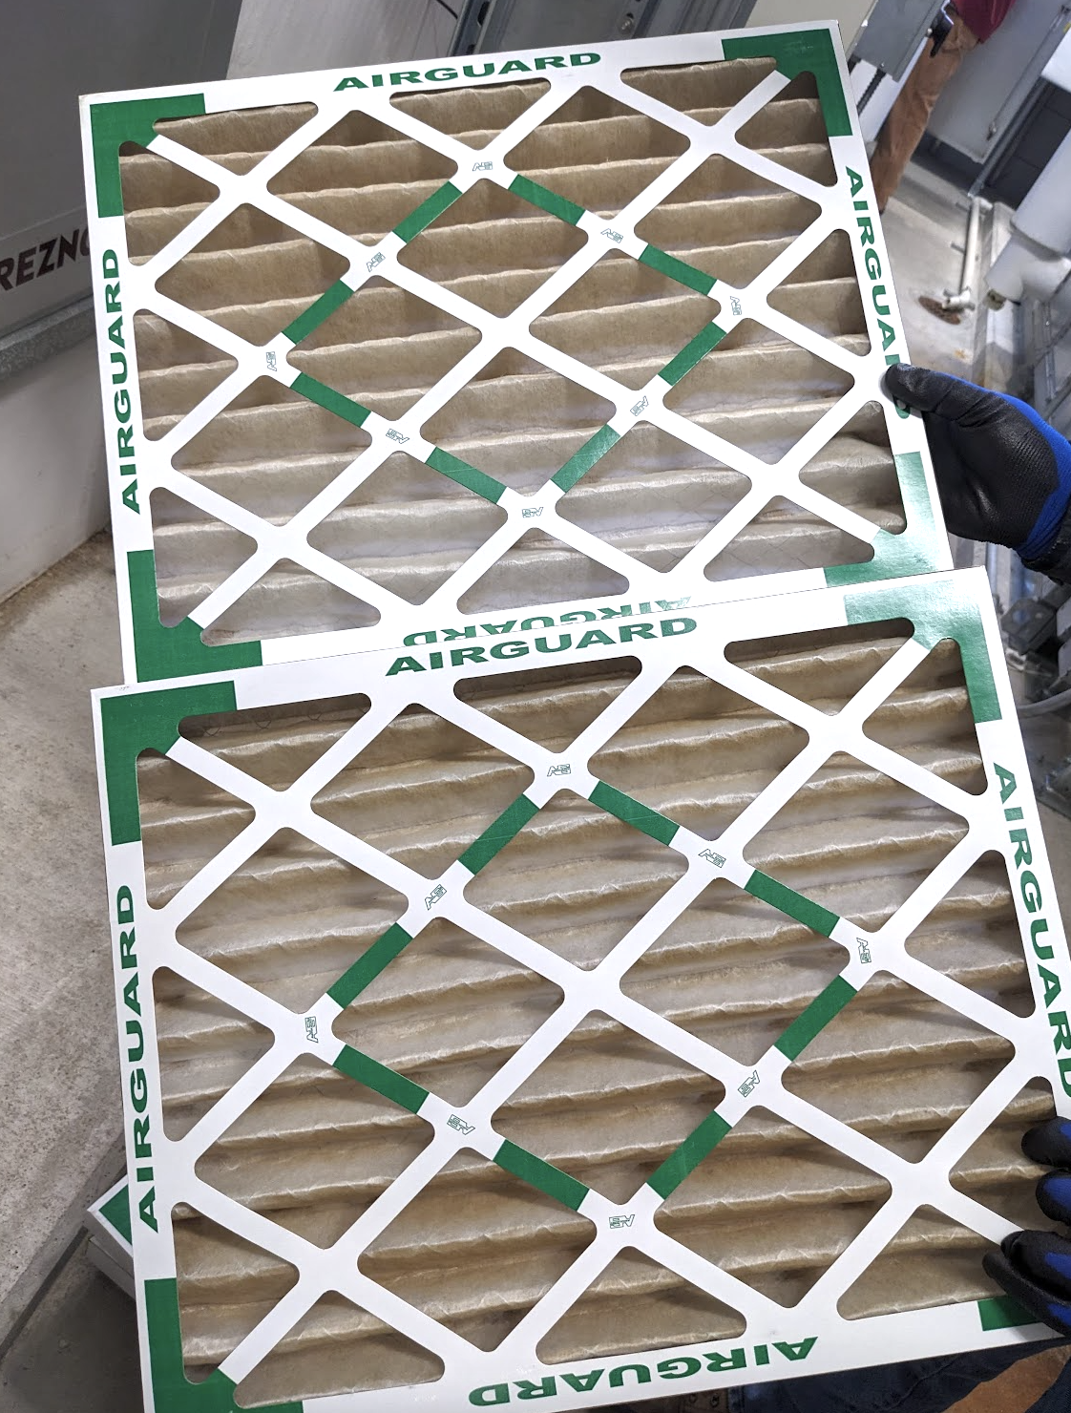
Some of the work at Mu2e (1/2)
Filters at MC1 on 28-Jan:
Following the incident Sunday 26-Jan, have cleared the air in MC1 and MC2
  Mon 27-Jan: paused work in buildings. ISD changed HVAC filters
  Tue 28-Jan: with PPD DSO and ESH IH, pause was removed and now work continues at MC2 (aka Mu2e) & MC1
  Thanks to ISD for the help with this
Issues with Mu2e air compressor (MC1)
  Thu 30-Jan, the air compressor ran out of oil… because it is leaking badly
  Trying to setup a contract with a vendor for periodic PM’s, including an in-depth diagnosis for the first PM…
  Thanks again to ISD for help with this!
(These had been replaced 10-Jan)

Slide 3
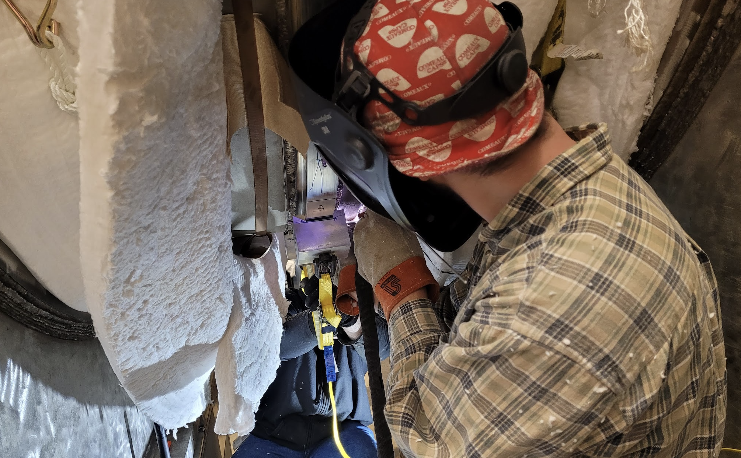
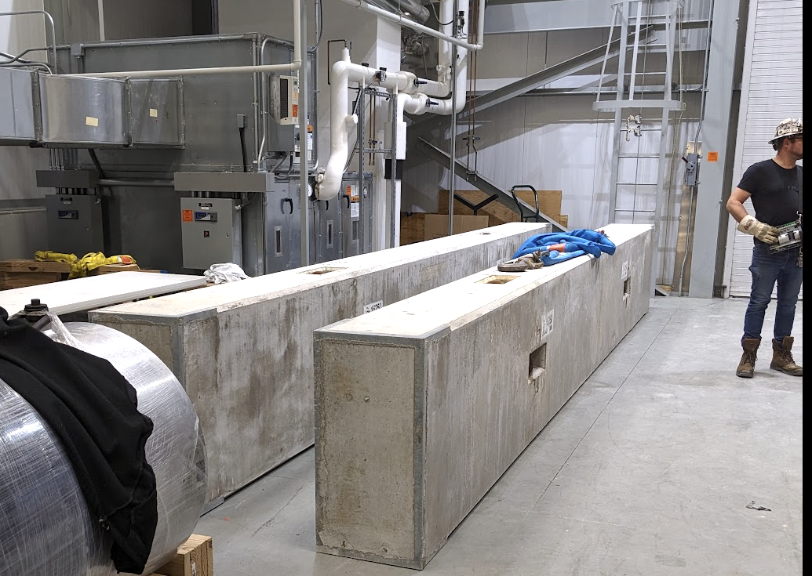
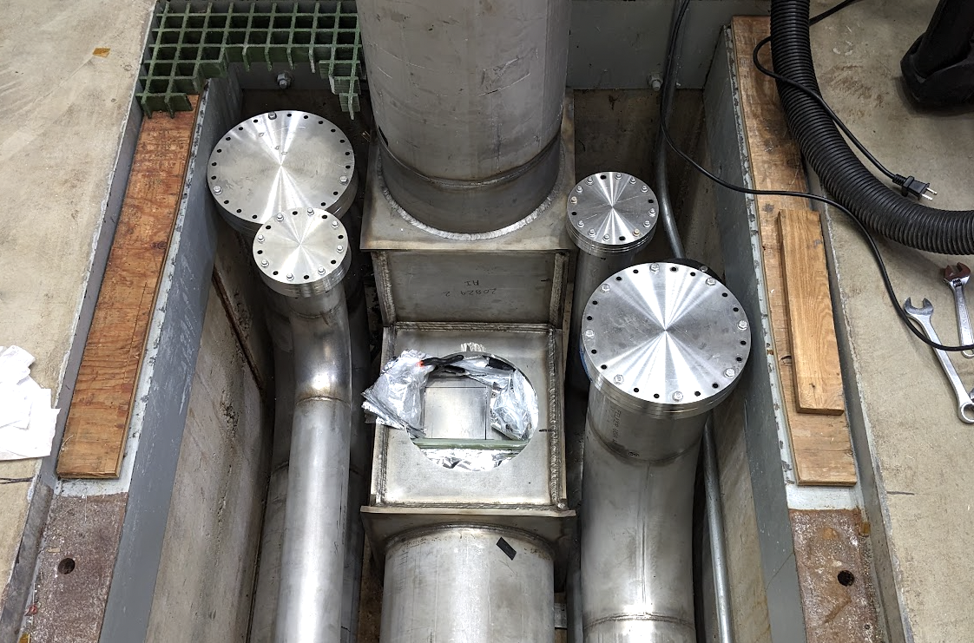
Some of the work at Mu2e (2/2)
Began program to heat TSu-TSd interconnect to remove the “Belleville effect”
  Recall: collimator at this interconnect needs to be able to rotate for charge selection
Starting to prep few shield blocks to install in hatch
  These are the ceiling for tracker and calo when we bring them to Mu2e later this year
  As well, for Detector Key Performance Parameter, we will put a few Cosmic Ray Veto modules on these
Continuing to search for leaks in…
  Cryo system at Mu2e
  Production Solenoid

Slide 4
Incoming
18-Feb: Replace Automatic Transfer Switch at MC1
  To automatically switch to backup power for Mu2e cryo plant
Extinction Monitor Collimator Filter is paused
  Need to get this going again…
Continue preparations to bring over Calorimeter and Tracker
  Lots to do here

