Slide 1
Linac Weekly Report
R. Sharankova
AD Operations meeting
31 Jan 2024

Slide 2
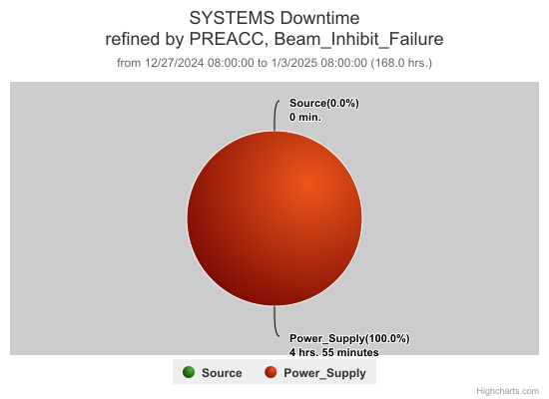
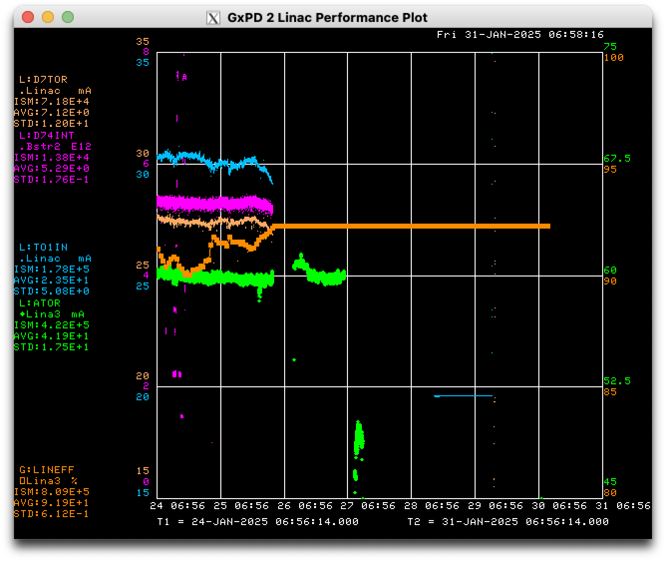
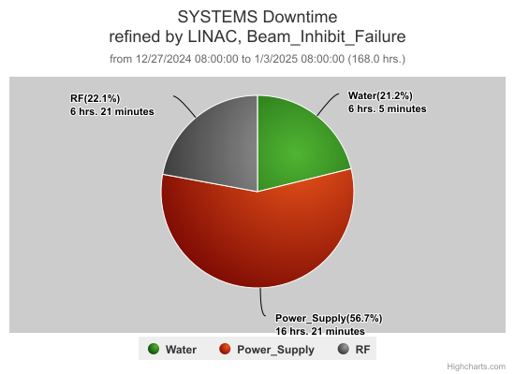
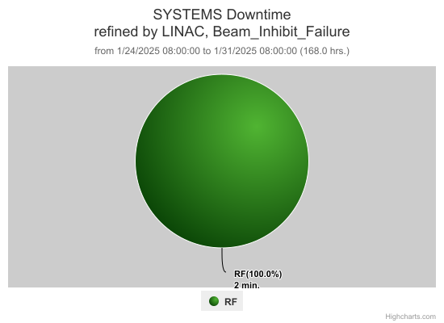
Preacc & Linac Weekly Performance
Fri: KRFD PFN trip
Sun: lost LCW, recovery of systems during the day
Mon: recovery of systems, Src A arc modulator failure
Tue: controlled access for klixon validation & other jobs
Thu: controlled access morning, KRF2 bad relay replacement
All week:

Slide 3
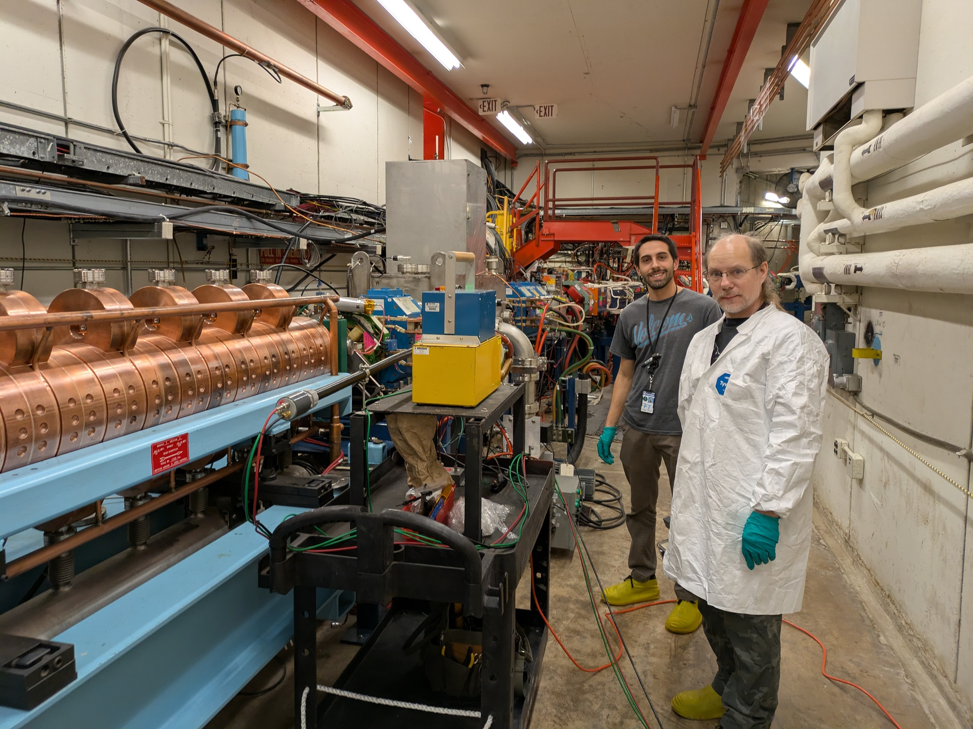
Work done during access
Validation of 400 MeV line & MTA magnet klixons
Booster & External Beams
Installation of portable TLM (testing for PIP-II)
Interlocks

Slide 4
Work done during access (2)
Measurements of Griffin detector positions & TDR of cables
Chandra, Salah, Ops

Slide 5
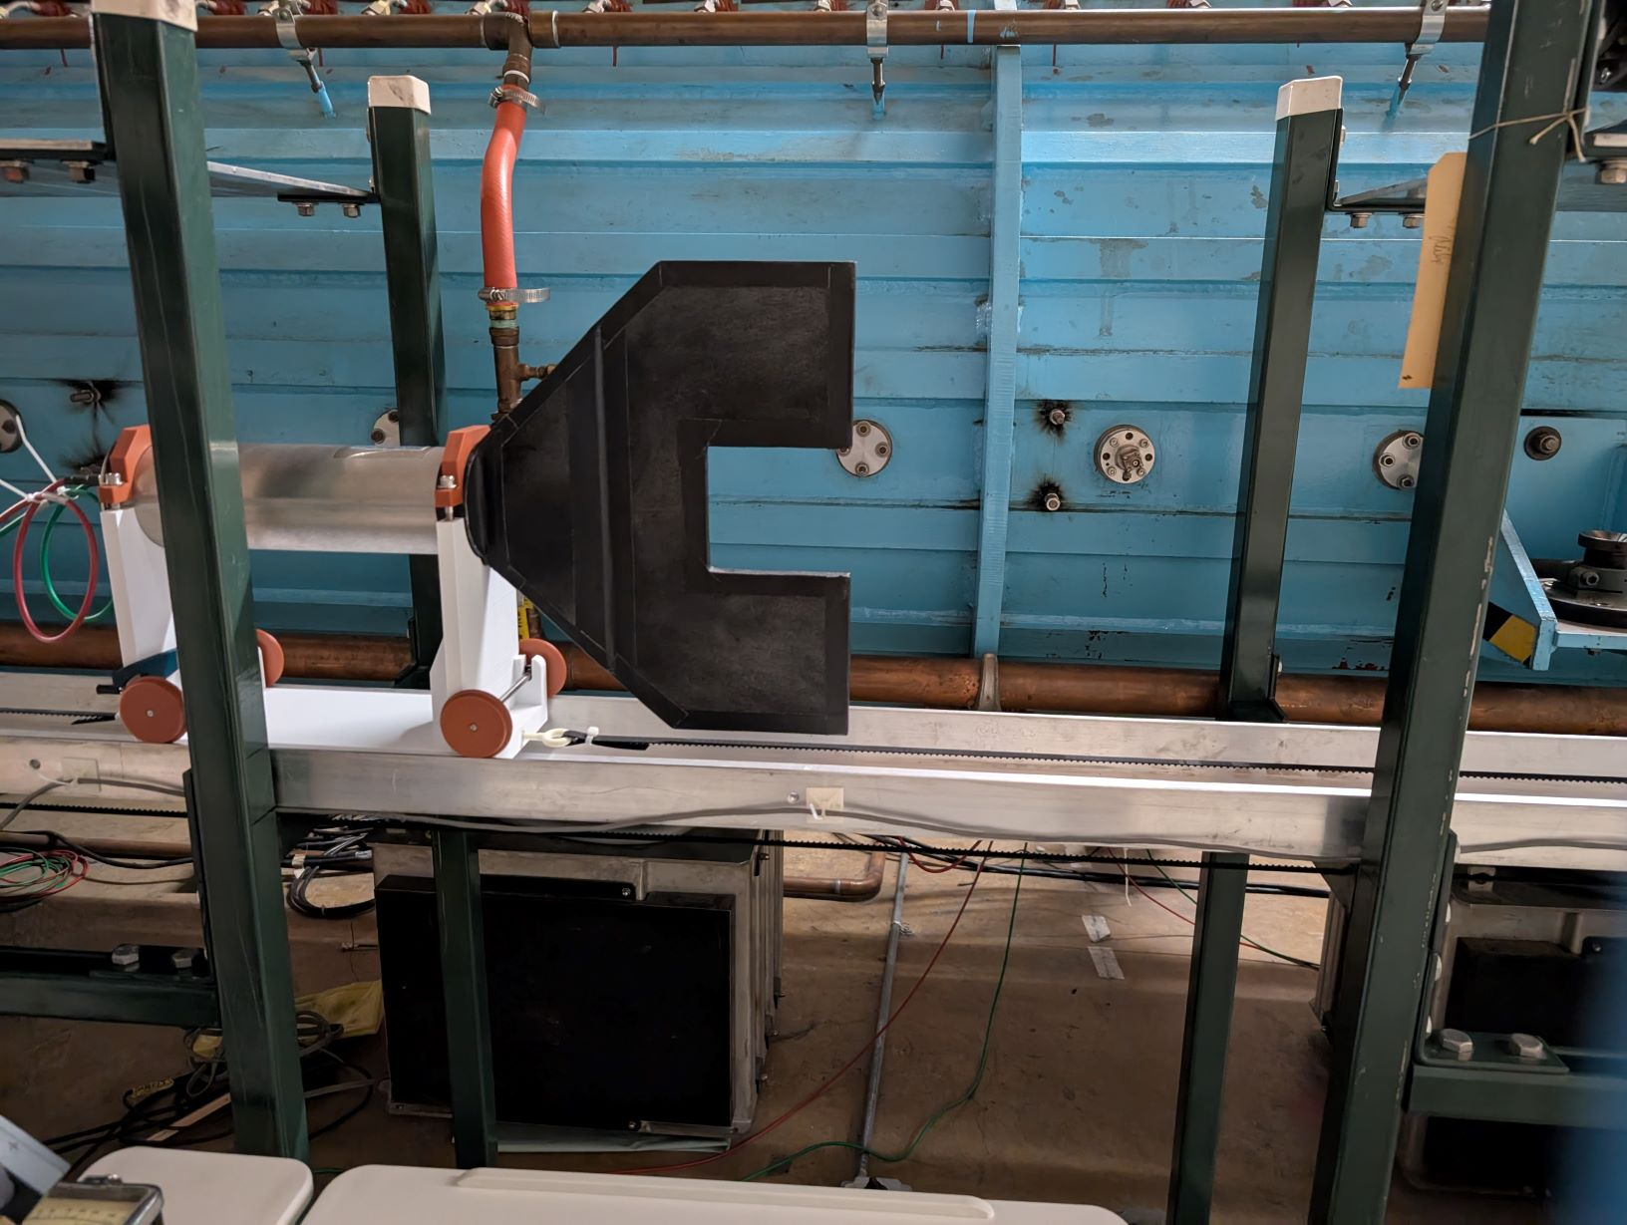
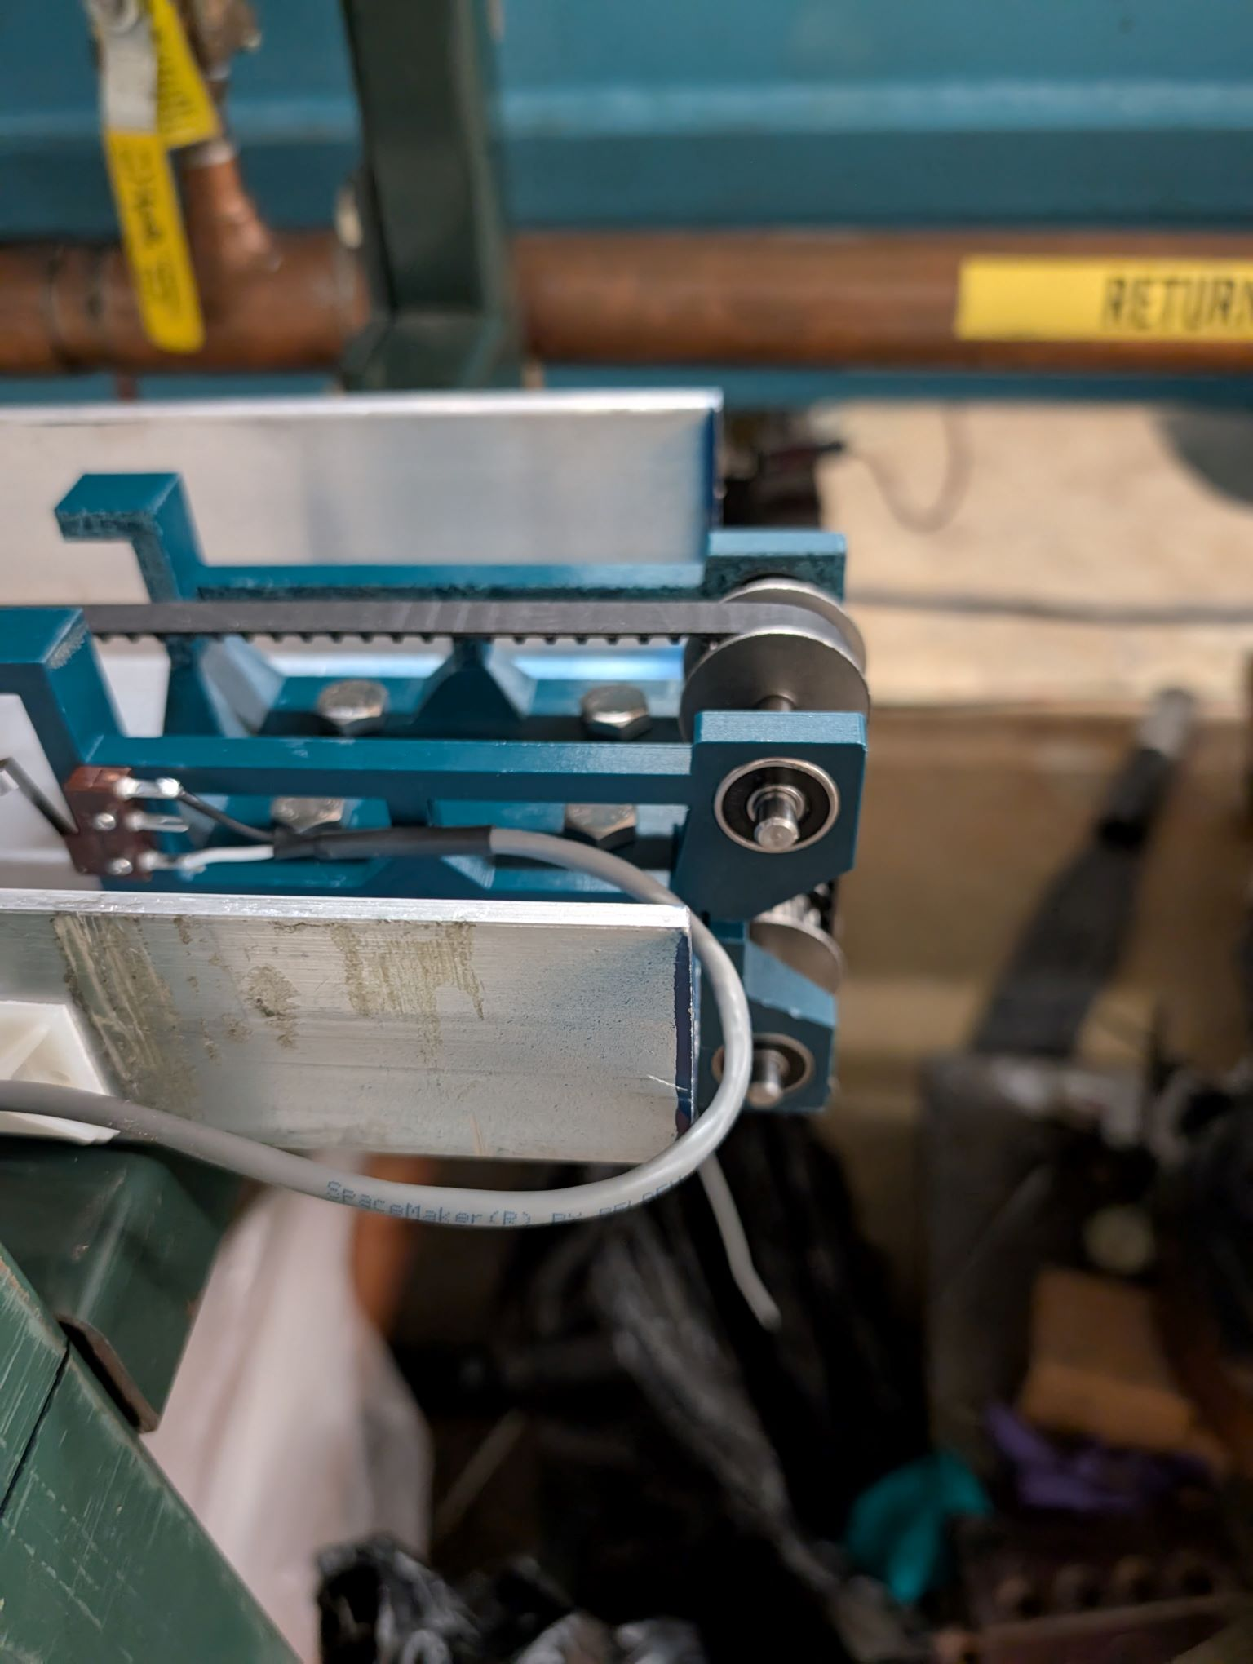
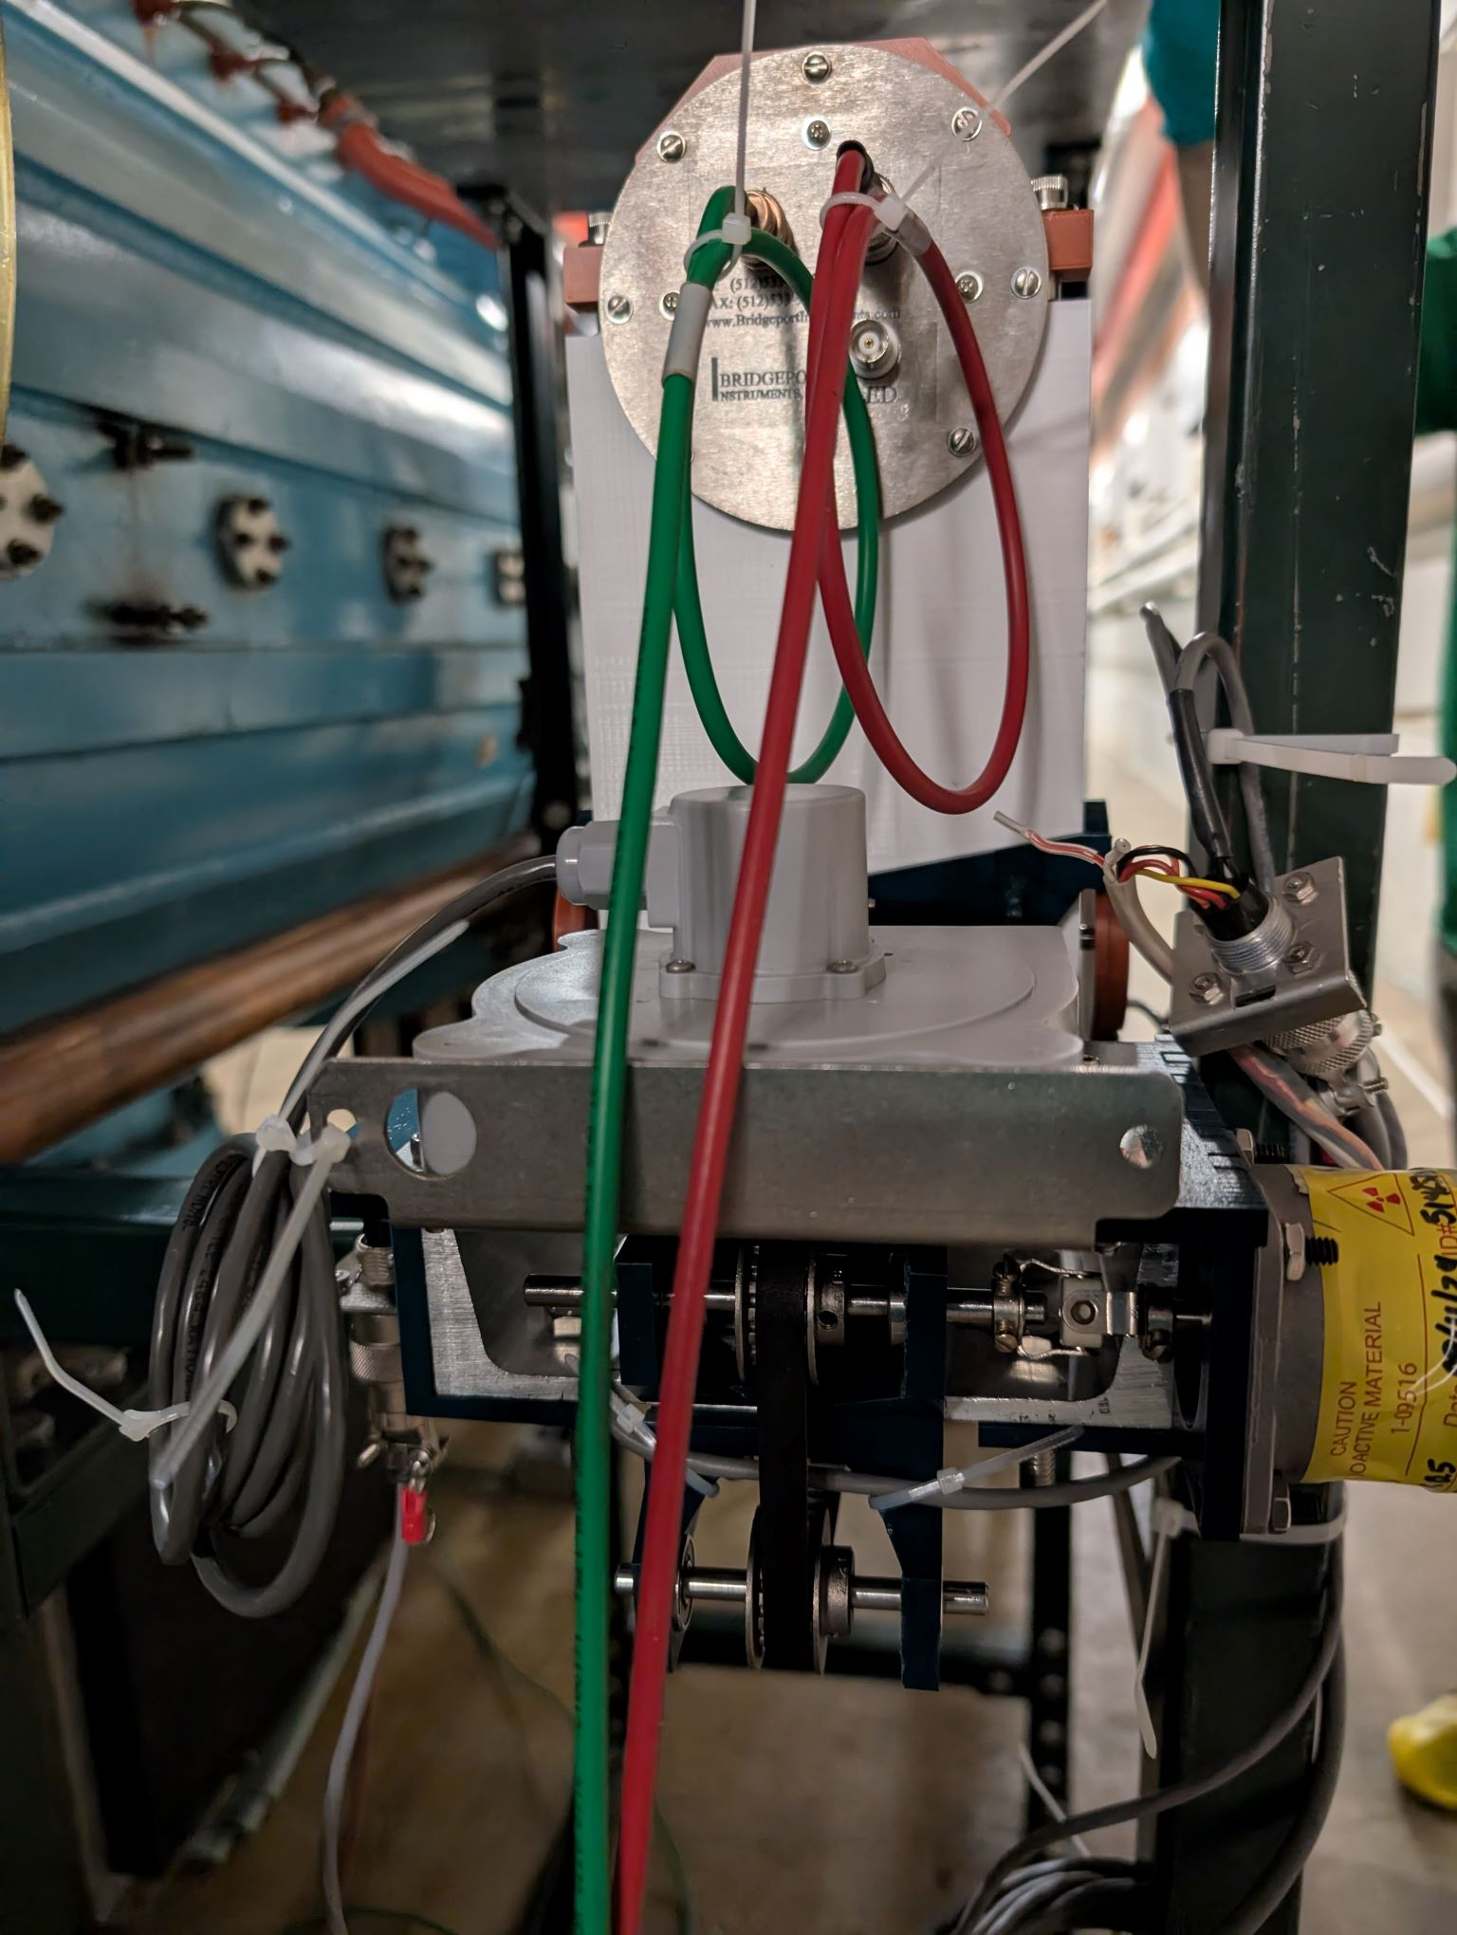
Work done during access (3)
Installation of translation mechanism for DTL1 BLM

Slide 6
Current Conditions/Plans
Source A – N/A
Linac input – N/A
Linac output - N/A to Booster
Linac efficiency – N/A
Remaining tasks:
Source experts conditioning Src A
Opportunistic downtime requests:
None

