Slide 1
Project Activities for MSD
Mayling Wong-Squires
AD Operations Friday 9am Meeting
31 January 2025

Slide 2
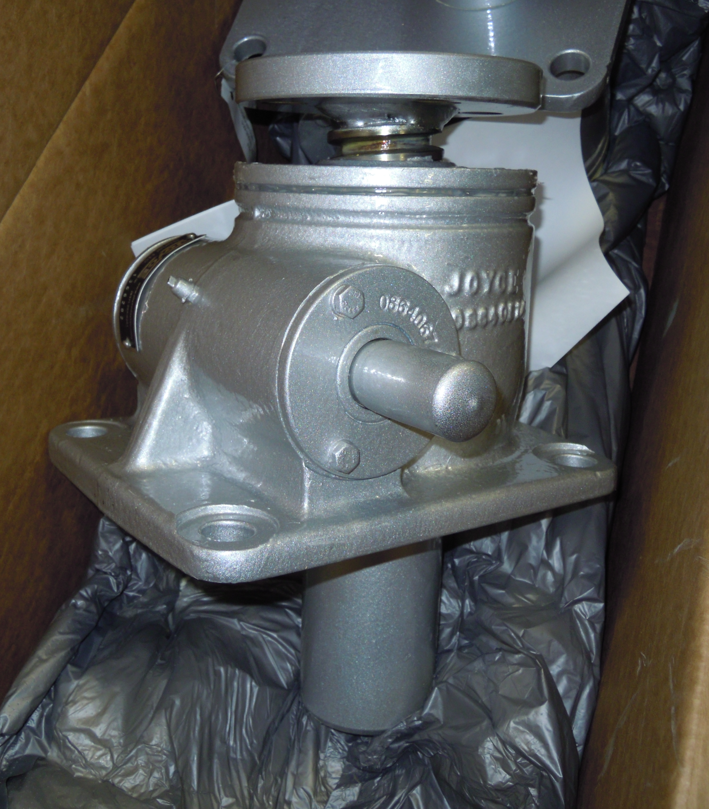
LBNF Primary Vacuum and Magnet Installation Kevin Duel, Ty Funk, Scott Oplt, Will Derylo, Dan Vrbos, Jason Kubinski, Dirk Hurd, Parth Gandhi
Magnet Installation
PO issued for corrector magnet stand prototype fabrication with estimated delivery in March
Spare stand parts sent out for plating for testing low friction tungsten disulfide coating
Primary Beam Enclosure dipole stand design continues with modeling and drawings, structural engineering note under review
Prototype screw jacks arrived and QC’d
Working out plans for testing under load
Toroid, RWCM and BPM instrumentation stand design continues
Primary Vacuum
Kicker ceramic beam tube titanium nitride (TiN) coating
Vendor working out some equipment issues before applying to 12” beam tube samples
Work on drawings and models for relocation of MI/RR components continues
Dipole Stand Screw Jack

Slide 3
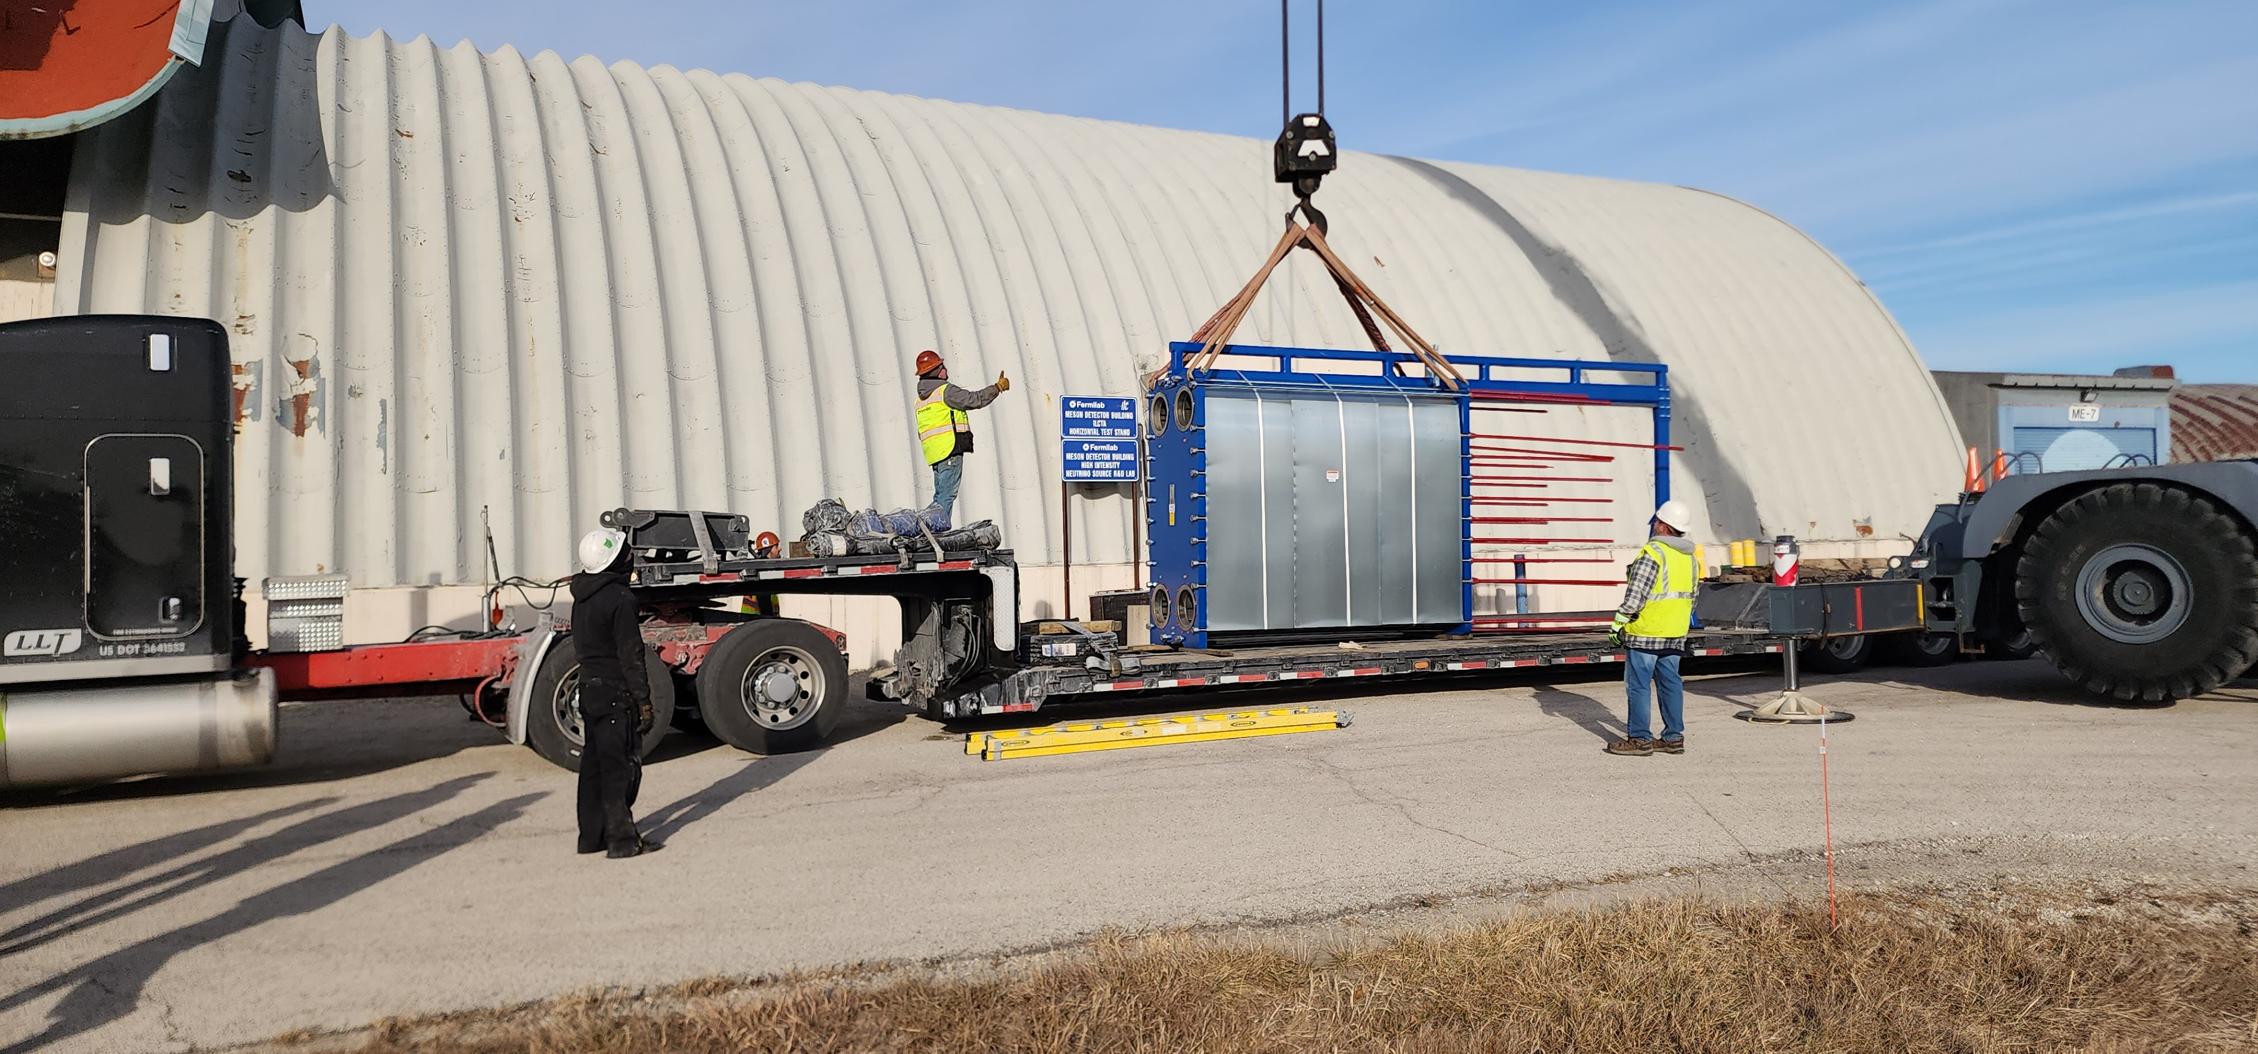
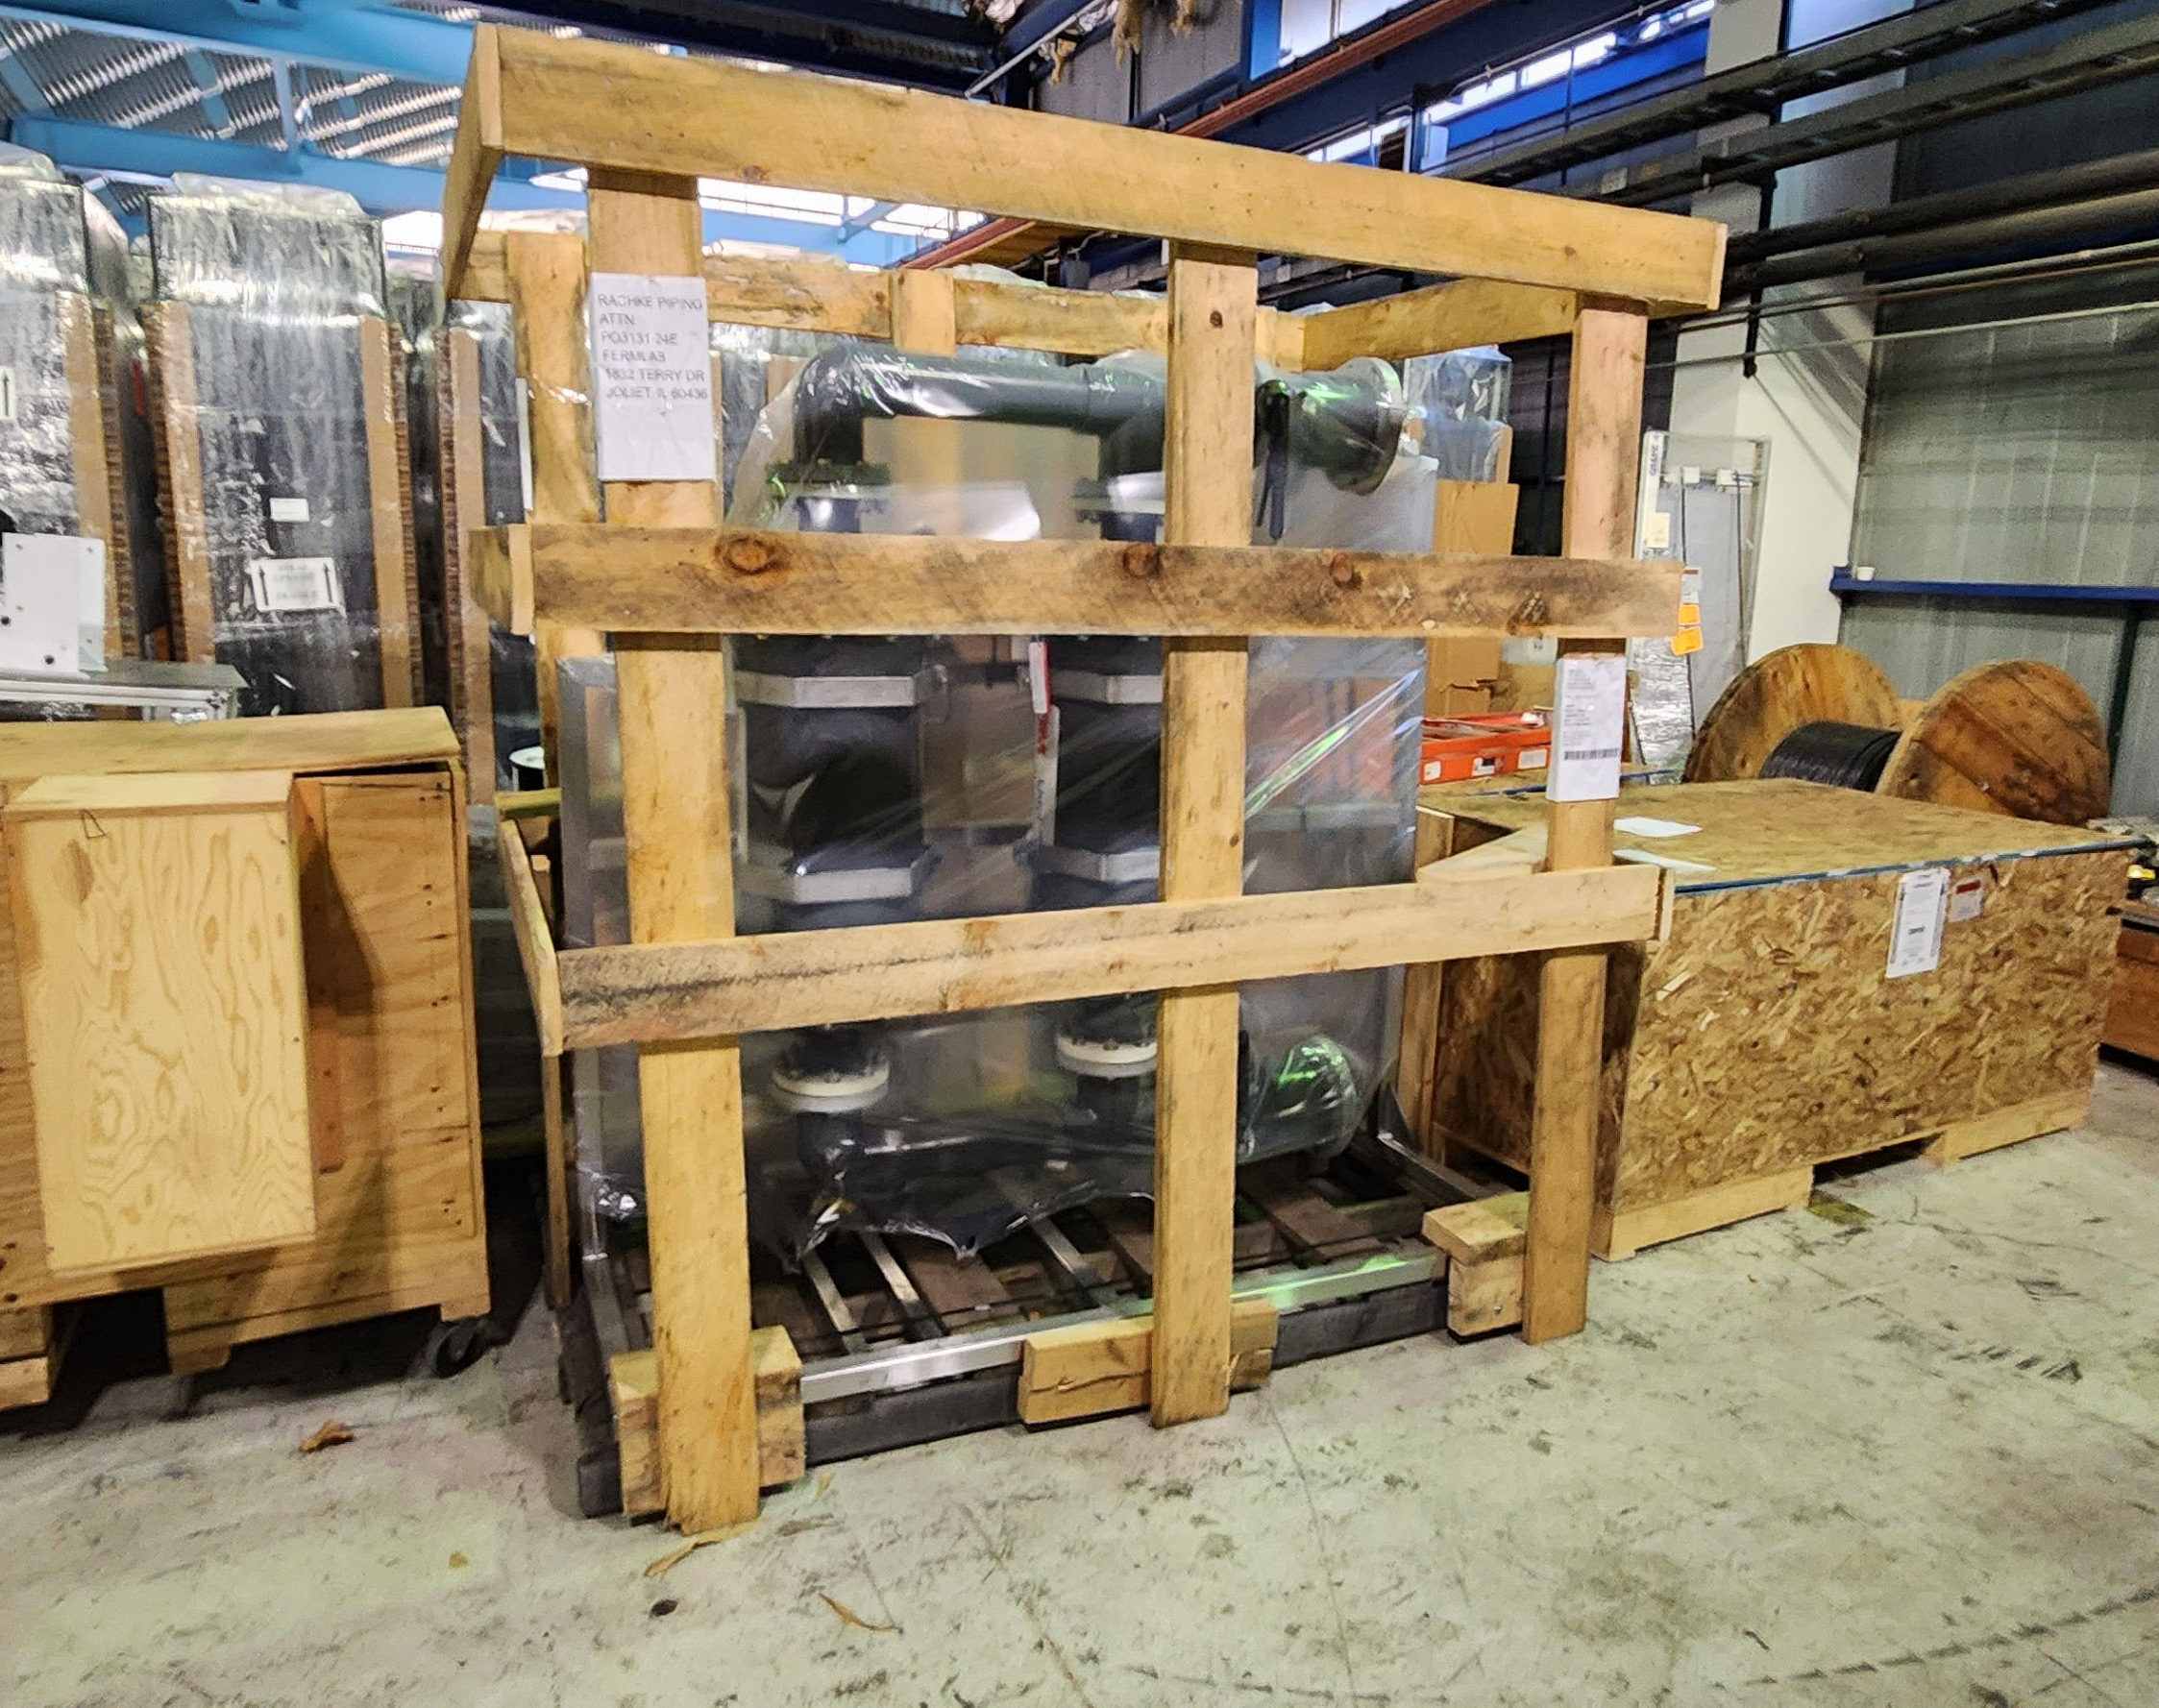
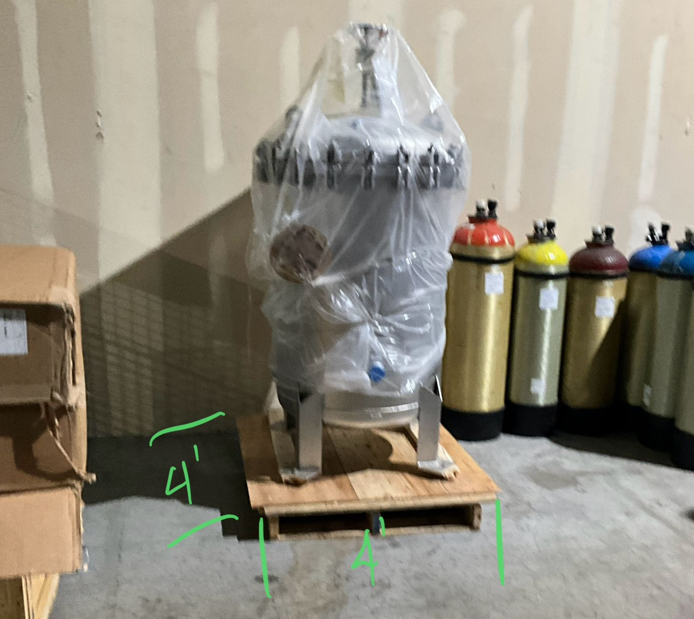
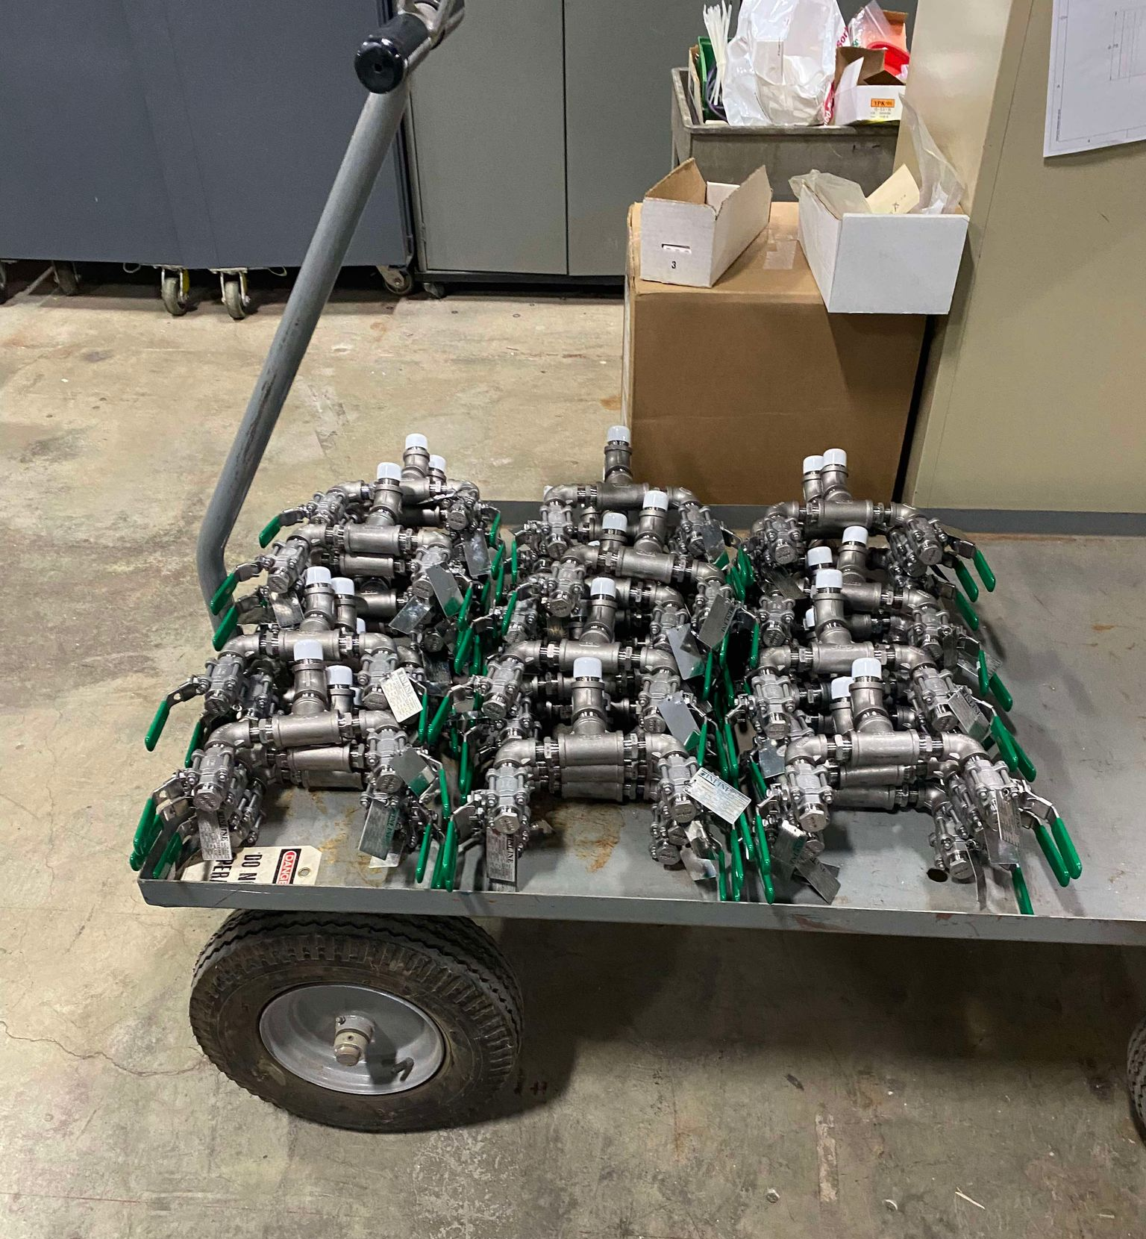
PIP-II Fluid Systems Update Maurice Ball, Michael Geelhoed, Michael Hanson, Jason Grischkat, Monika Sadowski, Frank Rios, Amos Horton
Process Clean Water(PCW) Piping System Installation
Contract deliveries continue/stored onsite
PCW Heat Exchanger arrived on flat bed lowboy trailer (plate/frame)
Dissolved Oxygen Skid
Particulate filter
Strategy meetings held with contractor/procurement to plan rigging and transport of heat exchanger to Utility Plant (UP)
Installation activity in UP scheduled to begin in Spring
“Goldilocks” and compressed air manifold assemblies underway by MSD techs
Procurement for HBB/WFE systems continue
Ion Source, LEBT, MEBT manifold bid procurement underway
RFQ intermediate skid bids under review
Absorber Cooling Skid Bid Procurement
25 KW RAW skid – out for bid
25 KW and 2 KW air cooling skids preparing bid packages
PCW Heat Exchanger arrived from Mfr on semi-truck flatbed (Top image)
Dissolved Oxygen skid for PCW system in MDB (Bottom left image)
Particulate filter for PCW system (Bottom center image)
“Goldilocks” LCW valve manifold assemblies, Courtesy MSD techs (Bottom right image)

Slide 4
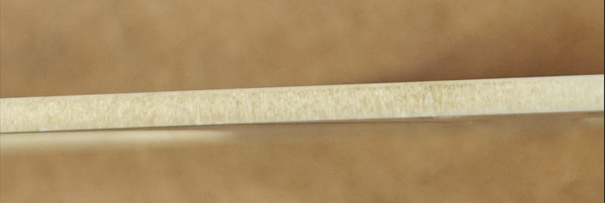
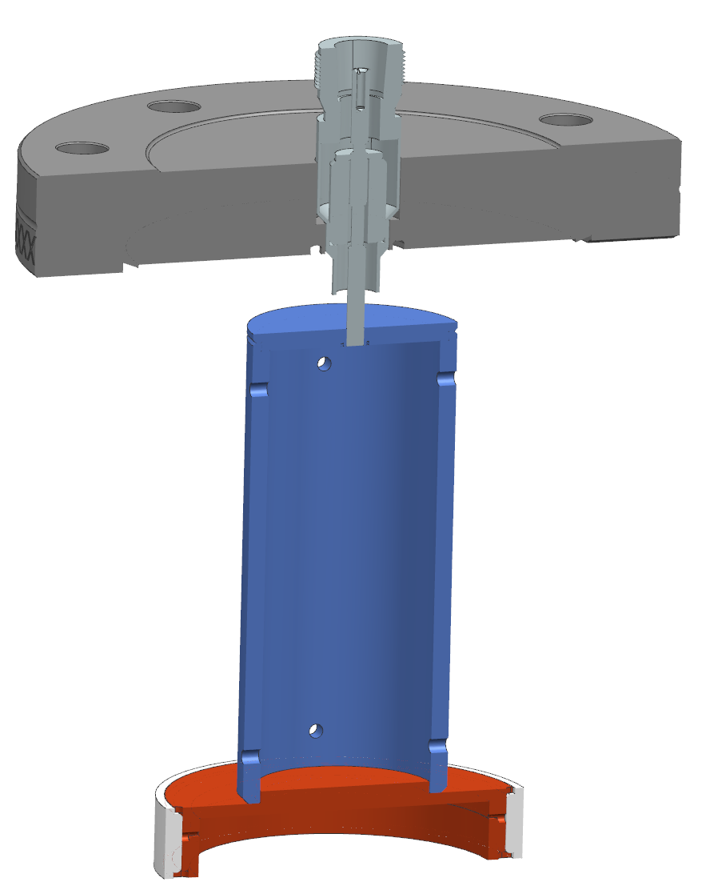
PIP-II Instrumentation Update Dakota Krokosz, Amadon Faul, Eric Pirtle
Wirescanners
BTL and diagnostic cart linear actuators bid awarded to Thermionics.
Established polishing process of poor-quality frames from CERcuits on-site with glass shot.
Reverse electroplating / Chemical stripping of wirescanner gold plating to begin, pending ES&H review.
Still waiting on a few machined components.
Emittance Scanners
LEBT construction delayed due to machined parts being late.
Assembly girder and vacuum chamber at NWA. Chamber is being cleaned.
Dry assembly of the MEBT AES is in progress. Waiting on new faraday cup as braze material leaked into the cavity.
Test station estimated to be ready by end of February.
Diagnostic Cart
85% of orders are currently placed. 35% or parts have been received.
BPM’s
Mechanical development of the model / concept for the elliptical shoebox split plane BPM is in progress. Plate shape pending final beam tube size selection.
2” BPM testing ongoing.
Laserwire
Faraday cup design complete.
Updating magnet drawings and will send out for bid again by March.
Glass shot polish (Top) Provided finish (Bottom)
Type-N Feedthrough
CF Flange
Faraday Cup
PIP-II Laserwire Faraday Cup

