Slide 1
Muon Campus Shutdown Report
Jim Morgan
Friday 09:00 Ops Meeting
January 31, 2025

Slide 2
Muon Campus loss of cooling water while powered
Loss of LCW flow from CUB early Sunday morning led to magnet damage
CUB lost power at 02:26, Muon Campus remained powered
MC-1 fire alarm at 02:42, probably from “Protectowire” in Extraction Enclosure
Many power supplies continued to run after loss of LCW
Some power supplies continued to run until tunnel access into DR & Extraction
Three power supplies in Transport ran 88 min. until turn-off commands were sent
Many power supplies tripped off, due to magnet temperature or other trip inputs
Not all power supplies were running, P1, P2, M1, M2 & M5 were off
Some magnets more vulnerable depending on type and dissipated power
Three MDC dipoles badly damaged from heat, V742, V743 & V906
Magnet thermal protection (klixons) and wiring checked out okay after incident
D:V742 and D:V906 power supplies are both Spang supplies
MDC dipoles have relatively high heat dissipation
Remaining concern over the health of other magnets
Beginning to test approximately 30 magnets that had high dissipated power and/or a long period without cooling water
Have performed visual inspection of all magnets that were powered on Sunday
No obvious signs of heat damage on other magnets
Smell from damaged coils remains in tunnel, sticky layer on nearby objects
Study – M1-M3 Optics
Study – Alternative M5 optics

Slide 3
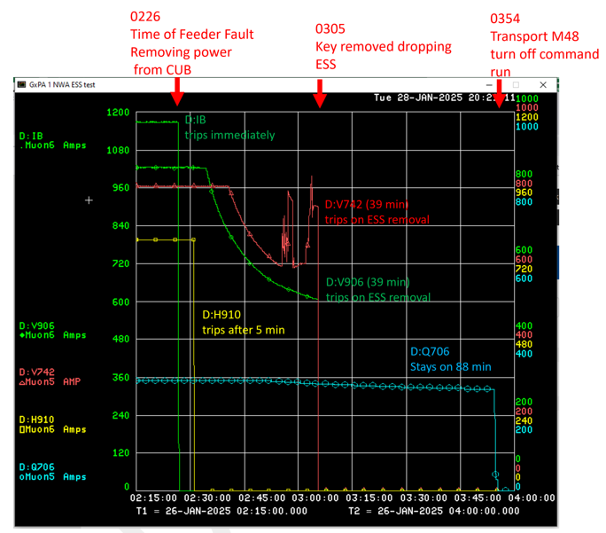
Electrostatic septa conditioning

Slide 4
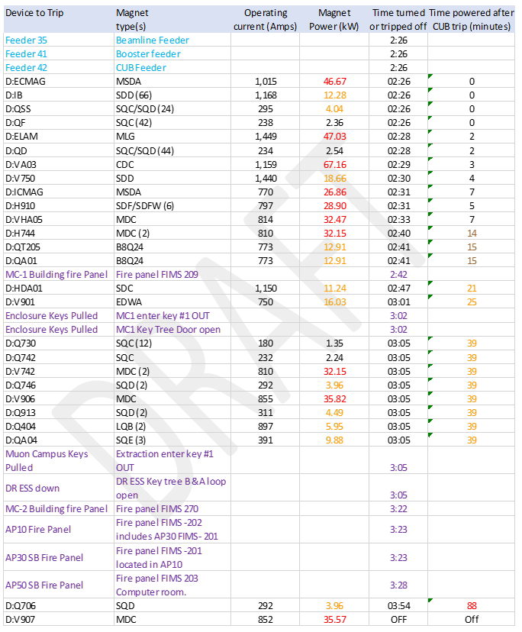
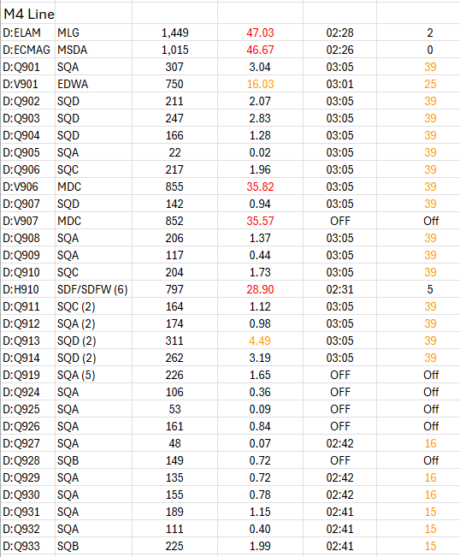
Timeline of events and magnet dissipated power
Current
Power
Time
Minutes

Slide 5
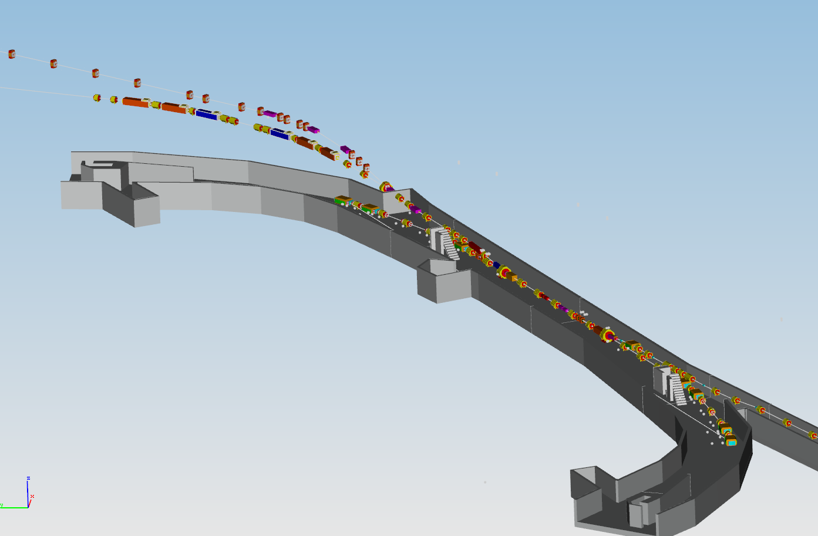
Location of damaged dipoles
V906
Delivery Ring Enclosure
D30 straight section
V743
V742

Slide 6
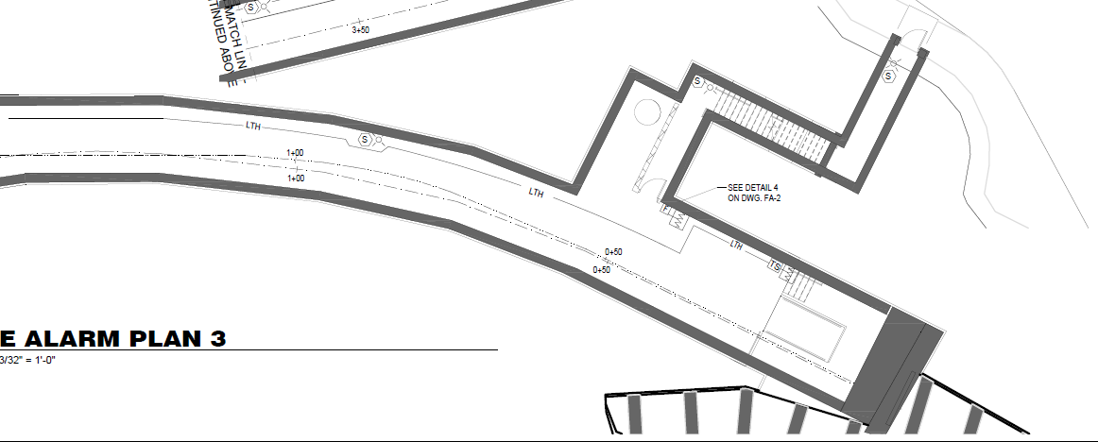
MC-1 fire protection Protectowire in Extraction Enclosure
Protectowire
Intake for exhaust fan
on berm north of AP-30
Extraction Enclosure
M4 Line
Delivery Ring Enclosure
V906

Slide 7
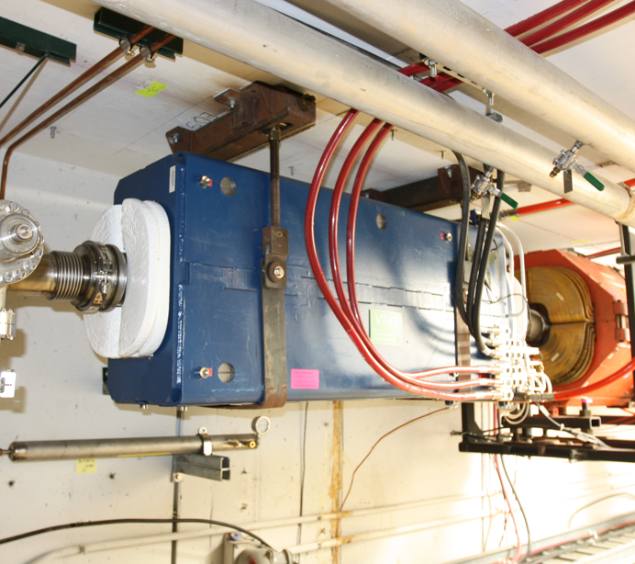
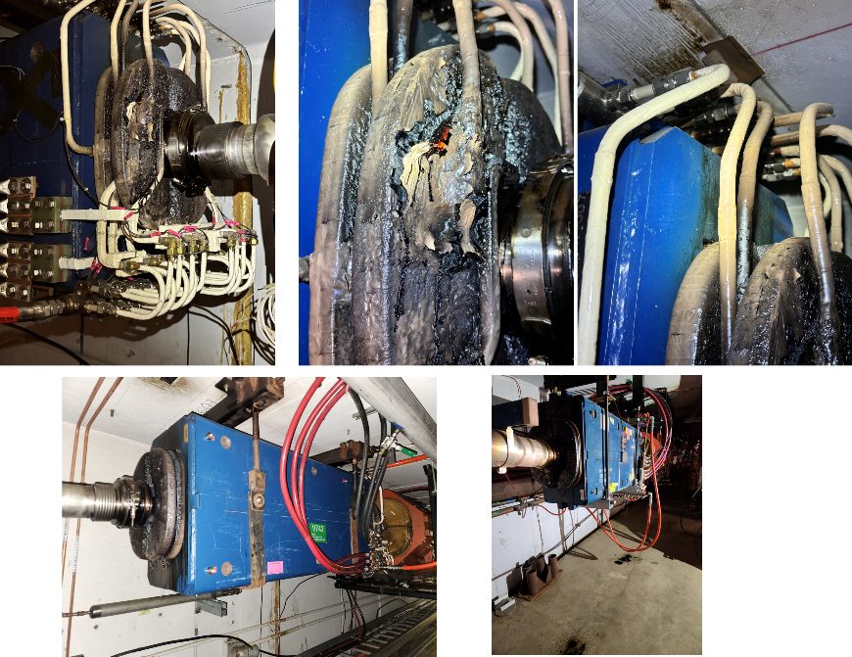
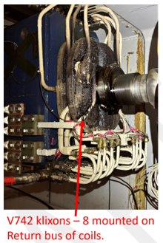
V742 Dipole
Before
Coil damage

Slide 8
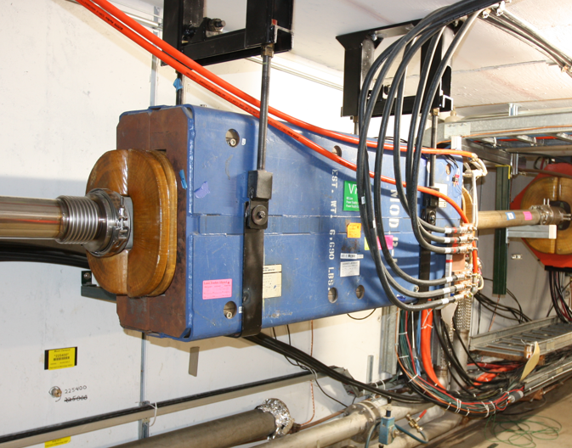
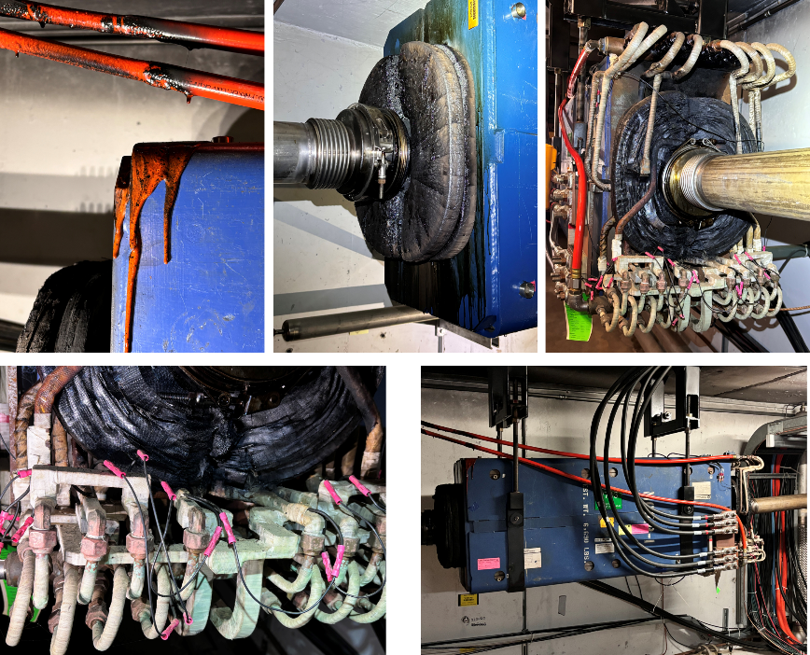
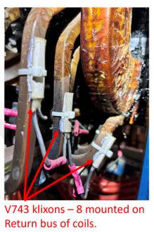
V743 Dipole
Before
Coil damage

Slide 9
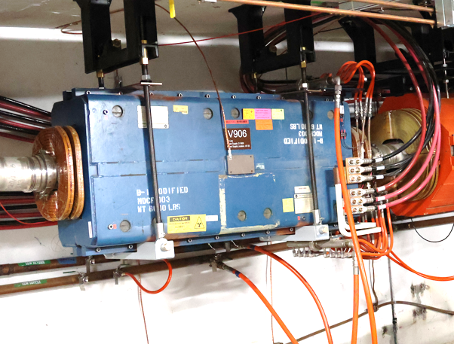
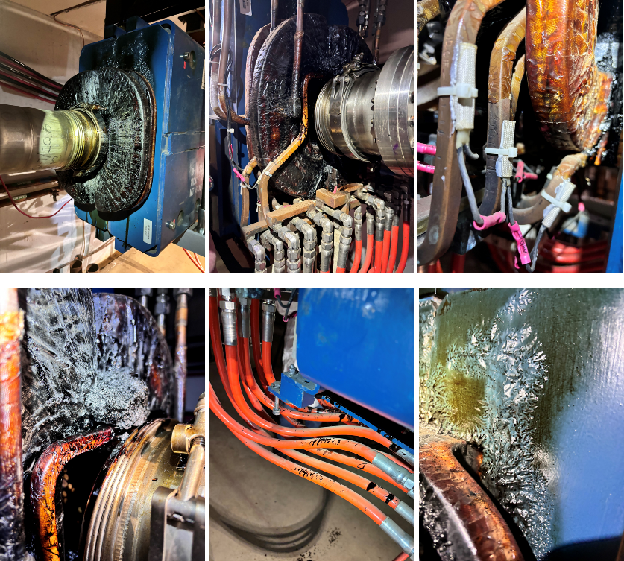
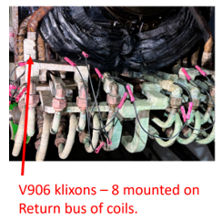
V906 Dipole
Before
Coil damage

Slide 10
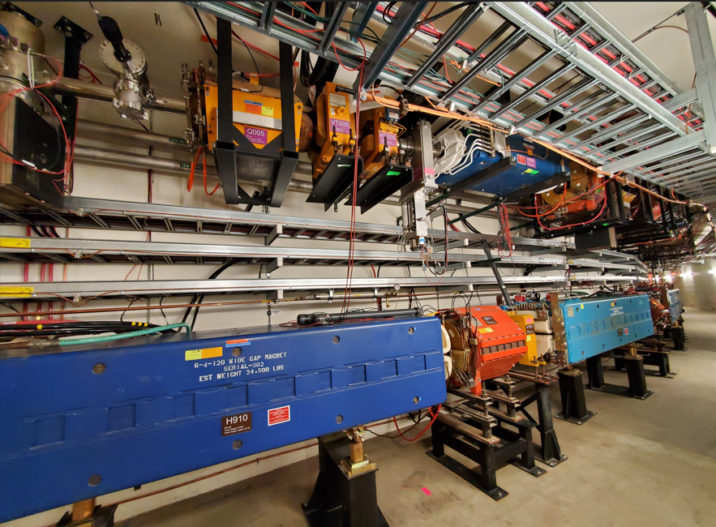
M5 MDC dipoles
M5 Line
H005
M4 Line

Slide 11
Moving forward
Klixons and magnet coil information
Klixons open at 80C, TD experts think placement on magnet is correct
Magnet coils are wrapped with fiberglass tape, impregnated with epoxy
TD experts say that epoxy will blacken above 250C
TD experts also said that epoxy must be above 650C to burn
In my opinion, there is no evidence that there was a fire
There was lots of smoke and heat however, Protectowire generates alarm at 88C
The (technical) path ahead
Need to replace three failed dipoles
Only one true spare, but four suitable MDC dipoles in M5 Line since g-2 has finished
Three M5 Left Bend dipoles H005, H008 and H011 will replace damaged magnets
M5 dipoles have special vacuum pipes, MSD has located three standard pipes
The V906 magnet hanger may need new parts due to the difference in MDC types
Check magnet thermal protection, especially ones with newer power supplies
Did not get beam sign-offs completed prior to Sunday’s incident
PIP-II 6-week pause began earlier this week
Hope to address warm power supply circuit breakers during 6-week pause
Replace several circuit breakers identified as running warm (especially V907)
Increase wire size on a few circuits to improve margin

