Slide 1
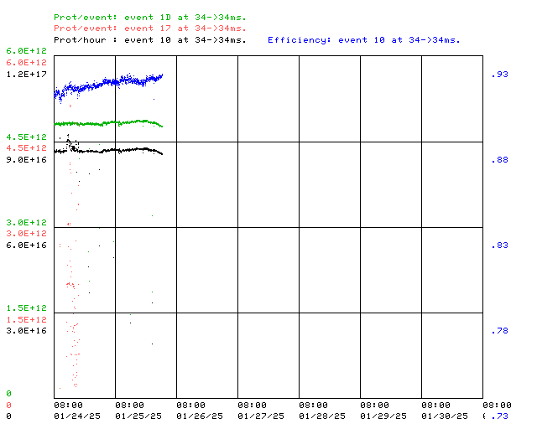
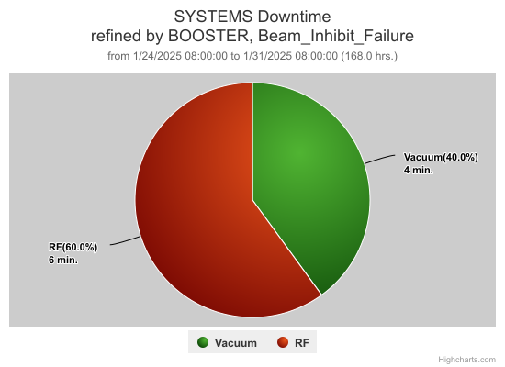
Booster Operations 01/24/25 – 01/31/25
F
Sa
Su
M
Tu
W
Th
F
F
Magnet/PS high temperature
Protection verification performed
Also:
BRF02 was found with a back tuner leak. Difficult to get to. 3 attempts this week to epoxy patch, much better ~ 1 drip every 15s, and on a safe place. Thanks MSD & RF Folks!
Magnet/PS high temperature protection verified for our systems.
Lots of worklist jobs completed this week.
Sump 12 floats were replaced, check valve was stuck. Thanks ISD!
BRF14 cavity transported to MI60 for repairs thanks again ESH, MSD, & RF folks.
Girder inspections with TD in planning for new Booster magnets in PIP II era.
Repaired some faulted IP HV cables
Leak checked areas where we’ve had increasing ion pump trips
BRF17 Control PS replaced
BTWBS HRM fan replaced
Kicker maintenance
Thanks to Ops for diligence & efforts on the off shifts
Power Outage
This week:
Started with Booster running well. Tuning in progress.
Booster Studies performed on Friday. Pushing 6.2E12/pulse.
Was delivering beam to BNB ~ 4.8E12/pulse 5Hz, 8.9E16 P/Hr
Feeder faults Sunday ~ 0230
Thanks to all who came in to help!
Early efforts assured all systems were in a safe state for return of power.
Later Booster access was made to verify all OK in tunnel.
Recovery and restore to operational status done through Sunday.
Ready to return to operations by Sunday evening.

