Slide 1
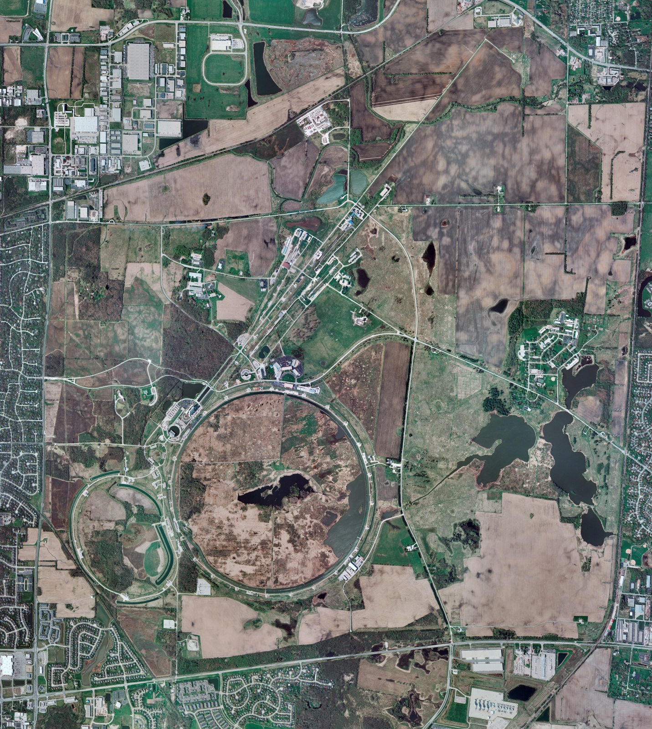



Helium Cryogenics
Status 1/31/2025 J.Makara
CMTF: SCP cold stable after power outage (8-hr); recovery that went fast, though had some controls issues fixed
CMTS: HECM26 at 2 K after power outage recovery (reached 50-120 K) and fully cold after 39 hrs
PIP2IT: South Stand being modified for SSR2 pCM
North Stand empty
MCTF cryo system shut off due to controls issues; seems fiber optic cables between MCC and MDB damaged (mice, rats, ??)
MDB/HTS: at RT
MDB/STC: at RT, next SRF 325 Hz cavity ready for testing
MDB Magnet: at RT
NML/FAST: Cryo system is shut down and isolated for extended shutdown period
CC1: at RT
CC2: at RT
CM: at RT
IB1: cryo system cold using ALAT CBx and running fine, CBx tripped on power glitch but recovered fine
Muon Campus: at RT with comprs off and system depressurized; LN2 system at RT; g-2 Expt Hall at ODH=0 (not ODH area)
Misc: …

