Slide 1
Accelerator Status
Jason Crnkovic & George Deinlein
Proton PMG/AEM:
February 6, 2024

Slide 2
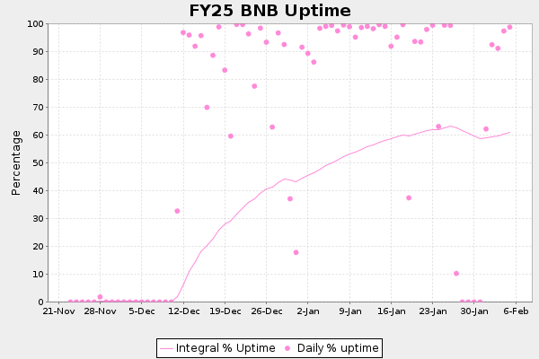
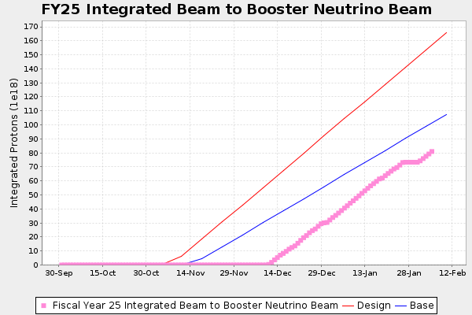
Recent Activities
Booster:
Running: 4.8E12 p/pulse (B:CHGB).
BNB:
Running: 8.8E16 p/hr @ 5 Hz (E:MBRATE @ E:MBPRTE).
MC/RR:
Working to get beam to and commissioning MC
PIP-II ductbank work limits RR power during the day until March 6, 2025.
Linac:
Running: 23.5 mA (I:D7TOR).
MTA:
Operational: Expecting users end of February.
BNB Integral: 7.999E+19 protons @ February 5, 2025 @ 12:00
Design Estimate
Base Estimate
What we have done

Slide 3
A few comments about the Muon Campus (MC) magnets
Dean Still, Jim Morgan, & Jerry Annala are writing a report to document the incident when MC magnets were damaged due to a Feeder 35 fault.
Following slides are based on the current combined AD understanding.

Slide 4
Incident Overview
Central Utility Building (CUB) suffered a power outage on Sunday January 26, 2025 at 02:26 AM
Feeder 35 faulted that then glitched CUB Feeder 42 and Booster Feeder 41.
All water-cooling pumping provided by CUB ceased.
MC was preparing to potentially receive beam on Monday January 27 and had turned on all magnet power supplies.
3 MDC magnets in the Delivery Ring (DR) were damaged due to excessive magnet heat.
Magnet fiberglass wrapping coated in epoxy materials melted causing large amounts of smoke to fill the tunnel.
Smoke reached the MC-1 service building pulling the fire alarm.
Fermilab fire department and accelerator operations were dispatched to MC-1 for an investigation.
Realization that smoke was originating from the DR prompted an immediate access into the DR and Extraction tunnel enclosures.
A key in the MCR was pulled at 03:05:30 AM to disable the electrical safety system (ESS) that in turn disabled the DR and Extraction power supplies.

Slide 5
Incident Conclusions
Root cause for magnet damage is power supplies not tripping off when there was excessive heating on the magnet Klixon temperature sensors.
Klixons sensors appear to have functioned properly, but power supply PLC code did not make use of input signals.
There is an error in the programmable logic controller (PLC) programming for the MC Spang power supplies; PLC code fails to tell a power supply to turn off.
This PLC function was tested in 2017 by opening Klixon signals at magnets, which was propagated to power supplies.
Since the test involved people being in the tunnel to open the Klixon circuit, the power supplies could not be on, so only the signal at the input to the PLC was verified.
Some signals were also sent to another oversight PLC (PSRAC) for further coordination, but magnet over-temperature signals were not.

Slide 6
Corrective actions
Near-term (before accelerator startup):
Identify all accelerator power supply systems using PLC control and perform a complete check of one of each type of such systems: demonstrate and document operation of the device protection system by showing that when the Klixon switch input is interrupted, the power supply turns off
Done for all systems needed for beam to BNB
Identified supplies in other beamlines will be tested before resuming beam in those areas
Mid-term:
Develop a testing procedure that ensures a comprehensive check of power supplies that are new or have PLC code modified
Long term:
Additional corrective actions to be determined by Event Response Team

Slide 7
Timeline of the incident

Slide 8
3 MC magnets got hot enough to produce smoke

Slide 9
3 MC magnets got hot enough to produce smoke

Slide 10
3 MC magnets got hot enough to produce smoke

Slide 11
Klixon sensors are used to monitor heat on magnets

Slide 12
Klixon sensors were tested

Slide 13
Current generates heat in the magnets

Slide 14
Vacuum degraded but is not believed to have developed a leak.

Slide 15
Other magnets are also being checked
Top 29 magnets were checked and no additional problems found?

Slide 16
Any Questions?

Slide 17
Incident Conclusions
Many were surprised that the first indication of smoke was seen on the MC-1 smoke detector FIRM 209.
It appears that smoke from the DR entered the Extraction enclosure and migrated to the cable penetrations under the M5 shield wall and then entered the MC-1 experimental hall.
Jerry and Jim did a quick small paper chad test and the air flow seems to be pulled from the Delivery Ring into the M4 beamline at the extraction enclosure gate.

Slide 18
Current generates heat in the magnets

