Slide 1
302.4.04 – Cryo-assemblies Horizontal Test Weekly status report
G. Chlachidze, S. Stoynev
Feb. 3rd, 2025

Slide 2
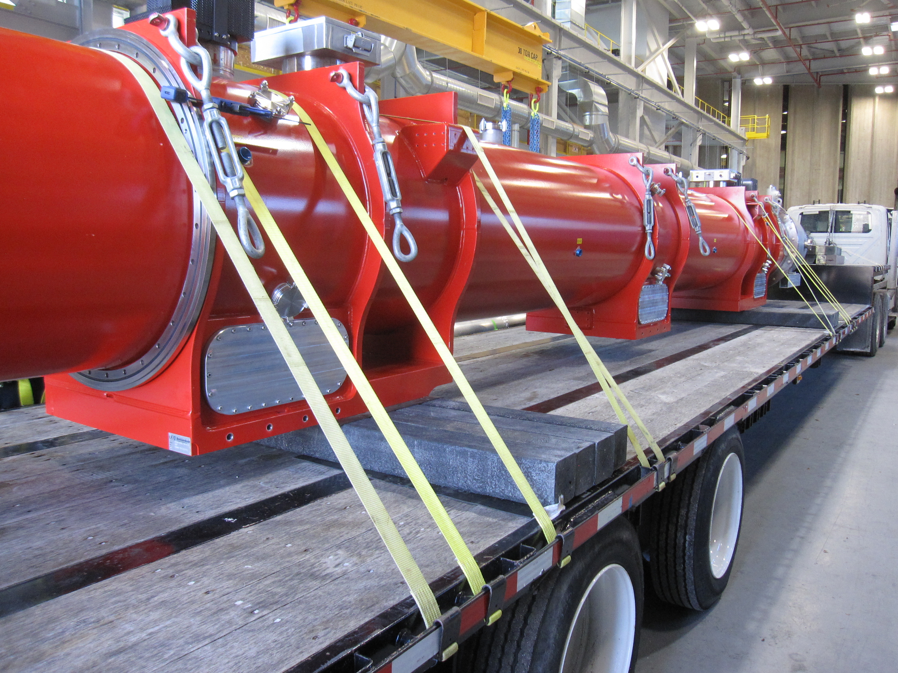
LQXFA/B03 transportation to IB1
Loading on the trailer in ICBA

Slide 3
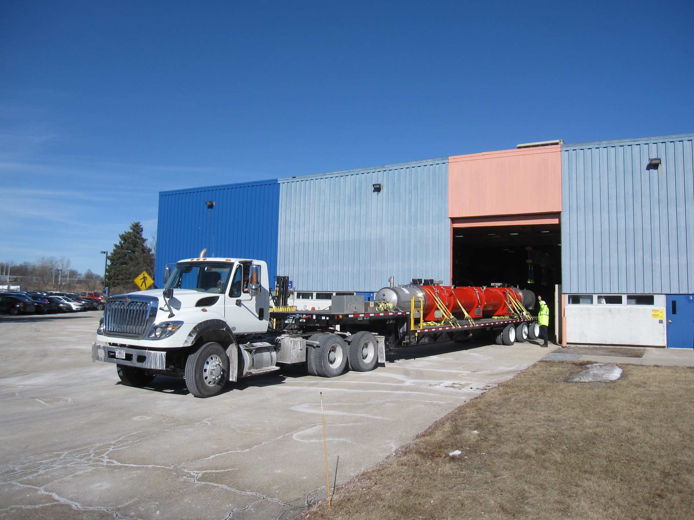
LQXFA/B03 transportation to IB1 (2)

Slide 4
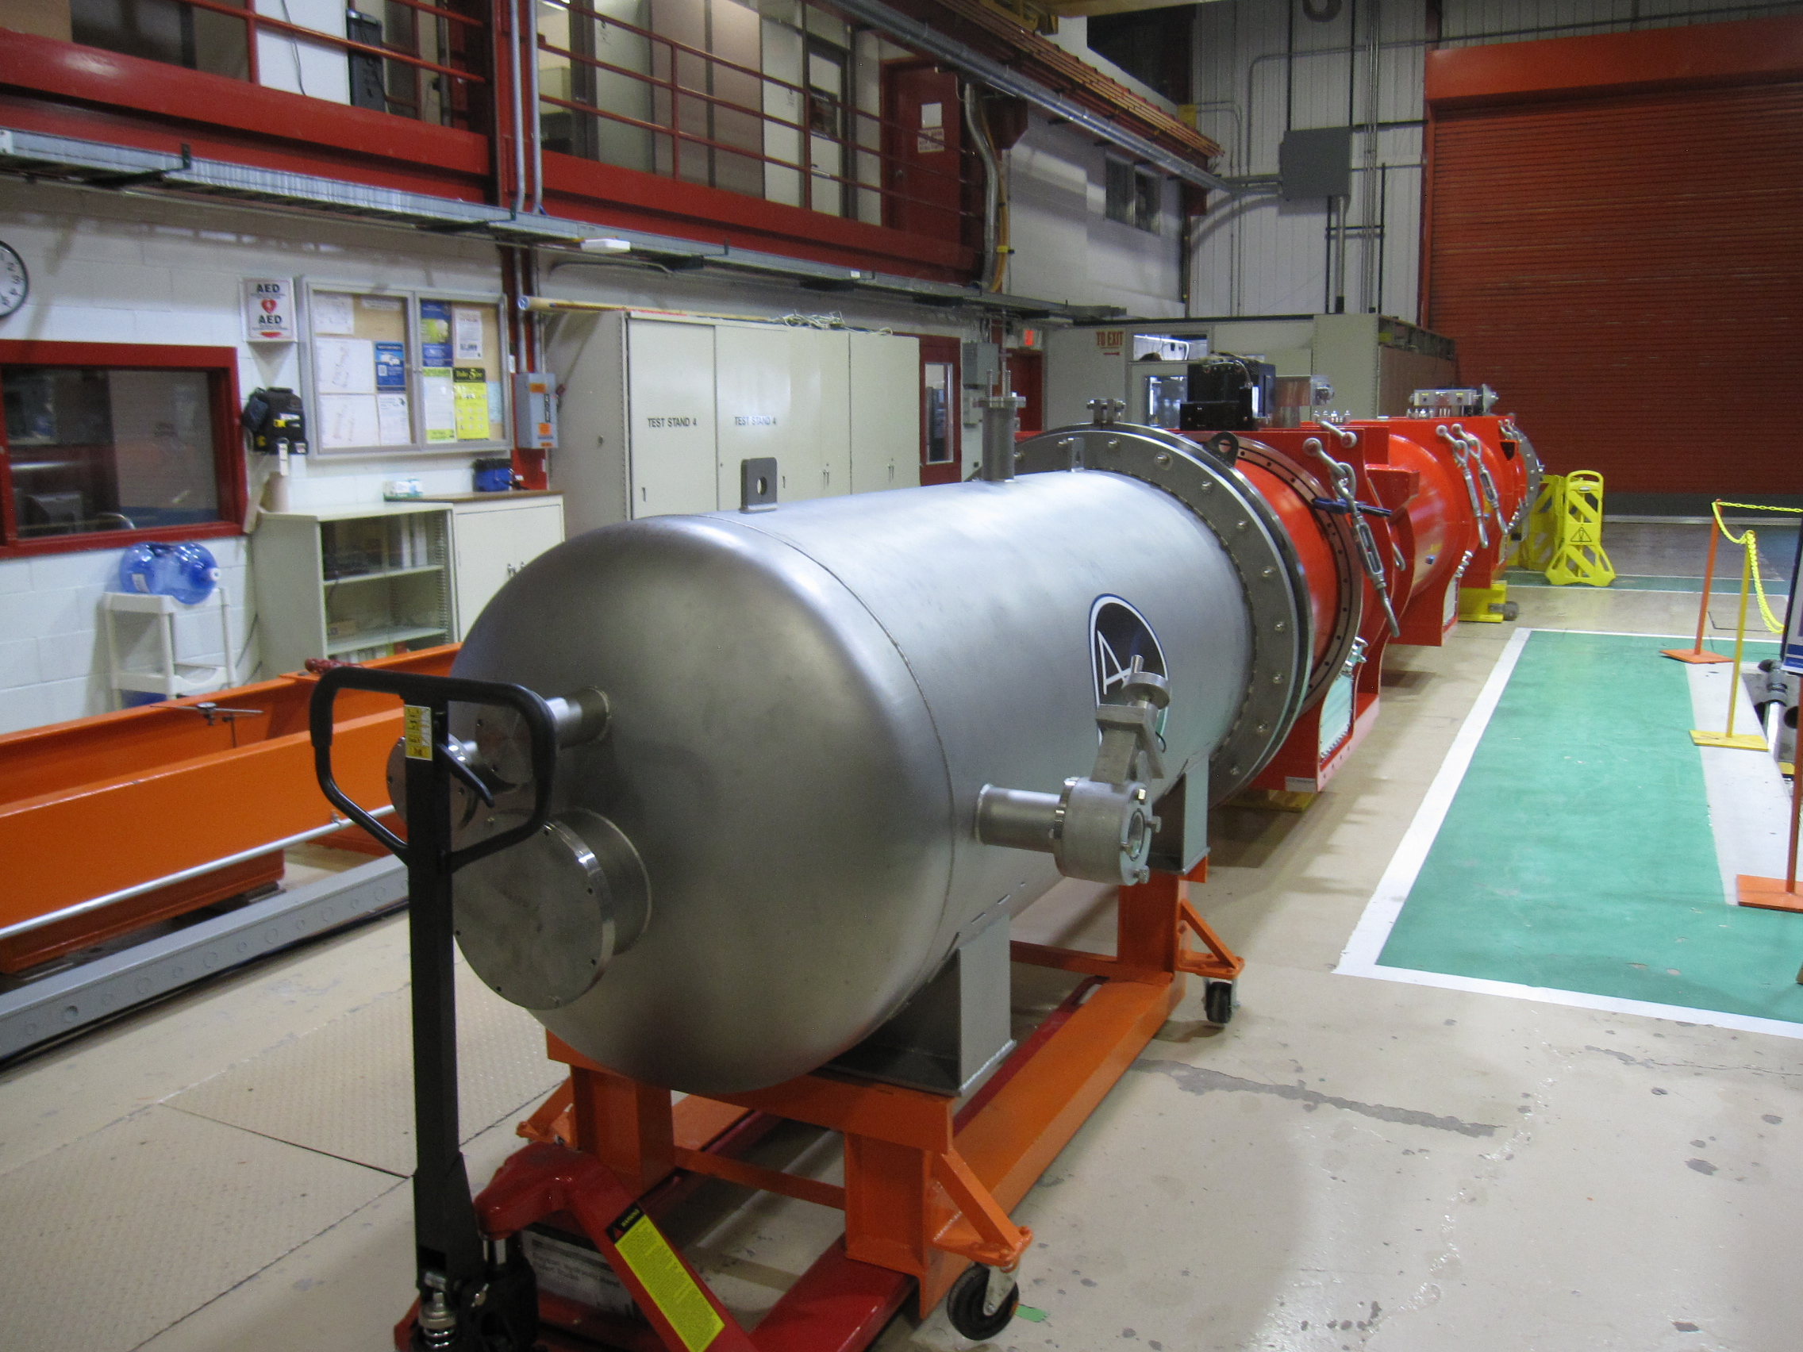
LQXFA/B03 transportation to IB1 (3)
LQXFA/B03 in the IB1 staging area

Slide 5
LQXFA/B03 test preparations
Jan. 28, Wed.
LQXFA03 transportation and unloading in IB1
Lead End Can removed
Final measurements of the flange joint locations in the LE interconnects
Jan. 29, Thu.
Full electrical checkout in the staging area
RT Hipots: Coil to Ground (QH grounded) at 368 V, QH to Coil (coils grounded) at 460 V
Jan. 30, Fri.
Top plate Hipot: Lead to Ground at 2500 V
Magnet leads preparation, soldering voltage taps

Slide 6
LQXFA/B03 test preparations (2)
Next Steps:
Finish wiring fixed voltage taps, insulate and prepare for installation on the stand
Complete MLI blanket on the thermal shield (CA side)
Install the vacuum sleeve
CA support survey – Feb. 4
CA installation on the stand – Feb. 4 or 5
Start interconnect work – Wed., Feb. 5
LQXFA03 test documentations
LQXFA03 Test Plan approval in progress, Doc # 5628

Slide 7
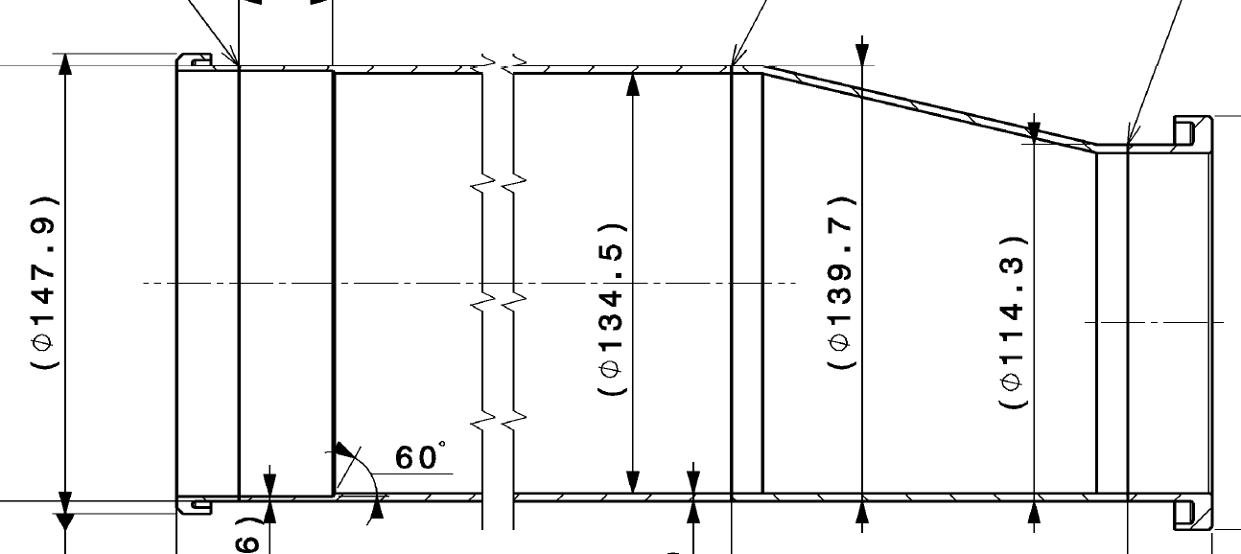
CM04 busbar cover welding
Tripple flange
Weld

