Slide 1
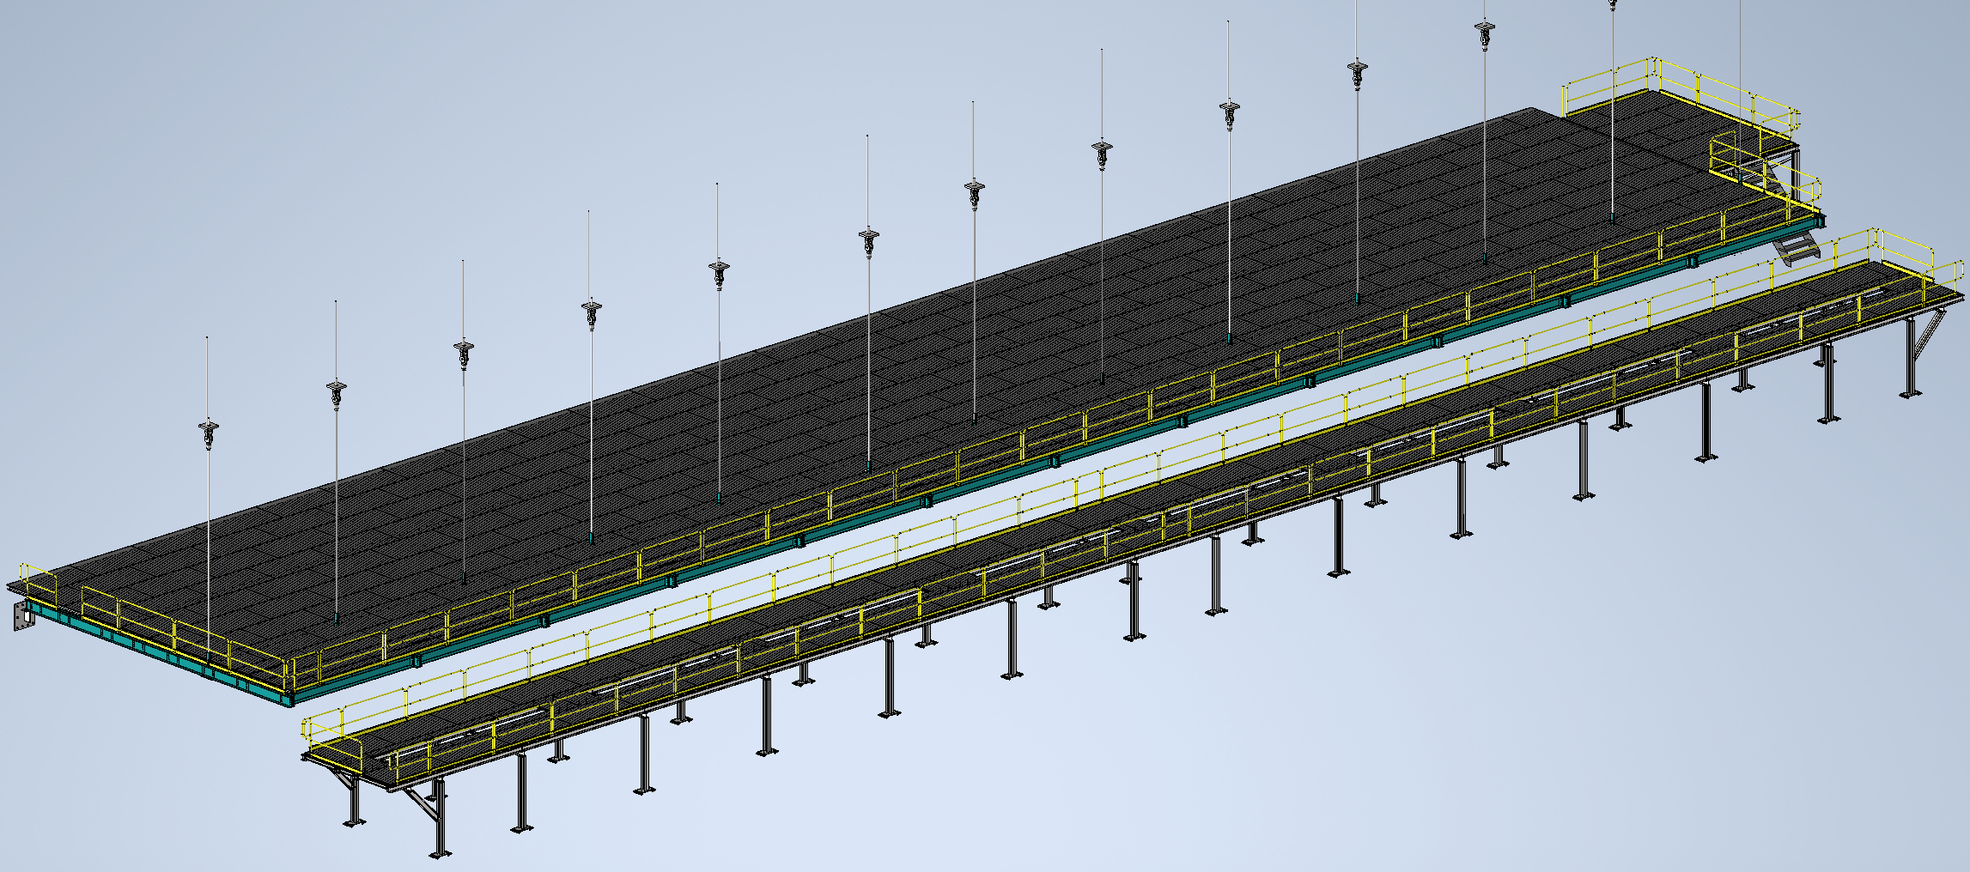
Mezzanine Flooring and Railing
Status
  Design note and calculation note uploaded to edms
    264185
  Beginning Technical Spec
Walking surface and railings for mezzanines
Install Activity:
Install flooring and railing onto detector, cryo, and ledge mezzanines
16-Sept-26
Tech Spec. | N/A | In Process
3D Model | N/A | Complete | 11/1/24
Design Note | N/A | First Draft Complete | 11/8/24
Eng. Analysis | N/A | Complete | 1/28/25
CO Report | N/A | Complete | 1/31/25
2D Drawings | N/A | Complete | 1/31/25
Schedule Contact | N/A | Empty
Install Procedure | N/A | In Process
Store/Move 120d - 4mo
Fabrication
30d – 1mo
Procurement plan
  Decking and railings are COTS
  Two types of custom railing mounts will be required
  Self install
Procurement
90d – 3mo
Latest “Submit to Procurement”
16-Jan-26
Fabrication/delivery
PRR Target: Dec. 2024

Slide 2
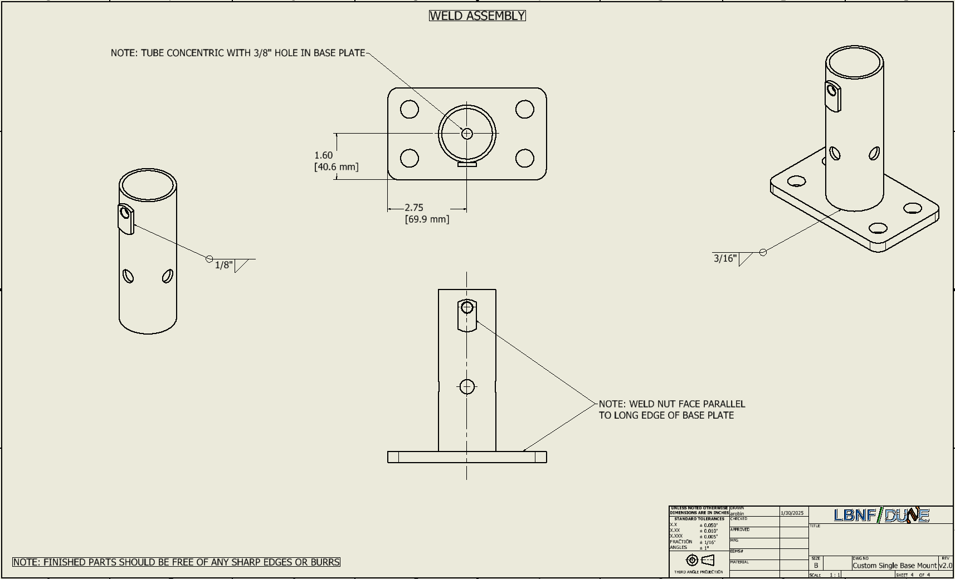
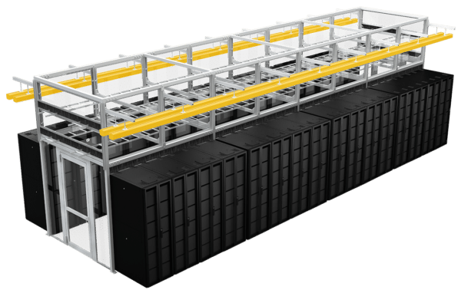
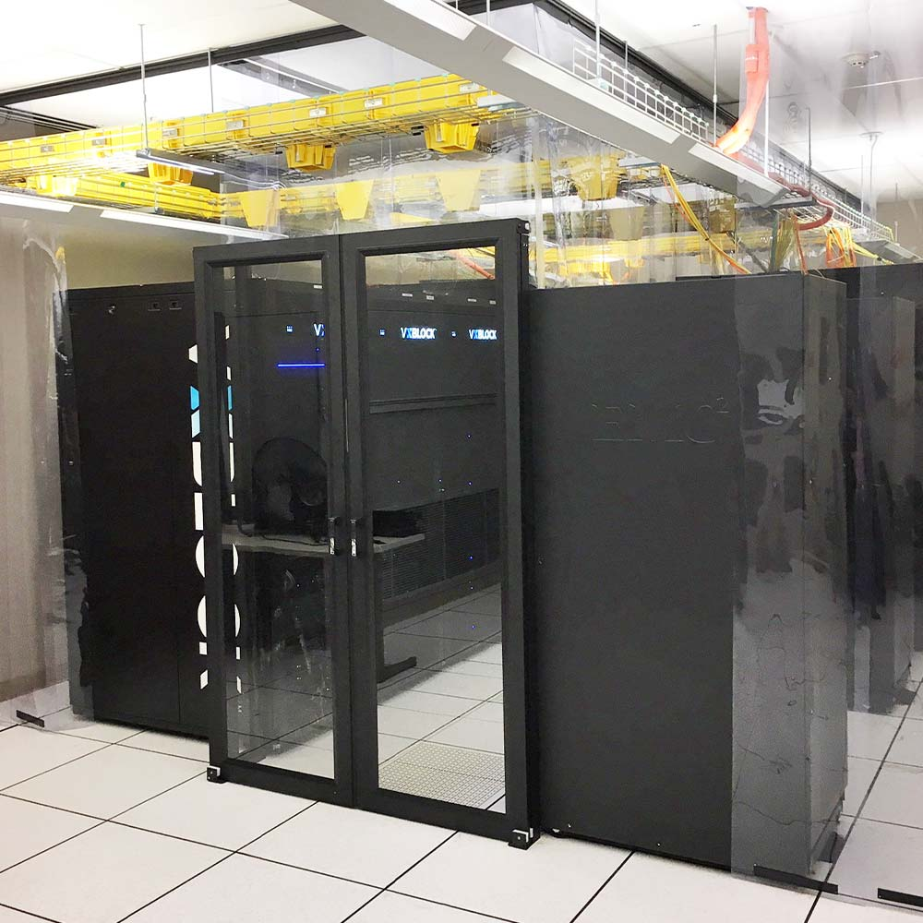
Last Week(s)
Railing Base Analysis
  Completed Compliance Office updates
    Approved by Gianluigi on 1/31/25
  Generated 2D manufacturing drawings
  Sent out quote requests to three shops to get rough pricing
Mobile Crane and Material Handling
  Beginning checks on moving the crane itself through the caverns
DAQ Barracks
  Supplier for PortaFab rooms no longer has capacity for the project, working with PortaFab themselves to get a new supplier
  Working with two cold aisle containment design companies to get initial designs and quotes on cold aisle design and construction
    Expecting quotes by the end of the week

