Slide 1
HD/VD engineering update – 2/4/2025
Air handling equipment for cryostat installation
Received specification document, in review
Cryostat external ladder/guardrail cable (fall protection system)
Working on additional cryostat roof railing connection
Cryogenic mezzanine structure
Received c.o. feedback on engineering note, working on revision 1 of document per comments
Completed BOE updates for HD cryo infrastructure/Roof gas systems
Cryogenic pipe support structures
Iterating designs with cryogenics team and feedback from installation leads
VD roof decking support beams
Will analyze beam configuration once cryo mezzanine feedback is reviewed

Slide 2
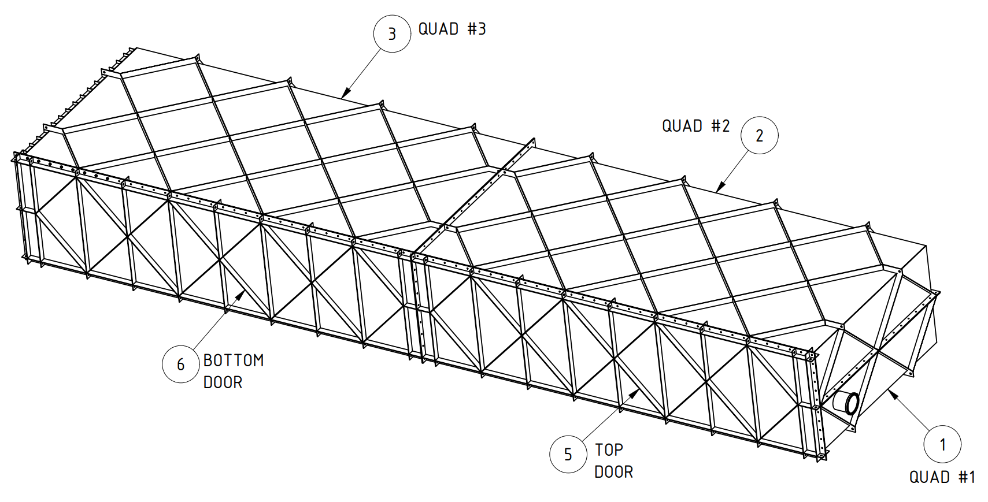
HD Coldbox
https://edms.cern.ch/project/CERN-0000252193
Status
Documents released
PRR held Oct. 28, 2024
PRR panel questions answered, final report due Nov. 25
QC requirements checklist received, added documents to procurement specification
Working on critical lift plan
PRR Recommendation tracker responses submitted 12/27/24
On hold per further APA discussion
Install Activity:
Assemble the cold boxes for the HD detector
8-Jun-26
Tech Spec. | 252224 | Released | 10/17/2024
3D Model | 252254 | Released
Eng. Analysis | 252285 | Released
CO Report | 252317 | Released
2D Drawings | 252347 | Released
Schedule Contact | 252407 | Empty
Install Procedure | 252437 | Released
Store/Move 120d - 4mo
Fabrication
180d – 6mo
Procurement plan
LPTA
Fabrication drawings send to vendor
Final subassemblies delivered to SDWF
Procurement
180d – 6mo
Latest “Submit to Procurement”
15-Dec-24
Fabrication/delivery
PRR Target: October 2024

Slide 3
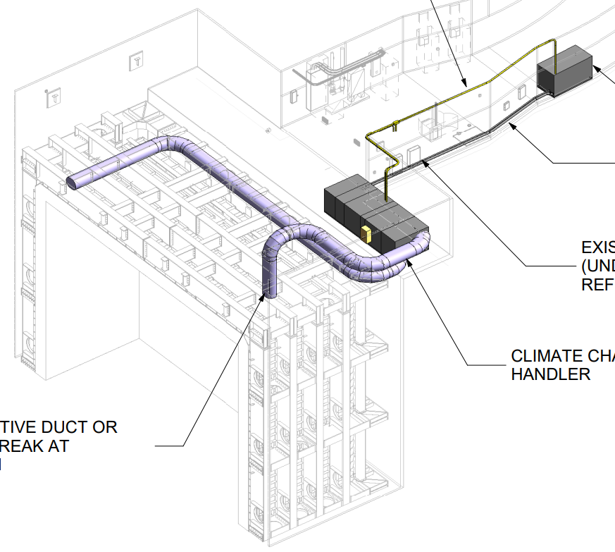
VD Temporary AHU
https://edms.cern.ch/project/CERN-0000252187
Status
Procurement specification, 2D drawings created
Specification document received 1/28/25
Install Activity:
Install the air units and filters on the manholes of the cryostat in the South Cavern 24-Jan-26
Tech Spec. | 252218 | Eng. Check | 10/17/24
3D Model |  | n/a
Eng. Analysis | 252278 | Released | 04/13/23
CO Report |  | n/a
2D Drawings | 252341 | In work | 10/17/24
Schedule Contact |  | Empty
Install Procedure |  | n/a
Store/Move 120d - 4mo
Fabrication
90d – 3mo
Procurement plan
Best Bid Value
Installed by vendor
Procurement
120d – 4mo
Latest “Submit to Procurement”
30-Mar-25
Fabrication/installation
PRR Target: ISD/ESH document review Oct 2024 (fulfills PRR)

Slide 4
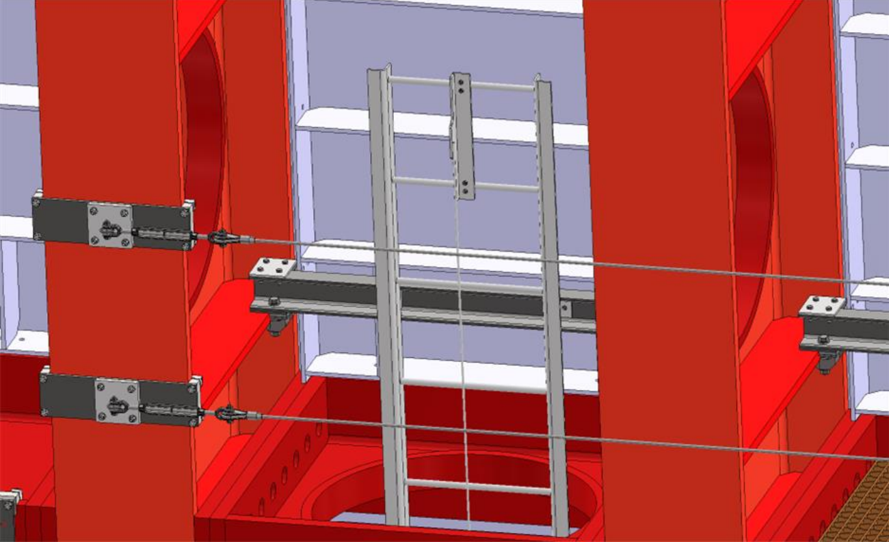
VD Cryostat Fall Protection (Ladders/Guardrails)
https://edms.cern.ch/project/CERN-0000252186
Status
Procurement specification drafted, reviewing by ES&H
2D drawings created, with interfaces
Installation to be self-performed
Need loads for analysis plan (OSHA 1926.502, OSHA 1910.28)
Provided by c.o. 12/17/24
Install Activity:
Install the ladders and the access system for the side walls of the cryostat in the South Cavern
24-Jul-26
Tech Spec. | 252217 | In work | 10/17/24
3D Model |  | Empty
Eng. Analysis |  | Empty
CO Report |  | Empty
2D Drawings | 252340 | In work | 11/11/24
Schedule Contact |  | Empty
Install Procedure |  | Empty
Store/Move 120d - 4mo
Fabrication
180d – 6mo
Procurement plan
LPTA
Fabrication drawings send to vendor
Final subassemblies delivered to SDWF
Procurement
180d – 6mo
Latest “Submit to Procurement”
30-Apr-25
Fabrication/delivery
PRR Target: March 2025

Slide 5
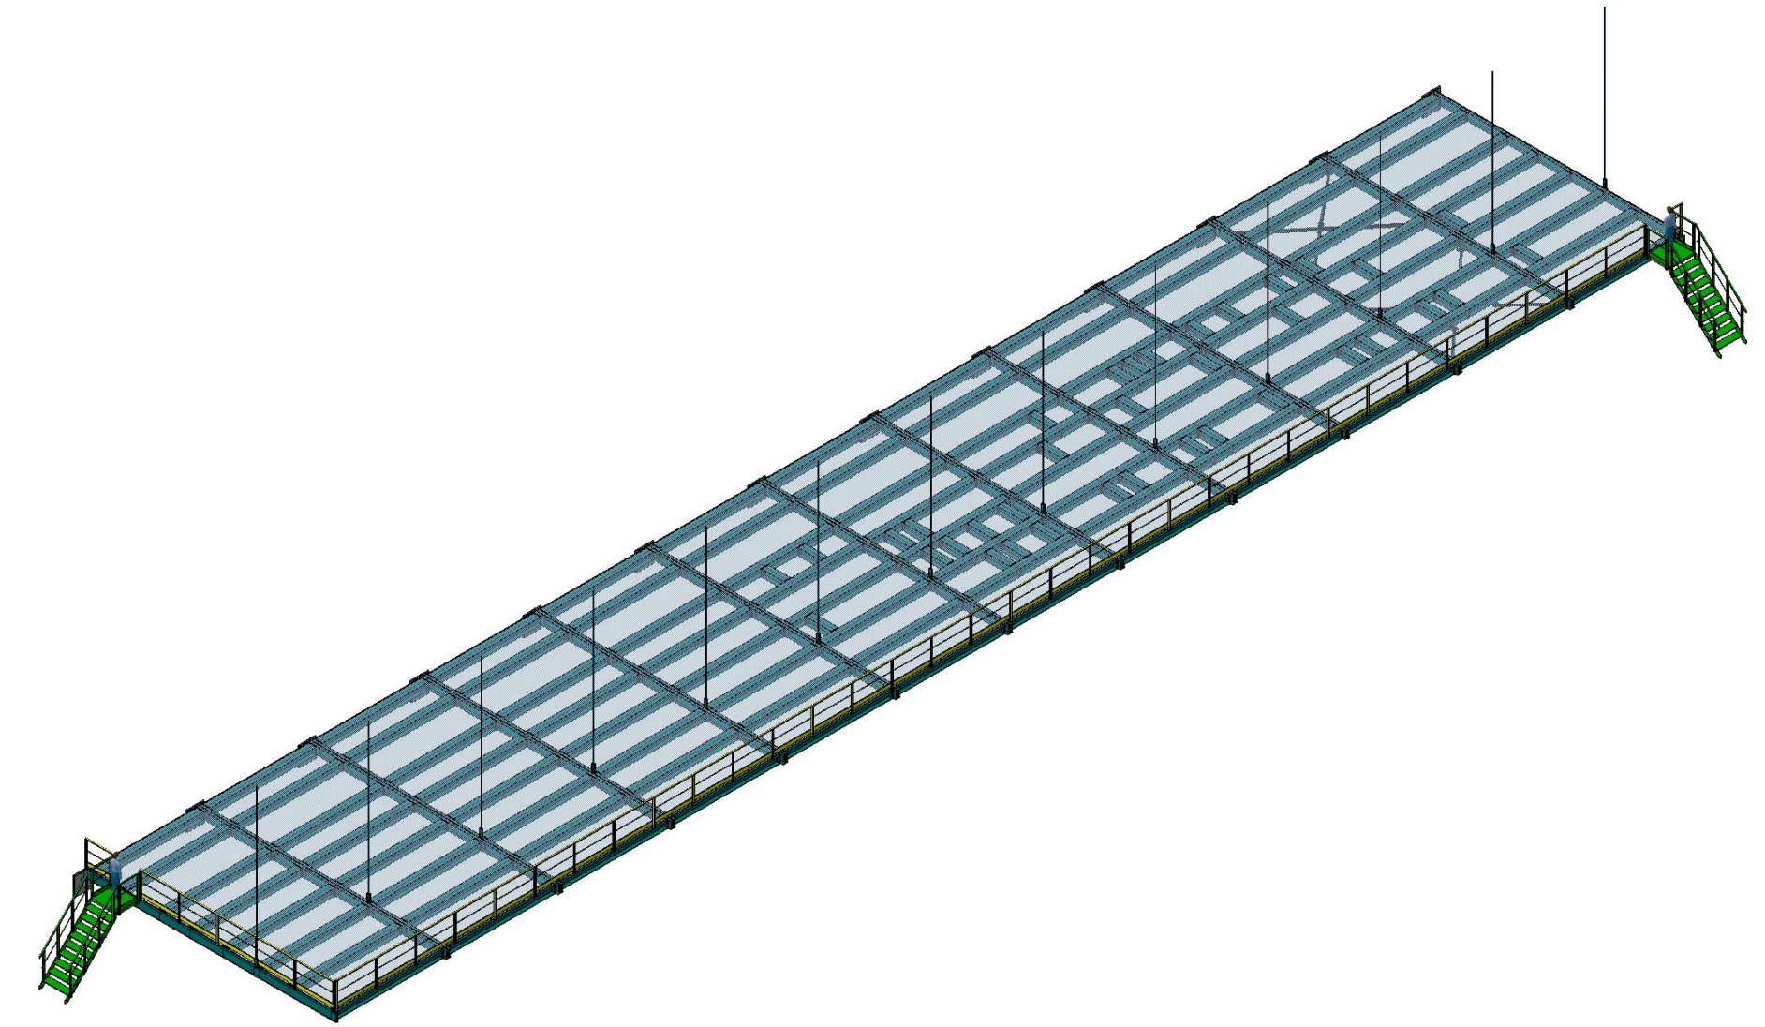
HD/VD Cryogenic Mezzanines
https://edms.cern.ch/project/CERN-0000252179
Status
Revising model and engineering note for accommodating updated assembly plan and beam profiles
Documents submitted to c.o.
Working on revision 1 of comments
Install Activity:
Install cryogenic Mezzanine level 1 for cryostat #1 - FNAL personnel 28-Jul-26
Tech Spec. | 252213 | Empty
3D Model | 252243 | Eng. Check | 12/18/2024
Eng. Analysis | 252273 | Eng. Check | 12/18/2024
CO Report | 252306 | In work
2D Drawings | 252336 | Eng. Check | 12/18/2024
Schedule Contact | 252396 | Empty
Install Procedure | 252426 | Empty
Store/Move 90d - 3mo
Fabrication
150d – 5mo
Procurement plan
LPTA
Fabrication drawings send to vendor
Structural components delivered to SDWF
Installed by contractor
Procurement
180d – 6mo
Latest “Submit to Procurement”
3-Jun-25
Fabrication/installation
PRR Target: December 2024

