Slide 1
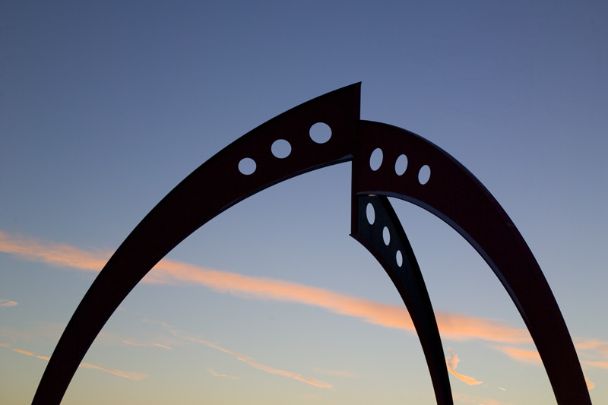


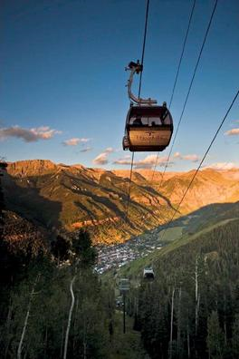

Muon collider detector R&D (mcdrd):
computing resources and status
Muon Collider simulation status and plans
Hans Wenzel
May 8th 2013
Hans Wenzel
Fermilab
Feb. 22nd 2012

Slide 2
Muon Collider Documentation
Created Confluence page:
https://confluence.slac.stanford.edu/display/MCPDS/Home
Look for:
Documentation for Accessing MCD R&D Computing Resources
You can sign up here:
https://jira.slac.stanford.edu/signup/

Slide 3
MCDRD: computing resources
- Virtual Organization (VO): mcdrd
Sign up at: https://voms.fnal.gov:8443/voms/mcdrd
(we have 250 dedicated slots on fermigrid and we are part of OSG)
- reference machine on the fermicloud: mcdrd.fnal.gov
To get an account contact service desk and request a fermicloud account and request access to mcdrd.
- 1 TB of dedicated disk space on bluearc: /grid/data/mcdrd
- software installed in: /grid/data/mcdrd/sw
detectors jas-assembly-0.9.9 jdk1.7.0_21 mac slic
  e.g. To run slic:
. ../slic/v00-00/geant4/9.6.p01/bin/geant4.sh
/grid/data/mcdrd/sw/slic/v00-00/slic/HEAD/build/bin/slic -m run_Higgs.mac
- data available in: /grid/data/mcdrd/data

Slide 4
MCDRD: computing resources (cont.)
requested (approved): 100TB in fermilab mass storage system (dcache, enstore) --> will write instructions once it's installed and working.
Right now resources are limited but we can probably ask for more when we need it (easier to extend than start from scratch)

Slide 5
Changes to slic and Geomconverter
Thanks to Jeremy:
Slic now uses the latest version of geant 4 (4.9.6.p01) and new build system.
Now optical properties can be specified in compact.xml and propagate to .lcdd and .gdml files.
Simple switch allows to enable optical physics processes and change calorimeter into dual readout calorimeter (slow)
Now we have the chance to kill particles entering a specific volume (e.g. the tungsten cone)

Slide 6
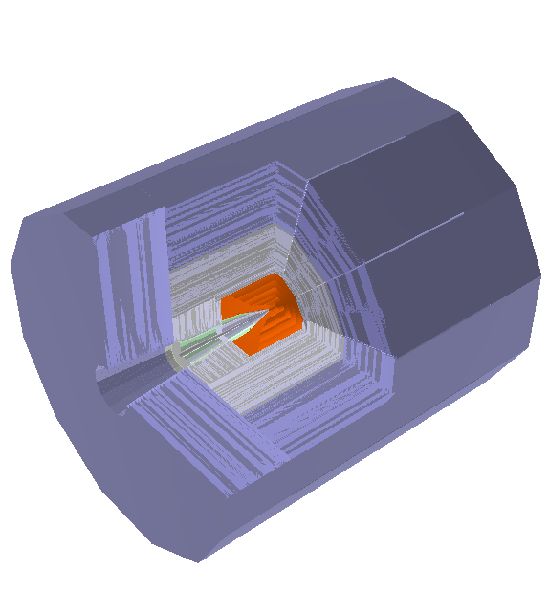
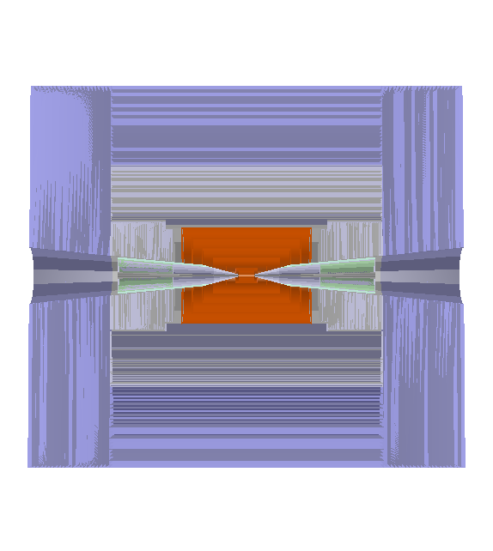
The mcdrcal01 detector in org.lcsim
5T solenoidal field,
radius=3.075m
Calorimeter dimensions:
Rmin: 1.36 m
Rmax: 3.07 m
Length: 2x3.702 m

Slide 7
Calorimeter Properties for Barrel and Endcaps
 | EM | Hadron | Muon
Material | BGO (PbF2) | BGO (PbF2) | Iron
Density [g/cm^3] | 7.13 (7.77) | 7.13 (7.77) | 7.85
Cell size [cm^3] | 1x1x2 | 2x2x5 | 10x10x10
Layers | 10 | 30 | 22
Detector Depth [cm] | 20 | 150 | 220
Radiation Length [cm] | 1.1 (0.93) | 1.1 (0.93) | 1.76
Nuclear Interaction Length [cm] | 22.7 (22.4) | 22.7 (22.4) | 16.8
Total Nr of IA length (em+had) | 7.5 (7.6)

Slide 8
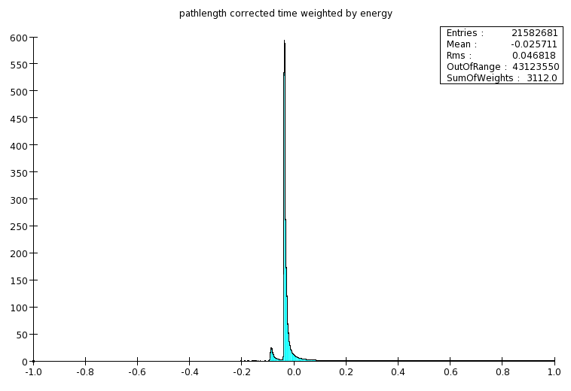
Z'-> e⁺ e⁻

Slide 9
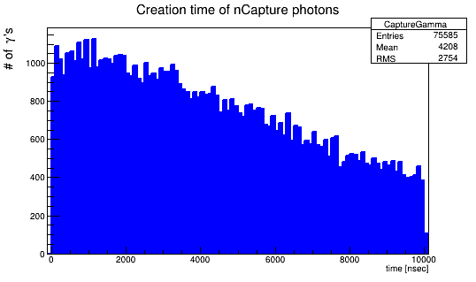
Contribution of neutron Capture process in 5 GeV π⁻ showers
Response |  | Response due to nCapture |  | Fractional nCapture Response
Ionization [GeV] | Cerenkov [# C phot.] | Ionization [GeV] | Cerenkov [# C phot.] | Ionization [%] | Cerenkov [%]
4.322 | 1.977E5 | 0.734 | 0.456E5 | 17 | 23
n→ thermalize → neutron Capture
→ γ → visible Energy
(mean Time: 4.2 μ sec)

Slide 10
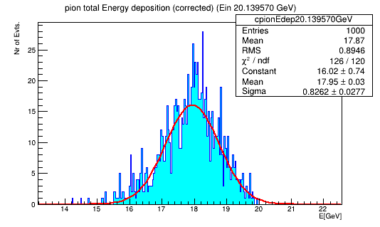
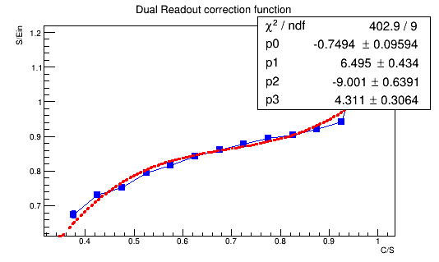
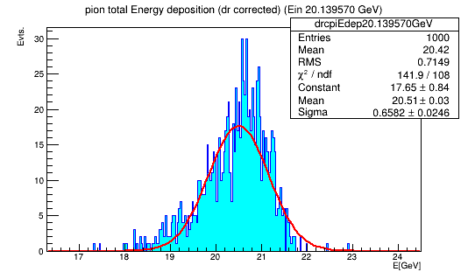
Effect of dual read out correction: all contributions no gate
Before Dual Read out correction:
Mean: 17.95 GeV
σ: 0.826 +/-0.03GeV
After DR correction:
Mean: 20.5 GeV
σ: 0.66+/-0.02 GeV

Slide 11
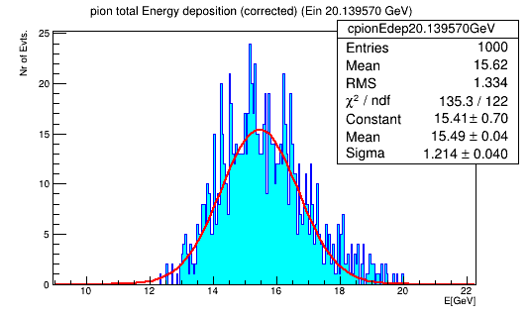
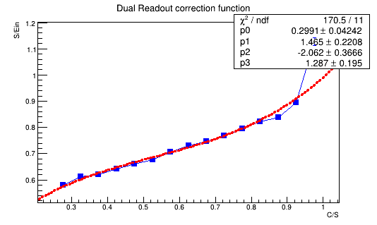
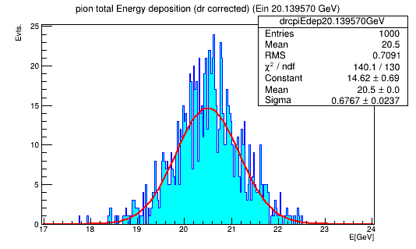
Effect of dual read out correction: γ ‘s from neutron Capture discarded
20 GeV π⁻
No DR
correction
20 GeV π⁻
With DR
correction
Before Dual Read out correction:
Mean: 15.5 GeV
(reduced by 13.6 %)
σ: 1.21+/-0.04 GeV
After DR correction:
Mean: 20.5 GeV
σ: 0.68+/-0.02 GeV

Slide 12
Mcdrcal01: Tracker
Simplified geometry: cylinders and disk no segmentation

Slide 14
Caveats
New detector description still needs to be copied to .lcsim/cache by hand!
No Material for coil included
Not enough iron to return flux of 5T solenoidal field
Simulation of DR (Cerenkov photons) is very slow due to the use of the Geant 4 G4Cerenkov process. Calculating the number of produced in the optical calorimeter sensitive detector class will speed up the process significantly. Currently the data sets are without optical processes enabled.

Slide 15
Near term plan
Check the detector description!
Implement sensitive detector that counts the Cerenkov photons in slic and replaces use of G4Cerenkov.
Provide scripts to run slic on fermigrid.
Then generate single particle, Higgs, SM bgr. and machine bgr. once available.

Slide 16
Backup slides

Slide 17
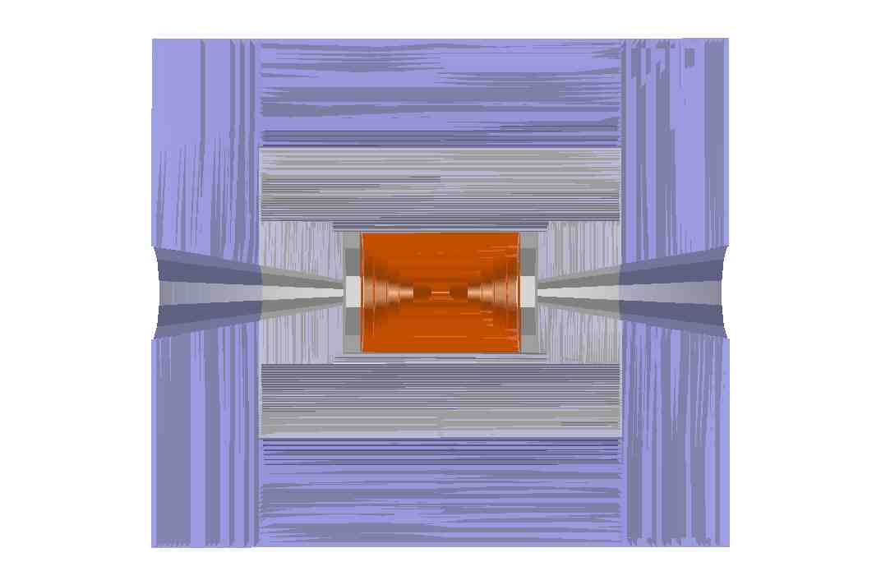
The mcdrcal00 detector in org.lcsim

Slide 18
Plan
Implement sensitive detector that counts the Cerenkov photons.
Implement sensitive detector for the tungsten cone
Generate single particle and other data samples.

Slide 19
Data samples
Fully simulated events on detsim (replacement of ilcsim and ilcsim2):
/ilc/sid/wenzel/muoncolliderdata/slcio/bgr
/ilc/sid/wenzel/muoncolliderdata/slcio/signal
Zp3TeVtoee.slcio
Zptomumu_3TeV_mcdrcal00.slcio

Slide 20
Plan
Need a working detector model for the muon collider (Work with SLAC). Challenge is to deal with backgrounds while maintaining high precision (can it be done?). Needs detailed studies
Calorimeter:
  Dual readout (need to study how timing will affect the resolution after dual readout correction is applied) --> implement new optical calorimeter
  Raja type: (digital sampling calorimeter with traveling time gate, software compensation)
Tracker:
  More like LHC than ILC, double or triple layers might be needed to help with pattern recognition. Need fast timing to reject background --> this will all come at a price (material budget)
Once we have it: debug, biggest challenge will be to deal with the huge backgrounds and getting them into the simulation. (much more challenging than pile up at LHC and that was already difficult)

Slide 22
Machine Backgrounds
Precision Physics @ muon collider depends on the the ability to get the machine induced BGR. (caused by muon dacay) under control
  Optimize machine parameters, proper shielding, IR, MDI
  Detector design and choice of technology--> detector simulation critical to determine detector parameters and study how it affects physics performance. Dealing with the large bgr is a huge computational problem

Slide 23
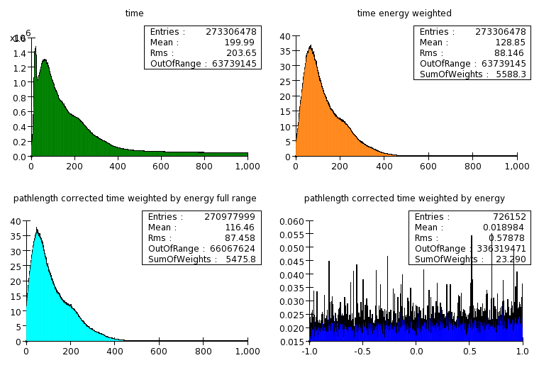
Timing of bgr. Hits in the Calorimeter
TeV's of energy deposited
In about 500 nsec
Exact amount varies a
lot depending on machine
parameters
~ 4% of 1 bunch crossing, no Bethe Heitler muons

Slide 24
Getting muc off the ground
Need dedicated disk area for muon collider data samples, muon collider software (currently SID)
(may be migrate some of the ilc disk space)
Need Muon Collider VO for grid submission + dedicated slots on fermigrid

Slide 25
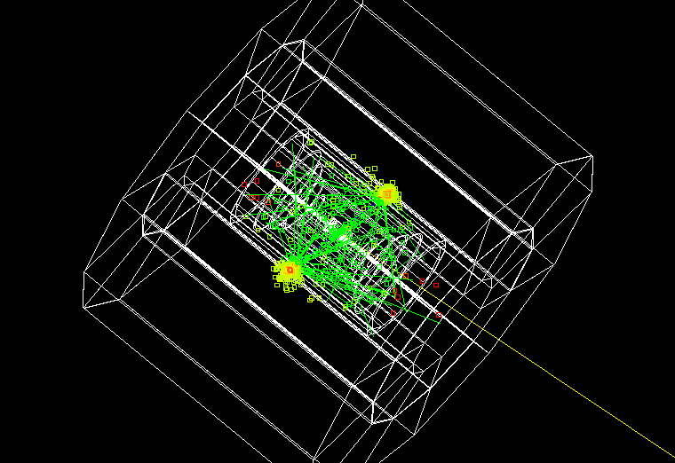
Z'(3TeV) -> e⁺e⁻
Fight time correct time weighted by energy
Range +/- 1 nsec

Slide 26
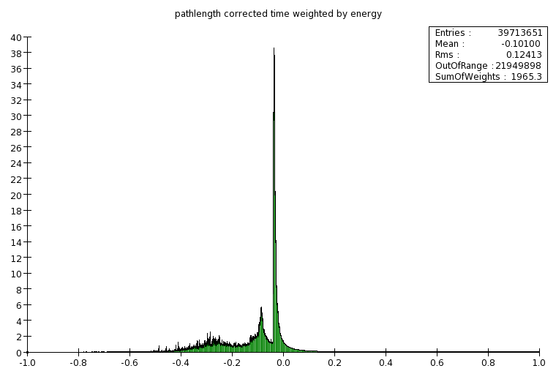
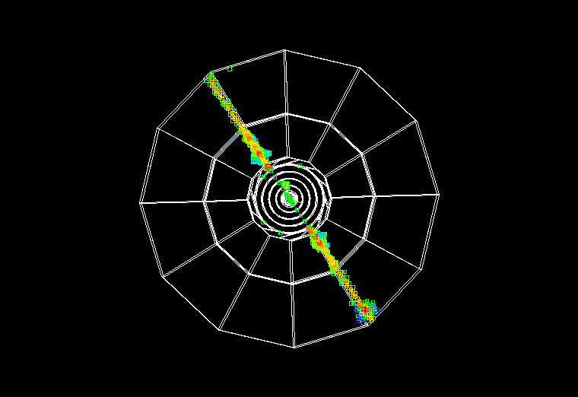
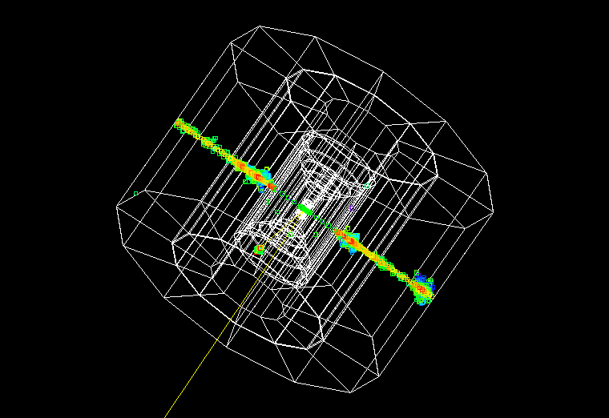
Z'(3TeV)->m⁺m⁻

Slide 27
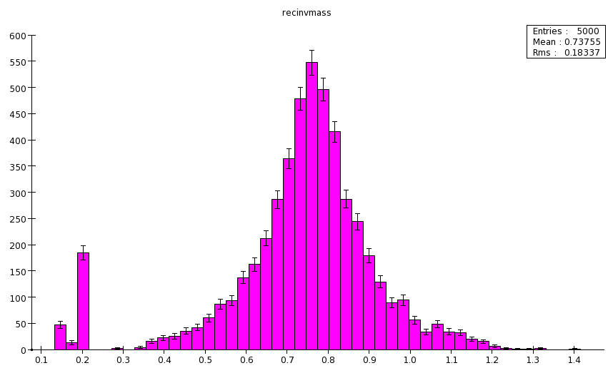
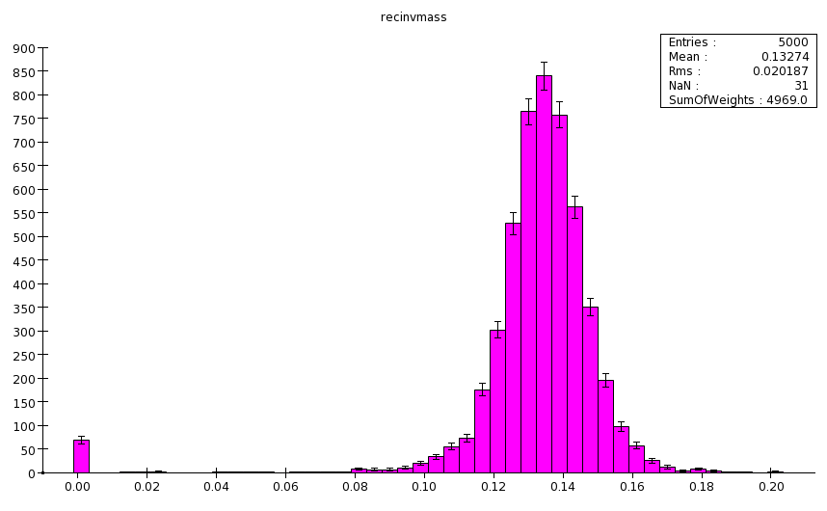
Analysis chain
r --> p⁺+g
Get entire chain running at Fermilab (together with Alex Conway, YK student and Norman Graf)
  Event generation (pythia)
  Simulation (SLIC)
  Event reconstruction (lcsim.org)
  Analysis (jas3)
  Documentation (confluence pages)
.
p⁰ --> g g
Needs Tracking and calorimetry

Slide 28
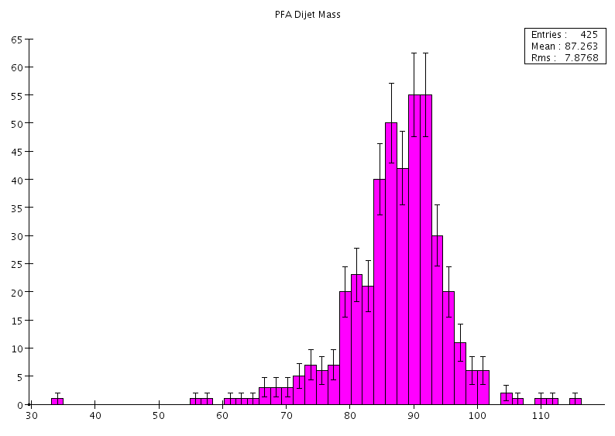
Invariant mass reconstruction
Steve Magill, Alex Conway, Hans Wenzel (ccal02)
Steps are as follows: Find jets--> apply dual readout correction--> correct for magnetic field contribution to invariant mass (global correction) --> use PFA algorithm to assign tracks to calorimeter clusters and use track for invariant mass calculation if match passes stringent requirement (avoid confusion term in PFA)
ZZ-> nnqq

Slide 29
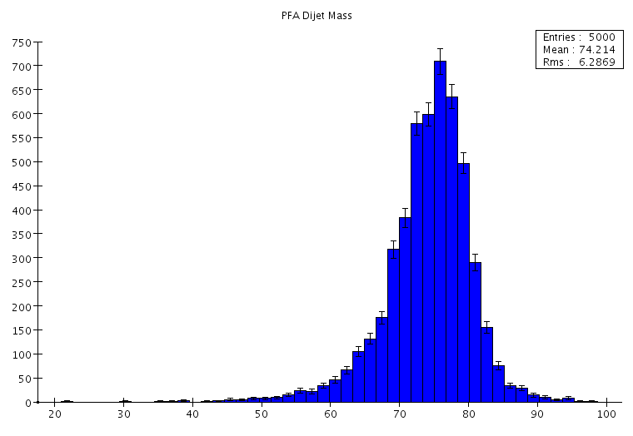
Invariant mass reconstruction (cont)
Code is in CVS: Steve Magills contrib area name of the driver is: PFADRSelect. (but needs zip file with the correct conditions data)
W-> qq

