Slide 1
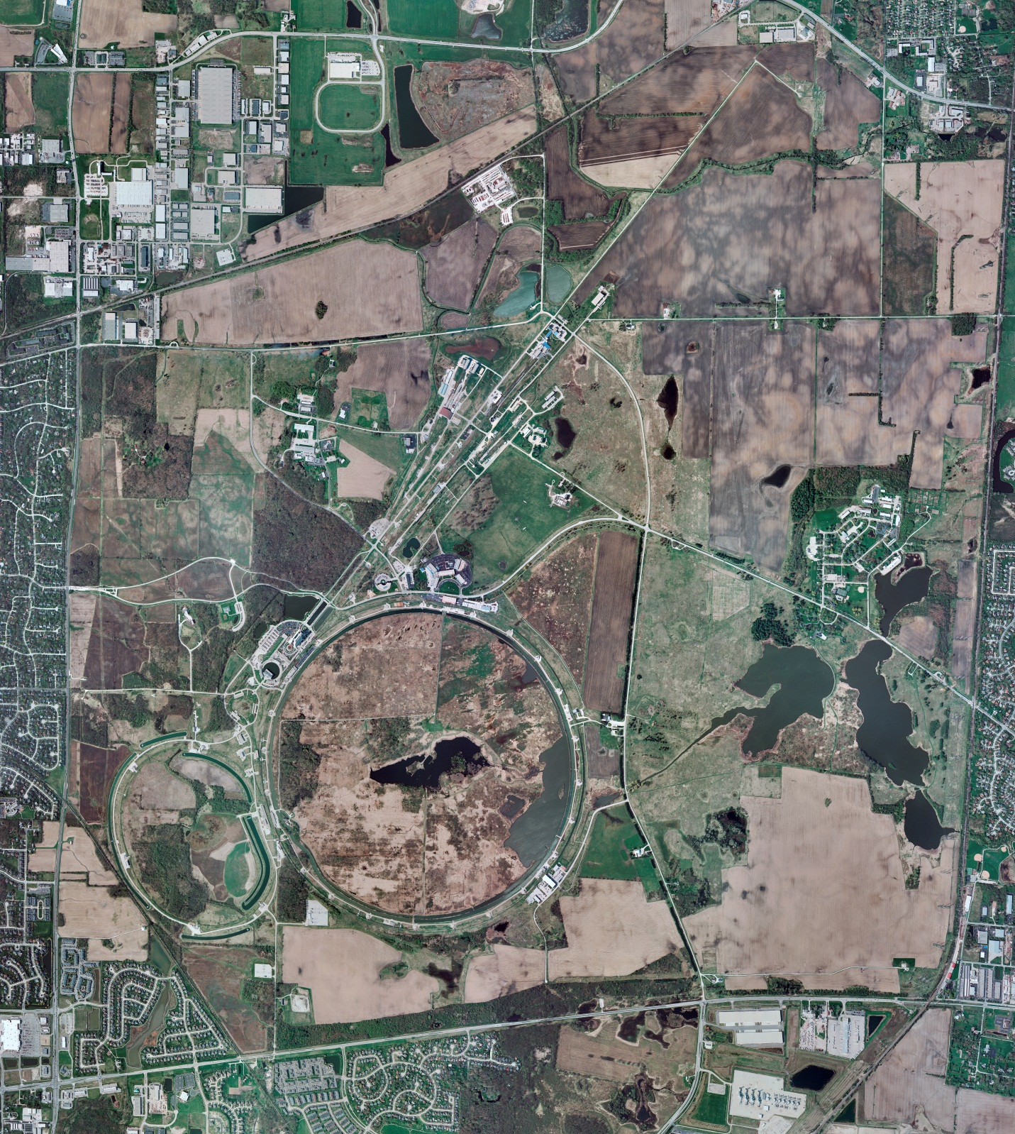
Helium Cryogenics
Status 2/7/2025 J.Makara
CMTF: SCP cold and running fine
CMTS: HECM26 at 2/4 K for more cryo testing
PIP2IT: South Stand being modified for SSR2 pCM
North Stand empty
MCTF cryo cold running fine after AD/Controls' repairs of mice damaged fiber optic cables at MCC; 3 comprs/2 Fridges with Mobile Purifier online
MDB/HTS: at RT
MDB/STC: at 2 K for SSR2 cavity RF testing
MDB Magnet: at RT
NML/FAST: Cryo system is shut down and isolated for extended shutdown period
CC1: at RT
CC2: at RT
CM: at RT
IB1: cryo system cold using ALAT CBx and running fine,
Muon Campus: at RT with comprs off and system depressurized; LN2 system at RT; g-2 Expt Hall at ODH=0 (not ODH area)
Misc: …

