Slide 1
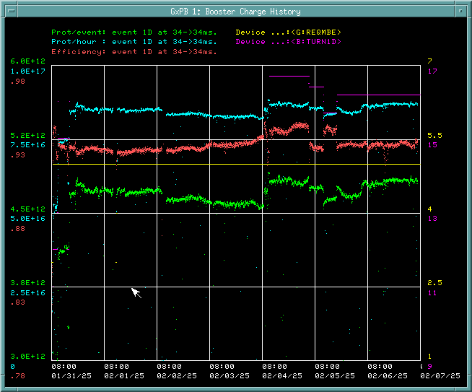
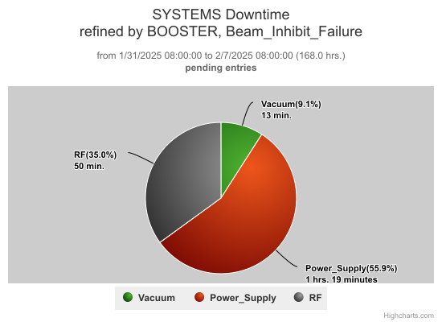
Booster Operations 1/31-2/7
GMPS vacuum trip
SXL19 Regulator failure
Downtime over week : ~2.4hrs
Misc RF station trips ~50 min
SXL19 Regulator issues-on going
GMPS vacuum trip trouble shooting on-going
Last Friday Day shift began running beam to BNB from pause.
Ran 5Hz to BNB all week as conditions permitted. 4.5-4.8E12 ppp 93-94% efficiency.
Adjusted and tuned to change in Linac beam current.
Brief Vacuum related trips over week at periods 21 and 22 and 14. Leaked checked areas in past have not leak yet.
Today owl shift had B:SXL19 Reg issues and GMPS Vacuum trip indication trouble-shooting
Thanks to Ops for keeping things running well.

Slide 2
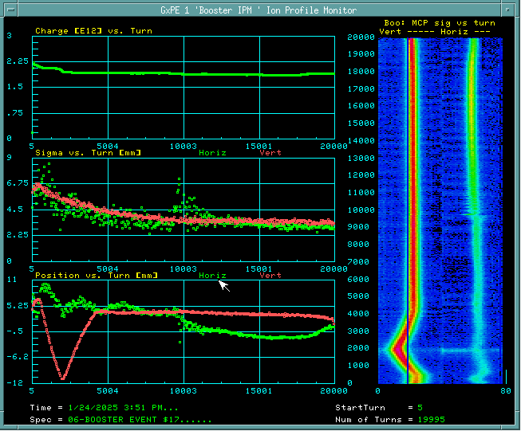
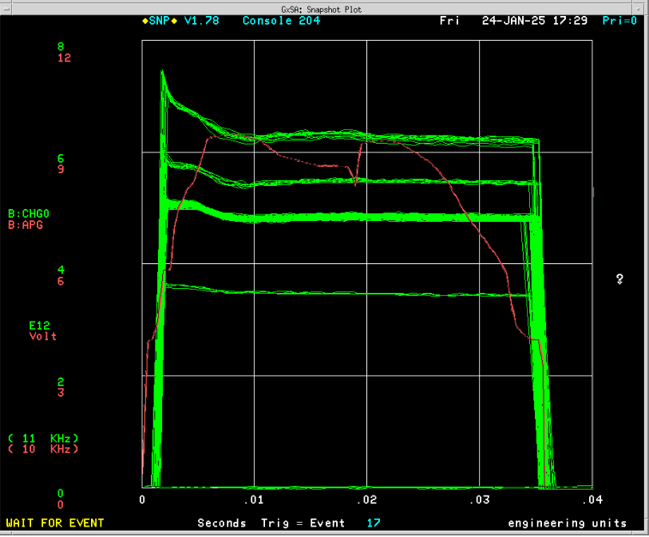
Booster Dedicated/Parasitic Study Report:01/24/2025-02/06/2025
IPM/BPM Calibration (For PIP/PIP-II)
Participants: Michael Balcewicz, SChaurize and Kent Triplett
Goal: Develop a non-invasive emittance monitoring system for Booster (CYTan) using BPMs. Calibrate both IPM & BPM in Booster.
Type of Study: Parasitic(~4hr)
Study Details
Initial Calibration with zero beam for IPM, & 6 turn beam for IPM as well as BPM.
Addressed BPM Emittance Issues: Data have been taken with 9, 8, 6 turn beam for BPM to understand emittance fluctuation.
Recalibration And Intensity Increases: Beam intensity up to 6.2E12 at extraction.
Low Intensity Bumping and Collimation: As a part of the IPM calibration beam position was moved around the IPM with a bump at low energy and low intensity with a bump.
Flat Injection Study (continuation)
Participants: CBhat, Schaurize
Type of Study: Parasitic (~1.5 hr)
Goal: Effect of different shapes of B:BFLAT
PIP-II type Beam Intensity (For PIP2)
Participants: Cbhat and SChaurize
Goal: Demonstrate 6.5E12ppp at extraction
Type of Study: Parasitic (~2 hr)
Study Details
With hybrid-LLRF injected up to ~7.2E12ppp and extracted ~6.2E12 ppp ~85% efficiency. Needed transition tuning.
Found out that we do need more RF power (voltage) for such high intensity beam.
WCM data have been taken for emittance and couple bunch instability studies.
Horizontal IPM
Vertical IPM
6.2E12ppp
Results will be posted in PS Sharepoint
https://fermipoint.fnal.gov/org/as/ad/hqsupport/
PSStudy/Shared%20Documents/Forms/AllItems.aspx

