Slide 1
Muon Campus Shutdown Report
Jim Morgan
Friday 09:00 Ops Meeting
February 7, 2025

Slide 2
Recovery from loss of LCW on January 26
Continued investigation into sequence of events and magnet assessment
Three MDC’s damaged, believe all other magnets are okay
Some magnets are more vulnerable depending on type and dissipated power
Vacuum in V906 area recovered okay, don’t believe there was a leak
MC-1 fire alarm at 02:42 was from MC-1 Hall VESDA, not “Protectowire”
Fire techs provided detailed information about timing sequence of alarms
Have created a document of our findings
Magnet damage checks
Have performed several visual inspections of all magnets that were powered
No signs of heat damage on other magnets
Tested 29 magnets that had high dissipated power and/or a long period without cooling water, all check out okay
Preparing to replace MDC dipoles V742, V743 & V906
Hazard Analysis was submitted last week, approved this morning
Alignment did “as found” of both existing and replacement magnets
Still need to remove power leads on damaged and replacement magnets
Put fans with filters in tunnel to reduce eye and throat irritation from smoke
LCW system restarted on Monday in 1-pump (shutdown) mode for now
Conductivity recovered, make-up rate is low
Study – M1-M3 Optics
Study – Alternative M5 optics

Slide 3
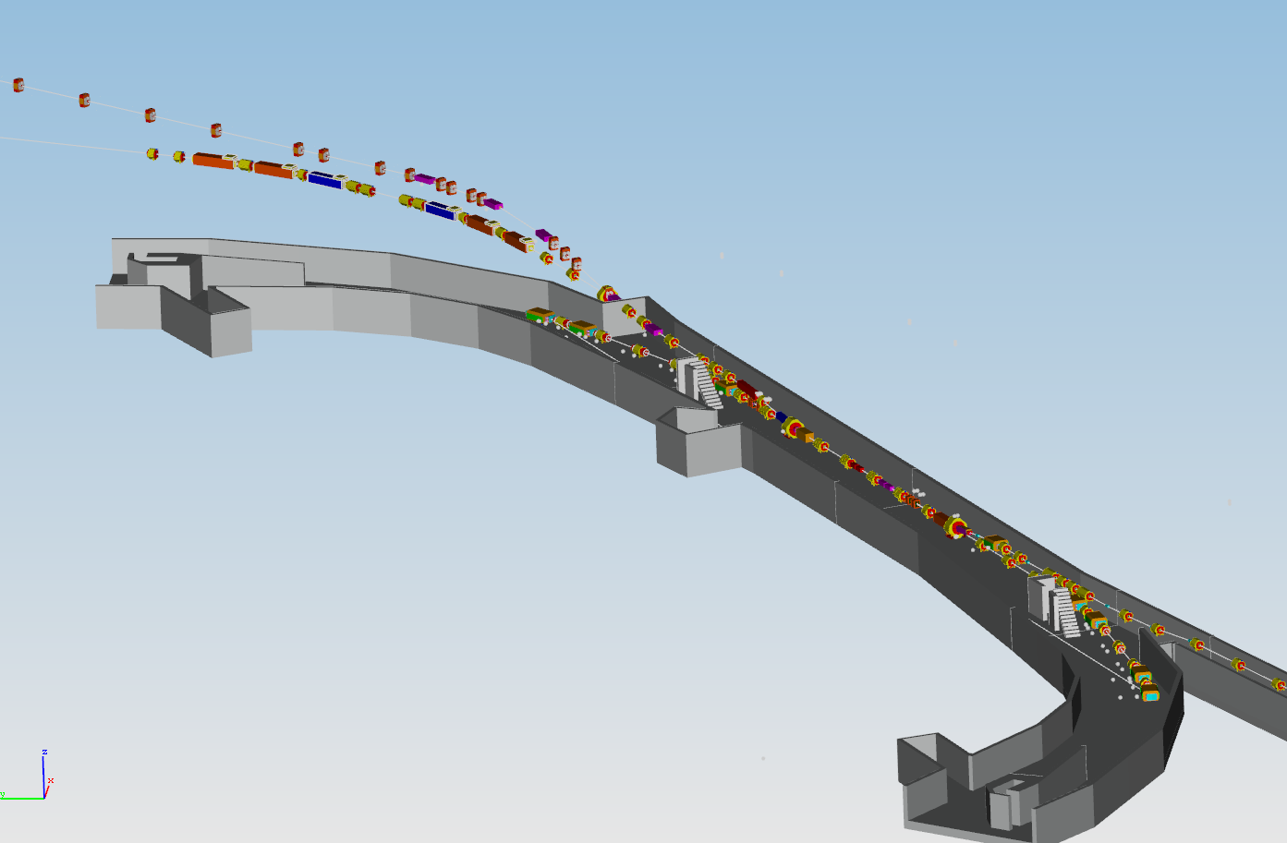
Location of damaged and replacement MDC dipoles
Replacement magnets from M5 Line
V906
Delivery Ring Enclosure
D30 straight section
V743
V742

Slide 4
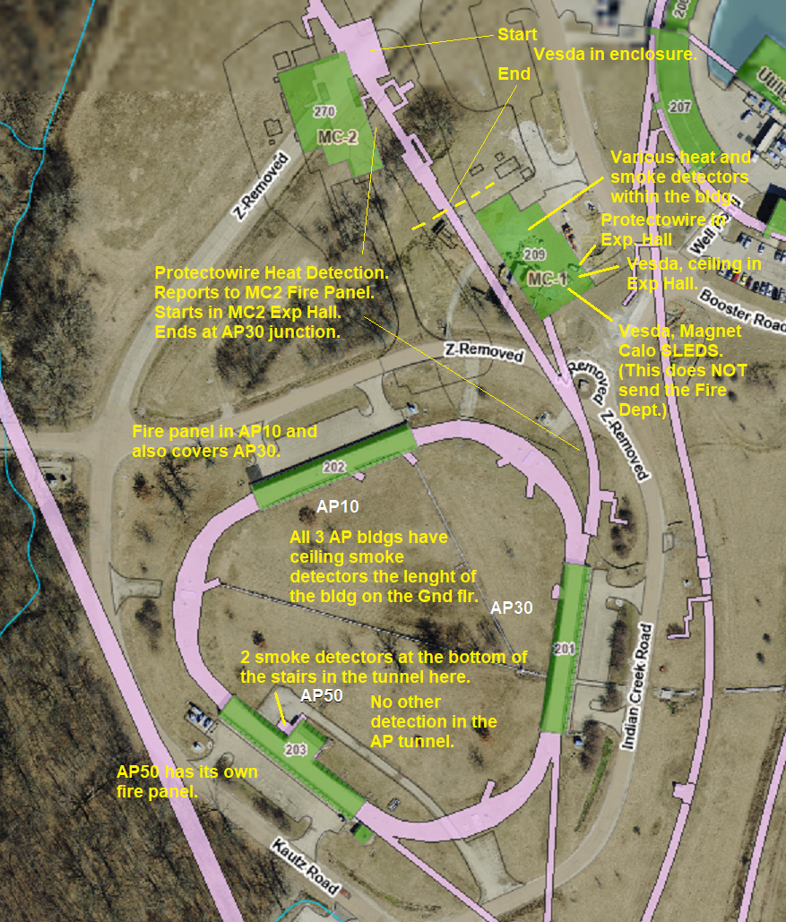
Muon Campus fire protection
Very Early Smoke Detection Apparatus
(VESDA)
V906
Illustration from
Mark Kujawa, ISD

Slide 5
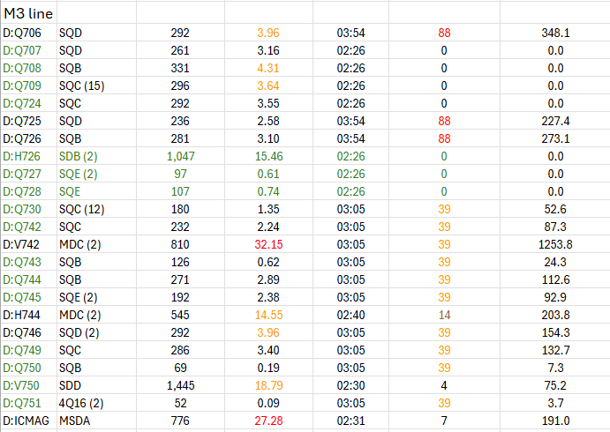
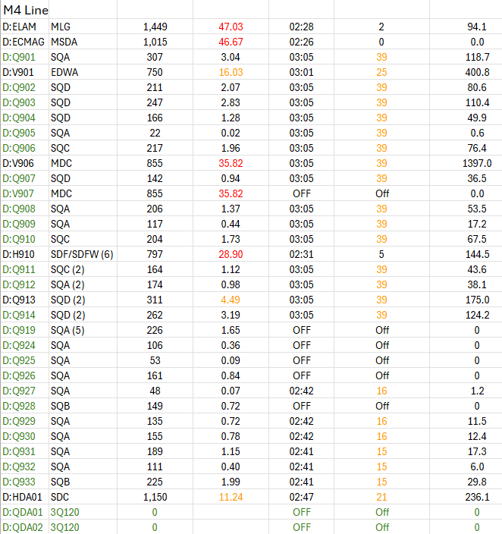
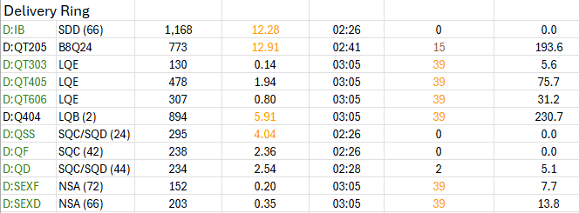
Magnet dissipated power and time without LCW
Current
Power
Time
Minutes
Power*Time
Current
Power
Time
Minutes
Power*Time

Slide 6
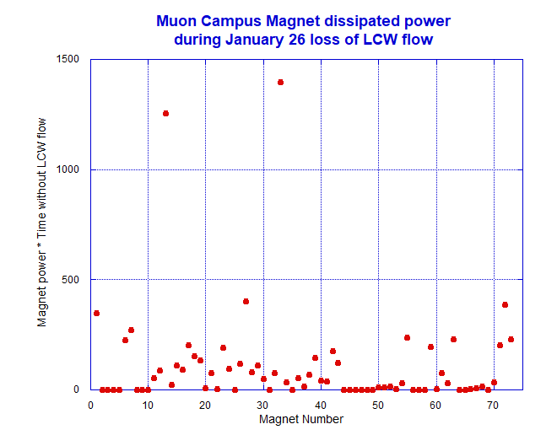
Total power loss in Muon Campus magnets
V906
V742 & V743

Slide 7
Moving forward
The path ahead
Need to replace three failed dipoles, believe other magnets are okay
Three M5 Left Bend dipoles H005, H008 and H011 will replace damaged magnets
May need to open two hatches to get lifting equipment properly staged
M5 dipoles have special vacuum pipes, MSD has located three standard pipes
The V906 magnet hanger may need new parts due to the difference in MDC types
Check magnet thermal protection on power supplies with PLC for interlocks
Did not get beam sign-offs completed prior to January 26 incident
Continue to improve tunnel air filtering effort
Repair a few lingering LCW leaks
PIP-II 6-week pause began last week
Expect Main Injector heat exchanger issues will cause delay beyond PIP-II pause
Hope to address warm power supply circuit breakers during 6-week pause
Replace several circuit breakers identified as running warm (especially V907)
Increase wire size on a few circuits to improve margin

