Slide 1
RR/MI/MI-8 status
Cristhian Gonzalez-Ortiz
Ops Meeting
February 7, 2025

Slide 2
Summary
Summary
Successful OTR Studies on Monday (Matilda and Randy)
Access to check RAW skid level indicator at MI-Abort (MI-40)
I:4WL101 was recovered on Tuesday (Marty)
Leak was found at F0 coming from I:Q714 PS (Ops, PESD, ISD)
Recycler bulk supply R:C402 leak discovered (PESD aware)
Responded to R:K1COOL alarm on Wednesday (Wren)
MI Magnet System Pressures Increasing
Jesse and Pete D gave us a hand. Pressures are now stable.
Monitoring and tuning the MI-8 line
Next Week
Start of work for I:LAM52 leak repairs
Keep monitoring and tuning the MI-8 line

Slide 3
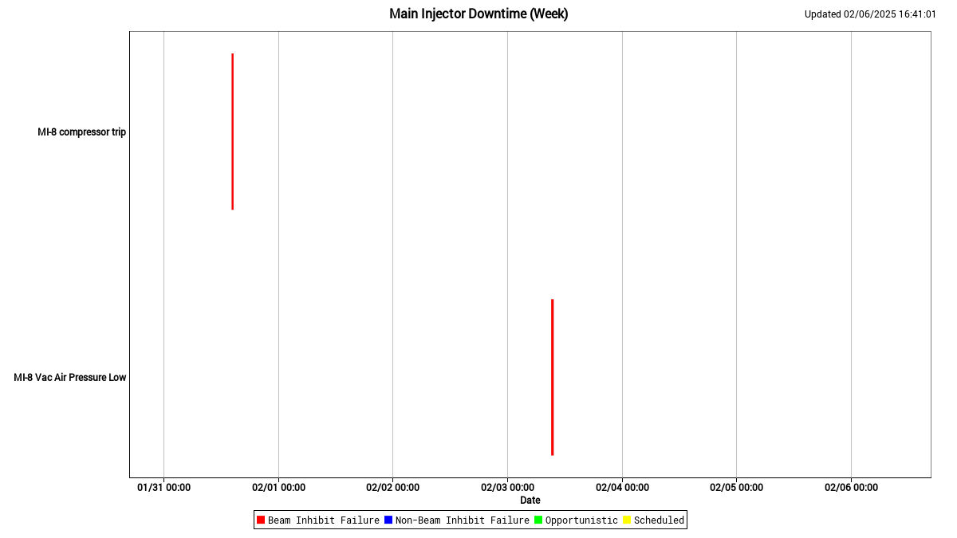
Summary Plots

Slide 4
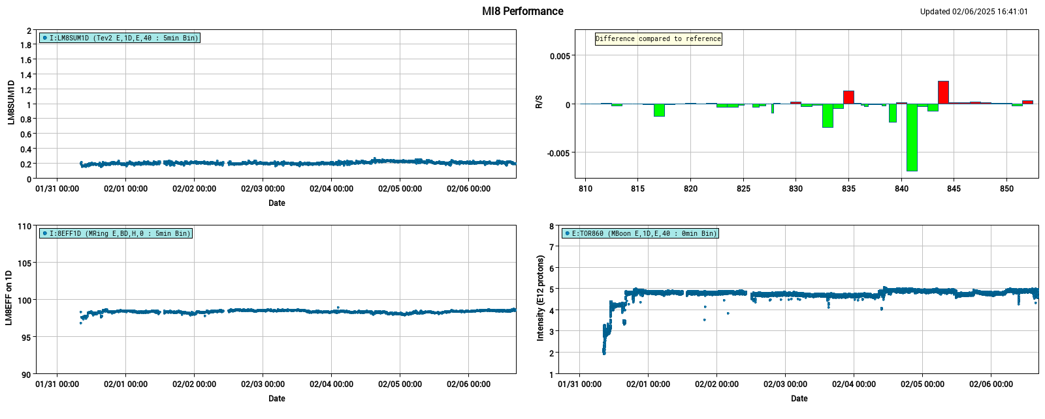
Summary Plots

