Slide 1
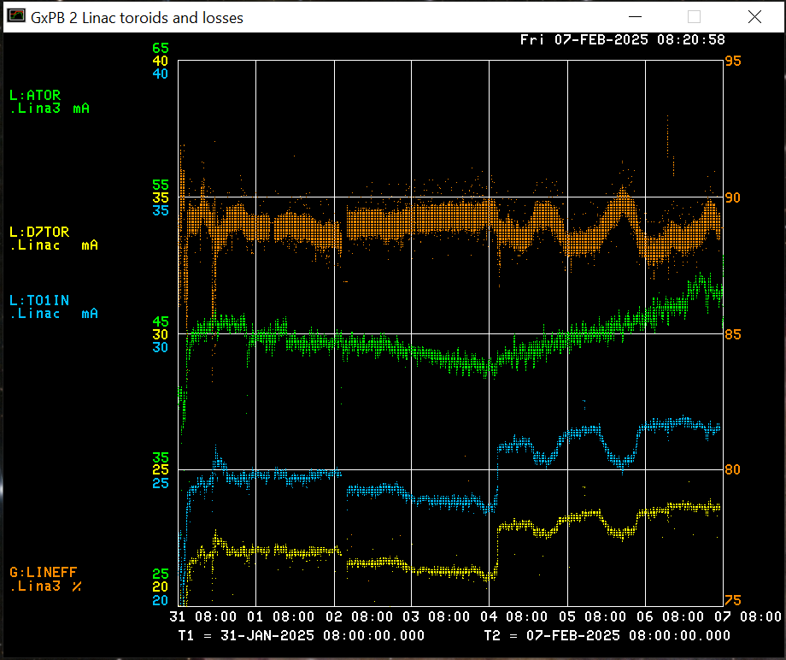
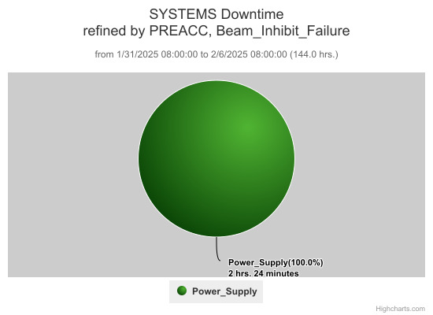
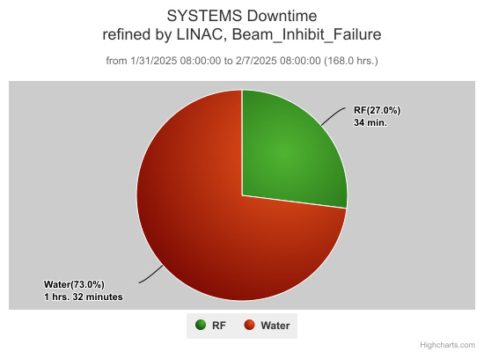
Linac Operations Report
Beam output: Source: 48.8 mA
TO1IN: 26.6 mA
D7TOR: 23.6 mA
Efficiency: 88.7 %
Downtime:
LEBT trim PS issues (2 hrs)
Klystron Vernier H₂O regulation (1.5 hrs)
Try a test today hopefully to diagnose
Various RF trips

