Slide 1
Mu2e report
Greg Rakness (FNAL)
Friday 9am AD meeting
07-Feb-2025
https://indico.fnal.gov/event/68165/

Slide 2
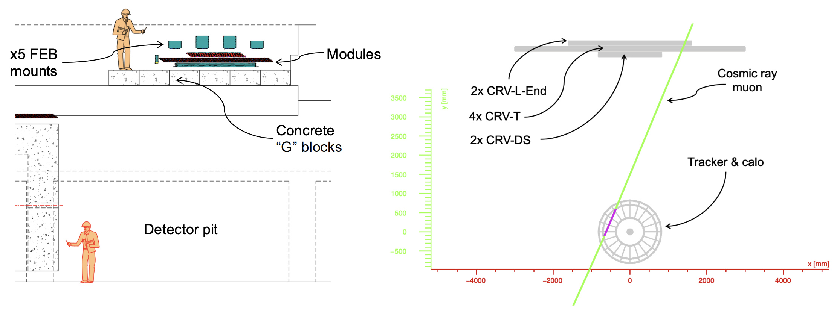
Some of the work at Mu2e
Dump resistor mods complete
Setting up equipment for testing at D0
Prepping a few shield blocks to install in hatch
For Project Detector Key Performance Parameter, these are the “ceiling” for tracker and calo and the “floor” for Cosmic Ray Veto
Prep = clean and paint
CRV
blocks
Trk + Calo
From Sam Grant (mu2e-docdb-51523)

Slide 3
G-blocks in the hatch!
Other preparations to bring over Calorimeter and Tracker include…
Access techniques for tracker and calorimeter
Investigating environment (since Mu2e is not a clean room, where Calorimeter and Tracker have been living for years)

Slide 4
Incoming
18-Feb: Replace Automatic Transfer Switch at MC1
To automatically switch to backup power for Mu2e cryo plant
Week of 17-Feb: restart Extinction Monitor Filter installation
Requires coordination of AD experts, contracted riggers, PPD alignment, and scientists
Finally ordered cable to monitor sump level via ACNET
Thanks to Jim Morgan for his advice

