Slide 1
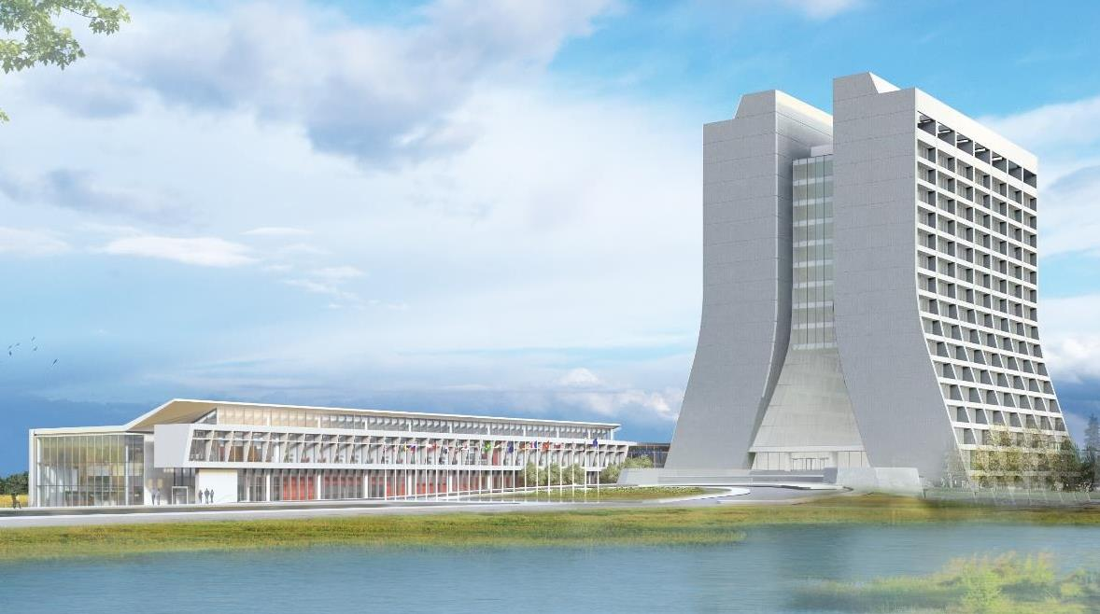
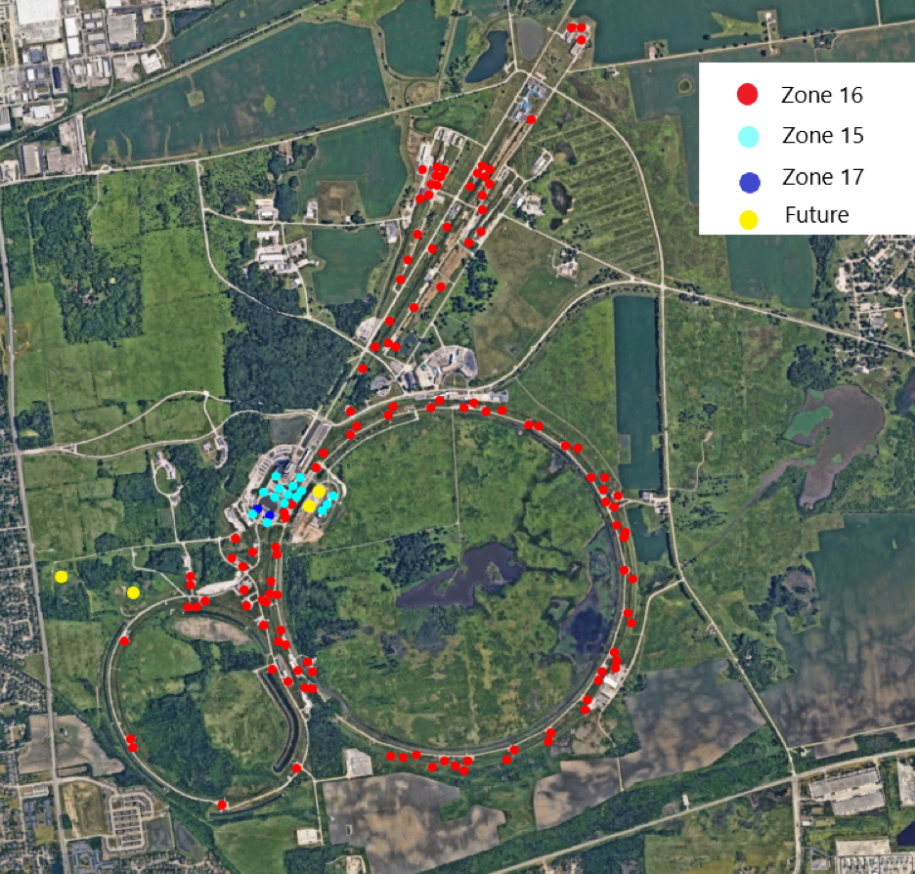
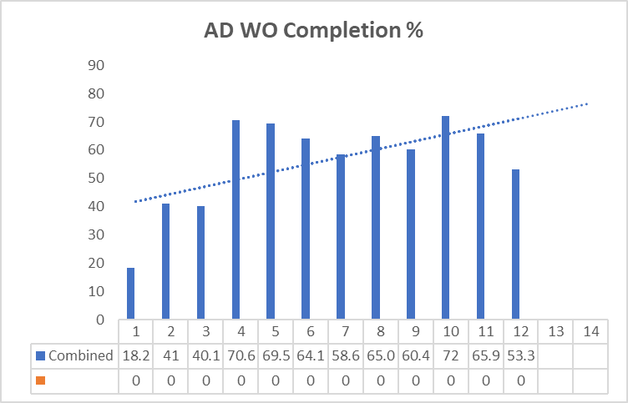
Infrastructure Services Division Updates
Pressing Issues / Special Topic: Batteries
Work Ticket Breakdown for the Q1
JAN 2025
18.8%
_______
Increase

Slide 2
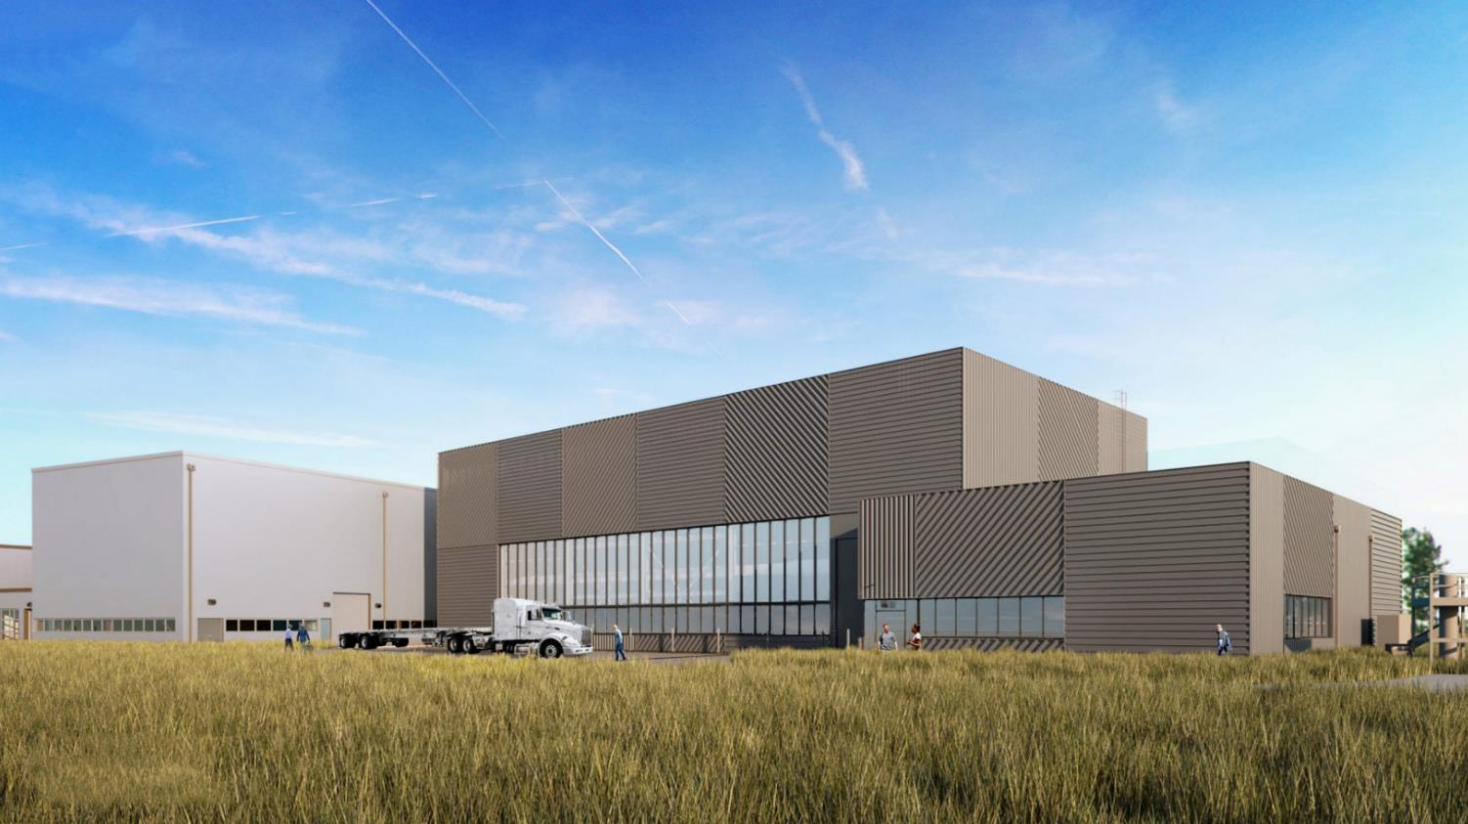
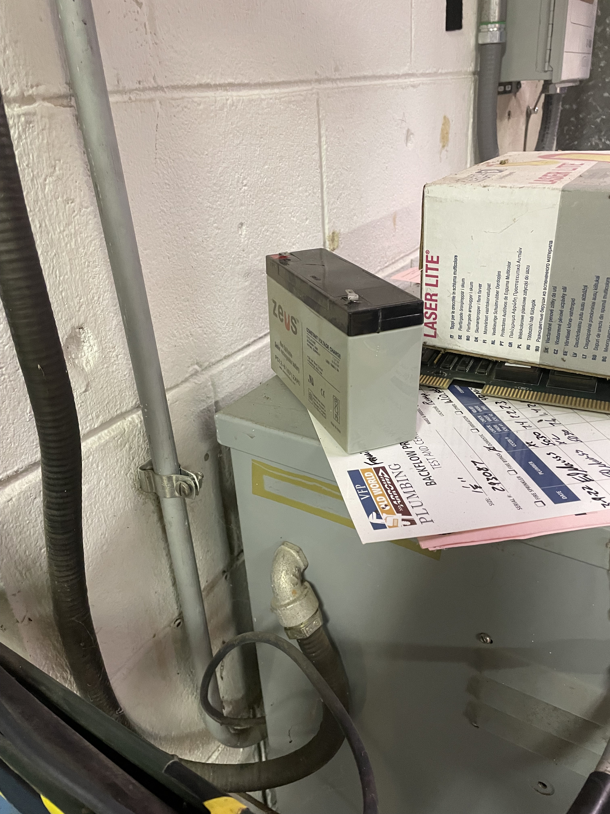
Special Topic:
Battery Removal – Tighter safety protocols being enforced.
Situation – At an undisclosed building (NS1), it was found a lonely battery sitting on a transformer. It looked used.
What happened after was a series of protocols discussed with the AFM about Fermi’s Prime Contract importance, followed by DOE Order 436.1 (departmental sustainability) responsibility, leading to a discussion on EO 13834 Efficient Federal Operations requirements, Part III, plus the Pollution Prevention Act of 1990.
You would think my understanding would be good, but it was discussed further with by adding the importance of Resource Conservation & Recovery Act (RCRA) and the National Environmental Policy Act (NEPA), which all boiled down to Fermi is working with a 2023 target of 50% diversion.
The cool part I found out was, if you are not sure if, or how, to tag something for removal to reach out to Frank Gattuso at Site 40.

Slide 3
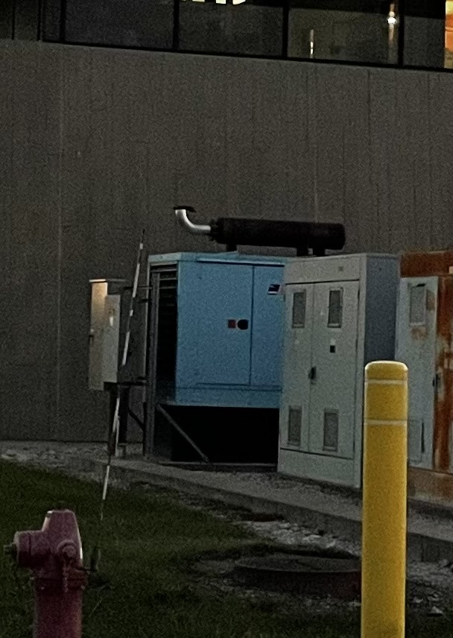
Bonus Special Topic:
Generator PMs and stuff – Just some background information on the generators for your buildings.
Question – “Recent events got me thinking about how long a generator can run in the event of an extended unplanned power outage?”
Answer: Diesel Generators have “day tanks”, meaning they are meant to run for at least 24hr at expected load without needing refueled.
In the event of a long-term power outage, we call a fuel contractor and line them up to come daily and top off the tank.
The tank levels are checked monthly by the ISD electricians when they do their monthly run and checks. When levels drop below 90%-ish they are put on the list to be refueled that month.

Slide 4
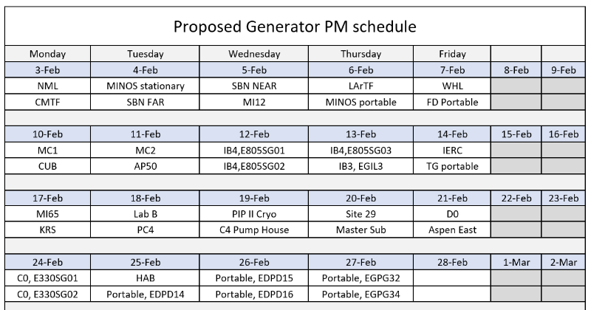
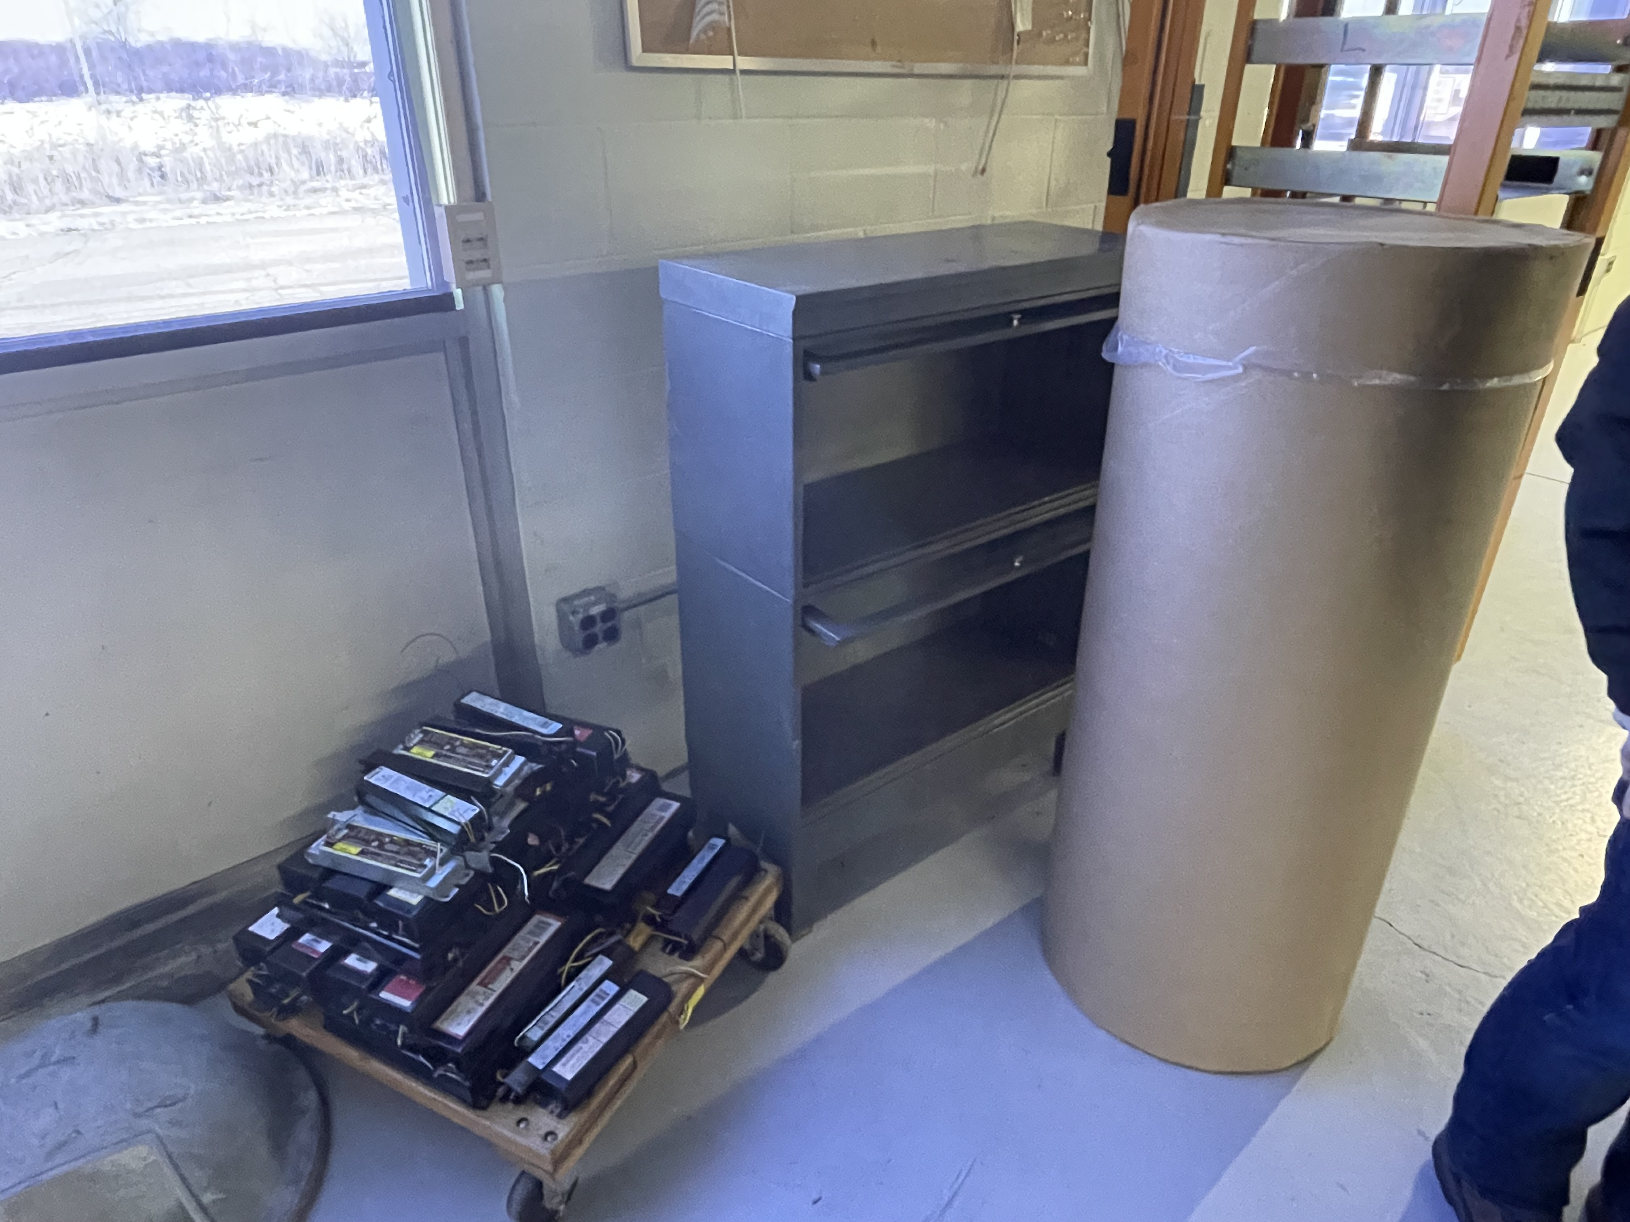
Noteworthy Items
NS3 – Door Replacements – HA has been submitted
Generator PMs – starting next week
NML-ESB concrete work – HA has been submitted
NML-ESB HVAC work – HA has been submitted
MI60/C0 Battery/Bulbs Pick Up - Completed
New Roofs
Site 40 – hopefully have contractor start the roof in April
Village Gym/Fuel Station - are pretty much done just doing punch list items and waiting on tin work.
Minos – Emergency Roof – In review process. In Progress
12 Roof Package – We’ve been meeting with contractor and procurement and are so close to finalizing the plans to get started. Projected start time in spring 2025.
A0 Kicker A0 Lab A0 Service Building
IB#3 IB #4 MI30
AP50 MI52 MI60
MI62 NTSB Site 40

Slide 5
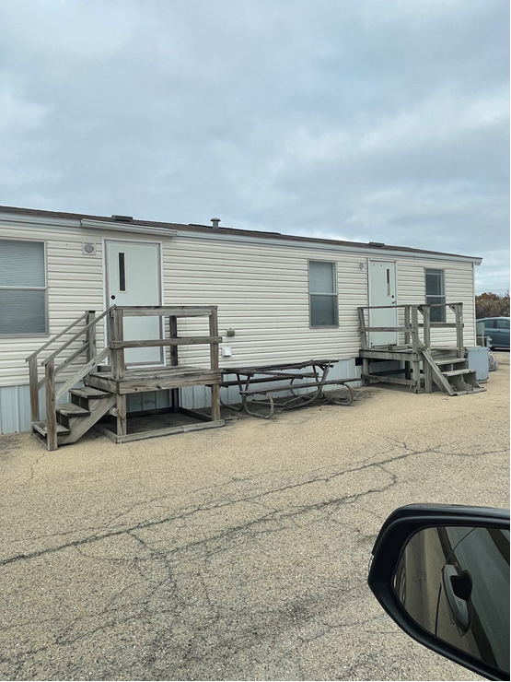
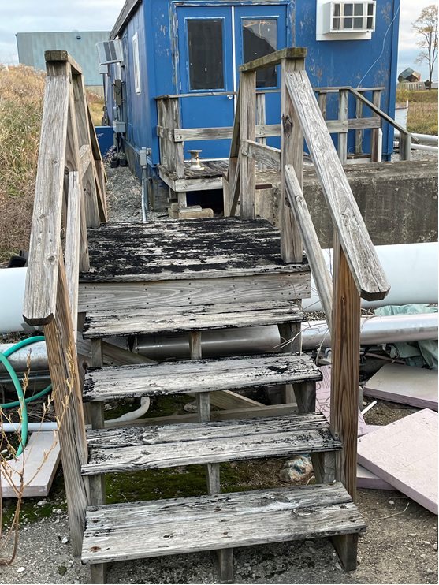
Active Projects still in motion and Contractors on Site
Other Happenings:
FREP (Fermilab Resilience & Efficiency Project) - has been walking various buildings working out details of the future scope of work (SOW) for controls and HVAC upgrades. - Completed
NWA – Split Unit at NS4 was installed this week. - Completed
Structure Moves – We are in the planning phase of moving 3 trailers, one at F4 and two at ME7.
TSIB – Punch list walk throughs for concerned parties have been Completed. Follow up items are in progress with turnover sometime in July. In the meantime, some equipment is starting to be installed.
C0 – Is moving to the next phase of the project. Planning for window replacements and door repairs are coming. Finished Floor work on the north room this week and plumbing work
.

