Slide 1
9 AM Meeting
Keymonty Bullock
MCR Crew Chief
Friday February 7, 2025

Slide 2
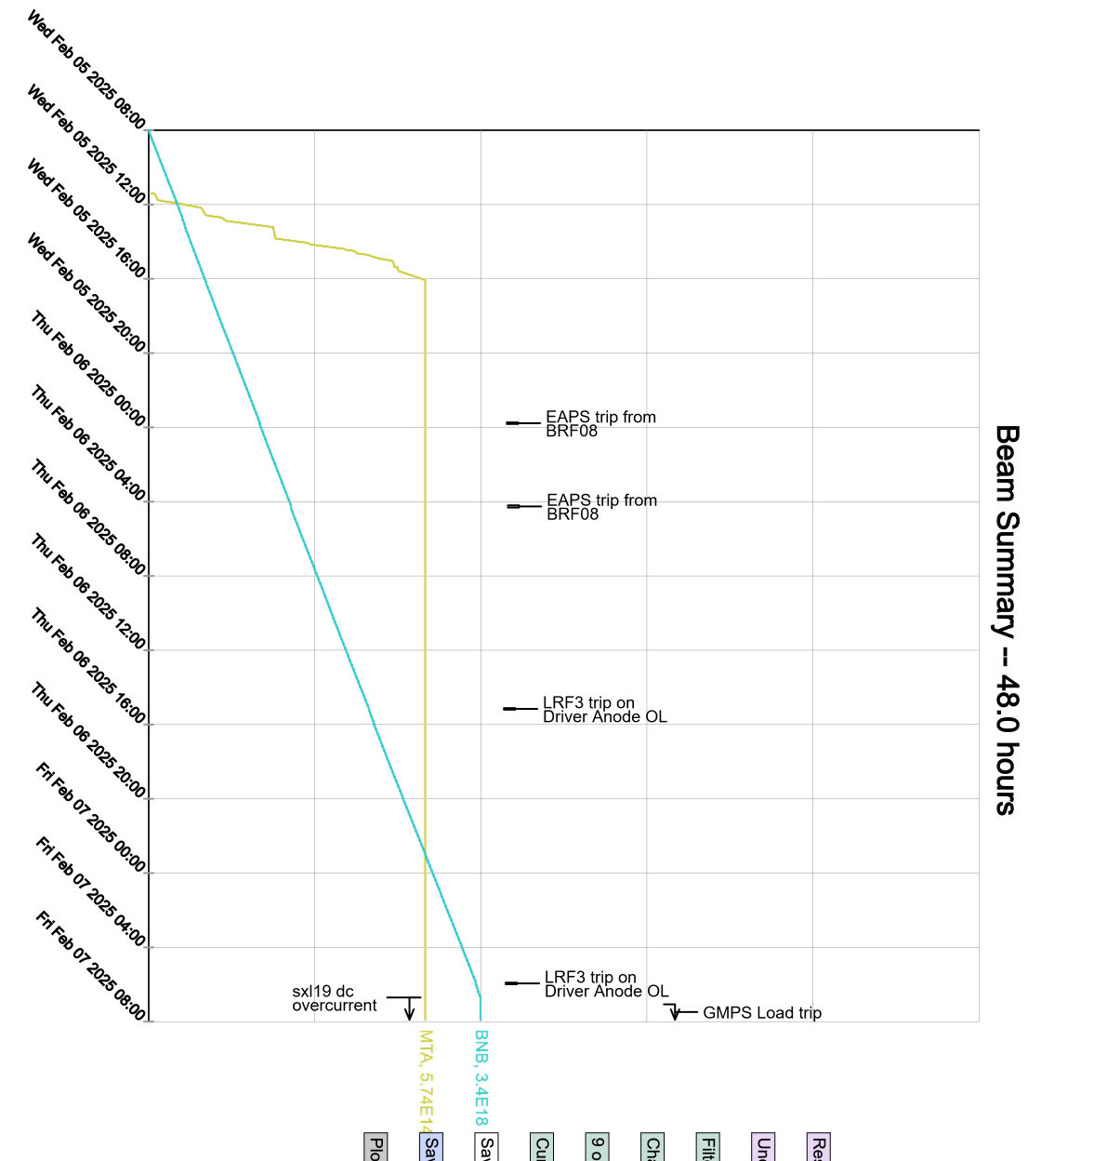
Since Wednesday…
Monitored systems
Supported MTA and Booster studies
Booster trim and GMPS load trip.
Experts investigating
Beam disabled during booster troubleshooting

