Slide 1
Protons in IOTA
1st ASTA User Meeting
Moses Chung/APC
With many inputs from
V. Shiltsev, A. Valishev, G. Stancari, S. Nagaitsev,
V. Scarpine, B. Hanna, J. Steimel

Slide 2
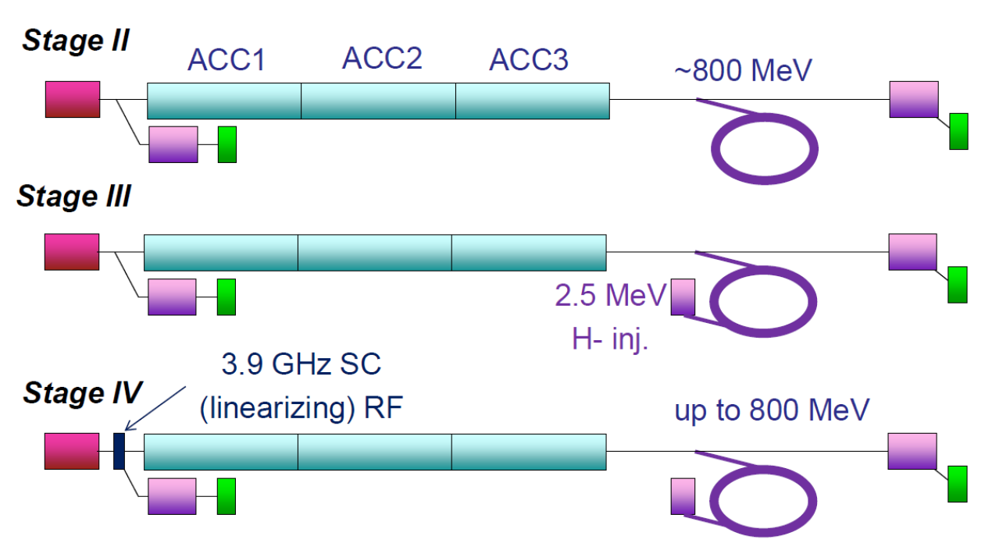
Protons in IOTA: Stage III

Slide 3
Protons in IOTA: Why?
Nonlinear integrable optics needs to be tested with beams with space-charge
Beam halo suppression by nonlinear integrable optics should be verified
Dedicated study on space-charge compensation using electron column is possible
Suppression of e-p instability in nonlinear lattice can be investigated
+ Many more ideas are welcome !

Slide 4
Protons in IOTA: Basic requirements
1. Range of magnetic rigidity:
2. Availability of the proton beam:
Ion source, LEBT, and RFQ of the HINS program will be reused as a proton injector for the IOTA ring with an energy of 2.5 MeV and a nominal current of 8 mA
3. Non-negligible space-charge:

Slide 5
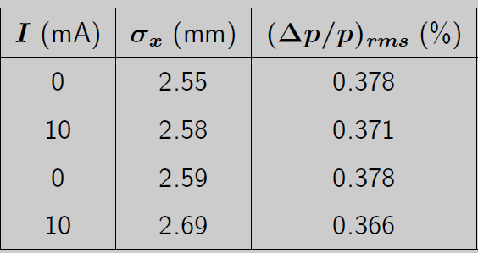
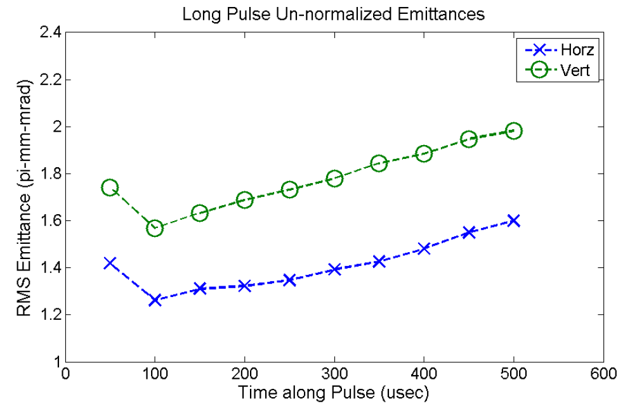
Proton beam parameters from HINS:
Estimated momentum spread
Water-leak
for RFQ
By Eliana Gianfelice-Wendt
Bunch width ~ 2 x 0.3 ns
(from fast Faraday cup by Vic)
By Vic Scarpine
~2.0 pi-mm-mrad vertical
~1.6 pi-mm-mrad horizonal

Slide 6
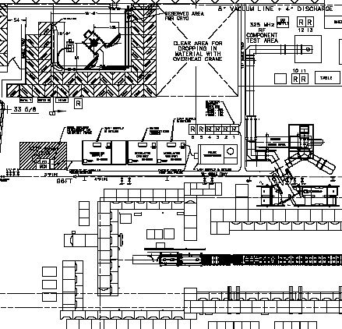
Current configuration of HINS at MDB
Part 2:
Klystron + Circulator
+ waveguides
(2MW 325 MHz)
Part 3:
Charging supply
+ modulator
+ pulse transformer
Part 1: Ion source + LEBT + RFQ + Beamline + Diagnostics

Slide 7
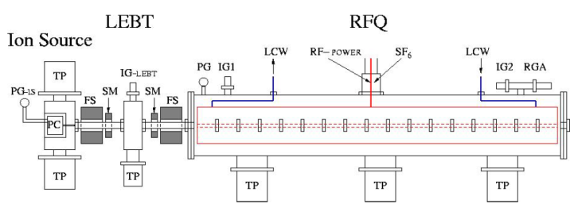
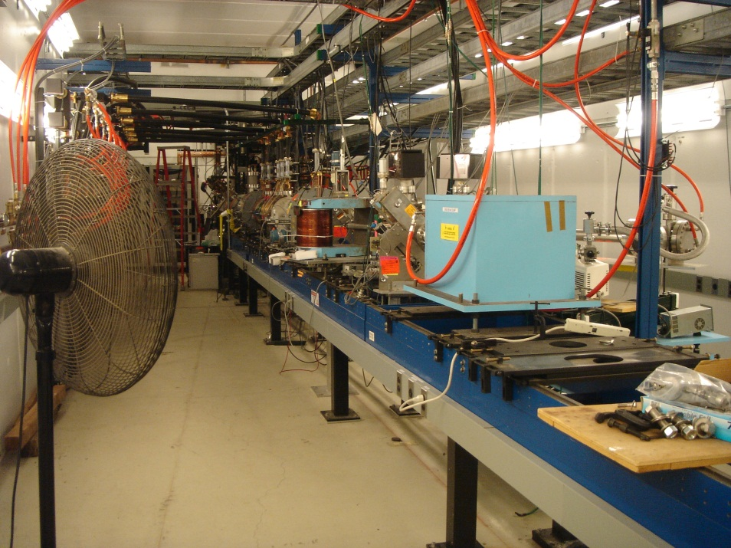
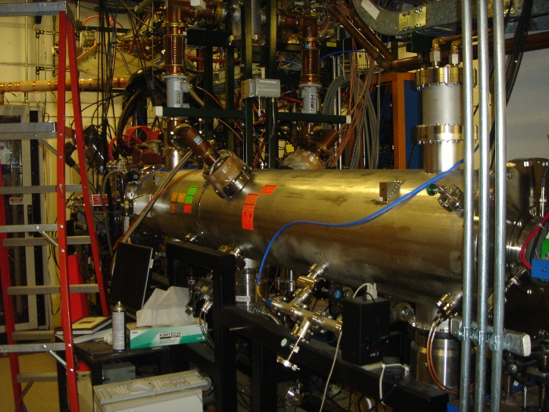
HINS Beamline components
No 6 cavity for ITOA injection
~ 4.7 m
dump

Slide 8
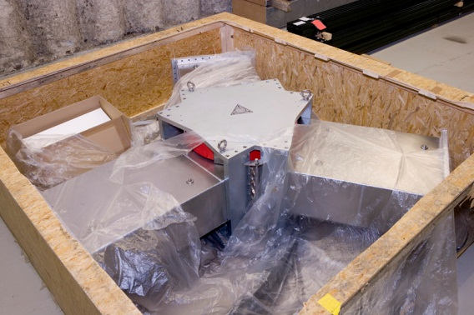
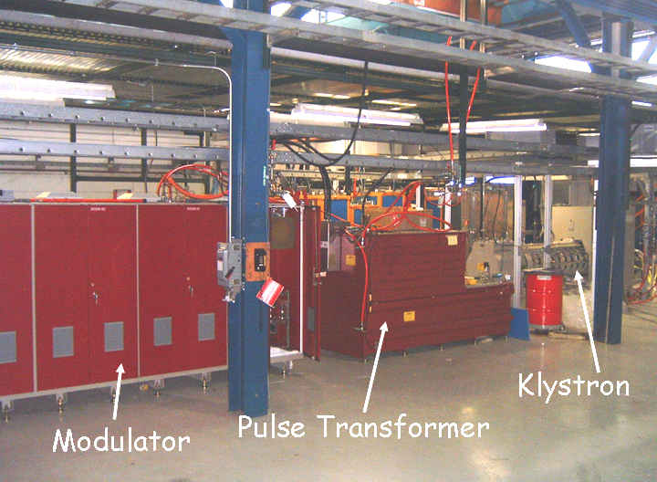
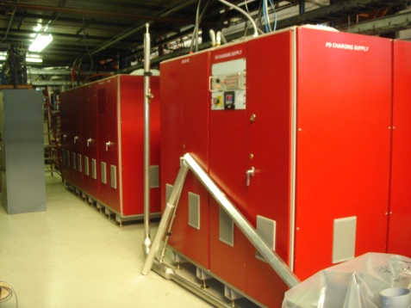
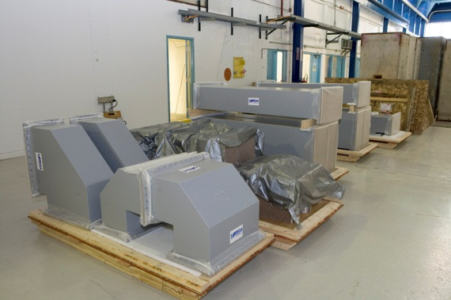
HINS RF components
2nd Kylstron has arrived from Toshiba (input from Jim Steimel)
Circulator
Charging supply
Waveguide components

Slide 9
Space to relocate HINS front end and RF system
We may relocate whole HINS RF system
Or
Only relocate 325 MHz Klystron and
reuse (or share) modulator system
Possible location
of the HINS front end
~ 36 m
5 MW for CM1 → will eventually be superseded by
a 10 MW multi-beam klystron system to drive the 3 CM string.
2 x 0.3 MW
for CC1&2
5 MW
for gun

Slide 10
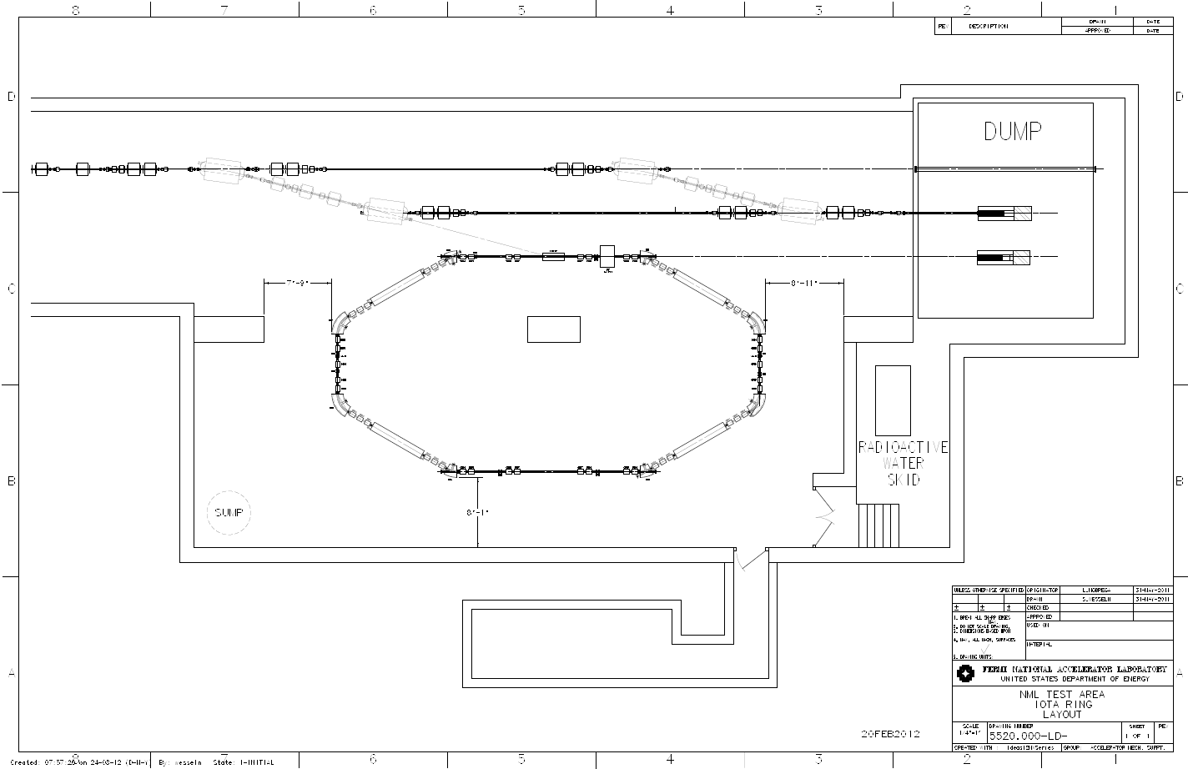
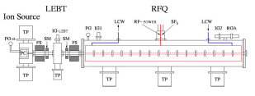
Possible configuration 1:
Single-turn injection of proton→ Some emittance growth and needs gap
Co-direction of electron injection → need to change dipole polarity
1.52 m
Beam line for diagnostics
7.9 m
~5 m
kicker

Slide 11
Possible configuration 2:
Single-turn injection of proton→ Some emittance growth and needs gap
Counter-direction of electron injection → need to reroute beamline
~5 m

Slide 12
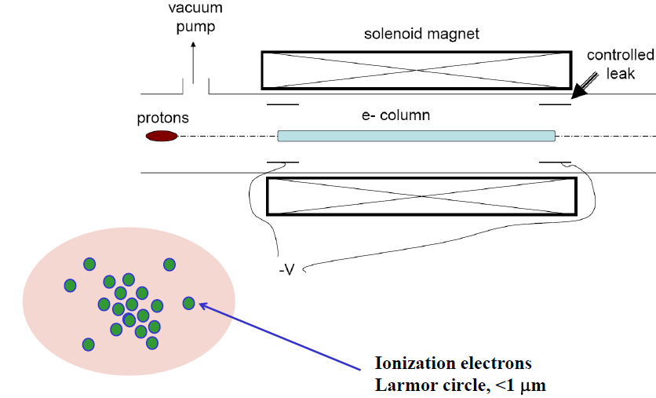
Example of an experiment with proton
: Space-Charge Compensation
Electrons are created by beam-induced rest gas ionization, and confined by solenoid and electrodes → Gas focusing + Penning trap
0.5 T
1m
Electron generation
by rest-gas ionization
Proton beam shape
~ Trapped electron profile
How to maintain the stability of the beam-plasma system ?
(beam: e-p instability, plasma: radial expansion or growth of diocotron mode)

Slide 13
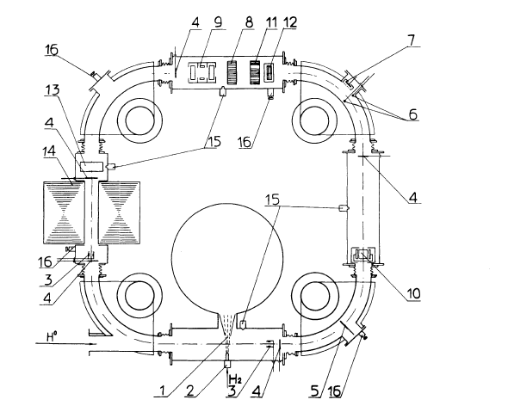
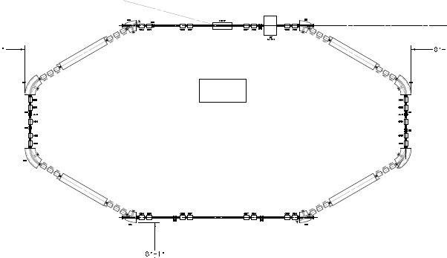
IOTA proton-beam: better than Novosibirsk PSR
2.5 MeV
7000 G
~5 m
5 cm
0.56 MHz
up to 1000 µsec
0.2; 1 Hz
up to 8+ mA
G. I. DIMOV and V. E. CHUPRIYANOV (1983)
Betatron tune = 3 ~ 5
Synergy with e-column
and nonlinear magnet

Slide 14
Conclusion
The combination of the IOTA ring with the HINS front-end will be a great asset to the advanced accelerator R&D community, in particular for the Intensity Frontier.
So far, we see no immediate technical show-stopper to inject a 2.5 MeV proton beam into the IOTA ring. But we need to investigate technical details with local experts and outside users.

