Slide 1
Status and plan for ASTA drive laser system
Jinhao Ruan, D. Edstrom Jr., Todd Johnson, J. Santucci

Slide 2
Outline
System Diagram
System Performance
Next Stage plan
Future upgrade

Slide 3
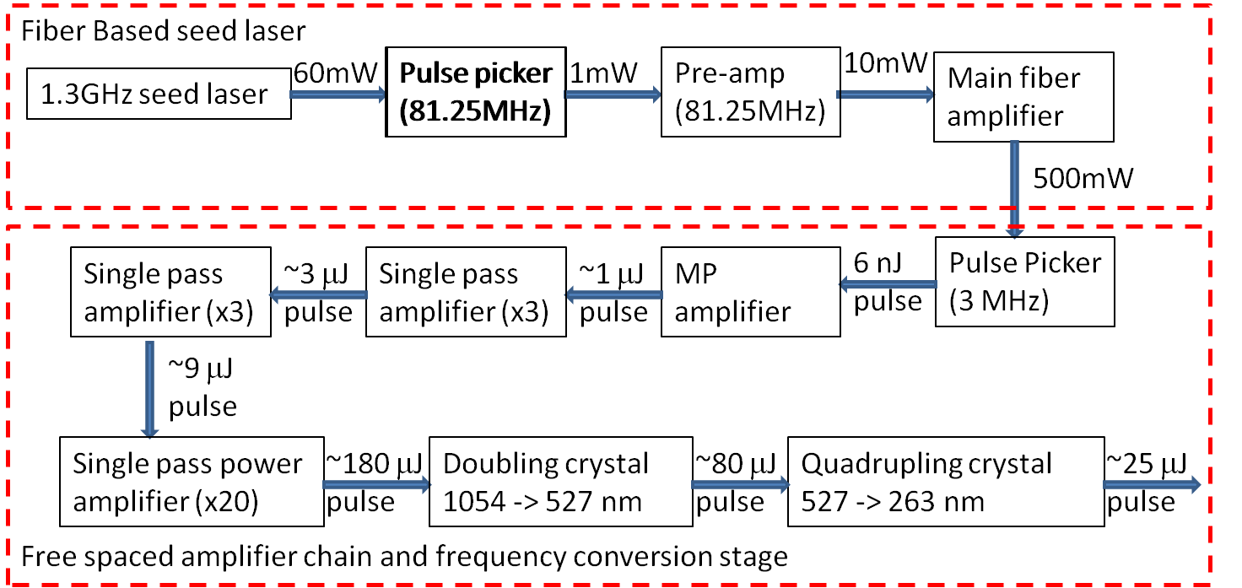
System Diagram

Slide 4
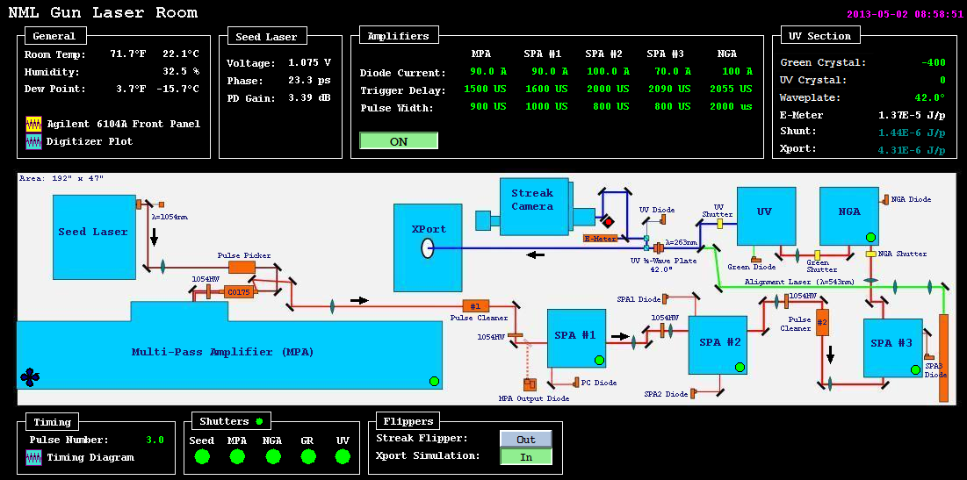
User Interface

Slide 5
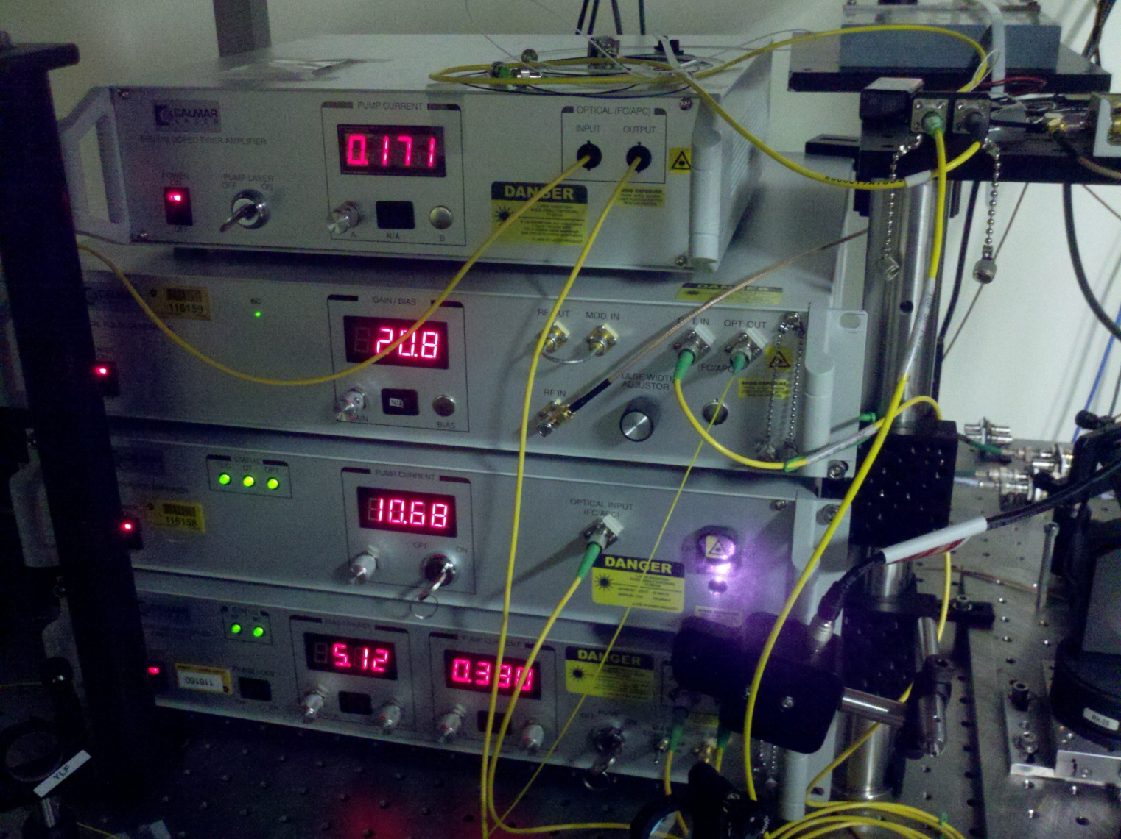
System Performance: Seed Laser

Slide 6
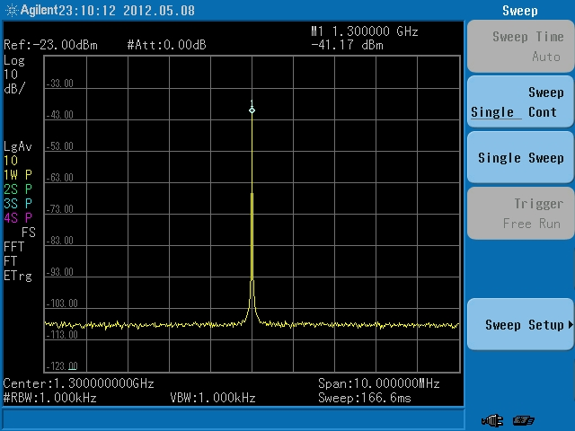
System Performance: Seed Laser

Slide 7
System Performance: Seed Laser

Slide 8
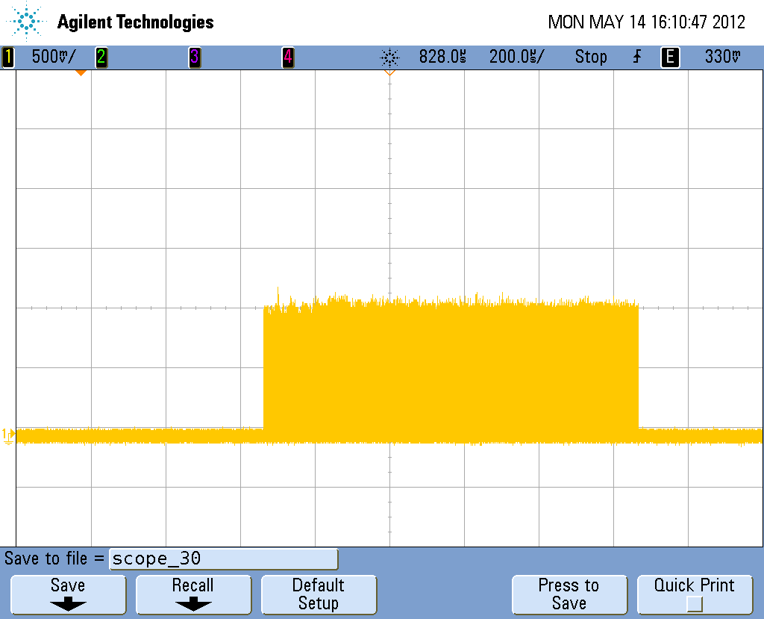
System Performance: Amplifier

Slide 9
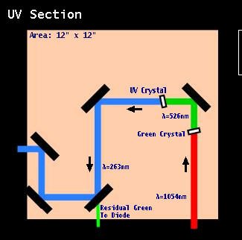
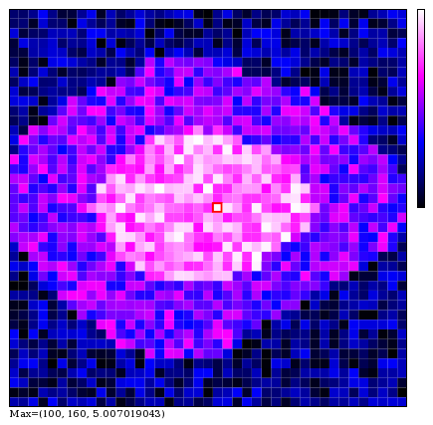
System Performance: UV section

Slide 10
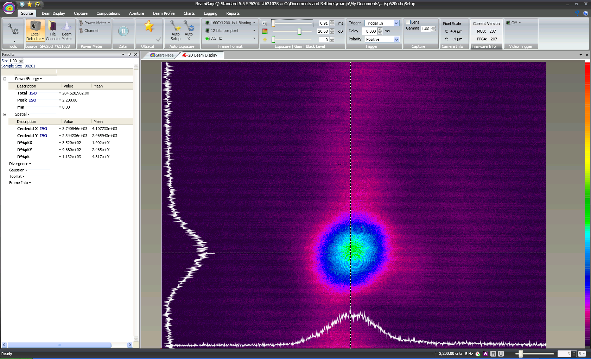
System Performance: UV section

Slide 11
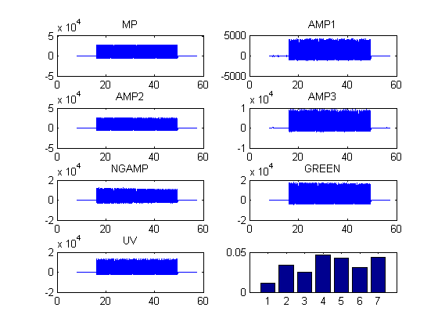
System Performance

Slide 12
Current Status
Laser is up running with 3MHz pulse train and 5Hz repetition frequency
User interface is set up
The longest flat pulse could be easily up to 200~300μs. Some extensive tuning (~3-4 hours) would be needed for 500~600μs long pulse train with lower chargies.

Slide 13
Near future plan
Establish 1ms long pulse operation (by the end of this year)
Clean up the longitudinal structure we observed during the initial commissioning
Setup energy calibration and QE monitoring for the CsTe cathode

Slide 14
Future plan
Upgrade the 3MHz operation to 9 MHz operation
Explore the possibility of running 81.25MHz bunch train to further test the SRF CM.

