Slide 1
MEIC Electron Cooling and Fast Kicker R&D
Yuhong Zhang
For
JLab MEIC Design Study Team
1st Advanced Superconducting Test Accelerator (ASTA) User’s Meeting
Fermilab, 23-24 July 2013

Slide 2
Need an ultra fast kicker
Critical for ERL circulator cooler
A great idea: beam-beam kicker
Like a proof-of-concept experiment
No experiment plan yet
Looking for a facility (ASTA?)
Looking for collaborators
Outline
Introduction
MEIC and Its Cooling Scheme
ERL Circulator Cooler
Technology Development
Summary

Slide 3
Introduction
Jefferson Lab has developed a conceptual design of a polarized Medium energy Electron-Ion Collider (MEIC) based on the 12 GeV CEBAF recirculating SRF linac
The MEIC machine design takes advantages of
A high bunch repetition CW electron beam from CEBAF
A proven luminosity concept but new to a collider involving hadron beams
A new ion complex for producing high bunch repetition ion beams
A figure-8 shape for all ion rings for delivering superior ion polarizations
Cooling of protons/ions is essential for achieving ultra high luminosity
MEIC design adopted a multi-staged cooling concept
Based on conventional electron cooling, at the pre-booster and the collider ring
Continuous cooling during collision to compensate IBS induce beam degradation
A concept of an electron cooler based on an ERL and a circulator ring has been developed; an ultra fast beam kicker is needed for operation of the circulator cooler ring
3

Slide 4
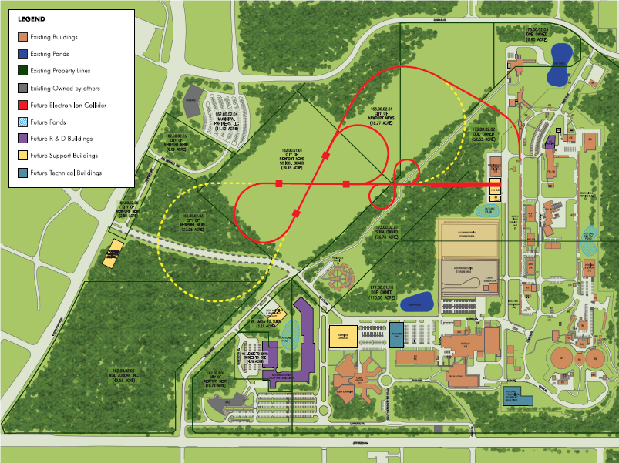
MEIC at Jefferson Lab
SRF linac
Booster
(3 to 25 GeV/c)
Three Figure-8 rings
stacked vertically
Ion
source
Full Energy EIC
Pre-booster
electron collider ring (3-12 GeV)
Medium-energy IPs
SC ion collider ring (20-100 GeV)
MEIC
IP
Injector
12 GeV CEBAF
IP
Energy: e: 3-12 GeV, p: 20-100 GeV, i: 12-40 GeV/u
Ion species: Polarized light ions: p, d, ³He,
Un-polarized light to heavy ions up to A>200 (Pb)
Up to 3 detectors
Luminosity: up to 10³⁴ cm⁻²s⁻¹ per interaction point
Polarization: All polarizations >70%
At IP: long. for both, trans. for ions only
Upgradeable to higher energies & luminosity
20 GeV electron, 250 GeV proton, 100 GeV/u ion
Pre-booster
Ion linac
CEBAF

Slide 5
Multi-Staged Cooling Scheme
Full Energy EIC
 | Stage | Ion (GeV/u) | Electron (MeV) | Cooling beam /Cooler
Pre-booster | Assisting accumulation of positive ions | 0.1 | 0.59 | DC
 | Initial cooling for emittance reduction | 3 | 2.1 | DC
Collider ring | Final cooling at top energy for emittance reduction | Up to 100 | 55 | Bunched /ERL
 | During collision to suppress IBS emittance growth | Up to 100 | 55 | Bunched /ERL
IP
MEIC
IP
state-of-art
Pre-booster
Ion linac
CEBAF
pre-booster (3 GeV)
(accumulator ring)
medium energy collider ring
ion sources
DC cooling
Bunched cooling
SRF Linac
large booster
(25 GeV)
5

Slide 6
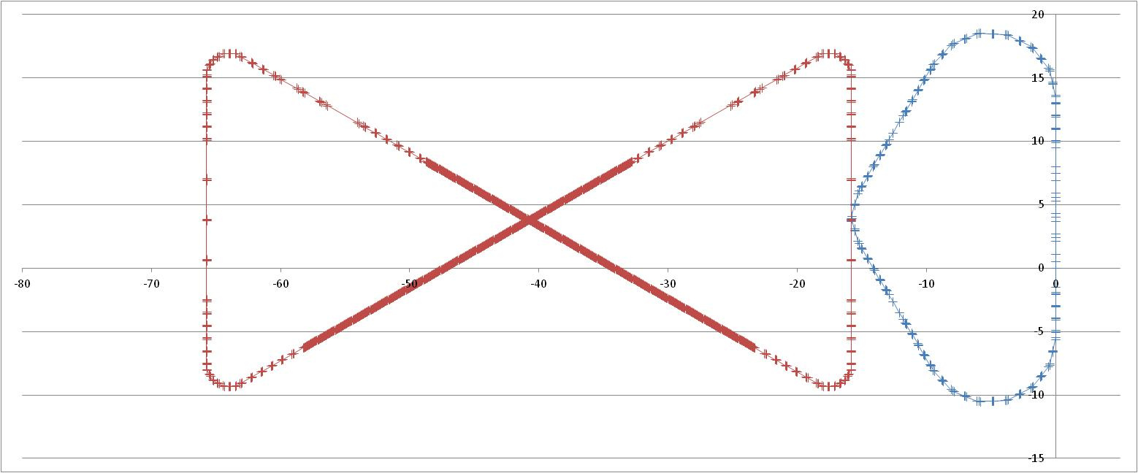
ERL Circulator Cooler Concept
Design Choices
Energy Recovery Linac (ERL)
Compact circulator ring
to meet design challenges
Large RF power (up to 81 MW)
Long gun lifetime (average 1.5 A)
Required technologies
High bunch charge (2 nC) magnetized gun
High current ERL (55 MeV, 15 to150 mA)
Ultra fast kicker
solenoid
ion bunch
electron bunch
Cooling section
Fast kicker
circulator ring
Fast kicker
energy recovery
dump
injector
SRF Linac
recirculating 10+ turns ➔ reduction of current from an ERL by a same factor
decompression
Previous proposals
RHIC luminosity upgrade
Using ERL technology
(Ben Zvi, et.al. 2000~2007)
HERA luminosity upgrade
Using circulator ring
(Brinkman, et.al. ~1997)
CCR
dump
beam exchange system
dechirper
cooling solenoids
ERL
SRF
rechirper
injector
D. Douglas C. Tennant
recompression
Slide 6
6
Notes:
6

Slide 7
MEIC Cooler Design Parameters
Max/min energy of e-beam | MeV | 54/11
Electrons/bunch | 10¹⁰ | 1.25
bunch revolutions in CCR |  | ~30
Current in CCR/ERL | A | 1.5/0.05
Bunch repetition rate in CCR/ERL | MHz | 750/25
CCR circumference | m | ~160
Cooling section length | m | 30x2
RMS Bunch length | cm | 1/3
Energy spread | 10⁻⁴ | 1 – 3
Solenoid field in cooling section | T | 2
Beam radius in solenoid | mm | ~1
Beta-function | m | 0.5
Thermal cyclotron radius | μm | 2
Beam radius at cathode | mm | 3
Solenoid field at cathode | KG | 2
Laslett’s tune shift @60 MeV |  | 0.07
Number of turns allowed in the cooler ring is primarily determined by degradation of beam quality caused by coherent synchrotron radiation (CSR), longitudinal space charge and inter/intra beam heating up.
Preliminary simulation studies have shown quality of the beam (and cooling efficiency) is still reasonably good after 30+ turns in the circulator ring.
This leads directly to a 30+ times saving of electron currents from the source/injector and ERL.
7

Slide 8
Perspectives of MEIC Cooling R&D
Electron cooling
High energy (up to 100 GeV p / 55 MeV e) ⬅ an order of magnitude above the state-of-art
Bunched cooling electron beam from an SRF linac
Multi-stage
Cooling while collisions
Electron cooler
A magnetized photo-cathode electron gun with long life-time
High bunch charge (2 nC) ⬅ a significant challenge in injector/ERL
High Average current and high repetition rate
High current ERL
Ultra fast kicker with high repetition rate and short rise/full time
Transporting a magnetized beam
Collective beam effects (Coherent synchrotron radiation, longitudinal space charge)
Intra and inter beam heating
Coupling of multiple beams (colliding beams and cooling beam)
Cooling is the No.1 priority of MEIC accelerator R&D!
Medium energy
Bunched e-beam
ERL
Circulator ring
8

Slide 9
Ultra Fast Beam Kicker for ERL-CCR
solenoid
ion bunch
It requires an ultra fast kicker for switching bunches in/out of a CCR
The kicker must be able to operate at a high repetition rate (~26 MHz)
Rise/full time must be shorter than sub ns to avoid disturbing the neighboring bunches
Cooling section
Fast kicker
circulator ring
Fast kicker
energy recovery
E. Nissen
injector
SRF Linac
dump
RF kicker
Like an RF separator, driven by a waveform which is a superposition of multi harmonic waveforms
Very high duty factor
Low power requirements
Requires a multi-harmonic signal amplifier
Engineering design & proto-typing are underway
A. Hutton, A. Kimber, E. Nissen
9

Slide 10
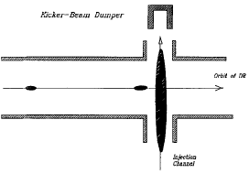
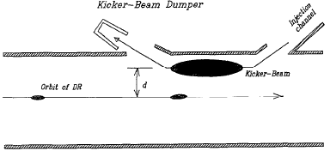
Beam-Beam Kicker Concept (Shiltsev, 1996)
Originally developed for injection/ejection of linear collider damping rings
Deflection force of the kicker is produced by a high pulse current
Can provide kick duration of about fractions of a nanosecond
TESLA DR: requires 2.4 nC (ejection), 300 nC (injection) for 0.435 mrad deflection
Head-on Scheme
Cross Scheme
Kicking time: τ=l/c
For a transversely round Gaussian beam
kicking angle
kicking strength

Slide 11
Beam-Beam Kicker for MEIC Cooler
A short (1~ 3 cm) target (flat) electron bunch passes through a long (15~50 cm) low-energy flat bunch at a close distance, receiving a transverse kick
The kicking force is
integrating over the kicking bunch gives the total transverse momentum kick
Proof-of-concept test of this fast kicker idea is needed for MEIC proposal
F
surface charge density
v≈c
D
h
σ_{c}
kicking beam
v₀
L
Circulating beam energy | MeV | 33
Kicking beam energy | MeV | ~0.3
Repetition frequency | MHz | 5 -15
Kicking angle | mrad | 0.2
Kinking bunch length | cm | 15~50
Kinking bunch width | cm | 0.5
Bunch charge | nC | 2
Possible an ASTA experiment?
Has a RF photo cathode
Has a flat beam program
Has beam diagnostic (?)
11

Slide 12
Summary
MEIC is considered the primary future of the JLab nuclear physics program. A comprehensive design report was released in Aug. 2012
Multi-staged (conventional) electron cooling is essential for formation and cooling of the high intensity ion beam for MEIC.
Conceptual design of an ERL circulator-ring based electron cooler has been proposed to provide a high intensity (1.5 A) and high energy (up to 54 MeV) cooling electron beam.
Development of an ultra fast kick is critical R&D. Beam-beam kicker is one (and top) candidate.
We are developing the possibility of a proof-of-principle experiment for a beam-beam fast kicker at ASTA
12

Slide 13
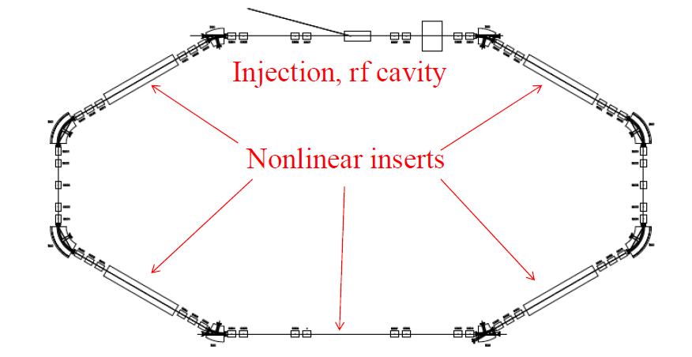
ERL-Circulator Cooler Proof-of-Concept Experiment at JLab FEL-ERL
kicker
Dechirper
Rechirper
Cooler Test Facility @ JLab FEL ERL
Purpose
Demonstrate the cooler design concept
Develop/test key accelerator technologies (faster beam kickers, etc.)
Study dynamics of the cooling electron bunches in a circulator ring
Phase 1 scope
Using the existing ERL without new upgrade except two 180° beam lines (available at JLab)
Supporting MEIC to deliver the high luminosity (5.6~14 x 10³³ 1/cm²/s),
To be completed before 2016
ERL-Circulator cooler test facility???
Medium energy
Bunched e-beam
ERL
Circulator ring
13

Slide 15
Energy Recovery Linac
JLab FEL Program
Energy Recovery
Energy | MeV | 80-200
Charge/bunch | pC | 135
Average current | mA | 10
Peak current | A | 270
Beam power | MW | 2
Energy spread | % | 0.5
Normalized emittance | µm-rad | <30
SRF ERL based FEL
High average power, up to14 kW (world record)
mid-infrared spectral region
Extension to 250 nm in the UV is planned
Photocathode DC injector, 10 mA class CW beam, sub-nC bunch charge
Beam energy up to 200 MeV, energy recovery
A world leader in ERL technology!
15

Slide 16
Cooling is Essential for Achieving High Luminosity
MEIC design concept for high luminosity is based on high bunch repetition rate CW colliding beams
KEK-B has reached >2x10³⁴ /cm²/s
JLab is poised to replicate the same success in an electron-ion collider:
A high repetition rate electron beam from CEBAF
A new ion complex specifically designed to match e-beam
Multi-phase electron cooling of ion beams
Very small bunch charge
8x smaller than KEK-B
20x smaller than HERA
Beam Design
High repetition rate
Low bunch charge
Very short bunch
Very small emittance
 |  | KEK-B | MEIC
Repetition rate | MHz | 509 | 748.5
Energy (e⁻/e⁺ or p/e⁻) | GeV | 8/3.5 | 60/5
e⁻/e⁺ or p/e⁻ per bunch | 10¹⁰ | 3.3/1.4 | 0.42 / 2.5
Beam current | A | 1.2/1.8 | 0.5/3
Bunch length | cm | 0.6 | 1/0.75
Horizontal & vertical β* | cm | 56/0.56 | 10/2~4/0.8
Luminosity/IP, 10³³ | /cm²s | 20 | 5.6 ~ 14
IR Design
Small β*
Crab crossing
Synchrotron radiation damping
Cooling
Multi-stage
During collision
16

