Slide 1
IOTA – Integrable Optics Test Accelerator Sergei Nagaitsev ASTA Users Meeting July 23-24, 2013

Slide 2
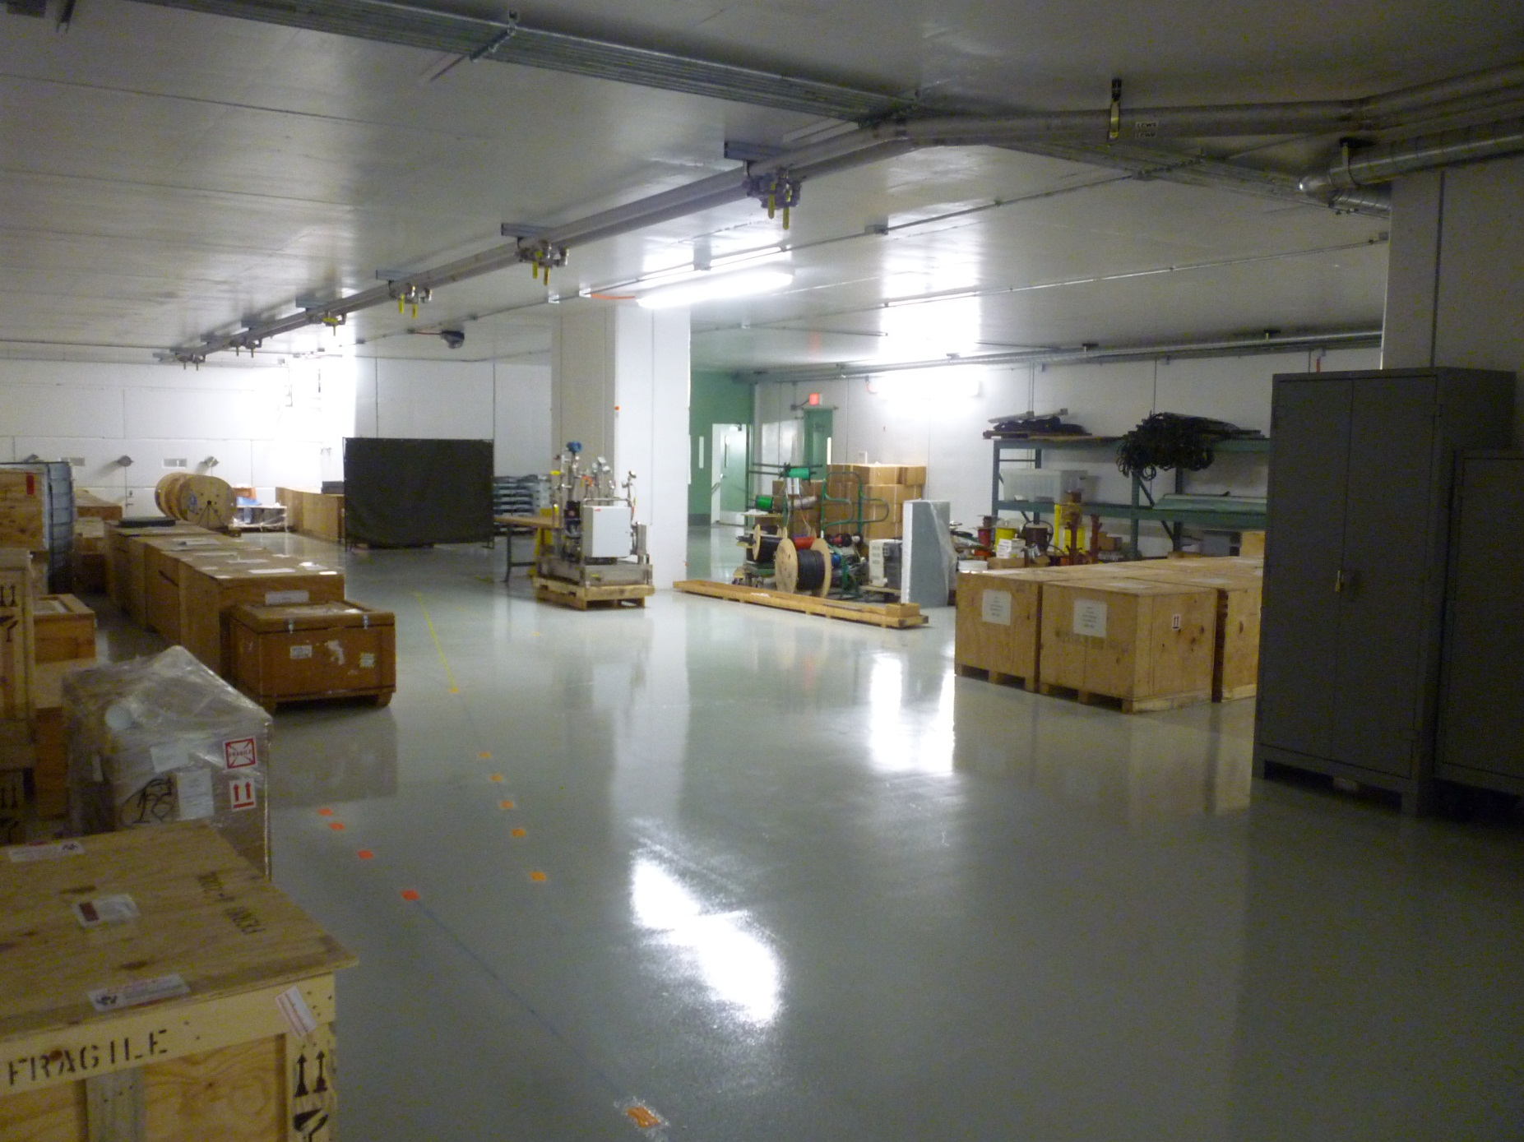
ASTA : Downstream part (now)
beam dump
IOTA

Slide 3
Experimental Proposals at IOTA Storage Ring
Integrable Optics Test (electrons and protons)
Optical Stochastic Cooling Experiment (electrons)
Space Charge Compensation in High Intensity Circular Accelerators (protons)
Electron Wave Function Size Measurements in IOTA Ring (electrons)

Slide 4
IOTA at a glance
Parameter | Value | Unit
Circumference | 38.7 | m
Bending dipole field | 0.7 | T
RF voltage | 50 | kV
Electron beam energy | < 150 | MeV
Number of electrons | 2 10⁹
Transv. emittance r.m.s. norm | 2 | π μm
Proton beam energy | 2.5 | MeV
Proton beam momentum | 70 | MeV/c
Number of protons | 8 10¹⁰
Transv. emittance r.m.s. norm | 0.2 | π μm

Slide 5
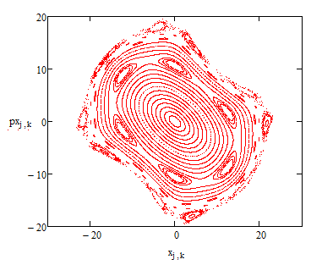
Integrable Optics Test: Motivation
The main feature of all present accelerators – linear focusing lattice: particles have nearly identical betatron frequencies (tunes) by design.
Hamiltonian has explicit time dependence
All nonlinearities (both magnet imperfections and specially introduced) are perturbations and make single particle motion unstable due to resonant conditions
Stability depends on initial conditions
Regular trajectories for small amplitudes
Resonant islands (for larger amplitudes)
Chaos and loss of stability (for large amplitudes)

Slide 6
Consequences of linear focusing
Single-particle losses
Losses are result of unstable particle dynamics under perturbations (magnetic fields, space-charge forces, beam-beam forces)
All high intensity accelerators are beam-power-limited by losses (rings, cyclotrons, linacs)
Instabilities
Instabilities are intrinsic to the way we build accelerators now – linear optics

Slide 7
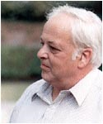
Landau damping
Report at HEAC 1971
Landau damping – the beam’s “immune system”. It is related to the spread of betatron oscillation frequencies. The larger the spread, the more stable the beam is against collective instabilities.
The spread is achieved by adding special magnets -- octupoles
External damping (feed-back) system – presently the most commonly used mechanism to keep the beam stable.

Slide 8
Does Focusing Need to be Linear?
Are there “magic” nonlinearities with zero resonance strength?
The answer is – yes (we call them “integrable”)
Search for a lattice design that is strongly nonlinear yet stable
Orlov (1963) -- attempt failed (non-integrable)
McMillan (1967) – first successfull 1-D example
Perevedentsev, Danilov (1990 - 1995) – several 1D, 2D examples
Cary and colleagues (1994) – approximate integrability
Our goal (with IOTA) is to create practical nonlinear accelerator focusing systems with a large frequency spread and stable particle motion.
Danilov, Nagaitsev, Phys. Rev. ST Accel. Beams 13, 084002 (2010)

Slide 9
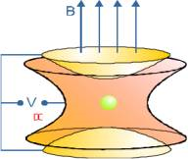
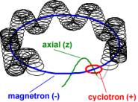
Ideal Penning trap
An ideal Penning trap is a LINEAR and integrable system
It is a harmonic 3-d oscillator

Slide 10
Kepler problem – a nonlinear integrable system
Kepler problem:
In spherical coordinates:
Example of this system: the Solar system

Slide 11
A roadmap to high-intensity rings
Develop the theoretical basis of beam instabilities with strong space charge in a highly-nonlinear focusing system
What betatron frequency spread is required to make the beam stable?
Develop highly-nonlinear focusing lattices and elements with reduced chaos
Reduce chaos in beam-beam effects
Ultimately, develop accelerators for super-high beam intensity
Self-consistent or compensated space-charge
Strong non-linearity (for Landau damping) to suppress instabilities
Stable particle motion at large amplitudes

Slide 12
Integrable Optics Collaboration
FNAL, SNS, JINR, Budker INP, BNL, JAI, U. of Colorado, TechX, UMD, U. of Chicago
Internal review (Feb 2012):
https://indico.fnal.gov/conferenceDisplay.py?confId=5151

Slide 13
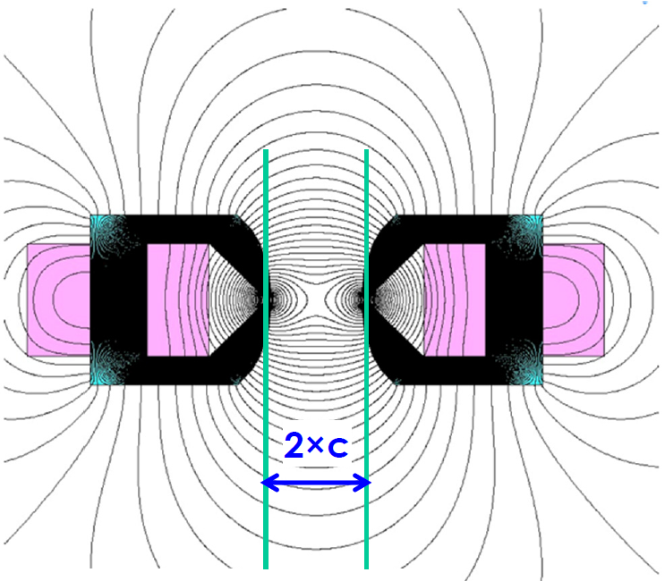
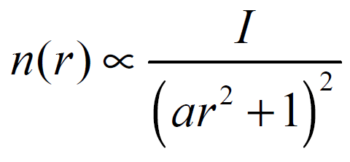
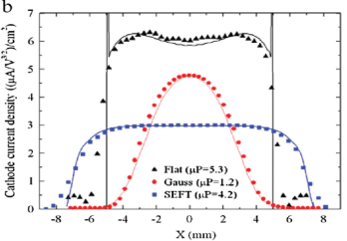
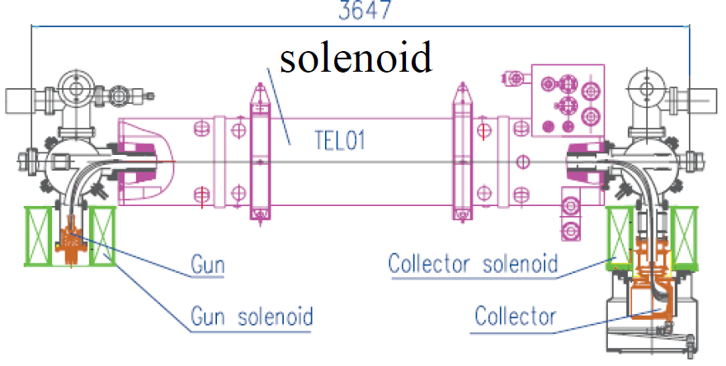
Elements of Integrable Optics Concept
“Integrable Optics” solutions:
Make motion regular, limited and long-term stable (usually involves additional “integrals of motion”)
Can be Laplacian (with special magnets, no extra charge density involved)
Or non-Laplacian (with externally created charge –e.g. special e-lens E(r) ~r/(1+r^2) – “McMillan type”
Both types will be tested in IOTA

Slide 14
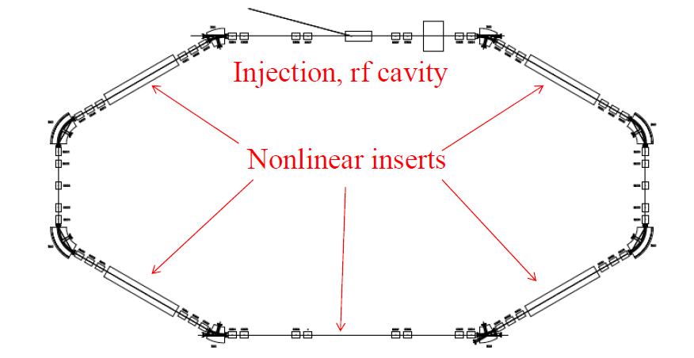
Integrable Optics at IOTA
Main goals for studies with pencil electron beam:
Demonstrate a large tune spread of ~1 (with 4 lenses) without degradation of dynamic aperture ( minimum 0.25 )
Quantify effects of a non-ideal lens and develop a practical lens (m- or e-lens)

Slide 15
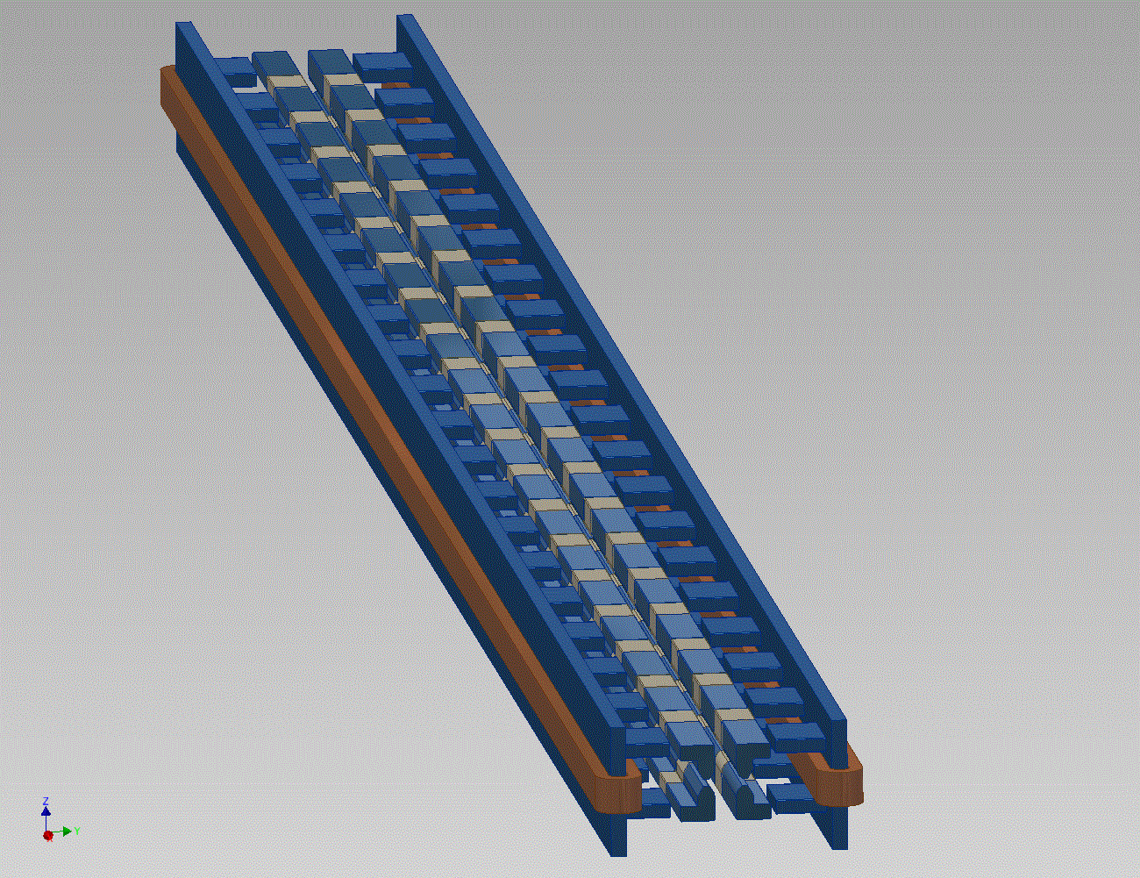
SBIR Phase I Grant: Radiabeam Technologies
Concept: 2-m long
nonlinear magnet

Slide 16
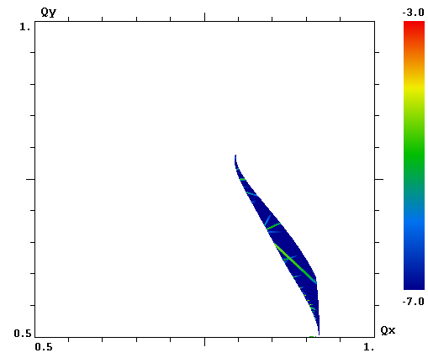
Ideal case: single nonlinear lens
A single 2-m long nonlinear lens creates a tune spread of ~0.25.
FMA, fractional tunes
1.0
Large amplitudes
ν_{y}
Small amplitudes
(0.91, 0.59)
0.5
0.5
ν_{x}
1.0

Slide 17
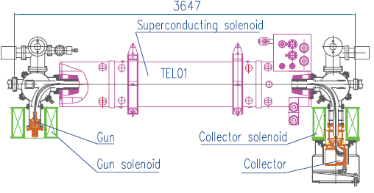
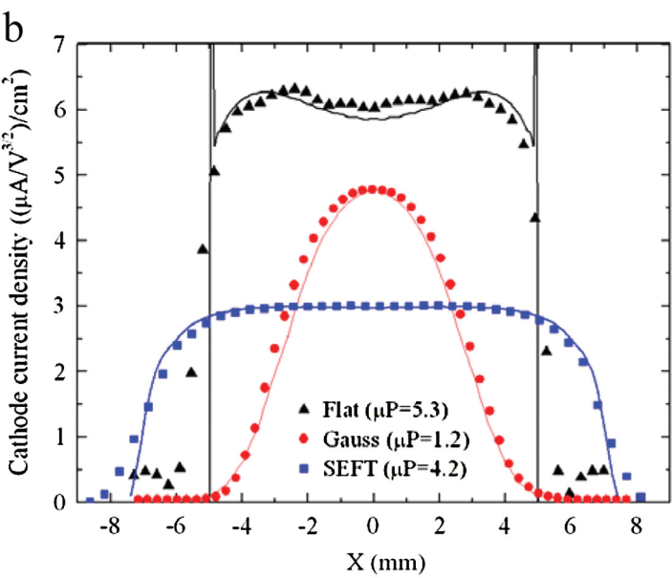
Experiments with electron lens
solenoid
150 MeV beam
Example: Tevatron electron lens
5-kG, ~1-m long solenoid
Electron beam: ~0.5 A, ~5 keV, ~1 mm radius
Electron lens
current density:

Slide 18
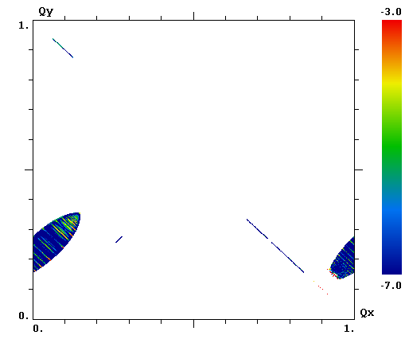
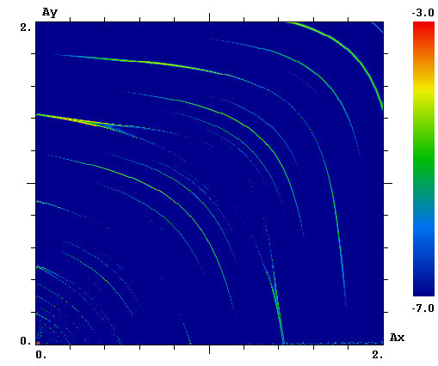
Practical McMillan-type round electron lens
e-lens (1 m long) is represented by 50 thin slices. Electron beam radius is 1 mm. The total lens strength (tune shift) is 0.3
FMA analysis
All excited resonances have the form k ∙ (ν_{x} + ν_{y}) = m
They do not cross each other, so there are no stochastic layers and diffusion

Slide 19
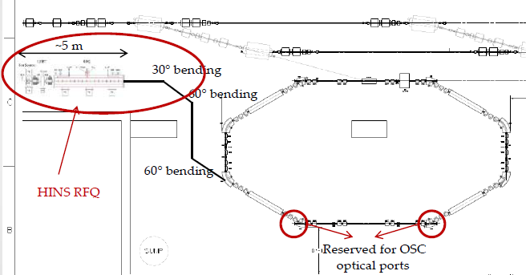
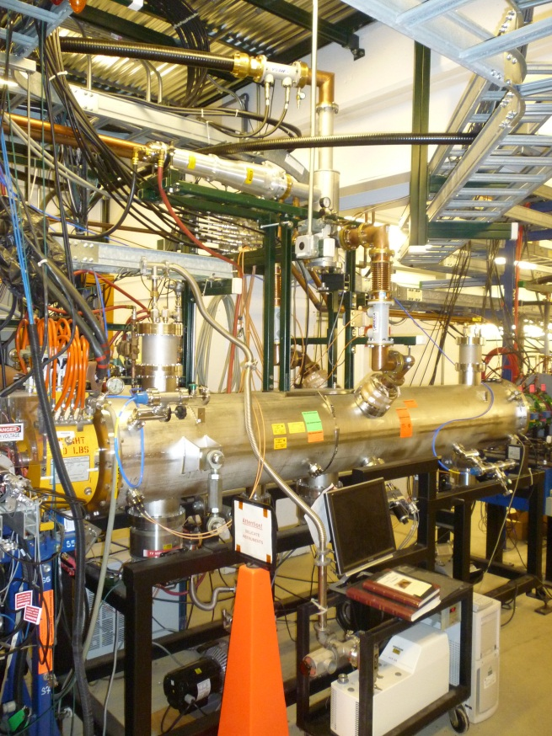
Space Charge Compensation:
Bringing Protons to IOTA
2.5 MeV RFQ HINS
Allows tests of Integrable Optics with protons and realistic Space-Charge beam dynamics studies
Allows Space-charge compensation experiments

Slide 20
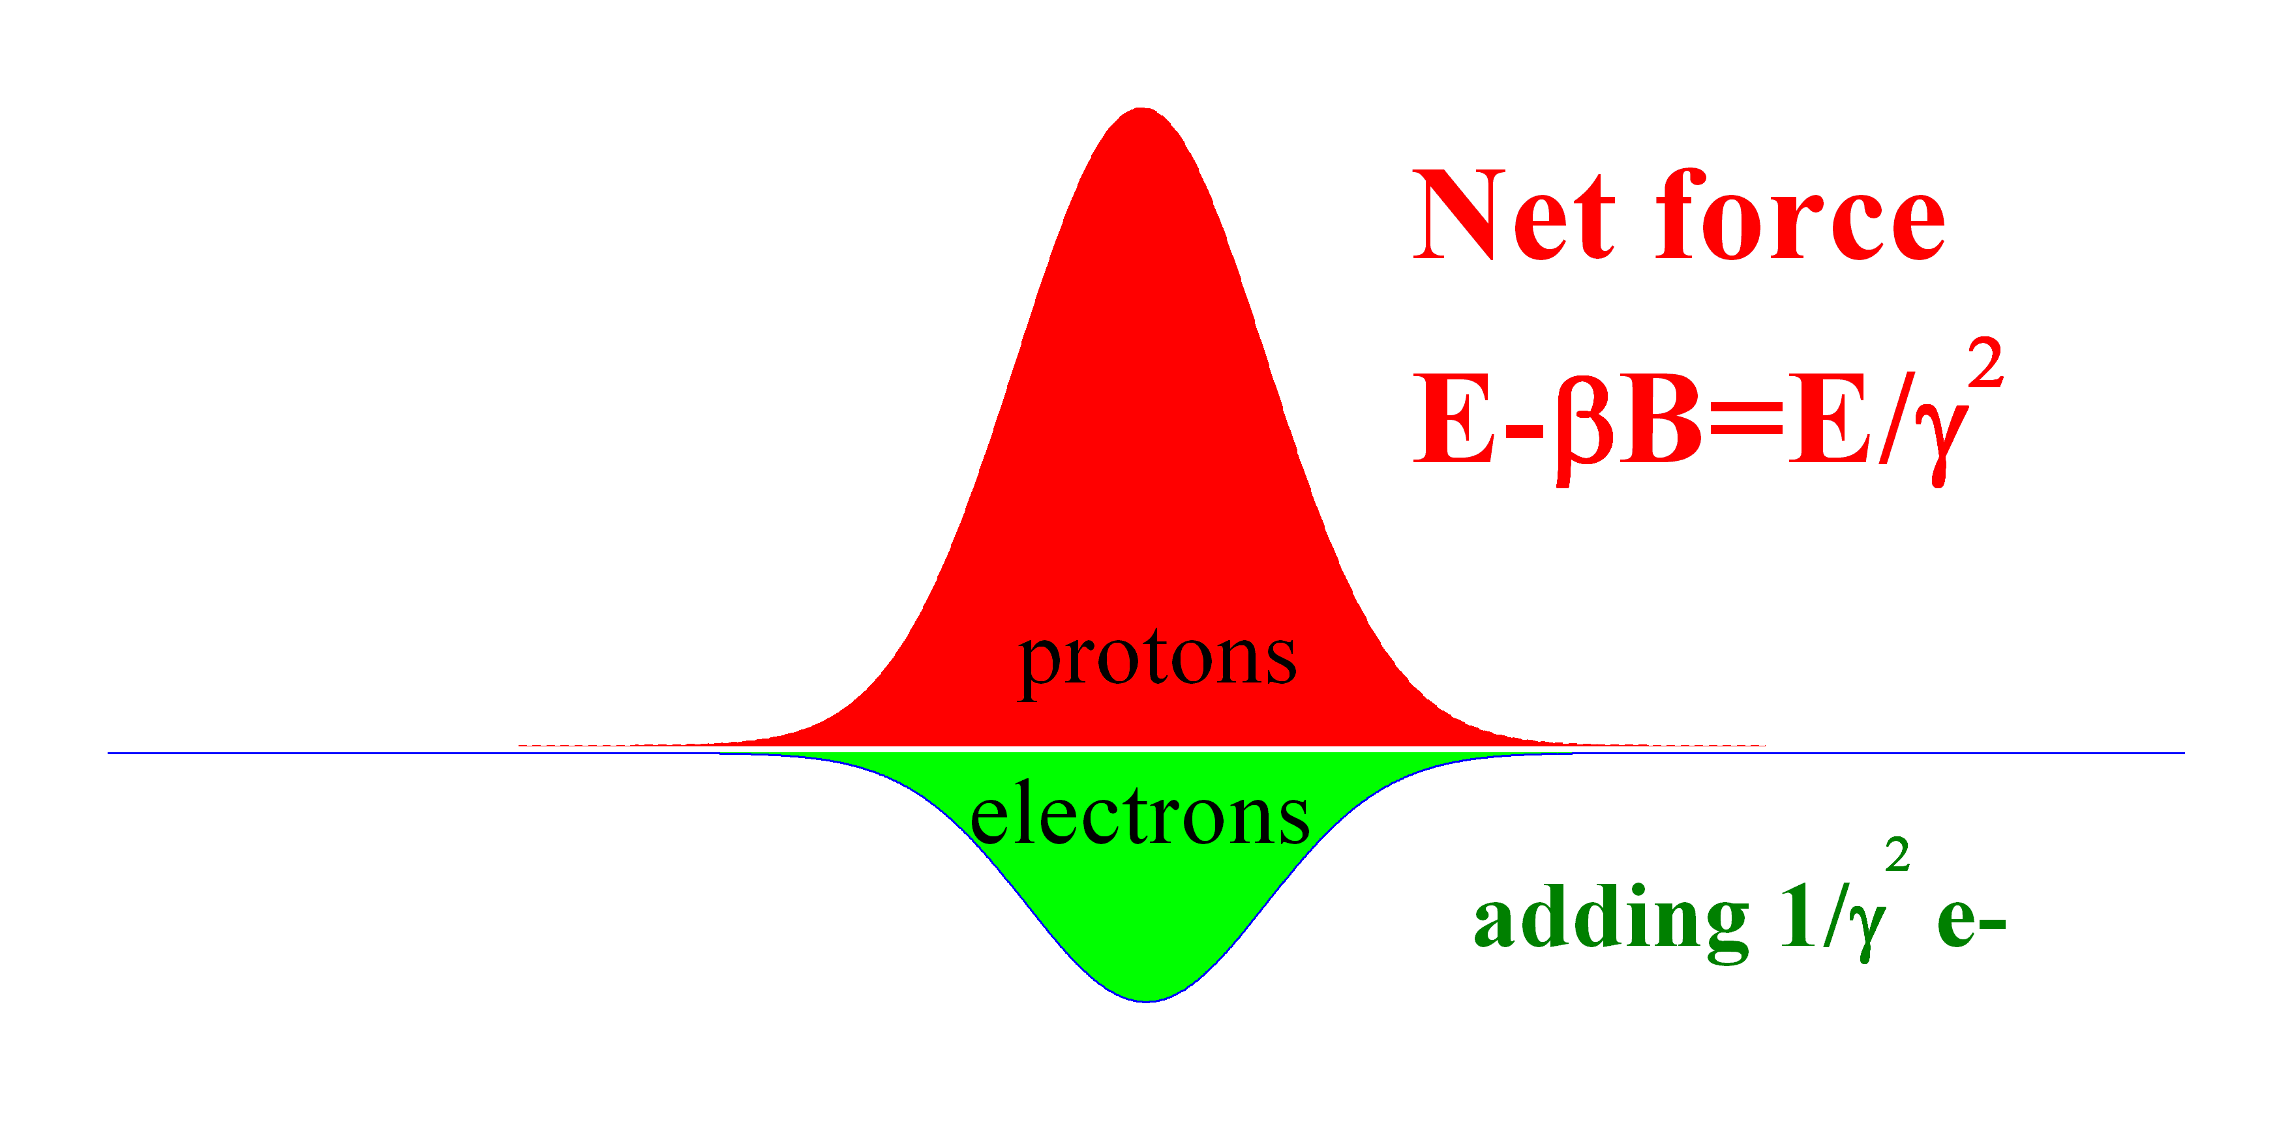
Space Charge Forces & Compensation
Z, beam
direction
B=βE
r, across the beam

Slide 21
Space-Charge Compensation in Circular Accelerators
Goal:
Experimental demonstration of the space-charge compensation technique with electron columns/electron lenses at dQ_sc >1
Collaboration Team:
Fermilab (M.Chung, V.Shiltsev, et al)
Why ASTA:
Need 2.5 MeV high-current protons and IOTA – flexible lattice storage ring
Relevant accelerators:
All current and future high intensity proton rings (Booster, MI, all LHC injectors, MC rings, etc)

Slide 22
Optical Stochastic Cooling Experiment
Goal:
Experimental demonstration of the optical stochastic cooling technique (1st – no optical amplifier, then with OPA)
Why ASTA:
Need IOTA – low energy (150 MeV – minimal synchrotron radiation damping) flexible lattice e- storage ring
Motivation:
Cooling for high energy accelerators (e.g. LHC, MC)

Slide 23
Optical Stochastic Cooling
Suggested by Zolotorev, Zholents, and Mikhailichenko (1994)
OSC obeys the same principles as the microwave stochastic cooling, but exploits the superior band-width of optical amplifiers, ~10¹⁴ Hz
Pick-up and kicker must work in the optical range and support the same band-width as the amplifier
Microwave pickups can not be scaled to µm
Undulators were suggested
Initial experiments can be done without an amplifier but eventually we will need state-of-art optical amplifier
High power
Low delay

Slide 24
Principles of OSC

Slide 25
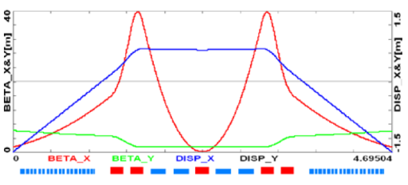
OSC experimental set-up (λ = 2 µm)
IOTA
Beam by-pass delay: ~4 mm

Slide 26
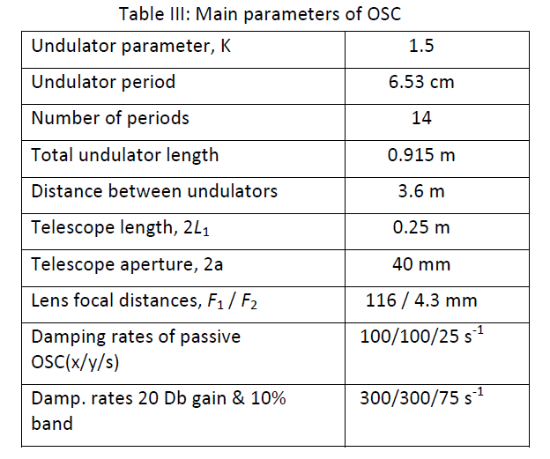
Main Parameters of IOTA OSC experiment
Natural SR
damping rate:
~2 s⁻¹

Slide 27
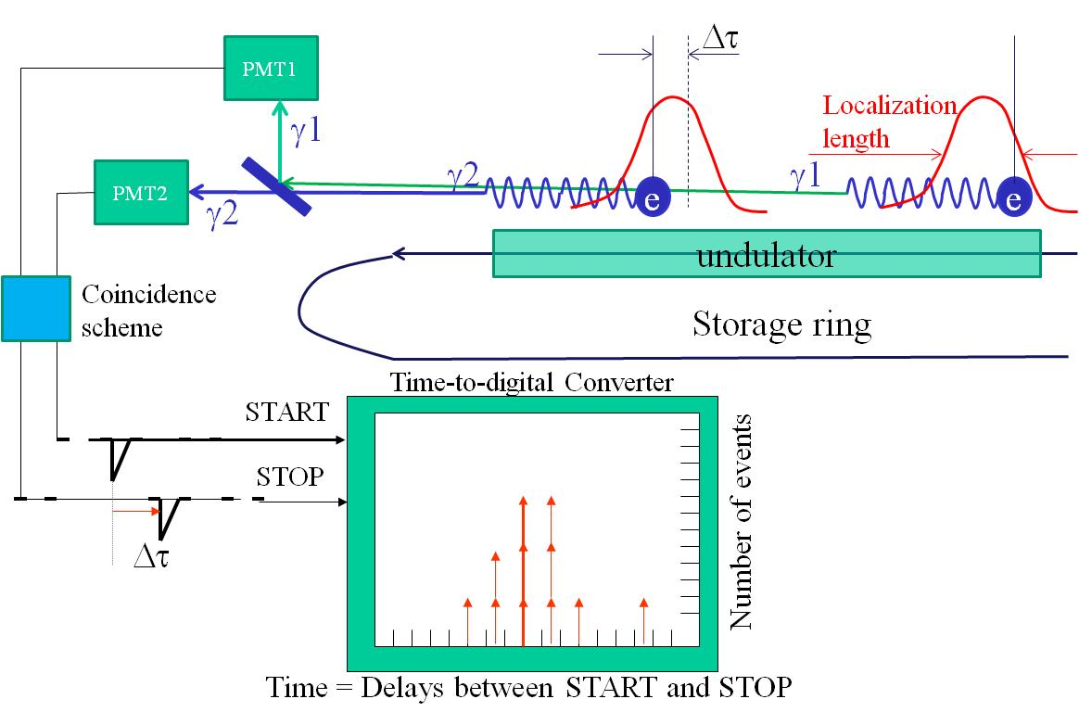
Electron Wave Function Size Measurements
Collaboration: S. Nagaitsev, V. Danilov (SNS) and N. Vinokurov (Budker INP)
Initial experiments at VEPP-3 (1990-s)
Unfortunately, the photomultipliers were slow – their response time was around 160 ps. The signal time difference from two photomultipliers was well within this number, therefore it was concluded that the wave function size is much shorter than that resolution.
Hanbury Brown – Twiss Interferometer

Slide 28
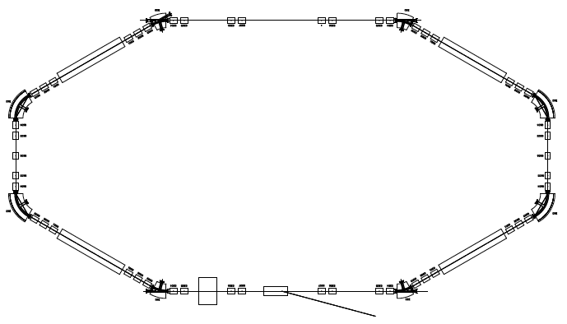
Proposed experimental scheme
photons in
visible range
detector
electronics
undulator
IOTA
single circulating electron
Having well-defined initial conditions and time structure, the radiation of a single electron may be a “standard candle” source for various kinds of quantum optics experiments with the high-order field correlation function. The experimental and theoretical investigation of the stationary state of the electron in a storage ring is useful for the development of non-perturbative methods of quantum electrodynamics, and, in general, the foundations of the quantum theory.

Slide 29
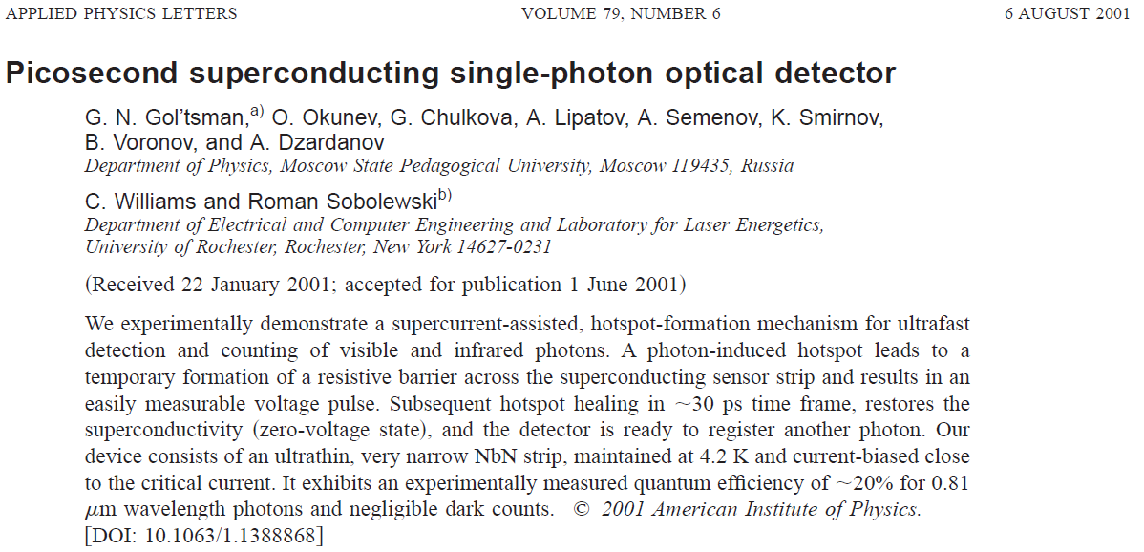
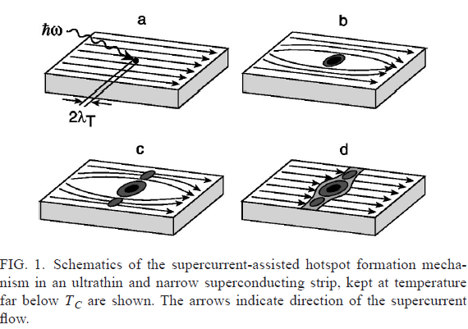

Slide 30
Summary
There are now 4 IOTA ring experiment proposals.
IOTA goals are well aligned with HEP investments in Intensity and Energy Frontiers
IOTA (and experiments) is a great project for post-docs and/or graduate students
Interest from U of Chicago, U of Colorado, UMD
Unique opportunity for US PAS students and for FNAL-sponsored internships.

