Slide 1
SUNSTAR: Sub-mm UNdulator test at the Advanced Superconducting Test AcceleratoR
July, 24th 2013
ASTA Users’ Meeting, Fermilab, IL
A. Garraud¹, B. A. Peterson², J. C. Thangaraj³,
M. G. Allen², D. P. Arnold¹
¹Dept. Electrical & Computer Engineering, University of Florida
²School of Electrical and Computer Engineering, Georgia Institute of Technology
³Accelerator Physics Center, Fermilab

Slide 2
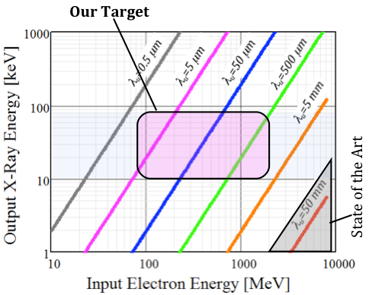
DARPA AXiS Project
Develop X-ray source technology
that will enable high contrast
when imaging soft biological tissues
(low-Z materials: C-H-O-N)
↓
Realize a compact X-ray source that is
mono-energetic, directional and tunable

Slide 3
Outline
Magnetic mini undulator
ASTA beam advantages
Considered experimentations
Expected outcome
Demonstrate the generation of monochromatic photons with a mini undulator

Slide 4
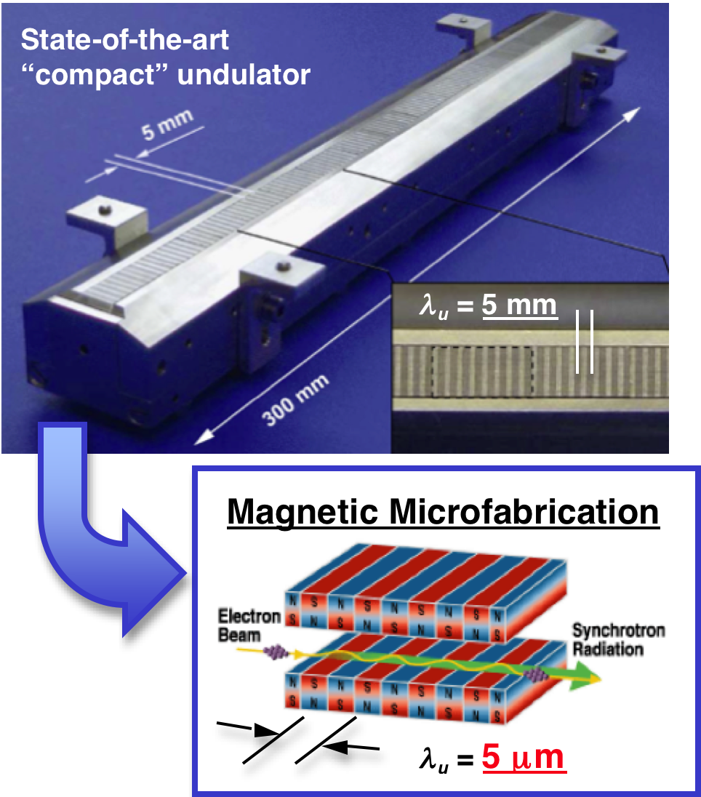
Overview of Magnetic Undulators
State-of-the-art undulator
Period ~ 5-50 mm
Peak field: B₀ ~ 0.1-1 T
Large total system size
Manual assembly
Micromachined undulator
Period ~ 5-500 µm
Peak field: B₀ > 0.2 T
Hard X-rays at lower beam energies
Microfabrication advantages
up to 1000x
reduction

Slide 5
Laser-Cut Magnets Process Overview
Bulk SmCo ~300 µm thick
Laser-cut into comb structures
Magnetize out-of-plane
Assemble and polish
Laser-machined SmCo comb array
(400-µm period)
Assembled magnetic array

Slide 6
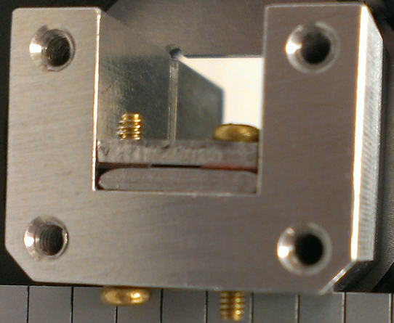
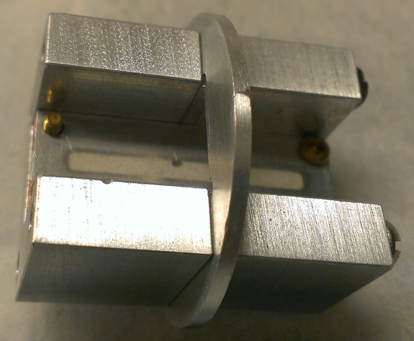
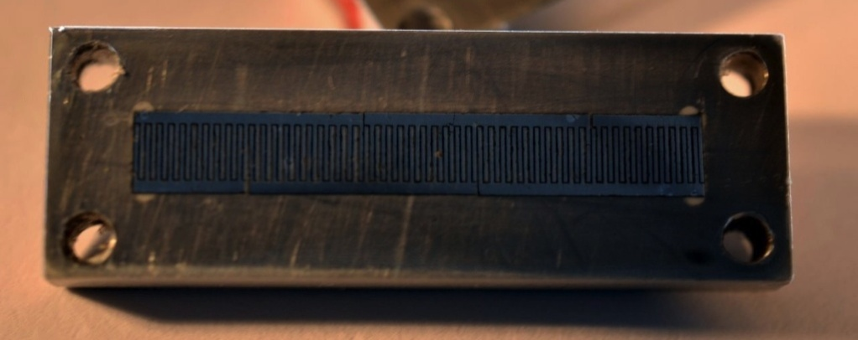
Assembled Prototype Undulator
200 – 400 µm airgap (Cu spacer shims)
400-µm period
20 mm × 2 mm active area
Easily disassembled / assembled
Tailored undulator holder
Longer undulators on the way
Assembly
views
26 mm
20 mm, 50 periods
2 mm
Laser-machined SmCo undulator array

Slide 7
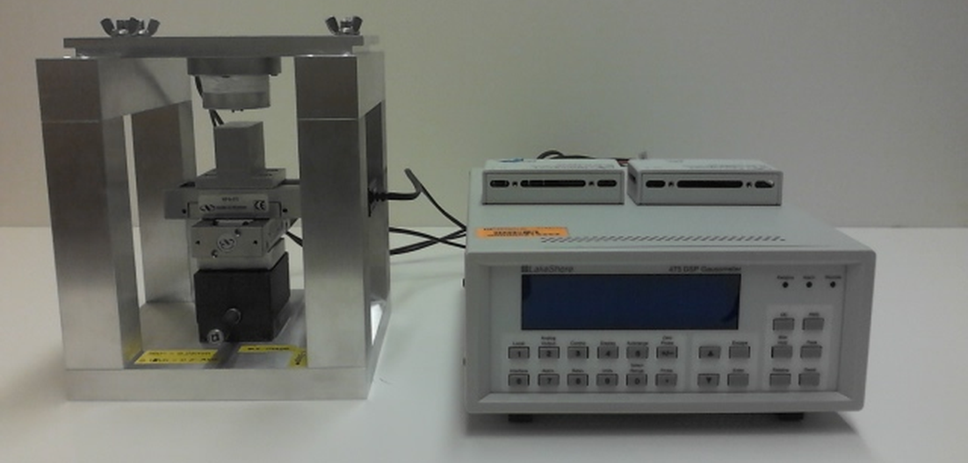
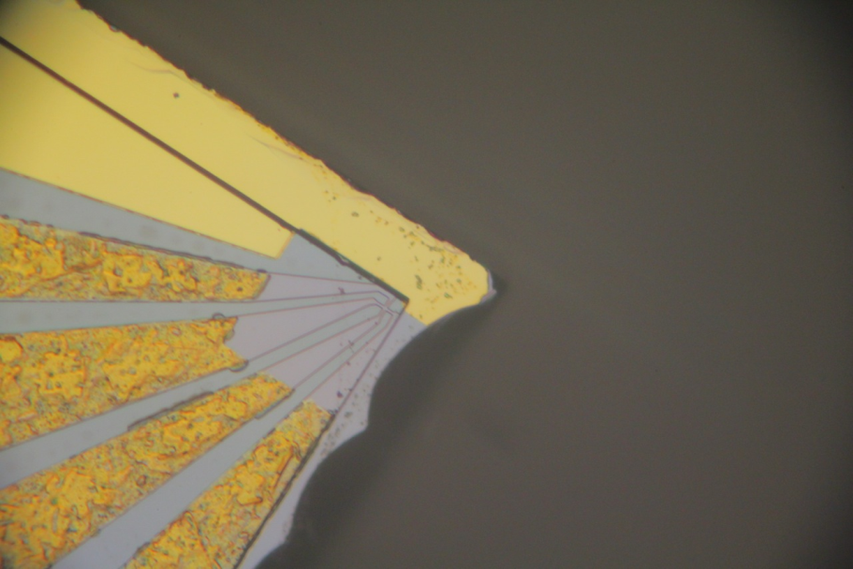
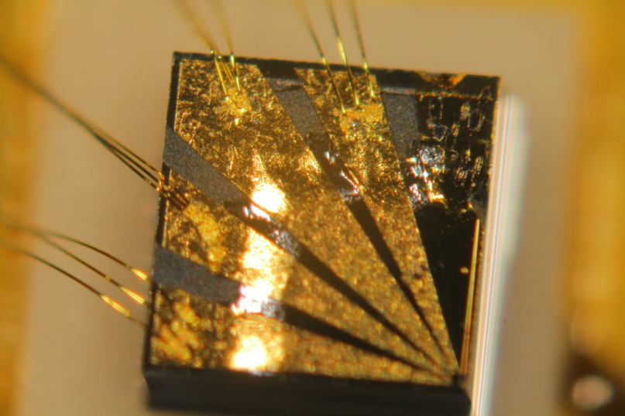
High-Resolution Magnetic Field Mapping
High-resolution Hall effect sensor (1 µm x 1 µm area)
3-axis stage with 100 nm step size (x, y axes)
Currently implementing automatic scan height control
Sensor module
1 µm x 1 µm
sensing area
Sample platform
x- y- and z-stages

Slide 8
Scanning Hall Probe Results
Example of single 400-µm-period magnetic array scans
y (mm)
B_{y} (T)
z (mm)
at ~100 µm scan height
B_{y} (T)
z (mm)

Slide 9
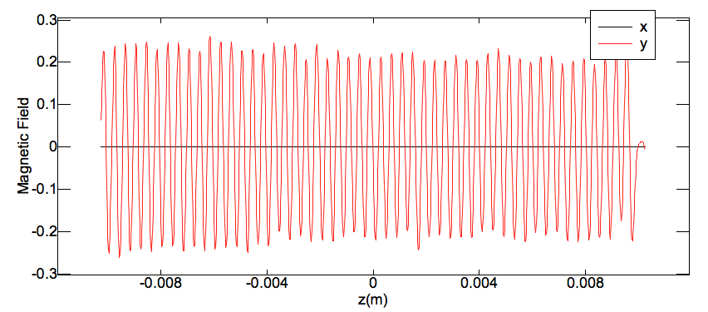
Scanning Hall Probe Results
Resulting field of a mini undulator (200 µm airgap)
B_{x}
B_{y}
B (T)
z (m)
On-axis B-field of a 400-µm period mini-undulator:
B₀ = 0.22 ± 0.02 T

Slide 10
Why ASTA Beam is the best place to test the mini undulator?
Low emittance
High quality of the beam
Flat beam generation
Compatible with the small airgap of the mini undulator
Expertise in flat beam generation with demonstrated experiments
High repetition rate
Will help in photon detection
Large range of beam energy and charge
Provides flexibility for experiments

Slide 11
Why the ASTA 50 MeV beam for SUNSTAR?
Enable 1st demonstration
of photons generation
with mini undulators technology

Slide 12
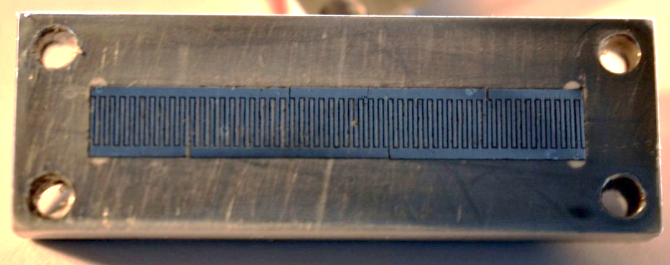
Planned Experimental Setup
Location of the mini-undulator
Beam dump
CAV1
CAV2
RTFB
X113
BC1
VUV detector
RTFB
Mini-undulator
Dipole
20 mm, 50 periods
e-
2 mm
e-
e-

Slide 13
Required Beam Parameters
Parameter | Value/Range | Units
Beam energy | 15, 50 | MeV
Bunch charge | 0.01 – 0.5 | nC
Bunch length | 3 | ps
Bunch repetition rate | 3 | MHz
Number of bunch/macropulse | 1 – 1000
Undulator airgap x / y directions | 2 / 0.2 | mm
Emittance ratio | 100 : 1
Estimation of 2 periods of 5 shifts each

Slide 14
Considered Experimentations
15 MeV e-beam (switch off cavity CAV2)
Alignment of the e-beam with the undulator axis
Beam position monitor + laser + corrector magnets upstream
Undulator mounted on an actuator
Expected wavelength: 220 nm (UV radiation)
Detectable by commercially available photodiode

Slide 15
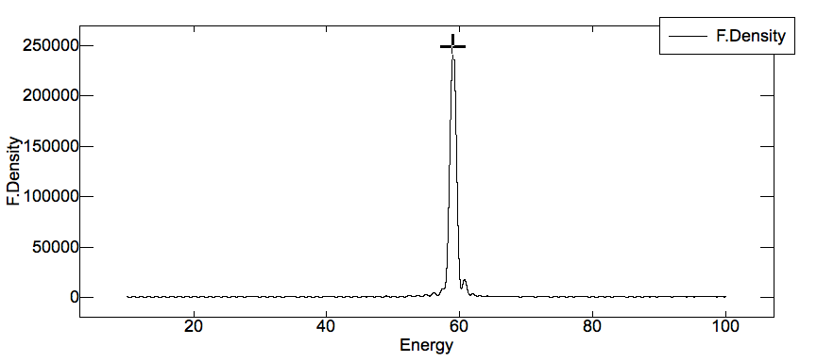
Considered Experimentations
2. 50 MeV e-beam (switch on cavity CAV2)
Expected wavelength: 20 nm (VUV radiation)
0.5 nC electron beam: ~ 10¹² photons/s
Simulated flux density [photons/(s.mm².0.1%BW)] vs. output energy [eV]

Slide 16
Summary
Sub-mm undulator and ASTA flat beams capabilities
2 periods of 5 shifts (estimated)
Unique experiment on the pathway to novel, compact light sources
Mini undulator (400 µm period)
reliable fabrication process
B-fields quantitatively characterized
More sub-mm undulators on the way
Halbach array (400 µm period)
micro undulator (50 µm period)

Slide 17
Acknowledgments
DARPA AXiS Project #N6601-11-1-4198
Pr. Philippe Piot (Fermilab/NIU) for clarifying the physics of flat-beam generation

Slide 18
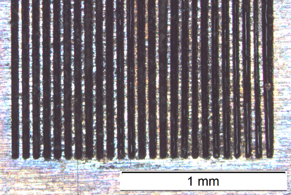
Future Magnetic Undulators from UF/GT
Halbach mini undulator
higher on-axis magnetic field
Micro undulator
magnetic period ~ 50 µm
selective magnetization process
Soft magnet magnetizing head (microscope view)
Patterned 5–µm–thick NdFeB film (magneto-optic image)

Slide 19
Selective magnetization process
Begin with unmagnetized electroplated Co₈₀Pt₂₀ or sputtered NdFeB film
Flood magnetize the film (high B-field)
Bring film in contact with magnetizing head Apply a lower reversal B-field
Magnetic patterns are formed based on the features of the magnetizing head

