Slide 1
Polarized Drell-Yan at PAX
Road towards Polarized Antiprotons
May 22, 2013 Frank Rathmann
(on behalf of the PAX collaborations)
FNAL, Batavia, USA

Slide 2
PAX – Overview
Contents of the talk:
Motivation (Why polarized antiprotons?)
Methods (What has been proposed?)
History (What has been done?)
Spin Filtering (How can it be achieved?)
FILTEX at TSR
PAX at COSY
PAX at AD
Future (What to do with it?)
HESR upgrade

Slide 3


Motivation
FAIR
PAC

Slide 4
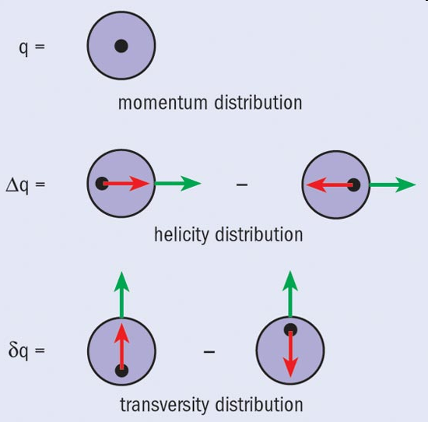
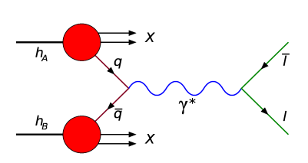
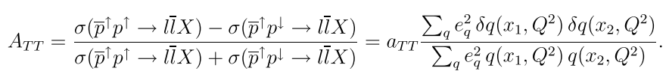
PAX – Motivation 1
Nucleon – spin-dependent distributions:
Transversity … remaining frontier of $k_{⊥}$-independent structure f´ons
Transversely polarized quarks
in
transversely polarized nucleon
Chiral-odd → difficult to access
PAX … valence quark region
Golden channel: Double polarized proton-antiproton DY-production

Slide 5
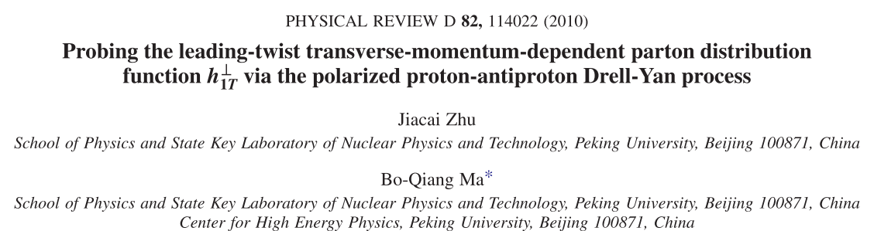
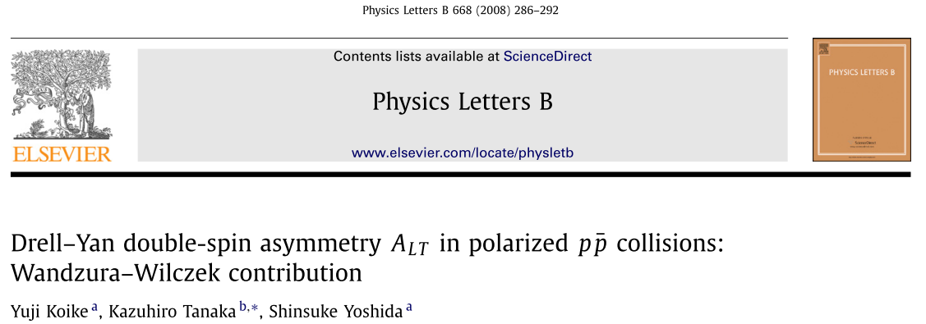
PAX – Motivation 1
Nucleon – spin-dependent distributions:
Further insight into partonic nucleon structure in Drell-Yan

Slide 6
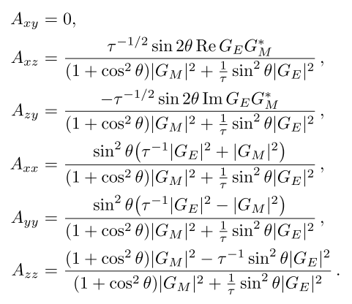
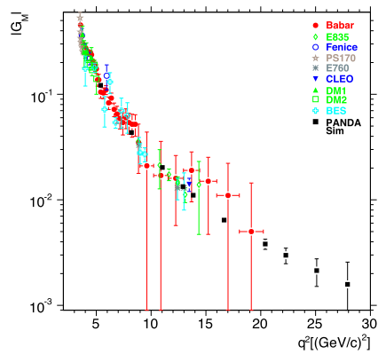
PAX – Motivation 2
Nucleon – electromagnetic form factors:
Nucleon form factors in time-like region (from $\overline{p}p→l^{+}l^{−}$)
Double spin asymmetries (Buttimore, Jenkins, EPJ A 31 (2007):
- moduli:
- relative phases
of time-like FFs

Slide 7
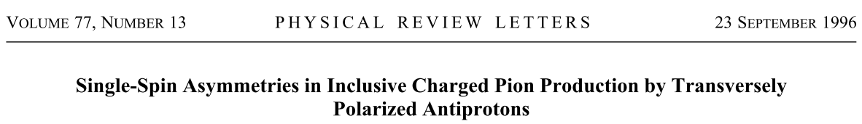


Methods
$\sim 5 x 105 p$/ spill ($20$s)

Slide 8
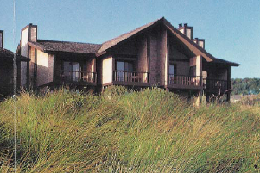
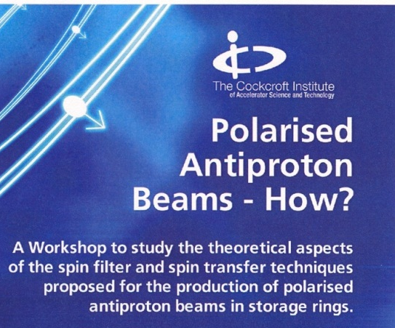
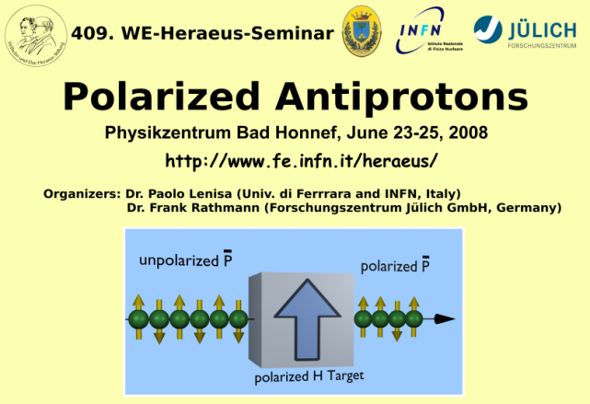
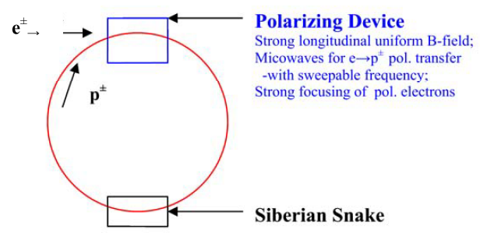
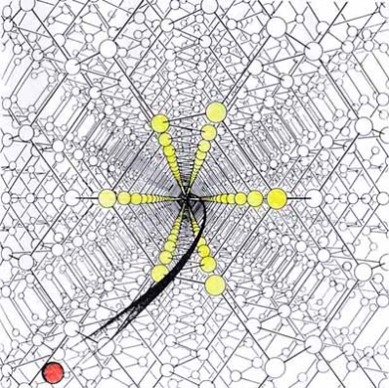
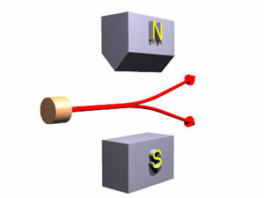
PAX – Polarization Methods 0
Ideas to polarize antiprotons:
Workshops: „Bodega-Bay“ (1985), „Cockroft“ (2007), „WEH“ (2008)
Antihyperon decay
Dynamic-Nuclear-Polarization in flight
Spin-splitter (repeated „Stern-Gerlach
kicks) → spatial separation of spin-states
Channeling in (bent) crystals
(…)

Slide 9
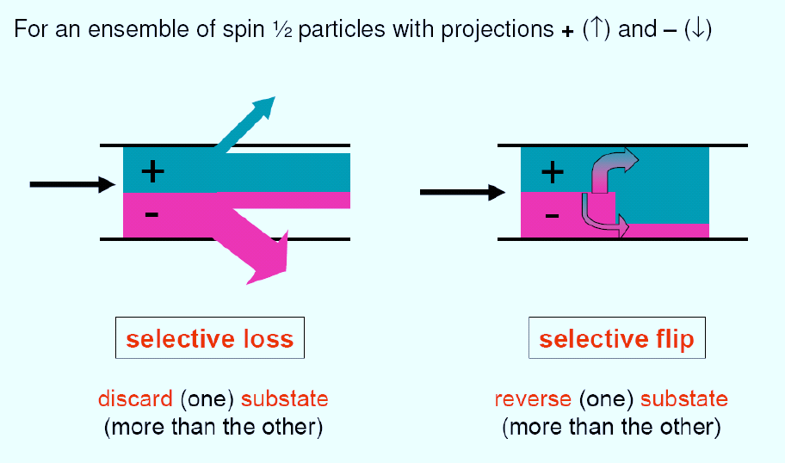
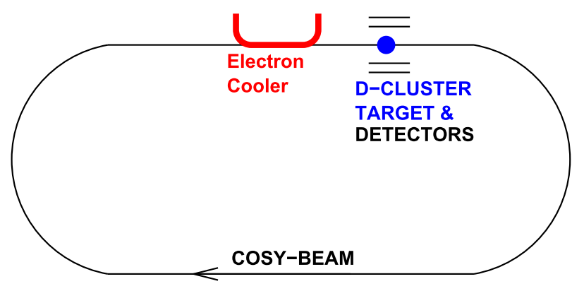
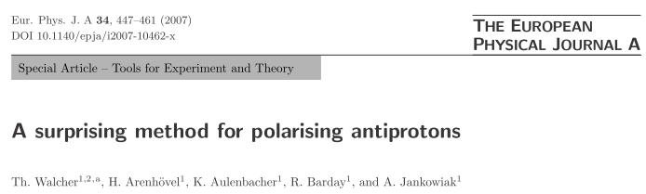

PAX – Polarization Methods 1
Selective flip:
Reverse (one) substate (more than the other)
Polarized
Positrons
Polarization
Analysis
Advantage:
No intensity loss
But: not feasible!
Circulating
Antiproton Beam
Th. Walcher et al.
$σ\sim {10}^{13}$b !!

Slide 10
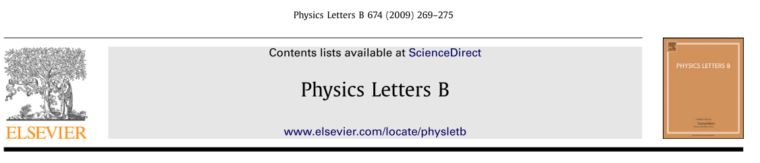

PAX – Polarization Methods 1
Selective flip:
Examination of method: de-polarization experiment
Test at
COSY
Un-Polarized
Electrons
(Cooler)
De-Polarization
Analysis
Advantage:
No intensity loss
But: not feasible!
Circulating polarized
Proton Beam
D. Oellers et al.
No effect: $σ ≪ 1013$ b !!

Slide 11
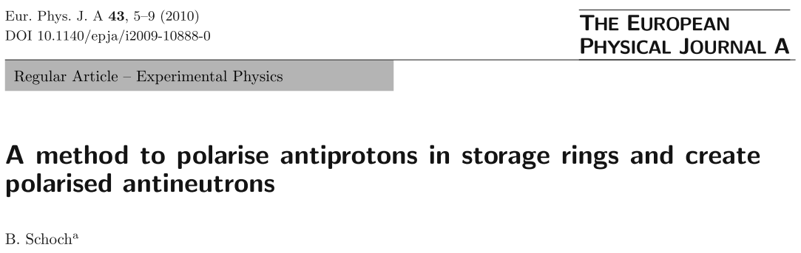
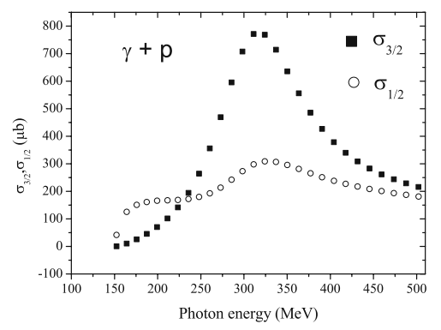
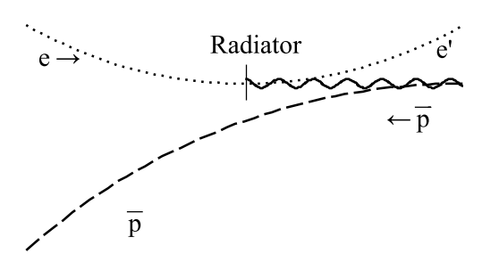
PAX – Polarization Methods 2
Selective loss: spin dependent reaction
$\overline{p}$-polarization build-up via $γp→π^{−}n$
B.Schoch
Circularly polarized photons

Slide 12
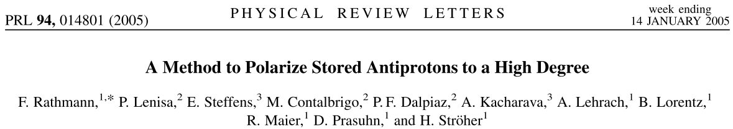
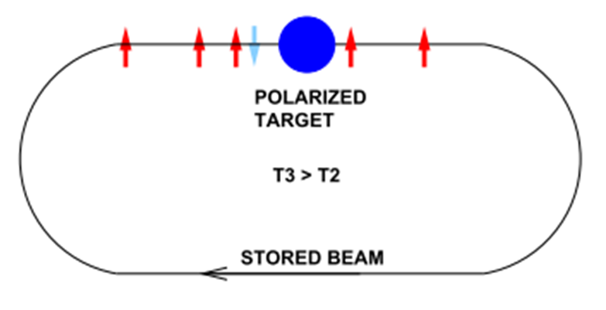
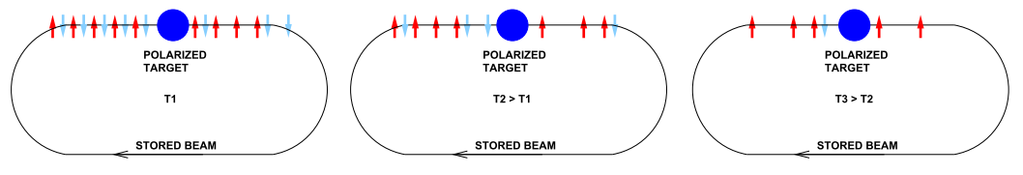
PAX – Polarization Methods 3
Selective loss: spin filtering
Repeated interaction of a stored beam with a polarized target
SF-principle:

Slide 13
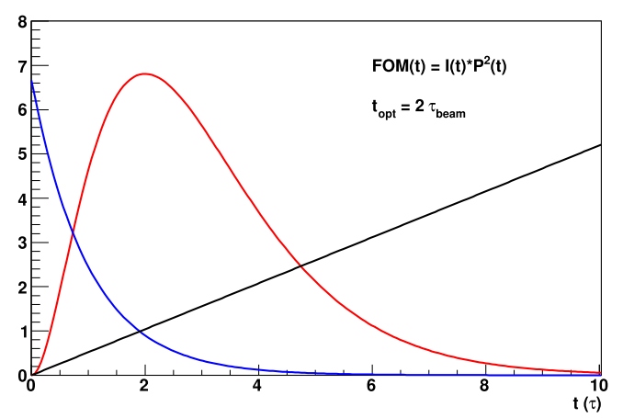
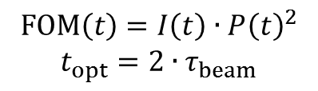
PAX – Polarization Methods 3
Spin filtering:
Loss of beam intensity – Figure-of-Merit (FOM)
FOM
$$FOM\left(t\right)=I\left(t\right)∙{P\left(t\right)}^{2}$$
$$t_{opt}=2∙τ_{beam}$$
Disadvantage:
Intensity loss
Filtering for
2 beam lifetimes
But: method works
Polarization
Intensity

Slide 14
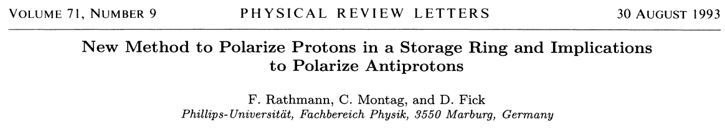
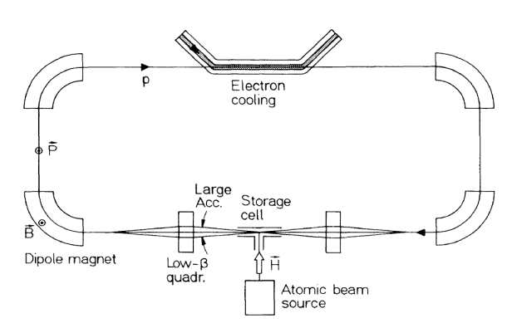
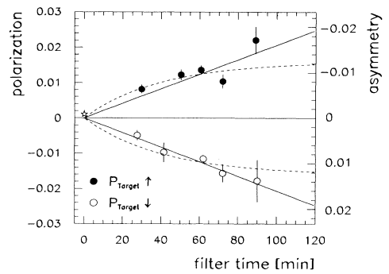

PAX – Polarization Methods 3
Spin filtering:
SF works for protons (FILTEX)
(…)
TSR (MPI-HD)
Pol-build-up rate $\sim 1.3 \%$per h
ABS & SC

Slide 15
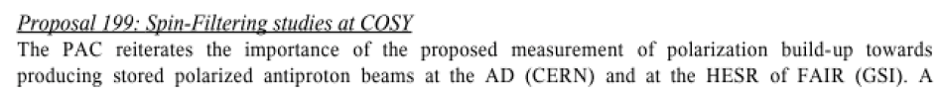

PAX at COSY
COSY
PAC
CERN
SPSC

Slide 16
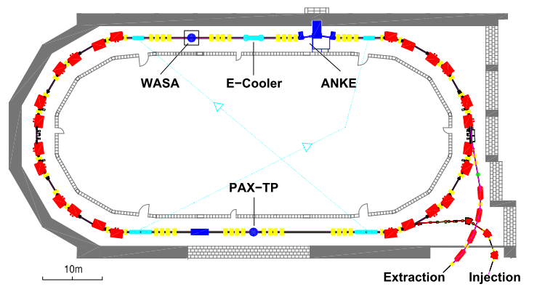
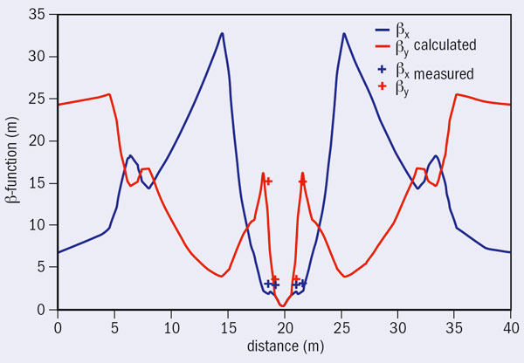
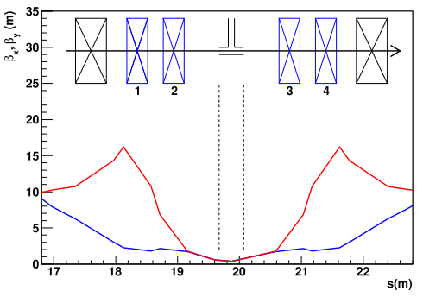
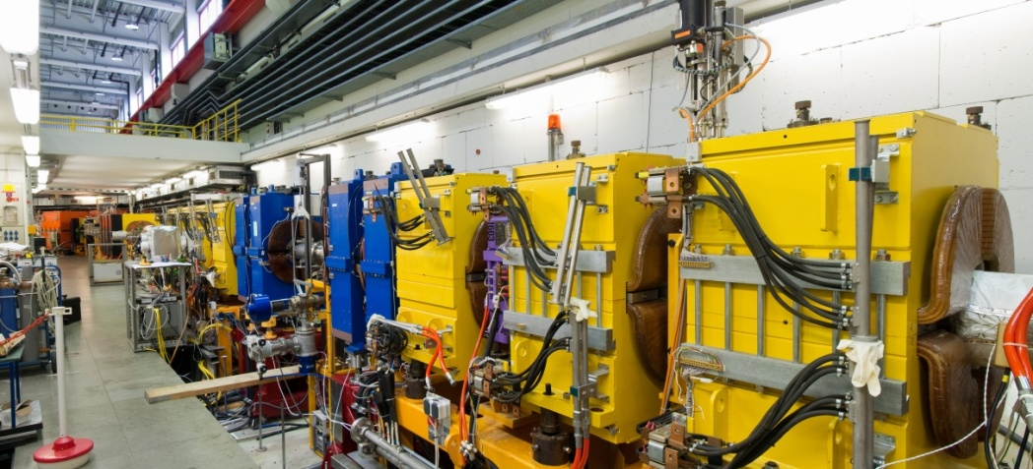
PAX – at COSY
Set-up for proton spin filtering:
Dedicated interaction point („low-ß“ section)

Slide 17
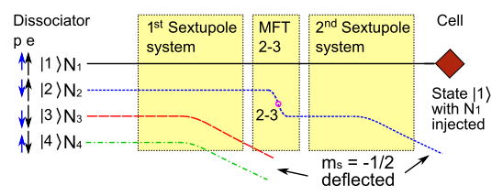
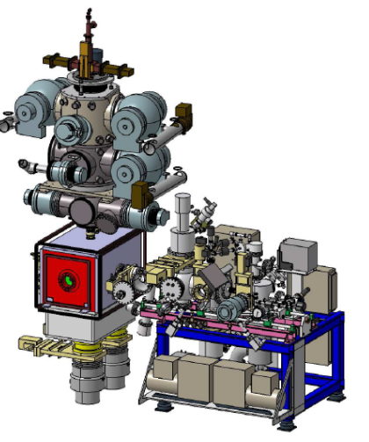
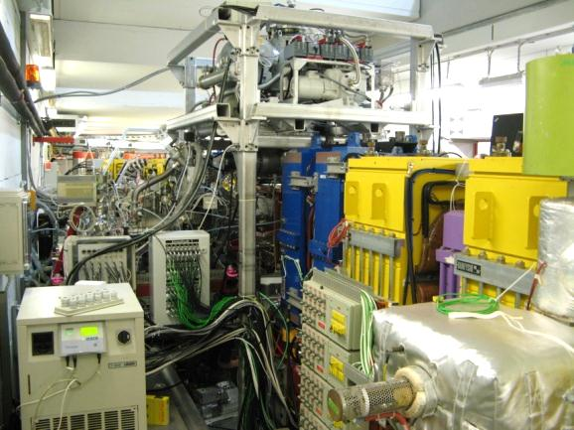
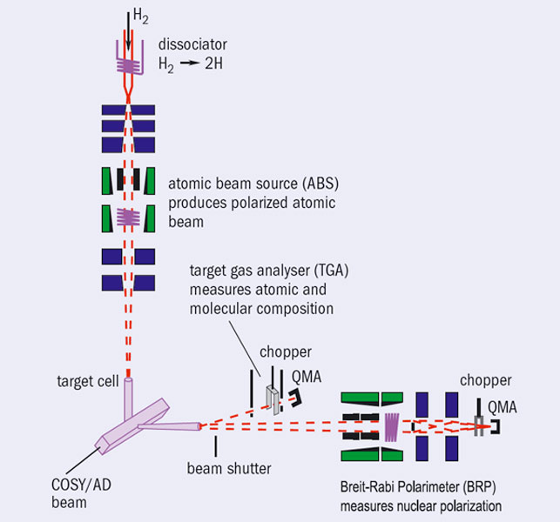
PAX – at COSY
Technical details of the set-up:
Polarized internal target (PIT) with ABS and BRP
ABS (operation) principle: Schematic set-up: Installation in COSY:
ABS
BRP

Slide 18
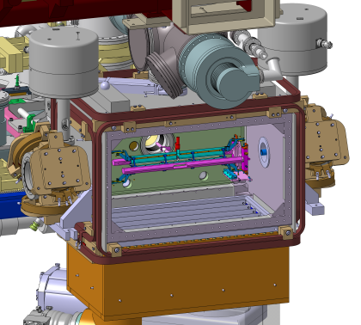
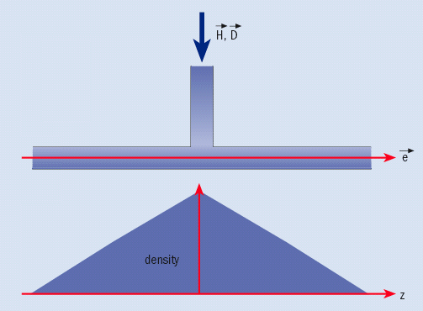
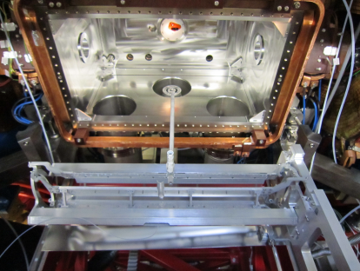
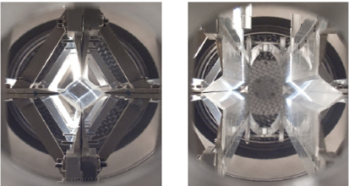
PAX – at COSY
Technical details of the set-up:
PAX target chamber and openable Storage Cell (SC)
Vacuum chamber:
Storage cell:
density
profile
SC
needed
for AD,
not for
COSY
closed
open

Slide 19
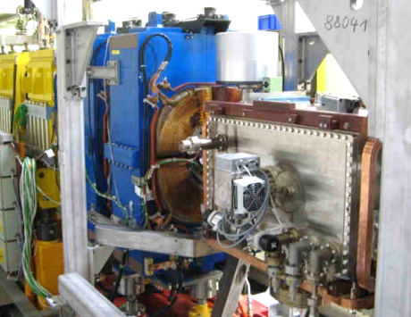
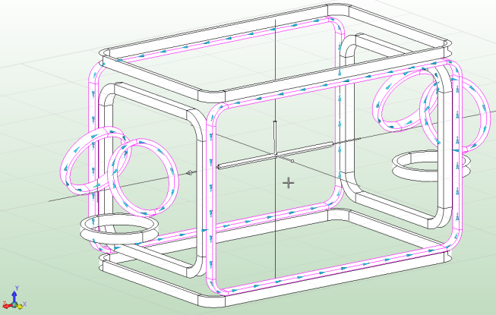
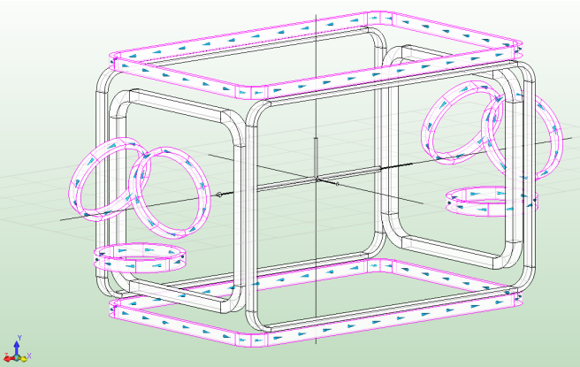
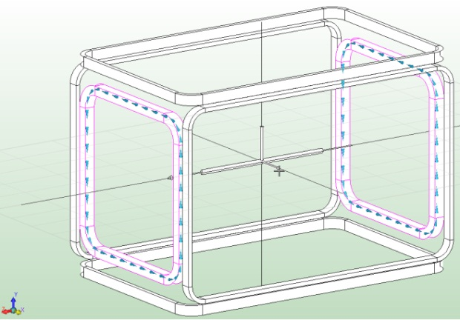
PAX – at COSY
Technical details of the set-up:
Magnetic holding field system for the PIT
Coils
Coils
x- y- s-direction

Slide 20
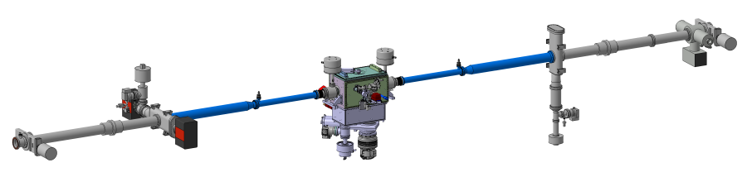
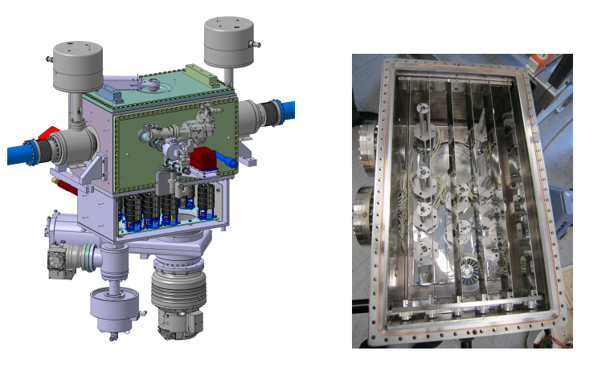
PAX – at COSY
Technical details of the set-up:
Vacuum installation at/in PAX target chamber
NEG pumping
system along
beam line
NEG
below
scattering
chamber
(+ heat shield)

Slide 21
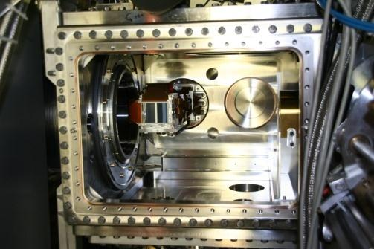
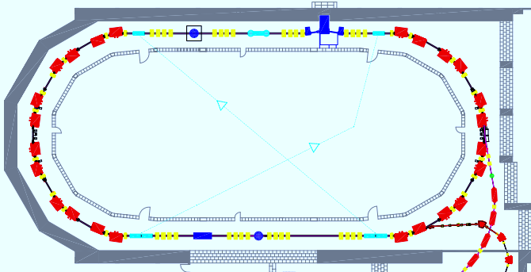


PAX – at COSY
Spin filtering measurement:
Polarization build-up at PAX → measurement at ANKE
Principle:
Set-up:
STT
Spin flips
Polarization analysis at ANKE
p … p
Spin filtering at PAX
pd elastic scattering:

Slide 22

PAX – at COSY
Spin filtering measurement:
Spin filtering cycle (schematically)
PAX
ANKE
PAX
ANKE

Slide 23


PAX – at COSY
Spin filtering measurement:
Spin filtering cycle (as used in COSY experiment)
Trigger rate
COSY beam intensity
2
spin
flips
Spin filtering PAX (16000 s)
Polarization analysis ANKE (2500 s)
Pressure at
filter target
(relative)
Pressure at
analysis target
(relative)

Slide 24


PAX – at COSY
Spin filtering measurement:
Experiment #199.2 – August 2011 → October 9, 2011
Machine development ($3$weeks)
    Beam lifetime, intensity, spin flip
Data taking ($5$weeks)
    $45$cycles (5h each) w/ spin-filtering
    $98$cycles w/o spin filtering
Data analysis:
    Calibrations, dead time, time dependences, …
    Analyze cycles w/o spin filtering → „zero“
    Blind analysis of spin-filtering cycles (+, -)
  → beam polarization
  → pol. cross section
Very complex prep´s
and measurement
Pol. build-up $0.002/h$
→ precision expt.

Slide 25


PAX – at COSY
Spin filtering measurement: $σ_{tot}=σ_{0}+σ_{1}\vec{P}\vec{Q}+σ_{2}\left(\vec{P}∙\vec{k}\right)\left(\vec{Q}∙\vec{k}\right)$
Experimental results: Physics Letters B 718 (2012) 64

Slide 26



PAX – at COSY
Spin filtering using Siberian snake
Longitudinally polarized target: $σ_{tot}=σ_{0}+σ_{1}\vec{P}\vec{Q}+σ_{2}\left(\vec{P}∙\vec{k}\right)\left(\vec{Q}∙\vec{k}\right)$
ANKE
ANKE
PAX
PAX
 | B⋅dl (Tm)
$pn→{\left\{pp\right\}}_{s}π^{−} at$ $353$MeV | $$3.329$$
PAX at COSY $140$MeV | $$1.994$$
PAX at AD $500$MeV | $$4.090$$
$Tmax$ at COSY $2.88$GeV | $$13.887$$

Slide 27

PAX – at COSY
Development of detector system
Optimize system for spin filtering with antiprotons (acceptance, ...)
Versatility:
  feasability of further experiments (pd breakup, TRIC …)
  measurement of all spin observables
Usage of existing equipment (HERMES detectors, readout electronics)

Slide 28


PAX – at COSY
Barrel-shaped, $φ$-symmetric detection system
$24$double-sided position sensitive silicon strip sensors in three layers ($300$μm, $300$μm, $1500$μm)
Strip pitch of $0.7$ mm results in a vertex resolution of $≤1$mm
All spin observables measurable with $φ$-dependence ($cos⁡(φ)$, $cos⁡(2φ)$)

Slide 29

PAX at CERN
CERN
SPSC

Slide 30

PAX – at CERN/AD
Spin filtering with antiprotons:
Move equipment to the antiproton decelerator (AD) at CERN
Proposed
place for
PAX set-up
p

Slide 31

PAX – at CERN/AD
Details of the set-up:
Installation in (changes to) AD
Step 1: Replacement of the current vacuum pipe

Slide 32

PAX – at CERN/AD
Details of the set-up:
Installation in (changes to) AD
Step 1: Replacement of the current vacuum pipe
Step 2: Installation of additional quadrupoles („low-ß section“)
Removal of existing central quadrupole

Slide 33

PAX – at CERN/AD
Details of the set-up:
Installation in (and changes to) AD
Step 1: Replacement of the current vacuum pipe
Step 2: Installation of additional quadrupoles („low-ß section“)
Removal of existing central quadrupole
Step 3: Installation of ABS, target chamber (SC, STT) and BRP
→ hardware ready for spin filtering

Slide 34

PAX – at CERN/AD
Status:
Preparatory work for installation in AD
Step 1: Preparation of „low-ß section“ – assembled in Jülich; ready
Step 2: Proposal not accepted (changes to AD)
Step 3: Tests at AD (beam lifetime …) – CERN shutdown, ELENA
Step 4: Transverse spin filtering at nominal AD energy (…)

Slide 35
PAX – at CERN/AD Saga
Oct 2009: Response to proposal from the SPS Committee
Taking into account the timeline and constraints of the various projects concerned, the SPSC encourages the PAX Collaboration to first perform their spin filtering measurements at COSY, and to report these to the Committee, following which the SPSC will further review the proposal.
Jan 2010: SPSC chairman (C. Valle) comments on ERC grant
Congratulation for getting approval of an ERC advanced grant… The comments by many of the referees on the risk and schedule issues of your project comfort me in the prudent attitude of the SPSC in respect with the necessary related AD modification … Looking forward to the PAX filtering measurements at COSY to proceed further with your review!
Jan 2011: Meeting with Heuer
Apr 2011: SPSC 101 recommendation
The SPSC received a report by the PAX collaboration describing the progress of their program at COSY The SPSC remains concerned by the impact of PAX on the AD antihydrogen programme, the risk factors and manpower requirements for implementing the PAX apparatus at the AD. The Committee considers any installation before the long shutdown to be premature.
The Committee is looking forward to the results of the spin filtering measurements.
Mar 2012: Draft sent to SPSC with final results of August-October 2011 SF beamtime
Apr 2012: mail from SPSC chairman
We were pleased to see that you finally succeeded to perform a spin filtering measurement at COSY, showing good control of your apparatus as well as theoretical understanding of spin filtering for protons. However in between many positive developments have occured at the AD, leading to an updated program for the coming years which is very constrained on both the scientific and logistic points of view.
We consider that PAX is now incompatible with this program.

Slide 36



PAX – Expected $\overline{p}$polarizations
Expectations:
Physics Letters B 690 (2010) 427
Lab acceptance angles
(10, 20, 30 mrad)
Lab acceptance angles
(10, 20, 30 mrad)

Slide 37

PAX for HESR
NuPECC
LRP

Slide 38

PAX – Next steps
Optimization of spin filtering:
Dedicated polarizer ring:
APR:
Antiproton
Polarizer
Ring
(need: large
acceptance!)
ESR
ESR:
Experiment
Storage
Ring
APR

Slide 39


PAX – Next steps
HESR upgrade:
E.g., a(n) (a)symmetric polarized antiproton-proton collider:
ESR
APR

Slide 40

PAX – Summary
Take away from talk:
Motivation (Nucleon structure, e.g. $δq$)
Method (Spin filtering)
PAX at COSY (First results)
PAX at AD (push!) (Proposal pending)
Future
APR design
HESR upgrade ($\vec{\overline{p}}\vec{p}$ collider)

Slide 41


… This is a long way to go …
BUT: Now and here or never!

Slide 42
PAX – Backup slides
Structure of the nucleon:
Leading-twist partonic nucleon structure: distribution functions
Boer-Mulders
Helicity
Transversity
Sivers
Pretzelosity

Slide 43


PAX – Backup slides
Structure of the nucleon:
Drell-Yan process in proton-antiproton (qq-) collisions:
Proton-Proton: Proton-Antiproton:

Slide 44


PAX – Backup slides
PAX-at-AD:
ELENA at AD: (cf. talk by T. Eriksson at EXA2011)
Internal
Experiment
(PAX)
External
experiments
ELENA

Slide 45



Polarimeter
Design

Slide 46



Polarimeter
Detectors
Detector | HERMES TIGRE 300 μm
Coupling | AC
Thickness (μm) | 300
Active area (mm) | 97.3 $×$97.3
No. of strips | 128
Strip pitch (μm) | 758
Depl. voltage (V) | $≤$50
Bonding to Kapton
8 modules available
Suitable for 1st and 2nd layer of detection system
50 μm polyimide with 5 μm copper traces
Existing Helix front-end has to be removed
Connect new pitch adapter to VA32TA2

Slide 47


Polarimeter
Detectors
Detector | HERMES TIGRE 300 μm | PAX TTT 300 μm | PAX TTT 1500 μm
Coupling | AC | DC | DC
Thickness (μm) | 300 | 300$±$15 | 1500$±$50
Active area (mm) | 97.3 $×$97.3 | 100.42$×$100.42 | 100.42$×$100.42
No. of strips | 128 | 128 | 128
Strip pitch (μm) | 758 | 760 | 760
Depl. voltage (V) | $≤$50 | $≤$70 | $≤$300
HERMES with
new pitch adaptor
PAX TTT

Slide 48


Polarimeter
Self-Triggering Front-End Chips
VA32TA2_2
 | VA32TA2_2
No. of channels | 32
Power dissipation | 3mW/channel
Linear range | 11MeV (±500fC)
Slow shaper (PT) | 2 μs
Fast shaper (PT) | 60-120 ns
Minimum trigger threshold | 0.04 MeV
Readout frequency | 10 MHz
Trigger threshold range | +/- (1.6 - 50) fC
90 mm
90 mm

Slide 49





Electronic Readout
Detector + Front-end electronic
ADC + Sequencer
R- Card
outside vacuum front-end interface
decouples front-end chip electronics
control signals to read out chips and to set trigger pattern of the R-card are provided via a flat cable
2 voltage inputs allow controlling the
thresholds and calibration pulse
amplitude
analog outputs
Repeater Card
Inner Vaccum Part
Detector strips bonded to Kapton pitch-adaptor
Connection to the self-triggering front-end chips
Kapton connection to the flange

Slide 50



Polarimeter
Detector Tests
Test station to select detectors
I-U characteristic
interstrip resitance
strip leakage current
strip capacity
Test station to optimize working parameters
operating temperature
bias voltage
chip settings
PT100
I2C Control System (Bias Currents and
Temperatures of PCBs and Detectors)

Slide 51


Polarimeter
Cooling System (Design and Tests))
Cooling and temperature stabilization of detectors and electronics is needed
Survive 450°C NEG activation and 80°C target chamber bake-out
Conductive cooling will be utilized
Simulations are under way
Prototype design and tests are in progress
Test-bench with diagnostic system is prepared (thermocamera and temperature sensors)

