Slide 1
Precision tracking based on Runge-Kutta integration; Benchmarking
Opportunities with polarized protons at Fermilab
FNAL, 22 May 2013
Yannis K. Semertzidis, BNL
We want to store particles for ~10³s. It takes about 1μs/revolution, so, in principle, we would need to simulate particle spin and beam dynamics for 10⁹ revolutions.
Runge-Kutta integration: precision, slow (0.5ps time step) and extrapolate… Need more than 1 method for cross-check.

Slide 2
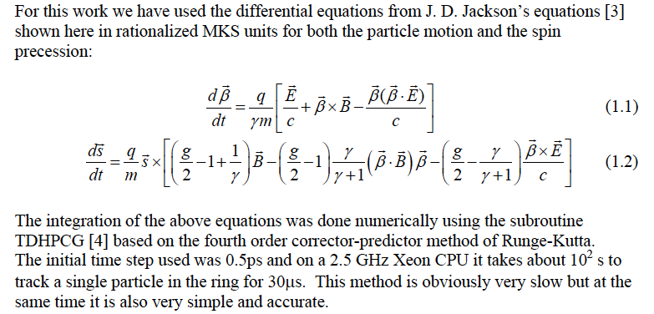
Method
ω_{a} can be obtained by taking the scalar product of s and β.

Slide 3
Spin Coherence Time: need >10² s
Not all particles have same deviation from magic momentum, or same horizontal and vertical divergence (all second order effects)
They cause a spread in the g-2 frequencies:

Slide 4
Spin Coherence Time: need >10² s
For the deuteron ring, estimation by Yuri Orlov:
To be canceled by 3-sextupole families… For deuterons: if we don’t do anything SCT~1s.

Slide 5
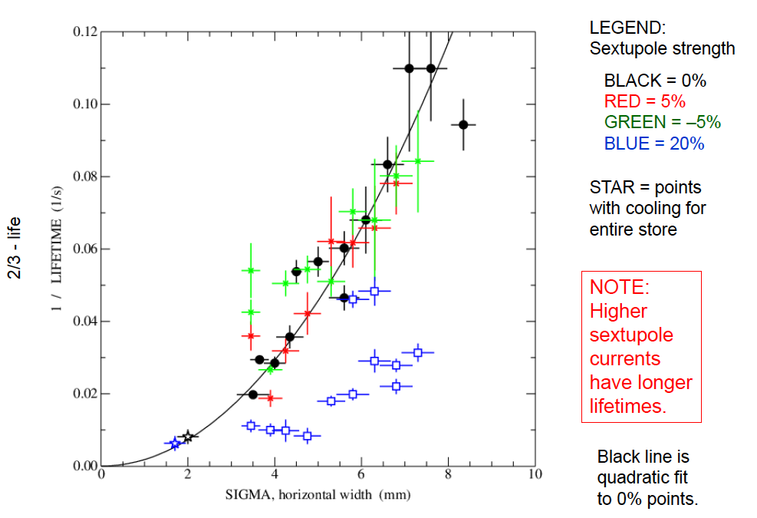
Benchmarking at COSY, Ed Stephenson et al. (turning on different sextupole families)

Slide 6
SCT measurements at COSY
For the deuteron ring, estimation by Yuri Orlov:
Benchmarking at COSY, Ed Stephenson et al.

Slide 7
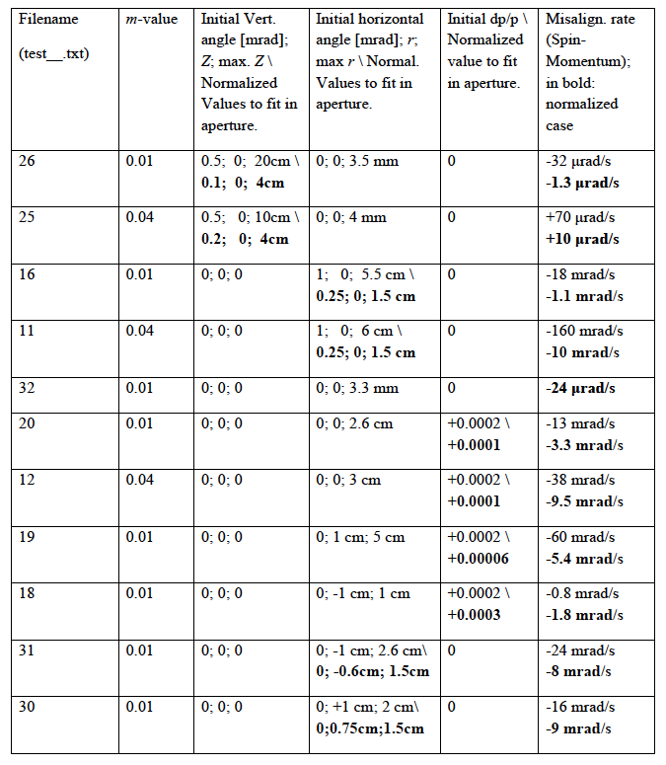
Vert. tune = .1
Protons in an all-electric ring:
Vertical
oscillations
Horizontal
oscillations
Horizontal
Oscill. dp/p

Slide 8
Task
Horizontal spin precession rate estimation to ~ppb→1rad in 10³s.
Other methods are much faster; how precise? Benchmark against standard, analytical estimations.
For muon g-2 experiment, the so-called pitch correction: vertical oscillations, 1mrad →0.5 x <θ²> = 0.25 ppm

Slide 9
Benchmarking
Vertical oscillations in a uniform B-field, no focusing
Vertical oscillations in a uniform B-field, electric focusing
Vertical oscillations in a uniform B-field plus magnetic focusing
Radial oscillation in an all-electric ring
Vertical oscillations in an all-electric ring
RF Wien filter in a magnetic ring

Slide 10
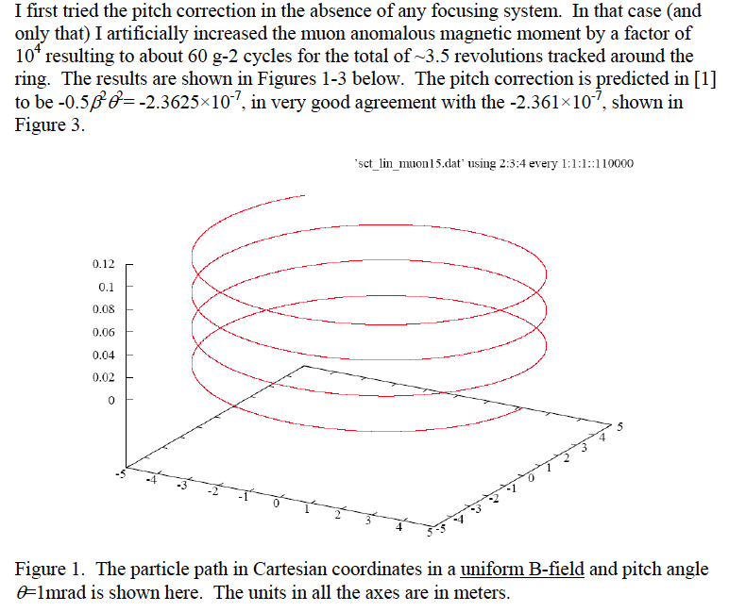
Uniform B-field, no focusing
1mrad vertical pitch
Z [m]
Y [m]
X [m]

Slide 11
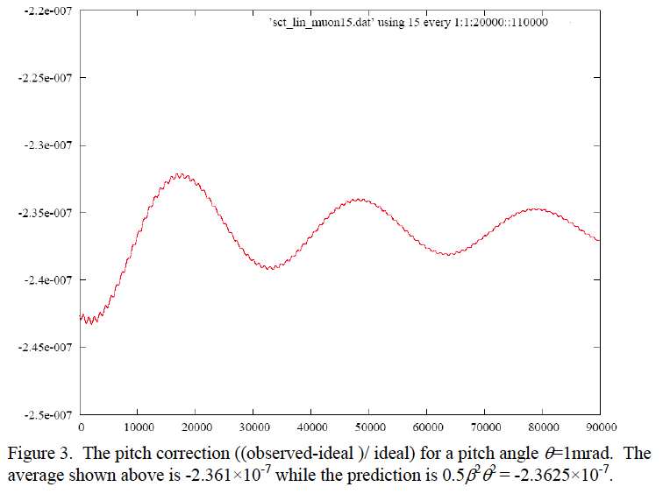
Uniform B-field, no focusing
1mrad vertical pitch

Slide 12
The tools
Uniform B-field,
E-field focusing
Simulate 0.5mrad vertical oscillation
amplitude. Expected g-2 deviation for
electric focusing:
0.25×(0.5mrad)²=6.25×10⁻⁸
Electric focusing
(g-2 phase – ideal)/ideal
Good to sub ppb
Time [s]

Slide 13
Uniform B-field, Electric focusing, Radial shift
Electric focusing, Maxwell
Equations satisfied
(cylindrical coordinates)
with 0.5mrad vert. oscill.
On Average: ~6μm.
r [m]
Electric focusing
(No Maxwell eq.)
with 0.5mrad vert. oscill.
Time [s]

Slide 14
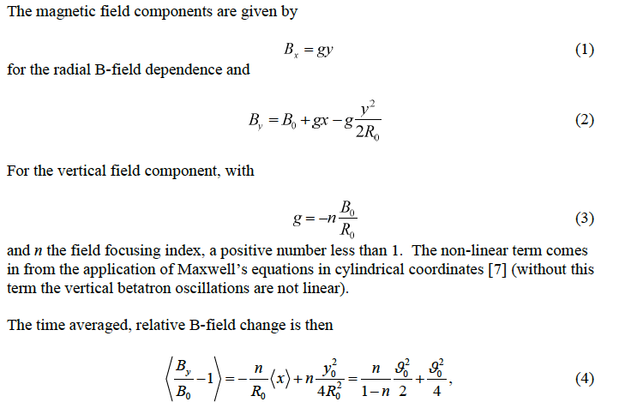
Magnetic focusing

Slide 15
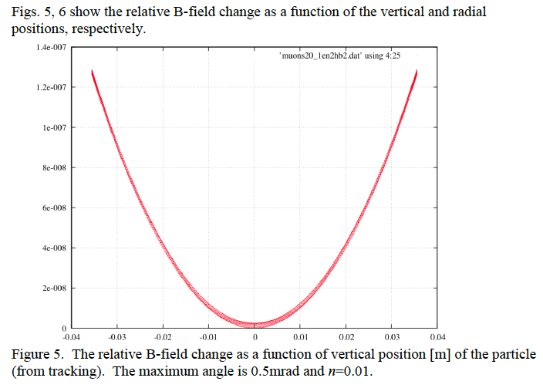
B-field vs. vertical position

Slide 16
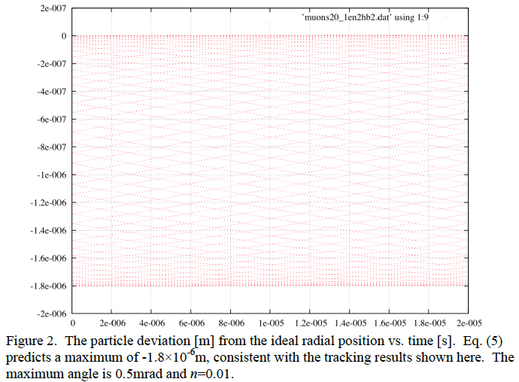
Radial oscillations

Slide 17
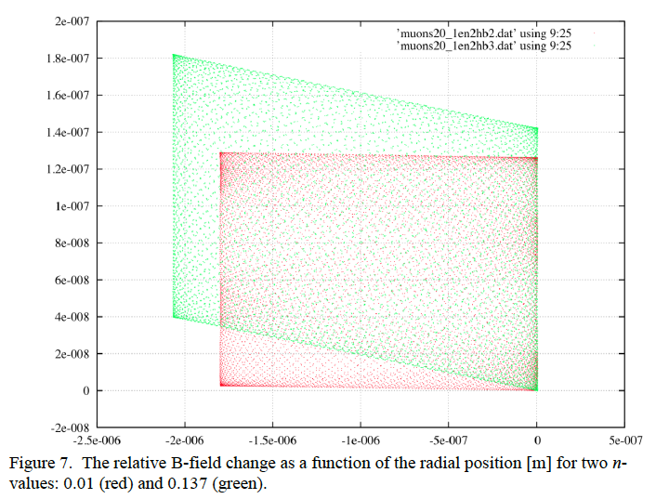
B-field vs. vertical position

Slide 18
Pitch effect with a uniform dipole B-field plus magnetic focusing
0.25×θ²=6.25×10⁻⁸
(for 0.5mrad
not conforming with Maxwell’s equations)
With a net effect on g-2 due to the vertical oscillations
(conforming with Maxwell’s equations)

Slide 19
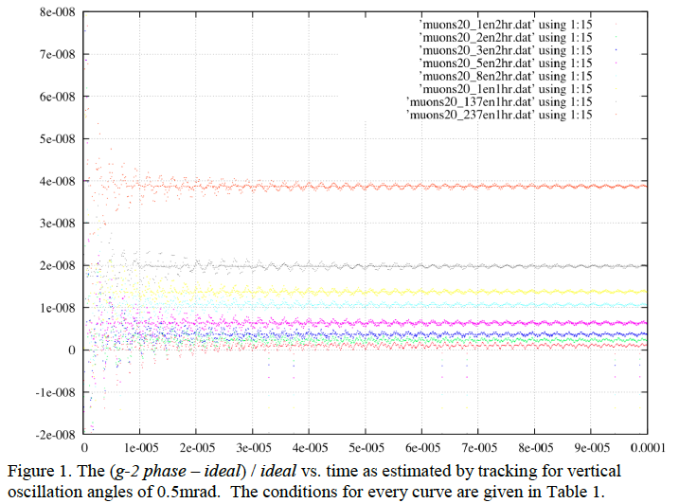
Net effect due to vertical oscillations

Slide 20
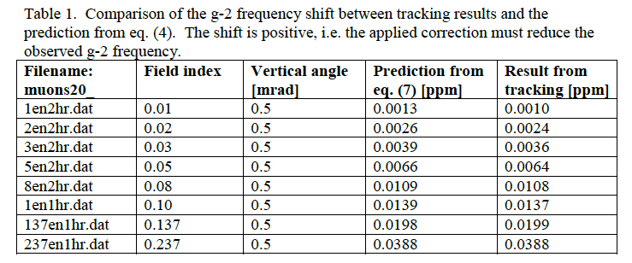
Compare estimation with tracking

Slide 21
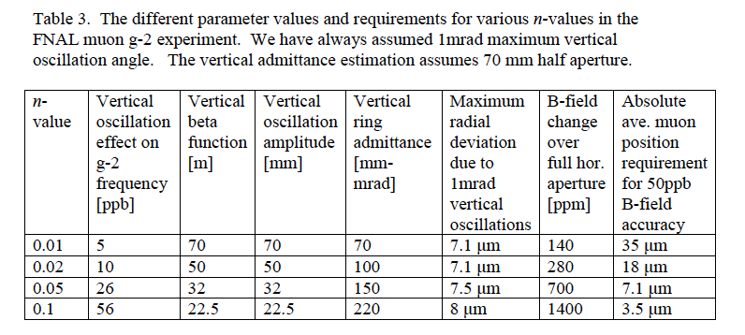
FNAL g-2 options

Slide 22
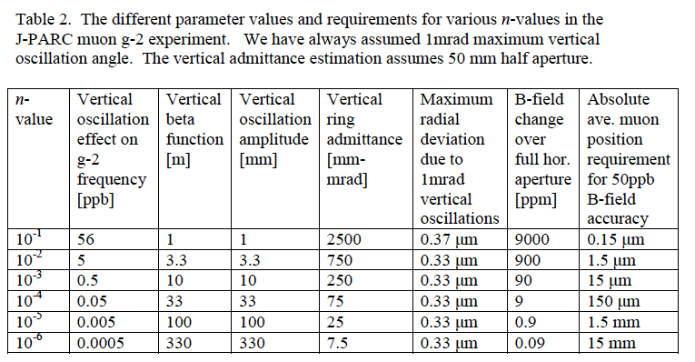
J-PARC case

Slide 23
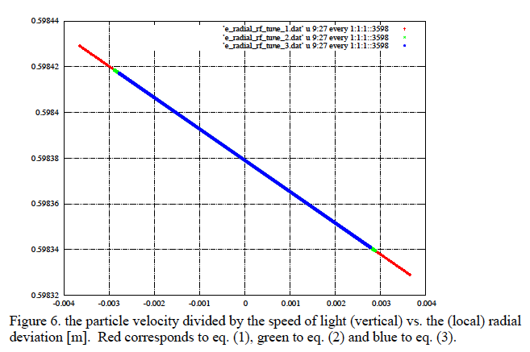
All-Electric ring
E-field complication: Kinetic energy changes with radial position → additional horizontal focusing
β
Velocity vs. radial position
Analytical work by S. Mane,
Y. Orlov,
R. Talman,
M. Conte,
etc.
[m]

Slide 24
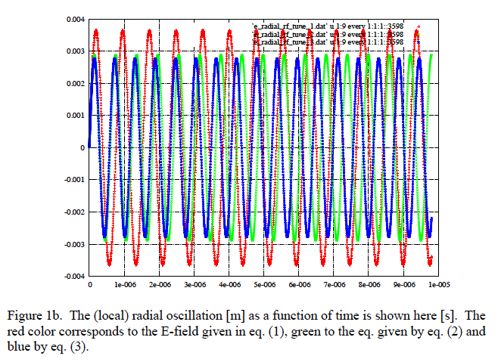
All-Electric ring
4th order R.K. integrator (accurate and slow)
Three different E-field
radial dependences:
1/R
Constant
R^{0.2}
Consistent with analytical
estimations:
E-field radial dep. | Horizontal tune
1/R | 1.275
Constant | 1.625
R^{0.2} | 1.680
Radial motion [m] vs. time [s]

Slide 25
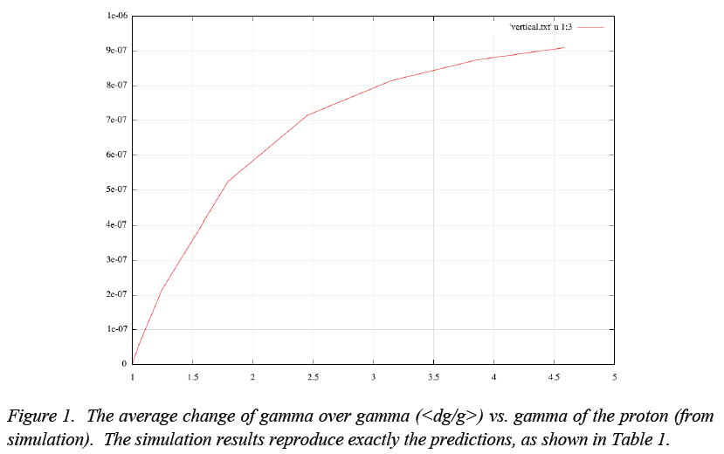
Vertical motion in an all-electric ring
Simulations, θ₀=1mrad
Cylindrical E-plates
No vertical focusing
dγ/γ
γ

Slide 26
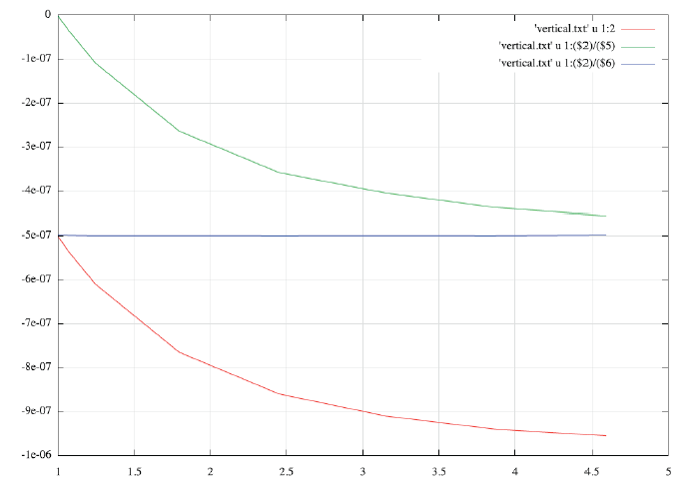
Vertical motion in an all-electric ring
Prediction with RF-ON
dr/r
Simulations, θ₀=1mrad
Cylindrical E-plates
No vertical focusing, RF-OFF
The curve moves up with RF-ON
γ

Slide 27
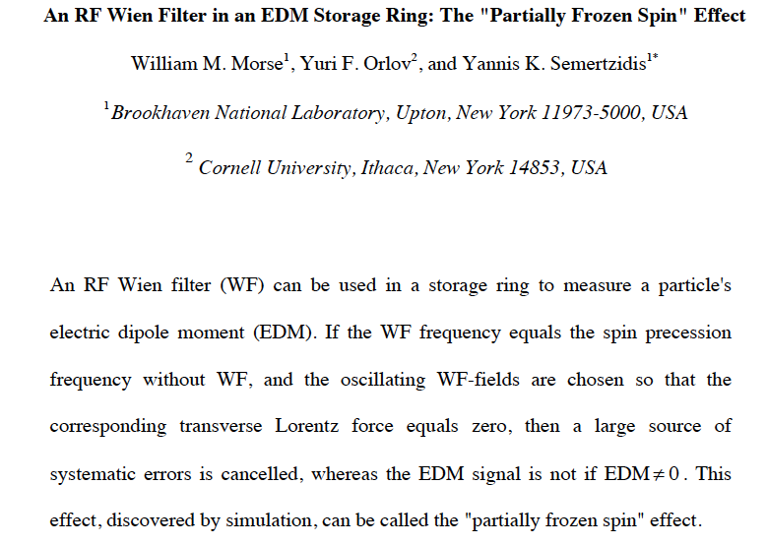

Slide 28
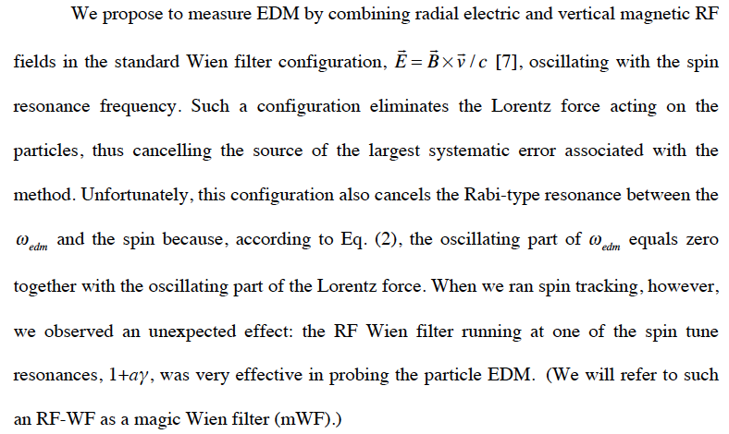
RF-Wien filter

Slide 29
Analytical estimation of EDM signal and systematic error

Slide 30
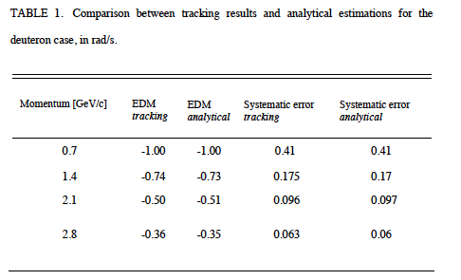
Comparison between analytical estimations and simulation

Slide 31
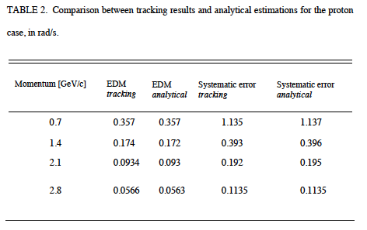
Comparison between analytical estimations and simulation

Slide 32
Conclusions
Runge-Kutta integration: accurate and slow
It passed all the benchmarks it was tested against, often to sub ppb level
It can be used to benchmark the faster programs
All-electric ring seems to indicate adequate SCT for 10³ s storage time
Simple all-electric field lattice seems stable and adequate for the needs of the proton EDM exp.

