Slide 1
The storage-ring proton EDM experiment
Yannis Semertzidis, BNL
Opportunities with Polarized Protons at Fermilab
Fermilab, May 20, 2013
Goal: 10⁻²⁹ecm and with a lot of work 10⁻³⁰ecm (stochastic cooling,…)
R&D: 1) SQUID-based BPMs, 2) Polarimeter, 3) Precision tracking/SCT, 4) E-field tests
Staging? <10⁻²⁷ecm; <10⁻²⁹ecm; <10⁻³⁰ecm

Slide 2
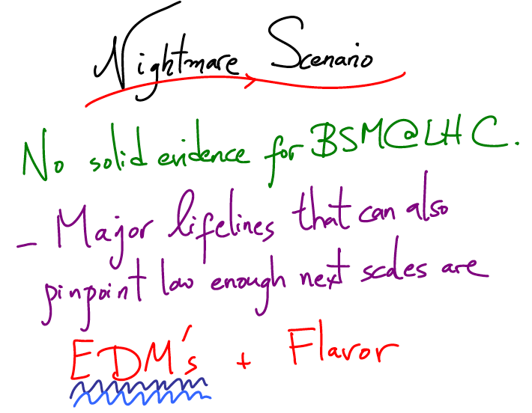
Physics of EDM of fundamental particles.
Proton EDM: >10³ TeV for SUSY-like New Physics
Nima Arkani-Hamed, Intensity
Frontier, Rockville, 2011
10⁴TeV for contact interactions NP

Slide 3
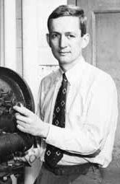
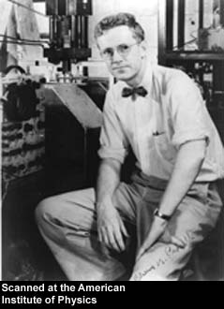
Purcell and Ramsey:
“The question of the possible existence of an electric dipole moment of a nucleus or of an elementary particle…becomes a purely experimental matter”
Phys. Rev. 78 (1950)

Slide 4
We have developed the Storage Ring EDM Method (g-2 technique with Electric fields)
(http://www.bnl.gov/edm)
Muon EDM sensitivity 10⁻²⁴ecm
Proton EDM sensitivity 10⁻²⁹ecm→10⁻³⁰ecm
Deuteron EDM sensitivity 10⁻²⁹ecm
³He (~neutron equivalent), …p, d, n EDMs are needed to decipher the CP-violation source…

Slide 5
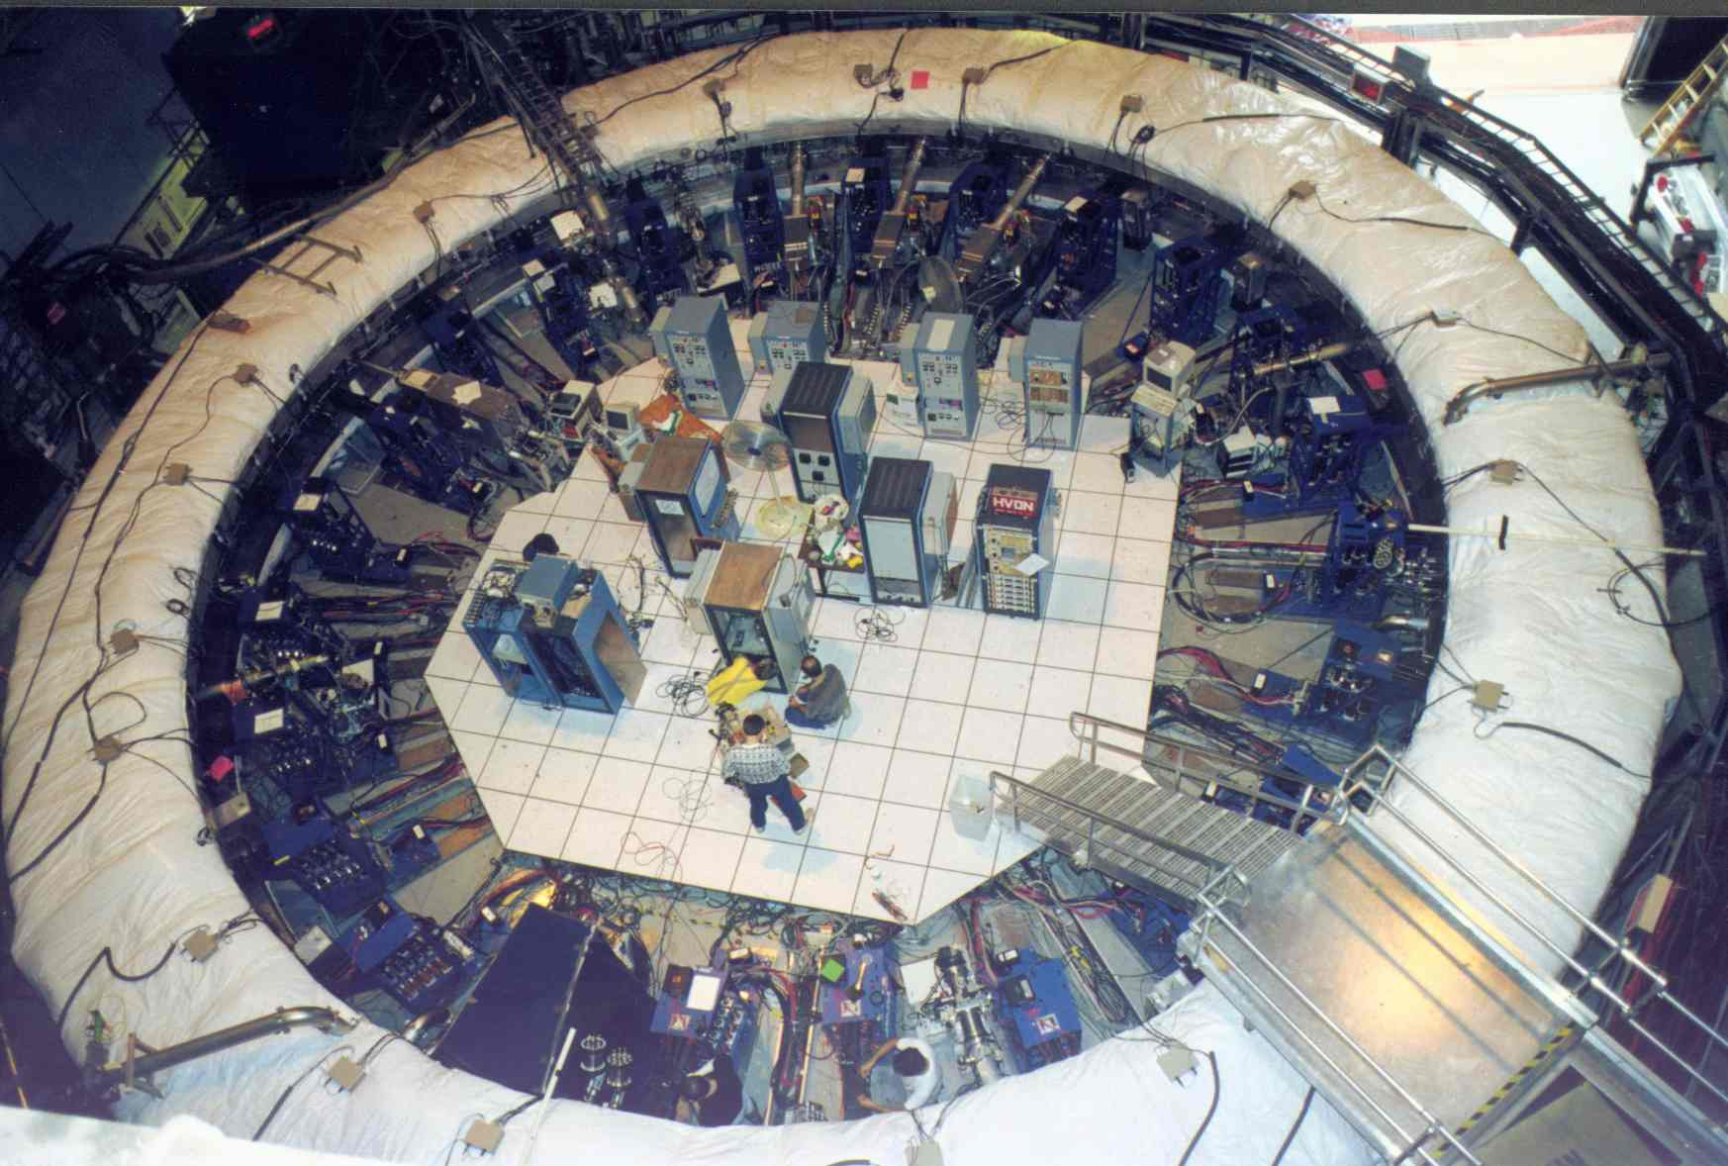
Muon g-2: Precision physics in a Storage Ring
Statistics limited… to improve sensitivity by a factor of 4 at Fermilab

Slide 6
The proton EDM uses an ALL-ELECTRIC ring: spin is aligned with the momentum vector
At the magic momentum
Momentum
vector
E
Spin vector
the spin and momentum
vectors precess at same
rate in an E-field. Similar
to muon g-2 method.
E
E
E
Yannis Semertzidis, BNL
Notes:
Yannis Semertzidis, BNL
6

Slide 7
Comparing Methods
Neutrons in a box have an advantage: no electric force, small volumes
Protons in a storage ring (“g-2” with E-fields):
Primary source, revolution in statistics
Position displacement sensitive to background magnetic fields
Geometrical phase: EDM-like signal depends on azimuthal location; position displacement

Slide 8
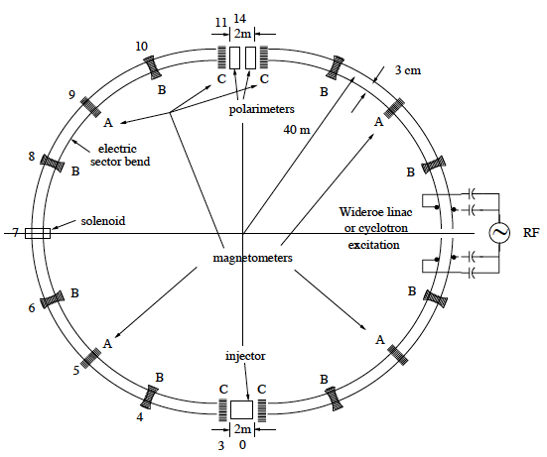
The proton EDM proposal to DOE NP: November 2011
Lattice: R. Talman
Weak vertical focusing to optimize
SCT and BPM operation
B: quadrupoles

Slide 9
Experiment Parameters (proposal)
Proton magic momentum: 0.7 GeV/c (233 MeV kinetic)
E = 10.5 MV/m for 3 cm plate separation
R = 40 m; plus straight sections
Weak vertical focusing: vertical tune 0.2→ 0.1
Stored particles: ~10¹⁰ per 10³s, 10⁴ injections

Slide 10
Beam parameters
C.R. proton beams | 0.7 GeV/c | ≥80% polariz.; | ~4×10¹⁰ protons/store
~10² m base length | Repetition period: 20 minutes | Beam energy: ~1J | Average beam power: ~1mW
Beam emittance: 95%, norm. | Horizontal: 2 mm-mrad | Vertical: 6 mm-mrad | (dp/p)_{rms}~ 2×10⁻⁴
CW & CCW injections: Average emittance parameters: same to ~10% at injection.
Beam parameters readily available at BNL.
We need a polarized proton source at Fermilab!
Notes:
10

Slide 11
Total cost: exp + ring + beamline for two different ring locations @ BNL
System | Experiment w/ indirects | Conventional plus beamline w/ indirects | Total
pEDM at ATR | $25.6M | $20M | $45.6M
pEDM at SEB | $25.6M | $14M | $39.6M
System | Experiment w/ 55% contingency | Conv. & Beamline w/ contingency | Total
pEDM at ATR | $39.5M | $29.2M | $68.7M
pEDM at SEB | $39.5M | $22.6M | $62.1M
EDM ring+tunnel
and beam line
EDM ring

Slide 12
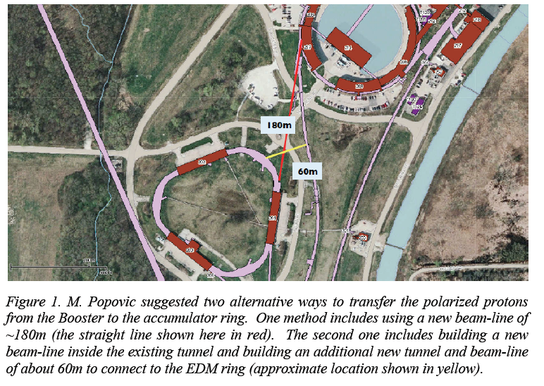
Fermi: need polarized proton source

Slide 13
International srEDM Network
Common R&D
srEDM Coll. pEDM
Proposal to DOE NP
EOI to FNAL
SQUID-based BPMs tests at RHIC
Precision simulation
Systematic error studies
E-field tests
…
JEDI (COSY/Jülich)
Ring design
EDM at COSY
Polarimeter tests
Spin Coherence Time tests
Precision simulation
Cooling
E-field tests
…

Slide 14
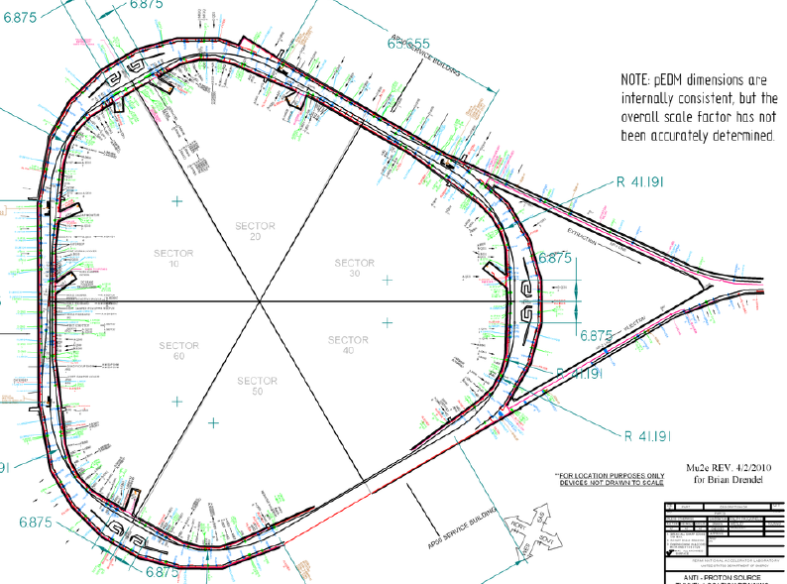
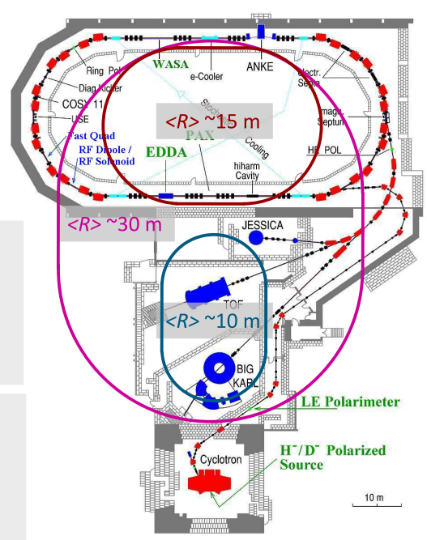
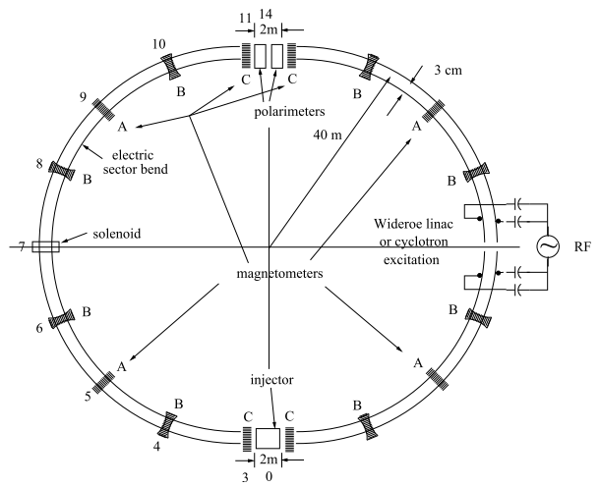
EDMs: Storage ring projects
pEDM in all electric ring at BNL or FNAL
Demonstration ring (R&D) at JPARC?
Jülich, focus on deuterons,
or a combined machine
(from R. Talman)
CW and CCW propagating beams
(from A. Lehrach)

Slide 15
Polarimeter Development (monitors proton beam polarization direction as a function of time)
Polarimeter tests with runs at COSY (Jülich/Germany) demonstrated < 1ppm level systematic errors: N. Brantjes et al., NIM A 664, 49, (2012)
Technologies under investigation:
Micro-Megas/Greece: high rate, pointing capabilities, part of R&D for ATLAS upgrade
MRPC/Italy: high energy resolution, high rate capability, part of ALICE development

Slide 16
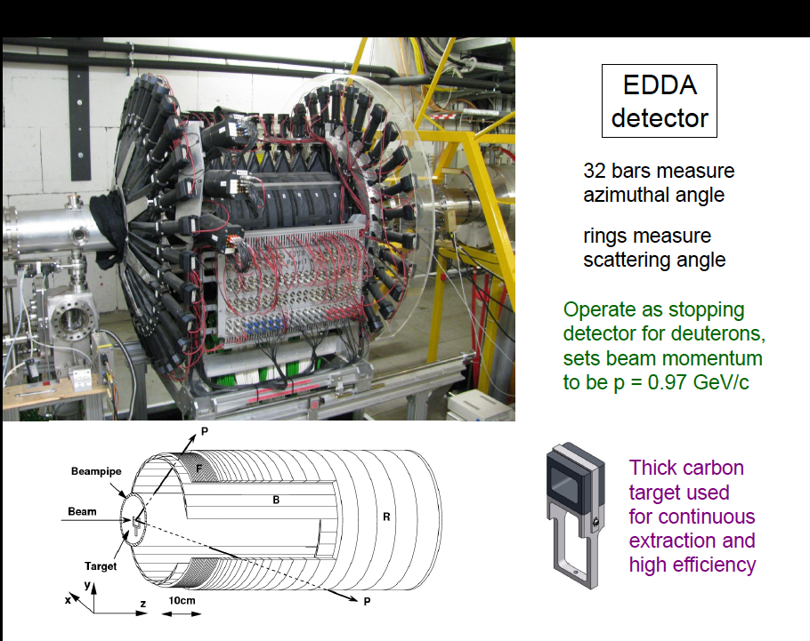

Slide 17
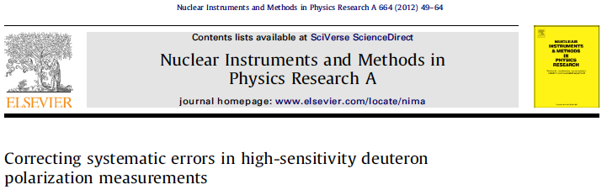
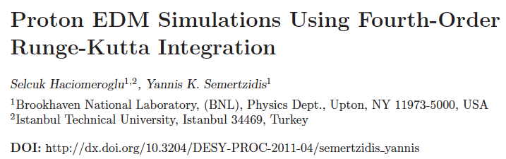
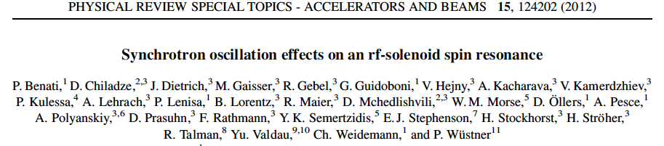
R&D progress

Slide 18
Clock-wise (CW) & Counter-Clock-wise Storage
Any radial magnetic field sensed by the
stored particles will also cause their
vertical splitting.
Equivalent to p-bar p colliders in
Magnetic rings
Notes:
18

Slide 19
1. SQUID-Based BPM
The beam separation depends on the strength of the vertical tune: plan for 0.1
Modulate vertical tune by ~10% at 10³-10⁴ Hz
This creates a radial B-field at 10³-10⁴ Hz to be picked up by a SQUID

Slide 20
B-field from (same sign) CR beams
Azimuthal B-field cancels
Vertical splitting creates a
radial B-field oscill. 10³-10⁴Hz
Low Tc SQUID sensitivity is adequate
Need to demonstrate in an accelerator environment
Two years R&D

Slide 21
Advantages of SQUID magnetometers for (same sign) counter-rotating beams
Non-destructive
Large dynamic range:
Counter-rotating beams cancel azimuthal B-fields to first order
Only a relative vertical offset creates a horizontal B-field.
By modulating the vertical tune we modulate the vertical separation and hence the horizontal B-field as well (10³-10⁴Hz).

Slide 22
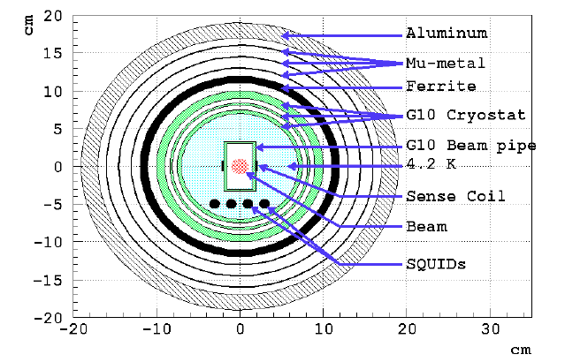
What is critical
The sense coils pickup the radial B-field at 10³-10⁴ Hz. Lots of shielding, it may be SC…
D. Kawall
Testing at RHIC

Slide 23
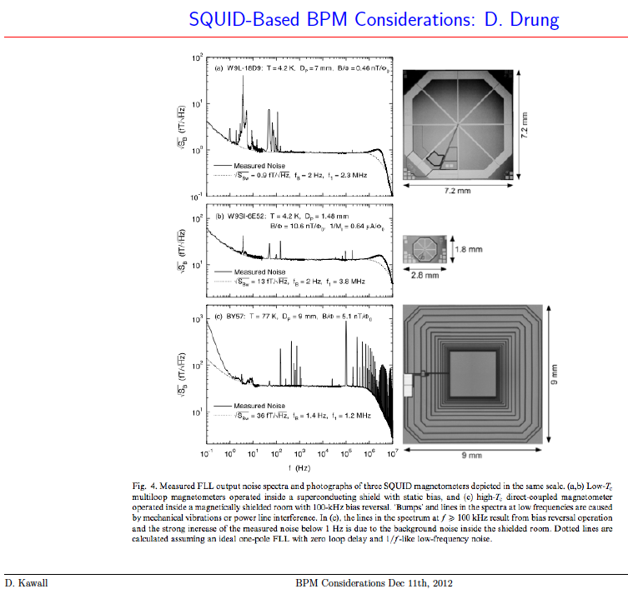
D. Kawall
Modulation
frequency range

Slide 24
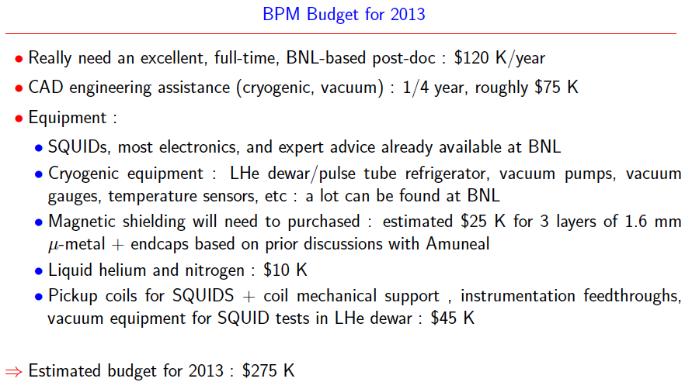
Budget for testing at RHIC, US-Japan by D. Kawall

Slide 25
Assuming a post doc
Setup at a lab (post doc, Sergio Rescia from Instrumentation Division)
Reproduce noise level in the lab
Setup at RHIC near an IP
Measure noise level in the tunnel
Setup detector as part of the beam-line

Slide 26
3. Spin Coherence Time: need >10² s
Not all particles have same deviation from magic momentum, or same horizontal and vertical divergence (all second order effects)
They cause a spread in the g-2 frequencies:
Present design parameters allow for 10³ s store Cooling/mixing during storage could prolong SCT (upgrade option?).

Slide 27
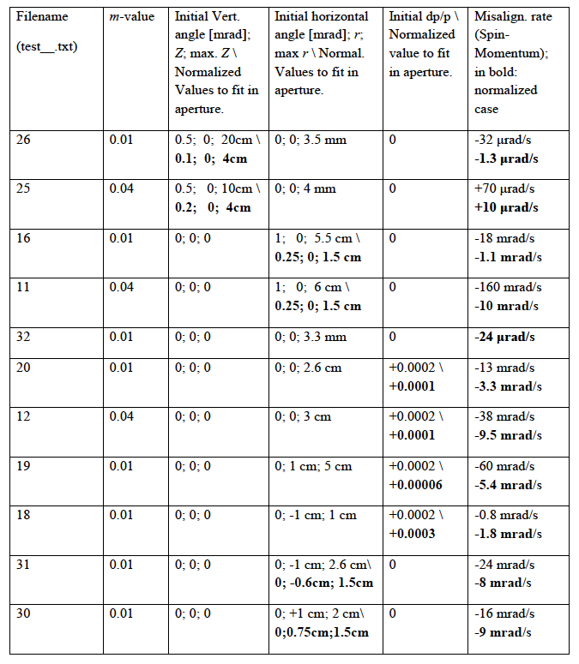
Vert. tune = .1
Vertical
oscillations
Horizontal
oscillations
Horizontal
Oscill. dp/p

Slide 28
E-field plate module: Similar to the (26) FNAL Tevatron ES-separators
Beam position
0.4 m
3 m

Slide 29
Large Scale Electrodes, New: pEDM electrodes with HPWR
Parameter | Tevatron pbar-p Separators | BNL K-pi Separators | pEDM
Length | 2.6m | 4.5m | 3m
Gap | 5cm | 10cm | 3cm
Height | 0.2m | 0.4m | 0.2m
Number | 24 | 2 | 10²
Max. HV | ±180KV | ±200KV | ±150KV

Slide 30
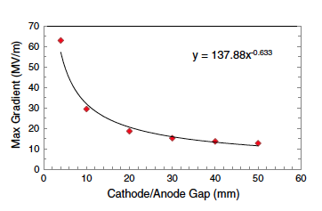
Recent development: Data!
Maximum E-field vs. Plate gap
No dark current detected for large grain Nb!
(need a post doc!)
PRSTAB 15,083502, 2012
R
10 MV/m @ 30 mm, 40 m
16 MV/m @ 30 mm, 26 m
20 MV/m @ 20 mm, 20 m
30 MV/m @ 10 mm, 14 m
R=40 m

Slide 31
Staging the experiment
Proton Intensity >10⁸ / storage; sensitivity: <10⁻²⁷e•cm
Proton Intensity 4x10¹⁰ / storage; sensitivity: 10⁻²⁹e•cm
Stochastic cooling: 4x10¹⁰ / storage; sensitivity: 10⁻³⁰e•cm

Slide 32
Proton EDM plan at FNAL
Test the SQUID-based BPMs: 1) lab, 2) RHIC. It will determine the method sensitivity level.
Confirm the JLab E-field vs. plate gap measurements for our geometry. It will define the ring radius and …the cost.
Determine a “stable and practical” electric ring lattice using at least two different methods. It will determine the ring lattice.
Build and test a polarimeter prototype at COSY. It will determine the statistical limits of the method.

Slide 33
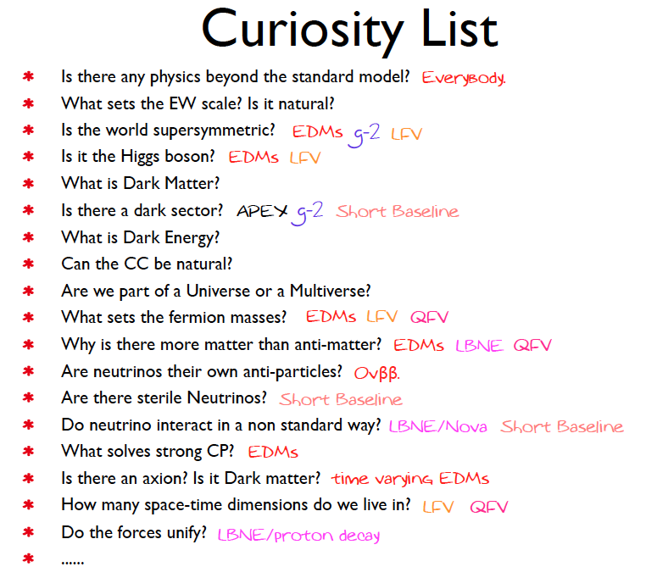
Roni Harnik,
Intensity Front. Snowmass
Argonne, April 25, 2013

Slide 34
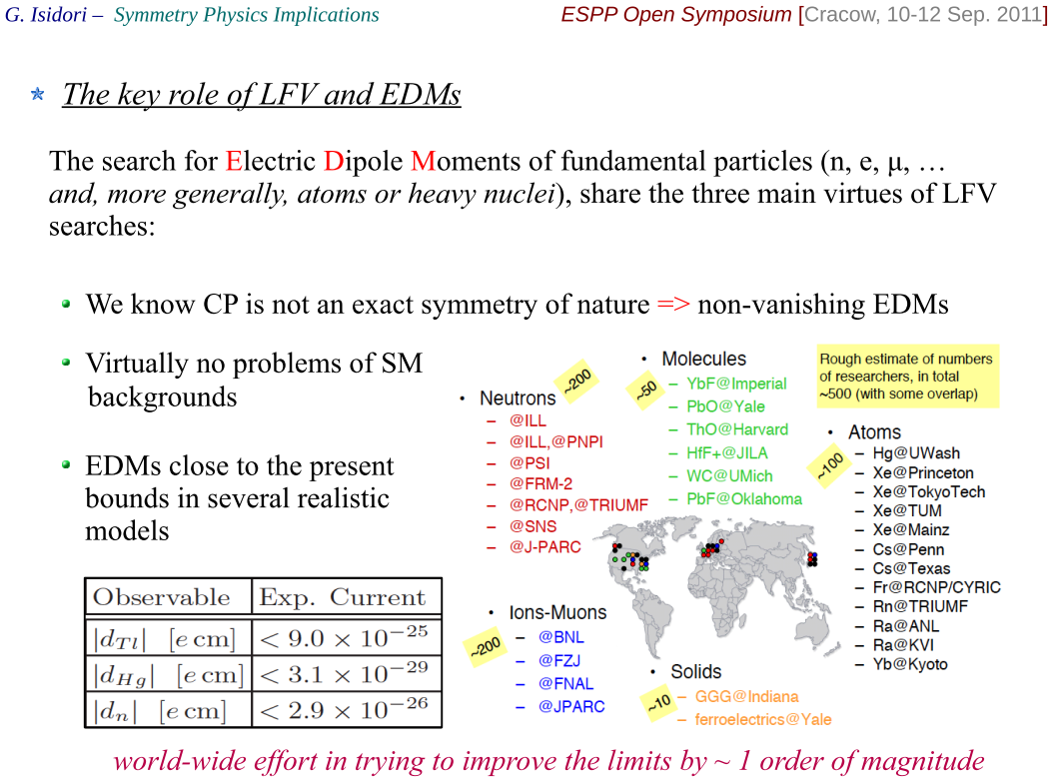
Physics: Potential of EDMs
G. Isidori at ESPP Open Symposium, Cracow (Sept. 2012)

Slide 35
Summary
Proton EDM proposal to NP DOE, Nov 2011: A revolution in EDM sensitivity 10⁻²⁹ecm → 10⁻³⁰ecm; different systematics from nEDM
Two major technical reviews at BNL: Dec 2009, March 2011
Mini, conceptual review, at FNAL by the local accelerator group: March 2012 (“we love it”; “it is time to develop the proposal for FNAL”). Let’s start!

Slide 36
Extra slides

Slide 37
Smaller-Ring Parameters
Ring circumference: 150 m; 100 m
Bending radius: ~20 m; 14 m
Plate distance: 2 cm; 1 cm
Radial E-field: 21 MV/m; ~30 MV/m
EDM limit: 10⁻²⁸ecm; 10⁻²⁷ecm

