Slide 1



RF Design and Modeling for the LHC Crab Cavities
Zenghai Li
SLAC
LARP Internal Project Review, June 10, 2013

Slide 2
Simulations used ACE3P parallel finite element suite of codes developed under the support of DOE SciDAC program
Simulations were carried out on supercomputing computers at NERSC supported by DOE Contract No. DE-AC02- 05CH11231

Slide 3
Outline
Modeling tools - ACE3P
Design and optimization of RF Dipole (RFD) Cavity (SLAC-ODU)
  Cavity shape optimization
  FPC and HOM coupler design
  Multipacting mitigation
Modeling of Double quarter wave (DQW) Cavity (BNL)
  FPC comparison – small vs large port opening
  Surface fields and multipole field components
  Multipacting simulation
Summary and plan

Slide 4
Accelerator Modeling with EM Code Suite ACE3P
SLAC’s suite of conformal, higher-order, C++/MPI based parallel finite-element electromagnetic codes
https://slacportal.slac.stanford.edu/sites/ard_public/bpd/acd/Pages/Default.aspx
ACE3P (Advanced Computational Electromagnetics 3P)
Frequency Domain: Omega3P – Eigensolver (damping)
S3P – S-Parameter
Time Domain: T3P – Wakefields and Transients
Particle Tracking: Track3P – Multipacting and Dark Current
EM Particle-in-cell: Pic3P – RF guns & klystrons
Multi-physics: TEM3P – EM, Thermal & Structural effects
Have been applied to cavity and rf component design for various accelerator projects
Cavity design and optimization, HOM damping, coupler design, multipacting, thermal and mechanical analysis, etc
As numerical probe to help understand experimental data (e.g. identifying trapped modes, understand bead-pull results, MP barriers, etc)
Notes:
4

Slide 5
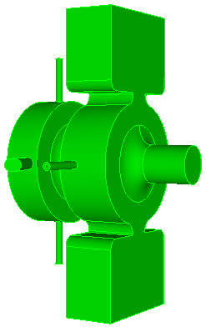
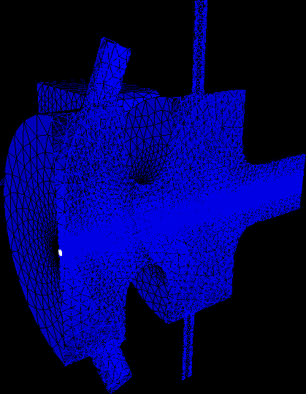
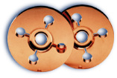
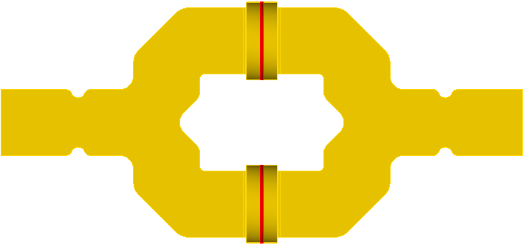
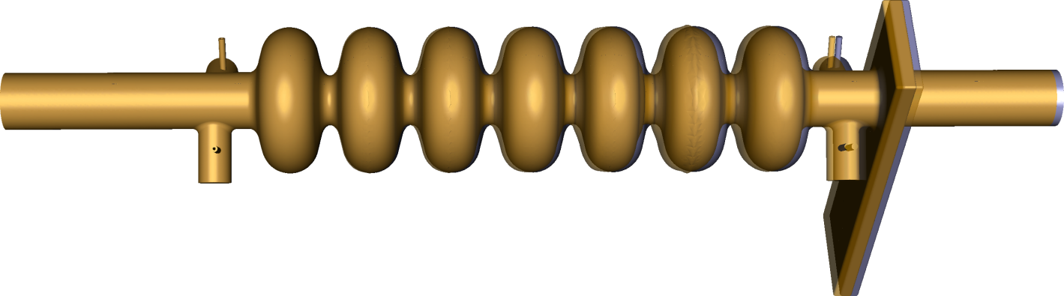
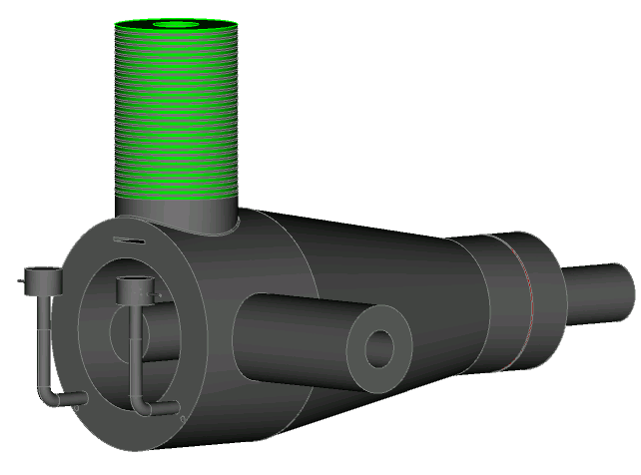


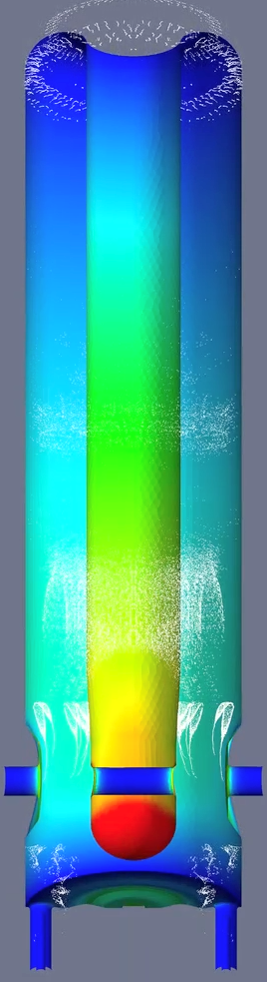
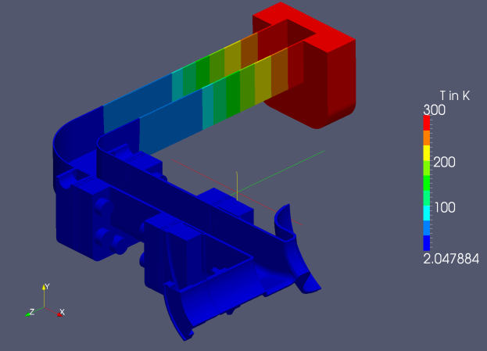
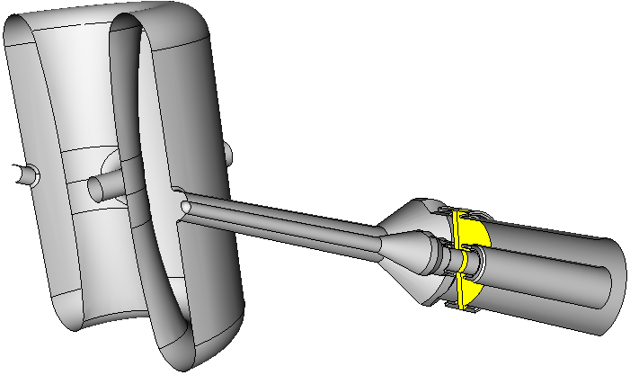
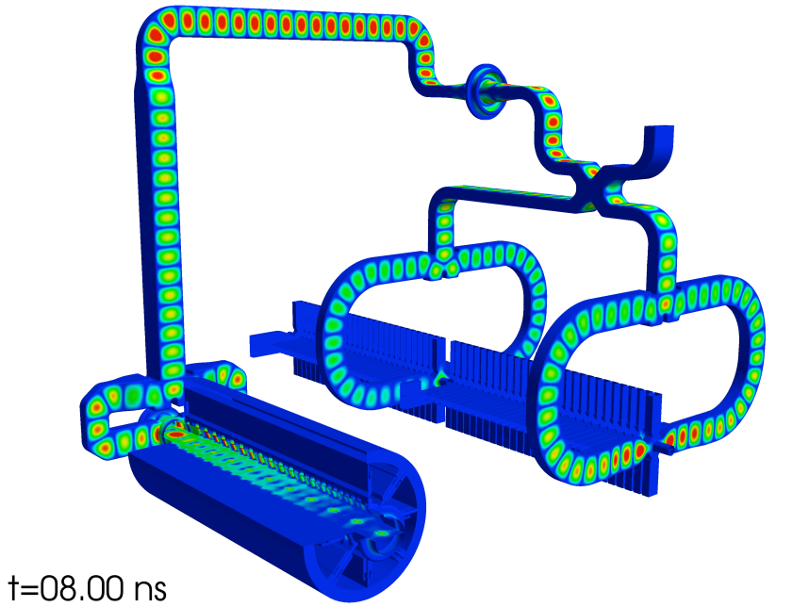
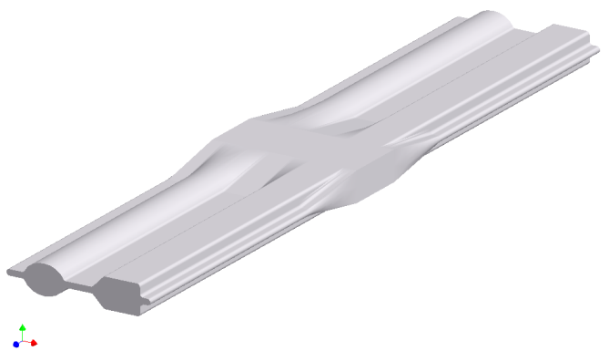
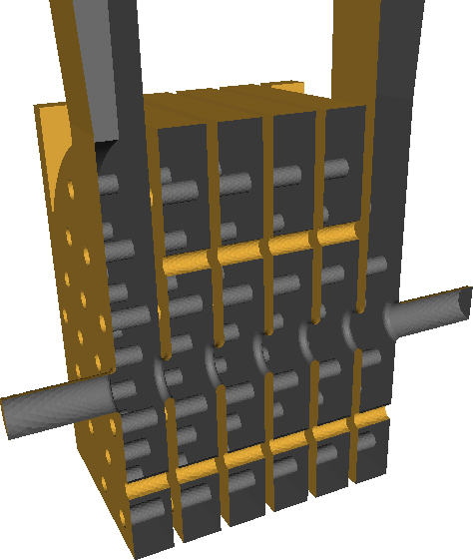
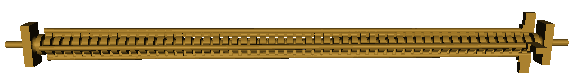
RF Modeling Using ACE3P - Examples
High precision structure & RF Gun design
SCRF cavity optimization, coupler design, shape determination
Multipacting, thermal mechanical analysis
Large scale system simulation, validation

Slide 6
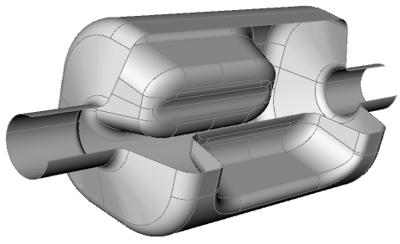
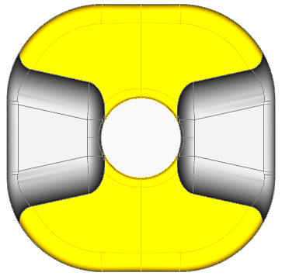
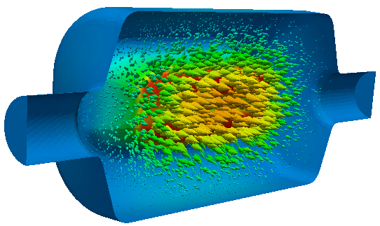
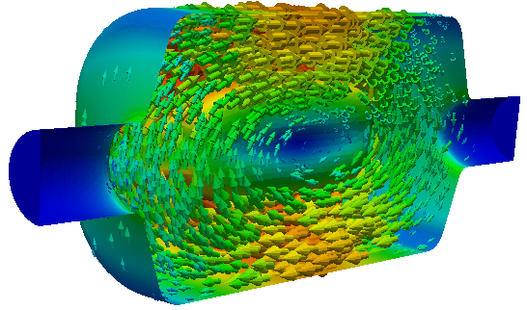
RFD cavity parameters
Shape: square cavity with double ridge deflecting poles
Operating mode: TE11 like
Compact size, suitable for both vertical and horizontal crabbing schemes
available space
194 mm
Frequency (MHz) | 400
Operating Mode | TE11
Lowest dipole HOM (MHz) | 633
Lowest acc HOM | 715
Iris aperture (diameter) (mm) | 84
Transverse dimension (mm) | 281
Vertical dimension (mm) | 281
Longitudinal dimension (w/o couplers) (mm) | 556
R_{T} (ohm/cavity) | 433
V_{T} (MV/cavity) | 3.34
Bs (mT) | 55.6
Es (MV/m) | 33.4
140.5 mm
second
beam pipe
42mm radius
RF dipole cavity & curved pole surface
TE11 like Electric and Magnetic fields

Slide 7
RFD Field Multipole Component
Curved pole surface to minimize amplitude of multipole fields
  b3 term reduced from 4000 to 500
  higher bn terms needs further optimization
Curved surface
b3 (mT.m)/m² (for Vt=10MV) | 486
b5 (mT.m)/m⁴ (for VT=10MV) | 2.2e6
b_{n} definition (2-fold symmetry, only cos term)

Slide 8
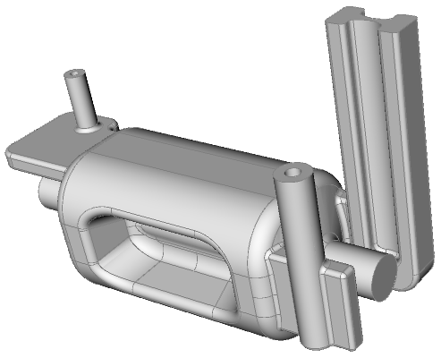
RFD Coupler Design
Design considerations:
All coupler port point to the same (vertical) direction for ease of interface
FPC port adapt to LHC main cavity FPC dimensions (27mm&62mm diameter)
Minimal local field enhancement at the port
Be able to handle beam power due to acc modes (for RFD acc at 750MHz, R/Q~200, maxP 48I²Q_{ext})
Multipacting suppressed
HOM-v
HOM-h
FPC
FP Coupler
  Coupling through symmetrizing waveguide stub
HOM couplers
  deflecting plane (H-plane): ridged waveguide
  Other plane (V-plane): selective waveguide stub+coax

Slide 9
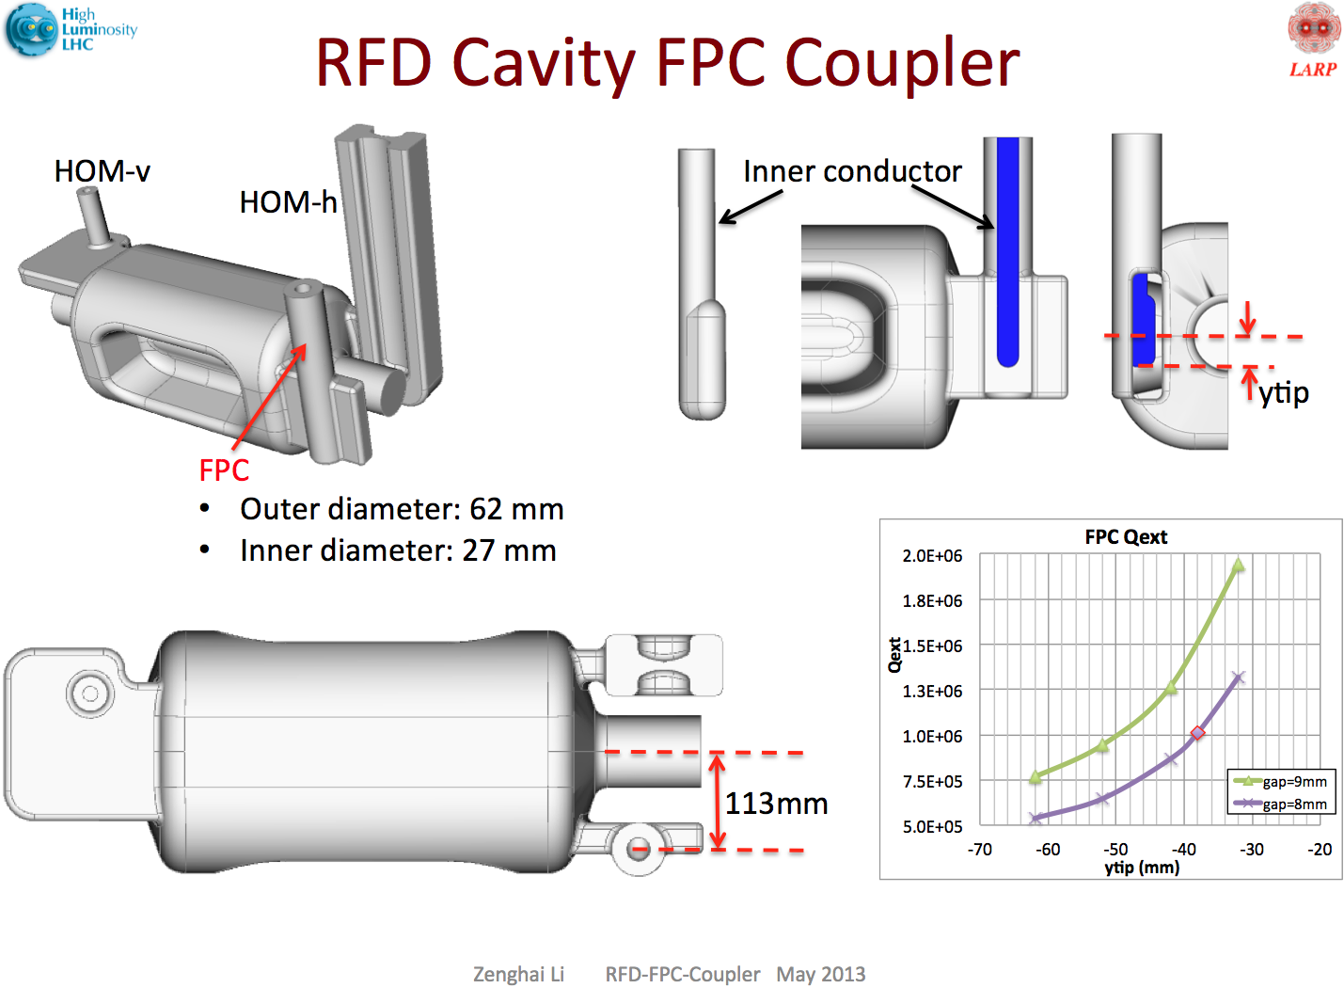

Slide 10

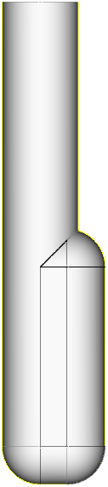
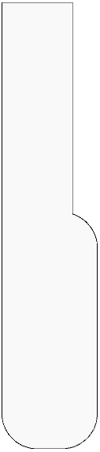
FPC Probe
27 mm
Fillet with certain radius is ok
90 mm
63 mm
36.5 mm
R13.5 mm

Slide 11
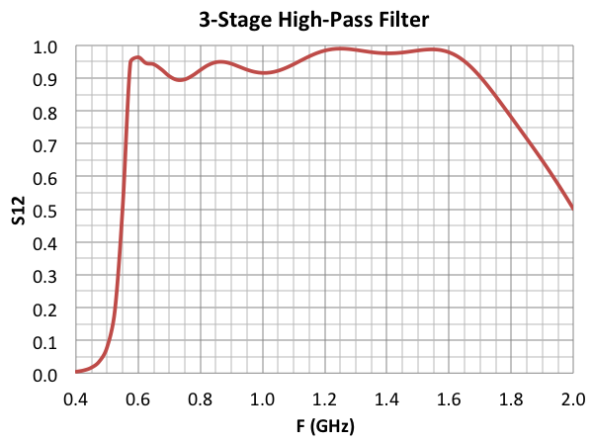
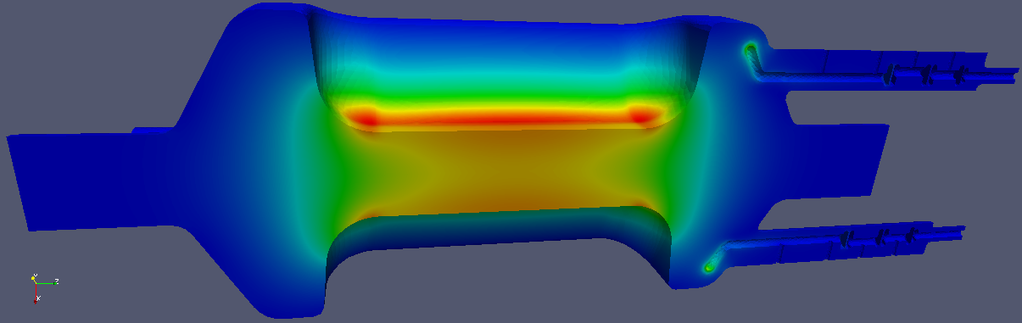
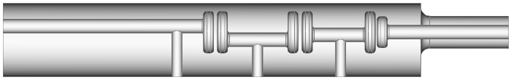
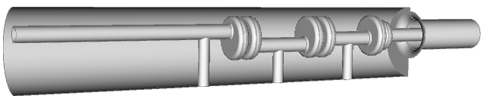
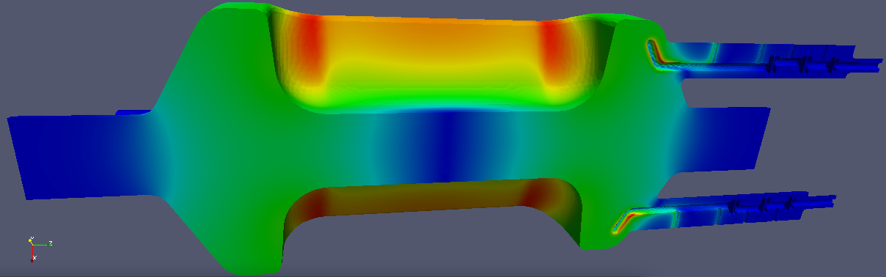
3-Stage High-Pass Filter HOM Coupler
A three-stage high-pass filter was originally designed. Both RFD and DQW prototypes adopted new coupler designs
RFD cavity - adopted a ridged waveguide coupler design
DQW cavity - compact high-pass filter being developed
Good isolation of the operating mode (400MHz)
Lowest HOM is around 600 MHz. Good transmission above 570 MHz
Lower transmission at higher frequency. Damping at higher frequency less stringent due to longer bunch length
Strong damping achieved for all the important modes
High B field on the HOM antenna is similar in amplitude as on the cavity wall
More optimization under way

Slide 12
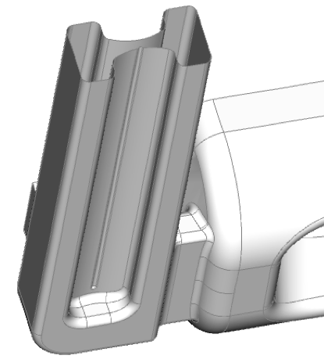
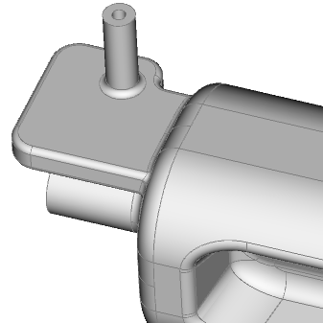
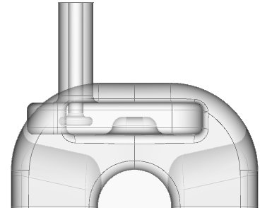
Ridged Waveguide & Selective Coupling HOM Couplers for RFD
Horizontal HOM coupler:
Ridged waveguide coupler
Operating mode below cutoff – naturally reject operating mode
Couple to both horizontal dipole and accelerating HOM modes
Vertical HOM coupler
Selective WG-stub-coaxial coupler, does not couple to operating mode - no filter needed
Damps both vertical HOM and accelerating HOM modes
Asymmetric waveguide stub and probe position to couple to higher HOMs (e.g. quad, etc)

Slide 13
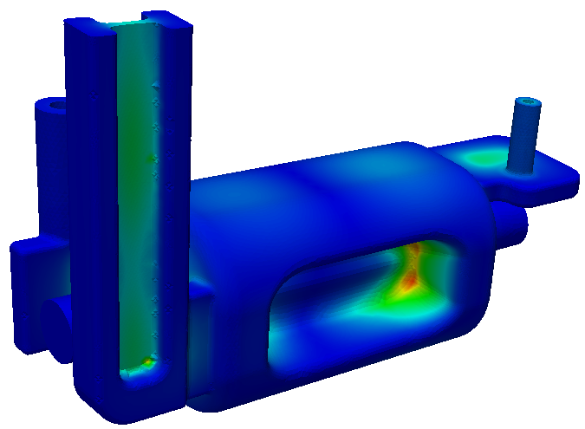
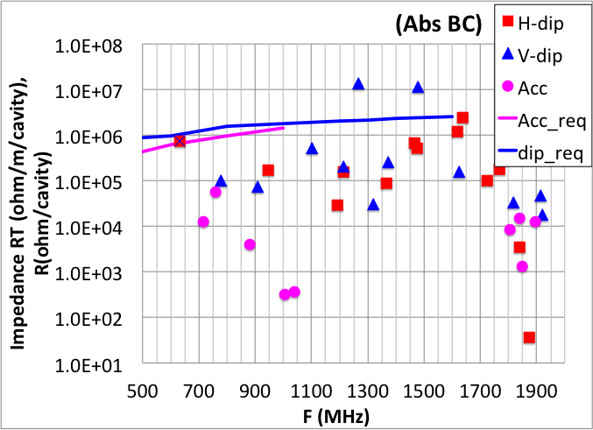
RFD Ridged Waveguide Coupler:
Qext & Impedance
H-HOM coupler couples to both H-dip and Acc modes
V-HOM coupler couples to both V-dip and Acc modes
Further optimization needed for V-dipole HOMs at 1.27 and 1.48 GHz

Slide 14
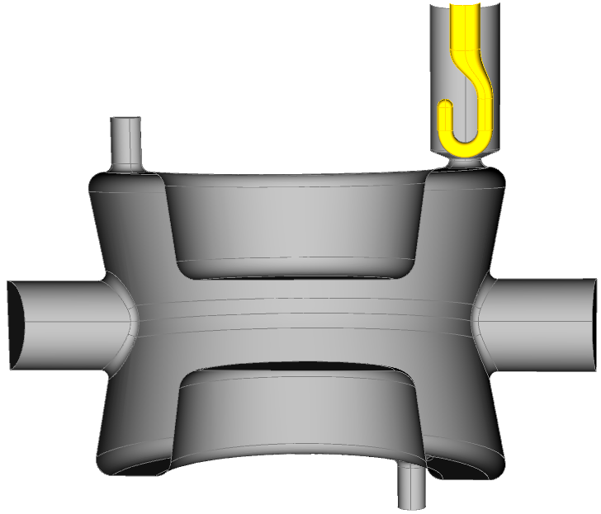
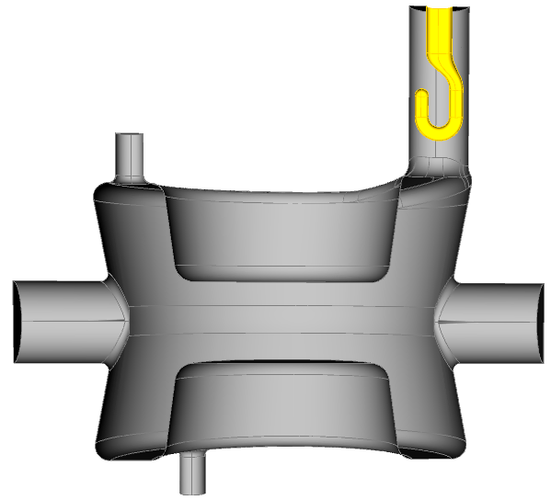
DQW Cavity Simulation- FPC coupler
small FPC
FPC coupling: 2.5e6
large FPC
FPC coupling: 1.1e6

Slide 15
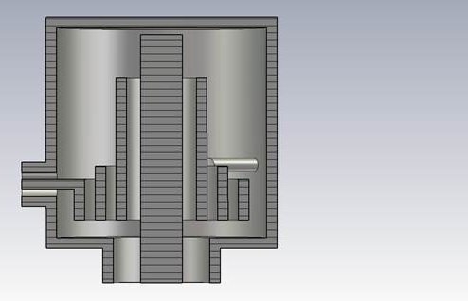
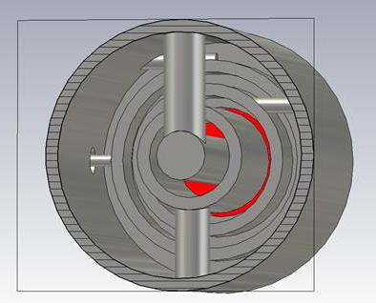
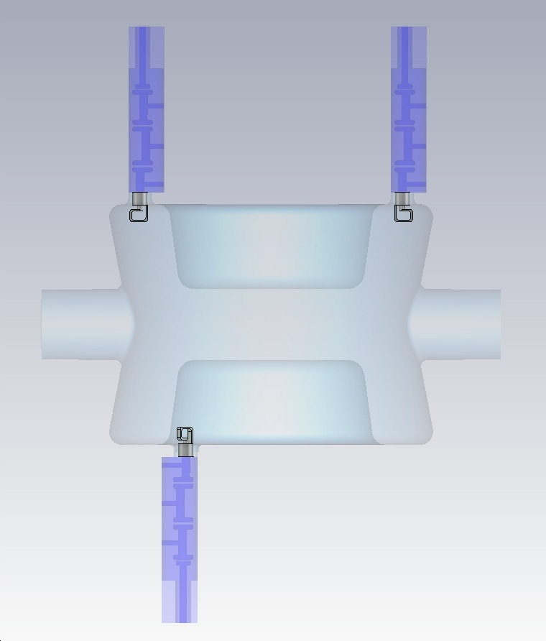
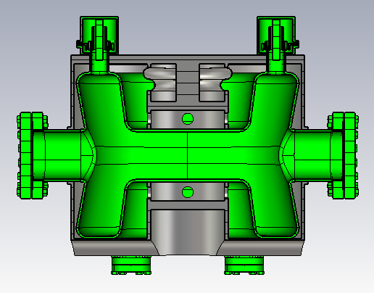
DQW Cavity with HOM high-pass filter
66 mm
66 mm
Z. Li @ 2nd Joint HiLumi LHC-LARP Annual Meeting
Modified from BNL HOM filter for 56 MHz SRF Quarter Wave Cavity

Slide 16
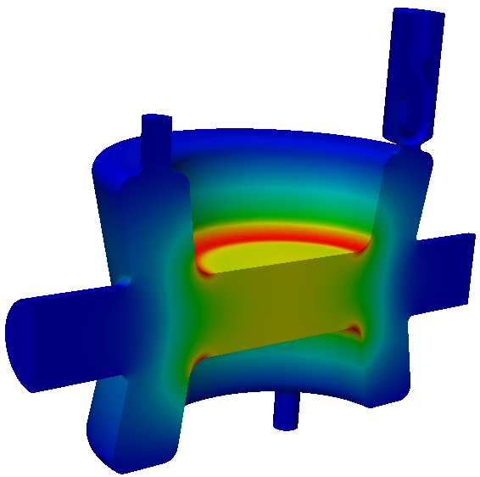
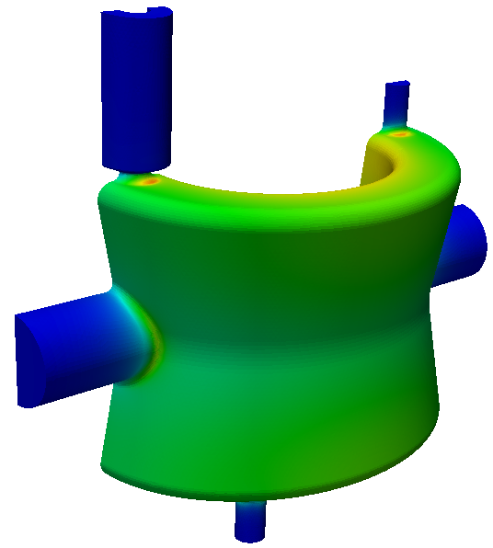
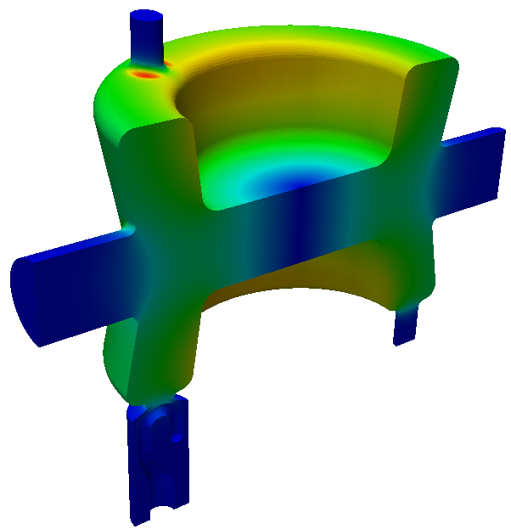
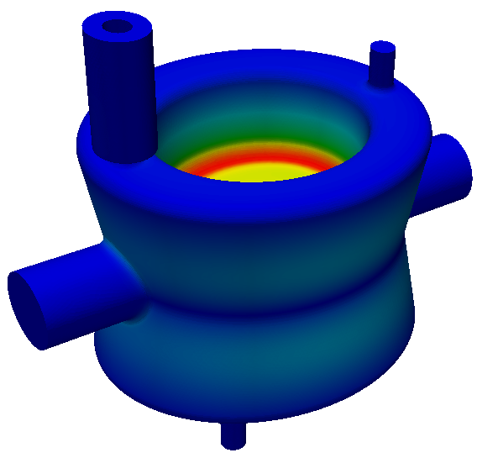
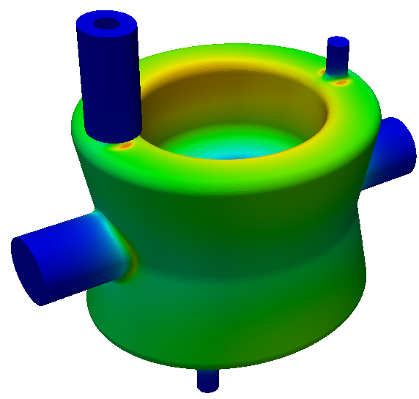
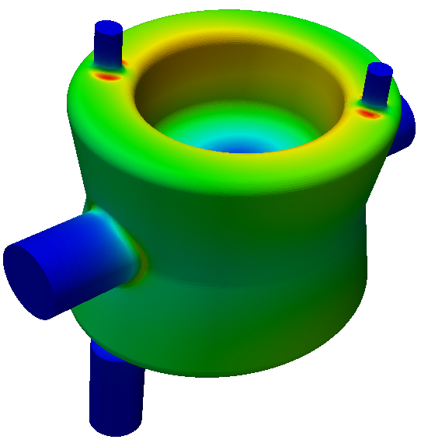
DQW Cavity Simulation – small FPC opening
same HOM small FPC
E B
diff HOM small FPC
Peak surface B field at the rounding of HOM port

Slide 17
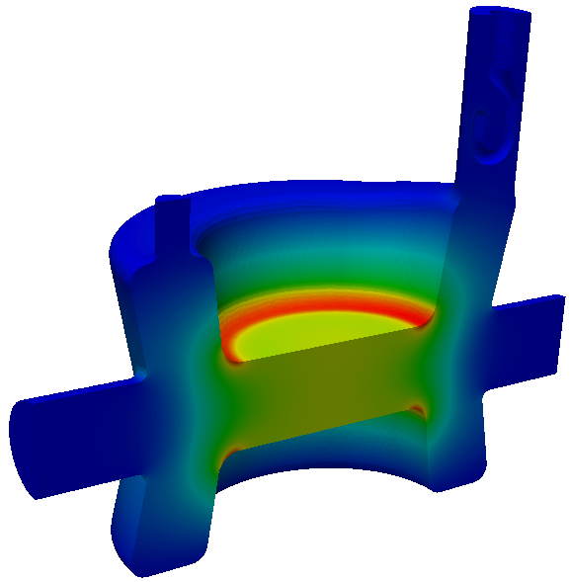
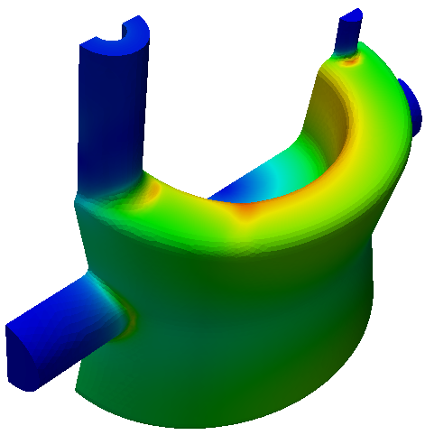
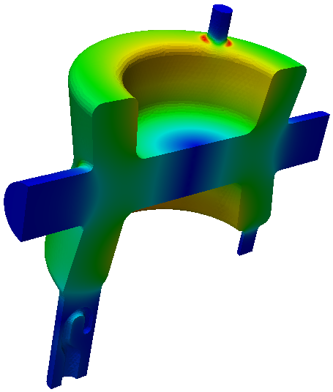
DQW Cavity Simulation – large FPC opening
E B
Peak surface B field at the rounding of HOM port
Field asymmetric due to large FPC opening, symmetrizing needed

Slide 18
DQW Cavity Parameters
Parameters | same HOM small FPC | same HOM large FPC
Frequency (MHz) | 398 | 396
Qext | 2.5e6 | 1.1e6
R_{T} (ohm/cavity) | 400
V_{T} (MV/cavity) | 3.34 | 3.34
Bs (mT) | 88 | 81
Es (MV/m) | 37.4 | 37.6
Electric center offset (mm) | 0.03 | 1.67
Multipole b3 (mT.m)/m² (for VT=10MV) | 1074 | 1096
Multipole b5 (mT.m)/m⁴ (for VT=10MV) | 1.7e5 | 8.9e4

Slide 19
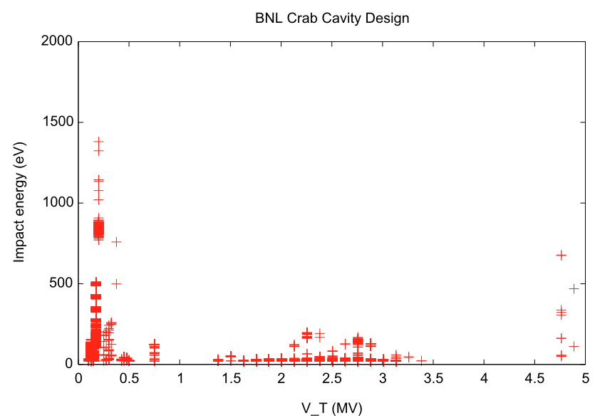
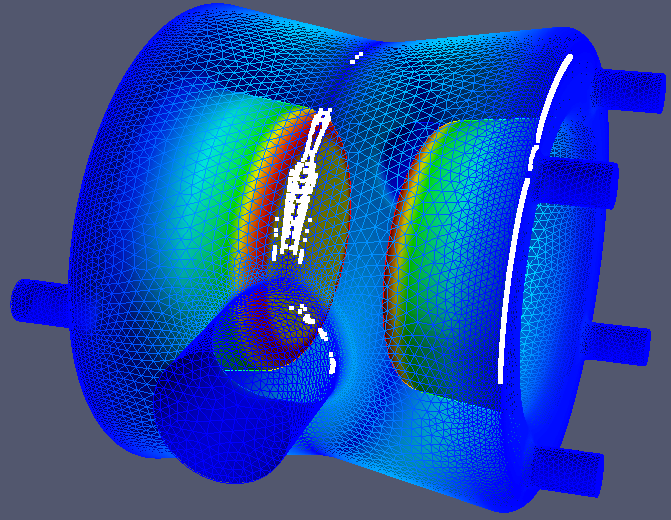
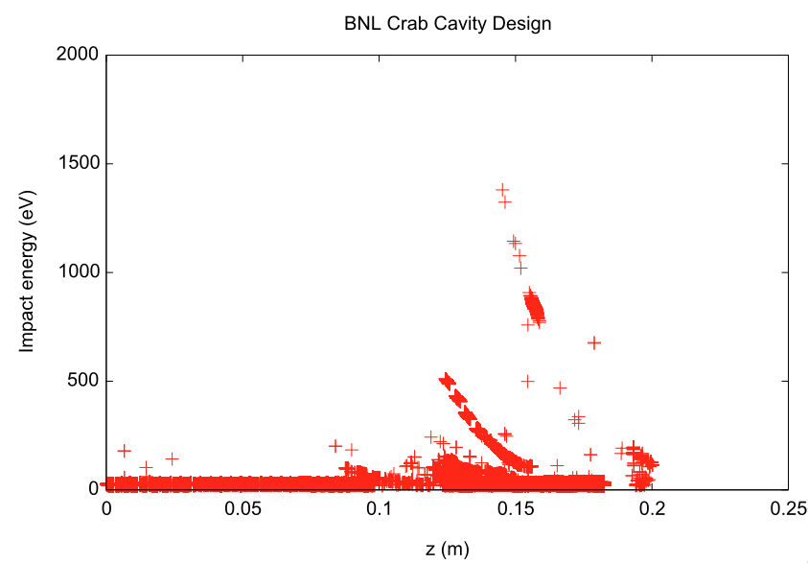
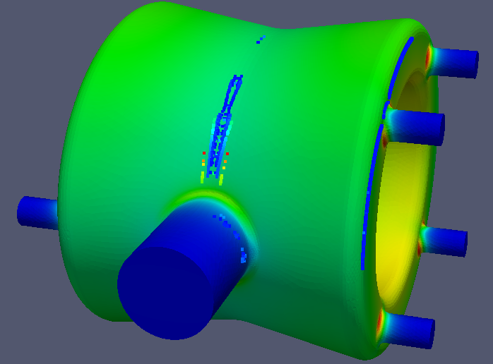
DQW Cavity Multipacting - preliminary

Slide 20






RFD - MP in FPC coupler
Hook-shaped probe with a flat surface:
there is an important multipacting band around the flat surface at lower deflecting voltages
MP Mitigation
a rounded hook-shaped probe which eliminated MP resonances
MP trajectories with low SEY due to high impact energy

Slide 21



RFD - MP in Waveguide HOM Coupler
  Significant MP in the ridged gap region
  Owning to an evanescent field in the waveguide, MP band continues to higher voltage while the MP region moves further away from the cavity
MP region moves upward at high voltages
MP region at a lower voltage
(incomplete data)
MP continues to higher deflecting voltages

Slide 22




Suppression With Grooves
parallel groove
slanted groove
Grooved surface around the ridged gap NOT effective in suppressing MP (due to limited groove depth)

Slide 23


RFD - WG HOM Coupler MP mitigation
Ridged waveguide with a larger curvature + local bump
Ridged gap with a larger curvature minimizes the MP region
Small bump on one side of ridged gap further suppresses MP resonances
ridged gap with a larger curvature
small bump on one side of gap

Slide 24


RFD - MP in Vertical HOM Coupler and Cavity Surface
Important multipacting bands on end plate at lower voltages, a prototype cavity of similar design was successfully processed without much difficulty (J. Delayen, et al, LARP CM20 and IPAC2013)
Less significant MP band inside the cavity at higher deflecting voltages, with low impact energies
No multipacting trajectories found in the WG-stub-coaxial coupler region

Slide 25
Summary and Plan
Summary
Significant progress in cavity/coupler design toward the prototypes for SPS test
Numerical analyses of cavity RF (e.g MP) being confirmed with measurement of prove-of-principle cavities
Mitigation of potential RF and MP issues through numerical modeling could result in improved cavity performances
Next steps
Finalize/Optimize design of RFD and DQW cavities for the SPS test modules
  Finalize the dimensions, evaluate RF parameters and MP in cavity/couplers
  Analyze any changes to the geometry needed for the engineering design
  Design peripheral components – waveguide, window, load, etc
  Analyze thermal, Lorentz force detuning using ACE3P

Slide 26
Summary and Plan
Further design and optimization toward the LHC implementation
  Improvements in cavity shape and couplers
  Cryomodule integration – cavity-cavity coupling
  Trapped modes
  Effect of imperfection, tolerances
  Etc
Collaborative modeling efforts for RFD and DQW cavities
  Using ACE3P as the choice of modeling tool
  Toohig fellow at BNL will start learning and using ACE3P, ODU Posdoc and staff continue using ACE3P on cavity modeling and analysis
  RFD and DQW cavities and peripheral RF components for the cryomodule will be designed/optimized for the SPS test and the LHC implementation with the SLAC, BNL, ODU modeling effort

