Slide 1
RF Dipole Cavity
Design and Plans
LARP Review
Fermilab, 10 June 2013

Slide 2
Acknowledgments
Work performed by
  Subashini De Silva (ODU PhD Student)
  Jean Delayen (ODU)
  Zenghai Li (SLAC)
  Julius Nfor (ODU Post-Doc)
  Rocio Olave (ODU Post-Doc)
  HyeKyoung Park (ODU Master Student/JLab Mech. Eng.)

Slide 3
Outline
Proof-of principle design and results
Prototype design vs proof-of-principle cavity
  RF parameters
  Multipacting
  Field flatness and multipoles
  Higher Order Mode analysis
Mechanical analysis
  Mechanical strength
  Pressure sensitivity
  Lorentz force detuning
Cryostat and ancillary components
  Tuner
  Helium tank
  Cryostat concept
Summary and Future plan

Slide 4
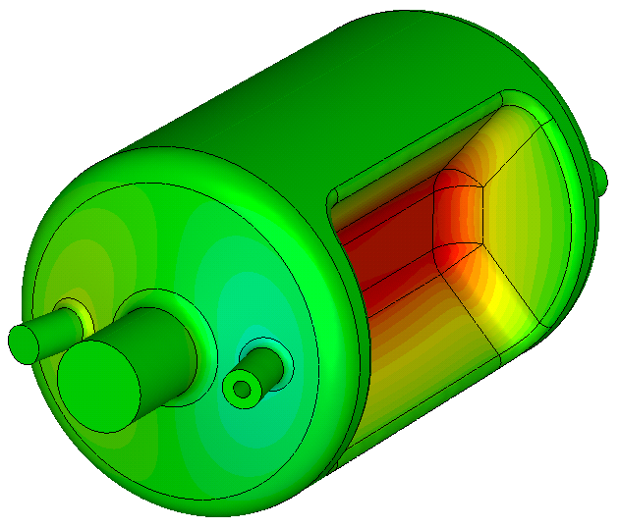
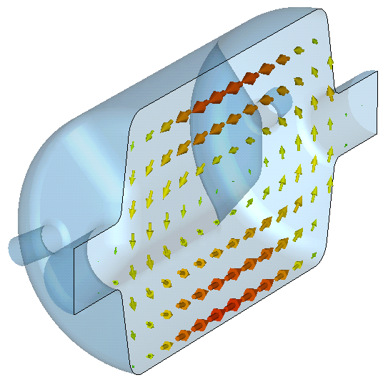
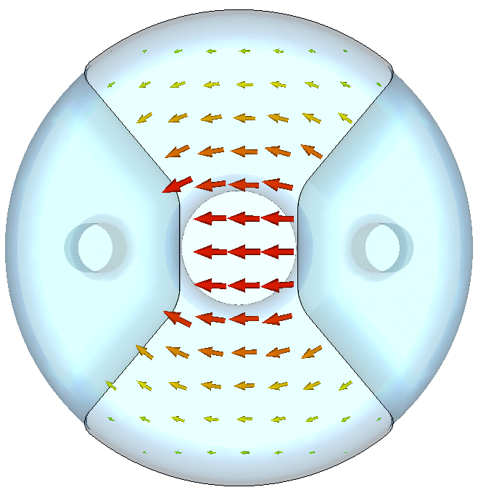
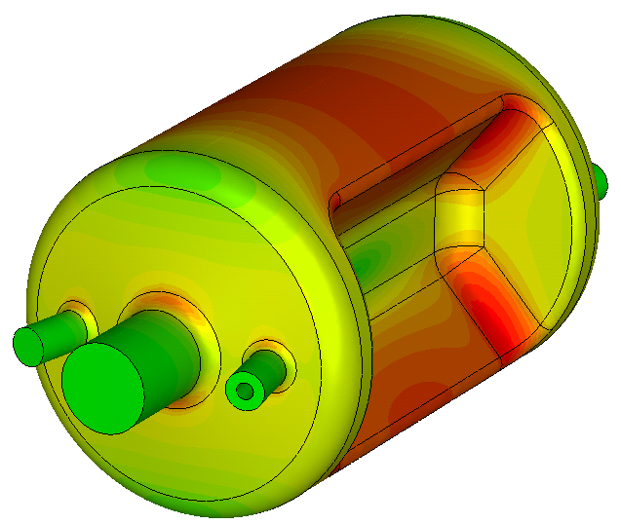


Proof of Principle Design
Design requirements
  Frequency = 400 MHz
  Beam aperture = 84 mm
  Total transverse voltage = 10 MV
  Transverse voltage per cavity = 3.4 MV
Transverse electric and magnetic fields
Surface electric and magnetic fields

Slide 5
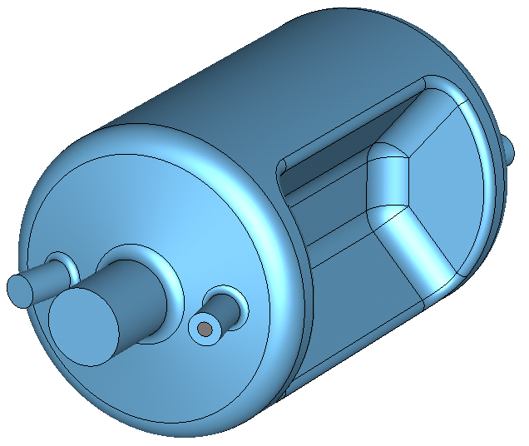
Basic Properties
Property | Value | Unit
V_{T}* | 0.375 | MV
E_{p}* | 4.02 | MV/m
B_{p}* | 7.06 | mT
B_{p}*/E_{p}* | 1.76 | mT/ (MV/m)
U * | 0.195 | J
[R/Q]_{T} | 286.95 | Ω
Geometrical Factor (G) | 140.86 | Ω
R_{T}R_{S} | 4.04×10⁴ | Ω²
At E_{T}* = 1 MV/m
34 cm
8.4 cm
52.8 cm
HOM Properties
No lower order modes
Separation of HOMs from fundamental mode ~ 190 MHz

Slide 6
Fabrication
Fine grain Nb – RRR 353-405
Cavity thickness – 3 mm

Slide 7
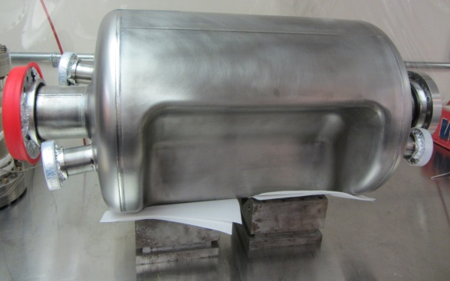
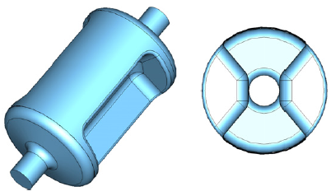
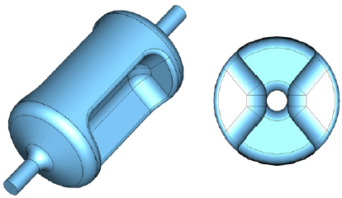
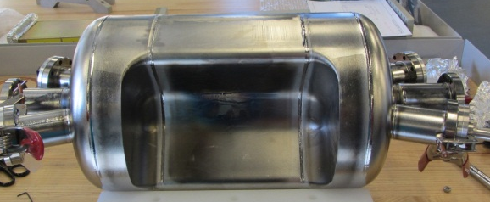
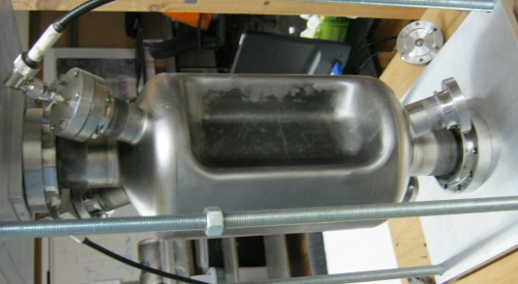
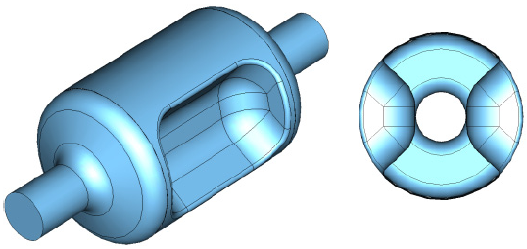
RF-Dipole Cavity Designs
400 MHz Crabbing Cavity for
LHC High Luminosity Upgrade
Frequency | 499.0 | 400.0 | 750.0 | MHz
Aperture Diameter (d) | 40.0 | 84.0 | 60.0 | mm
d/(λ/2) | 0.133 | 0.224 | 0.3
LOM | None | None | None | MHz
Nearest HOM | 777.0 | 589.5 | 1062.5 | MHz
E_{p}* | 2.86 | 3.9 | 4.29 | MV/m
B_{p}* | 4.38 | 7.13 | 9.3 | mT
B_{p}*/E_{p}* | 1.53 | 1.83 | 2.16 | mT/ (MV/m)
[R/Q]_{T} | 982.5 | 287.2 | 125.0 | Ω
Geometrical Factor (G) | 105.9 | 138.7 | 136.0 | Ω
R_{T}R_{S} | 1.0×10⁵ | 4.0×10⁴ | 1.7×10⁴ | Ω²
At E_{T}* = 1 MV/m
53 cm
34 cm
499 MHz Deflecting Cavity for
Jefferson Lab 12 GeV Upgrade
44 cm
24 cm
750 MHz Crabbing Cavity for MEIC at Jefferson Lab*
35 cm
19 cm

Slide 8
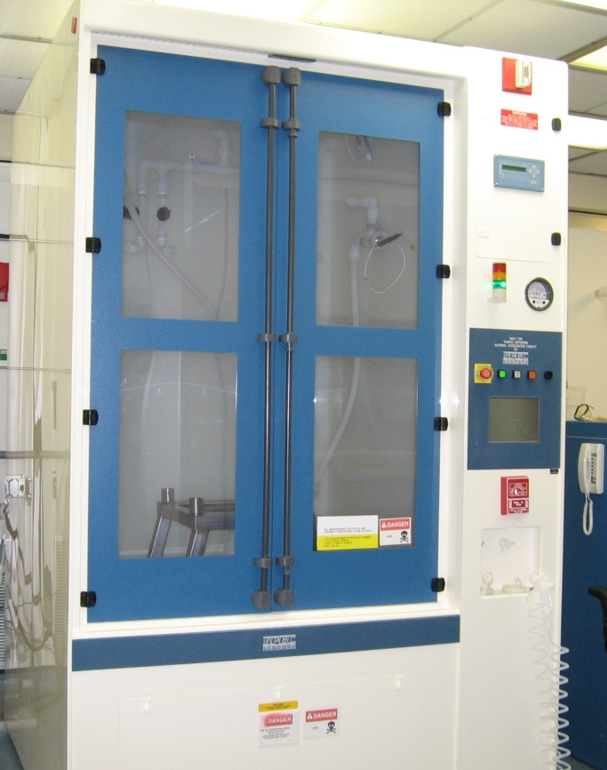
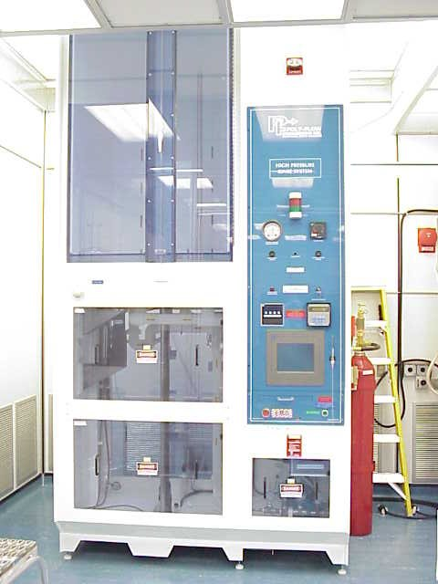
Surface Treatment, Preparation and Testing
Bulk BCP – 85 μm
Heat treatment – At 600⁰ C for 10 hours
Light BCP – ~10 μm
High Pressure Rinse – 3 passes
Assembly in the clean room
BCP Cabinet
HPR Cabinet
RF Test Plan
  High power tests at 2 K and 4 K
  Rs vs. T
  Pressure test
  Lorentz detuning
  No He processing was done
RF Tests Performed
  2 K high power test
  Cavity warmed up to 4 K
  4 K high power test
  Cavity cooled down to 2 K
  2 K high power test

Slide 9
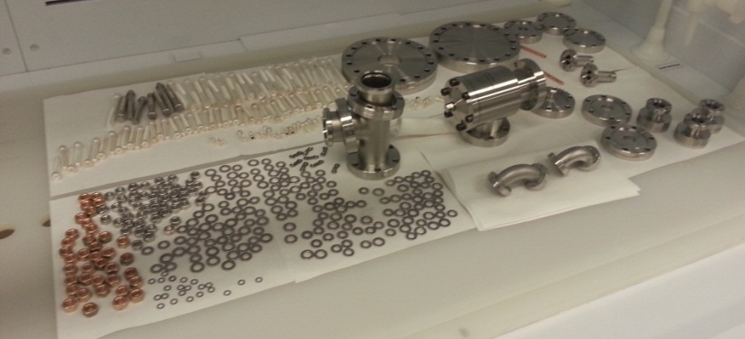
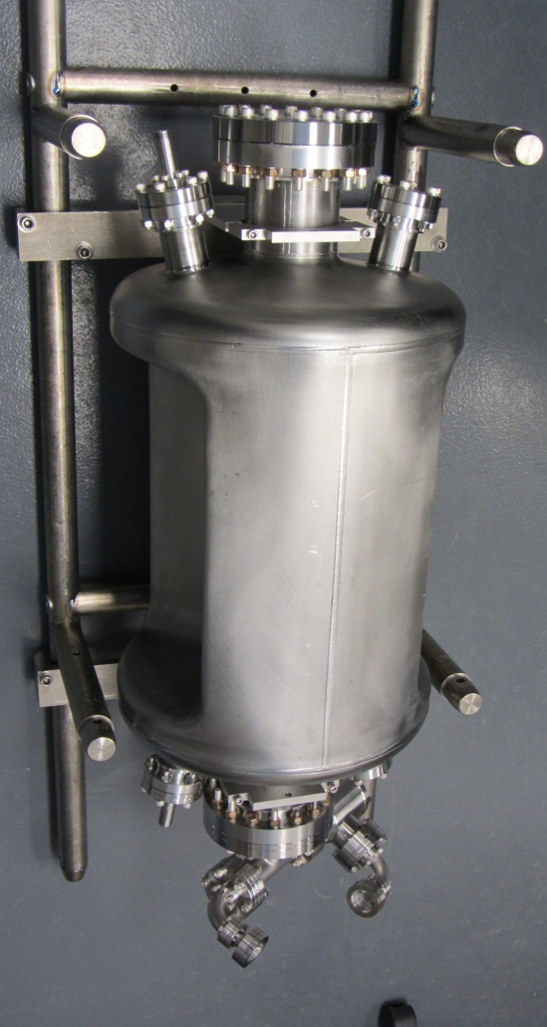
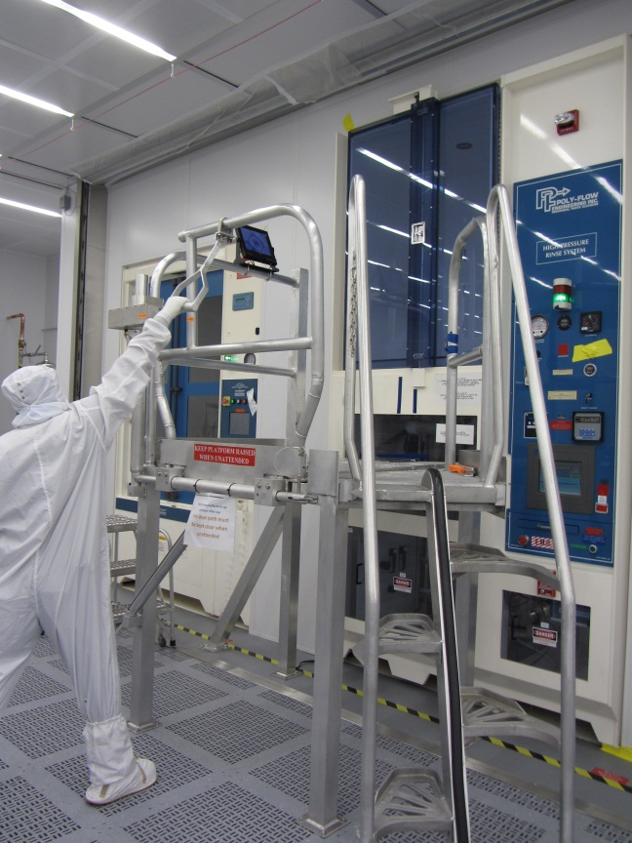
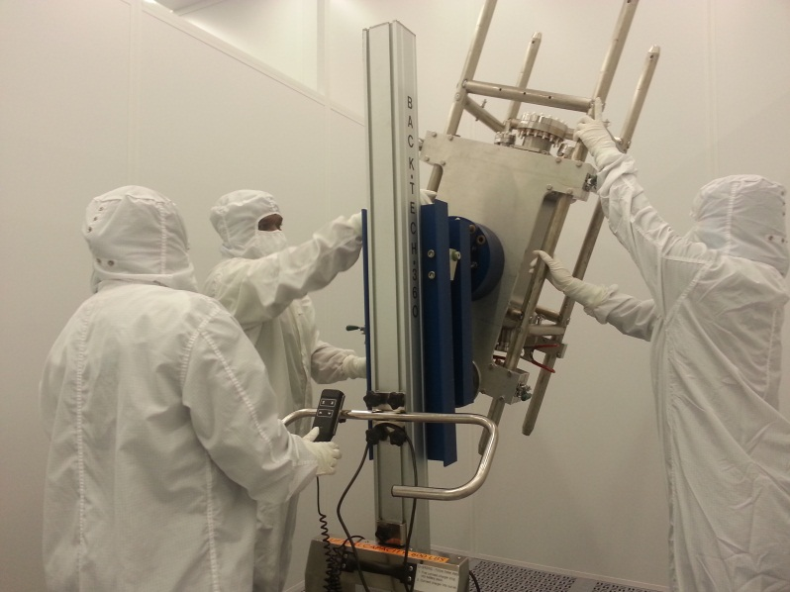
Assembly
Followed by a HPR of 3 passes
Ultrasonic degreased hardware
Leak tested
Assembly in clean room

Slide 10
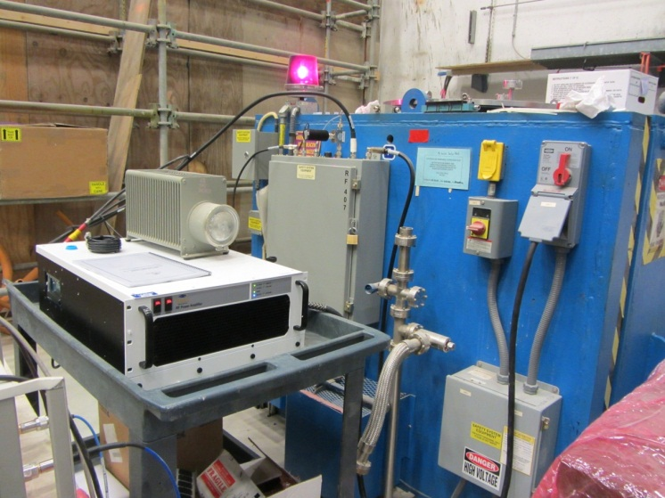
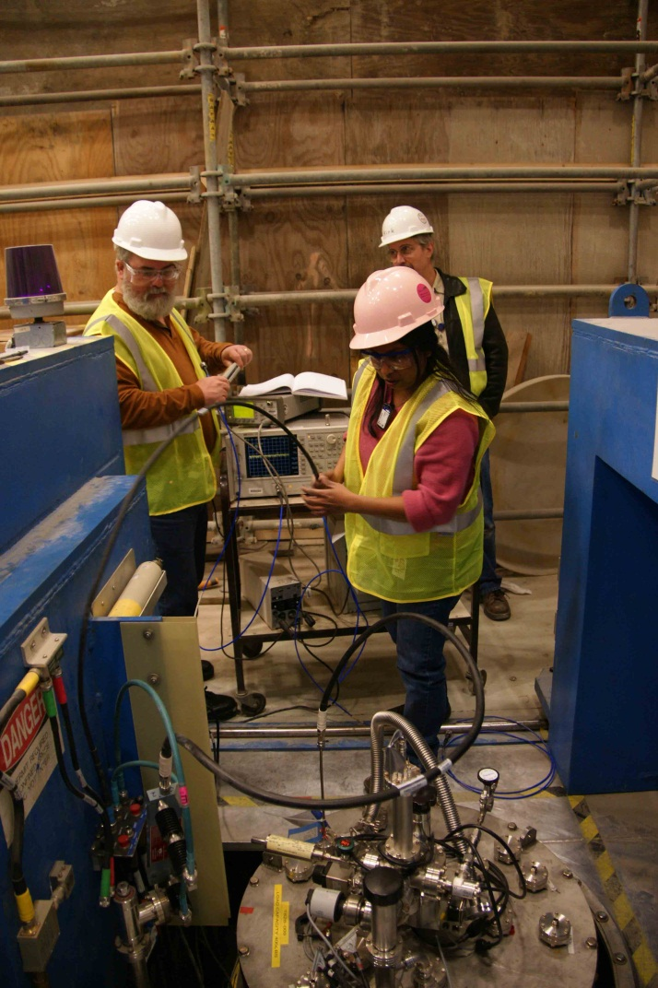
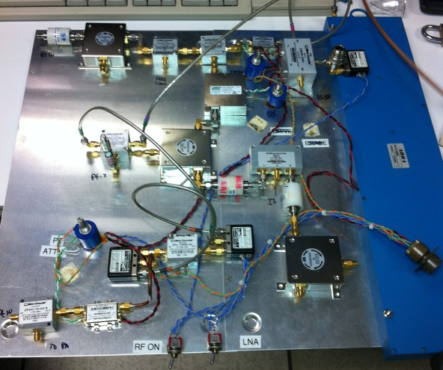
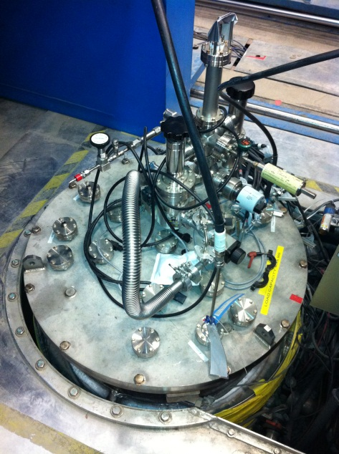
Preparation for Test
Cable calibration
  Q₁ = 2.76×10⁹
  Q₂ = 8.62×10¹⁰
LLRF control
Test with 500 W rf amplifier

Slide 11
2 K and 4.2 K Test Results
Multipacting easily processed and did not reoccur
No He processing
Achieved fields
  E_{T} = 18.6 MV/m
  V_{T} = 7.0 MV
  E_{P} = 75 MV/m
  B_{P} = 131 mT
Expected Q₀ = 6.7×10⁹
  At R_{S} = 22 nΩ
  And R_{res} = 20 nΩ
Achieved Q₀ = 4.0×10⁹
Quench
3.4
5.0

Slide 12
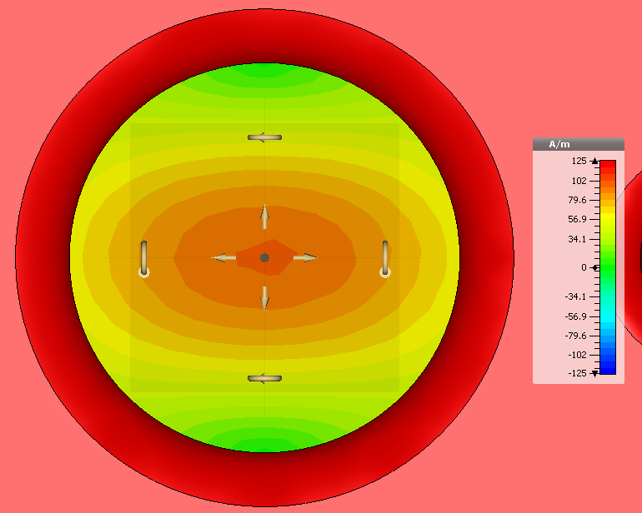
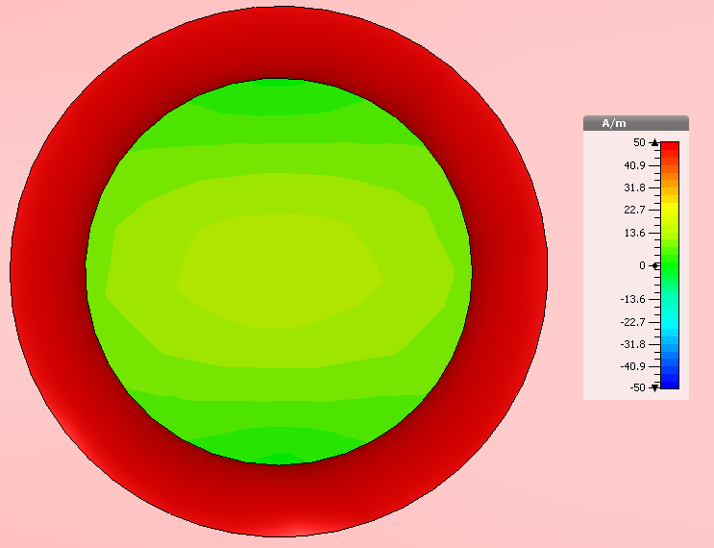
Low-field Q
Beam line port
Coupler port
Calculated Q due to stainless steel flanges : 3.7 10⁹
Measured Q : 4.0 10⁹

Slide 13
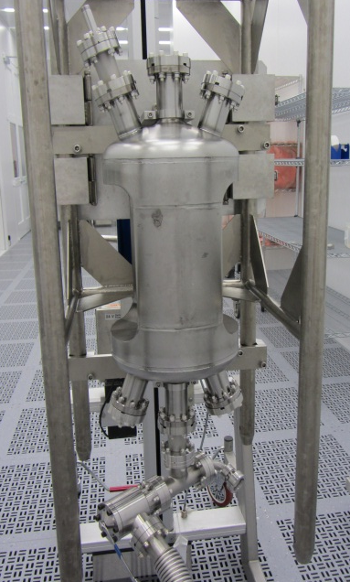
499 MHz Deflecting Cavity for JLab Upgrade
No multipacting
R_{res} ~ 5 nΩ

Slide 14
Summary on Proof-of-Principle
Proof-of-Principle cavity achieved 7 MV deflecting voltage cw
Residual surface resistance a little high (34 nΩ)
  Consistent with losses in stainless steel flanges
Multipacting quickly processed and did not reoccur
Proof-of-Principle cavity has achieved its purpose
Ready to move on to the prototype cavity
Reasonably confident that 10 MV can be achieved with 2 cavities

Slide 15
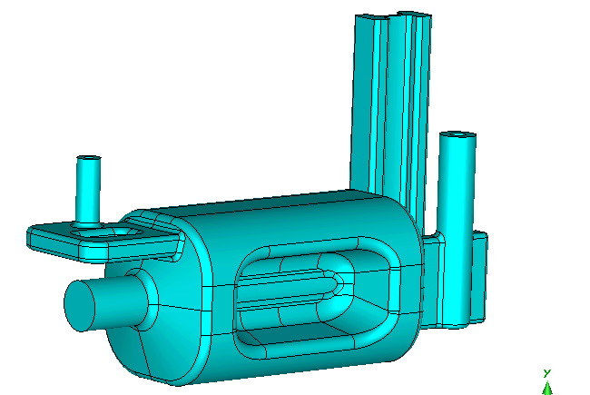
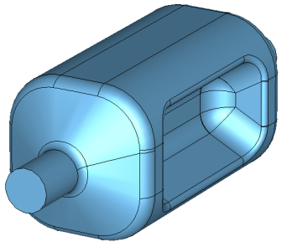
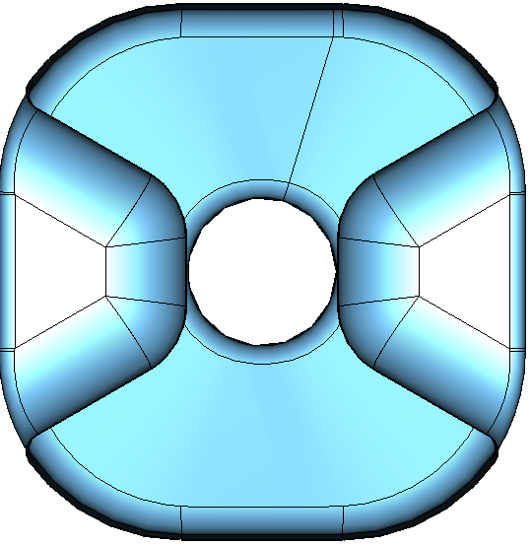
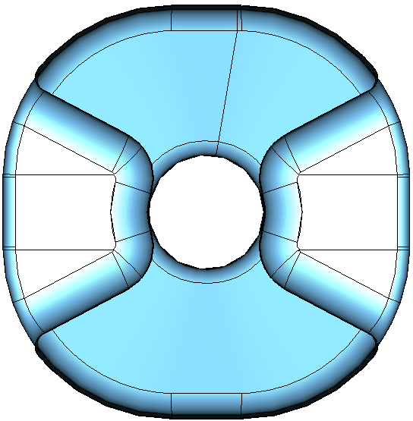
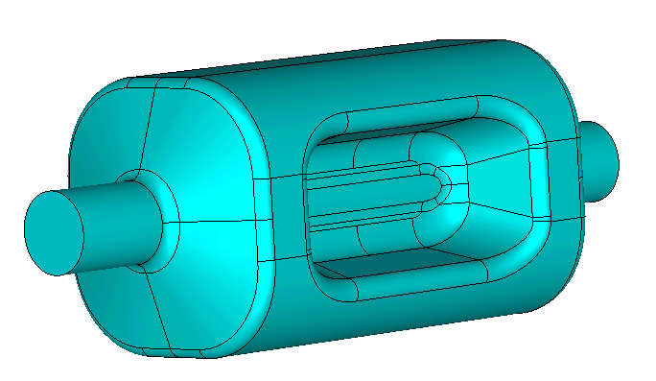
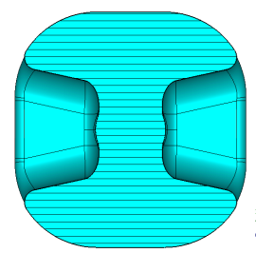
Prototype Design vs. Proof-of-Principle
ODU/SLAC
Cavity Design Evolution
Prototype Design
Cavity Dimensions
 | Prototype Design | Proof-of- Principle | Units
Radius | 140.5 | 170 | mm
Iris-to-iris Length | 535 | 528 | mm
Beampipe aperture | 42 | 42 | mm

Slide 16
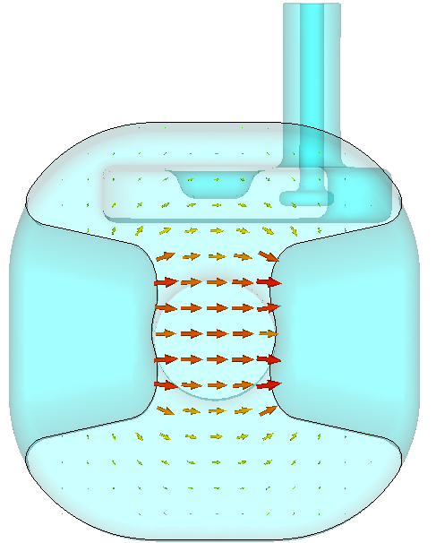
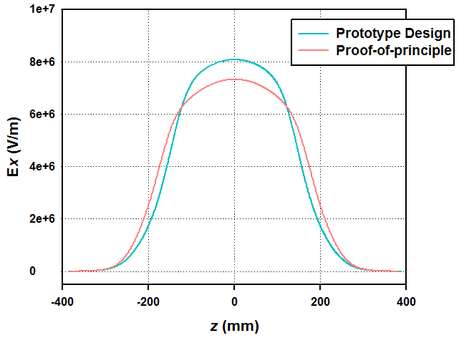
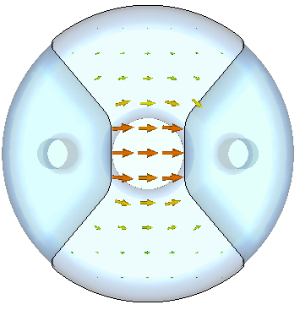
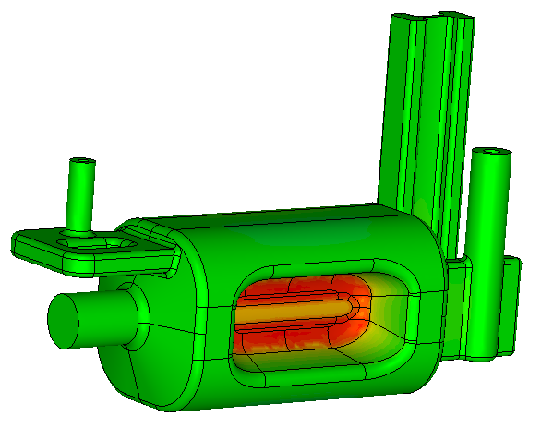
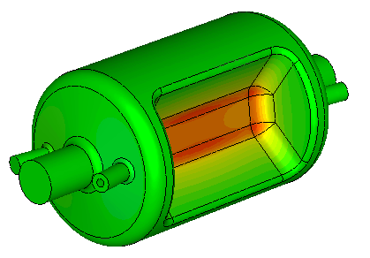
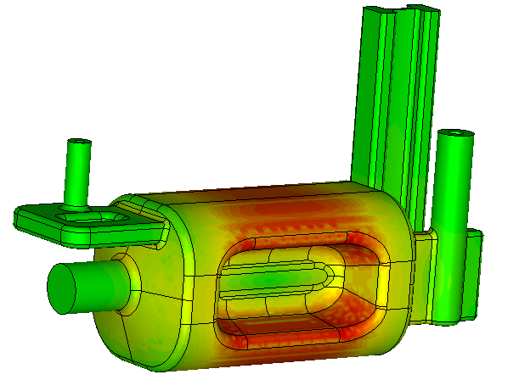
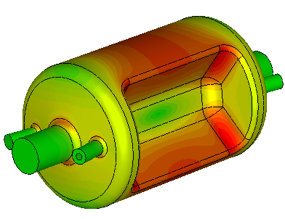
Prototype Design vs. Proof-of-Principle
Transverse
Electric Field
* At energy content of 1 J
Surface Electric Field
Surface Magnetic Field

Slide 17
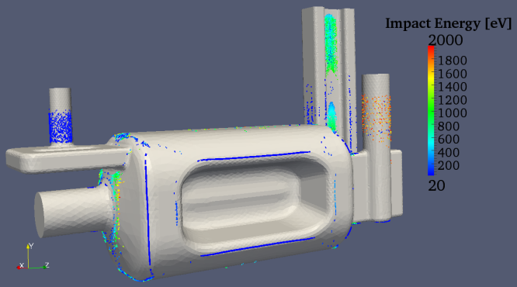
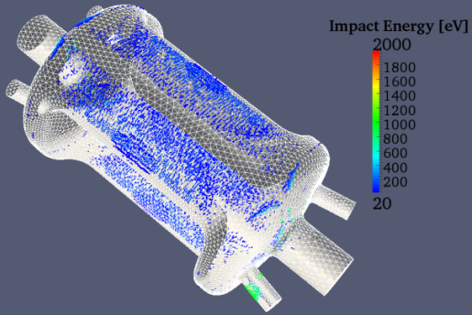
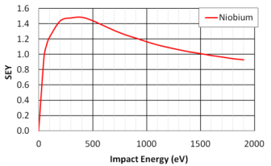
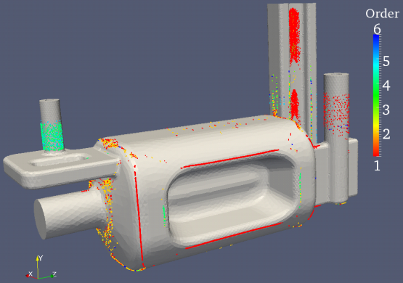
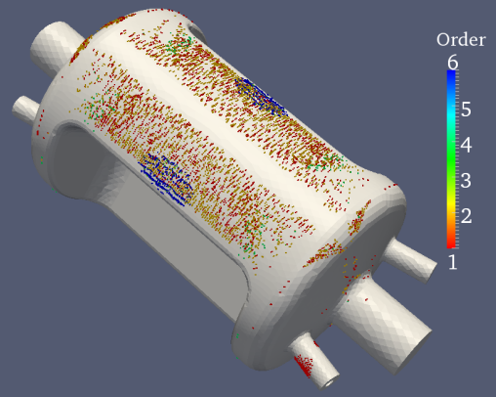
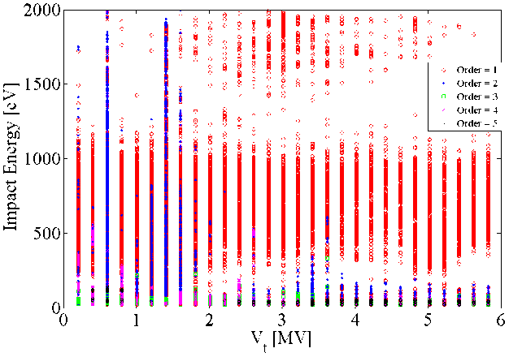
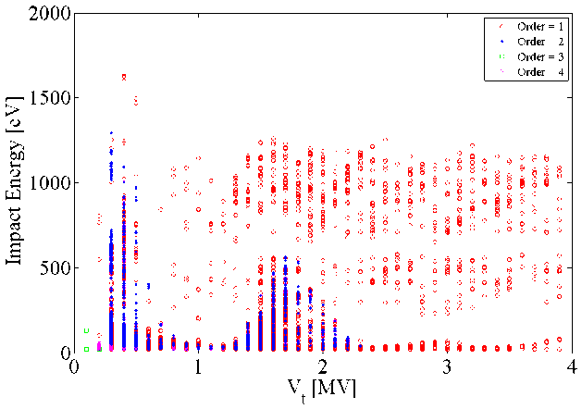
Prototype Design vs. Proof-of-Principle
Prototype design
Multipacting Simulations
Proof-of-Principle
Using Track3P from the ACE3P Code Suite developed at SLAC

Slide 18
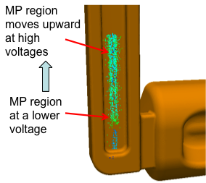
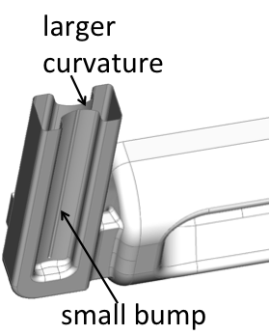
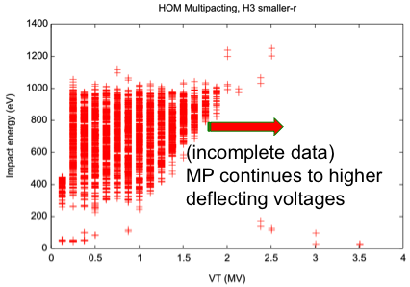
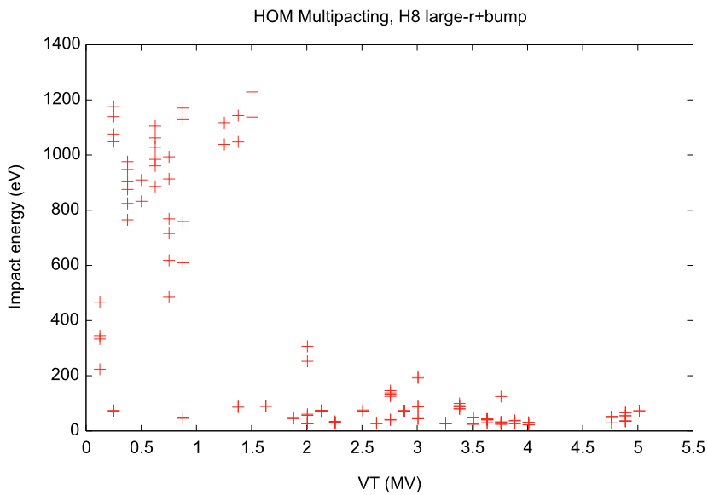
Multipacting Simulations

Slide 19



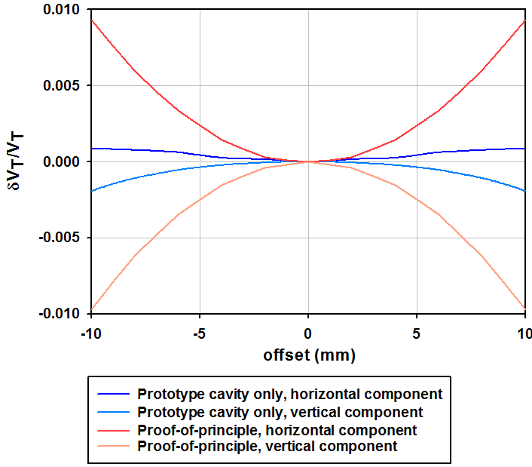
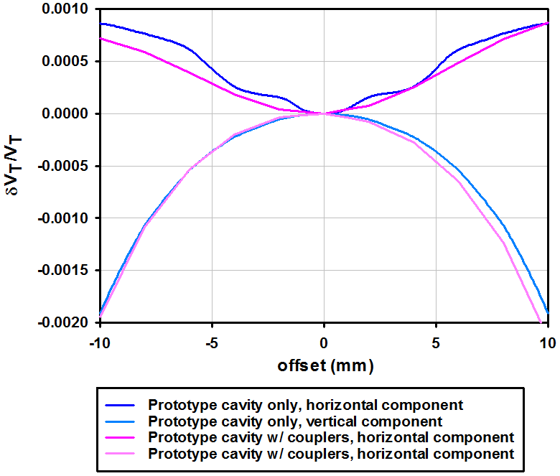
Prototype Design vs. Proof-of-Principle
Multipole Components
 | Prototype Design | Proof-of-Principle | Units
b₃ | 455.2 | 3.0×10³ | mT/m
b₄ | 24.62 | 0 | mT/m²
b₅ | -2.19x10⁶ | -4.6×10⁵ | mT/m³
At V_{T} = 10 MV
Field flatness /
Multipoles
Shift in electrical center of 55 μm due to the asymmetry introduced by the couplers

Slide 20



Prototype Design vs. Proof-of-Principle
Higher order mode analysis
Wide frequency separation between modes
Nearest cavity mode
~230 MHz away
Nearest cavity mode
~190 MHz away

Slide 21

Couplers

Slide 22

Almost Final Geometry
Still need to include access ports for chemistry and high-pressure rinsing
Still need to decide location of transitions and flanges

Slide 23








Prototype Design vs. Proof-of-Principle
RF PARAMETERS | Prototype design | Proof-of- Principle | Units
Deflecting voltage (V_{T}*) | 0.375 | 0.375 | MV
Peak electric field (E_{P}*) | 3.66 | 4.02 | MV/m
Peak magnetic field (B_{P}*) | 6.14 | 7.06 | mT
B_{P} / E_{P} | 1.67 | 1.76 | mT / (MV/m)
Stored Energy (U*) | 0.13 | 0.195 | J
Geometrical factor (G = QR_{S}) | 106 | 141 | Ω
[R/Q]_{T} | 427.2 | 287 | Ω
R_{T}R_{S} | 4.54x10⁴ | 4.04×10⁴ | Ω²
* at E_{T}= 1 MV/m
At V_{T} = 3.4 MV
Peak electric field (E_{P}) | 33.2 | 36.5 | MV/m
Peak magnetic field (B_{P}) | 55.7 | 64.0 | mT
Prototype is superior to Proof-of-Principle across all parameters
Electromagnetic design is now frozen

Slide 24


Mechanical Analysis
Mechanical strength – Stress
Worst case scenario:
Allowable stress 70 MPa
at room temperature and 2.6 bar external pressure
4mm thick formed plate added
4mm thickness
Weak area identified
(LHC crab cavity meeting, December 2012)
4mm thick stiffeners added

Slide 25


Mechanical Analysis
Results (Stress intensity)
Main body below 70 MPa
Stress concentration at coupler ports – solved by machining instead of stamping (flexibility to increase thickness at high stress areas)
Adjacent beam pipe is not needed for SPS test.
Then, stiffener will be identical top and bottom and still meets the requirements.

Slide 26


Mechanical Analysis
Pressure Sensitivity -30 Hz/torr
Tuning Sensitivity +90 kHz/mm
Lorentz Force Detuning -20 Hz/(MV/m)²
All characteristics improved from the proof of principle cavity design
Lorentz force detuning Deformation scale 5.8e+4
Niobium property at 2-4K
Picture not showing adjacent beam pipe but included in the analysis

Slide 27


Tuner Options
CEBAF Upgrade Coarse Tuner
Resolution/Deadband Test
JLAB scissor jack tuner fits with minimal scaling
Tuner can be driven by stepper motor or pneumatic control
Proven performance of JLAB mechanical tuner
  Resolution/Deadband/Hysteresis < 2 Hz
  Frequency drift due to Helium pressure fluctuations

Slide 28


Helium Tank
Dummy pipes
Simple stainless steel construction
All cavity and Helium ports on flat surface
Bellows connections to compensate thermal contraction
Dummy pipes or internal structure to reduce Helium volume if required.

Slide 29


Cryostat Concept
Helium tank/Tuner Assembly
Horizontal beam deflection
Vertical beam deflection
Ongoing brain-storming to use identical helium tank for both configuration if it is beneficial

Slide 30


Cryostat Concept
815 mm
940 mm
248 mm
2900 mm
Cross section view
Cryostat concept including as many parts as possible
He tank/tuner assembly
Magnetic shielding
Helium supply and return lines
Envelope for SPS (520x1200x3100mm) can be met without the adjacent beam pipe

Slide 31
Summary and Future Plan
“Final” prototype cavity design
  Better electromagnetic properties than proof-of-principle
  Includes power and HOM couplers
  Complies with safety requirements
  Complies with dimensional requirements
Integrated system design study ongoing
  More complete layout
  Mechanical tuner
  Helium tank
  Cryostat concept
Ready to build and test “final” prototype cavity

