Slide 1
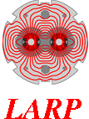
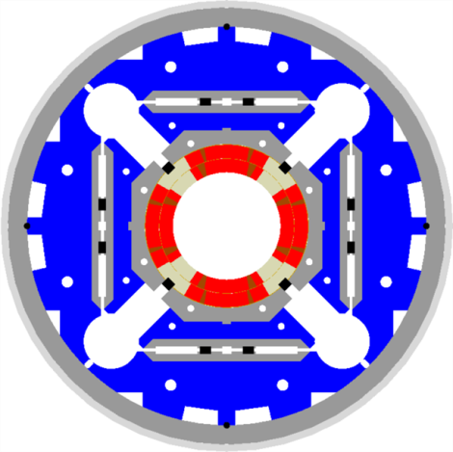
IR Quadrupole Production Plan
Mike Anerella
LARP Review
June 10, 2013

Slide 2
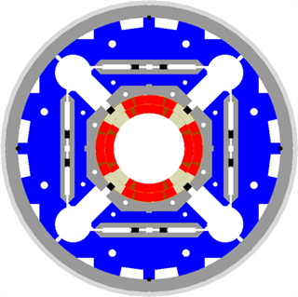
Scope
Assemble 20 (16 + 4 spares) Q1/Q3 quadrupole structures:
“structure” = coils clamped radially in aluminum shells, axially with stainless steel rods and end plates
4.5 coils per quad = 90 coils total
Cold test all 20 quads
Demonstrate 140 T/m Operation
Field measurements
Satisfy CERN production delivery requirements with suitable margin
(4/2022 1st unit, 12/2022 16th unit)

Slide 3
Work Breakdown
LBNL
FNAL (10)
BNL (10)
Superconductor cabling
Coil pack assembly
Coil pack assembly
Yoke / aluminum shell subassemblies
Coil structure assembly
Coil structure assembly
He vessel, cryostat installation (temporary)
Horizontal Test facility installation & test
Vertical Test facility installation & test
(Alternate breakdowns being discussed (single assembly site, single test site), but are not addressed herein)

Slide 4
Coil Plan
Coil fabrication is a dominant cost and schedule element in the program
→ prompted detailed review
After independent BNL & FNAL estimates & subsequent meetings to review:
 | Time (days)
Operation | BNL | FNAL | Production
React | 20.25 | 23 | 24
Impregnate | 30.75 | 26 | 30
Prep for cold mass assembly | 4 | 9 | 5
Example of added benefit of meetings: realization that FARO Arms for cmm inspection must be budgeted for each location; more efficient operation, standardized inspection, etc.

Slide 5
Resulting Coil Schedule
Series reactions=1 oven needed
Reaction fxt use = 3 needed
Parallel effort:
(cure OL/wind IL
Parallel effort:
2 impregnation lines (but 1 station)
1 coil every 15 days
Excludes measurement & midplane ground insulation (covered later)
(details next slide)

Slide 6
Coil schedule details
Resources per location:
Operation | Techs | Comments
Wind / cure | 2.5 | 2 techs wind/cure inner, wind outer - 0.5 tech cures outer*
React | 2 | 1 line
Impregnate | 4 | 2 lines in parallel
Prep for cm assy | 0.5 | *Same tech as outer layer cure
→ 7 coil techs total (excludes supervision)
Total Tooling per location:
Item | Qty | Comments
Winding mandrel assy | 2 | Includes pushers, spacers, segments, etc.
Reaction oven | 1
Reaction tooling | 3 | Prep occurs in parallel w/reaction, + reaction tool is occupied during 1st ~ 10 days of impregnation
Impregnation station | 1 | Actual install/impreg/remove takes only ~ 1/3 of duration
Impregnation tooling | 2
Note that 1 of each are available from R&D

Slide 7
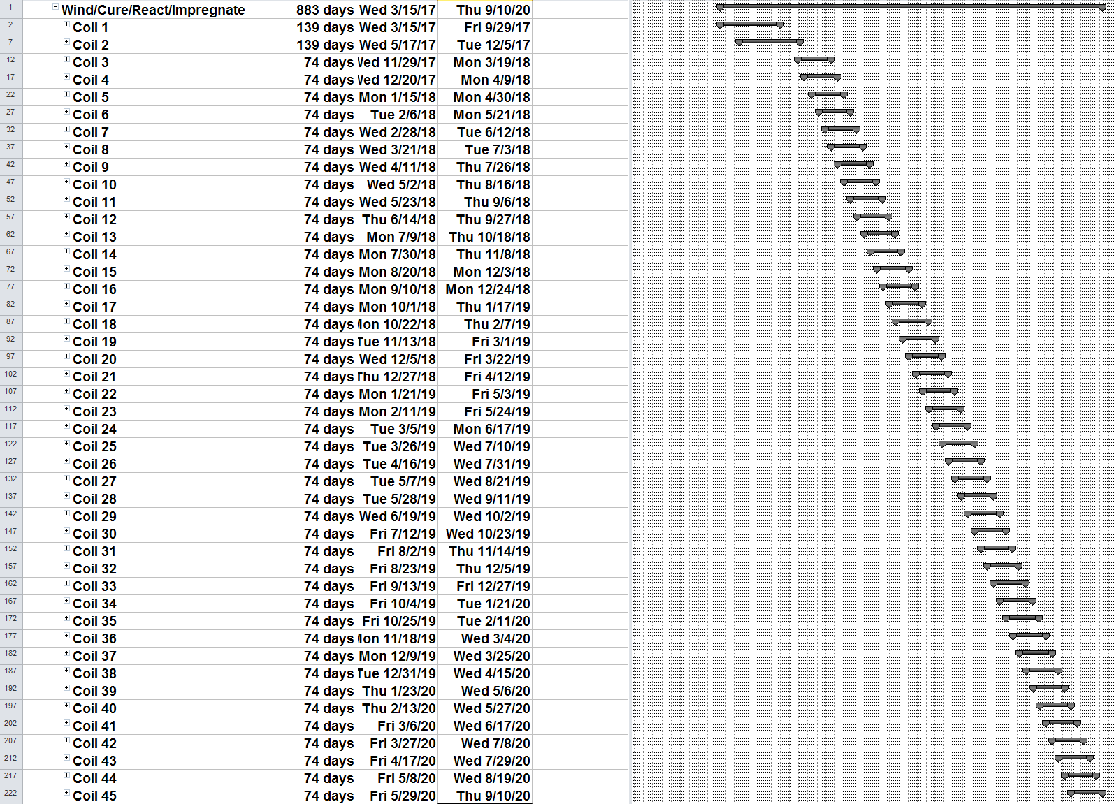
Complete Coil schedule
(1/2 production x 2 locations)
3/15/17 start
(after last R&D coil)
1st 2 coils with 2x duration (new tools)
9/10/20 finish

Slide 8
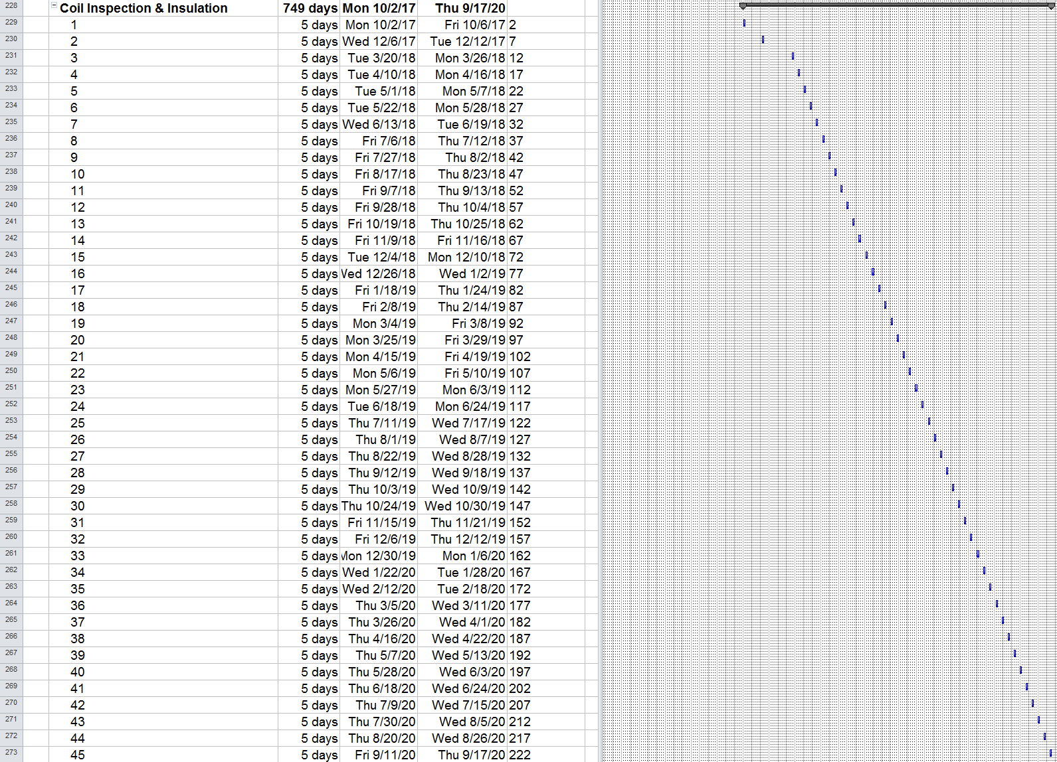
Coil Prep schedule
(1/2 production x 2 locations)
Cmm inspection
Install midplane ground insulation
Part time use of 3rd coil winder

Slide 9
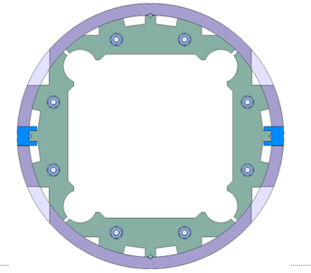
Yoke / Shell Subassembly
(1/2 production shown x 2 parallel lines)
Parallel effort to production
Early start due to (slightly) longer task duration
Assembly (2 x 2 Techs), Strain Gauge Installation (1 Tech) performed in parallel
→All subassemblies available for production, including shipping time
Need date
10/3/18
3/11/19
1/7/21

Slide 10
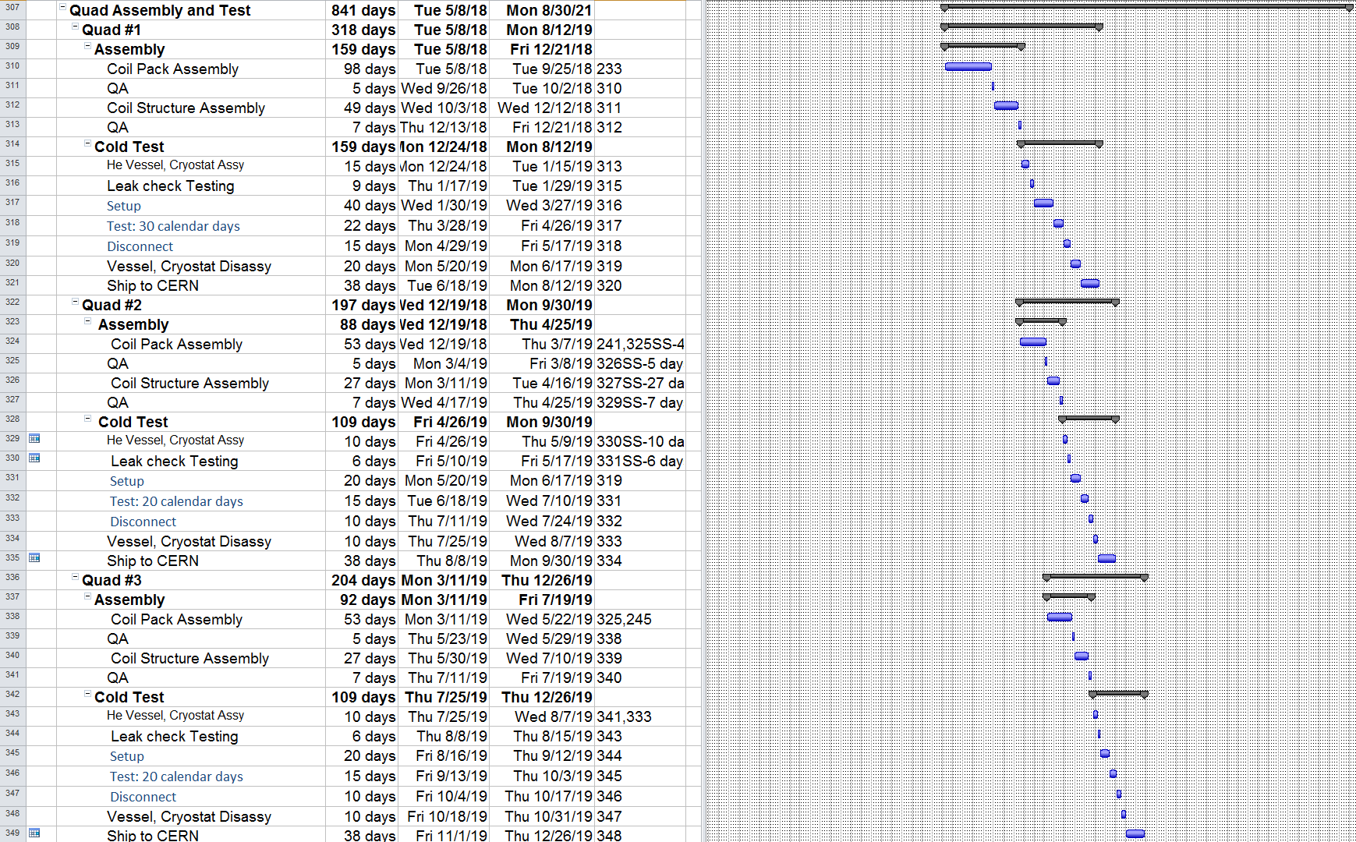
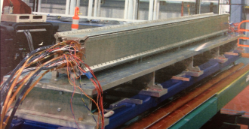
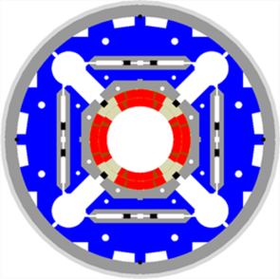
Quadrupole Assembly & Test
(1/2 production x 2 locations)
Coil Pack
Coil 5 done
1st assy with 2x duration
1st test with 1.5x duration
Test time based on FNAL
(BNL test time TBD)
Coil 15 done
Coil Structure
Coil Pack (2 techs) in parallel w/ Structure (2 techs)
NOT Optimized yet
Test setup in parallel w/ He vessel , cryostat assy
(2nd set of vessels req’d)
(2 testing techs,
4 assy/disassy techs)

Slide 11
Complete Production Schedule
(1/2 production x 2 locations)
April 2022 CERN need date (30 months float)
December 2022 CERN need date (18 months float)

Slide 12
Summary
Detailed estimates in support of overall plan
Efficiencies beyond R&D achieved through the use of multiple tooling sets
Plan meets CERN delivery requirements with adequate schedule float
Resources, i.e. staffing levels are manageable
Some optimization is still needed

