Slide 1
High Bandwidth Transverse Feedback
within the
LHC Injector Upgrade Project
(LIU)
W. Hofle
CERN BE-RF-FB
10.06.2013

Slide 2
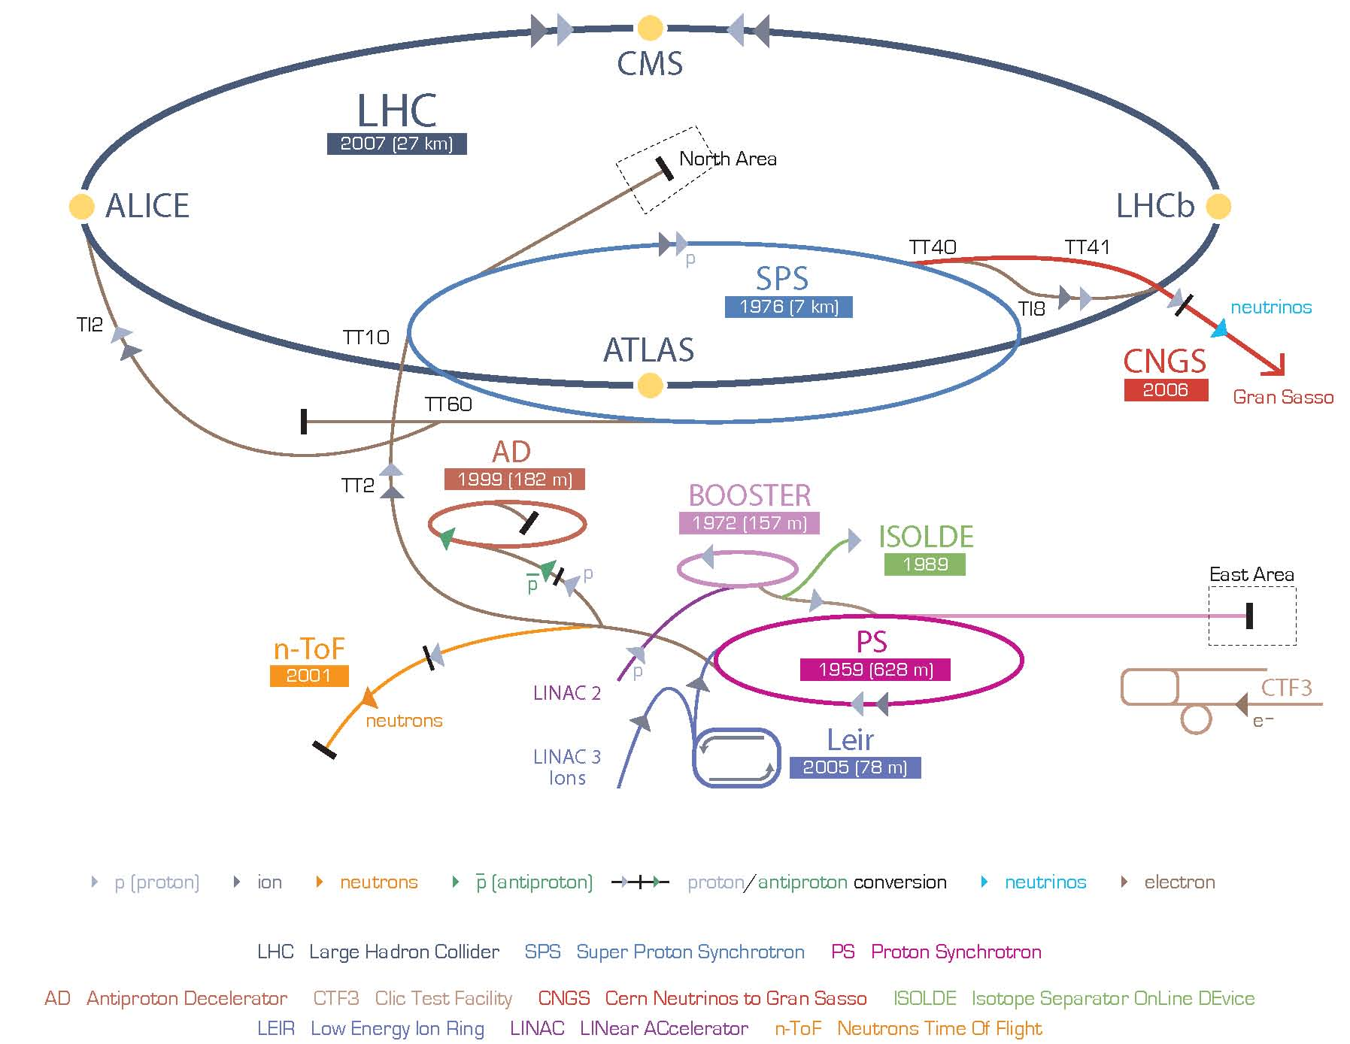
CERN Accelerator Complex
LHC: 450 GeV to 7 TeV, protons
400 MHz
SPS: 26 GeV/c to 450 GeV,
protons for LHC
200 MHz, 800 MHz
PSB: 50 MeV to 1.4 GeV,
future: 160 MeV to 2 GeV
0.6-1.7 MHz, 1.2-3.4 MHz
LINAC2 (protons), 200 MHz
to be replaced by LINAC4
(H- , under construction) 352 MHz
PS: Protons 1.4 GeV – 26 GeV/c
future: 2 GeV – 26 GeV/c
3 – 10 MHz, 13 MHz, 20 MHz, 40 MHz, 80 MHz
bunch structure of 25 ns created

Slide 3
Transverse Feedback Systems in LHC and its Injectors
Accelerator | Digital / analogue processing | Power / kicker / bandwidth | Status
PS Booster (protons) 50 MeV – 1.4 GeV kin. E. (future: 160 MeV to 2 GeV kin E) no ecloud, long bunches | multi turn injection from Linac 2 analogue beam offset signal suppression, analogue delay (cables & switches) | 100 W, 50 Ω stripline Limited to 13 MHz in operation But built for 100 MHz bandwidth, baseband | H-plane: used and required V-plane: beam stable w/o FB upgrade planned (LIU)
PS (protons, ions) 1.4 GeV – 25 GeV (kinetic E) (future injection at 2 GeV) ecloud observed when beam bunched at 25 ns Spacing, coupled bunch | digital system, synergy with LHC Damper for The low level digital processing 80 MHz clock frequency | 2 kW solid state power amplifier; 112 Ω stripline (0.9 m length), with ~30 MHz bandwidth in baseband, lower cut-off ~50 kHz | upgrade (LIU) commissioning started 2012 injection damping and feedback will be beneficial in particular for high intensity CNGS beams and LHC beams. Currently horizontal instabilities are cured by introducing coupling to the vertical plane which constrains the tunes
SPS (protons, ions) (14 – 450) GeV/c protons FT (26 – 450) GeV/c LHC beam ecloud observed and is a potential limitation for 25 ns spacing | digital notch filter and 1T-delay (Altera FPGA, 80 MHz clock) commissioned in 2000/2001 | tetrode amplifiers with two 30 kW tetrodes in push-pull directly coupled to a kicker (base band); feedback bandwidth ~10 kHz to 20 MHz | 2001 upgraded for LHC beams H-plane: used in operation V-plane: used in operation used and required for operation above 5x10¹² protons (max ~5.5x10¹³ ppp accelerated) upgrade under way
SPS High Bandwidth Feedback | digital @ 4 – 8 GS/s clock | under development within LARP/LIU, GHz BW | CERN LIU Project Feedback Review end July 2013
LHC (protons, ions) protons: 450 GeV/c – 7 TeV/c ecloud observed and is a potential limtation for 25 ns spacing | digital notch filter and 1T-delay, built-in diagnostics 14 bit DAC / DAC Altera FPGA, 40/80 MHz clock 2 um rms resolution | tetrode amplifiers with two 30 kW tetrodes in push-pull directly coupled to kicker (base band) similar to SPS system 3 kHz -> 20 MHz | 2010 fully commissioned injection damping feedback used in ramp and physics, essential for LHC operations

Slide 4
Intra-bunch Transverse Feedback
BPM
Kicker
Beam
Active closed loop
Feedback
Analog
Front
End
ADC
Signal
Processing
DAC
Analog Back
End
Power Amp
transverse
position
pre-processed
sampled
position
“slices”
calculated
correction data
correction
signal
pre-distortion
drive signal

Slide 5
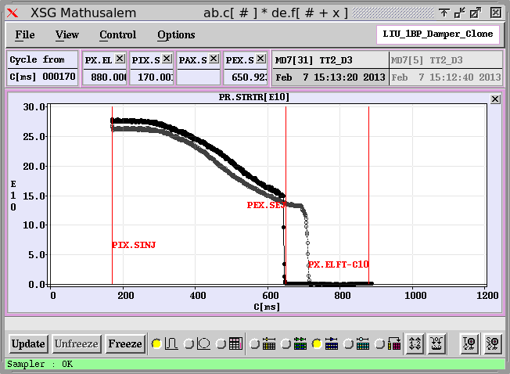
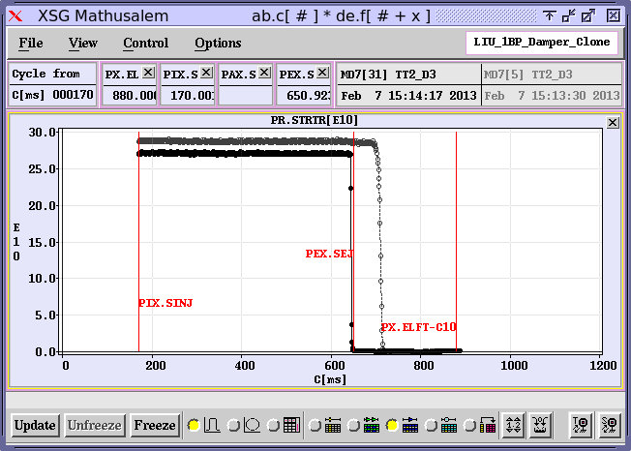
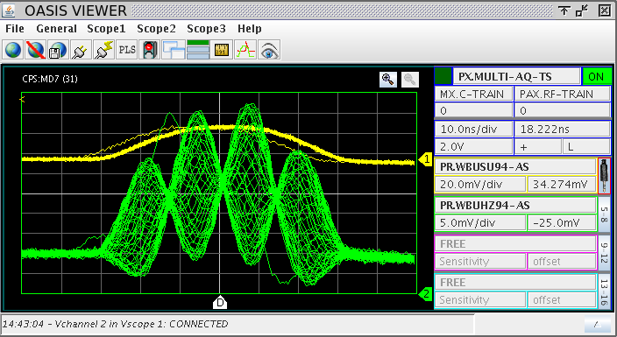
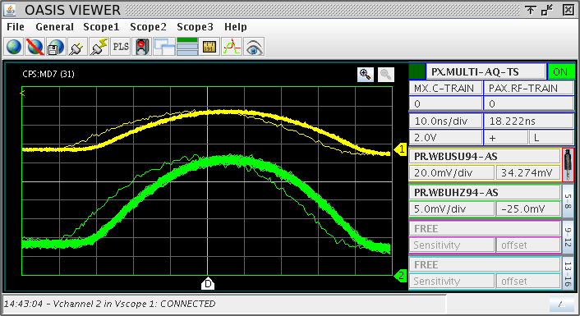
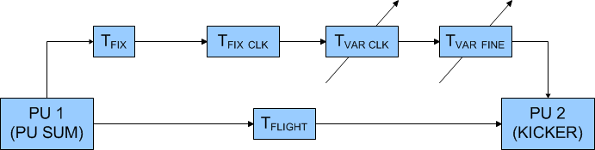
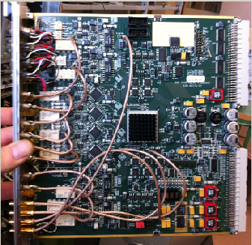
Intra-bunch Damping at Work: CERN PS Transverse Feedback
10 ns/div
10 ns/div
PS TFB OFF
PS TFB ON
1.4 GeV → 26 GeV
Challenge:
Time of Flight Compensation
Fully digital implementation
A. Blas et al.
IPAC’13, WEPME011
D. Perrelet (CERN BE-RF)
PS TFB ON
PS TFB ON
10 ns/div
10 ns/div

Slide 6
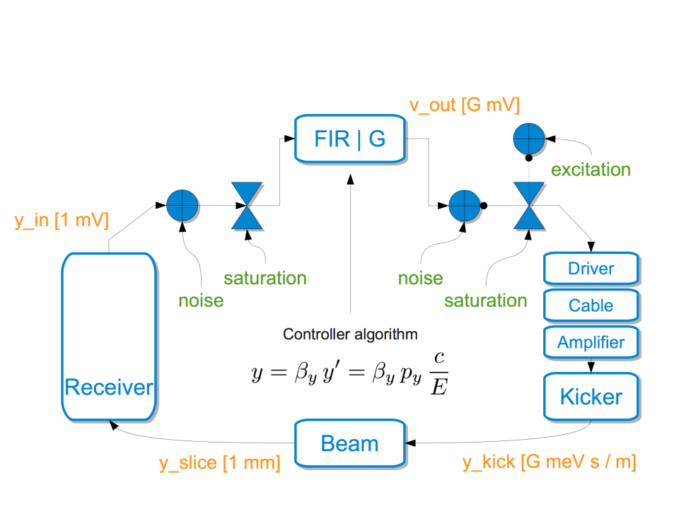
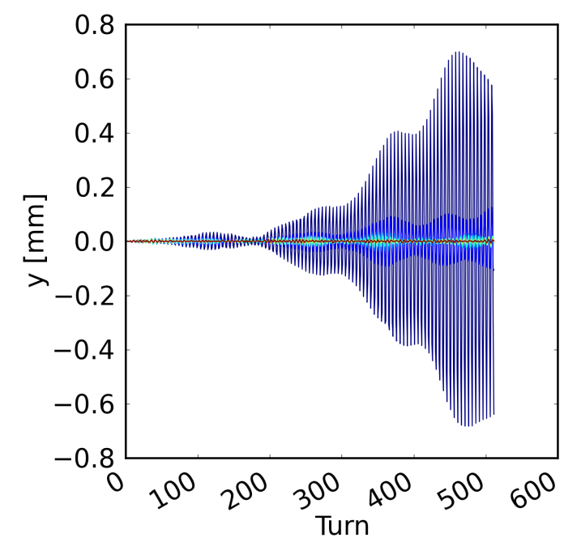
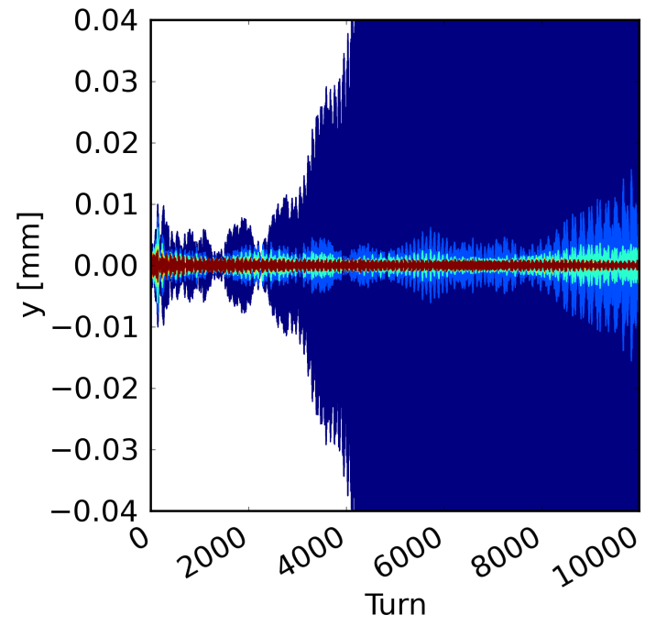
SPS Simulations with Feedback
K. Li et al., IPAC’13, WEPME042
Bandwidth need at SPS injection 450 GeV/c
from simulation (2.7 ns bunch length)
ECI: 500 MHz
TMCI: 200 MHz
CERN Headtail Code
ECI
TMCI
increasing FB gain
increasing FB gain

Slide 7
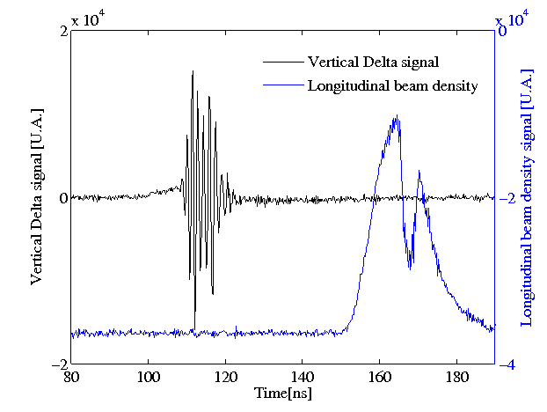
Transverse Instability in PS at Transition
Σ, ΔR, ΔV signals
S. Aumon, 2010
E. Métral et al., 2003
also candidate for cure by high bandwidth feedback
if it were / became a limitation
ecloud instability at PS extraction another candidate for high bandwidth feedback

Slide 8
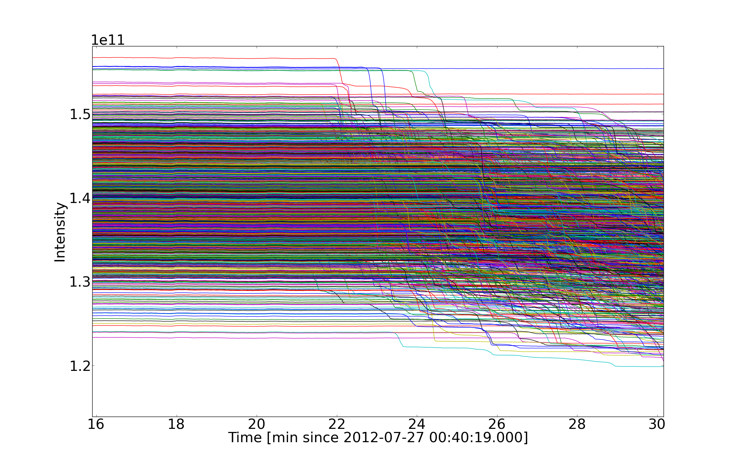
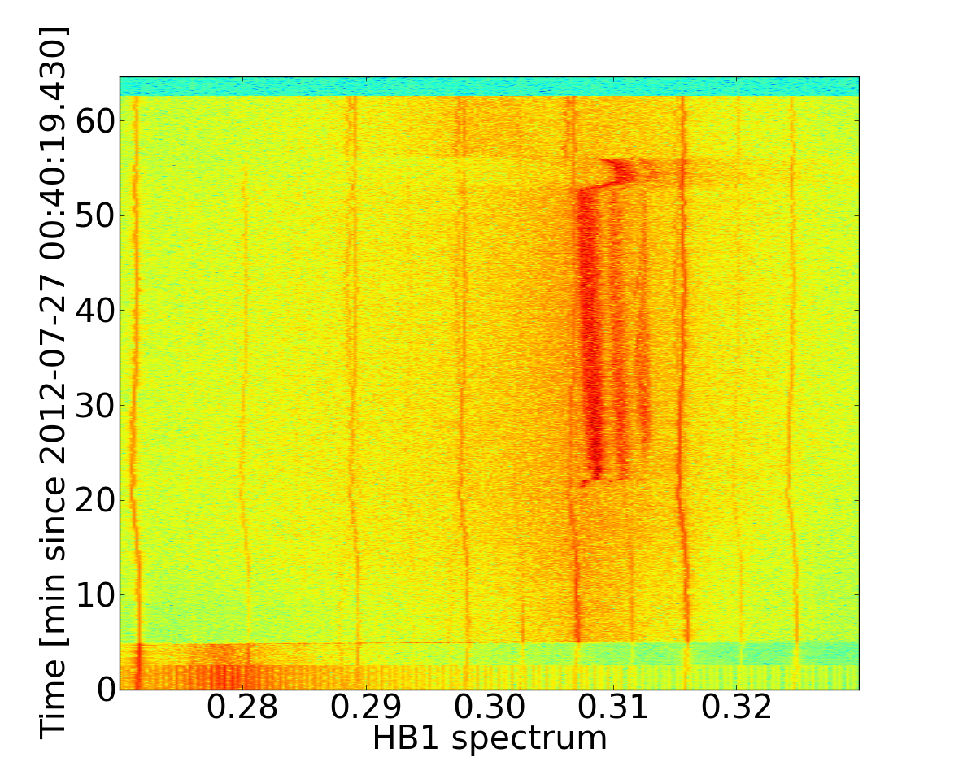
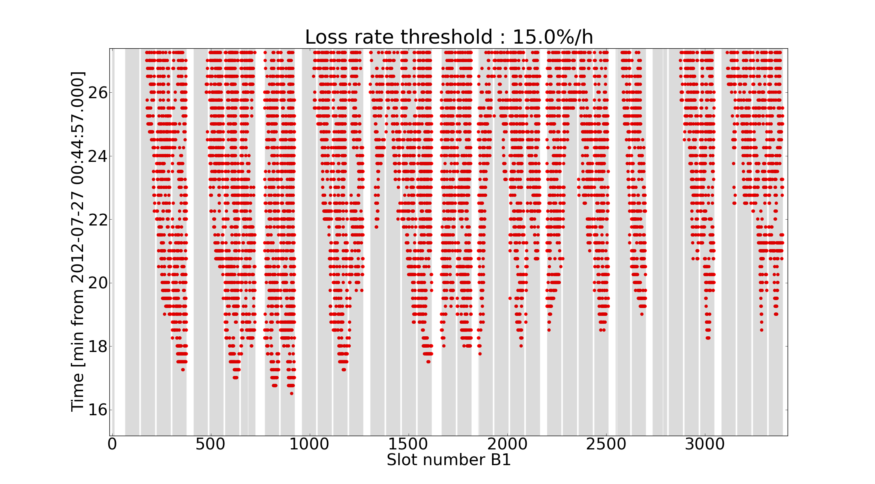
Example of LHC 2012 Instability at the end of Squeeze
Indications of intra bunch motion
Operational optimum being searched using existing systems for cure (bunch-by-bunch damper, octupoles, chromaticity)
Review of Instability Diagnostics http://indico.cern.ch/conferenceDisplay.py?confId=234589
Internal Review on Performance Limitations
(September 2013)
End of Squeeze
Can a High Bandwidth Feedback
help in LHC ?
B. Salvant et al., 2013

Slide 9
From established LHC Operation to
LHC High Luminosity Operation
Important for injectors:
two very different scenarios:
25 ns bunch spacing (ECI !)
50 ns bunch spacing (TMCI !)
LIU (“LHC Injector Upgrade”)
project addresses upgrades
in the injector chain
(LINAC)→PSB→PS→SPS→
to meet HL requirements
today
2014+
Future upgrade
 | LHC 2012 OP | LHC nominal | HL-LHC 25 ns | HL-LHC 50 ns
Energy | 4 TeV | 7 Tev | 7 Tev | 7 Tev
# Bunches | 1380 | 2808 | 2808 | 1404
bunch spacing [ns] | 50 | 25 | 25 | 50
p/bunch [10¹¹] | 1.55 | 1.15 (0.58A) | 2.2 (1.11 A) | 3.5 (0.88 A)
γε_{x,y} [μm] | 2.3 | 3.75 | 2.5 | 3.0
Peak lumi [10³⁴] | 0.66 | 1.0 | 7.2 | 8.3
Lumi levelling | no | no | 5x10³⁴ | 2.5x10³⁴
#Pile up | 34 | 25 | 123 | 123
Status from May 2012 (L. Rossi @LARP CM18)
added: leveling to lower peak lumi at 50 ns

Slide 10
LIU project: Goals and Means
  Increase performance → higher brightness
    LINAC4 (H- linac) is being constructed
    raise of injection energy into PSB from 50 MeV to 160 MeV (LINAC4)
    increase injection energy into PS (space charge limits) 1.4→2 GeV
    SPS: RF upgrade (power), Q20 optics (lower γ_{T}) → TMCI
    vacuum chamber coating in SPS as part of ecloud mitigation
    high bandwidth feedback
    LLRF upgrades in PSB,PS,SPS with additional long./cavity feedbacks
    upgrades for beam transfer, collimation, scraping, instrumentation
  Increase reliability and lifetimes (exploitation until 2030+)
  Spares, radio-protection, replacement of aging equipment
  Project timeline: “baseline” completed after LS2 (long shutdown 2 of LHC)
  installations; LS1 started at end of 2012

Slide 11
Motivation for High Bandwidth Feedback in SPS
objective: cure transverse “single bunch” instability by feedback
two collective effects are limiting the
SPS performance as LHC injector
  e-cloud
  TMCI
  similarities: both effects cause vertical intra bunch instability
high chromaticity suppresses instability to a certain extent
feedback expected to permit running at low chromaticity and at intensities beyond which high chromaticity is an established cure
review of SPS mitigation strategy (ecloud / TMCI) around 2015/2016
Feedback important to maintain small transverse emittances
Also beneficial to provide enhanced stability for scrubbing beam (two bunchlets spaced 5 ns every 25 ns)
Complementary to existing coupled bunch feedback (20 MHz bandwidth)

Slide 12
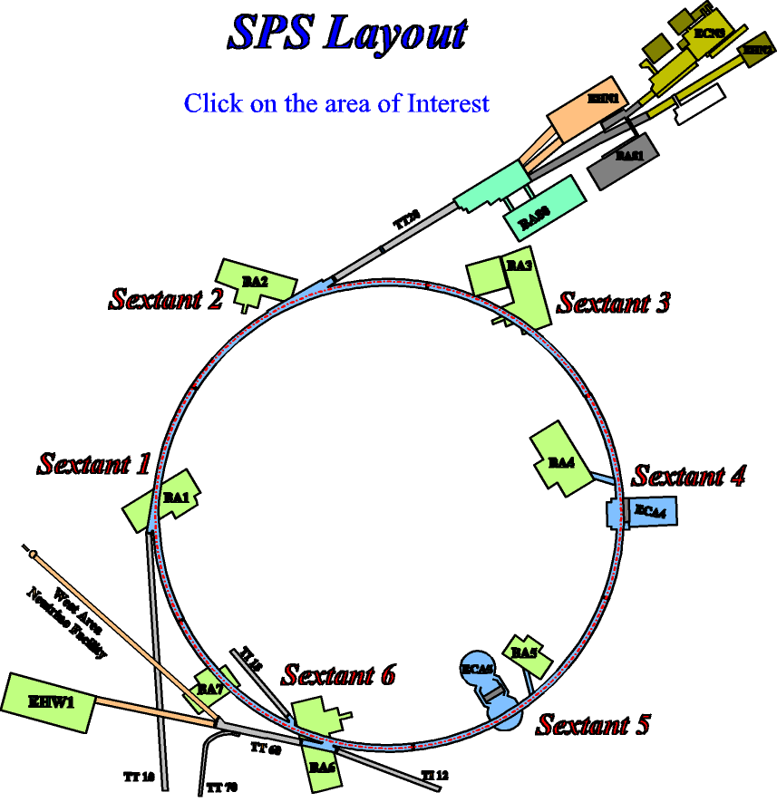
Implementation in SPS: Locations for transverse feedbacks in SPS
base line location
for wide band TFB
slow extraction
radiation high
current transverse FB
RF, low radiation
injection
extraction CNGS/LHC
special instrumentation
no RF infrastructure
LSS3 layout followed up
by working group under LIU
led by E. Montesinos (BE-RF)
extraction LHC
alternative location

Slide 13
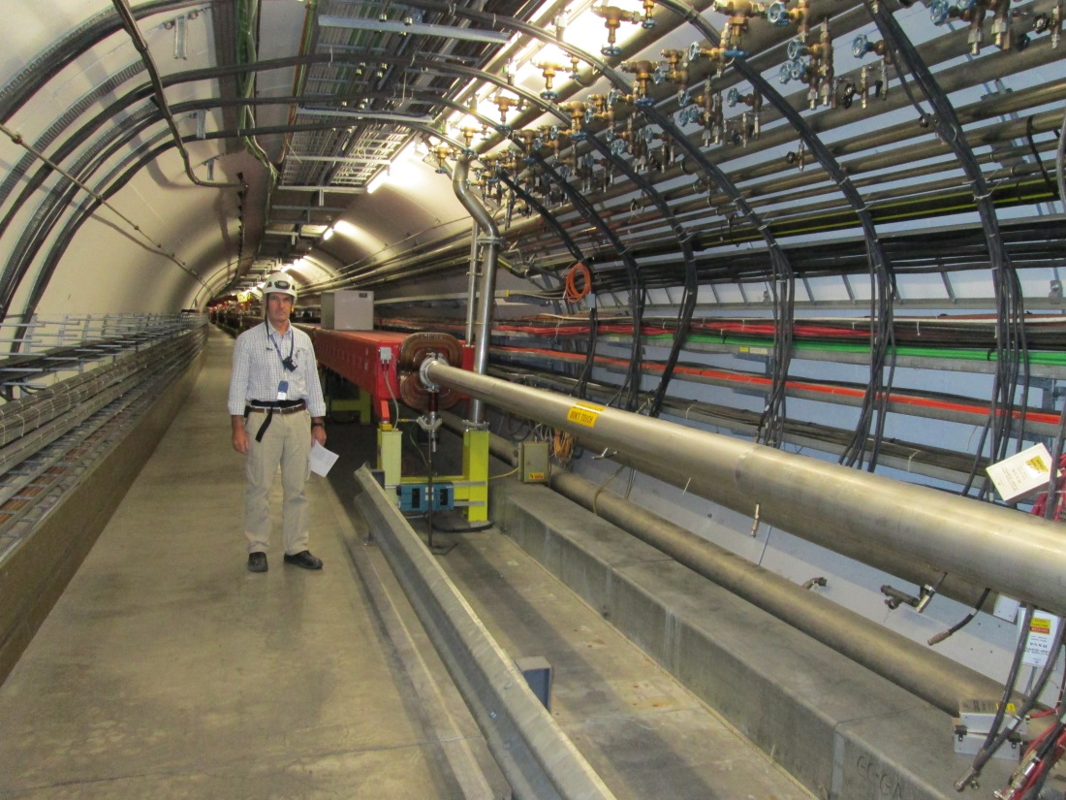
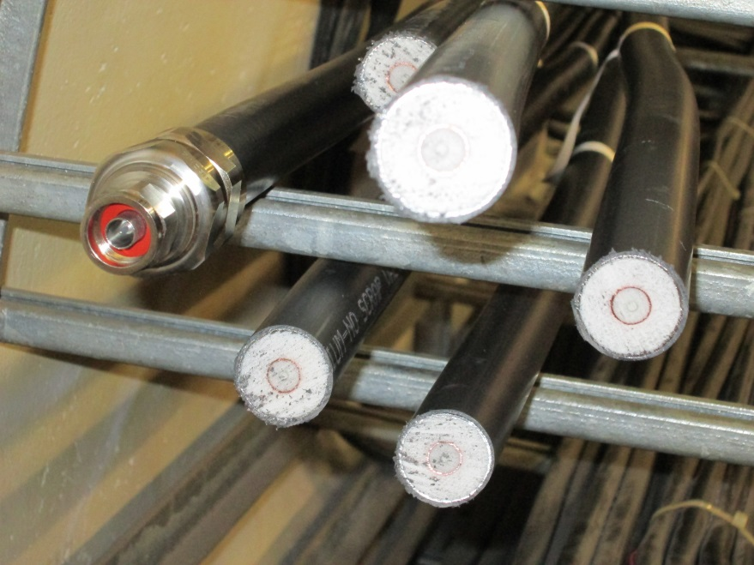
New kickers – Tunnel Space
  Short (array of) striplines, slotted wave guides, cavities ?
  Location: dispersion supressor, flat vacuum chamber
  Frequency reach < 1.5 GHz
  Cabling / Infra-structure being prepared in LS1 (2013/2014)
Low attenuation, low dispersion
“smooth-wall” coax-cables 7/8”
installed in May 2013

Slide 14
Time-Line: SPS Implementation of vertical High Bandwidth Feedback
review for
phase 2:
go / no-go
phase 3:
Year 1
Year 2
Year 3
Year 4
Year 5
Year 6
Year 7
2011
2012
2013
2014
2015
2016
2017
2018
2019
Phase 1:
demonstrator
power amplifiers for phase 2 tendering (s)
new pick-up design and construction
kickers design and construction
Phase 2:
phase 2 beam tests
Phase 3:
Final implementation

Slide 15
CERN contributions
  Accelerator Physics Support: Simulations, integration studies for implementation in SPS (optics, aperture, impedance)
  Coordination, interface for potential contributions in Europe (for example kicker hardware from INF – Frascati)
  Project fully integrated within LHC Injector Upgrade Project (LIU)
    Engineering (FPGA and electronics development)
    Pick-up design and construction
    Fabrication of final system, vacuum structures, electronics
    Integration of components, vacuum testing, tunnel infra-structure, cabling
    Integration with Control System
    Machine Developments, Commissioning

Slide 16
Summary
  SPS can profit from High Bandwidth Transverse Feedback in a number of ways: 25 ns and 50 ns upgrade variants (TMCI, ECI), and during scrubbing (scrubbing beam !)
  Interest and potential applications in PS and LHC → SPS is also a test-bed
  CERN committed to upgrade transverse feedbacks and high bandwidth transverse feedback in injectors within LIU Project frame
  2012 / 2013 Beam Tests with SLAC developed demonstrator hardware successful: Feedback loop closed with 3.2 GS/s digitization using a single bunch → confidence in digital technology
  Full exploration of demonstrator with beam requires new hardware be put in place to overcome bandwidth limitations of present kicker → down selection of kicker options ongoing, infrastructure put in place for installation of new kickers as early as at end of LS1, power amplifiers
  New pick-up design launched at CERN
  Full bandwidth tests in SPS between LS1 and LS2 mandatory to propose such a system for LHC as well as the final implementation for the SPS

