Slide 1
Proposed US Contributions to LHC Luminosity Upgrade
Eric Prebys
Director, US LHC Accelerator Research Program (LARP)
FRA Visiting Committee, March 28-29, 2013

Slide 2
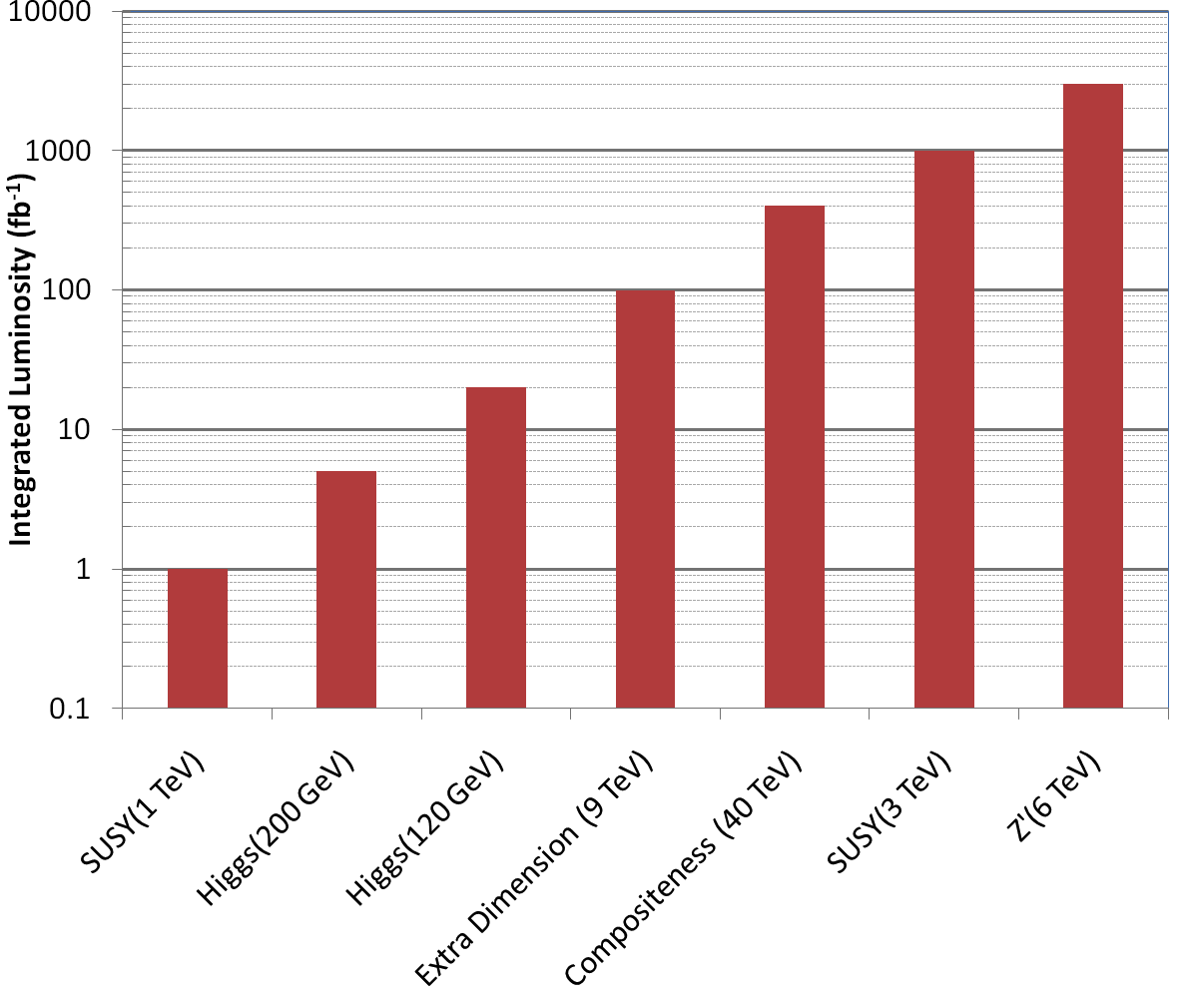
Motivation: The Big Picture
3000 fb⁻¹
~ 50 years at nominal LHC luminosity!
The future begins now

Slide 3
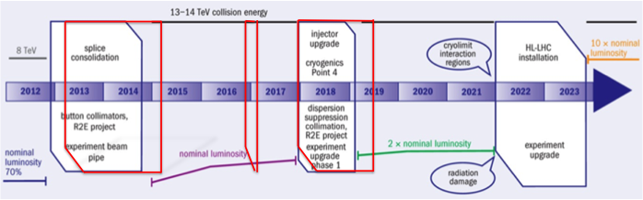
Baseline LHC Upgrade Path
Time Line:
  LS1*: “Nominal” (2013-2014)
    Complete repairs of the superconducting joint and pressure relief problems which cause “the incident” in 2008 and currently limit the energy to 4+4 TeV.
    “Lost memory” issues may limit the beam energy to somewhere between 6.5 and 7 TeV per beam.
    At least 1x10³⁴ cm⁻²s⁻¹ peak luminosity
  LS2: “Ultimate” (2017)
    injector and collimation upgrades
    At least 2x10³⁴ cm⁻²s⁻¹ peak luminosity
  LS3: “HL-LHC” (~2022-2023)
    Lower β* and compensate for crossing angle to maximize luminosity
    5x10³⁴ cm⁻²s⁻¹ leveled luminosity
*LS = “Long Shutdown”

Slide 4
HiLumi-LHC Design Study
The Luminosity upgrade planning will be largely organized through EU,
  Centrally managed from CERN (Lucio Rossi and Oliver Bruning)
  Non-CERN funds provided by EU
  Non-EU partners (KEK, LARP, etc) will be coordinated by HiLumi-LHC, but receive no money.
Work Packages:
  WP1: Management
  WP2: Beam Physics and Layout
  WP3: Magnet Design
  WP4: Crab Cavity Design
  WP5: Collimation and Beam Losses
  WP6: Machine Protection
  WP7: Machine/Experiment Interface
  WP8: Environment & Safety
LARP is now integrating most of its activities into this framework
  Two LARP meetings/year ➔two joint meetings/year (spring in US, fall in Europe)
Goal
  CDR: 2014
  TDR: 2015
Significant LARP and other US Involvement

Slide 5
LARP History
The US LHC Accelerator Research Program (LARP) was formed in 2003 to coordinate US R&D related to the LHC accelerator and injector chain at Fermilab, Brookhaven, and Berkeley
  SLAC joined shortly thereafter
  Has also had some involvement with Jefferson Lab, Old Dominion University and UT Austin
LARP has contributed to the initial operation of the LHC, but much of the program is focused on future upgrades.
The program is currently funded at a level of about
$12-13M/year, divided among.
  Accelerator research
  Magnet research (~half of program)
  Programmatic activities, including support for personnel at CERN

Slide 6
LARP Contributions to Current LHC Operation
Schottky detector
  Used for non-perturbative tune measurements (+chromaticities, momentum spread and transverse emmitances) – Operational (currently some issues)
Tune tracking
  Implement a PLL with pick-ups and quads to lock LHC tune – Fully integrated
  Investigating generalization to chromaticity tracking
AC dipole
  US AC dipole to drive beam
  Measure both linear and non-linear beam optics – Primary tool for high energy optics
Luminosity monitor
  High radiation ionization detector integrated with the LHC neutral beam
  absorber (TAN) at IP 1 and 5. – Functional, becoming primary fast system.
Synchrotron Light Monitor
  Used to passively measure transverse beam size and monitor abort gap
  Not a LARP project, but significantly improved by LARP – Operational (currently some issues)
Low level RF tools
  Leverage SLAC expertise for in situ characterization of RF cavities – Fully integrated
Personnel Programs
  Toohig postdoctoral fellowship
  Long Term Visitor Program

Slide 7
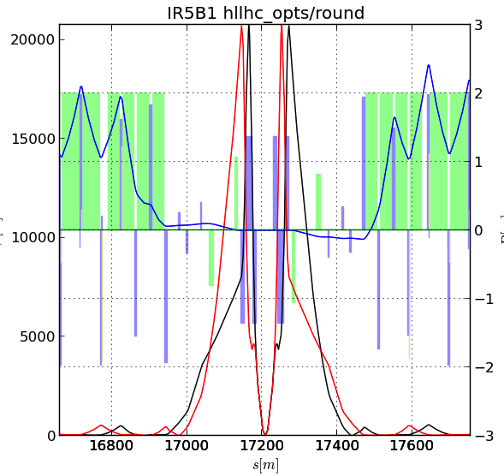
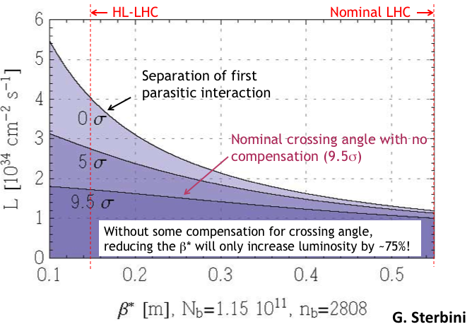
Key Components of HL-LHC
Reduce β* from 55 cm to 15 cm
  Requires large aperture final
  focus quads
  Beyond NbTi without making the quads
  unmanageably long.
  ➔Requires Nb₃Sn
    never before used in an accelerator!
    Nb3Sn R&D key component of LARP
BUT, reducing β* increases the
effect of crossing angle
“Piwinski Angle”

Slide 8
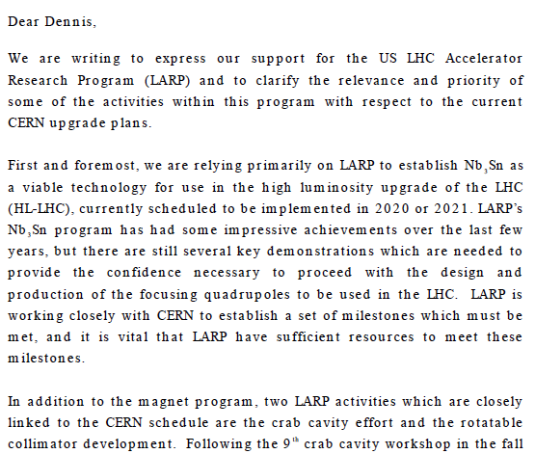
Relevance of LARP to CERN Upgrade*
Letter to Dennis Kovar, Head, DOE
Office of High Energy Physics, 17-August-2010
(…)

Slide 9
New Direction for LARP
LARP has historically been an R&D organization
  Not well structured for hard deliverables
  CERN upgrade plans in a state of flux
Recent developments
  CERN has formalized the planning for the luminosity upgrade
  In June 2012, CERN chose 150 mm as the aperture for the final focus quads
At the DOE’s request, we are in the process of transforming LARP into a project to encompass all US contributions to the luminosity upgrade of the LHC.
Budget Guidance
  Flat-Flat LARP funding @ ~$12.4M/year through FY16
  A total of $200M (then year dollars) TPC, assuming CD-3 at approximately the beginning of FY17
  “Some amount” of General Accelerator Research and Development (GAR D) funds invested in support of this program.

Slide 10
GARD Funds

Slide 11
(Rough) Budget Assumptions
“Traditional” LARP funding
  Flat-flat @ $12.4M/year through FY16
    $9.4M for these projects and related management
      =$37.6M
    $3M for continuing R&D which is not included here
Project Funding
  $200M
    Nominally starting in FY17
    Some funds available for procurement and infrastructure as early as FY15
Significant GARD and CERN contributions will not be represented by specific dollar amounts at this point, but rather as assumptions about what will be contributed from outside the project and therefore will not appear in our budget
  Clearly, this will have to be formalized at some point

Slide 12
Candidate Deliverables Considered
Traditional LARP Scope
  150 mm aperture Nb₃Sn quadrupoles
    Likely just cold masses, divided between here and CERN
  Crab Cavities
    Prototypes. Production Units. Cryomodules.
  High Bandwidth Feedback System
    Pick-ups. Processing Systems. Response Kickers.
  Collimation
    Rotatable collimators.
    Hollow electron beams.
New Scope
  11 T Nb₃Sn dipoles
    Used to make room for collimation in dispersion suppression region
    Has been a bilateral CERN/FNAL effort
  Large Aperture NbTi D2 separator magnets
    First dual aperture magnets near Irs
    Has been bilateral CERN/BNL effort

Slide 13
The Process
Committee formed consisting of
  LARP Management
    Eric Prebys, FNAL
    Tom Markiewicz, SLAC
    GianLuca Sabbi, LBNL
    Peter Wanderer, BNL
  CERN HL-
    Lucio Rossi, CERN
    Oliver Brüning, CERN
  DOE
    Bruce Strauss, DOE
  Labs
    Represented by Stuart Henderson, FNAL
  Project support
    Marc Kaducak, FNAL
Met several times over several weeks, including at the fall meeting in Frascati

Slide 14
In Broad Strokes….
A consensus quickly emerged among all concerned (CERN, DOE, LARP labs) regarding priority
  Core Priorities:
    Committed to a major stake in Nb₃Sn quads
      Less than “about half” not considered attractive by anyone involved
      This will eat up the lion’s share of resources
    Would like to commit to crabs up to the SPS test.
      As much production as possible
    High bandwidth feedback was seen as a high impact contribution for modest resources.
  Back up options:
    11 T dipoles
      It was felt that the current R&D work should be continued, funded by GAD funds, up to a negotiated hand-off project.
    Hollow electron beams for halo removal
      Although there is no solid plan for collimation, it was felt R&D into this effort should be supported, in the event it’s chosen as a primary technology and circumstances allow its funding.
  Low priority
    There was not much interest in pursuing the D2 separators.

Slide 15
Feedback from CERN
Top Priority
Backup

Slide 16
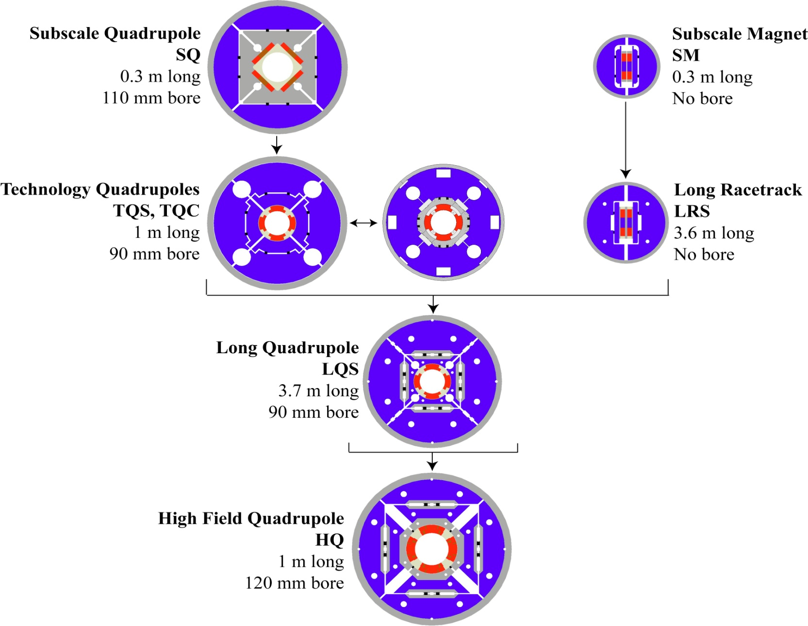
LARP Magnet Development Tree
Completed
Length scale-up
Achieved
220 T/m
High field
Accelerator features
Being
tested

Slide 17
Proposed Magnet Contribution
In June, 2012, the choice was made of 150 mm as the aperture for the focusing quads in the LHC upgrade.
LARP activities have been modified in accordance with this decision and recommendations of our July 2012 review
  Curtail existing 120 mm program
  Work with CERN to develop a 150 mm prototype (LQXF)
The program will then full transition into a production project to produce the focusing quadrupoles for the LHC upgrade
  US contribution
    Cold masses for the Q1 and Q3 quads, to be cryostated at CERN
    A total of 20 half length (4 m) cold masses, including 2 pre-series units, 16 production units, and 2 spares

Slide 18
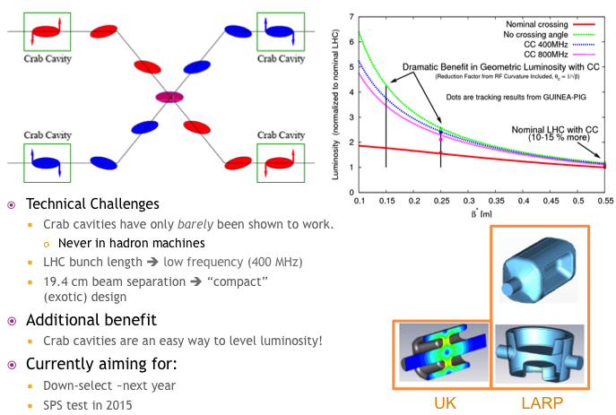
Crab Cavity Development

Slide 19
Proposed Crab Cavity Contribution
LARP has been a major proponent of crab cavities since the beginning
  Currently two of the three candidate designs are from within LARP
Crab cavities leverage US expertise and US industry
  All prototypes, including the UK prototype, have been built in the US.
Proposal
  The LARP R&D program will continue work on the two cavity designs:
    RF-Dipole
    Double Quarter Wave
  Efforts will increase at FNAL on cryostat design
  This will culminate with the delivery of a test cryostat with cavities of one of the designs for a beam test in the SPS (2015 or 2016)
  The project will undertake the production of 10 cryomodules (4 per IP + 2 spares) for installation in the LHC upgrade
    CERN will provide RF couplers and all required infrastructure

Slide 20
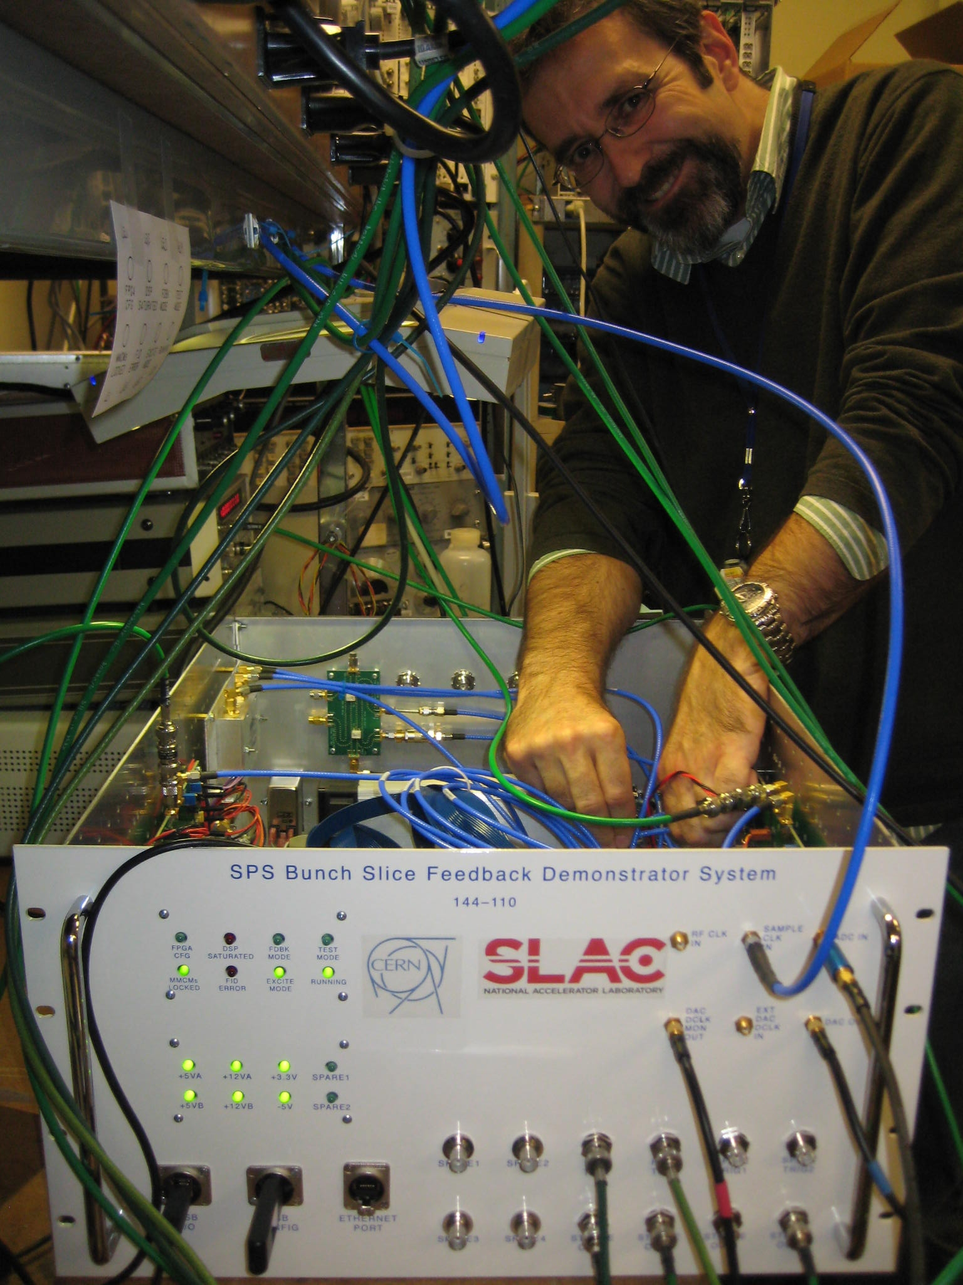
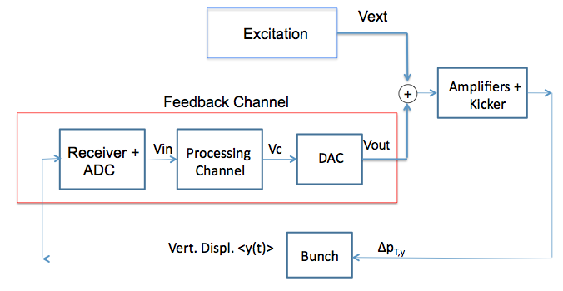
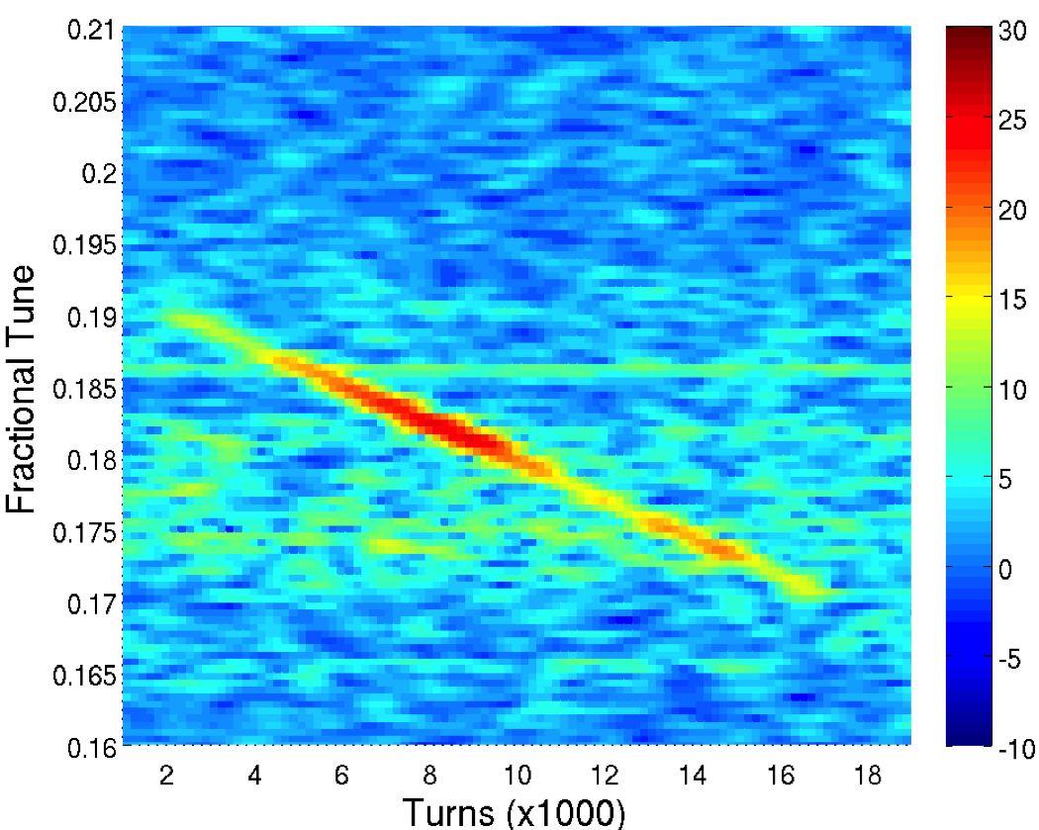
Feedback System

Slide 21
High Bandwidth Feedback System
The high bandwidth feedback system is a proposed feedback system for the SPS, which leverages LARP experience with the LHC LLRF system
Proposal
  LARP will continue R&D related to the system.
  The deliverable would be a functional feedback system the SPS, for which
    The US contribution would be the complete, full-function, instability control system hardware, firmware and software necessary to operate at the SPS (and potentially LHC, PS).
    The CERN contribution will include the vacuum structures (pickup(s) and kicker(s)) and all tunnel related cable plant.

Slide 22
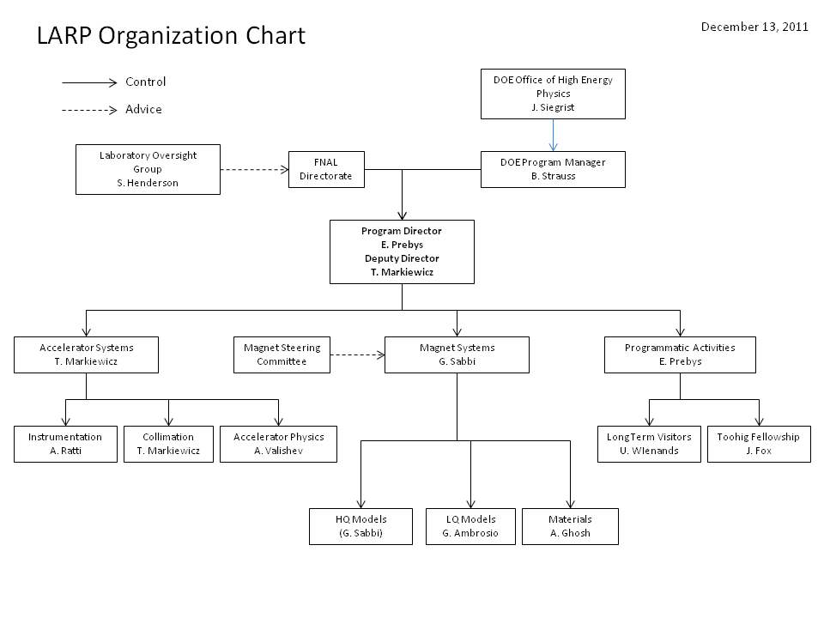
Traditional LARP Structure

Slide 23
Proposed New Structure
Traditional LARP

Slide 24
Traditional (non-Project) LARP
LARP continues to have significant R&D activities which are not yet ready to become deliverables
  Energy deposition studies (this will eventually move to the Magnet sub-project, along with the money).
  Beam-beam and general beam physics issues
  Hollow electron beams for halo removal
  Personnel programs
    Toohig postdoctoral fellowship
    Long Term Visitors (LTV) program
We are committed to preserving at least some non-project activities after the project starts

Slide 25
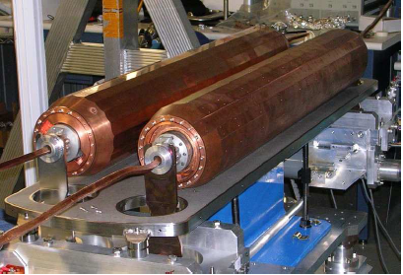
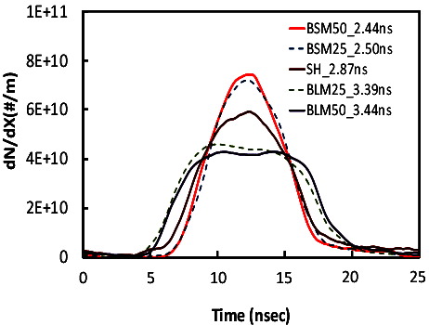
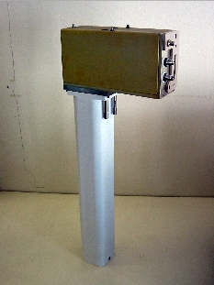
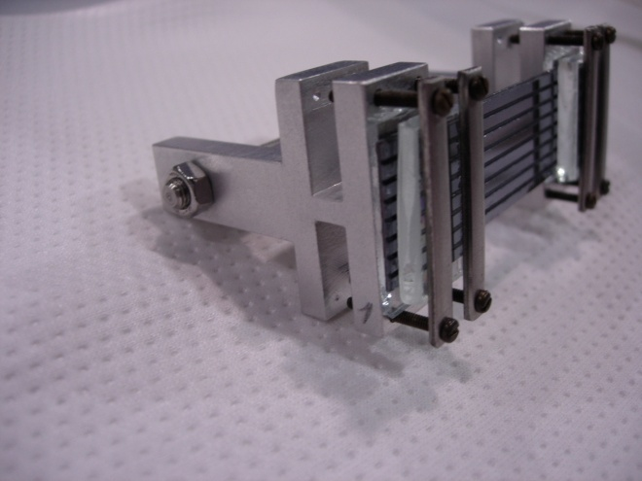
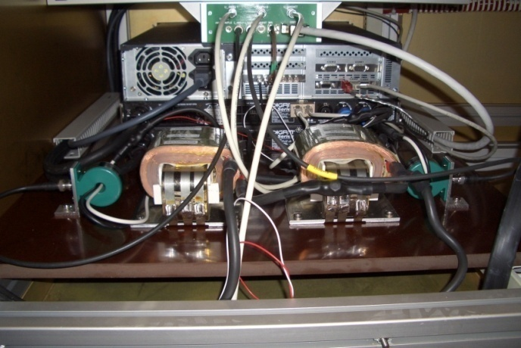
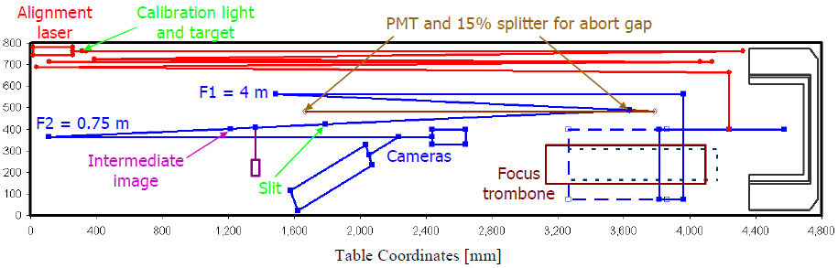
Some (random) LARP Activities
Flat Bunches
Luminosity Monitor
Rotatable Collimators
Crystal Channeling
Instability Modeling
AC Dipole
Personnel support (to date):
  11 Toohig Fellows
    Postdoctoral Fellows who divide time between CERN and LARP host lab
  8 Long term visitors
    Senior personnel spending between 6 months and two years at CERN.
Sync. Light Monitor

Slide 26
Impact of LARP Personnel Programs
Letter to Michael Procario, Acting Head, DOE
Office of High Energy Physics, 9-MARCH-2011
(…)

Slide 27
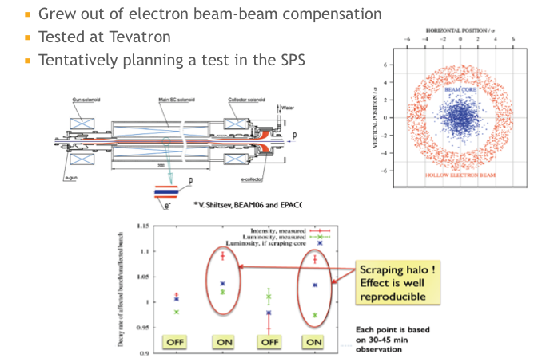
Example: Hollow Electron Beam R&D
CERN is very interested in this technology, but not yet ready to commit to a deliverable

Slide 28
DOE Reaction and Ongoing Plans
Briefed DOE on Feb. 1, 2013
  Wanted to make sure the necessary early funding wasn’t a non-starter.
Very supportive of proposed deliverables and open to early funding
Working with us to divert necessary General Accelerator Research and Development (GARD) funds, as well as additional funding to support our planned spending profile prior to FY17.
Since then, we’ve been moving forward
  This review is a very important part of the process…

Slide 29
“Virtual CD” Process
We are proposing to operate this project along the lines DOE Order 413.3b
However, DOE is considering delaying the formal “critical decisions” (CDs) until near the end of the process, with CD-3 occurring roughly the beginning of FY17.
Nevertheless, we plan to proceed as if we are preparing for the usual CDs
  And have been told funding can be released accordingly.
Approximate timetable
  “CD”-0: FY14
  “CD”-1: FY15
  “CD”-2: FY16
  “CD”-3: FY17

Slide 30
Goals for this Review
Are external risks (schedule, contributions) adequately considered?

Slide 31
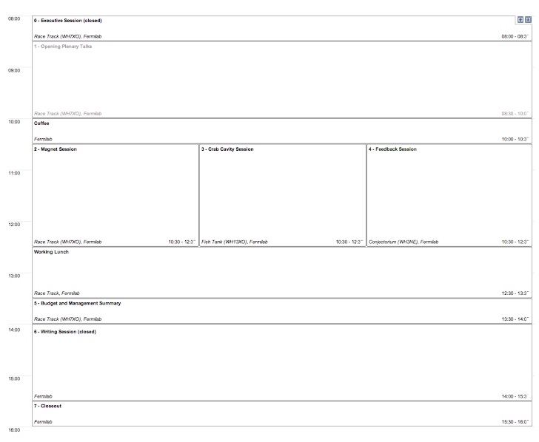
Organization of Review
Overview, CERN View, DOE View
Technical Details, Budget, Schedule
Overall Budget, Risks, Questions

Slide 32
Conclusion
LARP has been extremely successful at leveraging US capabilities to develop technology for the LHC.
We are in the process of transforming the program into a production effort to produce significant hard deliverables for the LHC luminosity upgrade.
We appreciate your help in that process.

Slide 33
BACKUP Material

