Slide 1




LARP Crab Cavities Overview
Ratti
LBNL

Slide 2
Outline
System requirements and description
  CERN’s functional specification (SPS)
  LHC requirements
Organization
Current status and LARP activity
  PoP and Prototypes, integration
  SPS test
Proposed US Construction Project
  Scope and Deliverables
  Interfaces and Boundaries
Next Steps and Planning - in the final talk
  Including Cost and Schedule

Slide 3
Why crabs?
Substantial upgrade of integrated luminosity
  Luminosity leveling, vertex density control
  Effectiveness increases with larger crossing angles
  Only known way to improve luminosity during the store
Significant R&D on cavity technology for several years
  Encouraging results are making this possible
  Three designs under study in Europe and the US

Slide 4
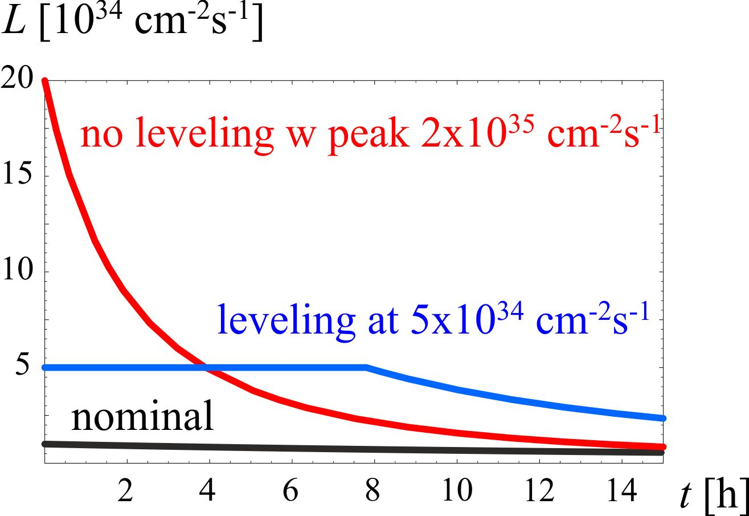
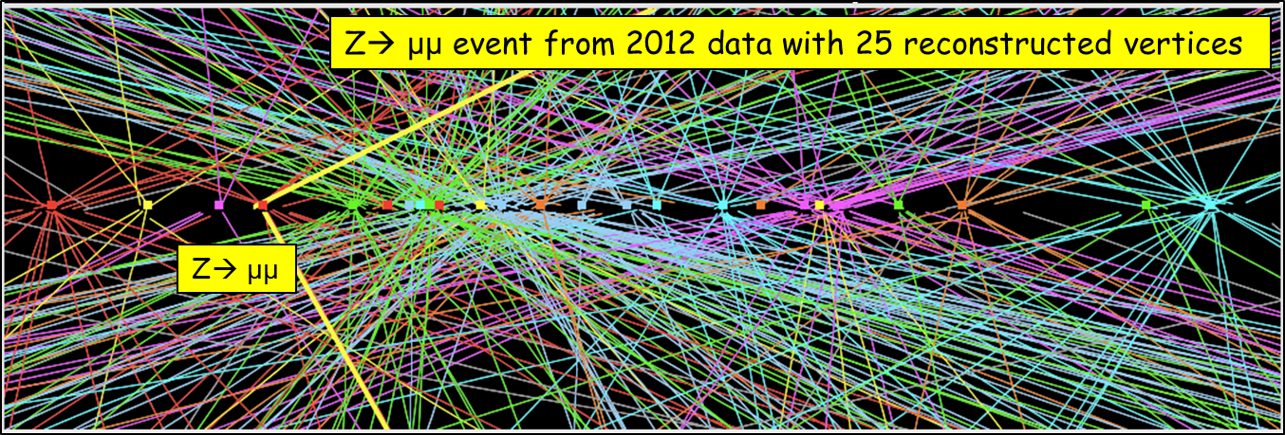
Luminosity Levelling
Luminosity decreases for proton burning (neglecting effects like emittance growth due to b-b, IBS, etc…)
Total number of collisions ∫Ldt in a run is limited by number of stored protons
⇒ store a lot of protons but keep instantaneous lumi «low» by detuning one (or more) parameter.
⇒keep the lumi constant by re-tuning the paramter(s) to compensate proton loss (and possibly any other effect).

Slide 5
System Requirements
Voltage >= 10 MV (3.3MV/cavity)
  SPS test 2 cavities/module
  LHC 3 cavities/module
Frequency = 400 MHz
Q_{ext} = 10⁵ - 10⁶, R/Q ~300 W
Cavity tuning/detuning ± 1.5-5.5kHz (or multiples of it)
Available RF power source = 60 kW (< 18 kW nominal)
Beam current ~ 0.5-1 A

Slide 6
Technical Specification
Functional parameters
  Including HOMs, Z…
Enclosures (incl. materials…)
Cryogenics
RF Power incl. couplers
LLRF
SPS Integration
Recently released by CERN

Slide 7
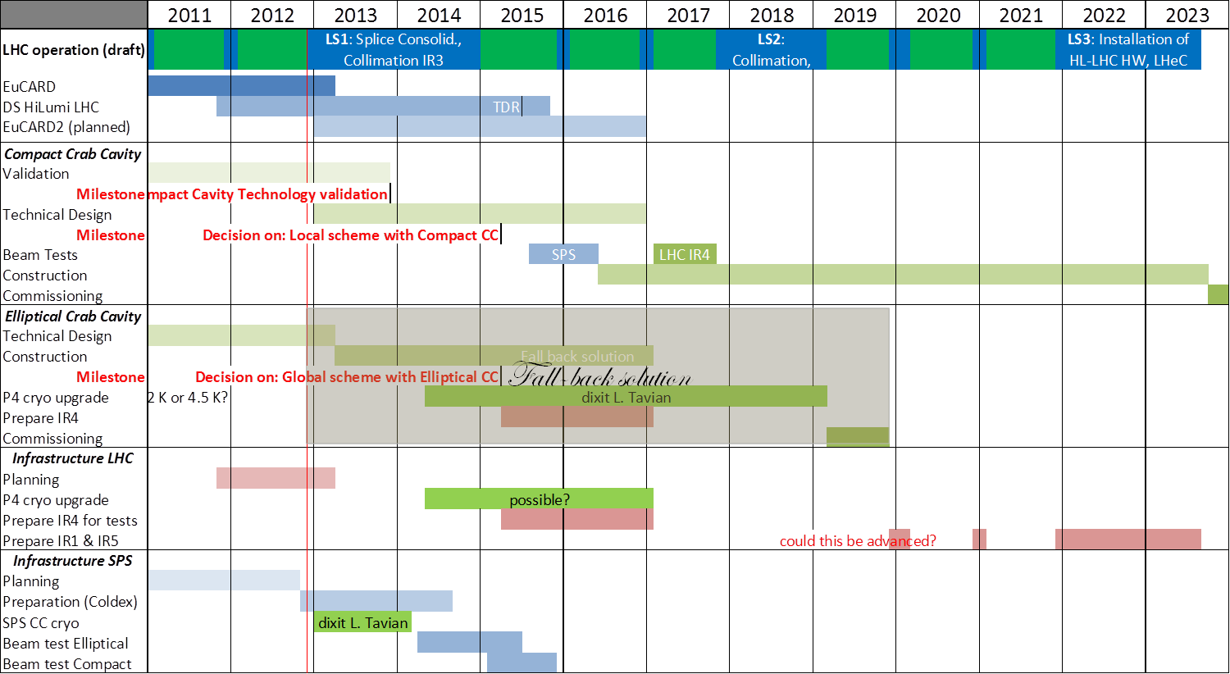
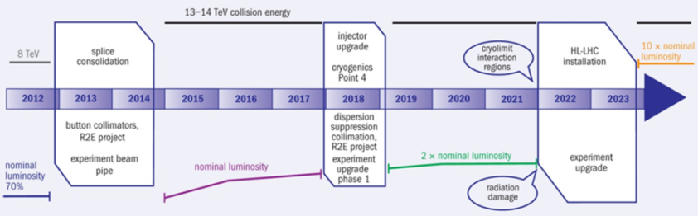
Overall CERN planning
L. Rossi: Nov. 2012

Slide 8
Global Organization
CERN leads the global collaboration
  Directly responsible for several tasks
    RF power and controls, local installation, cryogenics, machine protection…
  Cross disciplinary working group to prepare validation test
    Operations, RF, Vacuum, Cryogenics, Beam Dynamics, Machine Protection, Collimation, Instrumentation…
Lancaster Univ. and STFC actively involved in the UK
  4-rod cavity design and testing
  Cryomodule design
US to contribute a well defined part of the project
  Cavities and cryomodules

Slide 9
LARP Organization
Defined roles within LARP collaboration:
  BNL, ODU – cavity development with aux systems
  FNAL – Leads and coordinates cryomodule design and integration
  SLAC – Leads and coordinates EM modeling support
  FNAL, LBNL - beam dynamics studies
Today’s presentations will cover each of these areas
US Industry - Niowave
  Built all three prototype cavities to date
  Funded by DOE SBIR phase II program
Points of contacts defined at each institution

Slide 10
Scope of US Contribution
LARP funds R&D until the SPS test
  Deliver one cryomodule for testing in the SPS during the 2016-17 runs and possibly in Pt-4 in the LHC
    2 cavities, He vessels, tuners, HOM mode dampers
    RF couplers provided by CERN
    Cryogenics, RF power, local installation provided by CERN
US Construction Project funds production
  Deliver 10 cryomodules of 3 cavities each
    Contain cavities, He vessels, tuners, HOM mode dampers
    Cryogenics, RF power, local installation provided by CERN
    8 CM needed in pts 1 and 5, 2 spares (one per IP)
Feedback from DOE reminds that the effort on crab cavities should be carried through construction and not be limited to the SPS test

Slide 11
Caution(s)
LARP is funded year by year
  Guidance to keep CC funding >$1M per year
  As long as LARP is funded
    Presently planned until FY16 included
  Limited availability of LARP funds make our target of testing in the SPS a challenge
  GARD and SBIR funds greatly help
US construction project is still a proposal
  DOE looks at it favorably, but

Slide 12
Path to the HL-LHC
SPS Validation Tests
  Crab concept with proton beams
  Machine protection aspects
  Beam measurements (noise, heat loads..)
Essential to finalize LHC design
  CERN stated a final decision on a crab cavity system for the LHC will only come after a successful SPS test

Slide 13
SPS vs. LHC
3

Slide 14
Current LARP Activities
Proof of Principle Cavities – DQW, RFD
  Validating geometries and expected performance
Prototypes
  Build 2 cavities of each designs
Cryostat
  Build 1 cryostat to install in the SPS
  Not clear it will fit in PT4 if want to test with beam in LHC
Modeling Support
  EM cavity design with peripherals
  Beam beam studies

Slide 15
R&D Progress
Proof of Principle cavities testing
  ODU/SLAC cavity tested to 7 MV
  BNL cavity tests started
Prototype cavities design
  Underway at BNL and ODU
Cryostat integration
Modeling
  EM design at SLAC
  Beam beam studies at LBNL and FNAL (not presented at this review)

Slide 16
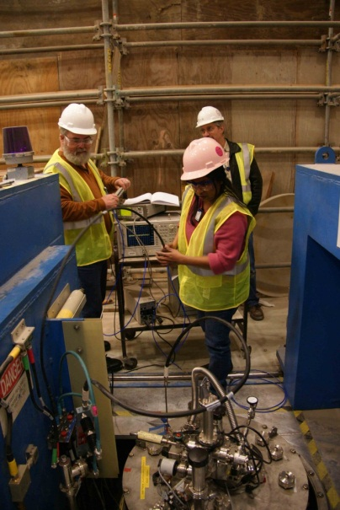

PoP RF Dipole 4.2 K and 2 K Test Results
Expected Q₀ = 6.7×10⁹
  At R_{S} = 22 nΩ
  And R_{res} = 20 nΩ
Achieved Q₀ = 4.0×10⁹
Achieved fields
  E_{T} = 18.6 MV/m
  V_{T} = 7.0 MV
  E_{P} = 75 MV/m
  B_{P} = 131 mT
Quench
3.4
5.0

Slide 17
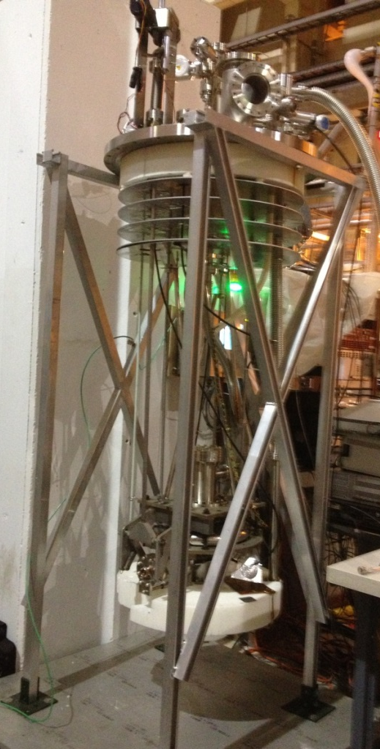
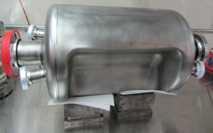
Status - PoP
Proof of Principle Cavities
  Successful test of RFD cavity proves that we can achieve the desired fields
  Yet reaching 7 MV in a vertical test does not mean we can assume cavities will operate at that gradient.
4-Rod and DQW test are underway
More focus now on peripherals and integration
  Tuners, dampers, power couplers…

Slide 18
Status - Prototypes
Developing the concepts for a prototype system to use in the SPS test for each design
  Fundamental differences in the approaches in tuning and coupling (FPC and HOM)
Cryostat concepts are starting from studies made in the UK
Plan to carry both US designs until final integration in SPS cryostat
  Greatly reduces technical and schedule risk

Slide 19
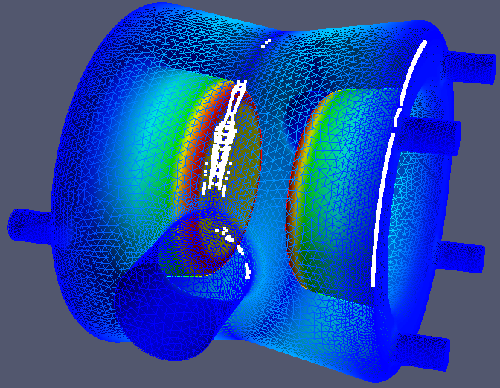
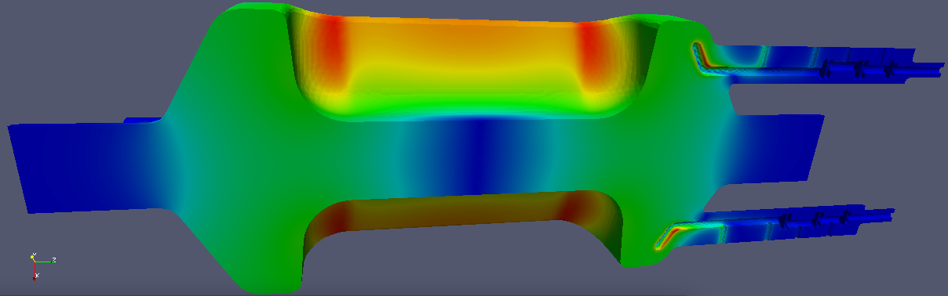
Modeling
Supporting EM design of cavities and auxiliary systems
  Multipacting analysis
  Mode dampers coupling
    And fundamental rejection
Studies of three candidate designs

Slide 20
Overall Plan
Complete prototype testing
Prepare for SPS test
From SPS lessons learned prepare a prototype cryomodule for LHC
  Assuming cavities are ok, no new development
Carry prototype to a horizontal test
Build production run
  Possibly count prototype as one of deliverables
Full presentation later

Slide 21
Conclusions
Crab cavities have been selected as one of the activities in the construction project for the HL-LHC
R&D program is making great progress
  Very encouraging initial results
  Detailed design of prototype cavities and integration of a system for SPS test
CERN very actively involved
Systems requirements document released
FNAL taking ownership of the cryomodule design and integration
US industry remains involved in a key role

Slide 22
Questions

Slide 23


4-rod testing @ CERN
Test interrupted by SM18 shutdown resumes at the end of April

Slide 24
Timeline

