Slide 1
First experiments with a Power Buildup cavity at 355 nm
Mark Notcutt: Boulder Precision E-O
Yun Liu and Chunning Huang: SNS ORNL
9/26/2013
Construction of the cavity
Making the 355 nm light resonant in the cavity
Buildup results and discussion: Intracavity Buildup factor of 25
Analysis of mirror Reflectivity after mirror spent some time in a high radiation environment
Work funded through the DOE SBIR program

Slide 2
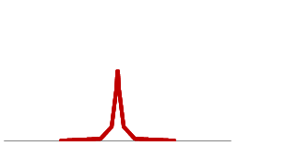
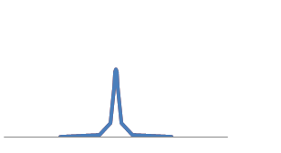
Buildup of circulation Power in a cavity: matching the recycled laser beam well to H beam pulse
The 50 ps laser pulse spans ~9 GHz (dispersion insignificant), and the rep gate determines the spacing of the comb lines.
Spacing between both laser and cavity modes
Precisely Equals the repetition rate of the laser 402.5 MHz (= accelerator rep rate)
In the time domain, the cavity round trip time
Is equal to the pulse arrival (rep) rate
Power Buildup ~ 1/T
T = Mirror Transmission ~ 0.003
Frequency Spectrum
Red – Laser
Blue - Cavity
Df = fsr = rep rate
Must Also Match the Phase of the circulating laser pulse and accelerator pulses: 50 ps Pulse = 15 mm length, so must match spatial to rep rate to ~500 μm

Slide 3
Cavity construction
GeV H Atoms
Cavity Mode
2 mm
One Guiding Idea was to keep the components as compatible as possible with a clean vacuum environment
Many fs buildup cavities (and other UV buildup cavities) suffer deposition of material on the mirrors in the area of the beam spot
short λ (700 & 532 nm) cavities are more susceptible to this than long λ
thought to be volatile molecules trapped in light beam
some regeneration possible, surface coating may help
Other concerns were deformation of the mirror surface from absorbed optical power (~50 ppm)

Slide 4
Comparison of Power buildup cavities of Pulsed beams
Experiment | λ [nm] | Pulse length | Rep Rate [MHz] | Circulating Power [kW] | Finesse | Pwr Buildup
Max Planck | 532 | 100 fs | 130 |  | 1200 | 380
Max Planck | 1042 | 200 fs | 78 | 18/40/80 |  | 1800
JILA | 1070 | 100 fs | 136 | 2.5 | 1000 | 260
This project | 355 | 50 ps | 400 | 20 | 300

Slide 5
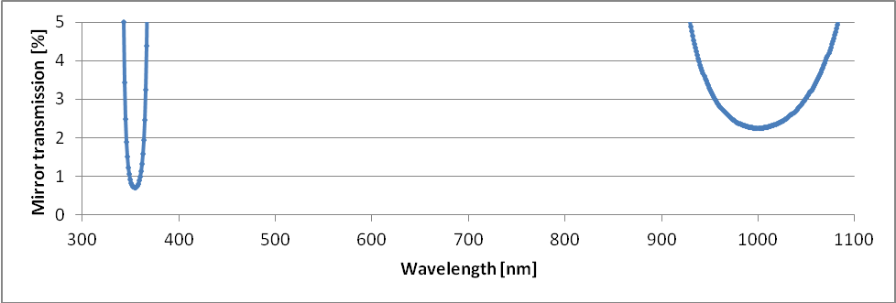
Cavity construction
Cavity length ~370 mm
Mirrors should be chosen create a beam of 2 mrad divergence and 2 mm dia.
Original Plan was to use Sapphire mirrors for thermal conductivity
To start, we used 2 x 1 m ROC fused silica mirrors as they were readily available, coated to have reflectivity at both 1064 nm and 355 nm

Slide 6
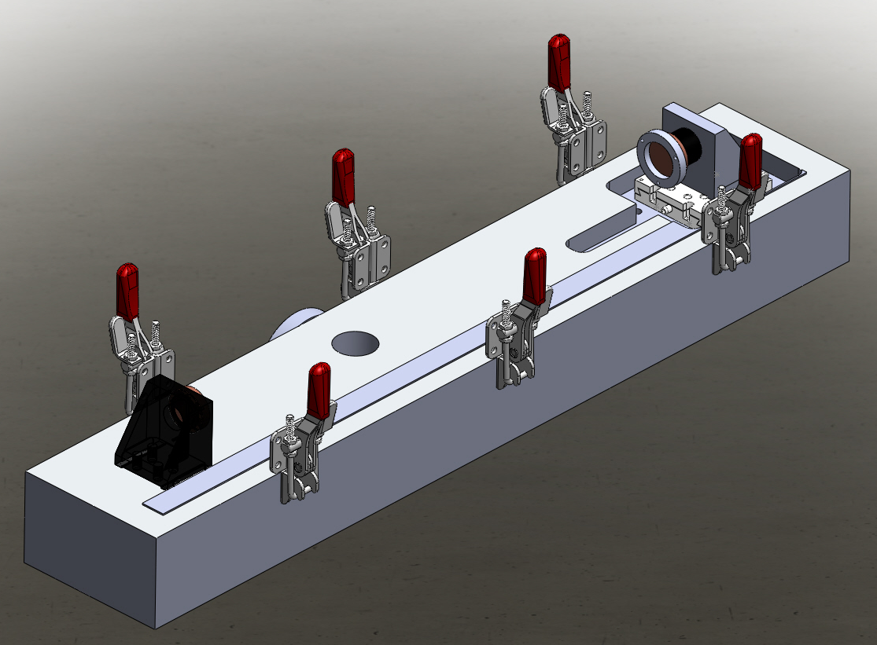
Cavity Construction
Angular adjustment of mirrors by shims to cut down on volatiles
To start, we mounted one mirror on a PZT (and locked the cavity to the laser) though now that can be changed
A vacuum compatible translation stage was used to set the length to a few um to match the fsr to the rep rate.

Slide 7
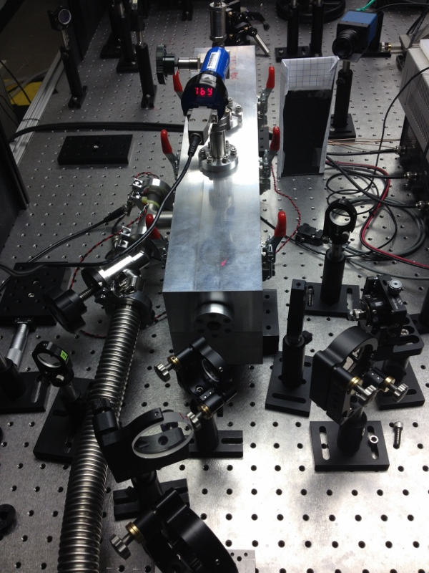
Cavity
Cavity assy sits on Viton
Pads for vibration isolation
From table vibrations
Bellows for pump: pumped w/
Small scroll pump: pumped continuously
Typical pressure 200 mTorr

Slide 8
Used Fringe-side locking to lock the 1064 nm light to the cavity
Limitations became obvious: uncertain where locking wrt peak
The frequency relationship between the red and blue cavity resonances wasn’t clearly known due to the group delay difference in the coatings & the coating centering
To measure intracavity power buildup, we measure the transmitted power and divide by the mirror transmission (0.7%).
Expect a power buildup of Finesse/π ~ 100
CW 1064 nm Laser
Amplitude Modulator
402.5 MHz Reference Oscillator
Optical Amplifier
Continuum System
AOM for Macropulse shaping (Add 40 MHz)
Amplifier and Frequency Tripling
1064 nm fiber
Circulator
PD
80 ps 402.5 MHz pulses with macropulse 10 us/10 Hz
Servo Controller
Function
Generator
AOM 30 dBm
32.5 MHz input
BUILDUP CAVITY
Diagnostics: Camera, Photodiode,
Power Meter

Slide 9
Sweeping the cavity length & frequency to look at the cavity modes
The relatively large TEM 02 peak
Mode matching not optimal
~90% of the IR light being coupled into the cavity
When the length of the cavity was set, the depth of TEM00 was maximized, iteratively pumping down to measure the contrast and then venting to tweak length.
Required accuracy was at limit of 80 tpi screw, say 3 microns
TEM02
TEM00
TEM01
TEM00
Frequency span = 402.5 MHz

Slide 10
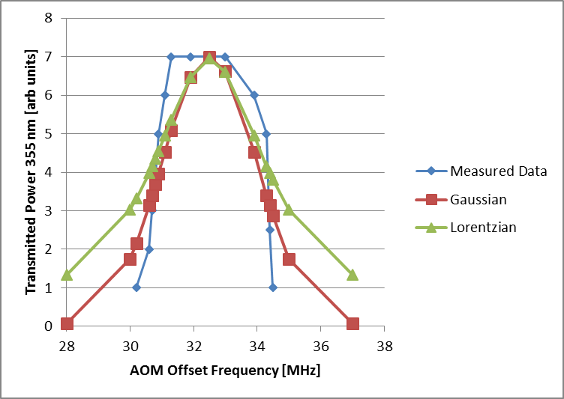
Sweep the frequency of the 355 nm Blue Light and look at the cavity transmission power
The resonance width of the cavity is ~ 1 MHz, so here we are measuring the linewidth of the 355 nm laser light
The seed laser at 355 nm laser a linewidth of ~ 30 kHz, so there is some broadening process ruining the coupling into the cavity
Δf ~2.6 MHz

Slide 11
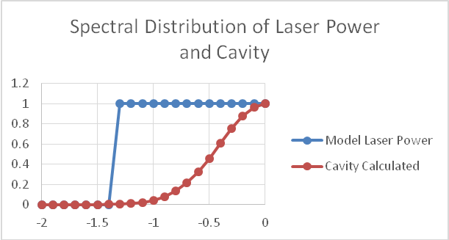
Estimating the Fraction of Power coupled into the cavity
Scaled Power
Frequency [MHz]
Graphically or by integration, the coupled fraction of power is 40%

Slide 12
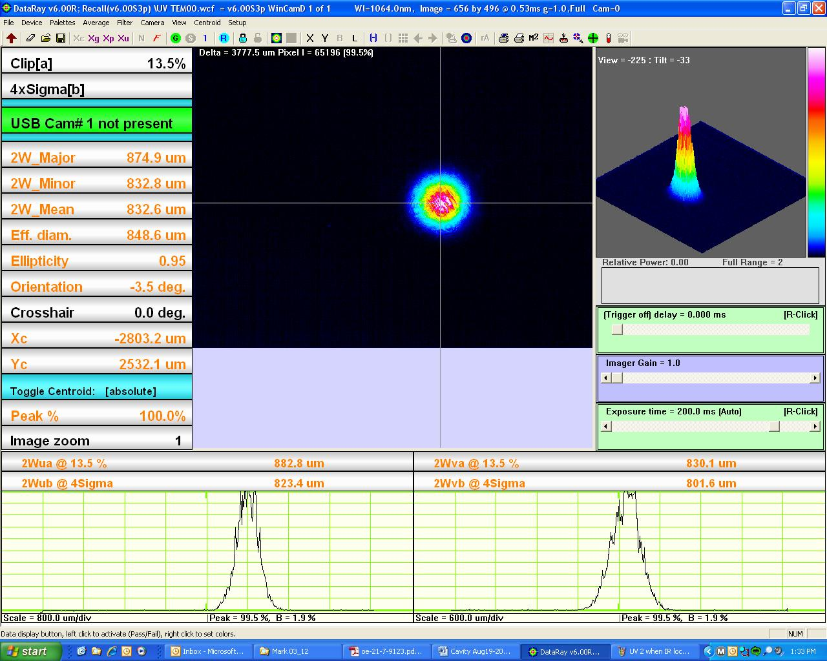
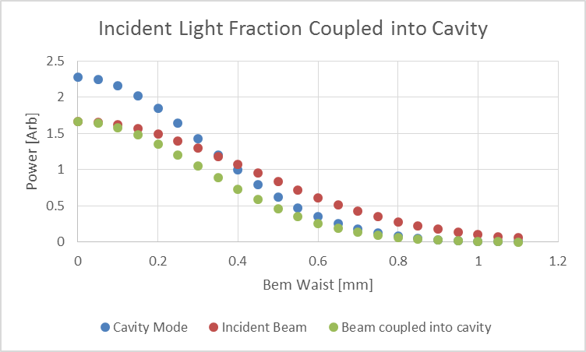
Estimating the effect of imperfect mode matching: need waist 880 um
880 um
840 um
The fraction of power coupled into the cavity is 82%
Multiplying the 40% from the frequency noise by 82% from mode matching = 36% ~ measured result

Slide 13
Summary of power buildup
The total power coupled into the cavity is ~25 % of the incident power, and with a calculated buildup factor of 100, this gives an modeled/estimated net buildup factor of 25.
We measure a factor 25.
We saw some mirror damage, but no sign of contamination
The broadening process has not been investigated yet, though self-phase modulation in the non-linear crystals or amplitude to phase noise in the amplifiers is possible.
Lowering the finesse to 120 would give buildup factor of 40 under present circumstances.
Yun & Chunning have measured the linewidth after 1 amplifier stage at 1064 nm and found it to be narrow.
Yun’s present work is working around these problems.
Lower power and higher finesse?

Slide 14
Mirror loss increase from 5 months near SNS beam tube. Loss Characterized by cavity ringdown measurements: Change is insignificant
 | Finesse Reference | Finesse after 3 month Irradiation | Mirror Loss change after 3 month Irradiation | Finesse after 5 month Irradiation | Mirror Loss change after 5 month Irradiation
1550 nm mirror | 120 000 | 120 000 | 0 ppm | 120 000 | 0 ppm
376 nm mirror | 140 000 | 125 000 | 3 ppm | 25 000 | 100 ppm
Mirror transmission for finesse 300 = 10 000

Slide 15

Thanks very much to the people (Yun, Chunning, Sasha, and others) at SNS ORNL for organizing the project, hosting it, and being very helpful and accommodating
Thanks to DOE for funding through SBIR SC0000747
BPEO will be consumed by Stable Laser Systems in the near future, so please contact us there

Slide 16
Power Buildup in a cavity contd
In the case that the cavity losses are much less than the mirror transmission,
all the incident light is coupled into the cavity and the circulation power is F/π times
the incident power .
The finesse, given approximately by F = π/T (T= transmission), also determines the width
Of each resonance of the cavity, df = 402.5 MHz/ F, so for F = 1000, df = 400 kHz.
The laser oscillator has some noise processes that broaden the spectral width of each
Line. A fiber laser has a width typically of a few 10 kHz. Since you have to have the laser
Linewidth somewhat less (say 1/3) of the cavity linewidth (no fast servos here) THIS SETS
THE LIMIT TO THE ACHIEVABLE FINESSE/BUILDUP FACTOR

Slide 17
What are the parameters of significance?
Peak Power | 1 MW
Average Power within MacroPulse | 20 kW
Average Power | 0.7 kW
Energy Density per pulse | 1.6 mJ/cm2 |  | Will Mirror coating be damaged?
Mirrors absorb | 40 ppm | Of incident power
then | 1/0.03 W | absorbed in mirror | How much will the mirror heat? Will the mirror deform from heating?

Slide 18

Mirror Damage and Mirror Loss Measurements
 | Damage Fluence @ 6 ns [J/cm²] | Damage Fluence @ 50 ps [J/cm2] | Required Fluence for 1 MW [J/cm²]
SiO₂/Ta₂O₅ | 2 | 0.2 | 0.002
SiO₂/HfO₂ | 7.5 | 0.75 | 0.002
Coating Materials | Coating Scattering and Absorption [ppm]
SiO₂/Ta₂O₅ | 40
SiO₂/HfO₂ | 560
Only loss A causes
Mirror distortion
Mirror Loss data from
Advanced Thin Films

Slide 19
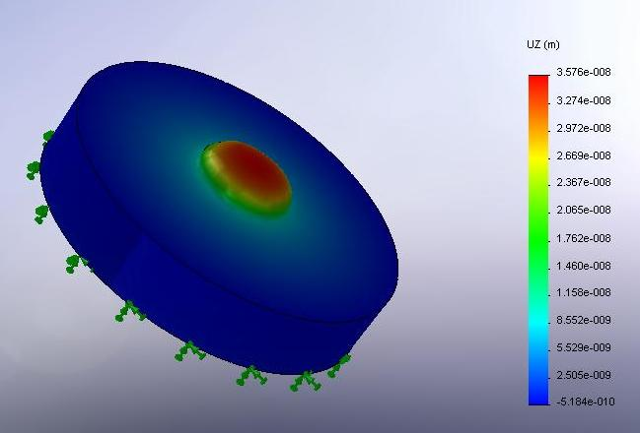
Mirror Material choice from thermal distortion calculations
Use Finite Element and analytical calculations to calculate first the temperature profile
In the mirror, and then the physical profile from thermal expansion. Lastly, the reduction
In coupling from the input laser beam to the new/distorted cavity mode is calculated
Material | Deformation (compare w/ 250 nm) [nm] | Peak Temperature Rise of mirror surface [deg C] | Change in Circulating power [%] | Thermal time constant [s]
Silica | 45 | 155 | 20 | 1
ULE | 3 | 594 | <1
Sapphire | 18 | 7 | 2.5 | 0.08
Silicon | 4.5 | 2 | <1 | 0.01

Slide 20
Practical Issues – vacuum quality
In the experiments that are done with buildup cavities, laser damage is an issue when pulse lengths are in the fs range, but this is less prevalent when pulses are > 10 ps.
Mirror losses increase as air is removed from the experiment, below a few Torr. The losses can be reversed by increasing the pressure above this value, or flowing O₂ onto the mirrors.
This effect is seen somewhat at 780 nm (Ti:Sapp) but markedly at 532 nm.
Possible explanations put forward:
  Contamination from outgassed molecules
  Mirror Damage from O₂ stripping
We take the approach of building a super clean cavity with low outgassing materials

Slide 21
Mirror Geometry
H Atoms
Mode should be 2 mm in diameter
And have a divergence of 3 mrad
To match the H atom beam doppler spread
And the beam width.
Not difficult to meet either one independently:
Not easy at same time.
Cavity Mode
2 mm
The size of a cavity mode is ~constant for many reasonable mirror
curvature combinations, and the instability limit must be approached to get a
Beam diameter 6 X larger than the confocal beam size.
One option: Concentric Cavity:
mirror focal Length = ½ cavity length
- must be very close to confocal to reach beam
Diameter dz ~ 0.15 mm
Divergence ~ 5 mrad
H Atoms
Cavity Mode
2 mm

Slide 22

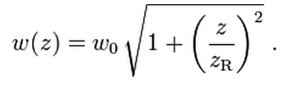


Can solve for optimal cavity geometry
The beam divergence is given by:
Which fixes w₀
The distance from the waist z is calculated from:
Where the Rayleigh Range Z_{R} is:
And the mirror curvatures from:
Solving, gives mirror curvatures of -0.5 and 0.9 m, which is a robust
Combination against instability for small length changes

Slide 23
Buildup Factor Dependence
The Thermal Distortion of the mirrors is dependent only on the maximum circulating power (not on buildup factor)
The buildup factor depends on the Finesse, and is inversely proportional to the cavity linewidth
If the linewidth (phase/frequency noise) of each laser mode (the noise will be correlated across modes) is less than 50 kHz, than buildup factors of ~1000 are possible (OK with fiber lasers)
First experiment has finesse 300, buildup 100 X

