Slide 1
Enhancement cavities
3rd mini-workshop on H- Laser Stripping and Accelerator Applications
François Labaye, Pr. Ye group at JILA, Boulder
francois.labaye@jila.colorado.edu
September 27, 2013

Slide 2
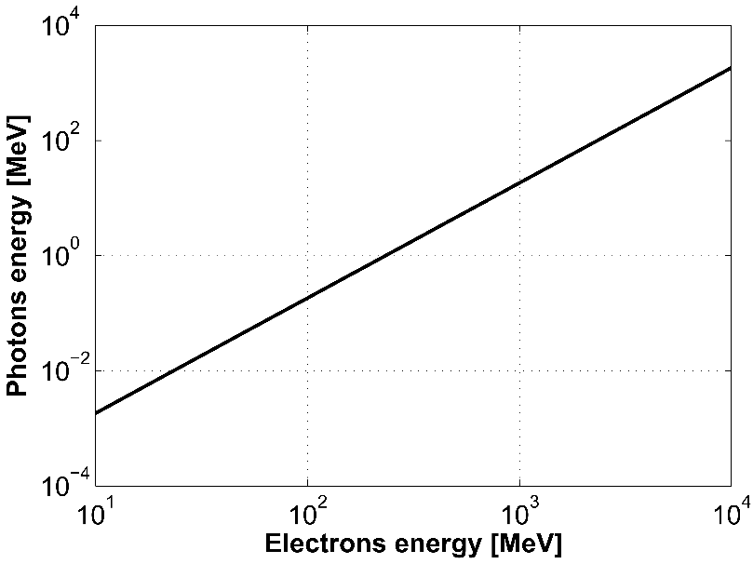
Applications of Compton backscattering
ℏ𝜔_{laser}=1.2 eV (λ=1032 nm)
ℏ𝜔_{ph}10-500 MeV
ℏ𝜔_{ph}1 MeV
High photons flux required
Two paths
High energy laser chain, low rep. rate
High average power, high rep. rate (MHz)
This is what enhancement cavities are good for
ℏ𝜔_{ph}10-100 KeV
Low energy applications:
Crystallography
Cultural heritage
Material science
Medical
Limit X\γ applications:
Nuclear survey
Nuclear waste
management
High energy applications:
Compton polarimeter
γ/γ collider
Laser wire
Polarized positrons source
$$L=N_{e^{−}}N_{laser}f\frac{\cos\left(φ\right)}{2π}\frac{1}{\sqrt{σ_{{ye}^{−}}^{2}+σ_{ylaser}^{2}}\sqrt{{\left(σ_{{xe}^{−}}^{2}+σ_{xlaser}^{2}\right)cos}^{2}\left(φ\right)+{\left(σ_{{ze}^{−}}^{2}+σ_{zlaser}^{2}\right)sin}^{2}\left(φ\right)}}$$

Slide 3
Outlines
Principle of a pulsed enhanced cavity
Cavity locking-stabilization
Current status & limitations
Past, ongoing and future experiments related to Accelerators

Slide 4
Principle of a pulsed enhanced cavity
Time domain
All the frequency comb must be
locked to the cavity
Feedback with two degrees of freedom:
Dilatation: f_{rep}
Translation: f_{ce}
When feedback done:
Frequency domain
$$=\frac{{\left|E_{circ}\right|}^{2}}{{\left|E_{inc}\right|}^{2}}$$
Frequency domain: frequency comb
Power enhancement
R. J. Jones et al. Optics Communications (2000)

Slide 5
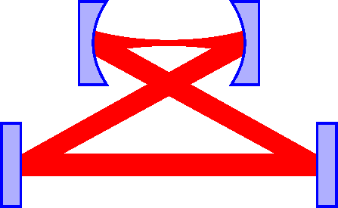
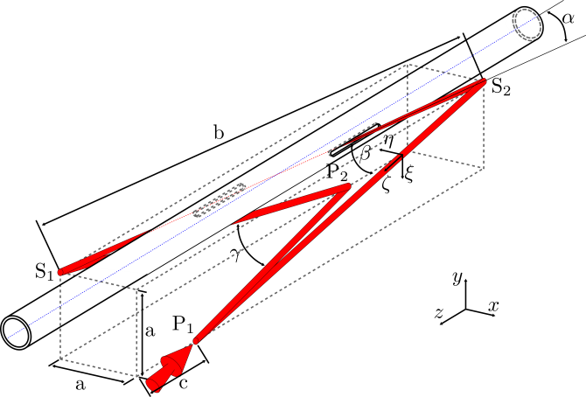
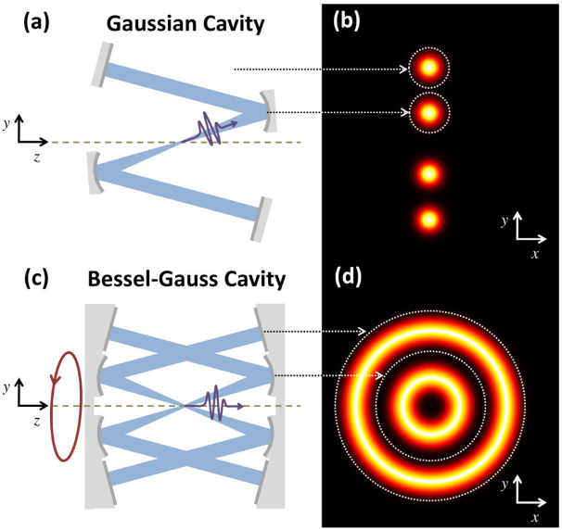
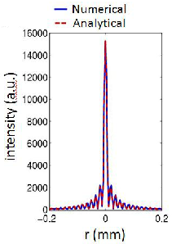
Cavity shemes
Two mirrors cavity
Most basic sheme
Linear or circular polarization
Limited beam size
Four mirrors planar cavity
Linear polarization
Small beam size
Four mirrors non-planar cavity
Circular polarization
Small beam size
F. Zomer et al. Applied Optics (2009)
Alternative: Bessel-Gauss beam enhancement cavities
W. P. Putnam et al. Optics Express (2012)
D. N. Schimpf et al. Optics Express (2012)
Complex scheme
Possibility of head-on collisions
Courtesy of W. P. Putnam

Slide 6
Outlines
Principle of a pulsed enhanced cavity
Cavity locking-stabilization
Current status & limitations
Past, ongoing and future experiments related to Accelerators

Slide 7
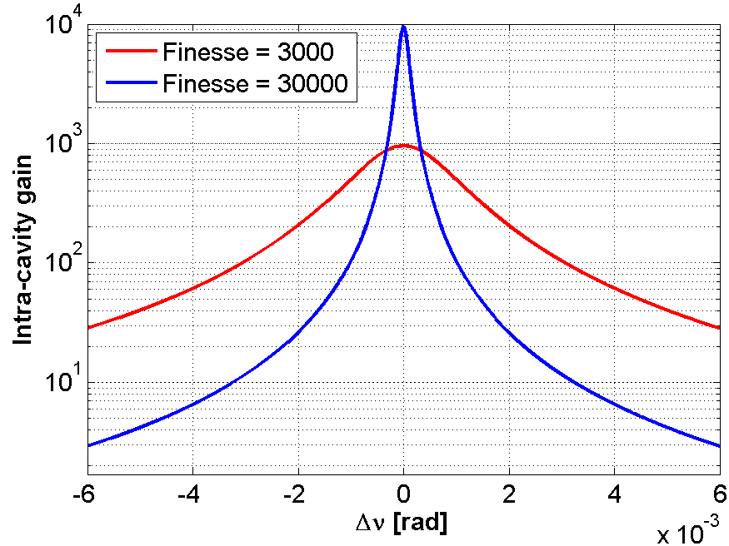
Cavity locking-stabilization
Zoom on a cavity mode
$$\frac{δν}{ν}\sim {10}^{−11}$$
$$\frac{δν}{ν}\sim {10}^{−10}$$
Several locking schemes:
Hänsh-Couillaud
T.W. Hänsch et al. Optics Communications (1980)
Pound-Drever-Hall
R. W. P. Drever et al. Applied Physics B (1983)
« Honda version »
Y. Honda et al. Optics Communications (2009)
Tilt locking
D. A. Shaddock et al. Optics Letters (1999)

Slide 8
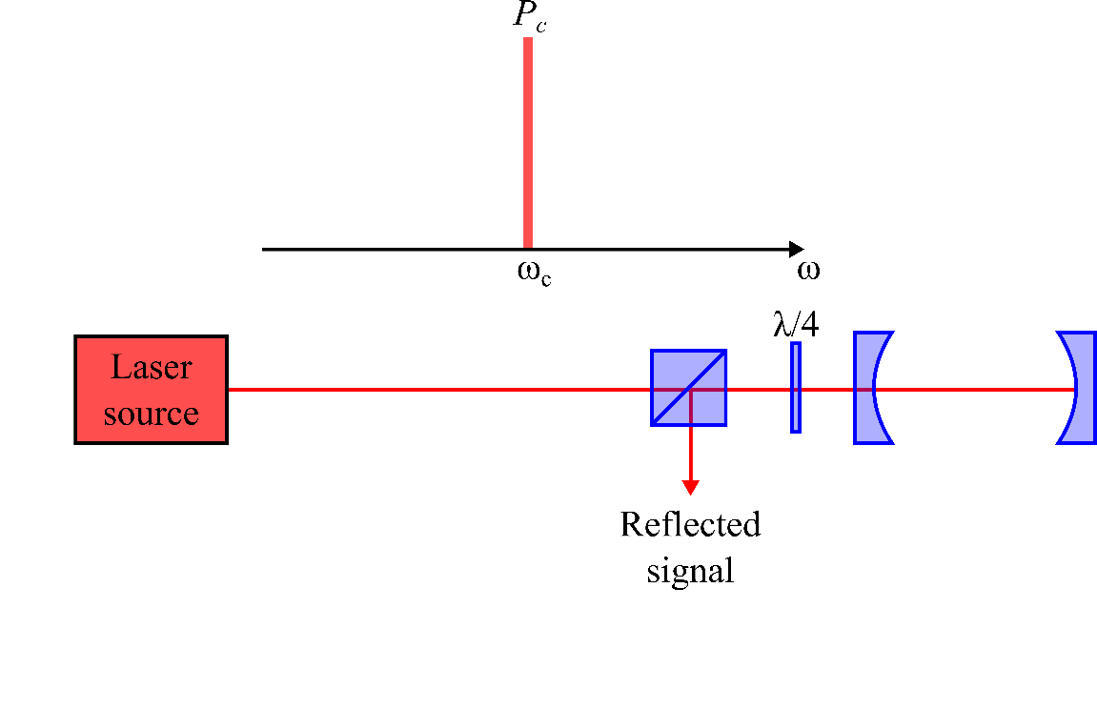
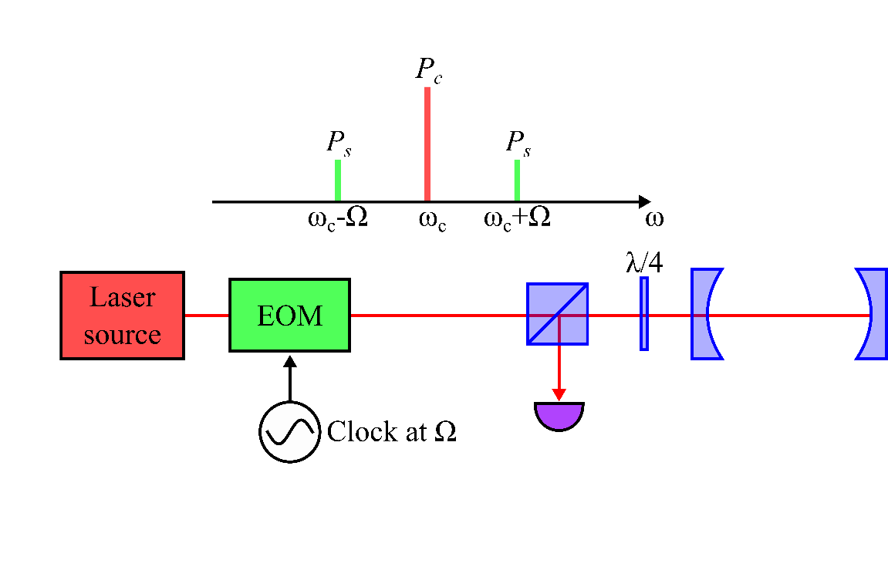
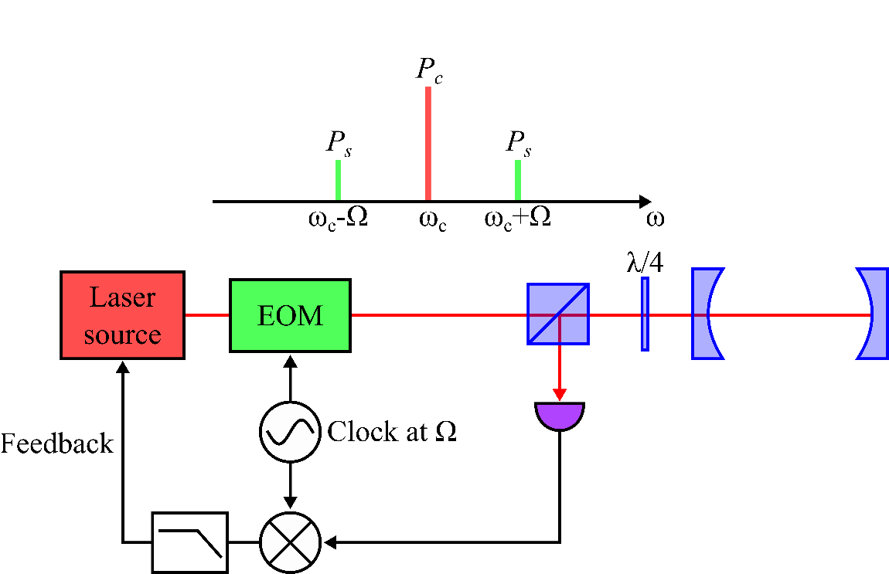
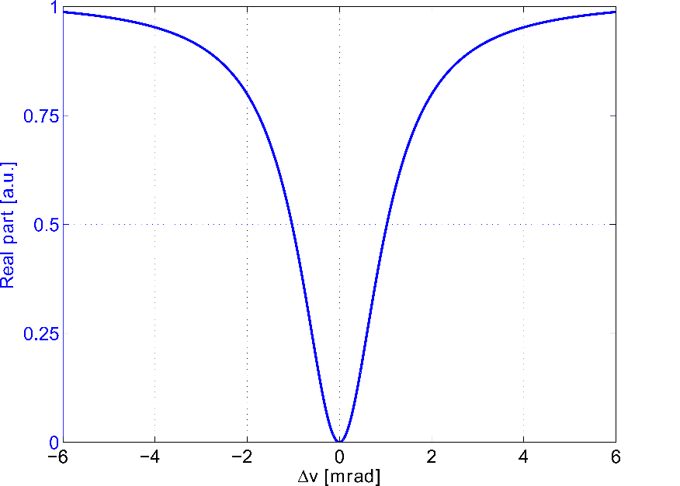
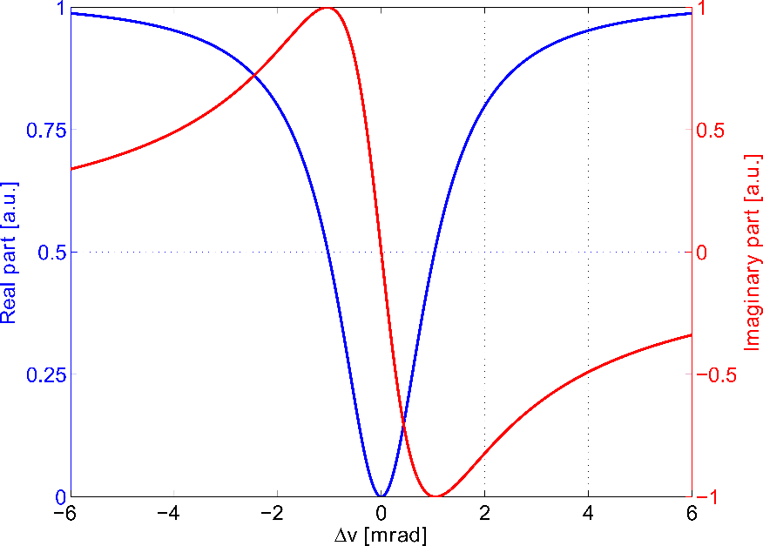
Pound-Drever-Hall
Cavity reflection transfer function
$$F\left(ω\right)=\frac{E_{ref}}{E_{inc}}$$
$$P_{ref}∝−4\sqrt{P_{c}P_{s}}Im\left\{F\left(ω\right)\right\}\sin\left(Ω\right)+(2Ω terms)$$
The imaginary part is detected
The principle of the PDH technique is
to able to detect the imaginary part
By mixing it and adding a low pass filter:
$$P_{ref}∝−4\sqrt{P_{c}P_{s}}Im\left\{F\left(ω\right)\right\}$$
R. W. P. Drever et al. Applied Physics B (1983)
E. D. Black Am. J. Phys. 69 (2001)

Slide 9
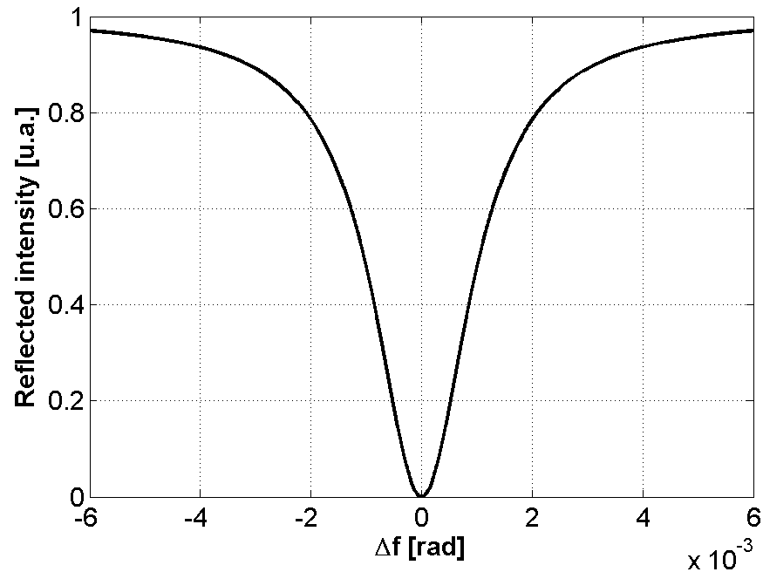
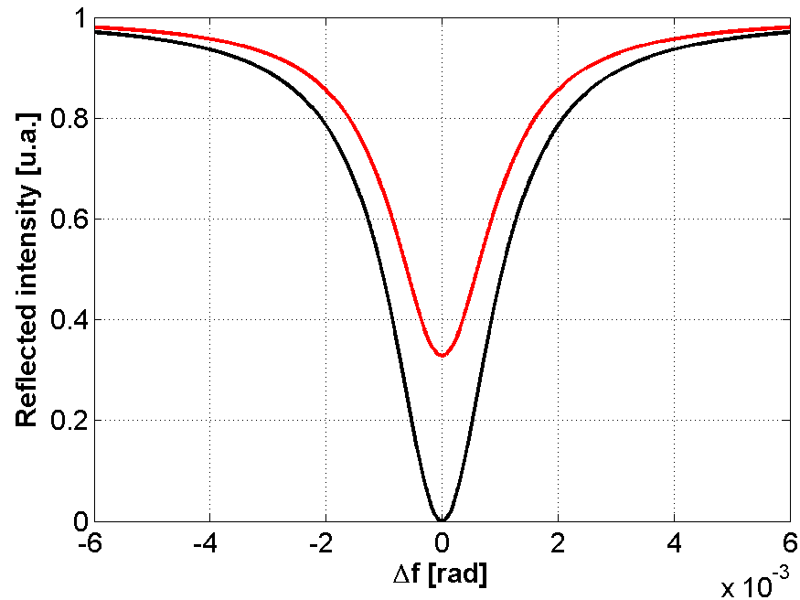
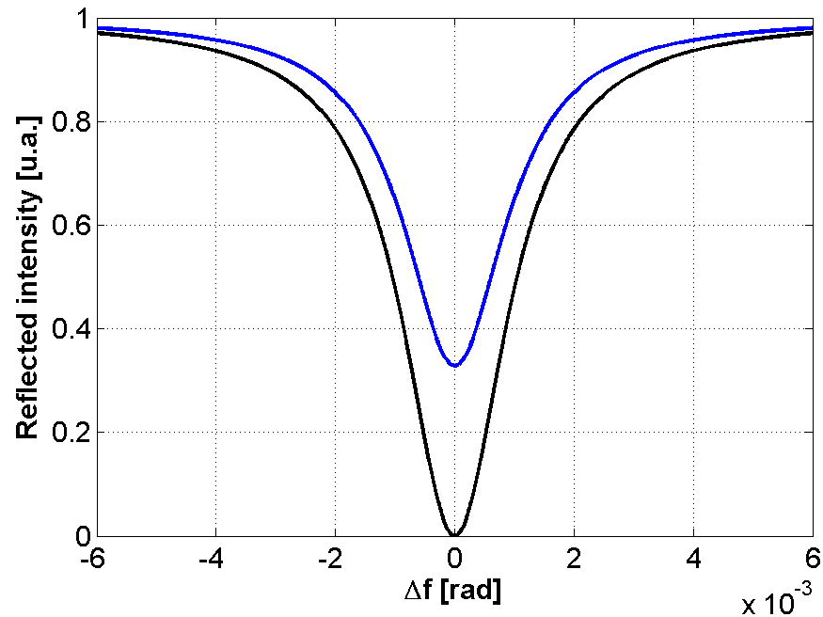
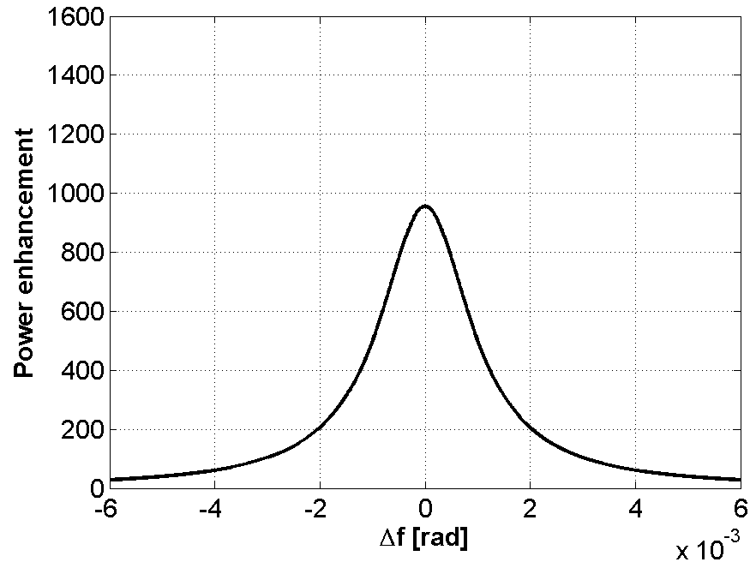
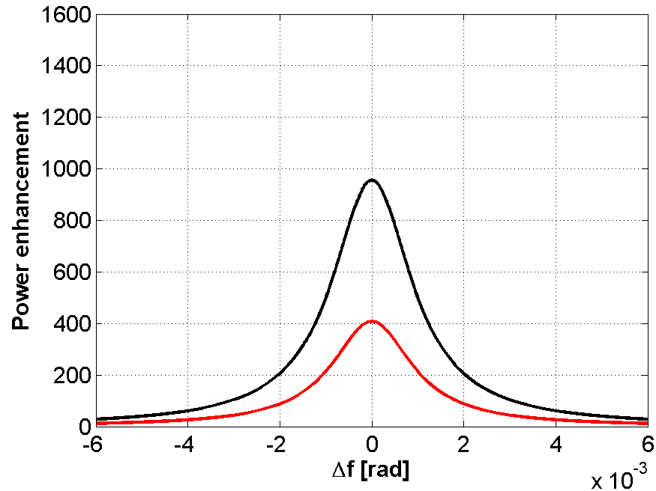
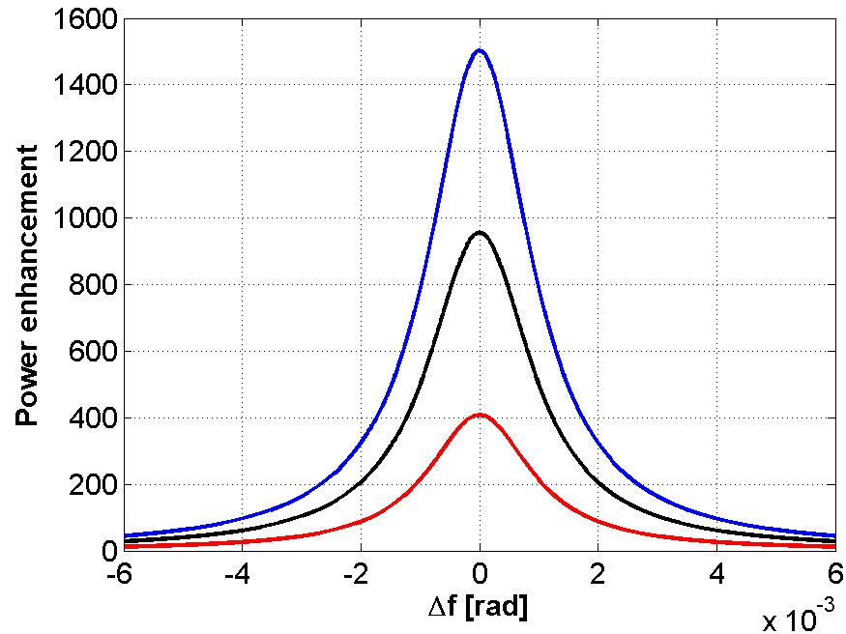
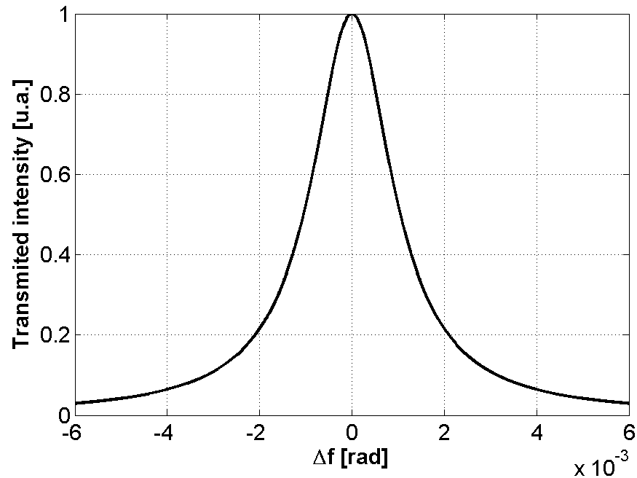
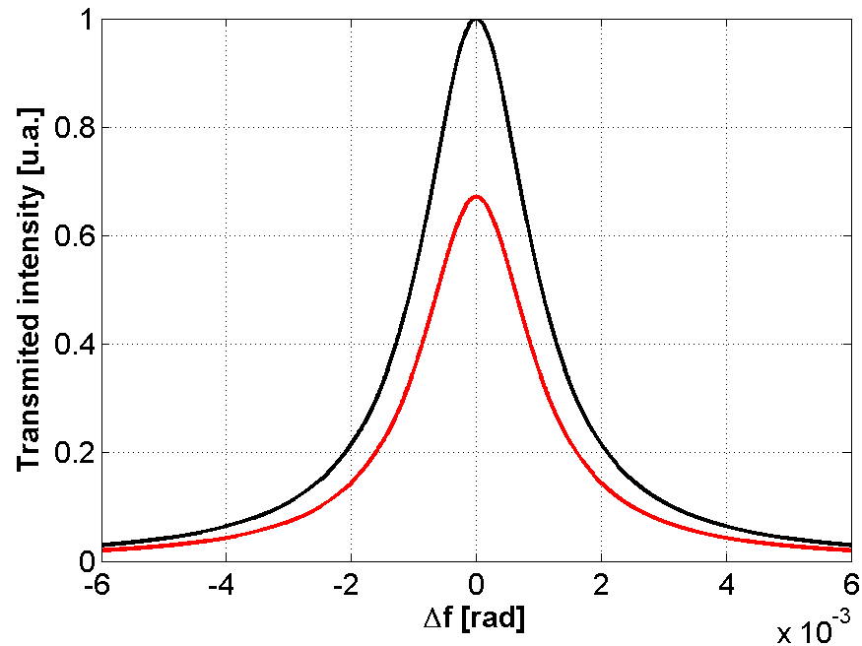
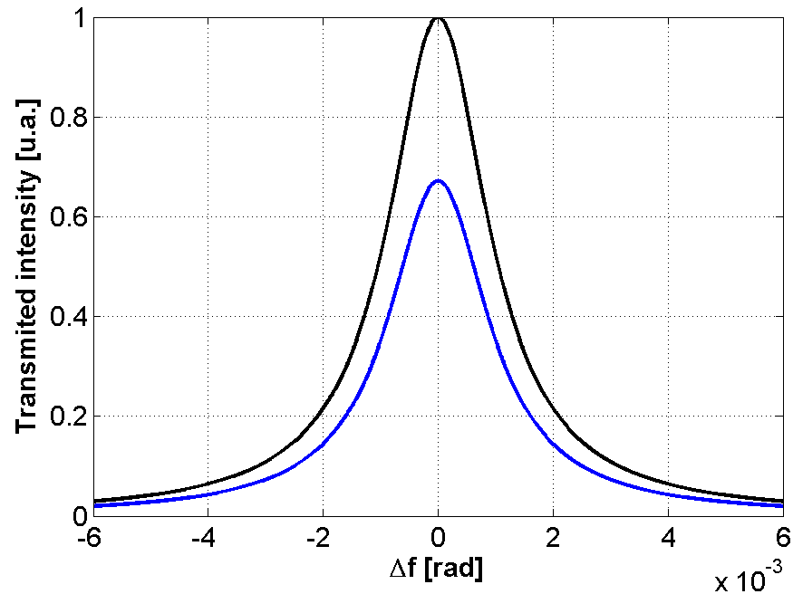
Coupling regime
Matching of the mirrors’ reflectivities
$$F≈\frac{π\sqrt{\prod_{1}^{n}{\sqrt{r_{i}}}}}{1−\prod_{1}^{n}{\sqrt{r_{i}}}}$$
$$Enhancement=\frac{1−r_{1}}{1+\prod_{1}^{n}{r_{i}}−2\prod_{1}^{n}{\sqrt{r_{i}}}}$$
$$r_{1}$$
$$r_{2}$$
Criticaly coupled
$$r_{1}=\prod_{2}^{n}{r_{i}}$$
$$r_{1}=r_{2}=99.9\%$$
Under coupled
$$r_{1}>\prod_{2}^{n}{r_{i}}$$
$$r_{1}=99.96\%; r_{2}=99.84\%$$
Over coupled
$$r_{1}<\prod_{2}^{n}{r_{i}}$$
$$r_{1}=99.84\%; r_{2}=99.96\%$$
For power enhancement cavities, the over coupled regime is the best one

Slide 10
Outlines
Principle of a pulsed enhanced cavity
Cavity locking-stabilization
Current status & limitations
Past, ongoing and future experiments related to Accelerators

Slide 11
Current status
Paper | Laser | f_{rep} [MHz] | τ_{circ} [fs] | P_{circ} [kW] | Enhancement
C. Gohle et al. Nature (2005) | Ti:Sa | 112 | 28 | 0.038 | 45
J. Lee et al. Optics Express (2011) | Ti:Sa | 50 | 80 | 1.3 | 217
I. Pupeza et al. Nature Phot. (2013) | Yb (fiber) | 78 | 57 | 6.7 | 155
A. Cingöz et al. Nature (2012) | Yb (fiber) | 154 | 120 | 8 | 270
I. Pupeza et al. Optics Letters (2010) | Yb (fiber) | 78 | 200 | 18 | 1800
 |  |  | 2000 | 72 | 1400
1st limitation: Intra-cavity peak power
Damages on mirrors
2nd limitation: Thermal effects
Change beam size
3rd limitation: Mirrors dispersion
Limit the cavity finesse/pulse duration

Slide 12
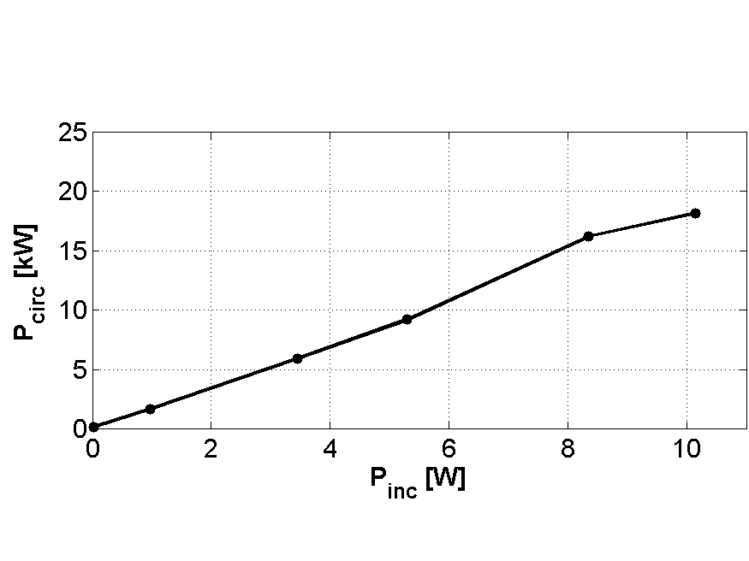
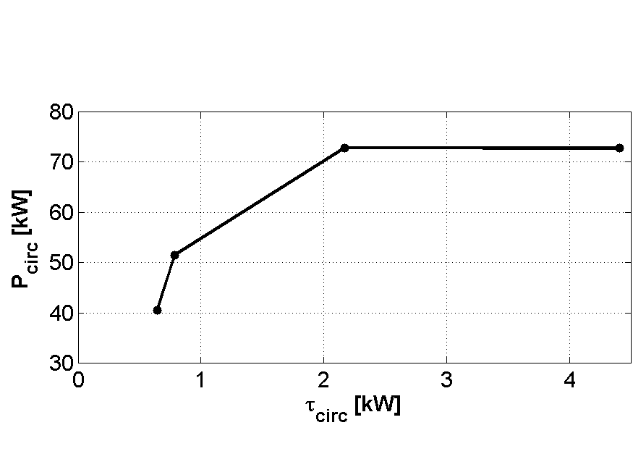
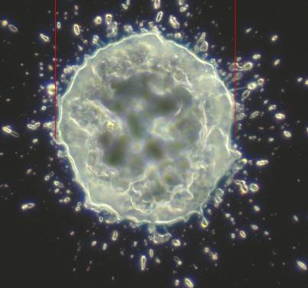
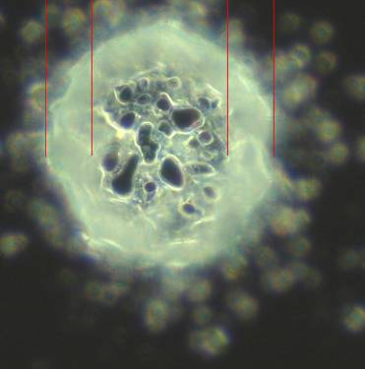
1st limitation: Intra-cavity peak power
Increasing P_{in}, τ_{circ}=200 fs Enhancement factor = 1800
Decreasing τ_{circ}, P_{in} = 50 W
Enhancement factor = 1400
Enhancement factor decreases
Under τ_{circ}=640 fs (P_{peak}=0.8 GW):
Locking instabilities
Mirrors dammaged
Above P_{circ}=18 kW (P_{peak}=1.1 GW):
Locking instabilities
Mirrors dammaged
State of the art mirrors can handle ≈ 3×10¹⁰-10¹¹ W.cm⁻²
66 μm
Solutions:
« Brute force »: Cavity design with larger beam size on the mirrors
J. Kaster et al. Conf. Paper. High Intensity Lasers and High Field Phenomena (2011)
H. Carsten et al. Optics Express (2013)
New cavity scheme such as the Bessel-Gauss beam one
Collaborations with companies/laboratories for coating development
While keeping the high reflectivity…
But:
Electron bunches duration is usually in the ps order of magnitude
For lot of Compton backscattering applications, there is no use of fs pulses
Example: enhanced cavity scheme for the ILC, f_{rep} = 325 MHz, τ_{cir} ≈ few ps
500-600 kW before reaching these peak powers
66 μm
40 μm
Courtesy of I. Pupeza
I. Pupeza et al. Optics Letters (2010)

Slide 13
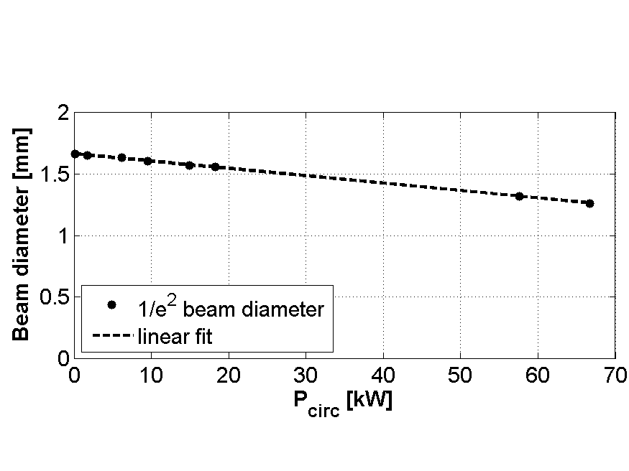
2nd limitation: Thermal issues
Beam diameter measurement behind a planar mirror
Enhancement factor:
1800
1400
The beam size:
scales with circulating average power
independent of pulse duration
Problems:
Almost no cooling by conduction because of the vacuum
Impossible to put a cooling surface on the backside of the mirrors because of their transmission
Active cooling would bring noise in the locking and instabilities
Solution?
Using other material for substrates like Sapphire
Cooling the mirrors’ edges via Peltier effect?
But introduces a gradient…
I. Pupeza et al. Optics Letters (2010)

Slide 14
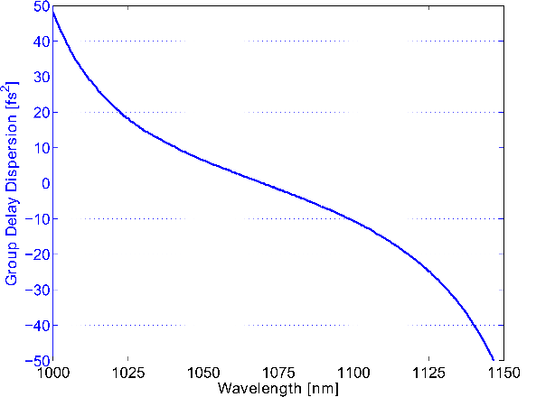
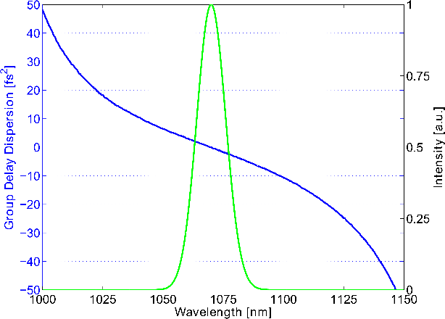
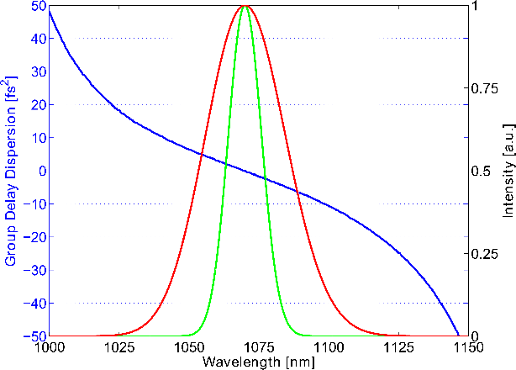
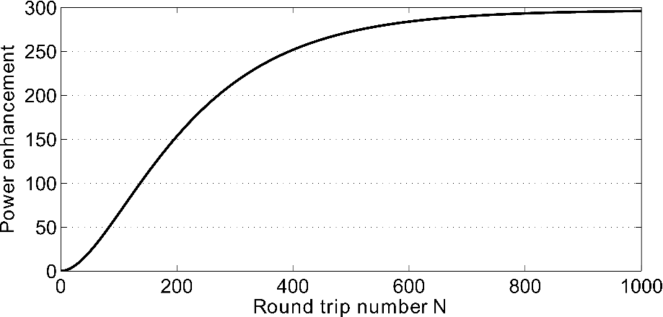
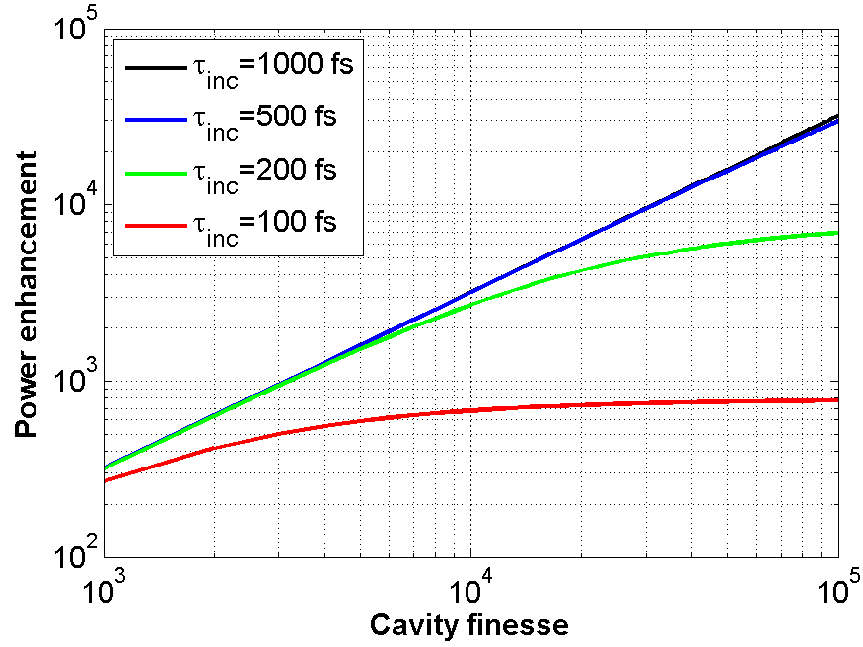
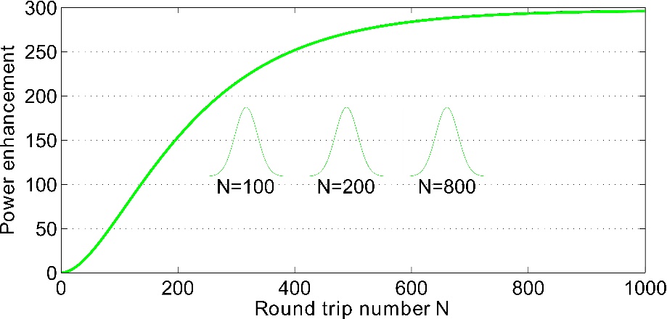
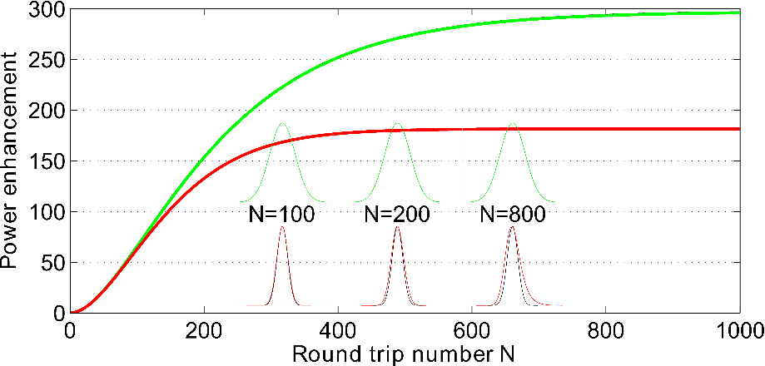
3rd limitation: Mirrors dispersion
Finesse≈500, over coupling regime
τ_{circ}=120 fs
τ_{circ}=50 fs
The separation between the cavity modes is not constant
The laser frequency comb cannot perfectly match the cavity modes
The broader is the spectrum, the higher is this effect
Round trip number increases with finesse
The higher is the finesse, the higher is this effect
Solution:
Again, collaborations with companies/laboratories for coating development with better dispersion management
While keeping them resistant to high intensities…
R. J. Jones et al. Optics Letters (2002)
J. C. Petersen et al. Optics Express (2003)

Slide 15
Outlines
Principle of a pulsed enhanced cavity
Cavity locking-stabilization
Current status & limitations
Past, ongoing and future experiments related to Accelerators

Slide 16
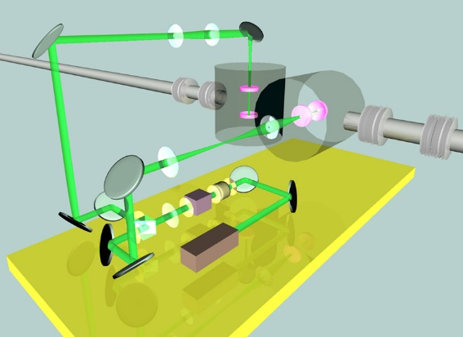
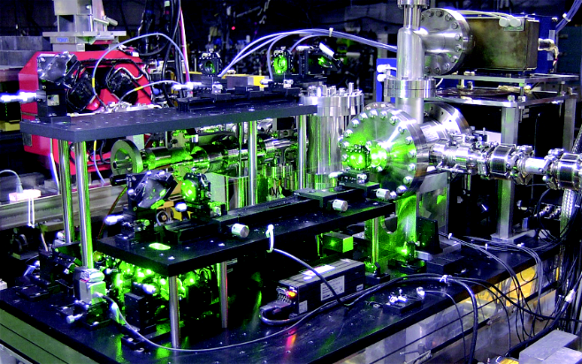
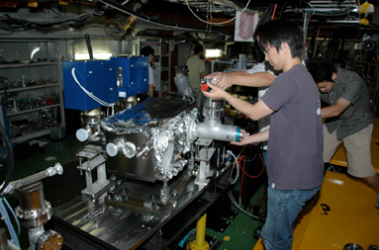
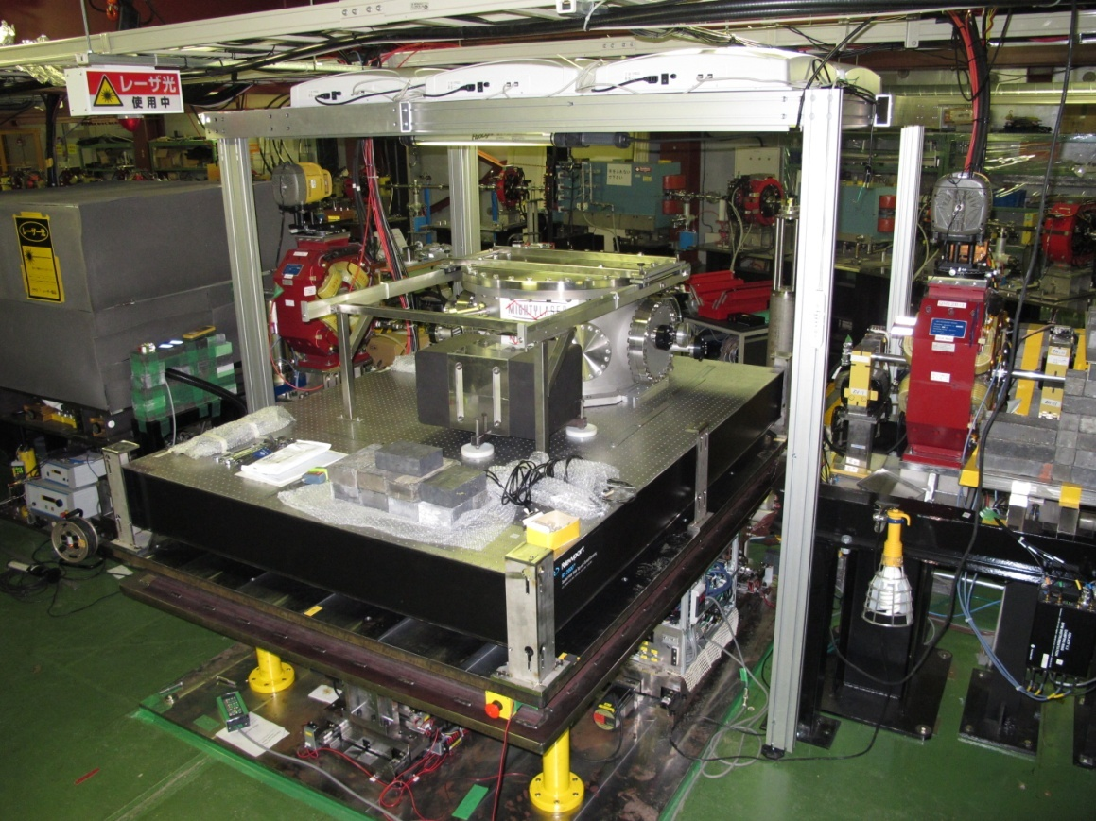
Experiments related to Accelerators
Polarimetry measurement
(See Abduraim Rakham talk)
N. Falletto et al. NIMA (2001) at JLab
A. Rakham et al. AIP Conf. Proc. (2009) at JLab
S. Baudrand et al. JINST (2010) at HERA, DESY
Laserwire (ATF, KEK)
H. Sakai et al. NIMA (2000)
H. Sakai et al. PRST: Acc. & Beams (2002)
Y. Honda et al. PRL (2004)
Design of a four mirrors cavity dedicated to laserwire:
A. Rawankar et al. (2013)
Circularly polarized γ–rays sources for positron production (ATF, KEK)
S. Araki et al. Proposal submited to the ILC workshop, Snowmass (2005)
Courtesy of J. Urakawa
ℏ𝜔_{γ}=24 MeV, 2.7×10⁸ γ.s⁻¹
Pcirc = 2.6 kW with an enhancement factor of 1200
H. Shimizu et al. JPSJ (2009) (Two mirrors cavity)
T. Akagi et al. NIMA (2013) (Four mirrors non-planar cavity)
Plan to go for an enhancement factor of 10⁴
Four mirrors non-planar cavity
ℏ𝜔_{γ}=24 MeV, 5.6×10⁶ γ.s⁻¹
P_{circ} = 160 W, with an anhancement factor of 1000
J. Bonis et al. JINST (2012) (Four mirrors non-planar cavity)
T. Akagi et al. JINST (2012) (Four mirrors non-planar cavity)
Now have 69 kW stable and 80 kW max with enhancement factor of 1800 (heading for 10⁴)
Currently being installed on the accelerator.
Installation of the 2-mirrors cavity
(October 2007)
Installation of the 4-mirrors non-planar cavity
(August 2010)

Slide 17
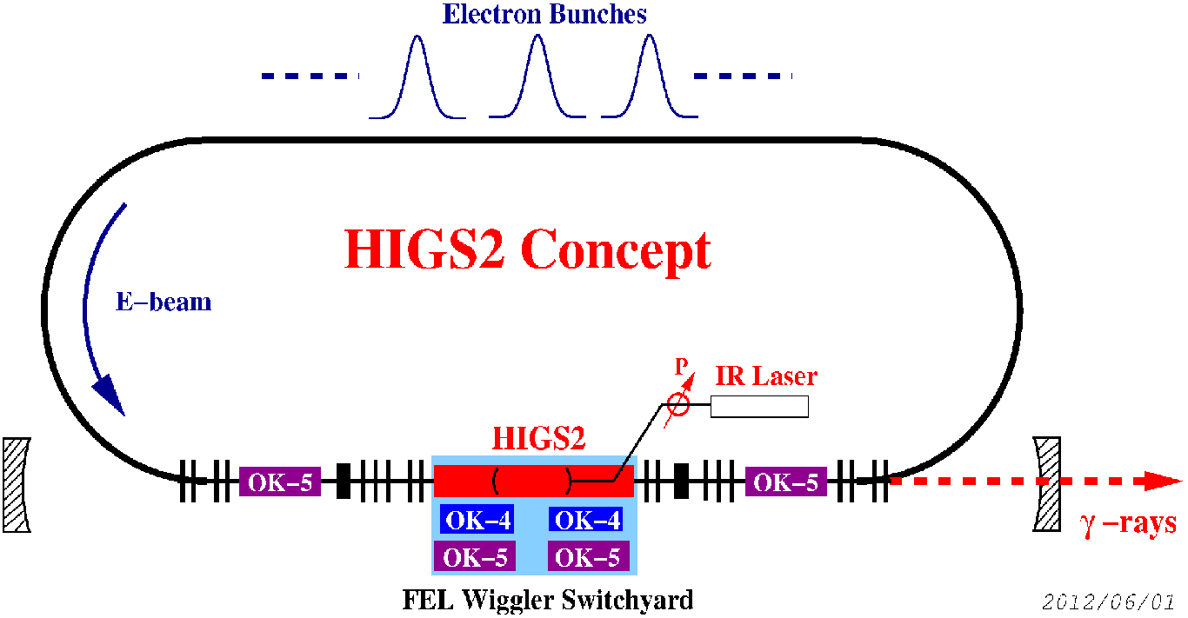
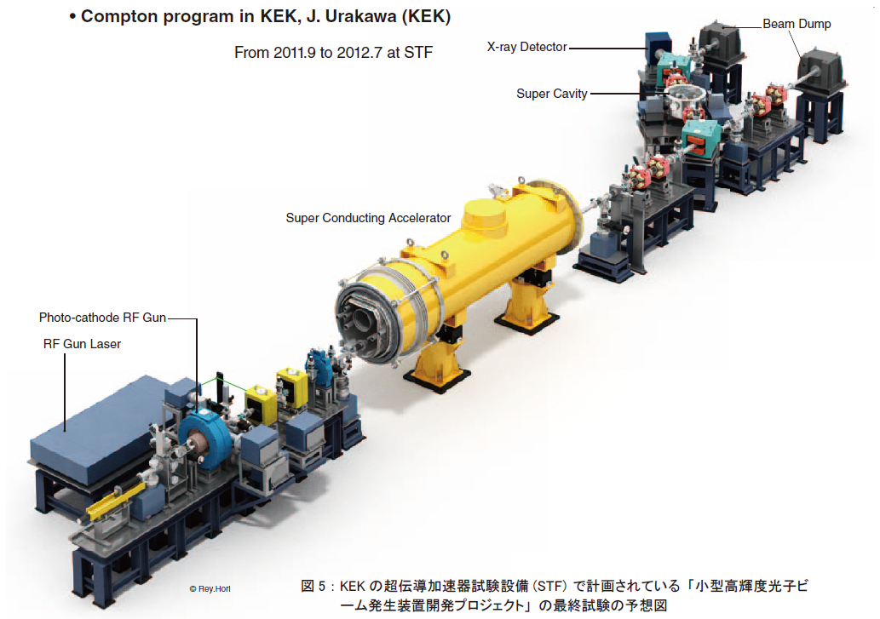
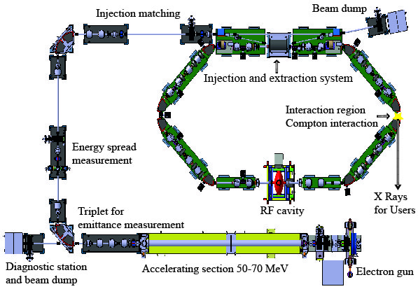
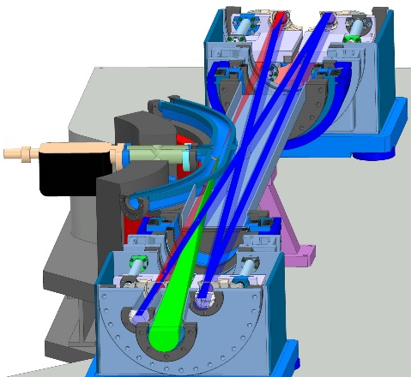
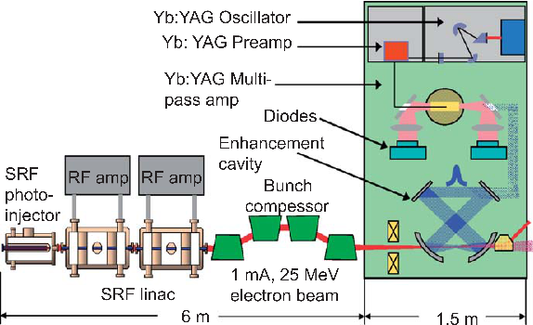
Future projects related to Accelerators
HIGS2 (USA, Duke)
Two mirrors cavity
ℏ𝜔_{γ}=2-12 MeV, 10¹¹ -10¹² γ.s⁻¹
P_{circ} = 10-20 kW, f_{rep} ≃ 90 MHz
Quantum Beam Project (Japan, KEK)
ℏ𝜔_{γ}=3-30 keV, 3×10¹⁴ X.s⁻¹
P_{circ} = ?, f_{rep} ≃ ? MHz, λ = 1064 nm
Courtesy of Y. K. Wu
ThomX (France, LAL)
Four mirrors cavity
ℏ𝜔_{γ}=50 keV, 10¹² -10¹³ X.s⁻¹
P_{circ} > 100 kW, f_{rep} ≃ 34.5 MHz, λ = 1032 nm
Runs should start around 2016
Courtesy of J. Urakawa
MIT Compton source (USA, MIT)
Four mirrors cavity
ℏ𝜔_{γ}=3-30 keV, 3×10¹⁴ X.s⁻¹
P_{circ} = 1 MW, f_{rep} ≃ 100 MHz, λ = 1032 nm
W.S. Graves et al. NIMA (2009)
Courtesy of A. Variola

Slide 18
Summary
Enhanced cavities coupled with high average power laser an alternative to high energy laser chains but undergo different problematic.
This technique is now mature and average powers of hundred(s) of kW are almost achieved
Yet, there are still three technical limitations
Mirror coatings damage due to peak-intensity
Thermal issue due to average power
Dispersion management on the mirrors coatings
Increasing number of projects related to accelerator start to use them

Slide 19
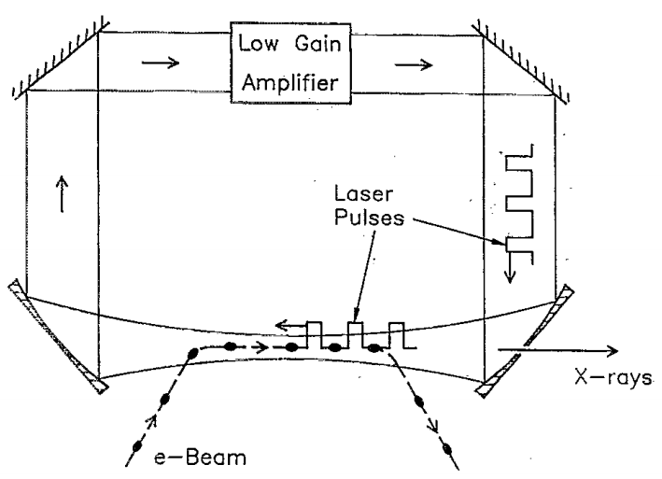
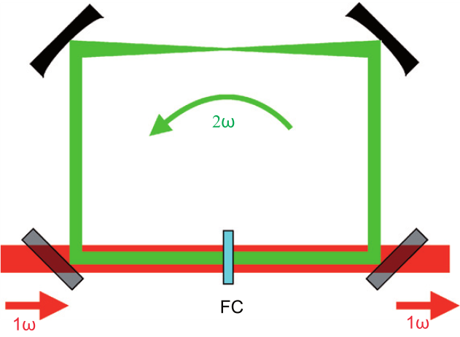
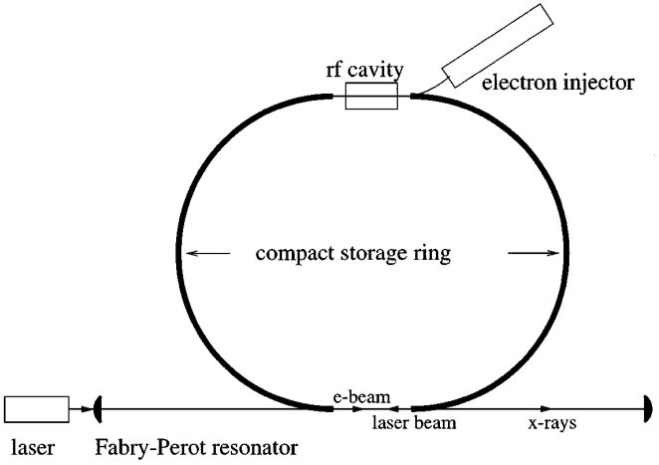
Technical solutions
Recirculation Injection by Nonlinear Gating (RING)
I. Jovanovic et al. NIMA (2007)
A. Murokh IPAC (2012)
Non-linear issues for very high energy
Regenerative cavity
P. Sprangle et al. JAP (1992)
Thermal issues in the pumped gain medium
High energy low rep. rate laser chain
Tsinghua Thomson scattering X-ray source
C. Tang et al. NIMA (2009)
Y. Du et al. Rev. Sci. Instrum. (2013)
ELI-NP
See ELI-NP White Book
Large installation
Cost
Enhanced cavity
Z. Huang et al. PRL (1998)

