Slide 1
Fiber Laser Amplifier Technology Based on Photonic Crystal Fibers
Donald L Sipes, Jason D Tafoya and Daniel S Schulz
Optical Engines Inc.

Slide 2
Topics
Amplifier Design goals
PCF Fiber
Monolithic Components
Amplifier Design
Pulsed Amplifiers

Slide 3
Optical Engines Inc.
Founded 2004 in Crystal Lake, IL
6 Full and Part time Employees
Background
Novel Fiber Devices, Fiber Lasers and Mid IR lasers
First SSL Pumped by BA Diode (1984)
532nm: 5mW @ $15k (1987) to 100mw @$80 today
First YbEr Amp:
21dBm @ $95k (1992) to 32dBm @ $3k today
Largest Distributed Amplifier Systems (Verizon)
Device Types
Multi Fiber Pumps and Combined Pumps to over 2kW
Co and Counter Pump Combiners
Fiber Amplifier Harnesses and Complete Amplifiers
Seed Sources

Slide 4
MOPA Hybrid Lasers Sources
Diode Laser Seed - Compact, Narrow Linewidth, High Speed Modulation
Fiber Laser Mid Stage – High Gain, Flexible Beam path High Average Power
Bulk Amplifier Stage - Low Gain, High Energy Storage, High Hold off
Isolated Fiber Stages
Bulk Stages
Beam
Shaping
Seed
Source
Issues:
Fiber Nonlinearities
Total Gain
Gain per Stage
Thermal distortions
The challenge is to create a fiber amplifier that has enough energy handling capability to consolidate these stages

Slide 5
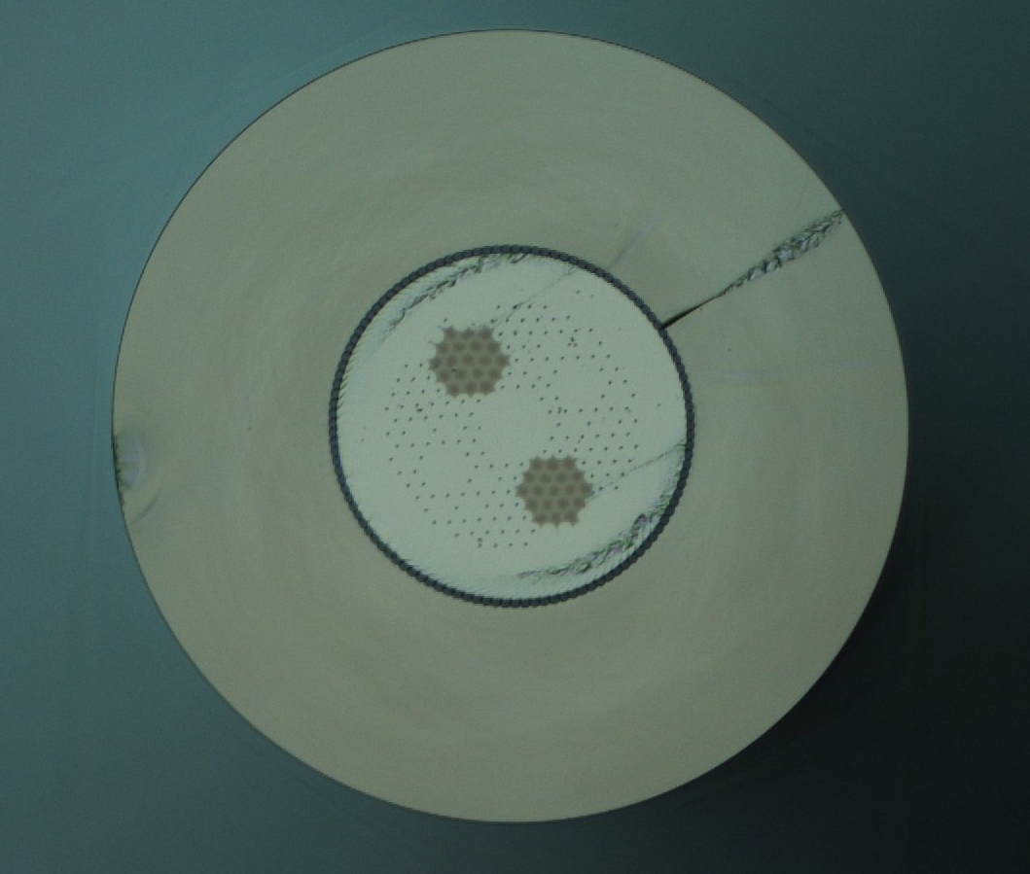
NKT Photonics PCF Fibers
Advantages
Large Core
Low NA
High NA Clad
Advanced Structures Possible
High F of M
Disadvantages
Expensive
Hard to Cleave, Splice
Custom Combiners
Current Records: approx 1mj in 2-4nsec
Over 1MW in the psec regime
40 um Core, 500um .55 NA Clad
PM Yb Doped Gain Fiber

Slide 6
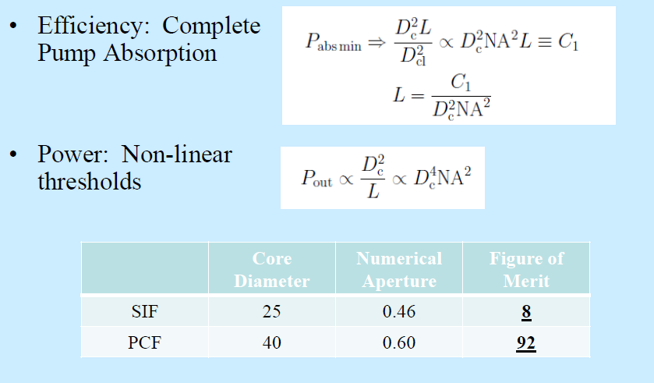
Why PCF Active Fibers?

Slide 7
Segmented Acoustic core with three different domains
Yb-2
Si
Si
990 W output power
73% slope efficiency
300 MHz linewidth
<1.3 M² value
Fabrication risk: Index matching of Yb-2 and Si has to be very precise in order to obtain perfect mode quality and modal stability.
Yb-1
Yb-2
Yb-2
Si
Craig Robin, Iyad Dajani, Clint Zeringue, Benjamin Ward and Ann Lanari, "Gain-tailored SBS suppressing photonic crystal fibers for high power applications", Proc. SPIE 8237, 82371D (2012)

Slide 8
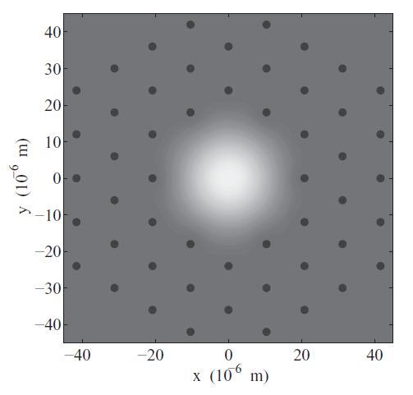
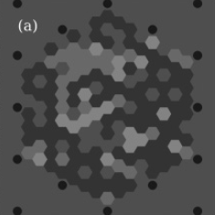
Better SBS suppression with smaller domains

Slide 9
µSAT fiber core with three different components

Slide 10
Gain Tailored uSAT Core Design
Successful SAT design
Improved µSAT design
A domain size of 2µm instead of 10µm improves SBS suppression.
Six identical outer cores provide better index homogeneity.

Slide 11
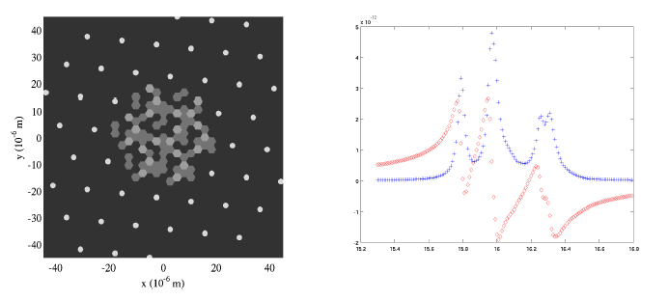
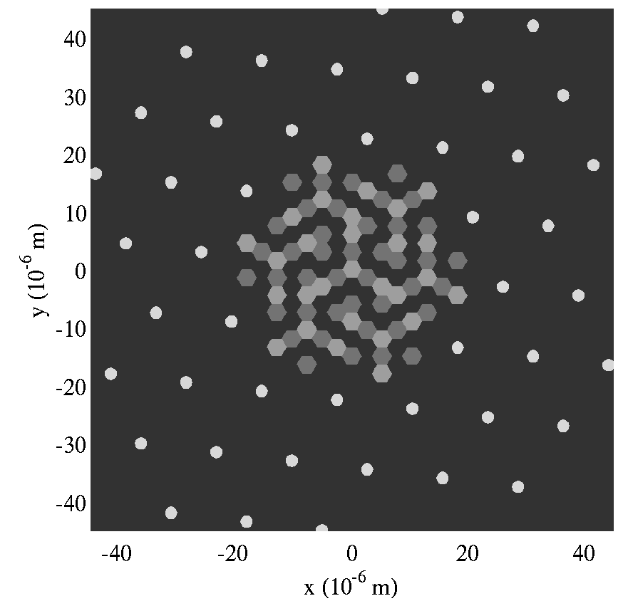
Collaboration with Lt. Col Ben Ward
Delivered
uSAT Fiber
3 Yb-1
8 Yb-2
8 Si
uSAT
Shows an
Up to
7.3dB
SBS
Improvement
Simulated
uSAT Fiber
4 Yb-1
6 Yb-2
9 Si

Slide 12
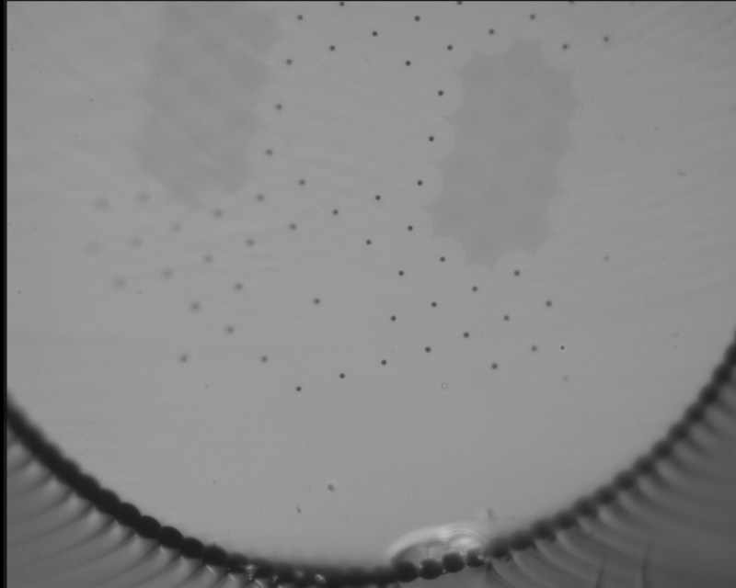
Fiber with mode suppressing side cores (MSS)
First higher order mode couples out of the central core by coupling to the side core.
Due to the airhole in the center, the fundamental mode does not couple to the side core.
Un-doped mode suppressing side core on either side of the central Yb-doped core.

Slide 13
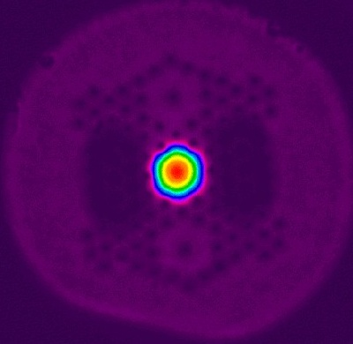
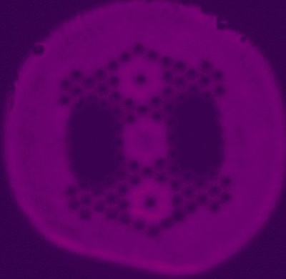
Passive MSS fiber tests
Same seed power
Slow axis, 1064nm, Ø28cm coil
Fast axis, 1064nm, Ø28cm coil

Slide 14
Etched Air Taper Combiner for Large Diameter PCF Fiber

Slide 15
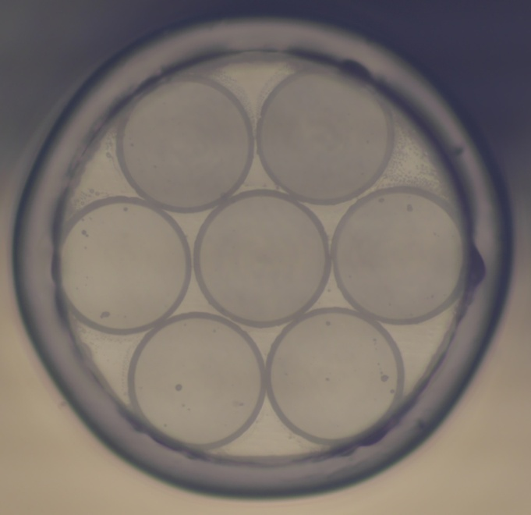
Etched Air Taper Combiner Fabrication

Slide 16
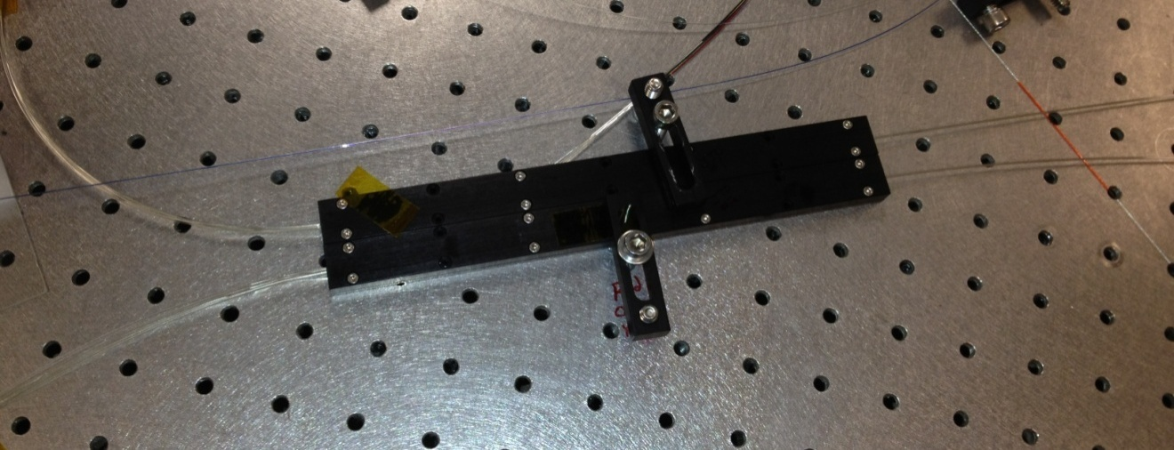
Combiner Fabrication Results: 2 Combiners Fabricated
 | Pump Port Loss (dB) |  |  |  |  |  | Average
Port # | 1 | 2 | 3 | 4 | 5 | 6
Combiner 1 | .21 | 0.10 | 0.14 | 0.13 | 0.08 | 0.09 | .125
Combiner 2 | 0.14 | 0.12 | 0.17 | 0.15 | 0.11 | 0.08 | .128
Combiner Pump efficiency at 97% - 60W heat load at 2kW Pump
PER: 20dB - Signal Efficiency Difficult to measure

Slide 17
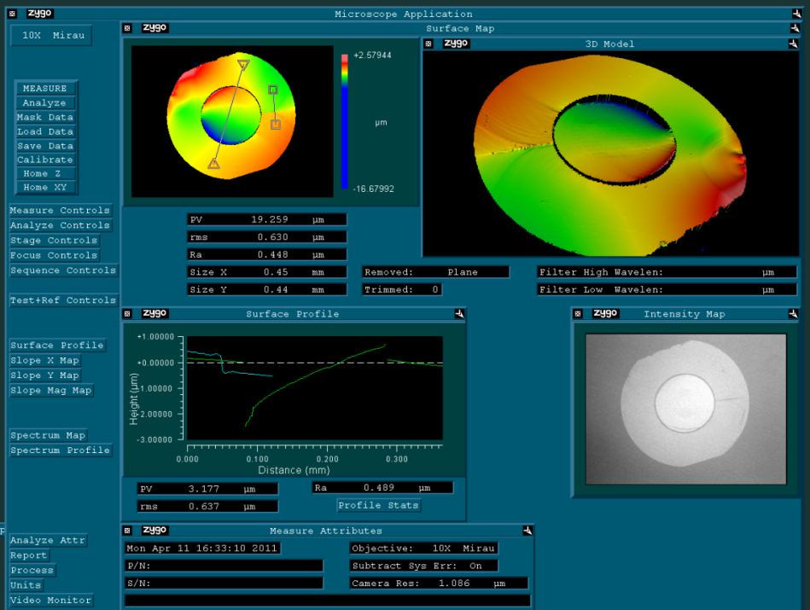
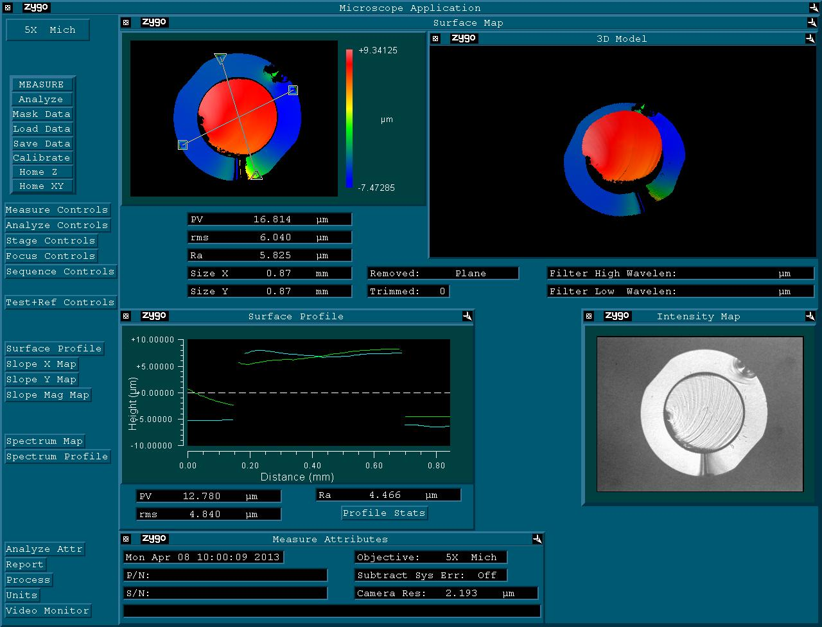
New Fiber PCF Cleaving
40/500 um PCF Web clad (2008)
40/525 um PCF Web Clad (2012)
40/200 um PCF beam Clad
All Excellent Cleaves
All Fibers delivered for this program are 40/530/875 with Beam type Air Clad
All have 20-30um Center Protrusion
Optical Engines has developed a “reinforcing” cleaving process that reduces protrusion to approximately 10um. Sufficient to progress – yet improvement is needed

Slide 18
PCF Passive – PCF Active Fiber Splice
Improve Cleaving
Process to
10um Protrusion
97.4% Pump Efficiency
95.2% Signal Efficiency
No Detectable
Air Hole Collapse

Slide 19
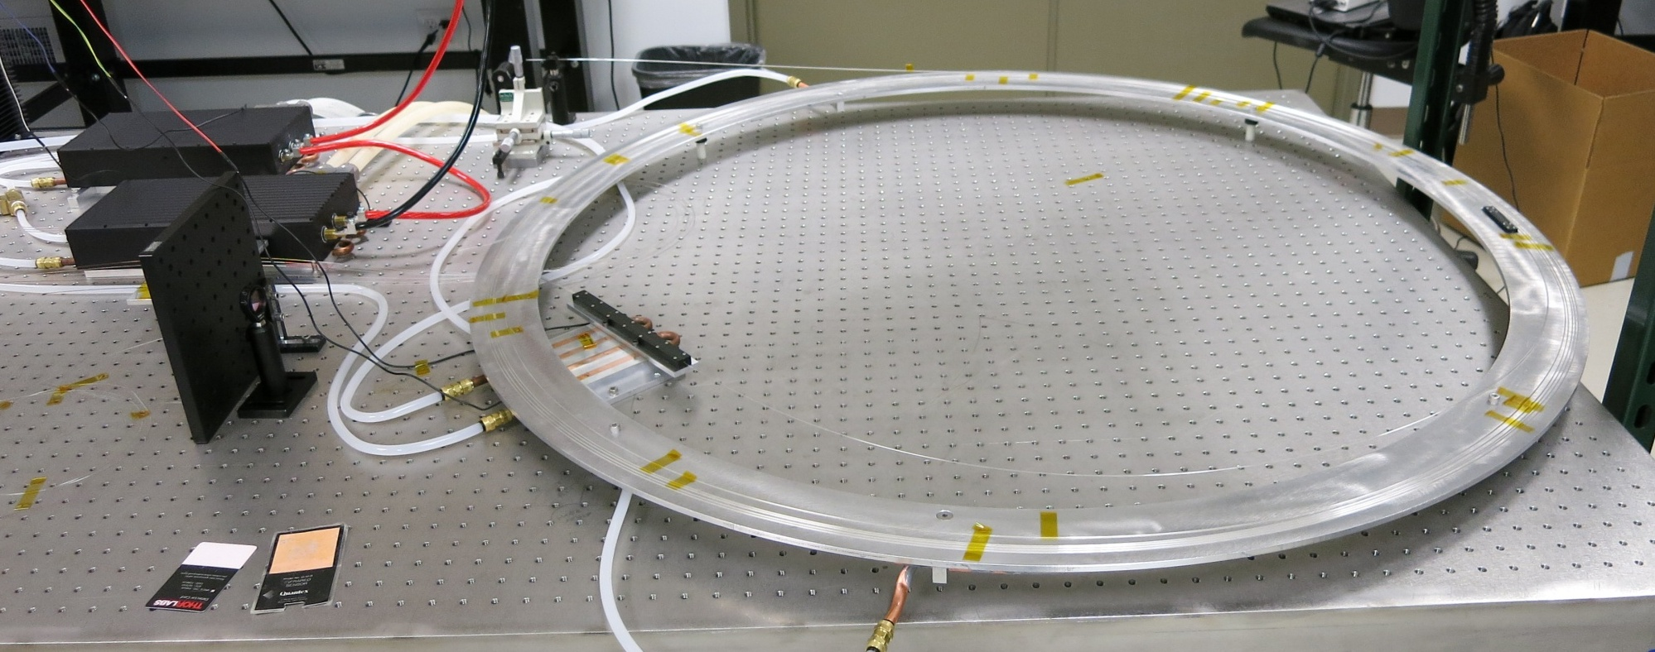
Power Amplifier Stage
Fiber Output
PCF P to PCF A Splice
Fiber Coupled Pumps
PCF Fiber on Water cooled Ring
Pump Combiner
The first fiber to be integrated is the AFRL2 SAT Fiber. This fiber does not have Coil Control, so it needs to be mounted on a large water cooled ring. The remaining fibers have coil control and can be mounted in the spiral mount

Slide 20
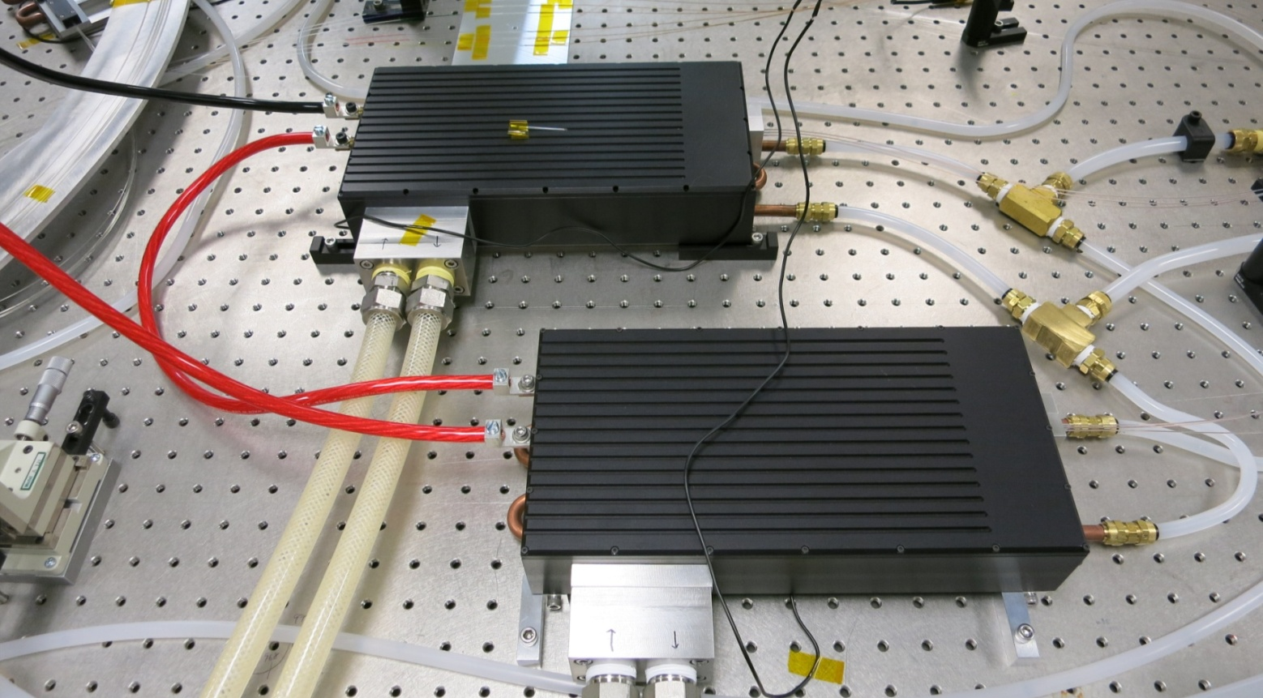
3X fiber Coupled Stacks
Fiber Outputs
3.8kW of available Laser Diode power, 1.8 – 2 kW of fiber coupled power into 6 400um.22NA fibers. Working to achieve over 3kW.
Possibilities: over 4kW fiber coupled pump, factor of 2-3 size reduction. Costs below $10/W

Slide 21
Current Status: AFRL2 PCF Fiber Results
At “Bring Up” stage to Check for thermal performance
20m AFRL2 SAT GT fiber, Co pumped – Monolithic
> 80% Slope Efficiency - 150 and 600MHz Modulation
SBS – MI: Begin to see first signs
Stage 4 Pump (W) | Core Power (W) | BWD Power (uW) | PER* (dB) | M² (U) | M² (V) | Absorbed Pump (W)
0 | 46.2 | 38 | 11.46
51 | 80.8 | 38 | 11.94
153 | 153.4 | 38 | 12.64 | 1.23 | 1.17
255 | 239.5 | 42 | 12.66 | 1.21 | 1.14
362 | 314.2 | 53 | 12.77 | 1.19 | 1.14 | 284
470 | 382.2 | 140 | 12.33 | 1.19 | 1.13
* PER Might be affected by slight amount of cladding light

Slide 22
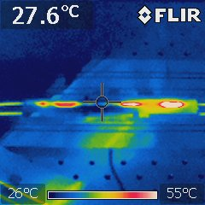
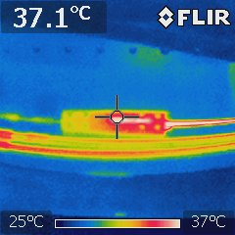
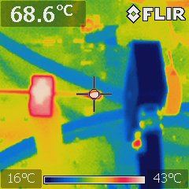
Current Status: AFRL2 PCF Fiber Results
@ 500w Input 976 nm Pump
Combiner
PCF P-A Splice
End Cap
96% Pump Efficiency
60% Signal Efficiency
97.4% Pump Efficiency
95.2% Signal Efficiency
~ 20W unabsorbed Pump
10% of Signal in Cladding

Slide 23
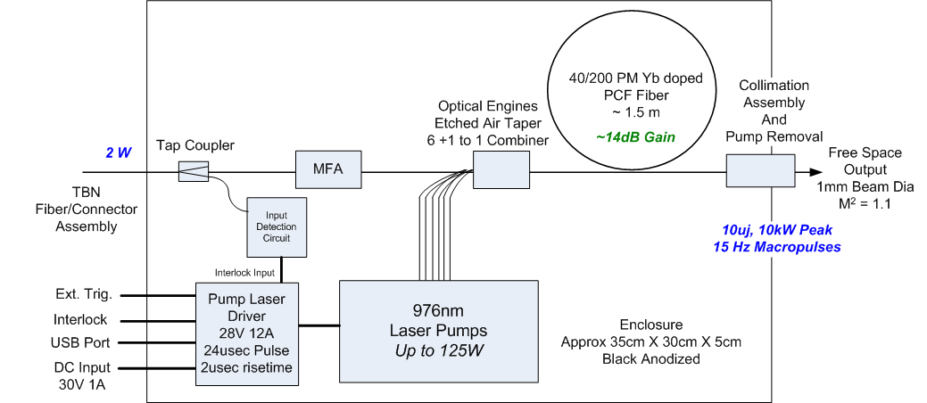
Pulsed PCF Amplifier Stage
1-3m Passive PCF Delivery Cable

Slide 24
Best of Both Worlds Amplifier
PCF Fiber Amplifiers
500uj in nsec pulses
Femtoseconds to CW
Doesn’t need coiling for mode control
Active and Passive Delivery Cables
Fiber Pumping
Can Remote pumps for bulk stages and deliver via fiber.
Bulk amplifier is a rod in the bundle

Slide 25
Summary and Conclusions
PCF Amplifiers have many Design “Handles”
Pumping Options to kW
Wide Array of Seed Options
Wide Array of Input and Output Options
High Degree of Hybrid Options
Wide array of integration options
Need to look at the whole pulse generation system
Call Us!

