Slide 1
Laser stripping for CERN HP-PS
W. Bartmann, B. Goddard, R. Steerenberg
with a lot of input from V. Danilov and D. Johnson
3rd mini-Workshop H- Laser Stripping and Accelerator Applications 26-27 Sept 2013, Fermilab

Slide 2
Outline
Introduction to HP-PS
Laser stripping concepts
H⁻ neutralisation
H⁰ --> p⁺ stripping
Laser characteristics
Issues & Questions

Slide 3
Introduction to HP-PS

Slide 4
Present CERN Accelerator Complex
LINAC 2: proton source with ~ 1 Hz
Time sharing between experiments
LINAC 2
50 MeV
Experiments & Test Beams
PSB
PS
SPS
LHC

Slide 5
Replacing LINAC2 by LINAC4
Double the brightness for existing accelerator complex
Also first stage of LP-SPL as injector for HP-PS
HP-PS in the framework of LAGUNA-LBNO study
Can pulse at 2 Hz, but ~ 1 Hz for the existing complex
LINAC 4
160 MeV
Experiments & Test Beams
PSB
PS
SPS
LHC

Slide 6
Possible CERN Accelerator Complex with HP-PS
HP-PS
3-fold Symmetry
1 Hz
Acceleration
Collimation
50 / 75 GeV
160 MeV
4 GeV
Inj. / Extr.
2 Hz
CN2PY
Target
2 MW
LINAC 4
LP - SPL
Experiments & Test Beams
PSB
PS
SPS
1 Hz
LHC

Slide 7
Low Power SPL parameters
Parameter | Values | Units
Kinetic Energy | 4 | [GeV]
Beam power | 0.144 | [MW]
Repetition rate | 2 | [Hz]
Beam pulse length | 0.9 | [ms]
Average pulse current | 20 | [mA]
Peak pulse current | 32 | [mA]
Protons per pulse | 1.13 x 10¹⁴ | -
Peak power per cavity | 0.5 | [MW]
Can be easily extended to required 2ms

Slide 8
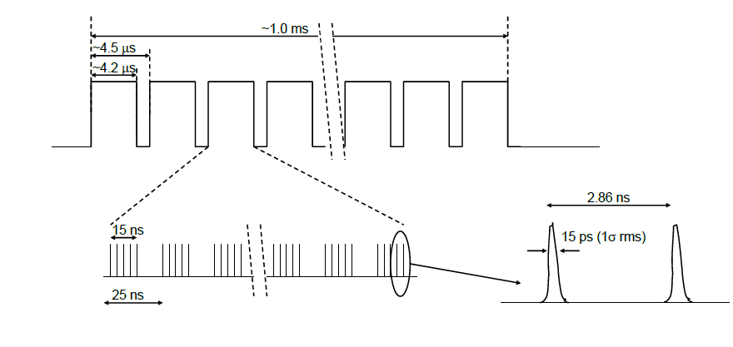
Beam temporal structure
Macropulse injection over ~2ms (500-600 turns)
SPL microbunch structure at 352 MHz

Slide 9
Parameters HP-PS cf PS2
Parameter | 50 GeV |  | 75 GeV | Units | PS2
Inj. / Extr. Kinetic Energy | 4 / 50 |  | 4 / 75 | [GeV] | 4/50
Inj./ Extr. Beam power | 0.19/2 | 0.13/2 |  | [MW] | 0.05/0.35
Repetition rate | 1 |  |  | [Hz] | 0.5
f_{rev} / f_{RF} @ inj. | 0.248 / 38.97 |  |  | [MHz]
RF harmonic | 157 |  |  | -
f_{rev} / f_{RF} @ extr. | 0.255 / 40.08 |  | 0.255 / 40.09 | [MHz]
Bunch spacing @ extr. | 25 |  |  | [ns]
Total beam intensity | 2.5 x 10¹⁴ |  | 1.7x10¹⁴ | - | 1.1e14
Number of bunches | 147 |  |  | - | 168
Intensity per bunch | 1.7x10¹² |  | 1.25x10¹² | - | 6.3e11
Main dipole field inj. / extr. | 0.17 / 2.1 |  | 0.17 / 3.13 | [T] | 0.0667/1.7
Ramp time | 500 |  | 500 | [ms]
Dipole field rate dB/dt (acc. ramp) | 3.9 |  | 5.9 | [T/s]

Slide 10
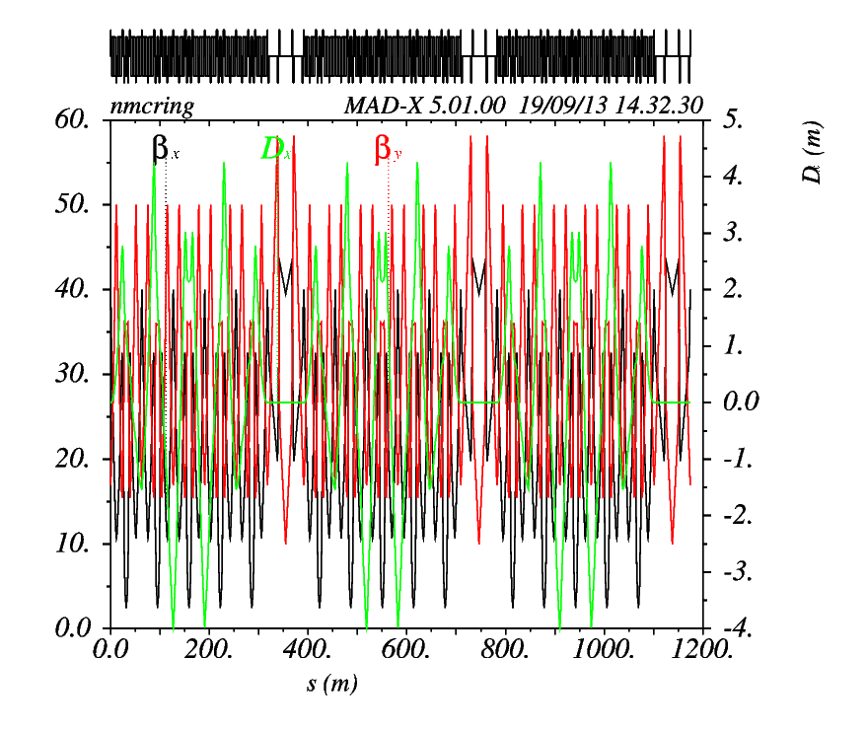
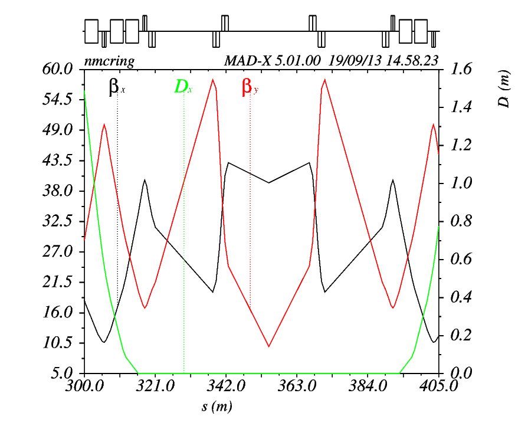
HP-PS lattice
One LSS for injection and extraction
Total length of LSS: 73.5 m
Triplet concept based on FNAL design
24 m for H- injection

Slide 11
H- injection foil stripping
24 m

Slide 12
Which parameters differ from PS2?
Number of injected turns
500-600 turns needed instead of 200-300
More foil hits, emittance blowup, foil heating
Beam loss and activation
Repetition rate
1 Hz instead of 0.5 Hz
Target emittance
13 um both planes (1 sigma rms normalised) instead of 2.5 um
Motivation to also look into laser stripping

Slide 13
Laser stripping for H- injection

Slide 14
Doppler shift of laser frequency
At 4 GeV:
n=2 can be reached with 47.5° between ion beam and laser
n=3 with 8.39 °

Slide 15
H⁻ neutralisation: Wiggler
Magnet with ∫B·dl
Vertical → no extra horizontal angular spread which would increase the laser power
Need at least 0.6 T to keep emittance growth small
Integration could be an issue

Slide 16
H- neutralisation: Laser
No emittance growth
Easier integration than wiggler?
Numerical calculation of neutralisation degree
Laser micro pulse energy required for 99% neutralisation
60mJ per micropulse
with factor 1000 reduction from recycling
f_{RF}=352MHz and T_{inj} =2ms
gives 42 J per macropulse

Slide 17
H- neutralisation: Laser Feshbach resonance as alternative?
Feshbach resonance appears at 113.49 nm (10.93 eV) in the H- photodissociation spectrum
With 1064 nm laser accessible with intersection angle of 37°
To reach 99% neutralisation (crosssection~1.39e-15 cm²) a laser micropulse energy of 190 uJ is required
However: Δλ/λ~5.2e-6 while beam Doppler spread ~2e-3
Need another factor 5e2 for full beam neutralization, leads to a laser micropulse energy of 73 mJ

Slide 18
H- neutralisation: Laser n=2 shape resonance as alternative?
The resonance at 112.95 nm for the reaction
$ℏω+H^{−}→ H_{n=2}+e^{−}$ cross-section of 9.8e-17 cm²
Requires 2.8 mJ micropulse energy but with much larger linewidth of 1.8e-4 resulting in a total micropulse energy of 31 mJ
The H⁰ is then already in an excited state and can be resonantly excited from n=2 to n=3
Dual advantage of longer lifetime for spontaneous decay and shorter lifetime for stripping to p⁺ in magnetic field

Slide 19
H⁰ --> p⁺ stripping
SNS scheme:
Resonant excitation of ground-state H⁰ in field free region
Stripping of excited electron in magnetic field
Large spread of effective resonance frequencies →divergent beam
For excitation to n=2 or n=3: 360 and 92 uJ laser micropulse energy
Spontaneous decay reduces the efficiency:
1.7% of n=3 decay in 25 cm drift between laser interaction and stripping point

Slide 20
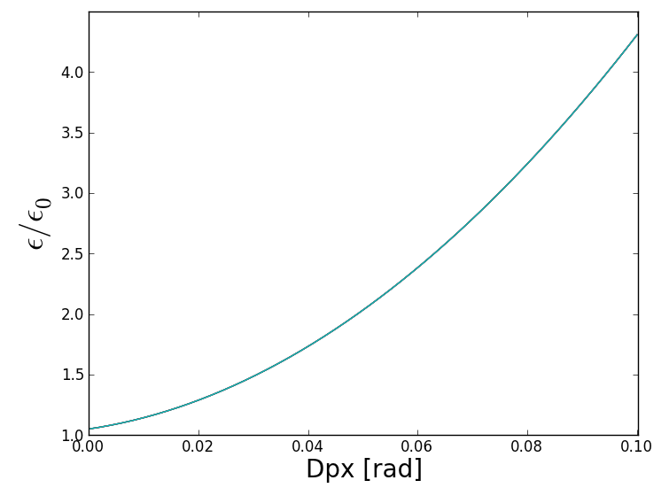
Dispersion tailoring
Need a Dpx of about 2.0 rad
LSS has zero dispersion
Target emittance should not be significantly affected by injection process
Assuming a target emittance of ~13 um
Injected transv emittance: 0.4 um, emittance growth less than 0.3 - 0.5 um
Assuming a maximum acceptable dispersion of 0.2 m
Dpx < 0.05 rad

Slide 21
Fringe field stripping – emittance growth
Normalised emittance growth for different H^{0*} quantum states as a function of peak magnetic field
Lifetime in magnetic field depends on quantum state, B-field and ion momentum
Lifetimes of 4 GeV H^{0*} in dependence of B and a simulated fringe field
numerically integrated to get rms angle error and hence emittance growth
n=3 gives Δε of 2 – 4 um for B = 1 T
Careful fringe field design needed!

Slide 22
Stark broadening
Overcome Doppler broadening by placing interaction region in a magnetic field → large Stark-broadening of transition
Single frequency can excite the resonance for all atoms
To reach Doppler width of 2e-3 need 0.3 T for n=3 transition
Lifetime of H^{0*} only 1e-10 s
Required laser micropulse energy slightly higher than previous method
Excitation takes place over ~0.5 m which introduces a large angle between injected and circulating protons → difficult integration
Stark-broadening of quantum levels vs B-field for 4 GeV H⁰

Slide 23
Laser characteristics (H⁰ --> p⁺ stripping)
Parameter |  | n=2 | n=3
Wavelength | nm | 1064 | 1064
Laser/H- angle | deg | 47.50 | 8.39
Angular spread | deg | ±0.10 | ±0.42
Micropulse energy | uJ | 360 | 92
Macropulse length | ms | 2 | 2
Macropulse energy | J | 253 | 65
Peak power (single pass) * 3 (margin) | MW | 21.6 | 5.5
Average power (single pass) | kW | 43.2 | 11.0
Average power (mode-locking) | W | 760 | 193
Average power (Q=100) | W | 432 | 110
Vertical laser beam height (1 σ rms) | mm | 1.5 | 1.5
Linac pulse, 1 σ rms separated by 2.84 ns | ps | 15 | 15
Laser pulse shape required, rectangular | ps | 50 | 50
Laser repetition rate (max) | Hz | 1 | 1
Availability | % | 99 | 99

Slide 24
Summary
Base line is foil stripping system
Foresee to combine it with a laser stripping system
Laser stripping base line:
Wiggler for neutralisation
Resonant excitation to n=3
avoid large emittance growth
Intersection angle 8.4°
Precludes operation below 4 GeV
Laser power remains main issue
Final stripping in 3rd chicane dipole (careful fringe field design)
Dispersion tailoring limited by emittance growth
Alternatives:
n=2 shape resonance to neutralize H⁻
resonant excitation from this level

Slide 25
Issues & Questions
Feasibility of laser parameters
Peak power?
Which Q values to be expected from optical resonators?
Mode-locking possible?
Is the 2ms pulse length an issue?
300 J through vacuum window?
Combination of foil and laser system, 3- and 4- magnet bumps with dispersion closed?
Fringe field design of stripping magnet

