Slide 1
Laser Optics for SNS Laser Stripping
Yun Liu
for SNS Laser Stripping Team
Notes:
1

Slide 2
Outline
Laser requirement for high efficiency laser-assisted H- beam stripping
Technical challenges in development and operation of lasers for the stripping experiment
Laser system for the SNS intermediate stage laser-assisted H- beam stripping
  Power ramping up of the customized amplifier
  New seed laser development
  Laboratory test of UV beam
Summary

Slide 3
Laser Assisted H- Beam Stripping Scheme
Our team developed a novel approach for laser-stripping which uses a three-step method employing a narrowband laser
Main problem –beam energy spread
Laser Beam
High-field Dipole Magnet
High-field Dipole Magnet
H⁻
H⁰
α
H^{0*}
proton
Step 1: Lorentz Stripping
Step 2: Laser Excitation
Step 3: Lorentz Stripping
H⁻ → H⁰ + e⁻
H⁰ (n=1) + γ → H^{0*} (n=3)
H^{0*} → p + e⁻
A proof-of-principle experiment has been conducted to demonstrate >90% stripping efficiency using a Q-switched laser with 10 MW peak power!

Slide 4
Tremendous Average Laser Power Required for Full-Cycle SNS H- Stripping
1/60 s
Energy gap requires laser wavelength at UV regime.
Peak power 1 MW.
Macrobunches of 1 ms duration at 60 Hz.
Microbunches of ~ 50 ps at 402.5 MHz.
20 KW average power at UV is required.
Macro-pulse
1ms
t
1 ms
1 μs
Mini-pulse
700ns
t
700 ns
2.5 ns
Micro-pulse
50 ps
t

Slide 5
MOPA Based Macropulse Laser System
Seeder
Pulse Picker
Amplifier
Harmonic Converter
Seeder: generate micro-pulses matching micro-bunch structure of ion beam
Pulse Picker: provide macro-pulses matching macro-bunch structure of ion beam
Amplifier & Harmonic Converter: boost power to the required level, e.g. 1MW @ 355 nm
~ 1 ms
~ 50 ps
1/60 ms
~ 2.5 ns
The Macro-pulse laser system can reduce the average power requirement from 20 KW to 1.2 KW!
Notes:
For obtaining high pulse energies in ultrashort pulses, it is frequently necessary to reduce the pulse repetition rate. This can be achieved by placing a pulse picker between the seed laser and the amplifier. The amplifier will then act only on the wanted pulses. The macro pulse duration is limited to 20µs due to the pumping scheme and conversion efficiency limitation.

Slide 6
Average Power Challenge in Pulsed Lasers
10³
1 mW
1 W
1 KW
1 MW
1 GW
CPA Lasers
1
Q-switch Lasers
Pulse Energy (J)
10⁻³
SNS Laser Stripping
10⁻⁶
Mode-Lock Lasers
10⁻⁹
10⁻³
1
10³
10⁶
10⁹
Repetition Rate (Hz)
6
Notes:
6

Slide 7
Negligible Photon Loss in Laser-Ion Beam Interaction
H⁻ beam 30 mA, 50 ps
laser pulse 1 MW, 50 ps, 355 nm
.
Number of electrons in single pulse: ~ 10⁷
Number of photons in single pulse: ~ 10¹⁴
Very low photon loss occurred during the stripping process. Therefore, it is highly desirable to recycle the laser power with an optical cavity.

Slide 8
Challenges in Optical Cavity Development
Optical Cavity
Doubly-Resonant Optical Cavity
.
PZT
Reflection
.
Error Signal Generation
Locking Circuit
Amplifier
Technical Challenges
Cavity locking technique to macropulses: is doubly-resonant cavity a solution and how to compensate dispersion?
Is the linewidth of MOPA output narrow enough to be recycled?
Operation in high grade vacuum
Coating damage threshold at 355 nm

Slide 9
Laser Operation for the Stripping Experiment
Reliability of high power laser
Stability of laser output
Laser induced damage to optical components
Location of laser
  Near the beam line – radiation damage concern to both laser components and power supply; remote control of laser system.
  Outside the beam line – laser transport line; UV beam loss; pointing stability
Notes:
Fiber laser cavity length is locked to a sub-harmonic of the repetition frequency, which induces mode hopping and side mode noise in its operation.
Thanks to the improvement in modulation bandwidth and the decrease in driving voltage, short pulse generation using electro-optic (EO) modulators has recently been attracting renewed attention.

Slide 10
SNS is pursuing an intermediate-stage laser-assisted H- beam stripping experiment
Main purpose: proof of practicality through verifying
Stripping efficiency on operational H- beam bunch structure
Reliability of high power, high repetition rate, UV laser
Phase locking between laser and accelerator RF signal
UV beam transfer line
Optics coating
Radiation effects

Slide 11
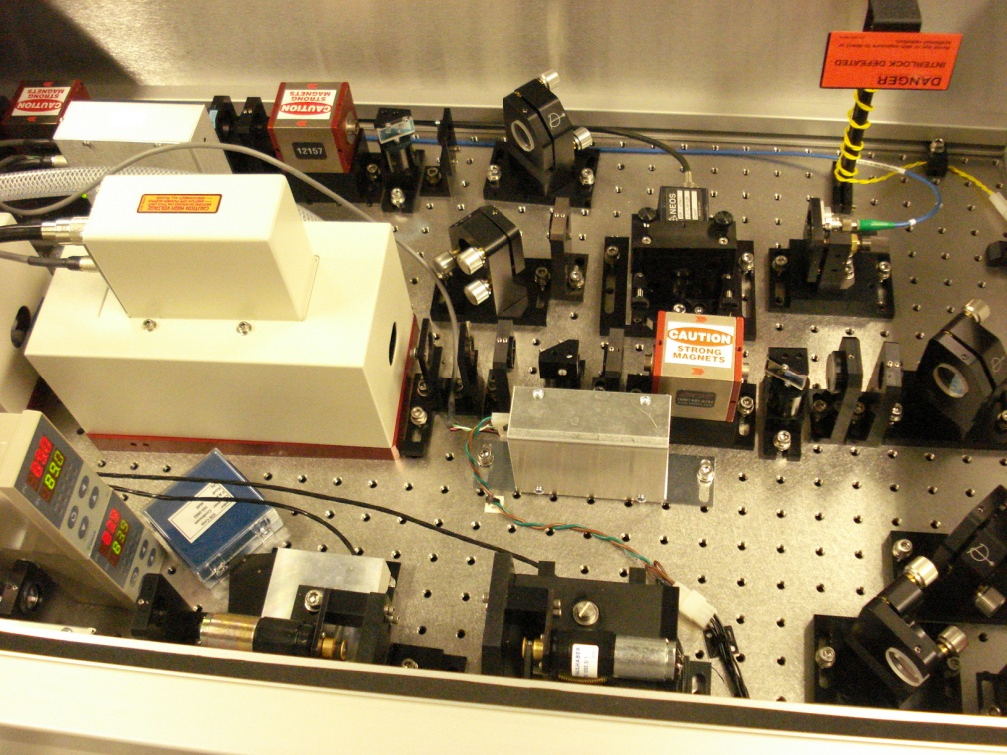
Macropulse Laser System for the SNS Intermediate-Stage Stripping
Mode-locked Seeder
Pulse Picker
Amplifier
Harmonic Conversion
…
…
…
…
…
…
2.5ns
10us
0.1s
λ=1064 nm
λ=355 nm
~50 ps
2.5 ns

Slide 12
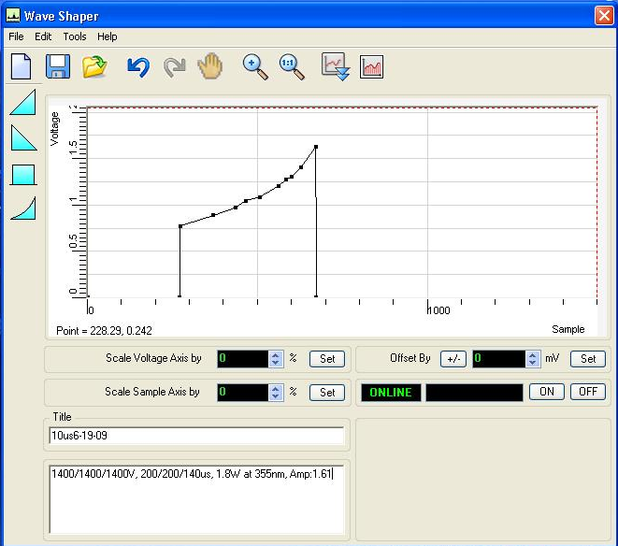
Optics Layout of Macropulse Amplifiers
9mm Amp
9mm Amp
UV Output
⊗
⊗
⊗
THG
SHG
0.5mm pinhole
Dual polarizer
Pockel’s cell
5mm apodizer
6mm Amp
6mm Amp
⊗
⊗
0.3mm pinhole
⊗
∼
AOM
⊗
⊗
⊗
From seeder
∼
HWP
5mm Amp
90° rotator
5mm Amp
Iris
O.I.

Slide 13
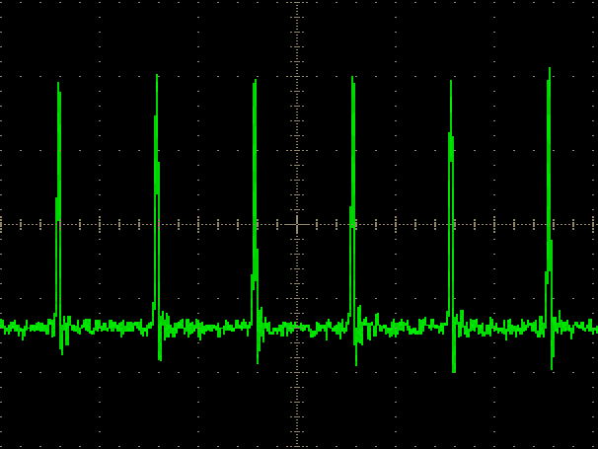
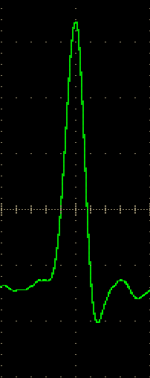
Macro- and Micro-Pulse Waveforms
Macro-pulse
2.5 ns
Micro-pulse
~55 ps

Slide 14
Power Ramp-up
Design: > 1 MW @ 355 nm; Delivered: ~ 0.75 MW @ 355
After tuning: 2 MW @ 355 nm
F5 mm
F5.5 mm
F8.5 mm
9mm Amp
9mm Amp
f9 mm
⊗
⊗
⊗
4.4 W
THG
SHG
13 W
0.5mm pinhole
Dual polarizer
Pockel’s cell
5mm apodizer
6mm Amp
6mm Amp
⊗
⊗
1.1 W
0.3mm pinhole
⊗
∼
AOM
⊗
⊗
⊗
From seeder
∼
HWP
5mm Amp
90° rotator
5mm Amp
Iris
O.I.

Slide 15
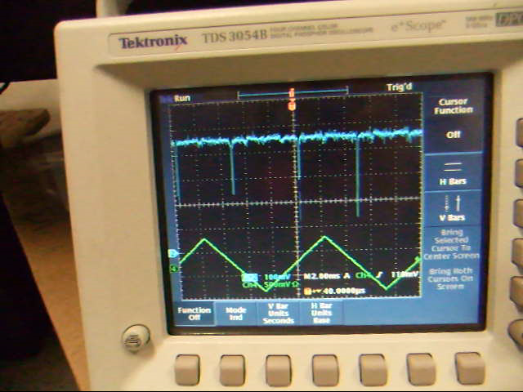
Seeder – Mode-Locked Fiber Laser
Laser cavity round-trip frequency: 4.43 MHz
RF drive frequency: 402.5 MHz
Phase lock is achieved by matching a high harmonic of the laser cavity frequency with the RF frequency.

Slide 16
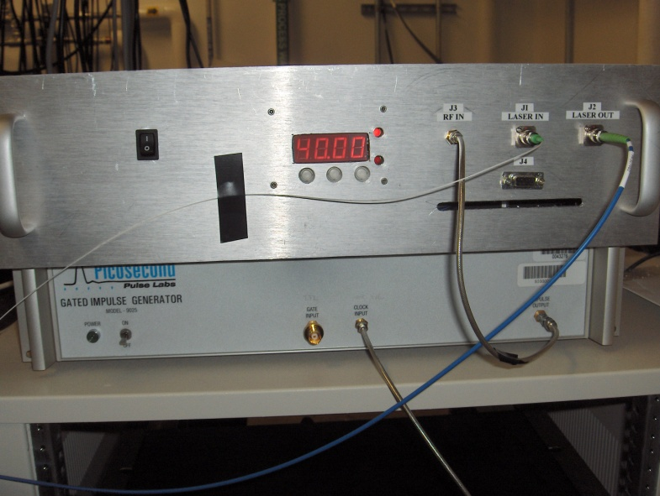
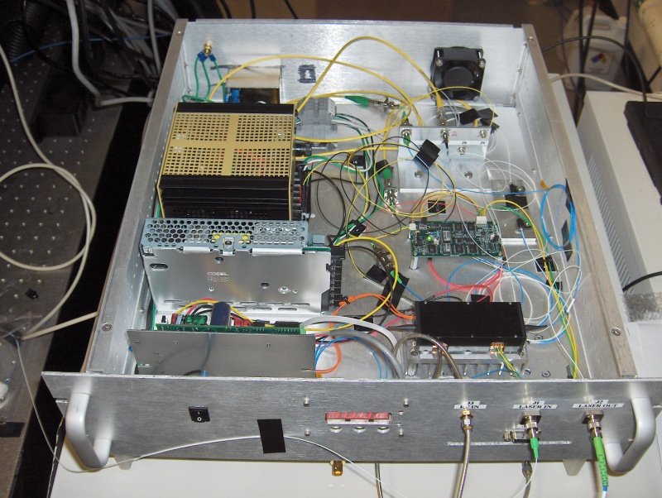
Development of New Seed Laser
  A new seeder is developed by directly modulating a narrow linewidth CW fiber laser output with a high bandwidth electro-optical modulator
Optical Isolator
to amplifier
Fiber Laser
EOM
YDFA
1%
402.5 MHz clock
RF Pulse Generator
Bias Controller
0.1%
Fiber laser linewidth: <5kHz
EOM extinction ratio: >45dB
RF pulse: ~80ps/402.5MHz
YDFA: 30dB gain
Notes:
Fiber laser cavity length is locked to a sub-harmonic of the repetition frequency, which induces mode hopping and side mode noise in its operation.
Thanks to the improvement in modulation bandwidth and the decrease in driving voltage, short pulse generation using electro-optic (EO) modulators has recently been attracting renewed attention.

Slide 17
Seed Performance
(a) RF pulse waveform and (b) YDFA output optical pulse waveform
Considering the effects of photodiode response time and cable, we speculate that the actual laser pulse width is slightly < 80 ps.
Extinction ratio of the modulated output is measured to be ~ 45 dB.
Notes:
The optical pulse is narrower than the RF signal due to the small amplitude modulation.

Slide 18
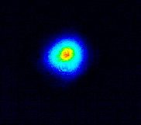
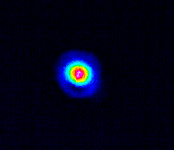
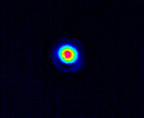
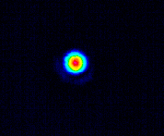
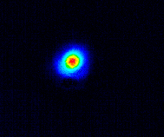
Beam Profile
Measured UV Beam Size
M² ~ 1.1
M²~1

Slide 19
Amplifier Output (UV beam)
Macropulse
Linewidth
Micropulse
Δν=140KHz

Slide 20
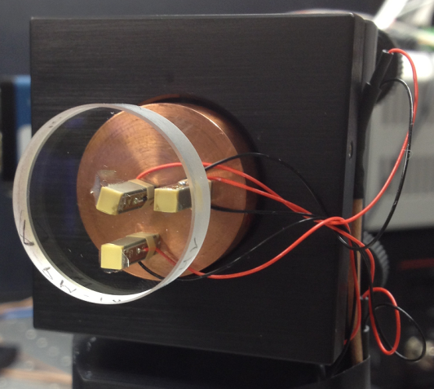
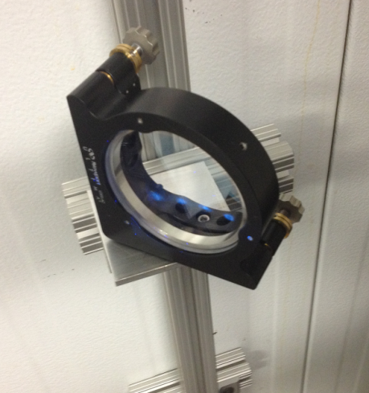
Lab Test I: UV Beam Propagation
Input | 1st round | 2nd round | 3rd round | 4th round
3.1 | 3.0 | 2.8 | 2.7 | 2.4*
4.1 | 4.0 | 3.7 | 3.5 | 3.1*
11.5 m per round
Power Meter
Controller
Steering mirror
Camera
From laser
Screen

Slide 21
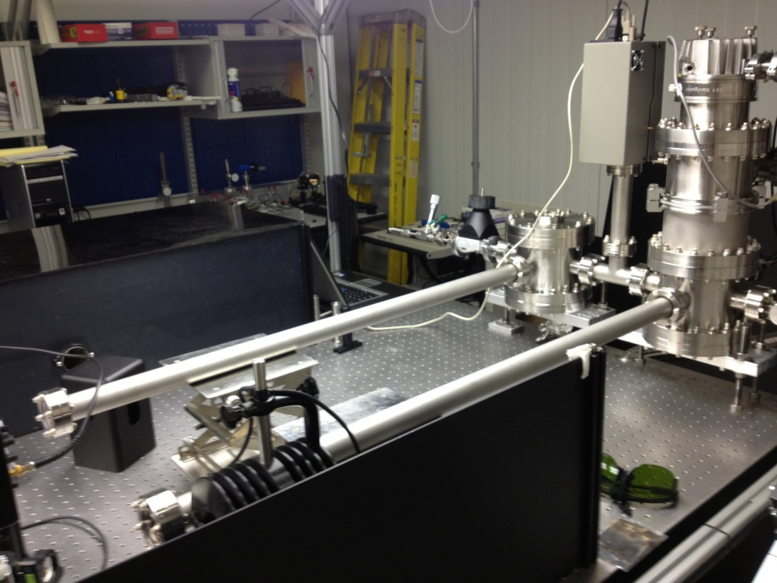
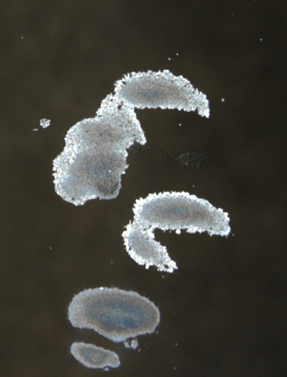
Lab Test II: Optical Coating in Vacuum
Courtesy of Y. Takeda
Experimental Setup
Measurement Results
Laser intensity: ~ 30 MW/cm² (~ 50 ps @ 402.5 MHz, 355 nm)
HR coating damage found on mirrors at the vacuum levels of 10⁻⁶ torr or lower
No AR coating damage was found on vacuum windows

Slide 22
Laser Parameters for SNS Laser Stripping
Parameters | Final Experiment | Intermediate Experiment | Present Status
Laser wavelength | ~ 355 nm | ~ 355 nm | 3rd harmonic of Nd:YAG
Micropulse duration | 50 ps | 50 ps | 50 ps
Micropulse energy | 50 μJ | 50 μJ | 100 μJ
Micropulse rep. rate | 402.5 MHz | 402.5 MHz | 402.5 MHz
Macropulse duration | 1 ms | 10 μs | < 100 μs New gain medium? Beam combining?
Macropulse energy | 20 J | 0.2 J | 0.4 J
Macropulse rep. rate | 60 Hz | 10 Hz | Limited by gain medium
Average power | 1200 W | 2 W | 4 W
Optical cavity | Yes | No | Developed seed laser; Doubly-resonant cavity; Need to study coupling efficiency
Average power w/ 100x cavity gain | 12 W

