Slide 1
Fermilab Linac Laser Notcher
David Johnson, Todd Johnson, John Sobolewski, Kevin Duel, Peter Prieto, Andrea Saewert

Slide 2
Background
Booster utilizes multi-turn injection of H- ions where the Linac pulse length is determined by N*τ_{REV} .
A “notch” must be created in continuous Booster bunch structure to allow for the rise time of the extraction kicker.
Current technique is to use fast kickers in the Booster to remove a section of the Booster beam (50-60 ns out of ~2.2 μs) at an energy of 400 to 700 MeV and deposit it in a shielded absorber in the ring.
To minimize activation, it is advantageous to create the “notches” in the Booster beam at the lowest energy possible.
Even better to create notches outside the Booster tunnel at an energy below to coulomb barrier potential (i.e. 750 keV, the energy of the Linac RFQ)

Slide 3
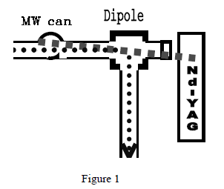
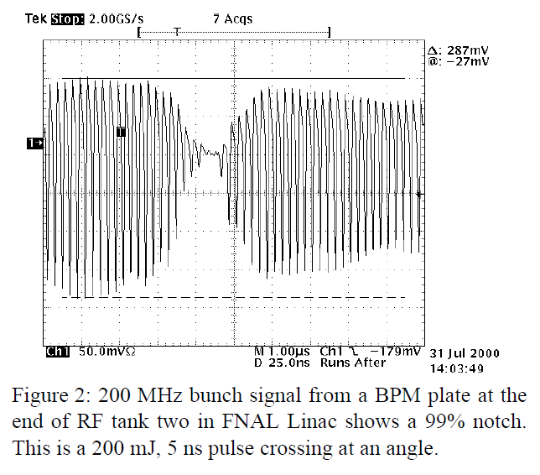
Laser Notching Experiment
In 2001, Ray Tomlin reported on a successful experiment to create notches in the CW linac beam in the H- 750 keV beam and have this notch survive at Booster injection.
He created a 25 ns notch utilizing a 200 mJ 5 ns laser pulse.

Slide 4
Linac Bunch Structure
~22-25 us
15 Hz macro pulse rep rate
MACRO
67 ms
2.2 us
450.75 kHz “notch” spacing (Booster rev. freq.)
MINI (11 turns)
24.2 us (~ 11 Booster turns)
~1-1.5 ns bunch length
5 ns (bunch spacing)
201.25 MHz bunch spacing
MICRO
10-12*5ns = 50 -60 ns
2.2 us
Choice:
laser with 60 ns pulse at 450 kHz with burst at 15Hz or
laser with 1.5 ns pulse at 201.25 MHz for 10 pulses and burst at 450 kHz and 15 Hz

Slide 5
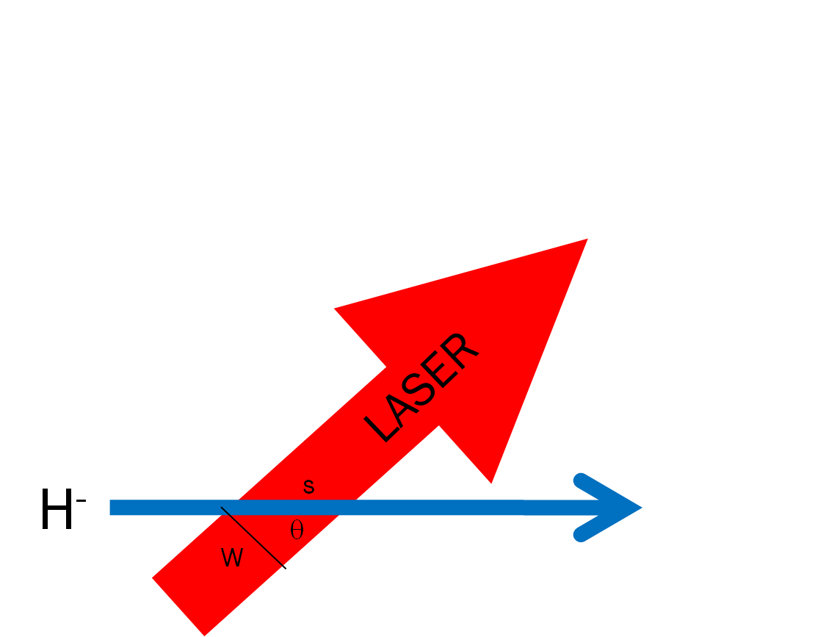
Photoneutralization (1)
The fraction of electrons that are detached from the moving H- ions is:
The photon flux (generated by the laser)
in the lab frame [photons/cm²/sec]
The photon flux in the lab frame is transformed into the
rest frame of moving ion as:
The interaction (crossing) time is just the ion path length/ ion velocity
The neutralization factor for an ion crossing on axis
of the laser beam may be written in terms of lab frame parameters
For θ ~ 90º term -> ~γ

Slide 6
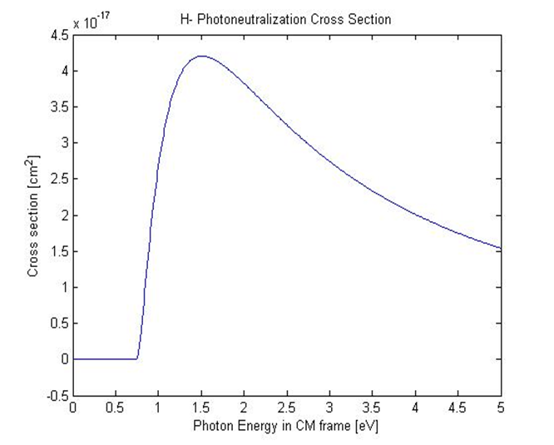
Photoneutralization (2)
fixed
To maximize the neutralization probability->maximize the product
To maximize
increase pulse energy -> minimize
reduce pulse length -> bunch length
reduce laser spot size -> ion size
Cross section 3.66x10⁻¹⁷ cm²
20-30 mJ
~1J
Assume:
Laser size 0.6x6mm
Rest frame energy 1.16 eV for
1064 nm laser
To maximize τ for a given H- ion energy
increase horizontal laser beam size or
increase the number of laser interactions
with the ion bunch

Slide 7
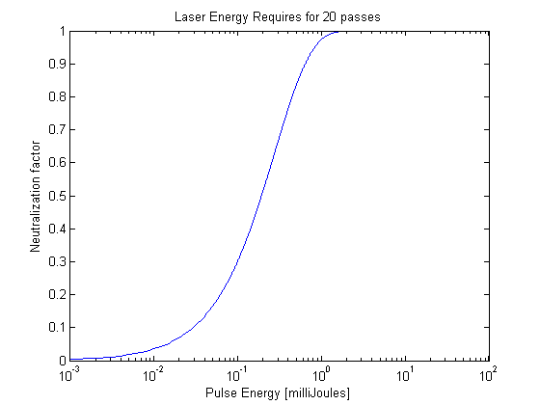
Reduction of Pulse Energy
To reduce the required pulse energy we can effectively increase the interaction time by utilizing an optical cavity such that the laser interacts with the ion beam multiple times.
H-
R. Shafer , 1998 BIW
Linear cavity (zig-zag)
2 mJ for 99.92%
Laser follows ion to interact many times (increase τ)
Cavity length proportional to number of interactions
Laser pulse length = notch length
Cavity dimensions determined by ion velocity and bunch spacing
Reduces required laser pulse energy by ~ number of interactions

Slide 8
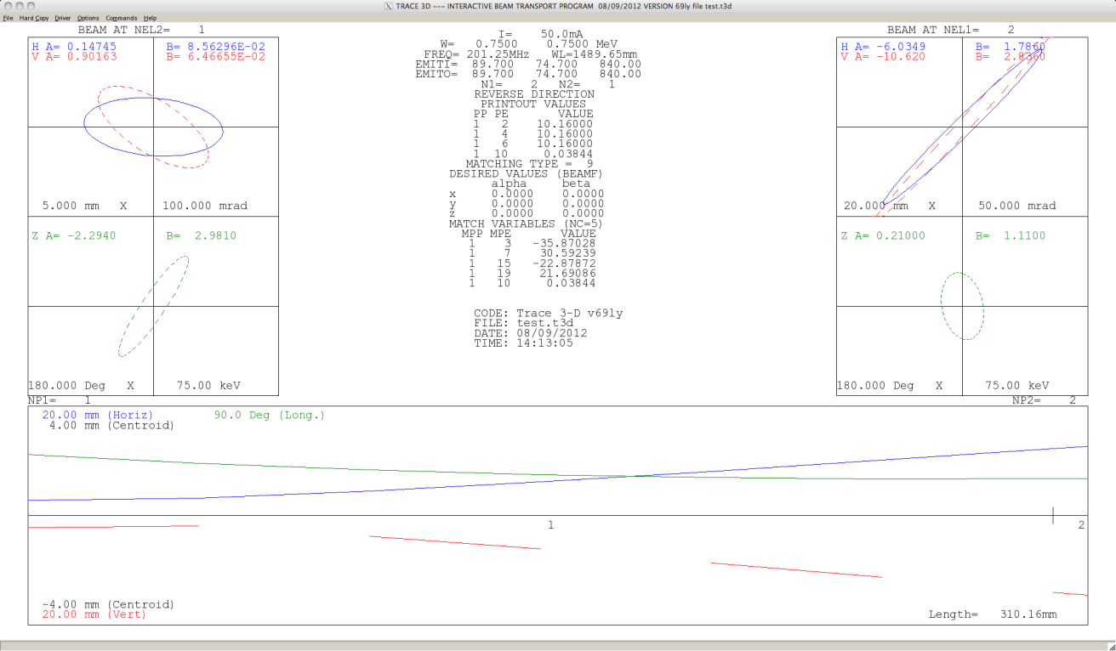
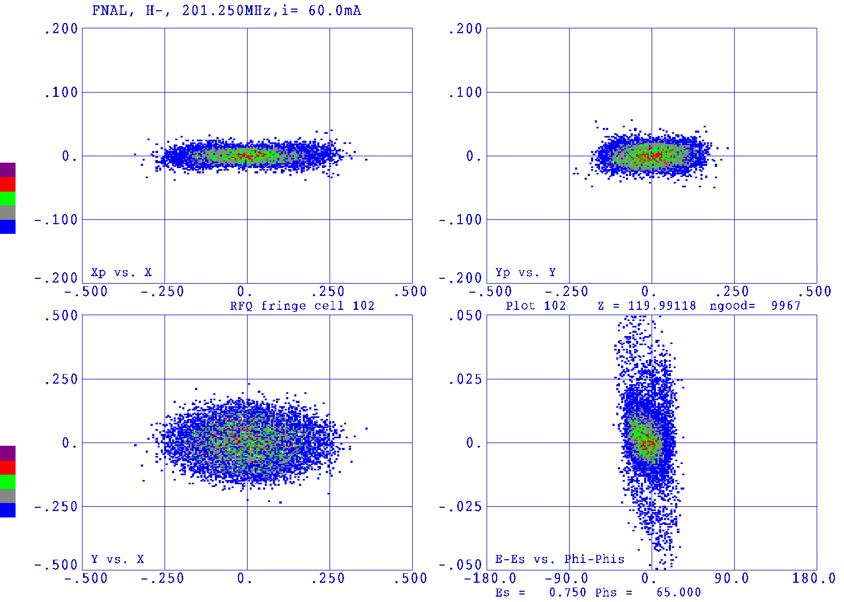
Expected Beam Dimensions
Trace 3D back calculation of beam size at exit of RFQ based upon emittance measurement at 178 kW power August 9, 2012 CY Tan.
Phase space simulation at end of RFQ (figure 4.40 of 750 KeV Upgrade Plan)
Laser beam vertical profile (1/e²) ~ 5 mm.
Initial design assumed that the vertical laser beam dimension of 1 cm.
Beam measurements indicate vertical laser size could be reduced to 6 mm
This is a variable parameter in the beam shaping optics.

Slide 9
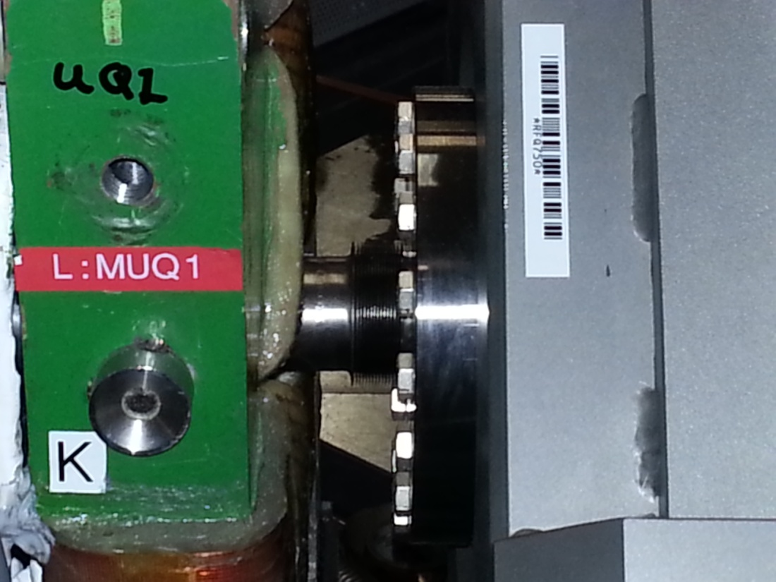
Location of Notcher
MEBT
RFQ

Slide 10
Laser system (1)
Laser system is a MOPA design
Major components of system
CW Seed source (100 mW Lumics)
Mach-Zander 10 GHz EOM modulator (Photline)
Arbitrary Waveform Generator
Two stages of fiber pre-amplifiers (10 nJ/360 nJ) (PriTel)
PCF based Fiber Amplifier (10 uJ) (Optical Engines) on order
Free Space DPSS amplifier (>2 mJ) (Northrop Grumman CEO) FY14
Beam shaping optics (current R&D effort)
Beam delivery (FY14)
Vacuum interface and optical cavity (in final design)
Laser diagnostics (conceptual design) (FY14)
Timing/controls system (conceptual design) (FY14)
We have set up the first three components and demonstrated the generation of temporally uniform optical pulses
OPG
In hand

Slide 11
Burst mode seed pulses to Fiber Amplifier followed by Free Space Amp
Laser System (2)
λ₁=1064nm
120 mW CW
SW=0.1 nm
Output modulator/Input fiber pre-amp:
201.25MHz pulses (1.25 ns pulse), 458kHz burst
10 GHz Mach-Zehnder
Modulator
L_{i}~1.8dB
Isolator
PM Fiber
Diode + TC
controlled
L_{ins} ~5dB
Pulse Generator
Amplifier, Timing
Line filter
Fiber Amp 2
Fiber Amp 1
Measurement point
Free
Space
Fiber Pre-Amp
*Notch 12 bunches -> 60 ns
10 notches/linac pulse
Clean up filter
Generate 24 us burst at 15 hz
Not needed with a pulsed Fiber Amp 2
15 Hz
Free Space Amp
Pockels cell
TRANSPORT BEAM SHAPING OPTICS &
OPTICAL CAVITY
Grumman CEO DPSS OEM
Updated 10/3/2012

Slide 12
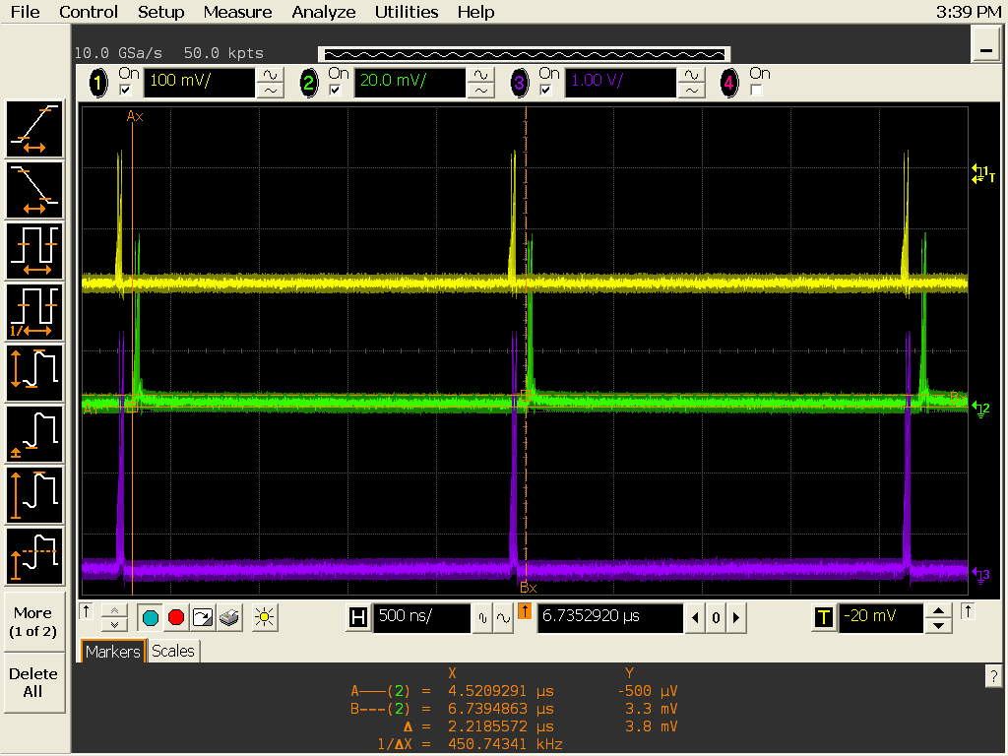
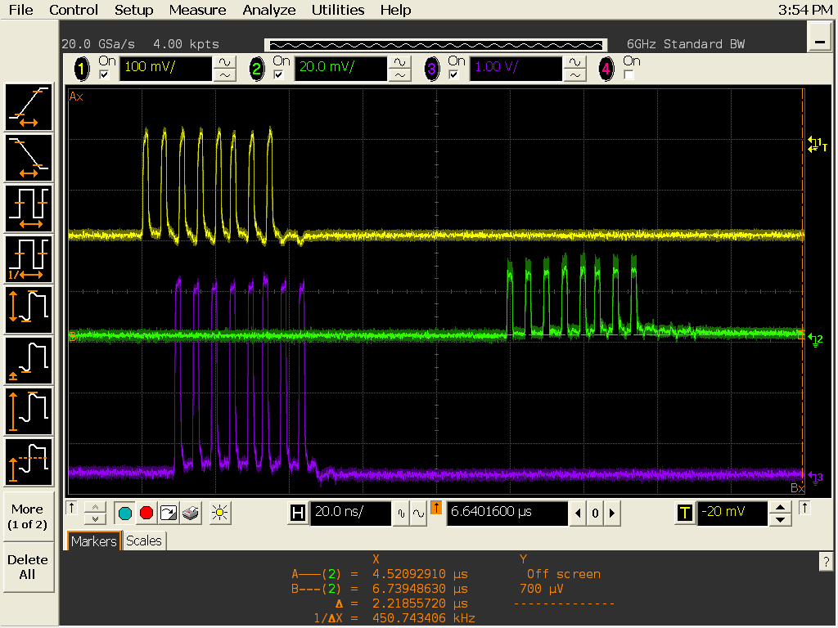
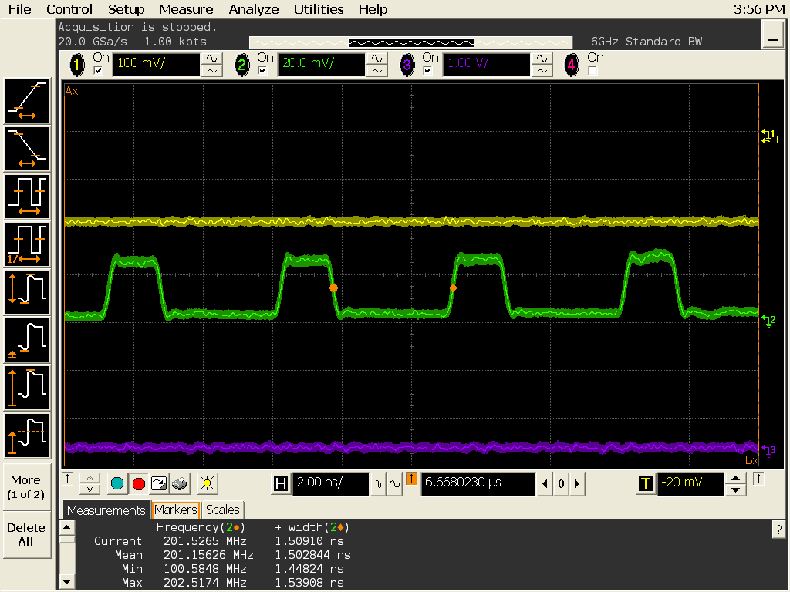
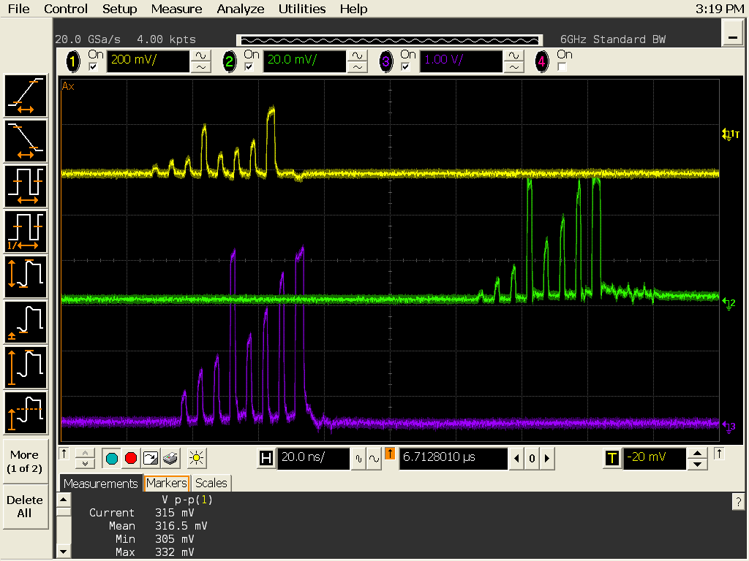
OPG test results
Yellow- AWG
Purple- RF Amp out
AWG: Chase Scientific DA12000 & CG6000 module
Green – signal form 1.2 GHz (free-space)PD →laser pulses out of fiber pre-amplifier
450.75 kHz burst of 201 MHz pulses
One set of 201.25 MHz pulses
Individual 201.25 MHz temporally uniform pulses
Pre-distortion of EOM pulses

Slide 13
Beam Shaping
Todd Johnson
We would like to demonstrate > 99% neutralization efficiency for all ions in the bunch, therefore we would like all ions to “see” the same photon flux regardless of their transverse amplitude. (i.e roof-top laser profile)
The vertical size of the laser beam should be ~> 6σ of the ion bunch
Squeezing the horizontal laser beam size increases the flux but also reduces the interaction time of the ions passing through (not a big effect due to multiple interactions) also, necessary for optical cavity geometry

Slide 14
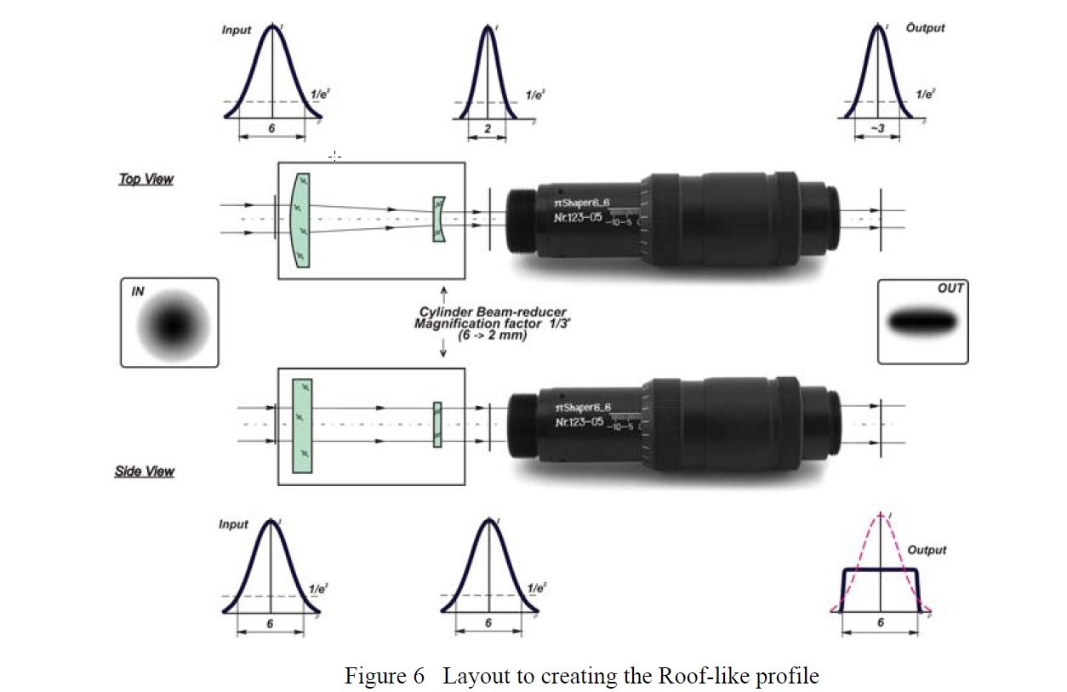
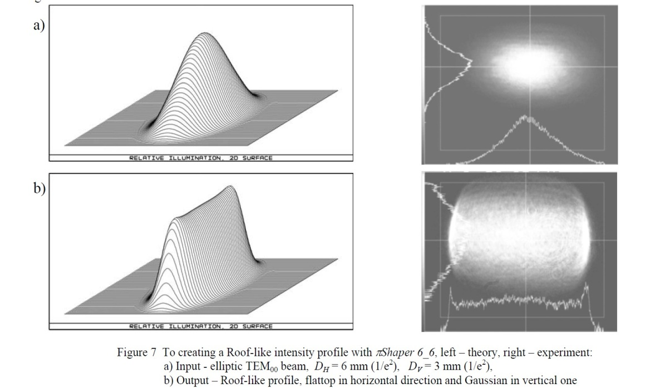
Beam shaping (2)
An elliptical laser profile with major/minor axis of roughly 6mm by 1 mm is created from the Gaussian output of the DPSS by a cylindrical matching telescope. (For testing purpose we use 532 nm diode)
Currently, this elliptical profile is matched into a refractive optical system (Galilean) which transforms a TEM00 profile into a collimated flattop (top-hat or uniform) profile through phase profile manipulations.
The device is called a πShaper (from AdlOprica GmbH)
Input
Output

Slide 15
Beam Shaping (3) the layout
Input πShaper
Output πShaper
Output Anamorphic prism

Slide 16
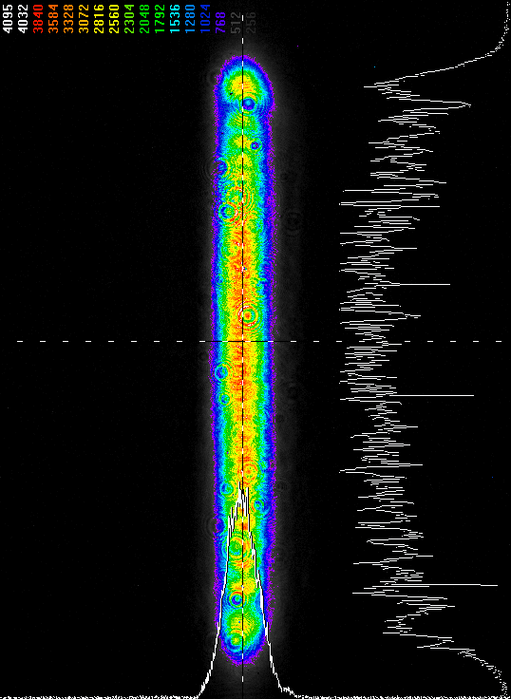
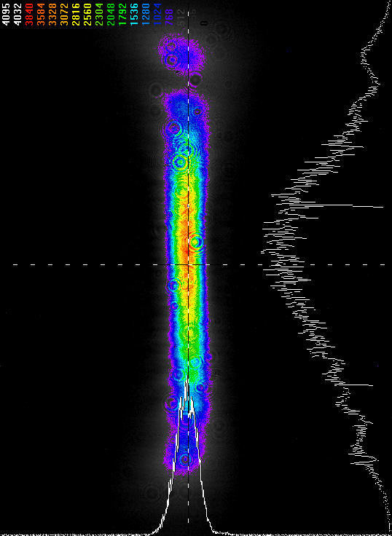
Beam Shaping (4) transport
Camera scale ~5 x 7 mm (HxV)
Todd Johnson
5 cm after the prism
50 cm after the prism
Optical cavity ~ 40 cm from optical box
Optical path length in cavity ~ 35 cm
Clearly have issues propagating roof-top profile
We are investigating other techniques to resolve this issue

Slide 17
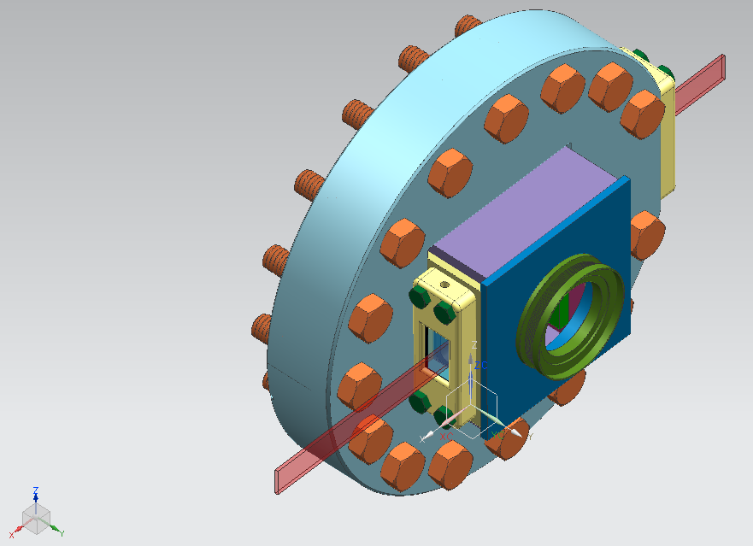
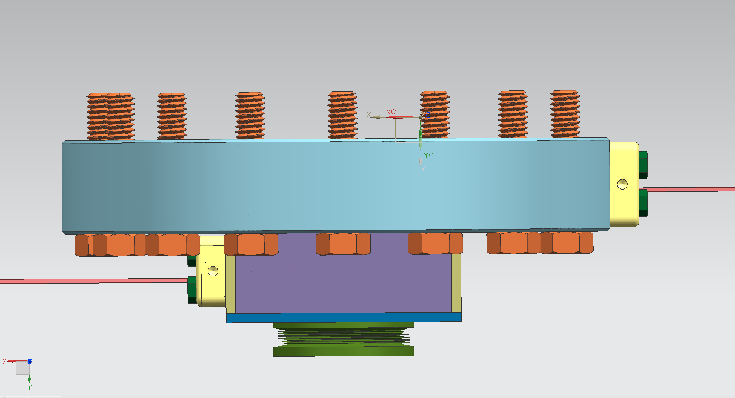
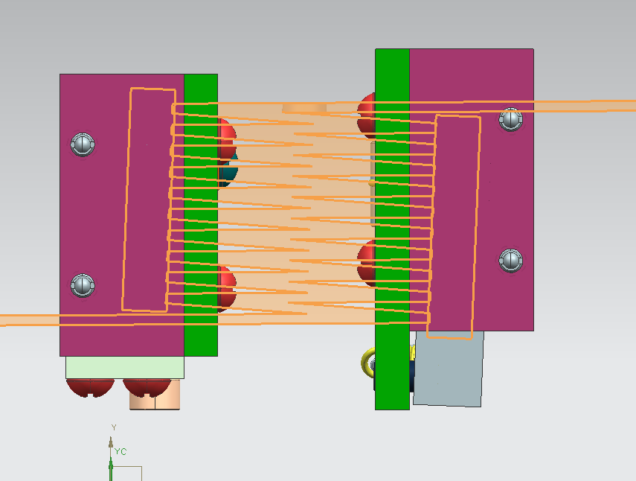
Optical Cavity
John Sobolewski
H-
Attach to RFQ
Laser IN
2”
Laser OUT
Interface with MEBT
Mirrors at 2.288º wrt H- beam
showing 21 interactions

Slide 18
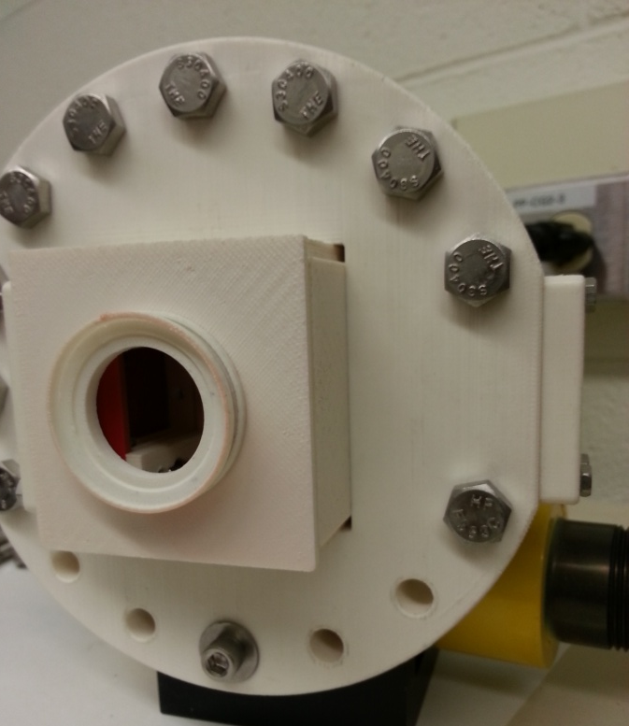
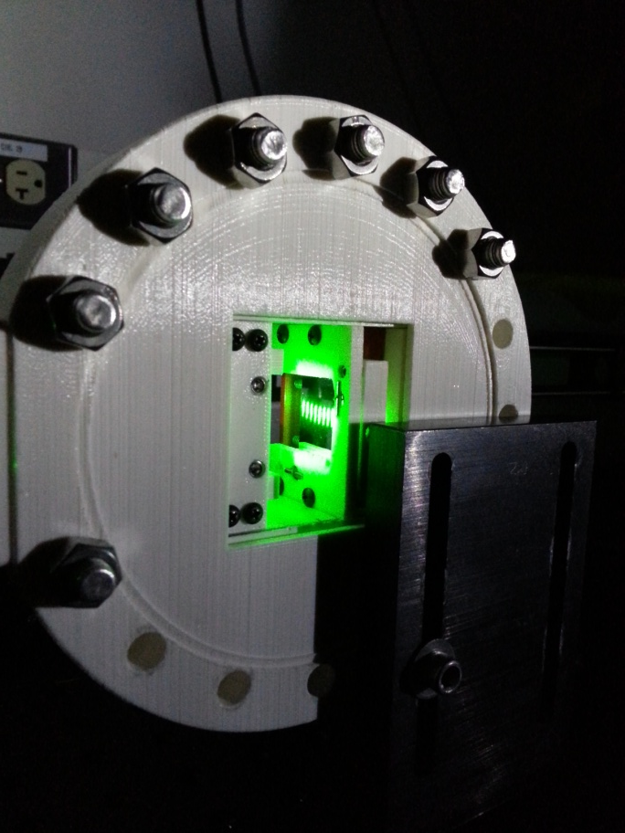
Optical Cavity (2)
We printed a 3D model to test design
This was very useful as it pointed out several
improvements/modifications to the design.

Slide 19
Other Applications
Broad band laser chopper (see next slide)
Emittance carving
Laser-controlled proton beam for medical imaging*(DOE/URA patent (U.S. PATENT NO. 5,760,395) Carol Johnstone
Employ a laser to perform selective extraction of a proton beam from a larger, parent H- beam through the photodetachment of the outer electron. → raster the laser across a larger transverse uniform H- beam.
Uses: proton radiography, proton cardiography, proton irradiation, and similar medical applications for the diagnosis and treatment of tumors
H- beam extraction technique using Nd:YAG laser
Proposed for JPARC Experimental Transmutation facility
Clean up of bunch longitudinal tails
Other ????

Slide 20
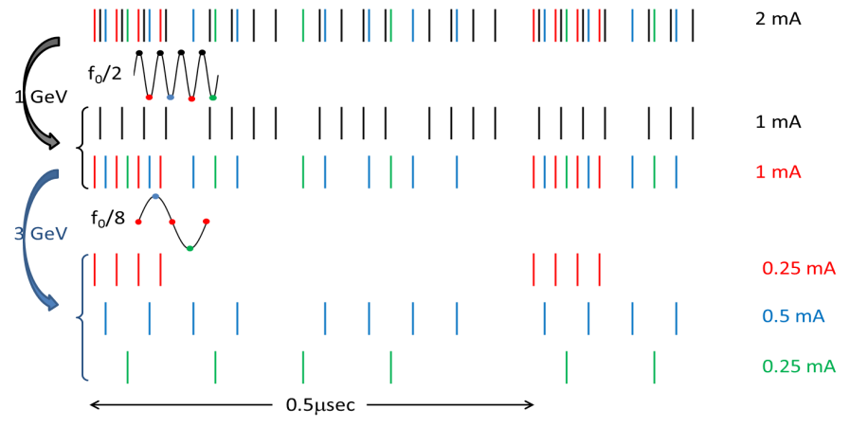
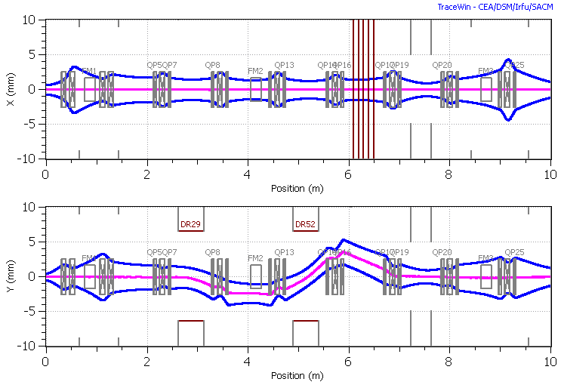
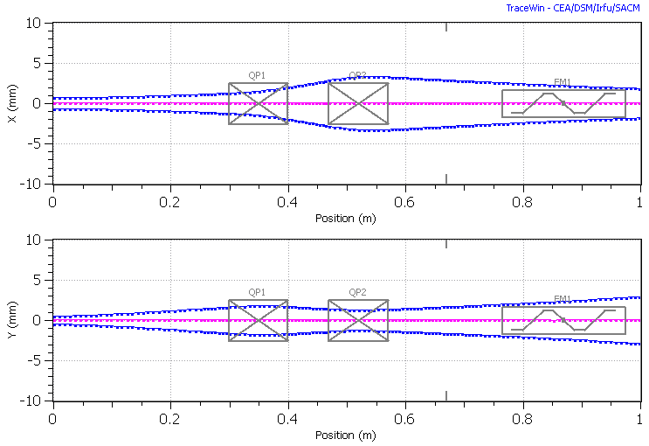
Laser Chopper (Example)
Could be for macro pulse or bunch-by bunch chopping
Project X /PXIE requires a wide band chopper to create a flexible bunch pattern for distribution of beam to rings and experimental areas.
Current design of MEBT and choppers

Slide 21
Chopping System Example
Estimate laser system required for previous chopping example:
Laser wavelength: 1 micron
Laser pulse length <~ 1 ns
Laser pulse energy: 250-300 micro-Joules
Number of reflections: 200
This is pretty long . Depending on laser design, maybe install multiple sequential systems
Zig-zag cavity insertion length: ~ 24 cm
Neutralization fraction: 99.96%
Average power at 162.5 MHz (CW): ~40 kW

Slide 22
Summary
We have proposed to develop a Laser Notching system for the Fermilab Linac-Booster system.
This project is funded through the Proton Improvement Plan
We have a design for the laser system, beam shaping, and optical cavity that will neutralize > 99% of selected linac bunches.
We have the front-end laser system with the final fiber amplifier on order and are in the process of R&D on beam shaping and working on the final design of the optical cavity
The current plan is to install the system in Q2 of Fy15
This could be utilized as a demonstration or prototype for laser chopping….

